Slide 1
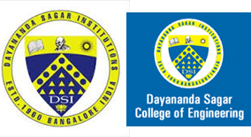
Mini Project Work – Final presentation-19EC6DCMPR
July/August 2022
Dayananda Sagar College of Engineering, Bangalore, Karnataka
Department of Electronics & Communication Engineering
Sem & Sec : 6D
BER PERFORMANCE ANALYSIS OF DIGITAL MODULATION TECHNIQUES
Mini Project Batch No : D9
USN : 1DS19EC708 (Sec-D) Name : BHANU PRASAD NAYAK
USN : 1DS19EC733 (Sec-D) Name : SATISH J
USN : 1DS19EC735 (Sec-D) Name : SHASHIDHAR NYAMAGOND
USN : 1DS19EC742 (Sec-D) Name : THOTA SAI GAUTHAM
Section Co-ordinator
Prof.SHOBHA.S
Mini Project Guide
Dr. T.C.MANJUNATH

Slide 2
Overview
Introduction
Problem Statement & Objectives
Literature Review
Methodology adopted with Block-Diagrams & Flow- Charts
S/w tools used
Results
Applications, Outcome and Limitations
Conclusion and Future Work
9. References

Slide 3
Introduction
Wireless communication is, by any measure, the fastest growing segment of the communication industry.
Digital modulation schemes contribute to the evolution of mobile communications by increasing the capacity, speed as well as the quality of the wireless network .
Digital modulation schemes provide more information carrying capacity, better quality communication
As such, it has captured the attention of the media and the imagination of the public. Cellular systems have experienced exponential growth over the last decade.
A popular way to achieve this is by using wireless Multiple Input Multiple Output (MIMO) communication systems.
MIMO systems utilize Space Time A Codes (STBC) as one of the leading ways to obtain higher data rates with limited bandwidth and power.
With several STBC methods currently available, this paper analyzes simulations using Orthogonal Space Time Block Codes (OSTBC) in Rayleigh fading channels to evaluate the performance of MIMO systems

Slide 4
Problem Statement & Objective
Problem Statement :
The goals of wireless communications are narrower bandwidth, lower power consumption, higher data rates, and error free data links
Objective :
Transmit diversity scheme employing Space-Time Block Code (STBC) helps to increase number of antennas. This scheme has been presented by Alamouti .
BER performance analysis for digital modulation techniques with STBC and without STBC
Reduction of the bit error rate increase the system capacity and more efficient use of the transmitted power.

Slide 5
Literature Review
S.L.NO | PAPER TITLE & JOURNAL NAME | MAJOR OBSERVATIONS
1 | Z. Wang, X. Xie, J. Zhao, Z. Tong and X. Yang, “Performance Analysis of Different Modulation Schemes for Coherent Optical OFDM System,” 2010 International conference on Communication, Shenzhen, 2010, PP. 23-25 doi: 10.1109/CMC.2010.289 | Shows that BER is the one of the best parameters to evaluate performance
2 | Mohhamed Salim Alouini and Andera J. Goldsmith, ‘Capacity of Rayleigh fading channels under different Adaptive Transmission and diversity combining Techniques’,IEEE Transactions on Vehicular Technology, Vol.48,No. 4,pp.1165-1181,July 1999. | Describes Rayleigh fading Channel Theoretical expression for BER in Rayleigh channel
3 | Siddhak Banerjee, Saswata Sundar Laga (March-2017 ) 'Study of Binary Phase Shift keying (BPSK) And Binary Frequency Shift Keying (BFSK) Characteristics through AWGN Channel with Signal to Noise Ratio (SNR) Using MATLAB and SIMULINK', International Journal of Scientific & Engineering Research, 8(3). | Compares BPSK BFSK in the aspect of performance based on probability of error Uses Simulink

Slide 6
Basic Concepts
SISO
MISO
INTERFERNCE
CONSTURCTIVE INTERFACE
DESTRUCTIVE INTERFACE
SPACE BLOCK

Slide 7
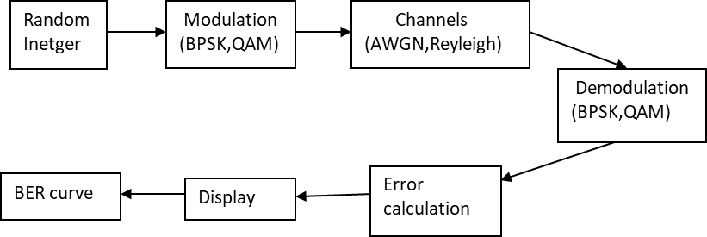
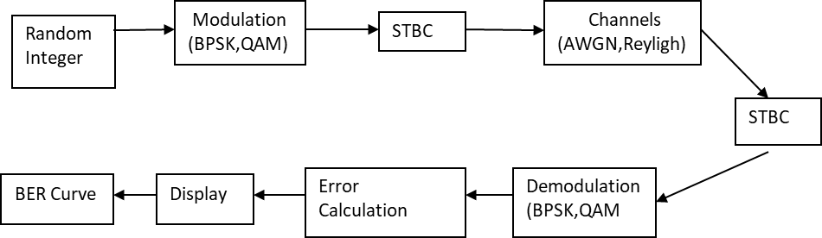
Methodology adopted with block-diagrams & flow-charts
Input
Modulation
Channel
Demodulation
Output
Dept. of E & CE, DSCE
7
11-Aug-22

Slide 8
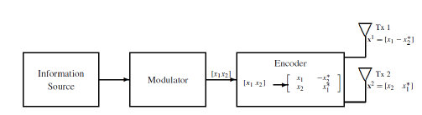
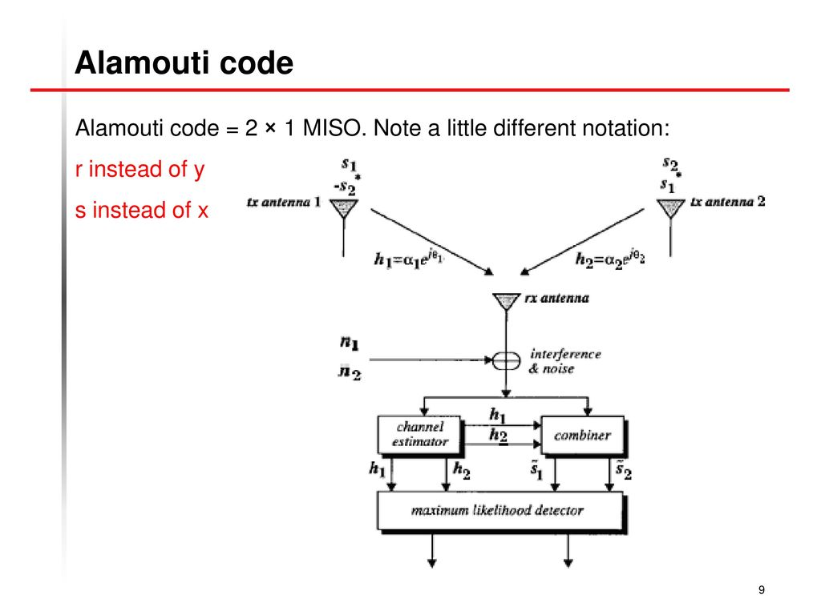
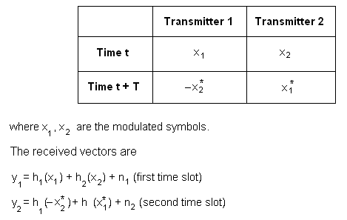
Combiner Equations
S1=h1*r1 + h2r2 S2=h2*r1 – h1r2*

Slide 9
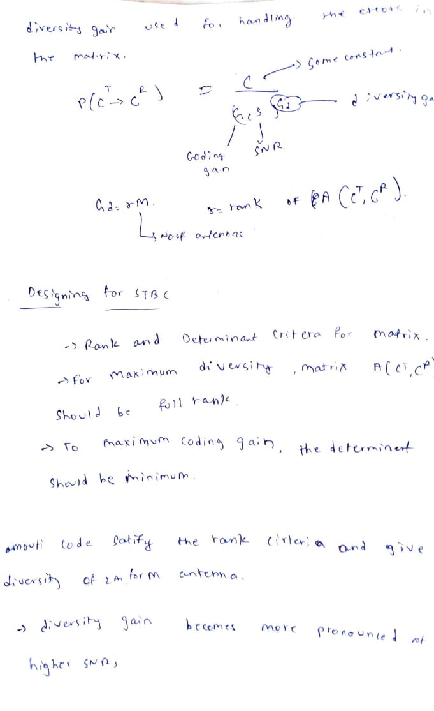

Slide 10
Software tools used
MATLAB AND SIMULINK

Slide 11
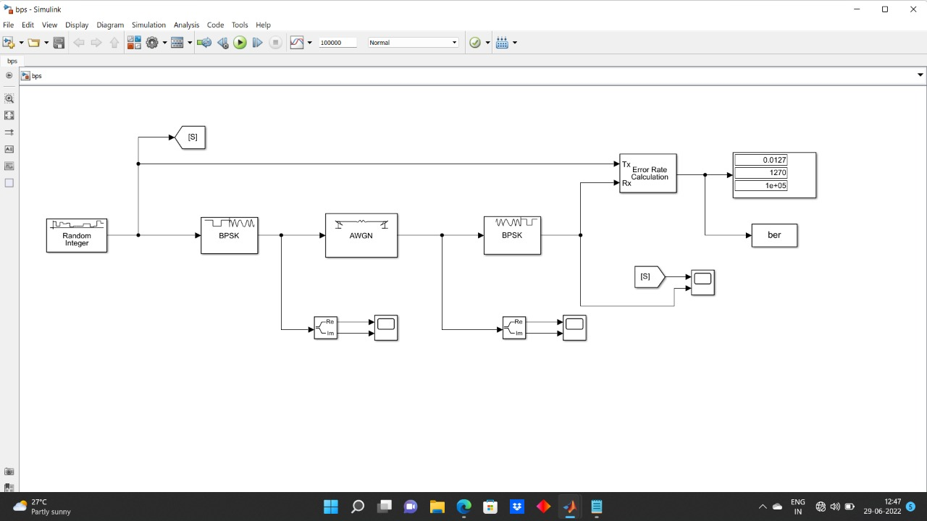
Blocks & Results
BPSK WITHOUT STBC :

Slide 12
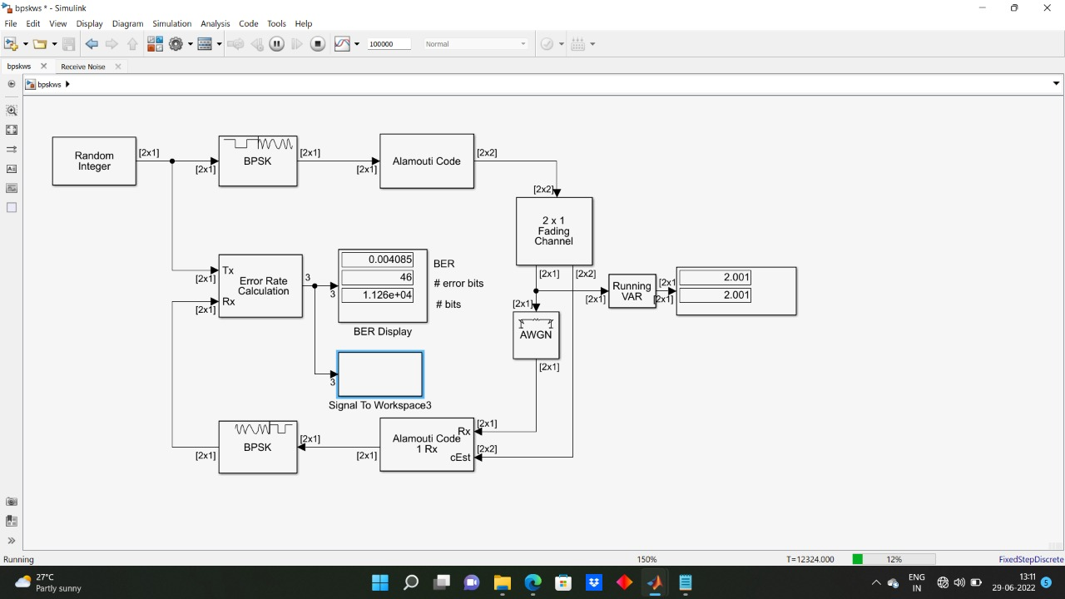
BPSK WITH STBC :

Slide 13
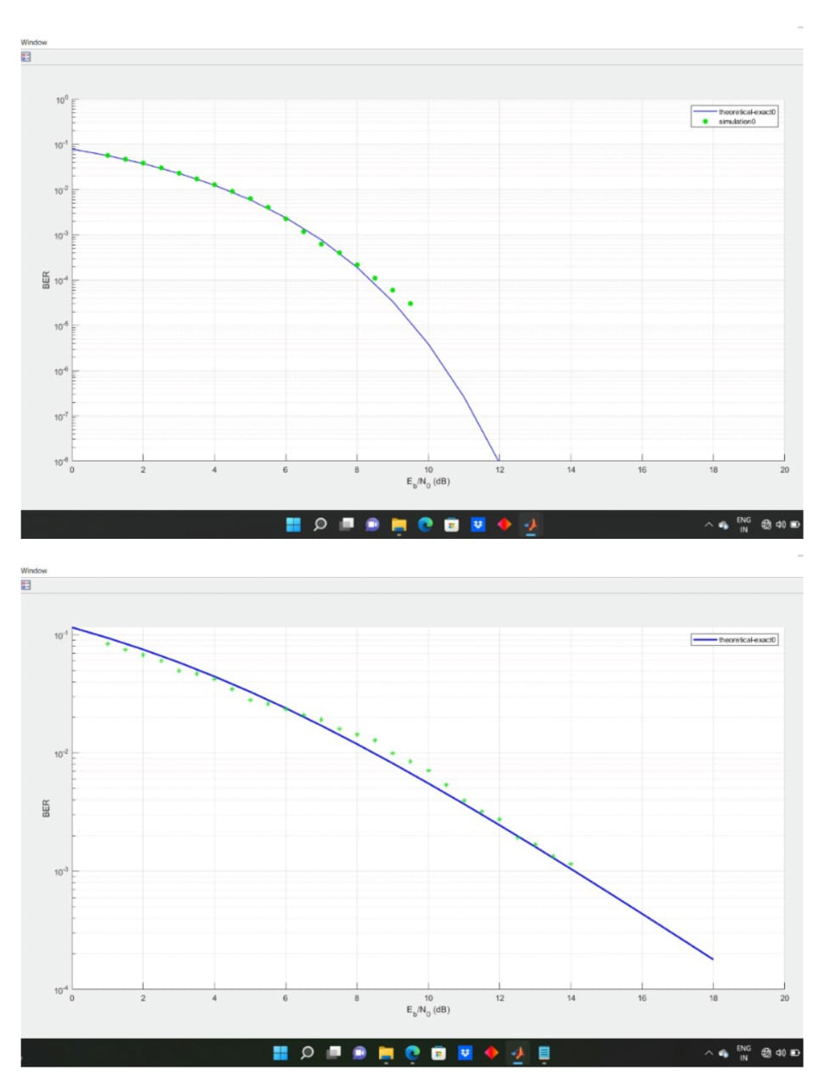
BPSK MODULATION OUTPUT :

Slide 14
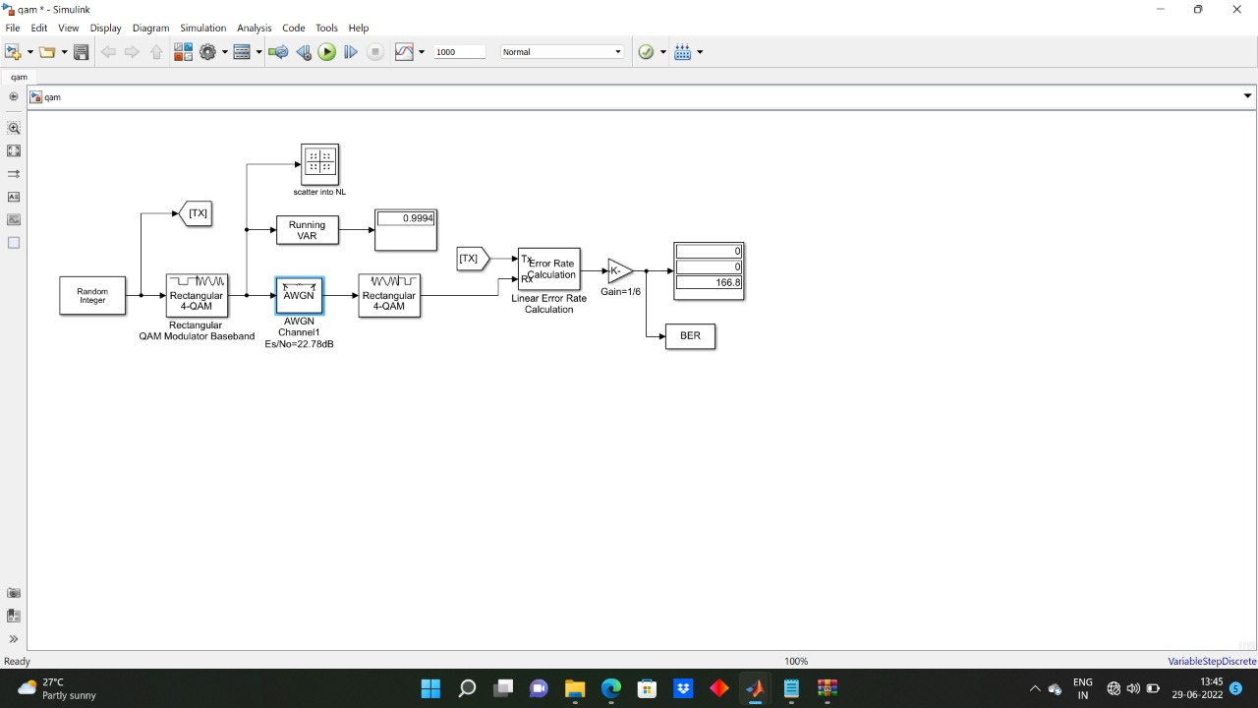
QAM WITHOUT STBC :

Slide 15
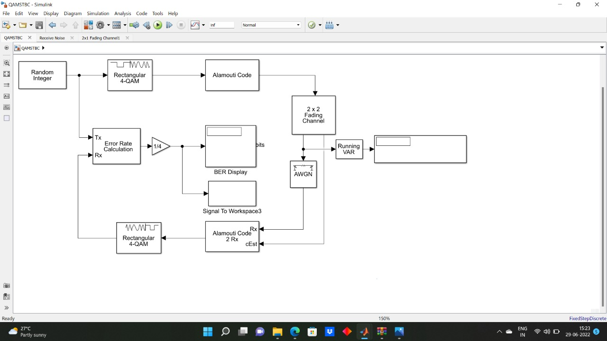
QAM WITH STBC :

Slide 16
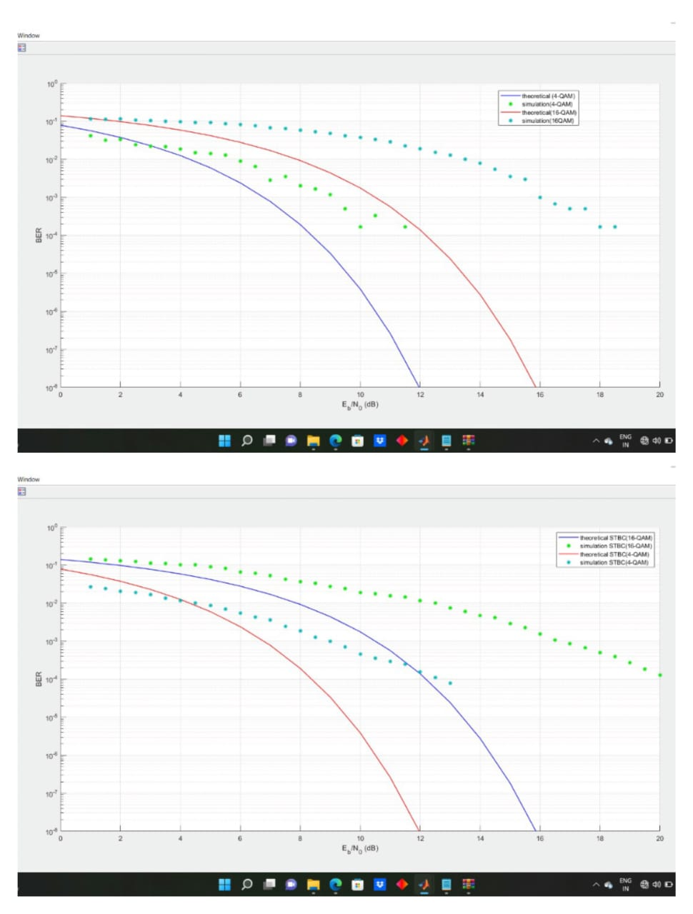
QAM MODULATION OUTPUT :

Slide 17
Applications, Outcome and Limitations
APPLICATIONS :
The STBC technique is combined with modulation and be used in atmosphere laser communication.
The STBCs are to be used at the receiver side to improve the accuracy of the localization. The improvement in positioning accuracy is essential especially for computer embroidery machine.
Mobile cellular networks

Slide 18
OUTCOMES :
higher data rate.
Signals can convey information with less noise, distortion, and interference.
Digital systems are more accurate, and therefore the probability of error occurrence are often reduced by employing error detection and correction codes.
STBC with spatial multiplexing for MIMO transmission results in performance enhancements, such as in high throughput WLANs.

Slide 19
LIMITATIONS :
The main disadvantage of MIMO system is that the multiple antennas required extra High Cost RF modules.
The extra RF modules increase the cost of wireless communication systems.

Slide 20
Conclusion and Future Work
CONCLUSIONS :
We discussed block codes with code rate of 2 by 1. We optimized rate one design to achieve minimum BER for Rayleigh fading channel realization when the information symbols are drawn from BPSK and QAM digital modulation technique.
The Alamouti scheme has been simulated for BPSK modulation in Rayleigh channel. The same Alamouti scheme has been again simulated in Rayleigh channel for 4-QAM and 16-QAM modulations and the BER are compared.
We observed that BER reduces as no. of antennas are increases but it reduce the energy per receive antenna.
Other correction techniques could be employed to improve the performance of such systems. However, in mobile technology, the bit error-rate is very important. In this case, accuracy is essential.
FUTURE WORK :
As a future expansion of this paper, it is possible to introduce different modulation schemes to increase the data rates.
Also we can increase the number of antennas at both transmitter and receiver without introducing any interference in between the antennas

Slide 21
References
International Journal of Distributed and Parallel subsystems (IJDPS) Vol 3.No.4 July 2012
Daniel W. Bliss, Keith W. Forsythe, and Amanda M. C “MIMO Wireless Communication “, Lincoln Laboratory Journal , Vol.15, No.1, 2005.
V. Tarikh, N. Seshadri, and A. Calder bank, “Space-time block codes from orthogonal designs”, IEEE Trans. Information Theory, vol. 45, pp. 1456–1467, July 2019.
S. Alamouti, “A simple transmit diversity technique for wireless communications”, IEEE Journal on Selected Areas in Communications, vol. 16, pp. 1451–1458, Oct 1998.
J. Wu and Gary J. Saulnier, “Orthogonal Space-time Block Code Over Time-varying Flat-fading Channels: Channel Estimation, Detection, and Performance Analysis”, IEEE Transactions on Communications, Vol. 55, no. 5, May 2017.

Slide 22


?
?
Questions

