Slide 1

Live Streaming with Raspberry Pi and OpenCV for Object Detection
Course Name : Internship
Course Code : 19EC8ICINT
Name :Thota Sai Gautham
USN : 1DS19EC742
8th Semester
19-05-2023 / Wednesday / 4:30-4:45
Guide Name: Dr.Dinesha P
Company Name : Digitectura Technologies Pvt. Ltd
Dept of Electronics & Communication Engg.
Dayananda Sagar College of Engg.
(An VIII Sem SEE Internship Viva-Voce Presentation)

Slide 2
CONTENTS
About the company
Timeline
Introduction
Technical Skills
Knowledge Gained
Modern Tools and Techniques
Applications Developed
Certificate
Conclusion

Slide 3
ABOUT THE COMPANY
DIGITECTURA TECHNOLOGIES PVT LTD
A startup company designing and manufacturing security systems and technology driven products
Products: They specialize in mobile application development, including emerging niche segments such as the Internet of Things (IoT), applications and tools, home automation, and industrial automation.
Innovation: The company's expertise lies in leveraging technology to address various business needs and challenges across industries.

Slide 4
Department
Software Design and Architecture: The department is involved in designing the overall structure, components, and modules of software systems. They define the architecture, frameworks, and patterns that guide the development process. They implement the functionality, logic, and algorithms that drive the software application or system.
Software Testing and Quality Assurance: The department conducts testing activities to identify and fix defects or issues in the software. They perform unit testing, integration testing, and system testing to ensure that the software meets quality standards and functional requirements.

Slide 5
R&D: Team is responsible for conducting research and developing innovative solutions, products, or technologies for the company. They work on exploring new ideas, improving existing products, and finding solutions to technical challenges. They collaborate, conduct experiments, analyze data, and work on prototypes to advance the company's technological capabilities

Slide 6
TIMELINE
May 20th, 2022: Internship start date.
June 2022: Beginning of training and orientation period.
July2022: Worked on the image formats, types, Datasheets.
August 2022: Begin of the project
September 2022: Development of skills and new technologies required for the project
October 2022: Finalizing and presenting completed projects; concluded the internship on Oct 25th, 2022.

Slide 7
TECHNICAL SKILLS
Raspberry Pi setup and configuration: The project requires setting up and configuring the Raspberry Pi for headless operation, including installing the necessary operating system and software components.
Networking and communication: Setting up a local network connection between the server and client, configuring IP addresses, and establishing communication protocols for video streaming.
Video encoding and decoding: Understanding video encoding formats and implementing the necessary algorithms for video compression and decompression on the Raspberry Pi.
Object Detection : Training the camera module to detect the objects according to application

Slide 8
TOOLS EXPOSED
Raspberry Pi: Learning to work with Raspberry Pi, a popular and versatile single-board computer widely used in various industries and projects.
Streaming protocols: Gaining familiarity with industry-standard streaming protocols like RTSP, which are widely used for video streaming applications.
Video encoding and decoding libraries: Utilizing modern libraries and tools for video encoding and decoding, such as FFmpeg or GStreamer, which are commonly used in the industry.
Advanced Ip Scanner , VS studio

Slide 9
INTRODUCTION
“Video Streaming using Raspberry Pi with server and client
in Headless mode”
Video streaming using Raspberry Pi involves combining the small and affordable single-board computer with server and client applications to create a video streaming setup.
This setup operated in headless mode
The server component captures video from a connected camera or video source, encodes it, and sends it over a network.
The client component receives the video stream and decodes it for display on a connected screen or device.
Raspberry Pi's low power consumption and compact size make it an ideal platform for various video streaming applications, including surveillance systems.

Slide 10
Objectives
Live surveillance over a network in headless mode through raspberry pi and object detection .

Slide 11
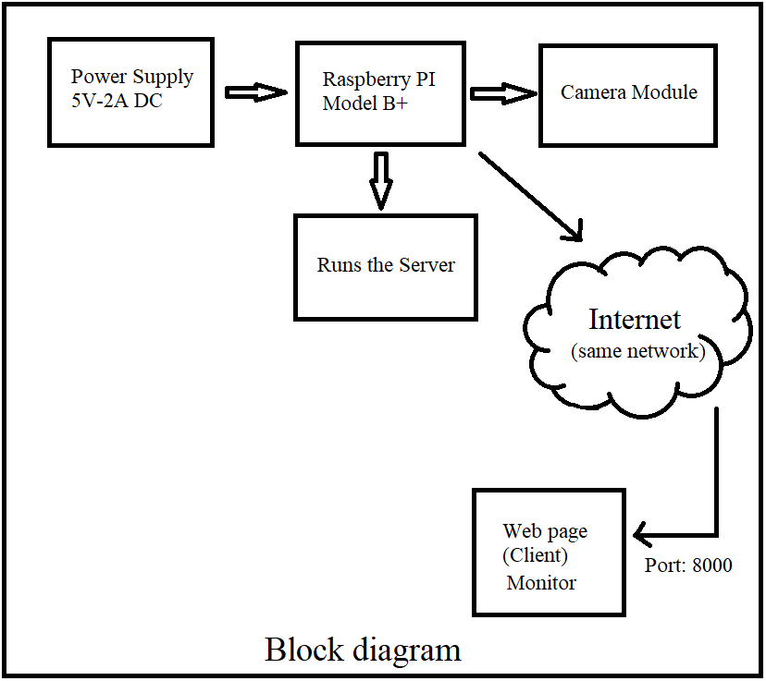

Slide 12
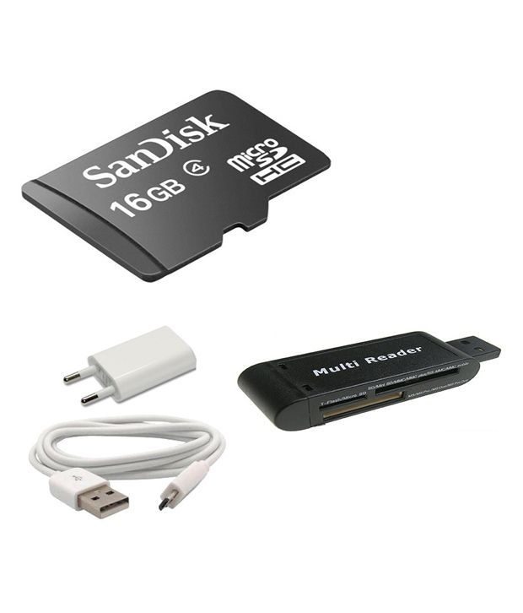
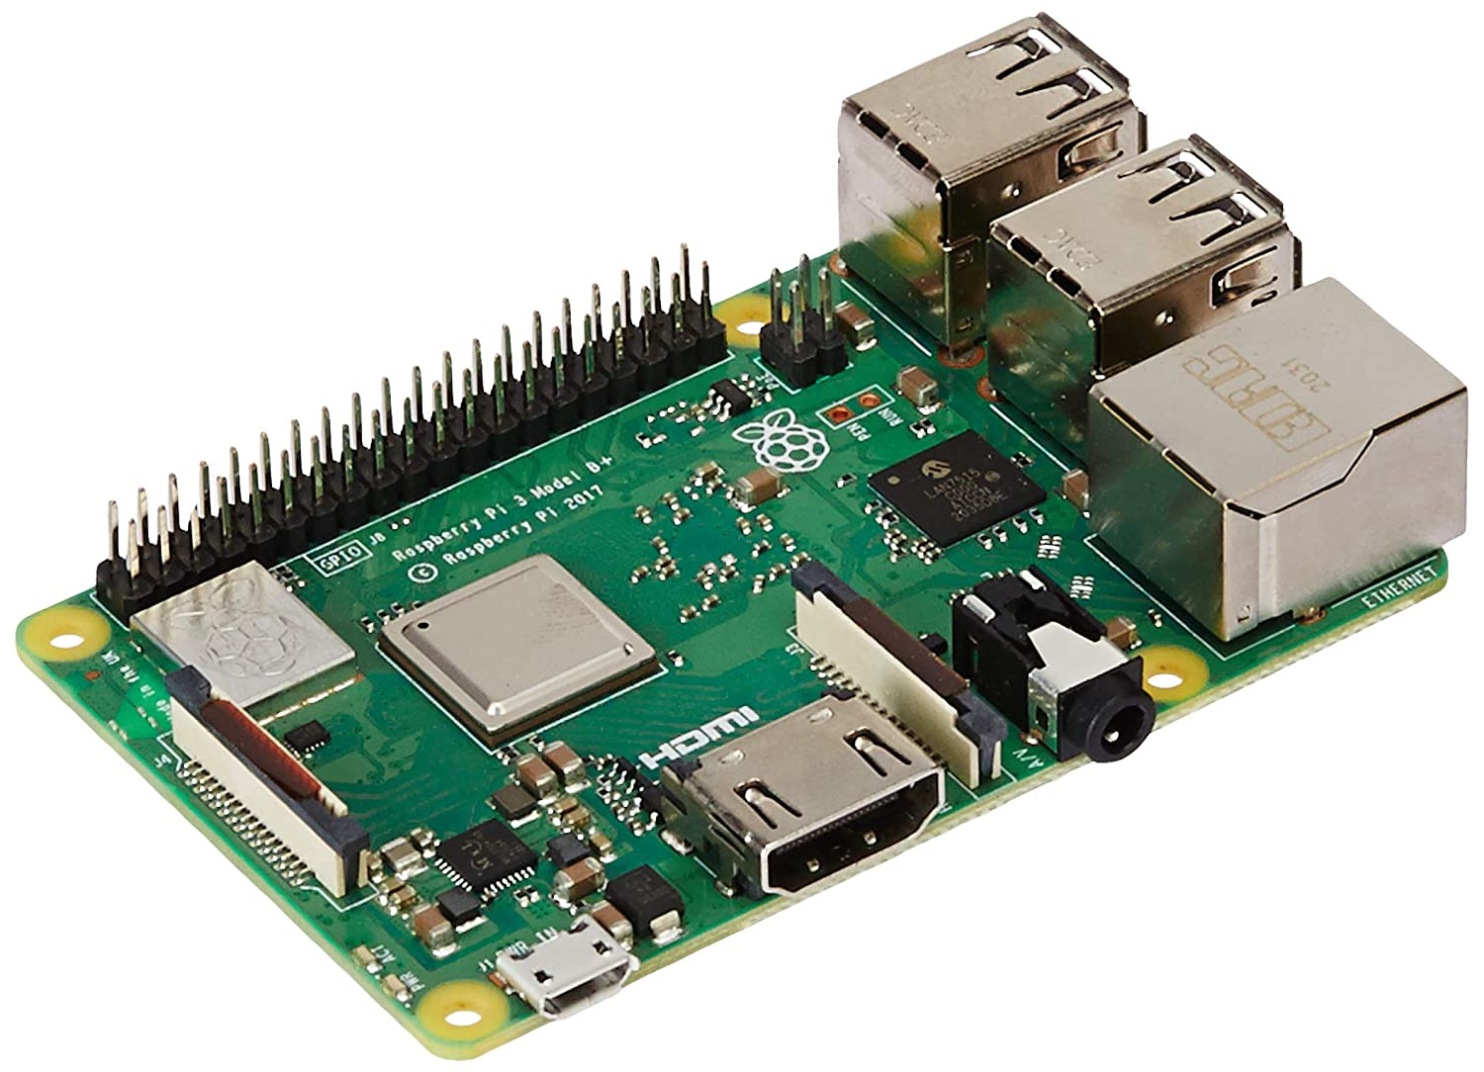
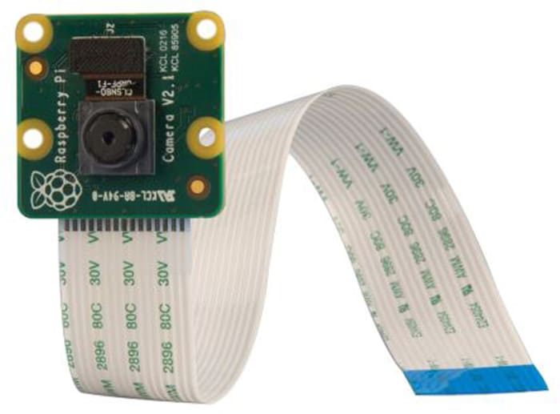
Fig 4: SD card and Power supply
Fig 2: Raspberry pi 3B
Fig 3: Pi Camera module

Slide 13
Implementation
Implementing a video streaming solution
Headless operation
Network connectivity
Robustness and error handling:
Efficient video encoding and decoding
Streaming in different formats
Extraction of image
Annotation

Slide 14
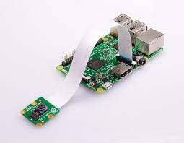
Video streaming system

Slide 15
KNOWLEDGE GAINED
Raspberry Pi configuration and operation: Acquiring knowledge about the setup and configuration of Raspberry Pi devices, including headless operation and software installation.
Video streaming principles: Understanding the concepts and principles behind video streaming, including encoding, decoding, and streaming protocols.
Network setup and communication: Gaining knowledge about local networking and communication protocols, such as IP addressing and data transmission.
Bounding Box Annotation: This involves drawing rectangular boxes around objects of interest within an image. It is commonly used for object detection and localization tasks

Slide 16


APPLICATIONS DEVELOPED
Developed a video streaming system using Raspberry pi
A client and server architecture for communication
captured image 1
captured image 2

Slide 17
APPLICATIONS
1. Remote Surveillance
2. IoT Applications.
3. Education and Research

Slide 18
FUTURE SCOPE
1. Mobile Application Integration.
2. Multiple Client Support: Enhancing system
3. Enhanced Security Features:
5. Video Analytics and Machine Learning

Slide 19
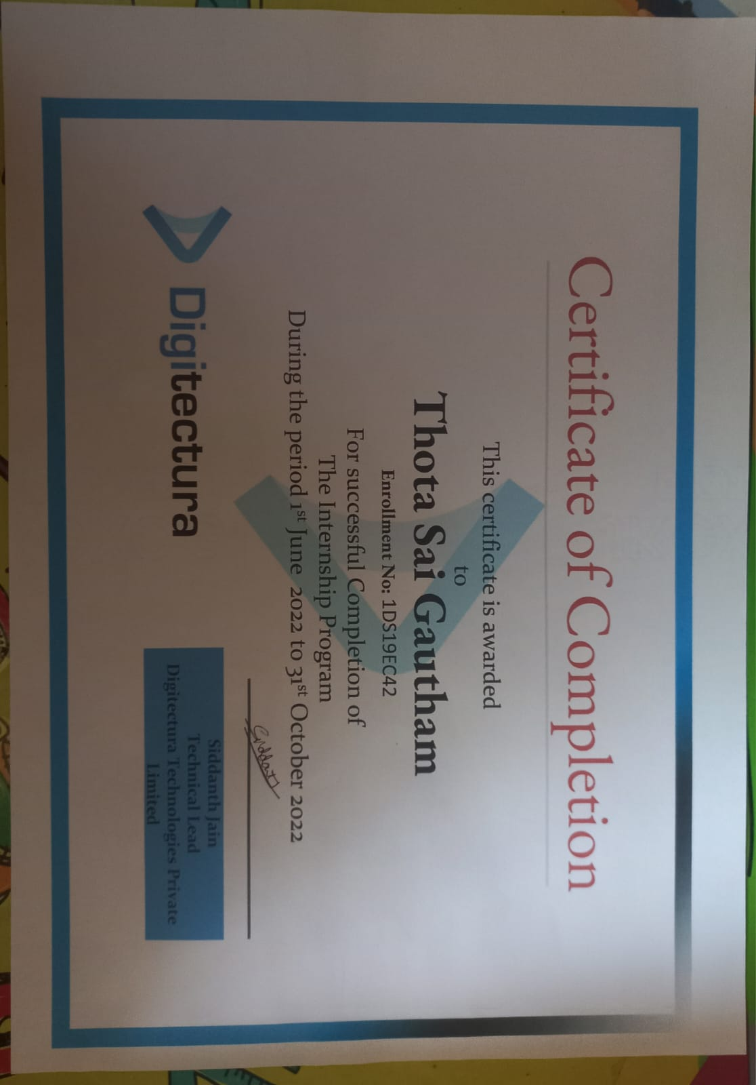
CERTIFICATE

Slide 20
REFLECTIONS
Developed technical skills in Image processing ,Raspberry Pi configuration, networking, and video encoding/decoding.
Gain knowledge of video streaming principles and industry-standard tools and techniques.
Learn to set up and configure Raspberry Pi for headless operation and software installation.
Enhance understanding of networking protocols, IP addressing, and data transmission for video streaming applications.

Slide 21
Thank you

