Slide 1
Overview of BLEU
Arthur Chan
Prepared for Advanced MT Seminar

Slide 2
This Talk
Original BLEU scores (Papineni 2002)
  Procedures and Motivations (21 pages)
    N-gram precision (15 mins)
    Modified N-gram precision (15 mins)
      Experimental Studies
    Brevity Penalty (10 mins)
  Experimental Evidence (10 pages)
    Only if we have time
A summary of the point of view of BLEU’s author
Slides could be found at
  http://www.cs.cmu.edu/~archan/coursework/Original_BLEU_V4.ppt

Slide 3
Bilingual Evaluation Understudy (BLEU)

Slide 4
BLEU – Its Motivation
Central Idea:
  “The closer a machine translation is to a professional human translation, the better it is.”
Implication
  A evaluation metric could be evaluated
    If it correlates with human evaluation, it would be a useful metric
BLEU was proposed
  as an aid
  as a quick substitute of humans when needed

Slide 5
What is BLEU? A Big Picture
Requires multiple good reference translations
Depends on modified n-gram precision (or co-occurrence)
  Co-occurrence: if translated sentence hit n-gram in any reference sentences
Computes Per-corpus n-gram co-occurrence
  n can have several values and a weighted sum is computed
Penalizes very brief translation

Slide 6
N-gram Precision: an Example
Candidate 1: It is a guide to action which ensures that the military always obey the commands the party.
Candidate 2: It is to insure the troops forever hearing the activity guidebook that party direct.
Clearly Candidate 1 is better
Reference 1: It is a guide to action that ensures that the military will forever heed Party commands.
Reference 2: It is the guiding principle which guarantees the military forces always being under the command of the Party.
Reference 3: It is the practical guide for the army always to heed directions of the party

Slide 7
N-gram Precision
To rank Candidate 1 higher than 2
  Just count the number of N-gram matches
  The match could be position-independent
  Reference could be matched multiple times
  No need to be linguistically-motivated

Slide 8
BLEU – Example : Unigram Precision
Candidate 1: It is a guide to action which ensures that the military always obey the commands of the party.
Reference 1: It is a guide to action that ensures that the military will forever heed Party commands.
Reference 2: It is the guiding principle which guarantees the military forces always being under the command of the Party.
Reference 3: It is the practical guide for the army always to heed directions of the party.
N-gram Precision : 17

Slide 9
Example : Unigram Precision (cont.)
Candidate 2: It is to insure the troops forever hearing the activity guidebook that party direct.
Reference 1: It is a guide to action that ensures that the military will forever heed Party commands.
Reference 2: It is the guiding principle which guarantees the military forces always being under the command of the Party.
Reference 3: It is the practical guide for the army always to heed directions of the party.
N-gram Precision : 8

Slide 10
Issue of N-gram Precision
What if some words are over-generated?
  e.g. “the”
An extreme example
Candidate: the the the the the the the.
Reference 1: The cat is on the mat.
Reference 2: There is a cat on the mat.
N-gram Precision: 7 (Something wrong)
Intuitively : reference word should be exhausted after it is matched.

Slide 11
Modified N-gram Precision : Procedure
Procedure
  Count the max number of times a word occurs in any single reference
  Clip the total count of each candidate word
  Modified N-gram Precision equal to
    Clipped count/Total no. of candidate word
Example:
Ref 1: The cat is on the mat.
Ref 2: There is a cat on the mat.
“the” has max count 2
Unigram count = 7
Clipped unigram count = 2
Total no. of counts = 7
Modified-ngram precision:
  Clipped count = 2
  Total no. of counts =7
  Modified-ngram precision = 2/7

Slide 12
Different N in Modified N-gram Precision
N > 1 is computed in a similar way
  When 1-gram precision is high, the reference tends to satisfy adequacy
  When longer n-gram precision is high, the reference tends to account for fluency

Slide 13
Modified N-gram Precision on Blocks of Text
A source sentence could be translated as multiple target sentences
Procedure in the case of corpus evaluation:
Compute the N-gram matches sentence by sentence
Add the clipped counts for all candidate sentences
Divide the sum by the total number of n-grams in the test corpus

Slide 14
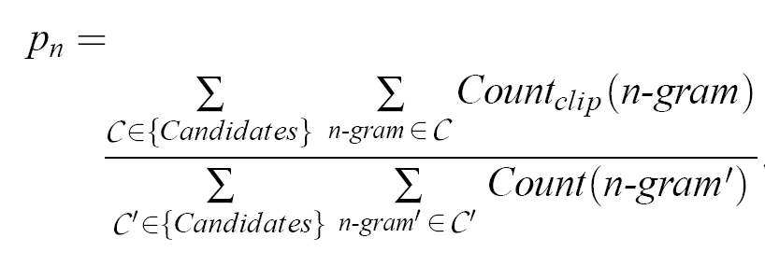
Formula of
Corpus-based N-gram Precision
Note: Candidate means translated sentences

Slide 15
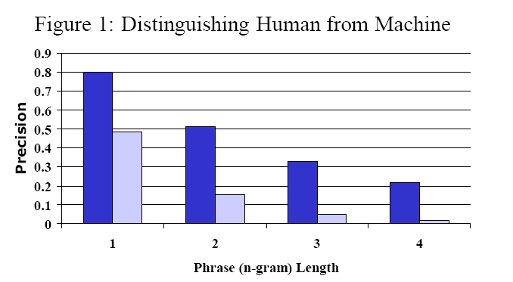
Experiment 1 of N-gram Precision:
Can it differentiate good and bad translation?
Source : Chinese, Target: English
Human (Blue) vs (Machine) Light Blue
Observation: Human scores much better than Machine
Conclusion: BLEU is useful for translation with great difference in quality.

Slide 16
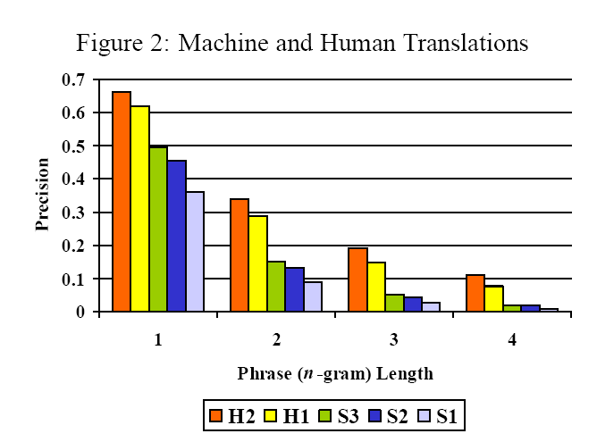
Experiment 2 of N-gram Precision:
Can it differentiate with very close quality?
From BLEU: H2 > H1 > S3 > S2 > S1
Same as human judgment
  Not shown in paper
Conclusion: It is still quite useful when quality is similar

Slide 17
Combining modified n-gram precision
The measure becomes more robust
Precision has exponential decay
  => Geometric mean is used
  => sensitive to higher n-gram
4-gram was shown to be the best among (3,4,5)-gram
Arithmetic means was also tried
  Underweighting of unigram found to be a good match with human.

Slide 18
Issues of Modified N-gram Precision : Sentence Length
Candidate 3: of the
Modified Unigram Precision : 2/2
Modified Bigram Precision : 1/1
Reference 1: It is a guide to action that ensures that the military will forever heed Party commands.
Reference 2: It is the guiding principle which guarantees the military forces always being under the command of the Party.
Reference 3: It is the practical guide for the army always to heed directions of the party.

Slide 19
Issues of Modified N-gram Precision : Trouble with Recalls
Good candidate should only use (recall) one possible word choices
Example:
  Candidate 1: I always invariably perpetually do. (Bad Translation)
  Candidate 2: I always do. (A complete Match)
  Reference 1: I always do.
  Reference 2: I invariably do.
  Reference 3: I perpetually do.

Slide 20
Authors on Recalls
“Admittedly, one could align the reference translations to discover synonymous words and compute recall on concepts rather than words.”
“Given that translation in length and differ in word order and syntax, such a computation is complicated.”

Slide 21
Solution: Brevity Penalty
When a translation matches a reference
  BP = 1
When a translation is shorter than the reference
  BP < 1

Slide 22
Brevity Penalty Computation
IBM’s BP –corpus-based
  best match lengths
    The closest reference sentence length
      E.g. If references have 12, 15, 17 words and candidate has 12
  Exponential decay in r/c if c < r
    r is the sum of the best match lengths of the candidate sentence in the test corpus
    c is the total length of the candidate translation corpus (?)
      (?) is c the candidate sentence?
(?) BP shouldn’t be computed by averaging sentence penalties in sentence-by-sentence basis
  => That will punish length deviation of short sentence very harshly.

Slide 23
Original Paper on the value c
Pretty confusing
  “c is the total length of the candidate translation corpus.” in Section 2.2.2
  “let c be the length of the candidate translation ……” in Section 2.3

Slide 24
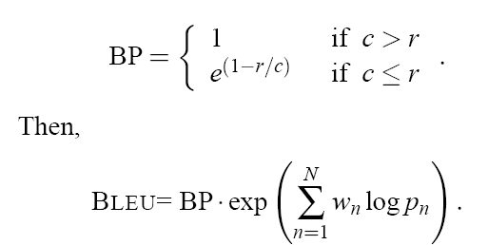
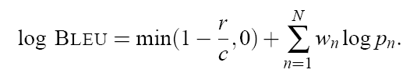
Formulae of BLEU Computation

Slide 25
NIST version
r: The average no. of words in a reference translation, average over all reference translations
c: The number of words in translation being scored
(Skipped here) NIST version also has different definitions of BP.

Slide 26
Experimental Evidence
Detail: Please read the reserved slides
Summary of Experimental Evidence from the original paper
  Ranking provided by BLEU is the same as ranking provided by Human
    The result is statistically significant with pairwise t-statistics
  Using BLEU, only one single reference is necessary
  BLEU shows that machine and human translation still have a big gap
  BLEU has been used in multiple languages and shown to be useful

Slide 27
Human vs. BLEU - Conclusion
Human and Machine Translation has large difference in BLEU
  In footnote: “significant challenge for the current state-of-the-art systems”
Bilingual group was very forgiving to fluency problem in the translation

Slide 28
Conclusion
Presented the scheme and Motivation of original IBM BLEU.
  The scheme is motivated
  Shown to be correlated with human judgment
  Also shown to be useful in {Arabic,Chinese,French,Spanish} to English
The author believes
  Averaging sentence judgments is better than approximate human judgment for every sentences
  “quantity leads to quality”
  Ideas could be used in summarization and NLG task

Slide 29
References
Kishore Panineni, Salim Roukos, Todd Ward and Wei Jing Zhu, BLEU, a Method for Automatic Evaluation of Machine Translation. In ACL-02. 2002
George Doddington, Automatic Evaluation of Machine Translation Quality Using N-gram Co-Occurrence Statistics.
Etiene Denoual, Yves Lepage, BLEU in Characters: Towards Automatic MT Evaluation in Languages without Word Delimiters.
Alon Lavie, Kenji Sagae, Shyamsundar Jayaraman, The Significance of Recall in Automatic Metrics for MT Evaluation.
Christopher Culy, Susanne Z. Riechemann, The Limits of N-Gram Translation Evaluation Metrics.
Santanjeev Banerjee, Alon Lavie, METEOR: An Automatic Metric for MT Evaluation with Improved Correlation with Human Judgments.
About T-test: http://mathworld.wolfram.com/Pairedt-Test.html
About T-distribution: http://mathworld.wolfram.com/Studentst-Distribution.html

Slide 30
Reserved: Experimental Evidence of BLEU
Arthur Chan

Slide 31
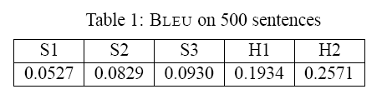
Experimental Evidence of BLEU
500 sentences (40 general news stories)
4 references for each sentence

Slide 32
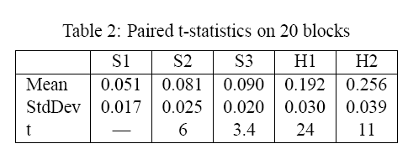
Means/Variance/t-statistics of BLEU
Sentences are divided into 20 Blocks, each have 25 sentences

Slide 33
Experimental Evidence of BLEU (cont.)
The difference of BLEU score is significant
  As shown by pair t-statistics
  pair t-statistics (? pairwise t-test) > 1.7 is significant

Slide 34
No. of reference required
The system maintains the same rank order when
  Randomly choose 1 out of 4 sentences.
  => Using BLEU, as long as using big corpus and translations are from different translators
    single reference could be used

Slide 35
Human Evaluation
Two groups of judges
  “Monolingual group”
    Native Speakers of English
  “Bilingual groups”
    Native Speakers of Chinese who lived in U. S. for several years.
  Each rate the sentence with opinion score from 1 (very bad) to 5 (very good)

Slide 36
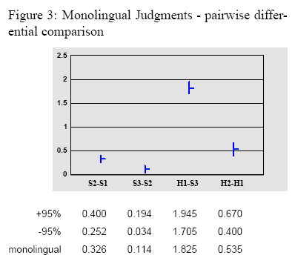
Monolingual Group

Slide 37
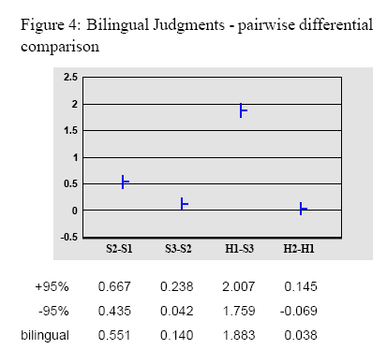
Bilingual Group

Slide 38
Some observations in Human Evaluation
Human evaluation shows the same ranking as BLEU does
Bilingual group seems to focus on adequacy more than fluency

Slide 39
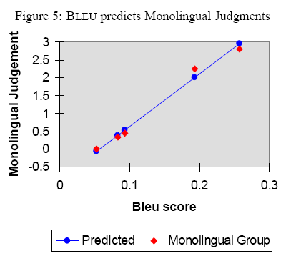
Human vs. BLEU
BLEU shows high correlation with both monolingual (0.99) and bilingual group (0.96)

Slide 40
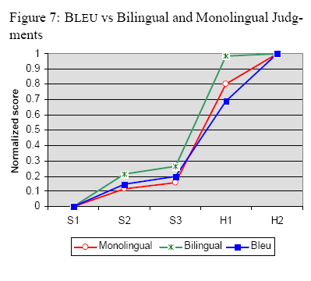
Human vs. BLEU (cont.)

