Slide 1
PHISHING WEBSITE DETECTION USING MACHINE LEARNING
Presented by:
P.SAI HAREEN(20NG1A1244) G.SANJAY BHARGHAV(20NG1A1221) K.RAMESH BABU(20NG1A1229) P.SIVA KOTESWARRAO(20NG1A1242)
Under The Guidance of : M.Rajesh Sir

Slide 2
ABSTRACT
Phishing is quite a popular form of cyber-attacks these days. In these websites, the user can be tricked into revealing his sensitive information such as username, passwords, bank details, card details, etc. The phishing URLs look almost similar to the legitimate ones. In our method, we make use of only the information about the URL of a website to determine whether the website is a phishing website or not.

Slide 3
TITLE JUSTIFICATION
The purpose of this project is to perform Machine Learning based classification.
There are different types of features based on web pages.
Hence, to prevent phishing attacks we must use a specific web page feature.
Here, a model based on Random Forest is used to detect phishing web pages.

Slide 4
OBJECTIVE
A phishing website is a common social engineering method that mimics trustful uniform resource locators (URLs) and webpages.
The objective of this project is to train machine learning models and deep neural nets on the dataset created to predict phishing websites.
Both phishing and benign URLs of websites are gathered to form a dataset and from them required URL and website content-based features are extracted.
SCOPE OF THE PROJECT
Employees and customers can easily detect phishing emails and messages
Important information like credit card passwords can be more secured

Slide 5
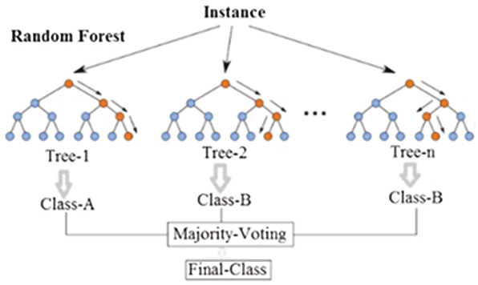
PROPOSED SYSTEM
Intelligent methods can be used to develop fake web pages.
This algorithm works by creating a number of classification trees randomly. These trees are created by making use of different samples from the same dataset.
Once the trees have been formed, we can do the classification by finding the results of each tree and then assigning it to the class that has been determined by the most number of trees.

Slide 6
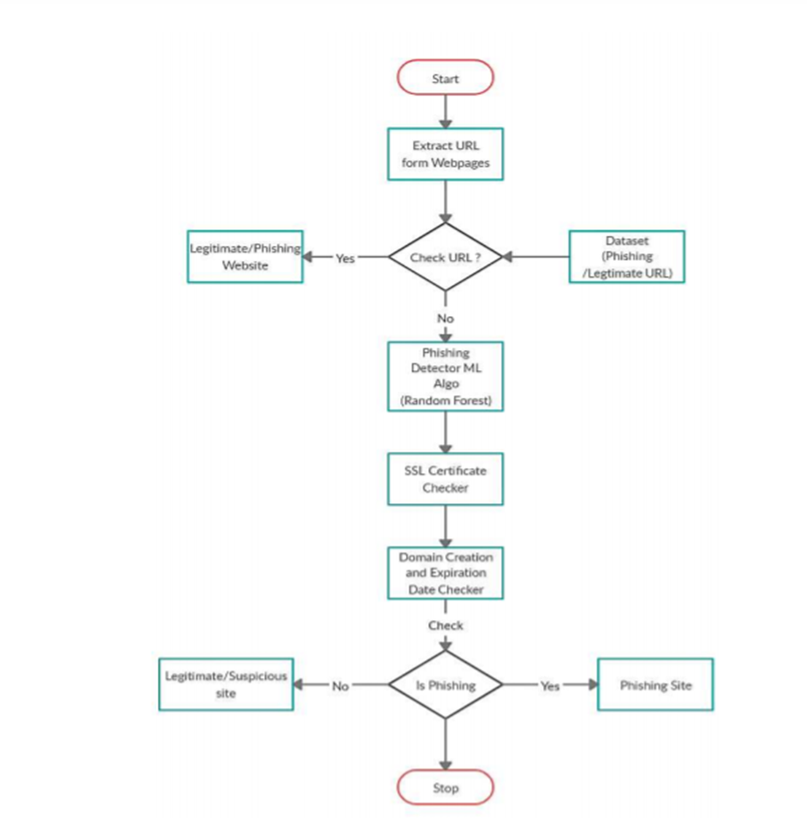
DESIGN FLOW OF THE PROJECT

Slide 7
TECHNICAL REQUIREMENTS
HARDWARE REQUIREMENTS
Processor: I5
RAM: 8 GB
Space on Hard Disk:320GB
SOFTWARE REQUIREMENTS
Coding language : python
Anaconda Shell Prompt

Slide 8
TOOLS
ANACONDA PROMPT
Anaconda is the Python distribution and the Anaconda Prompt is a command line shell (a program where you type in commands instead of using a mouse).
IDLE PYTHON
IDLE (Integrated Development and Learning Environment) is an integrated development environment (IDE) for Python. The Python installer for Windows contains the IDLE module by default. IDLE can be used to execute a single statement just like Python Shell and also to create, modify, and execute Python scripts.

Slide 9








PACKAGES USED
LIBRARIES
tldextract

Slide 10
ALGORITHMS USED
RANDOM FOREST
Random forest is a supervised learning algorithm which is used for both classification as well as regression.
But however, it is mainly used for classification problems.
As we know that a forest is made up of trees and more trees means more robust forest.
Similarly, random forest algorithm creates decision trees on data samples and then gets the prediction from each of them and finally selects the best solution by means of voting.

Slide 11
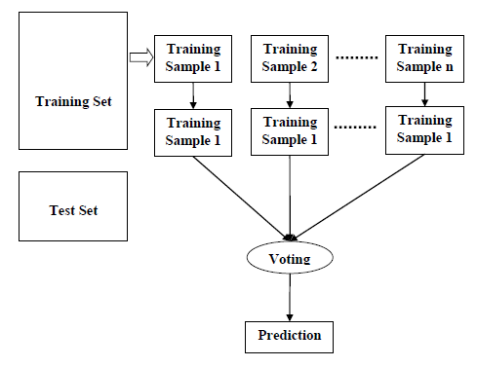
WORKING OF RANDOM FOREST ALGORITHM
We can understand the working of Random Forest algorithm with the help of following steps −
Step 1 − First, start with the selection of random samples from a given dataset.
Step 2 − Next, this algorithm will construct a decision tree for every sample. Then it will get the prediction result from every decision tree.
Step 3 − In this step, voting will be performed for every predicted result.
Step 4 − At last, select the most voted prediction result as the final prediction result.

Slide 12
APPROACH :
Pick a random K data points from the training set.
Build the decision tree associated with those K data points.
Choose the number Ntree of trees you want to build and repeat step 1 & 2.
For a new data point, make each one of your Ntree trees predict the value of Y for the data point, and assign the new data point the average across all of the predicted Y values

Slide 13
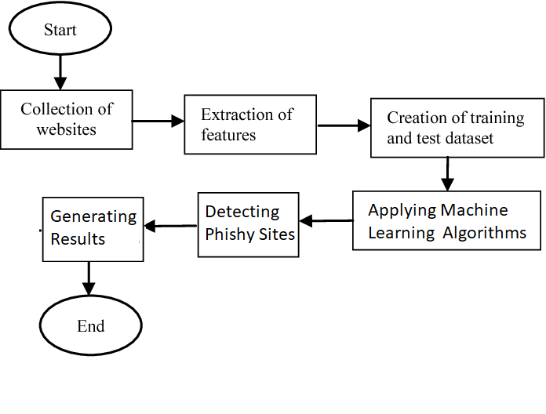
ARCHITECTURE DIAGRAM:

Slide 14
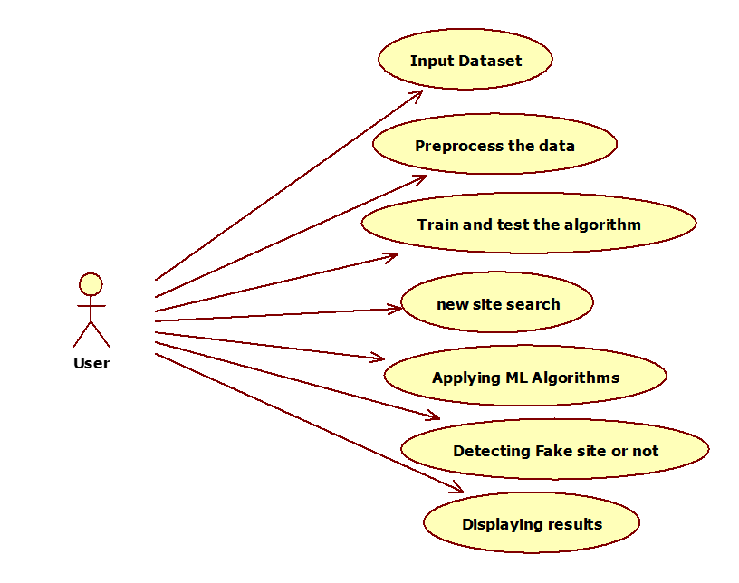
USE CASE DIAGRAM

Slide 15
SEQUENCE DIAGRAM

Slide 16
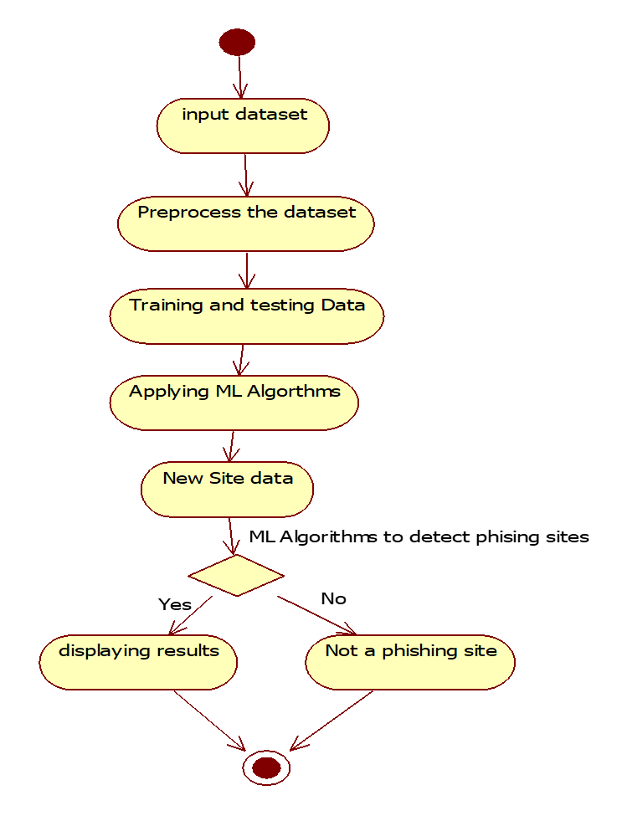
ACTIVITY DIAGRAM

Slide 17

UNDERSTANDING THE DATASET
We use the phishing dataset for website detection.
This dataset is downloaded from Kaggle website.
Dataset consists of 30 parameters and a result parameter

Slide 18

INPUT PARAMETERS
As an input we take data set . Here, we have 11055 rows and 31 columns of data.

Slide 19
INPUT PARAMETERS After pre processing the data

Slide 20
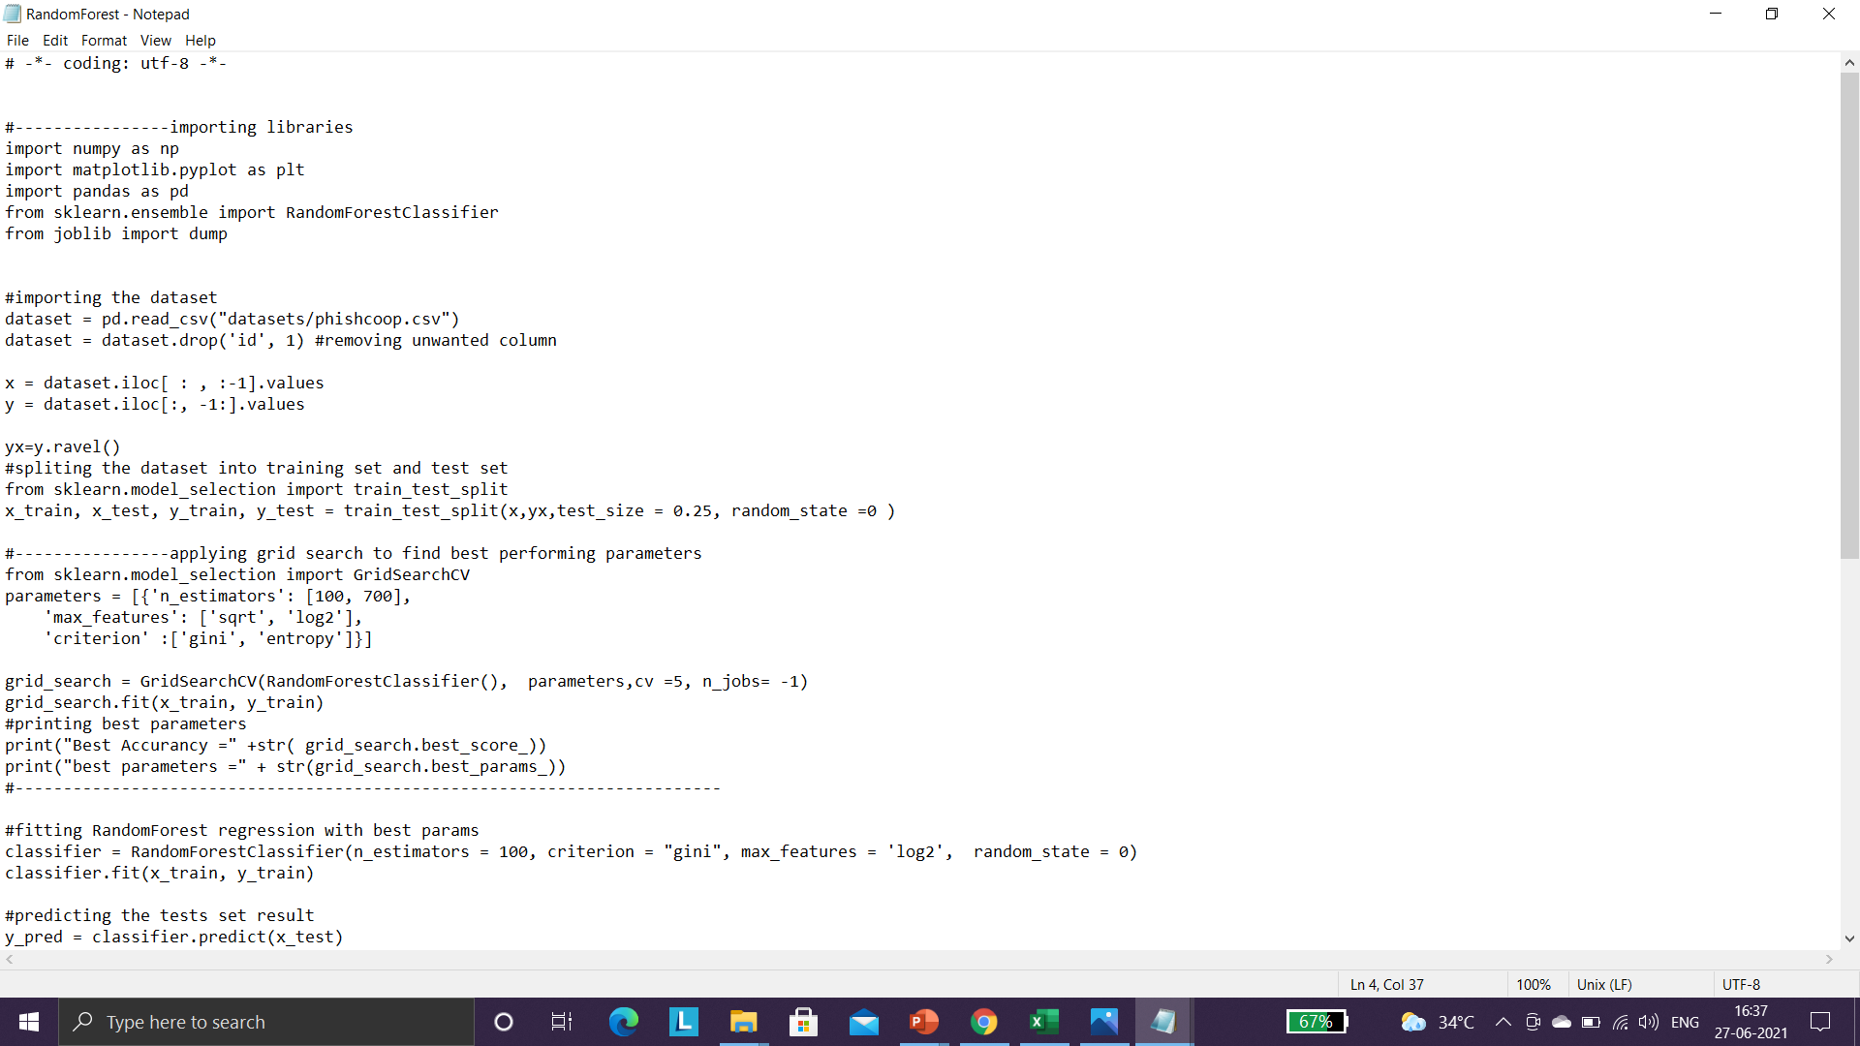
Importing the libraries, loading the dataset, preprocessing

Slide 21
OUTPUT PARAMETERS
Accuracy
Confusion Matrix
Variable Importance
Legitimate or Phishing

Slide 22
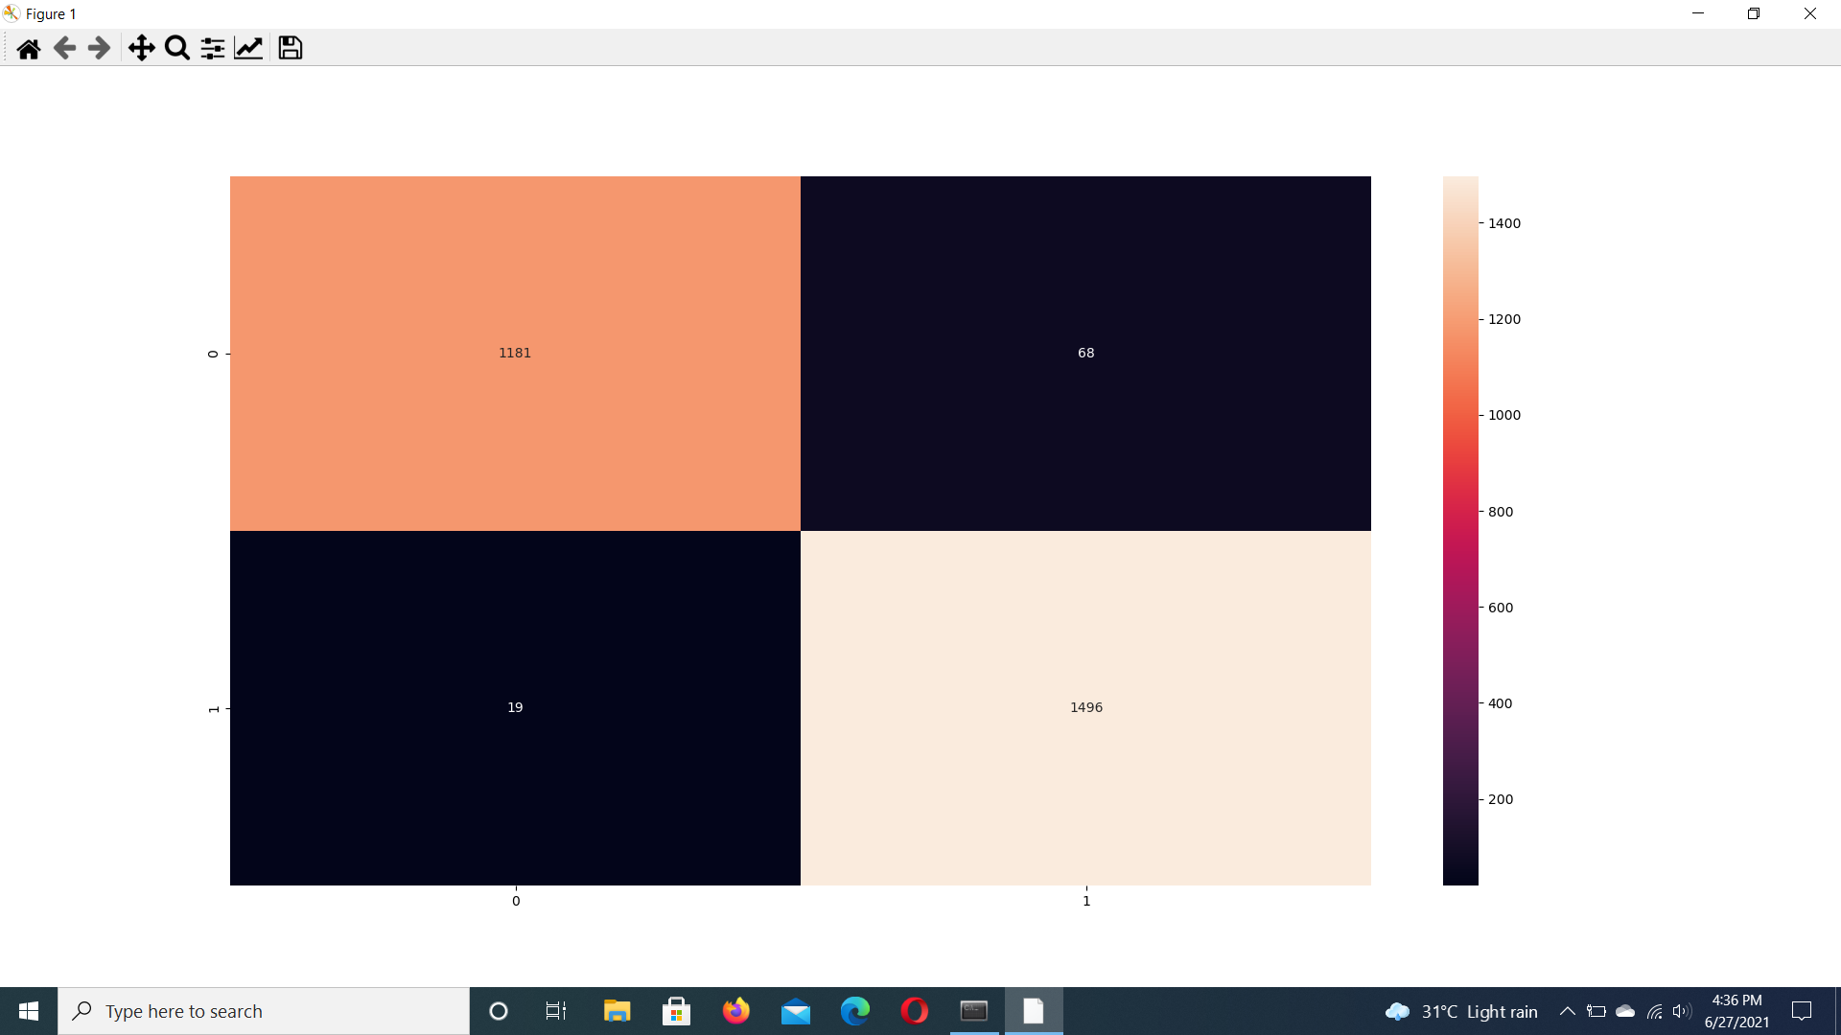
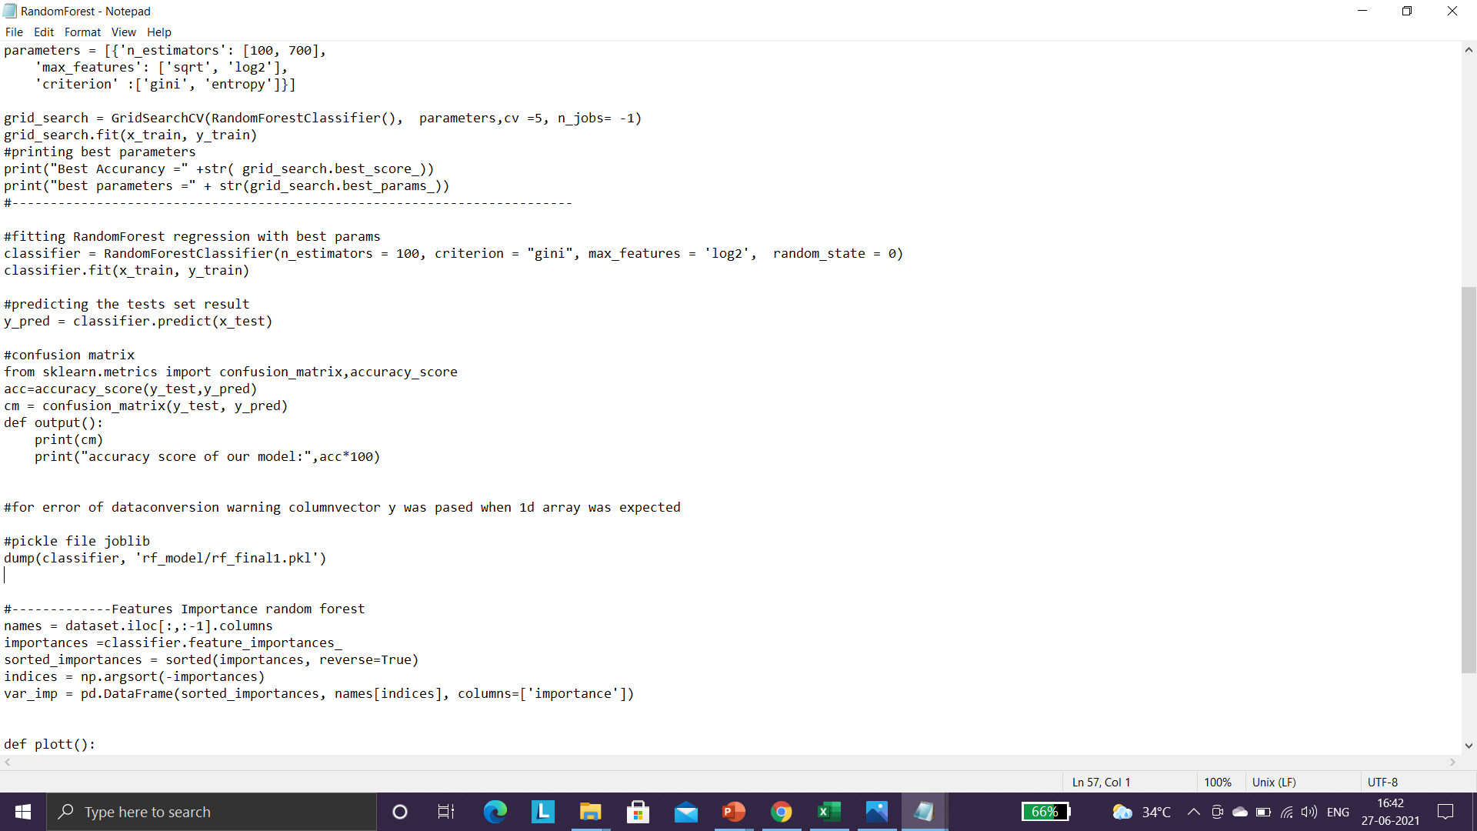
CONFUSION MATRIX
RESULT INTERPRETATION

Slide 23
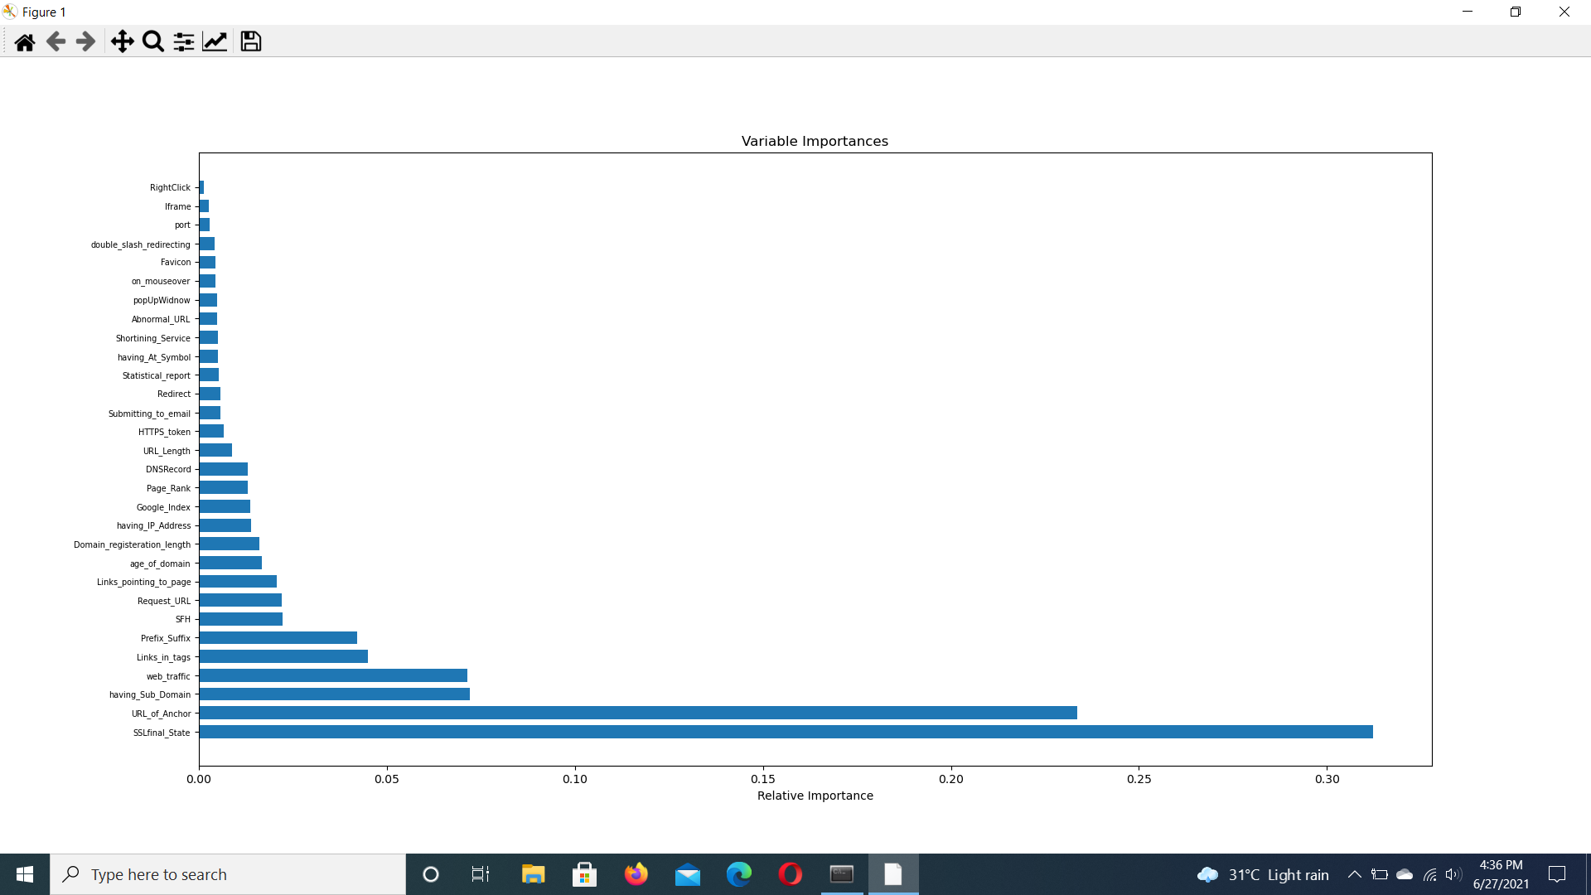
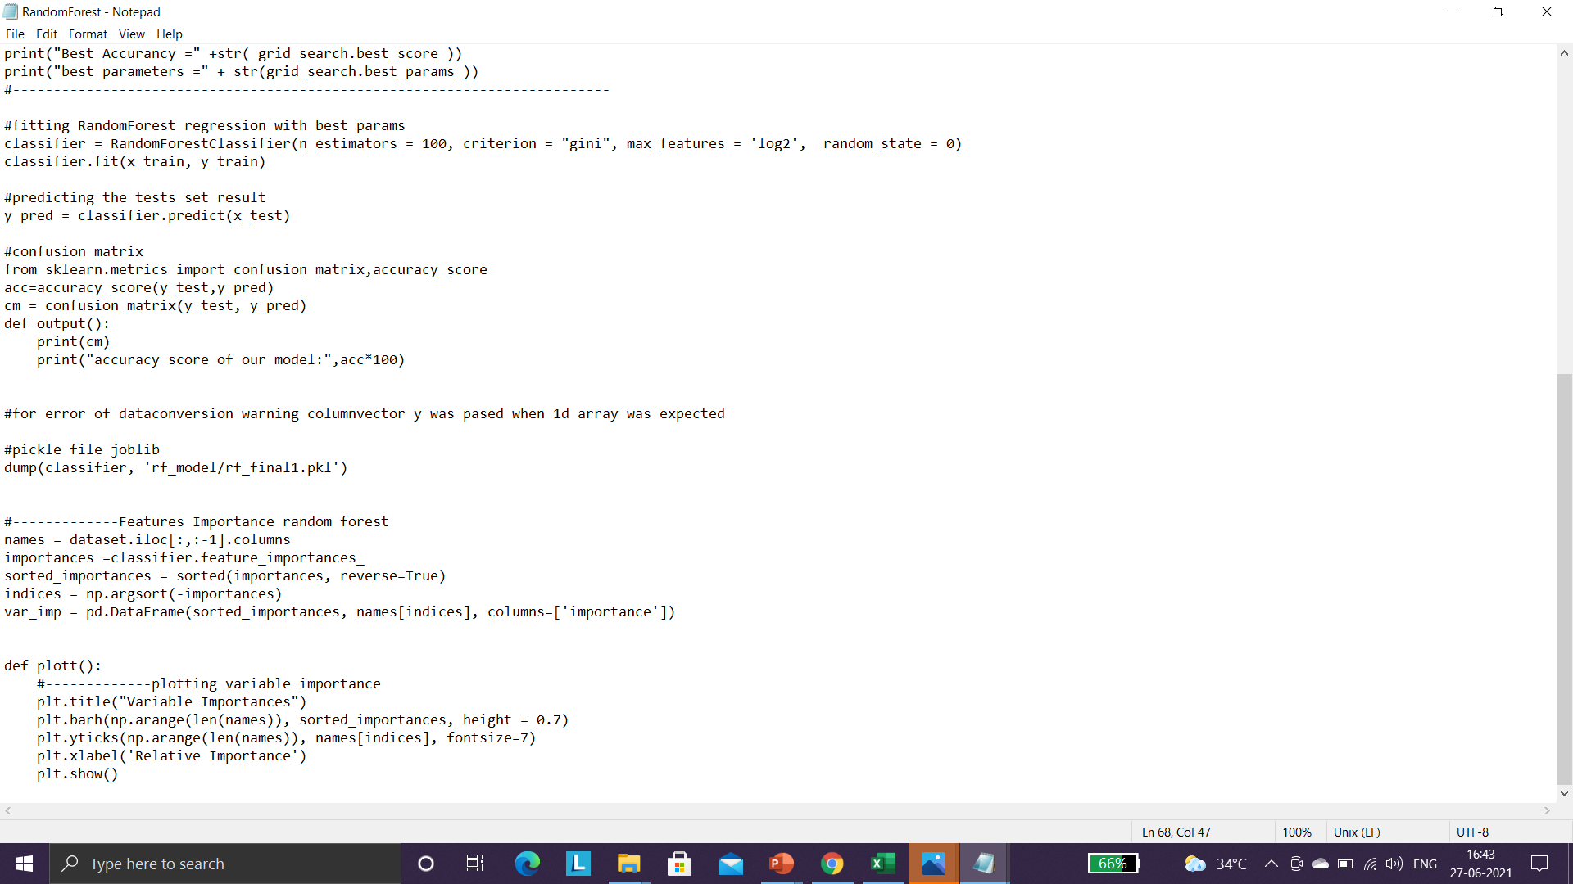
VARIABLE IMPORTANCE

Slide 24
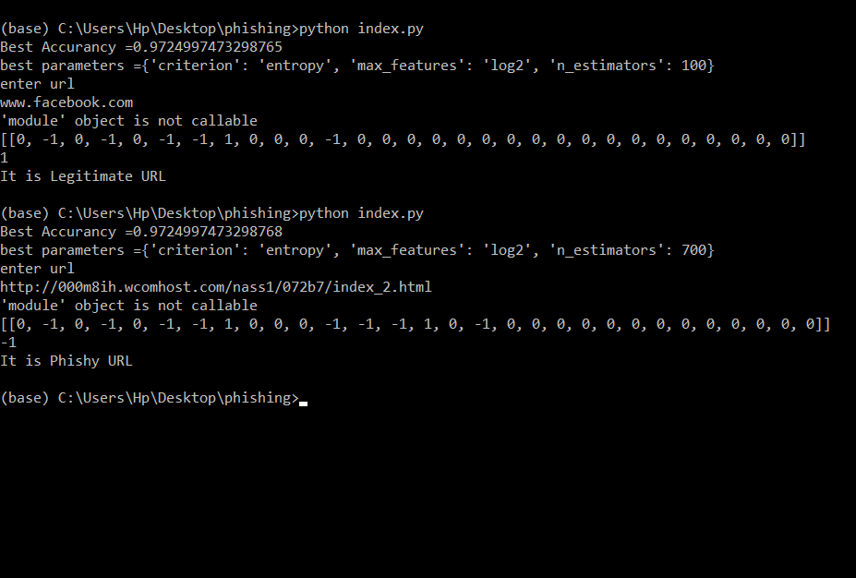
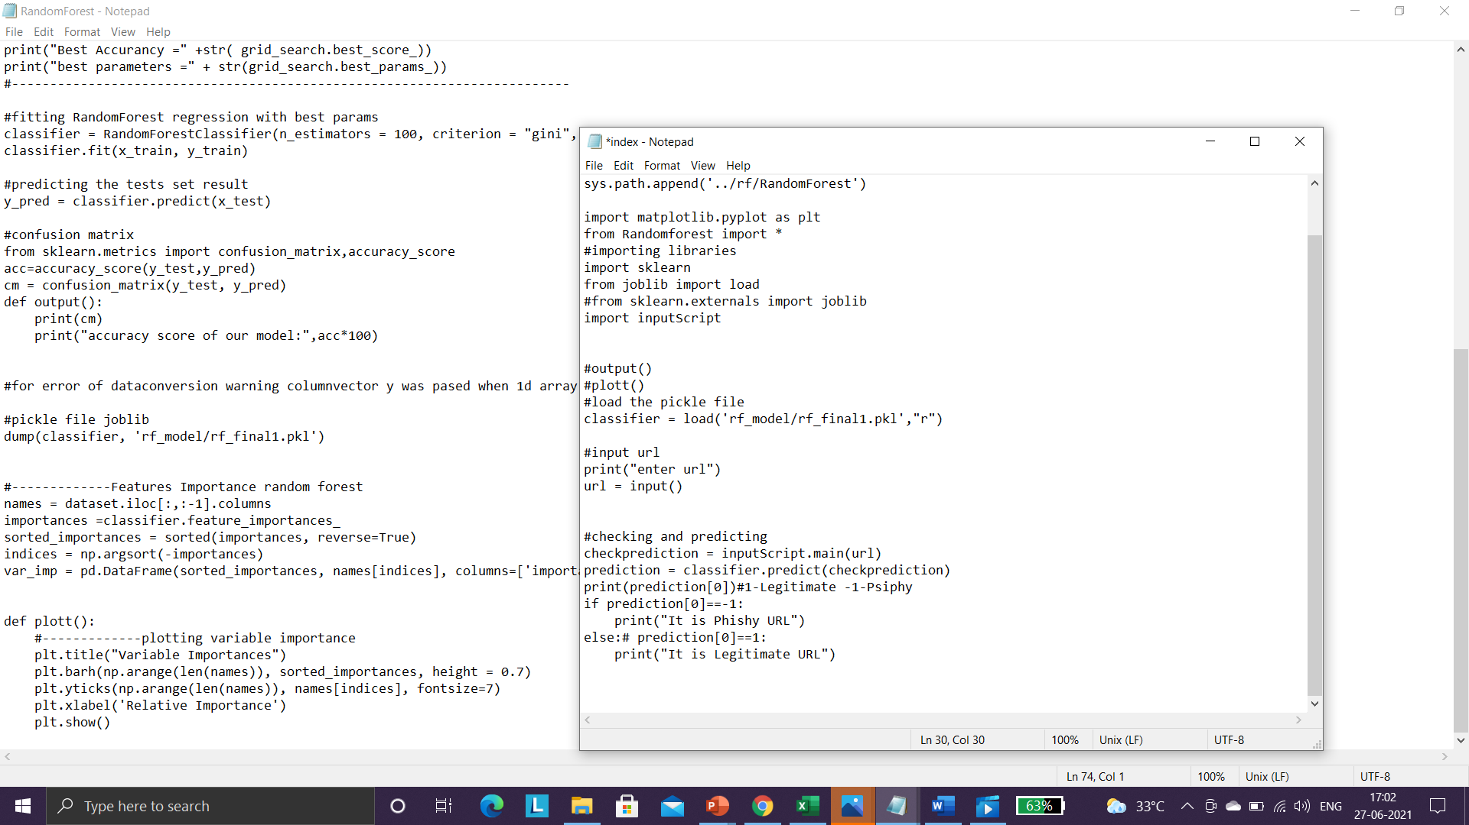
LEGITIMATE OR PHISHY CLASSIFICATION

Slide 25
CONCLUSION
In our work, we made use of a powerful classifier, namely Random Forest, to perform the classifications. Another advantage that Random Forest offers is that it doesn’t overfit the data, if the parameters are tuned and selected carefully. Thus, they are a suitable choice for use in URL Phishing datasets and in determining whether a URL is phishing or not.

Slide 26
Thank you

