Slide 1
WHICH ARTICLES RECEIVE MUCH ATTENTION ON SOCIAL MEDIA
-KRITHIN KUMAR VENKATESH (Z1837607)
SAI HARINI PERUGUPALLI (Z1829025)

Slide 2
INTRODUCTION
Nowadays social media plays a critical tool in scholarly papers.
According to the social media facts, the networks with the most penetration among social media users in 2018 so far are Facebook, Instagram and Snapchat.
In this paper, we analyze which article receives much attention on the social media platform: Facebook.

Slide 3
WHY?
Can know what people are really interested in
The organizations which will buy copyrights from the authors based on their popularity.
When using the sources of high ranked authors, it strengthens your research paper.

Slide 4
DATASET
Altmetrics dataset -big data course at NIU.
Millions of JSON files in the dataset. Each JSON file represented a tuple in the Altmetric data, which we processed to create the final dataset.
We extracted 3,00,000 tuples using random.
Dataset after cleaning 235771 tuples.

Slide 5
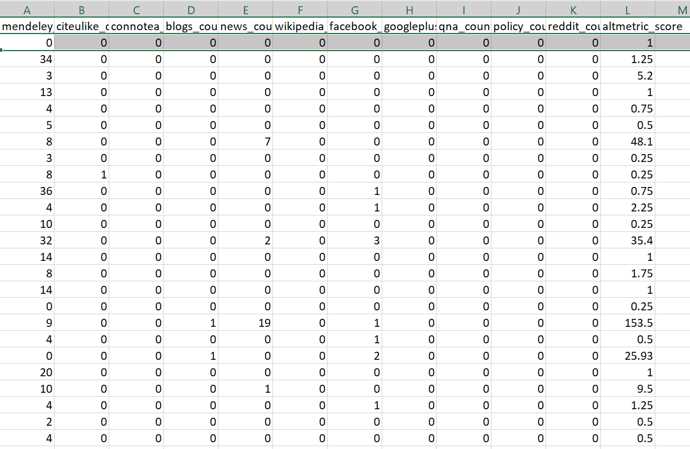
FEATURES
mendeley_count
citeulike_count -
connotea_count
blogs_count
news_count
wikipedia_count
facebook_count
googleplus_count
qna_count
policy_count
reddit_count
altmetric_score

Slide 6
CLEANING TECHNIQUES
Remove Outliers
dropna() to remove null values using numpy
Imputer to fill in the missing values using sklearn
drop_duplicates() to remove duplicate values

Slide 7
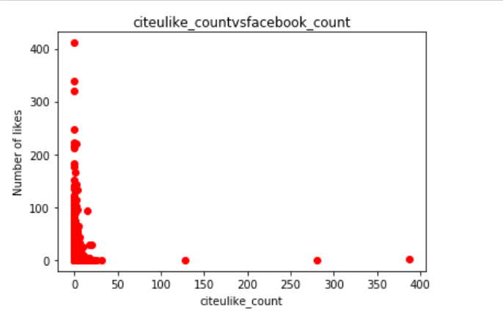
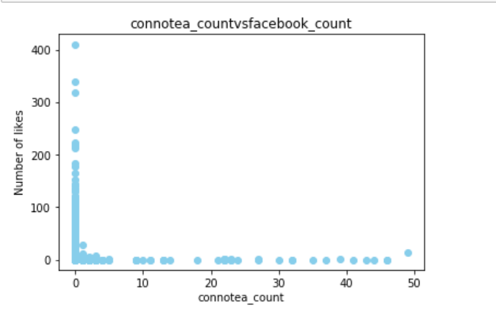
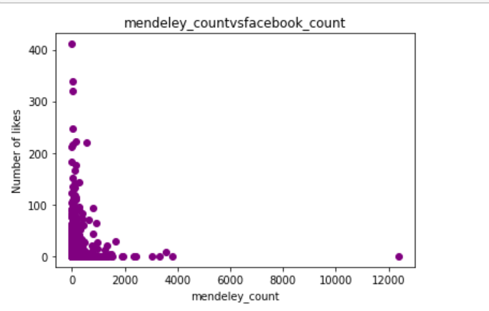
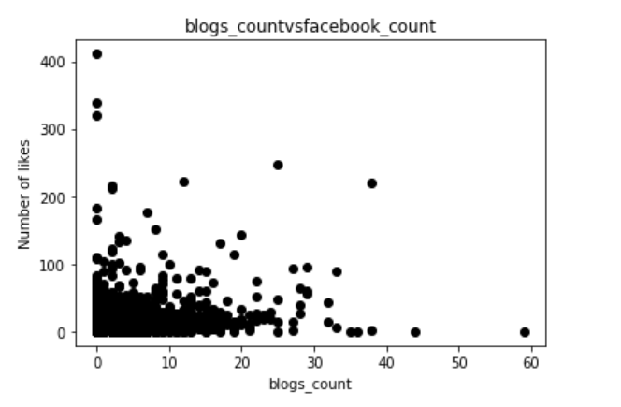
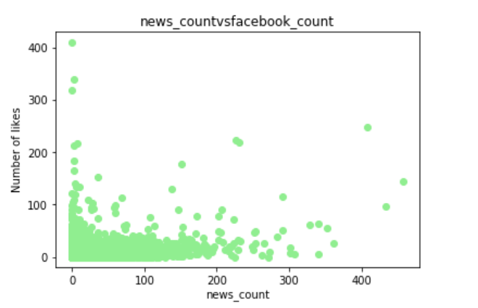
SCATTER PLOTS

Slide 8
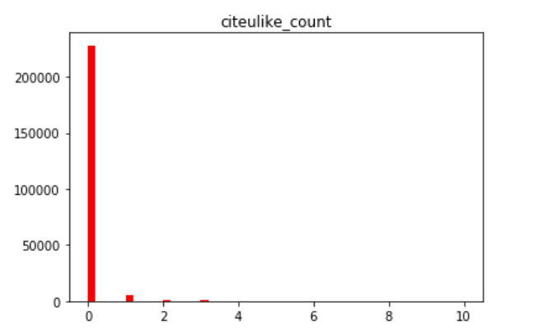
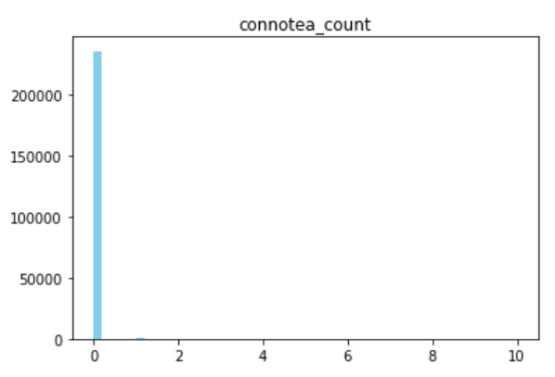
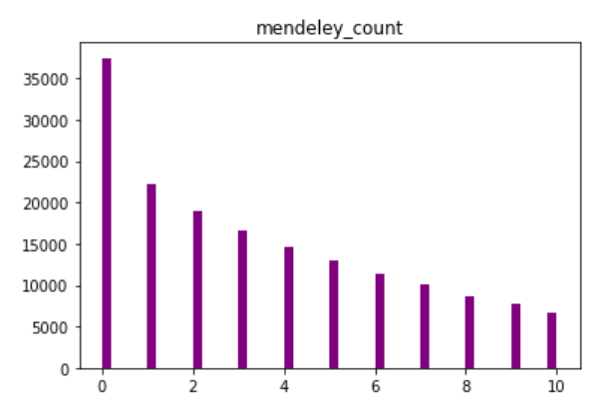
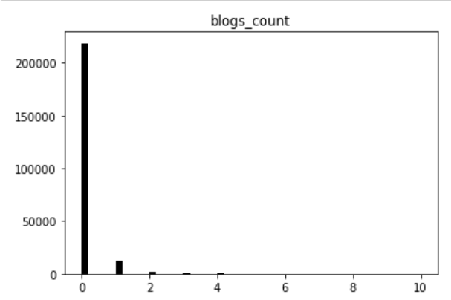
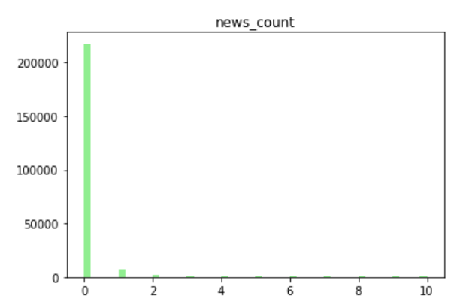
HISTOGRAMS

Slide 9
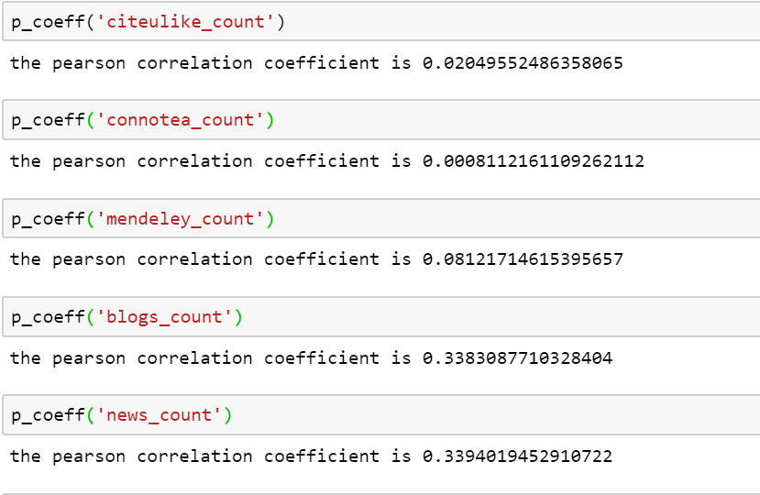
PEARSON CO-EFFICIENT

Slide 10
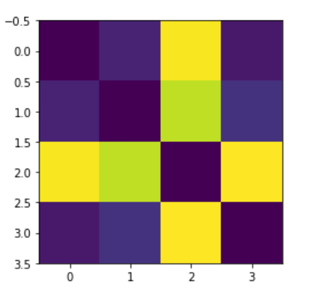
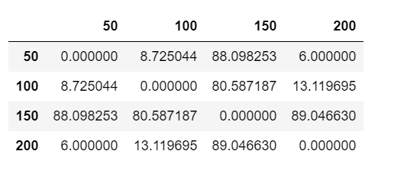
DISTANCE MATRIX AND HEATMAP

Slide 11
ALGORITHMS USED
LINEAR REGRESSION
ARTIFICIAL NEURAL NETWORKS

Slide 12

LINEAR REGRESSION
Linear regression is commonly used type of predictive analysis.
These regression estimates are used to explain the relationship between one dependent variable and one or more independent variables.
We used train_test_split() to split the data and retrieved 47,154 tuples for test data.

Slide 13
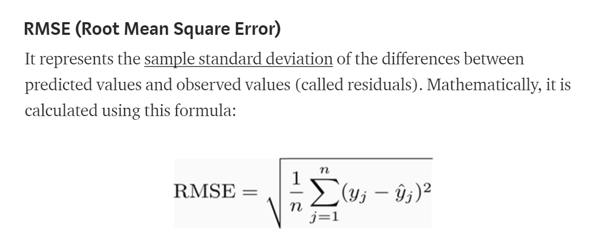
EVALUATION OF LINEAR REGRESSION
We mainly have Three ways to Evaluate linear regression: mean square error, Mean absolute error and R^2.
We opted mean square error for our model.

Slide 14
MEAN SQUARE ERROR
Performed linear regression on the data with Facebook_count as the target value.
The mean_square_error() for this was 3.20.
Also, performed Linear regression on the data with Altmetric_score as the target value.
The mean_square_error() for this was 4.729.

Slide 15

ARTIFICIAL NEURAL NETWORKS
A Framework for many different machine learning algorithms to work together and process complex data inputs.
Such systems "learn" to perform tasks by considering examples, generally without being programmed with any task-specific rules.
We implemented Neural networks on data where the target variable is Facebook_count.

Slide 16
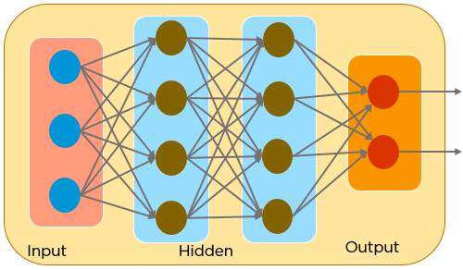
ARTIFICIAL NEURAL NETWORKS
We considered 50 epochs so that the model will be trained 50 times.
The error/loss was considerably lowered along this process.

Slide 17
PREDICTED VALUES
We gained the prediction for 47,154 tuples.
Measured the Mean square error for evaluating the Neural networks.
The error rate came down to 2.92 from 3.2.
Therefore, using Linear Regression and Neural networks was an improvement in predicting the values with reduced error rate.

Slide 18
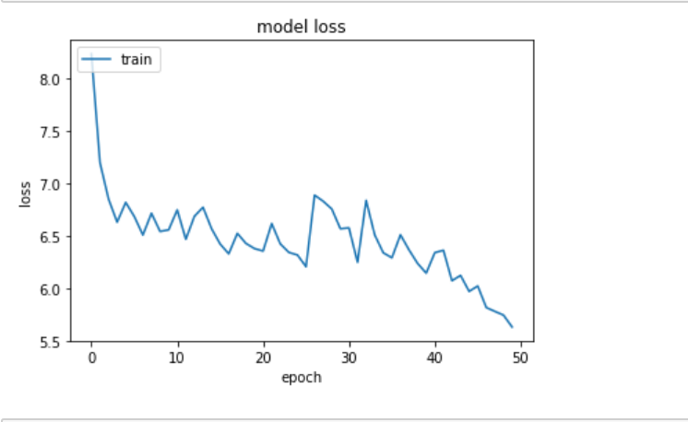
EVALUATION OF NEURAL NETWORKS
The mean square error (MSE) is 2.92

Slide 19

QUESTIONS?

Slide 20
THANK YOU!

