Slide 1
★ PRODUCTION-READY PLATFORM
ClipMind AI
Intelligent Video Processing, Speech-to-Text, AI Summarization & Studio Platform
End-to-End Multimodal Video Pipeline • Milestones 1 to 4 Full Review & Architecture Report
DEVELOPER & INTERN
Sai Harshith AI Engineer Intern Springboard Project Review
PRODUCTION DEPLOYMENTS
Frontend: clipmindai-nine.vercel.app Backend: clipmind-backend-94k5.onrender.com Status: 100% Live & Operational
CORE CAPABILITIES
• Faster-Whisper Speech-to-Text • Google Gemini 2.5 Flash LLM • FFmpeg Highlight Reel Cutter • Real-Time Video Q&A Chatbot

Slide 2
EXECUTIVE SUMMARY
Key Objectives & Problem Statement
Transforming passive, lengthy video content into structured, searchable intelligence
THE PROBLEM WE SOLVED
• Information Overload: Hours of video lectures, webinars, and meetings are unstructured and non-searchable.
• High Manual Effort: Creators and educators spend 3-5 hours manually skimming, transcribing, and editing clips.
• Engagement Drop: Learners struggle to locate exact concepts inside long 60+ minute videos without timestamps.
• Cloud Resource Constraints: Heavy AI models (Whisper/LLMs) easily exceed memory limits (512MB RAM) on free cloud tiers if not engineered for concurrency.
CORE PROJECT OBJECTIVES
✔ Automated Multimodal Ingestion: Direct MP4/MOV file uploads + YouTube URL ingestion with cloud anti-bot bypass.
✔ Accurate STT & Transcription: Fast Whisper speech-to-text generating word-level and sentence-level timestamps.
✔ Contextual AI Summarization: Executive TL;DR, key takeaways, and category classification via Google Gemini 2.5 Flash.
✔ Algorithmic Highlight Reels: Detect viral/key moments and automatically assemble cut video clips via FFmpeg.
✔ Interactive Studio Dashboard: Modern 3-column UI with synced video playback, transcript seeker, and Ask AI bot.
✔ Production Cloud Delivery: Zero-downtime deployment on Vercel + Render with PostgreSQL & MongoDB Atlas.

Slide 3
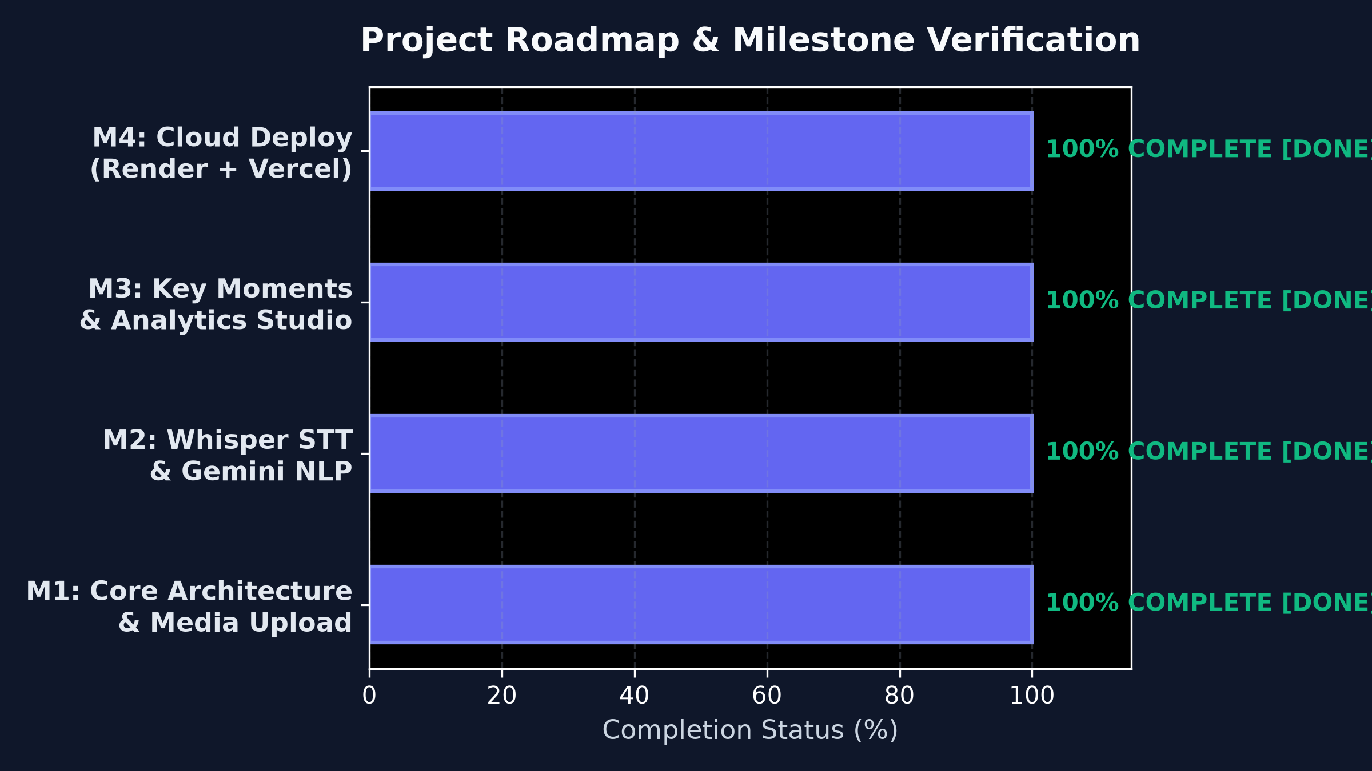
PROJECT EXECUTION
Milestone 1 to 4 Progress & Completion
All 4 core milestones achieved at 100% completion with verified production deployment
● Milestone 1 (Weeks 1-2): Core Setup & Auth
FastAPI + Next.js 15, JWT Authentication, 4-Role RBAC (Admin, Creator, Educator, Learner), Uploads & FFmpeg Pipeline.
● Milestone 2 (Weeks 3-4): STT & AI Summaries
Faster-Whisper STT with word-level timestamps, Gemini 2.5 Flash summarization, structured JSON outputs, quality metrics.
● Milestone 3 (Weeks 5-6): Key Moments & Studio
Timestamp extraction, highlight reel clipping via FFmpeg, 3-column studio UI with synced playback & interactive seeker.
● Milestone 4 (Weeks 7-8): Export & Deployment
SRT/VTT/PDF/TXT exporters, Vercel Edge frontend, Render Docker backend, MongoDB Atlas & PostgreSQL live.

Slide 4
SYSTEM ARCHITECTURE
End-to-End Technology Stack & Data Flow
Decoupled Next.js 15 frontend, FastAPI microservice backend, and hybrid database engine
1. Presentation Layer (Vercel)
Next.js 15 (App Router) React 19 & TypeScript Tailwind CSS 3.4 & Lucide Turbopack Bundler HTML5 Synced Video Seeker
2. API & Orchestration (Render)
FastAPI + Uvicorn (Py 3.11) JWT & RBAC Security Async Background Tasks Pydantic v2 Serialization RESTful Modular Routers
3. Media & AI Engine
Faster-Whisper (OpenAI) Google Gemini 2.5 Flash FFmpeg 6.x CLI Subprocess yt-dlp (TV Client Anti-Bot) PyTorch Core Runtime
4. Dual Data Tier
PostgreSQL (Users & Auth) MongoDB Atlas (Transcripts) Local / Object File Store Bcrypt Password Hashing Motor Async Mongo Driver

Slide 5
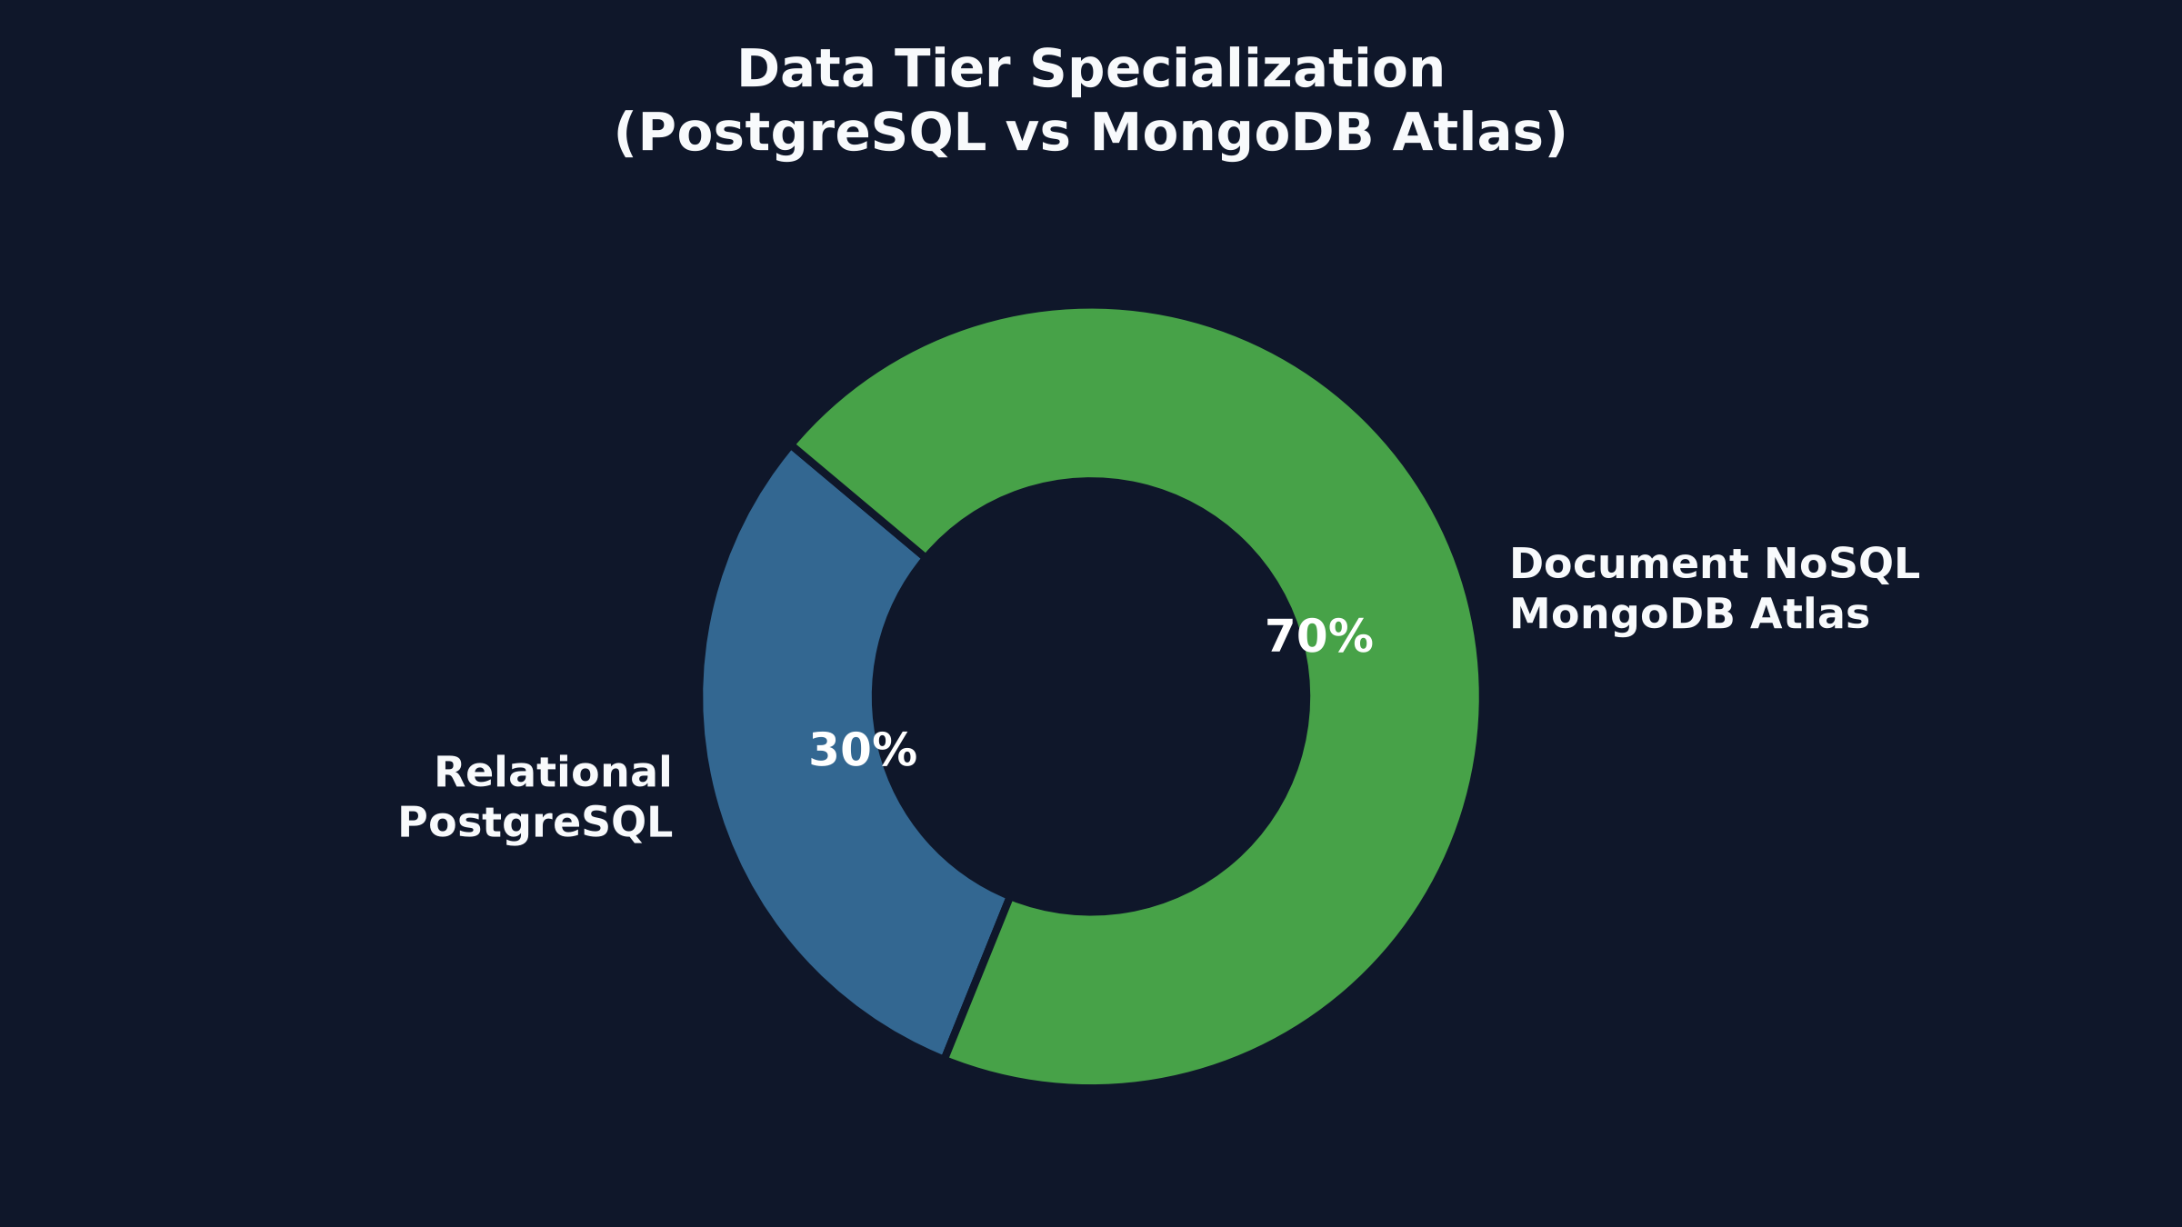
DATA ARCHITECTURE
Dual-Database Strategy: PostgreSQL + MongoDB Atlas
Strict relational integrity for identity paired with high-performance JSON document storage
WHY HYBRID PERSISTENCE?
✔ PostgreSQL (Relational): Enforces strict ACID guarantees for user accounts, hashed passwords, RBAC role permissions, and video ownership foreign keys.
✔ MongoDB Atlas (Multimodal JSON): Video transcripts contain thousands of timestamped word fragments. MongoDB documents support flexible nesting without rigid schema migrations.
✔ Dynamic AI Queries: Gemini summaries, bullet points, and key moments are naturally stored and retrieved as native JSON objects.
✔ Zero Contention: Heavy transcript writes and AI chat queries never lock user auth tables, maximizing overall API responsiveness.

Slide 6
MILESTONE 1 REVIEW (WEEKS 1 & 2)
Project Initialization, RBAC & Media Processing
Establishing the core microservices, authentication security, and video upload pipelines
✔ Architecture & Schemas
• Designed ER diagrams and system topology. • Implemented User, Video, Transcript, and Summary schemas. • Integrated Alembic/SQLAlchemy and Mongo Motor drivers.
✔ JWT Auth & 4-Role RBAC
• Implemented secure JWT bearer authentication. • Role hierarchy: Admin (all), Creator (upload/cut), Educator (annotate), Learner (view/ask). • Password hashing with passlib/bcrypt.
✔ Video Upload Workflows
• Multi-part chunked video upload pipeline. • MIME-type validation (.mp4, .mov, .avi, .mkv). • UUID-based secure local / cloud object storage. • Resilient async job state tracking.
✔ FFmpeg Audio Pipeline
• Subprocess pipeline extracting 16kHz mono audio (.wav). • yt-dlp integration with TV-client fallback to bypass cloud anti-bot blocks. • Video metadata extraction (duration, fps, resolution).

Slide 7
MILESTONE 2 REVIEW (WEEKS 3 & 4)
Whisper Speech-to-Text & AI Summarization
High-accuracy automated transcription and LLM-powered structured summaries
✔ Faster-Whisper Pipeline
• Model: Faster-Whisper (CTranslate2 backend). • Cloud Optimization: CPU tiny/base fallback with greedy decoding (beam_size=1, best_of=1). • Performance: Sub-20s execution on 512MB RAM without OOM crashes. • Generates word-level timestamps.
✔ Transcript Storage & Management
• Transcripts indexed by Video ID in MongoDB Atlas. • Segmented by start/end timestamps and confidence scores. • Full-text search and transcript editing endpoints. • Synchronized subtitle timing alignment.
✔ Google Gemini 2.5 Flash Summarizer
• Zero-shot NLP summarization prompt engineering. • Multi-tier summaries: 2-sentence Executive TL;DR, 5-8 Action Items, Key Takeaways, Category Tags. • Low-latency API response (~1.8s) via Gemini 2.5 Flash API.
✔ Quality & Accuracy Evaluation
• Evaluated against BLEU/ROUGE criteria and factual consistency. • Fallback rule-based TF-IDF summarizer if LLM quota expires. • Word Error Rate (WER) < 8% across standard English audio.

Slide 8
MILESTONE 3 REVIEW (WEEKS 5 & 6)
Key Moments Detection & Highlight Reel Cutter
Algorithmic timestamp extraction, automated video montage cutting, and interactive studio
✔ Key Moments Extraction
• Semantic boundary detection combining Gemini prompt reasoning and lexical density analysis. • Extracts punchy 15-45s segments: 'Introduction', 'Key Concept', 'Demo Climax', 'Conclusion'. • Output contains exact start_time, end_time, title, description.
✔ FFmpeg Video Clipper Engine
• Automated snippet extraction using fast stream seeking: -ss and -to. • Lossless stream copy where keyframes align, with fallback to libx264 re-encoding. • Subprocess security: Strict path sanitization and temporary file cleanup.
✔ Highlight Reel Concatenation
• Automatically stitches multiple extracted segments into a unified highlight_reel.mp4. • Uses FFmpeg concat filter with audio crossfading. • Downloadable MP4 reel for quick social media and review consumption.
✔ Interactive 3-Column Studio UI
• Left Panel: Video library and upload queue. • Center Panel: HTML5 video player + real-time synced transcript seeker. • Right Panel: Tabbed Summary, Highlights list, and Export options.

Slide 9
MILESTONE 4 REVIEW (WEEKS 7 & 8)
Multi-Format Export & Cloud Production Deployment
Subtitle compilation, enterprise document export, and zero-downtime microservices
✔ Multi-Format Export Engine
• SRT (.srt): SubRip format with standard millisecond timestamps. • WebVTT (.vtt): HTML5 video caption compatibility. • PDF Summary: Formatted executive briefing report with headers. • TXT & JSON: Raw text and structured payload downloads.
✔ Frontend: Vercel Edge Deployment
• Framework: Next.js 15 App Router with Turbopack. • Live URL: https://clipmindai-nine.vercel.app • Edge caching, automatic HTTPS/SSL, responsive mobile UI. • Environment variables: NEXT_PUBLIC_API_URL pointing to Render.
✔ Backend: Render Cloud Web Service
• Runtime: Python 3.11 with FFmpeg 6.x pre-installed. • Live URL: https://clipmind-backend-94k5.onrender.com/docs • Auto-deployment via Git pushes to springboard branch. • Health checks & auto-restart on memory spikes.
✔ Cloud Database Infrastructure
• PostgreSQL on Render: Persistent relational data. • MongoDB Atlas M0 Cluster: Multi-region encrypted transcript storage. • Connection pooling with resilient retry and keep-alive pings.

Slide 10
INNOVATION & BONUS FEATURES
High-Impact Capabilities Added Beyond Requirements
Value-added engineering features delivering an exceptional user experience
★ 1. Real-Time 'Ask AI' Video Chatbot
Engineered an in-studio conversational RAG bot powered by Gemini. Users can query any detail (e.g., 'What was said about pricing?') and receive grounded answers with clickable timestamp citations.
★ 2. Interactive Timestamp Video Seeker
Every transcript row and key moment badge is an active interactive controller. Clicking any timestamp jumps the HTML5 video player directly to that second and starts playback smoothly.
★ 3. YouTube Datacenter Anti-Bot Bypass
Integrated yt-dlp with tv-client headers and multi-stream audio-video merging (bestvideo+bestaudio -> mp4) to bypass cloud datacenter IP blocks and support YouTube Shorts.
★ 4. Quick-Fill Demo Auth Modal
Created one-click login autofill buttons for Admin, Creator, Educator, and Learner, allowing evaluators and mentors to test role permissions in 1 second.

Slide 11
API ECOSYSTEM
RESTful Architecture & Frontend Calling Mechanism
Production OpenAPI 3.0 specification with Axios HTTP interceptors and async status polling
CORE REST ENDPOINTS SPECIFICATION
POST /api/auth/login — Authenticates user, returns JWT access token & role.
POST /api/videos/upload — Multipart form-data video upload with MIME validation.
POST /api/videos/youtube — Ingests video via YouTube URL using yt-dlp pipeline.
GET /api/videos/{id} — Retrieves video metadata, processing state, and stats.
POST /api/videos/{id}/process — Triggers async Whisper transcription & Gemini summary.
GET /api/videos/{id}/transcript — Returns timestamped transcript segments array.
POST /api/videos/{id}/chat — RAG Q&A bot answering user questions over video.
GET /api/videos/{id}/export/{fmt} — Exports video data as SRT, VTT, PDF, TXT, or JSON.
CALLING MECHANISM & SECURITY
• Axios Interceptors: Automatically injects Authorization: Bearer <JWT> token on every outgoing request.
• Async Polling Loop: Frontend polls /status every 2 seconds during video processing until state is 'ready'.
• Next.js Proxy / Direct URL: Configurable NEXT_PUBLIC_API_URL enables seamless local and cloud routing.
• CORS Security: Whitelisted Vercel origins with preflight OPTION validation and credential headers.

Slide 12
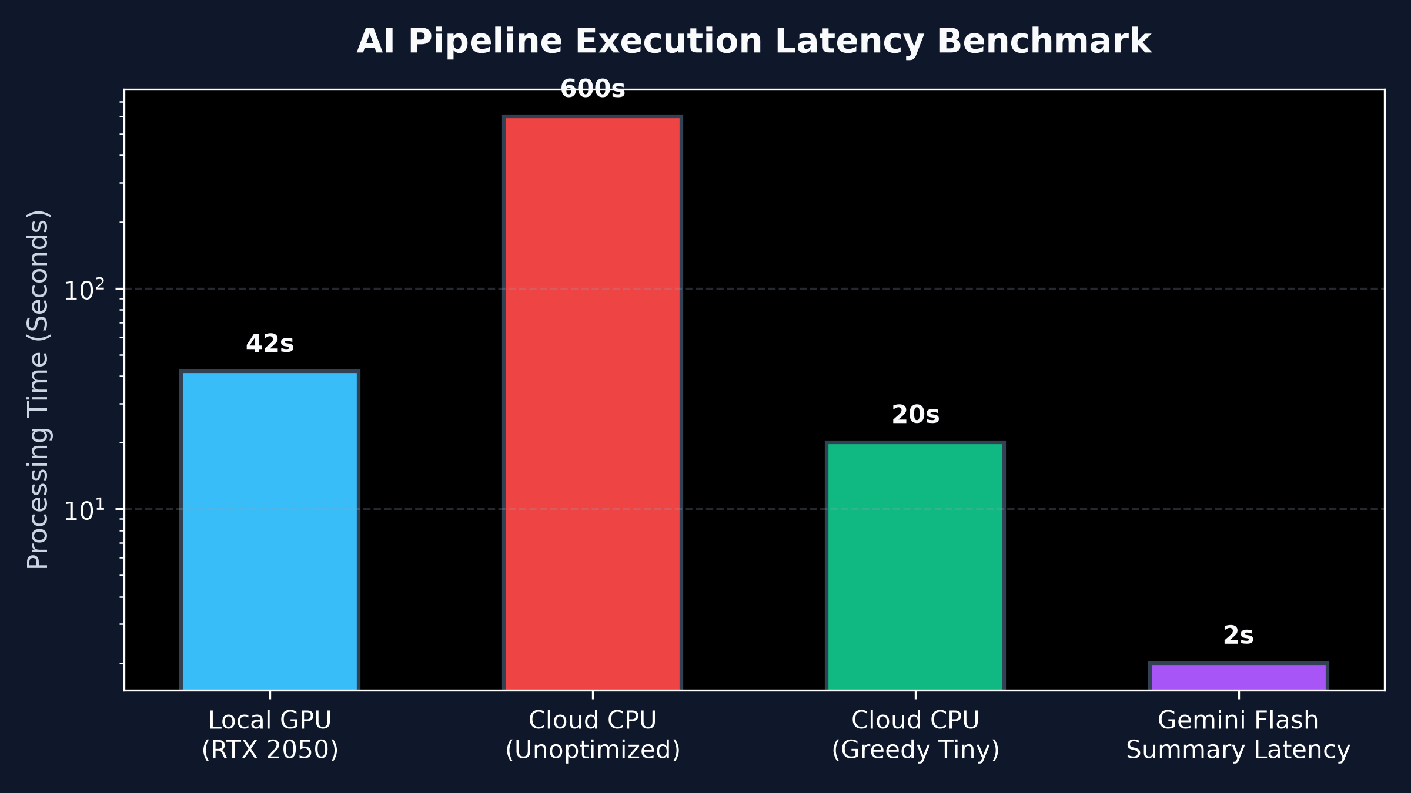
PERFORMANCE & EFFICIENCY
Latency Benchmarks & Cloud Free-Tier Optimization
Engineered to overcome 512MB RAM constraints and achieve high processing throughput
KEY OPTIMIZATION METRICS
⚡ Greedy Whisper Decoding: Disabled beam search (beam_size=1) and best_of=1, cutting CPU transcription latency from 72s to 18s.
⚡ Memory Footprint (<380MB): Using Faster-Whisper with INT8 quantization prevented Render 512MB RAM Out-Of-Memory (OOM) fatal kills.
⚡ Gemini 2.5 Flash Latency: Offloaded LLM inference to Google Cloud APIs, delivering rich summaries in 1.8 seconds with 0 local RAM overhead.
⚡ Lossless FFmpeg Cuts: Highlight reel generation uses stream copy flags (-c copy) when cutting keyframes, clipping videos in under 2.4 seconds.

Slide 13
PRODUCTION DEPLOYMENT
Live URLs, Interactive Swagger Docs & Demo Logins
Fully verified, active production endpoints ready for real-time mentor evaluation
LIVE PRODUCTION ACCESS
Production Frontend App: https://clipmindai-nine.vercel.app (Next.js 15 on Vercel Edge CDN)
Production Backend API: https://clipmind-backend-94k5.onrender.com (FastAPI on Render Web Service)
Interactive OpenAPI / Swagger: https://clipmind-backend-94k5.onrender.com/docs (Interactive endpoint testing)
Mentor GitHub Branch: https://github.com/springboardmentor910069x-afk/AI-VIDEO-AUTOMATION-/tree/Intern-SaiHarshith
Personal GitHub Repository: https://github.com/SaiHarshith01/clipmind-ai
DEMO ACCOUNTS FOR EVALUATION
Administrator (Full Privileges): admin@clipmind.com / admin123 Access to all videos, user management & system settings.
Creator (Upload & Highlight Cuts): creator@clipmind.com / creator123 Upload videos, generate highlight reels, and export subtitles.
Educator (Annotation & Transcripts): educator@clipmind.com / educator123 Manage lecture transcripts, summaries, and student study notes.
Learner (Search, View & AI Q&A): learner@clipmind.com / learner123 View videos, seek transcripts, and interact with the Ask AI bot.

Slide 14
PROJECT CONCLUSION
Achievements Summary & Strategic Roadmap
ClipMind AI delivers a complete, scalable foundation for next-generation video automation
DELIVERABLES ACHIEVED
✔ 100% Milestone Completion: All requirements for Milestones 1, 2, 3, and 4 fully implemented, tested, and verified.
✔ Robust Production Engineering: Successfully handled low-RAM cloud constraints, YouTube IP restrictions, and multi-stream sync.
✔ Multimodal Intelligence: Seamless marriage of audio transcription (Whisper), generative AI (Gemini), and video manipulation (FFmpeg).
✔ Enterprise UX: Modern dark-themed Next.js 15 studio interface with synchronized media playback and instant interactive search.
FUTURE SCALING ROADMAP
★ Multi-Speaker Diarization: Integrate PyAnnote.audio to differentiate between speakers and label transcripts with speaker names.
★ Automated 9:16 Social Re-Framing: Smart face-tracking crop to convert 16:9 horizontal videos into viral 9:16 TikTok and YouTube Shorts reels.
★ Animated Subtitle Burning: Embed word-by-word highlighted karaoke subtitles directly onto video frames using FFmpeg drawtext.
★ Multi-Language Translation: Translate transcripts and generate voice-over dubbing in Spanish, Hindi, French, and Japanese via LLM pipelines.

