Slide 1
IBM University Engagement Project Submission
“Exploring the Power of Agentic AI with IBM Granite and IBM Bob”

Slide 2

Project Tile – Fitness Buddy – AI Powered Personal Fitness Assistant
Domain of Project – Health & Fitness
Student Name | Recent Passport Photo | Email ID | Mobile number [WhatsApp]
Kancherla Sai Hima Sindhu |  | sindhukancherla2003@gmail.com | 7569193934
Recommended font style and size:
Font Style: Arial
Font Size (Heading): 28
Font Size (Content): 20

Slide 3
Problem Statement -
Problem Statement : Fitness Buddy – AI Powered Personal Fitness Assistant
The Challenge
Many individuals struggle to maintain a healthy lifestyle because of:
Lack of personalized fitness guidance
Busy schedules and time constraints
Inconsistent motivation
Limited access to affordable fitness coaching
Traditional fitness solutions are expensive and not always available when needed.
Objective
Build an AI-powered Fitness Buddy that:
Recommends home workouts
Suggests healthy meal ideas
Provides motivational guidance
Encourages habit building
Delivers personalized fitness support anytime
Based on your problem statement screenshot.

Slide 4
Proposed Solution -
Proposed Solution: Fitness Buddy – AI Powered Personal Fitness Assistant
Fitness Buddy is an AI-powered virtual fitness coach developed using IBM Granite Models and IBM Cloud Lite Services.
The system interacts with users through natural language conversations and provides:
Personalized workout plans
Daily fitness recommendations
Healthy meal suggestions
Habit tracking support
Motivation and wellness tips
Users can enter age, weight, fitness goal, activity level, and preferences to receive customized guidance.

Slide 5
Technology Used
IBM Bob platform -For designing and orchestrating multi-agent workflows visually
IBM Grainte model - for eg – ibm-granite-3-2-8b – For natural language understanding, reasoning, and personalization
IBM Cloud – It provides the infrastructure to build, deploy, and scale the Nutrition Agent efficiently. IBM Cloud enables a reliable, secure, and scalable environment for deploying the Nutrition Agent.
IBM Watsonx.ai - For model deployment, embeddings, and AI governance
Python (Flask)
HTML
CSS
JavaScript

Slide 6
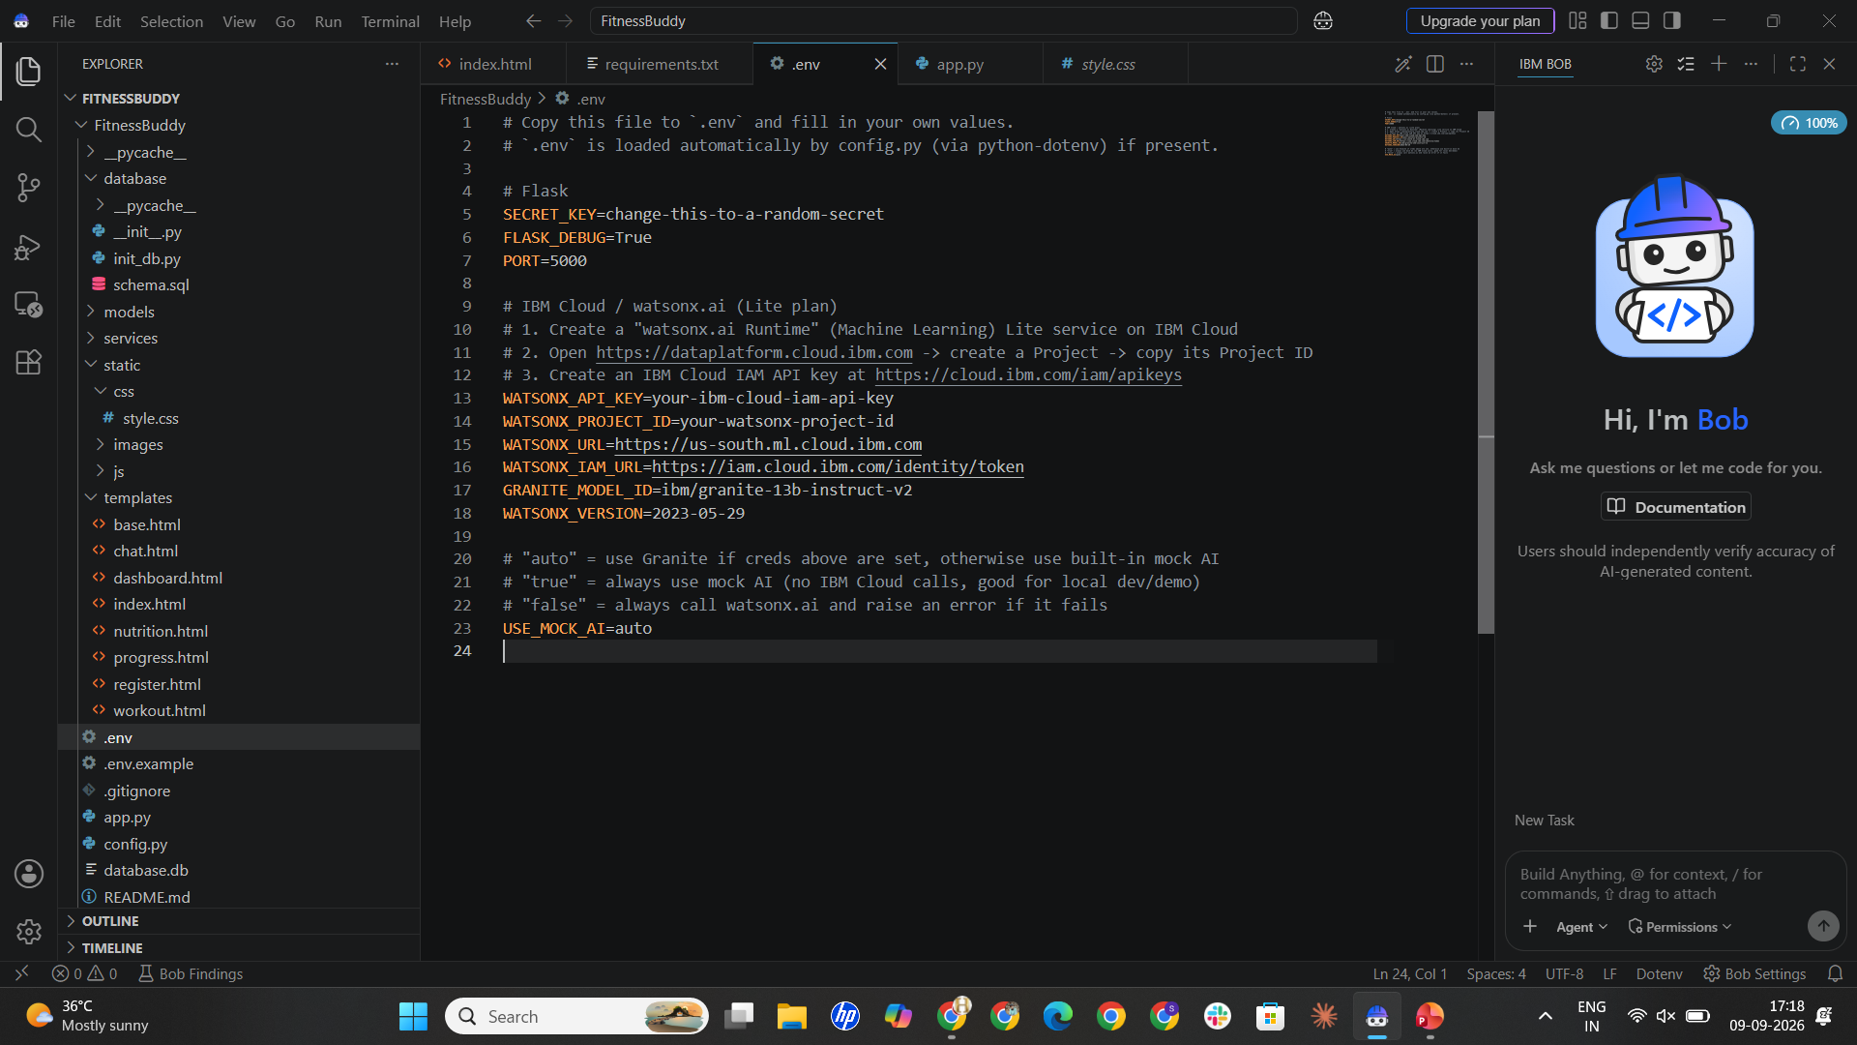
Required Files created using IBM bob -
App.py
Requirements.txt
Style.css
.env
Index.html

Slide 7
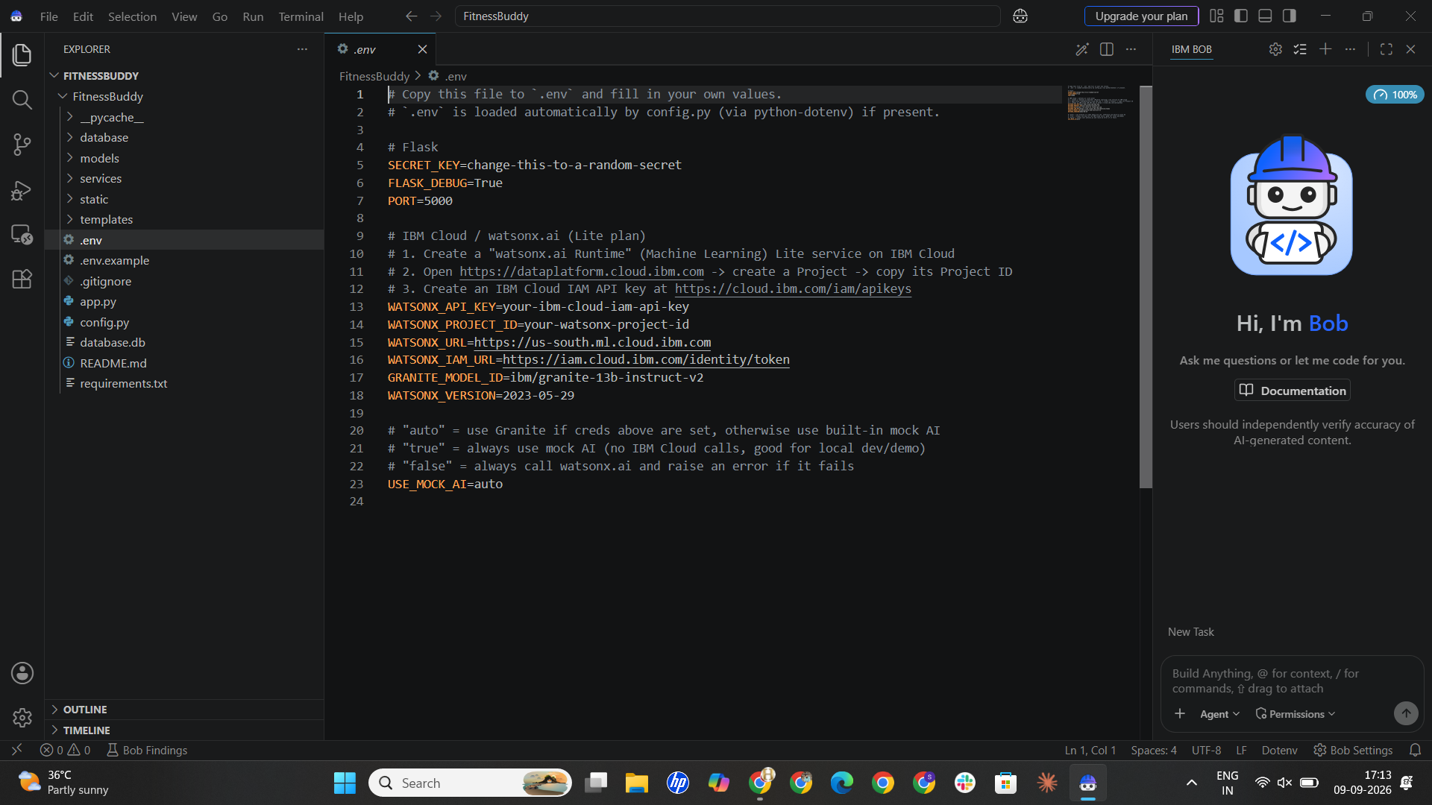
IBM Bob Screenshots:

Slide 8
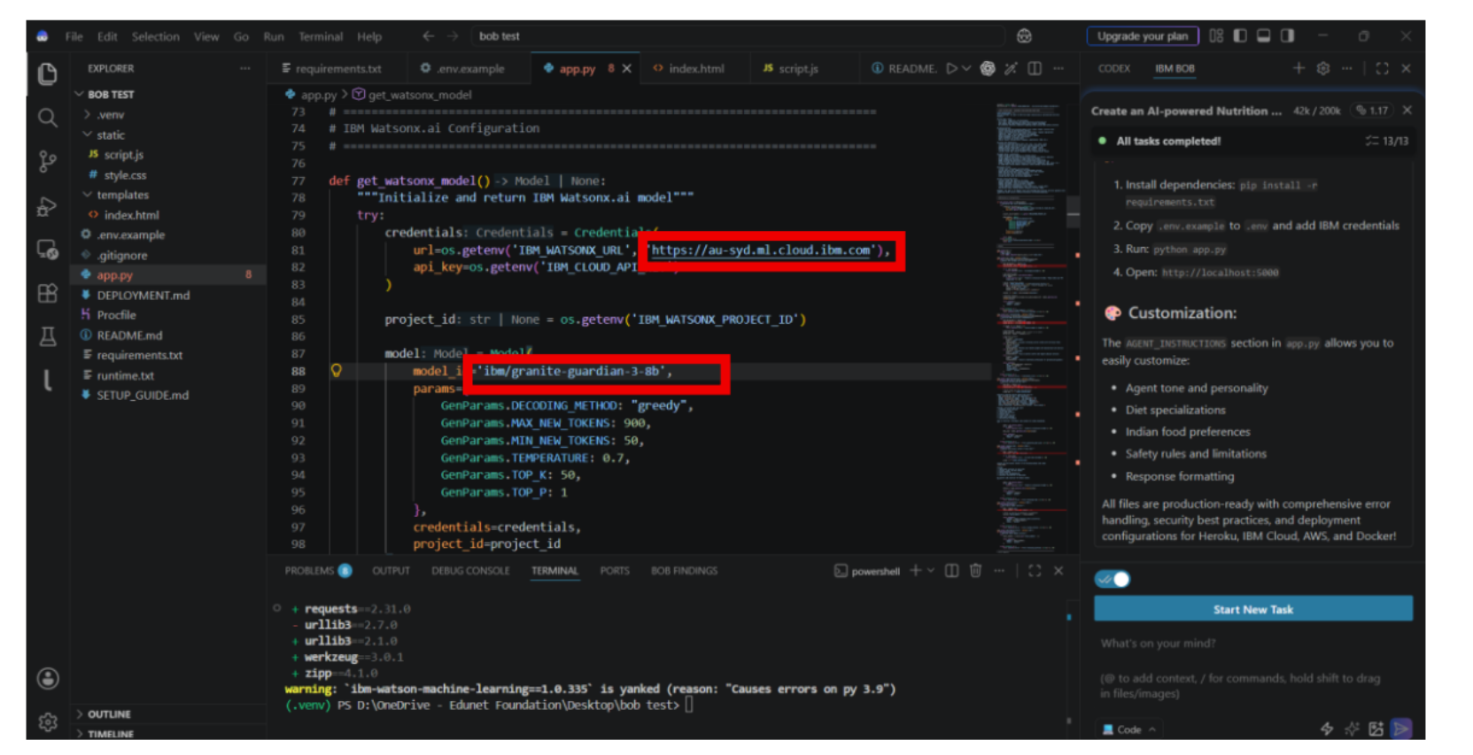

Slide 9
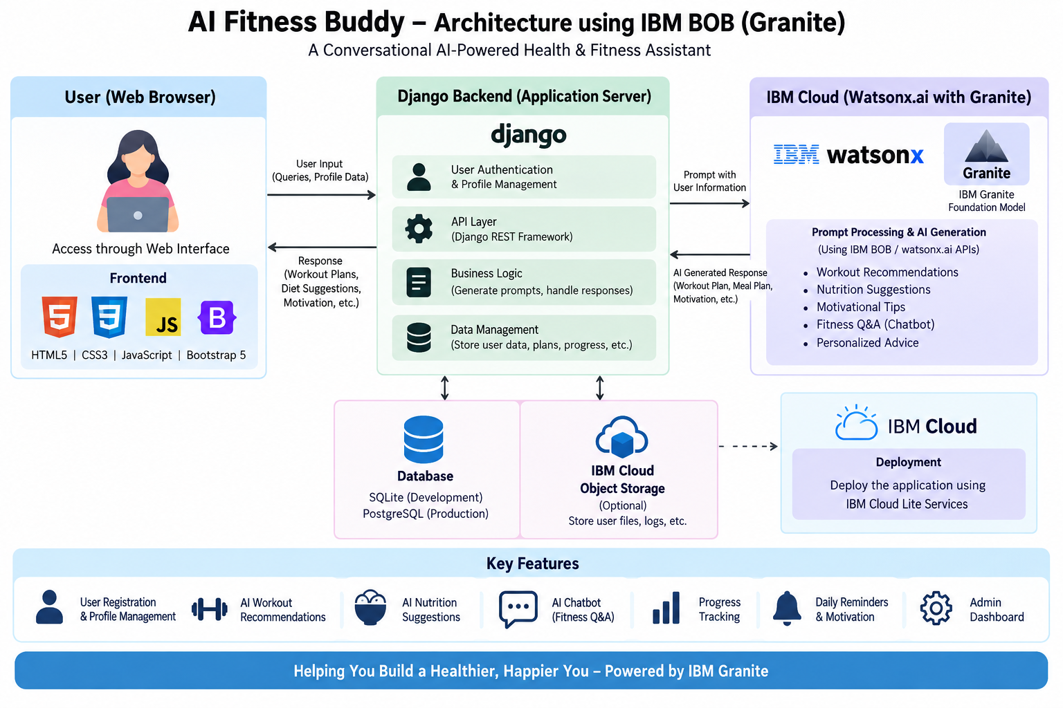
Architecture blueprint for IBM bob:

Slide 10

Role of Agentic AI in the solution
Role of Agentic AI in Fitness Buddy
Agentic AI enables Fitness Buddy to operate as an intelligent virtual fitness coach.
Specialized Agents
Workout Agent
Nutrition Agent
Motivation Agent
Habit Tracking Agent
Benefits:
Personalized recommendations
Context awareness
Goal-oriented guidance
Continuous interaction
Better user engagement

Slide 11
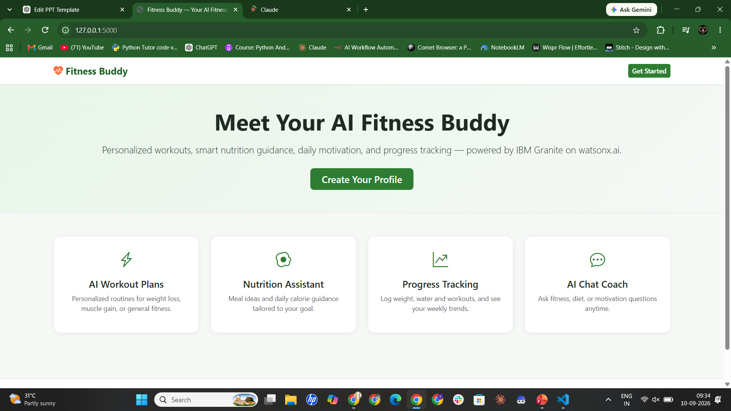
Project Output Screenshot
Please put IBM Bob output screenshots with 2-3 prompts.
You can take 2-3 more sides for each screenshot
·
·
·

Slide 12
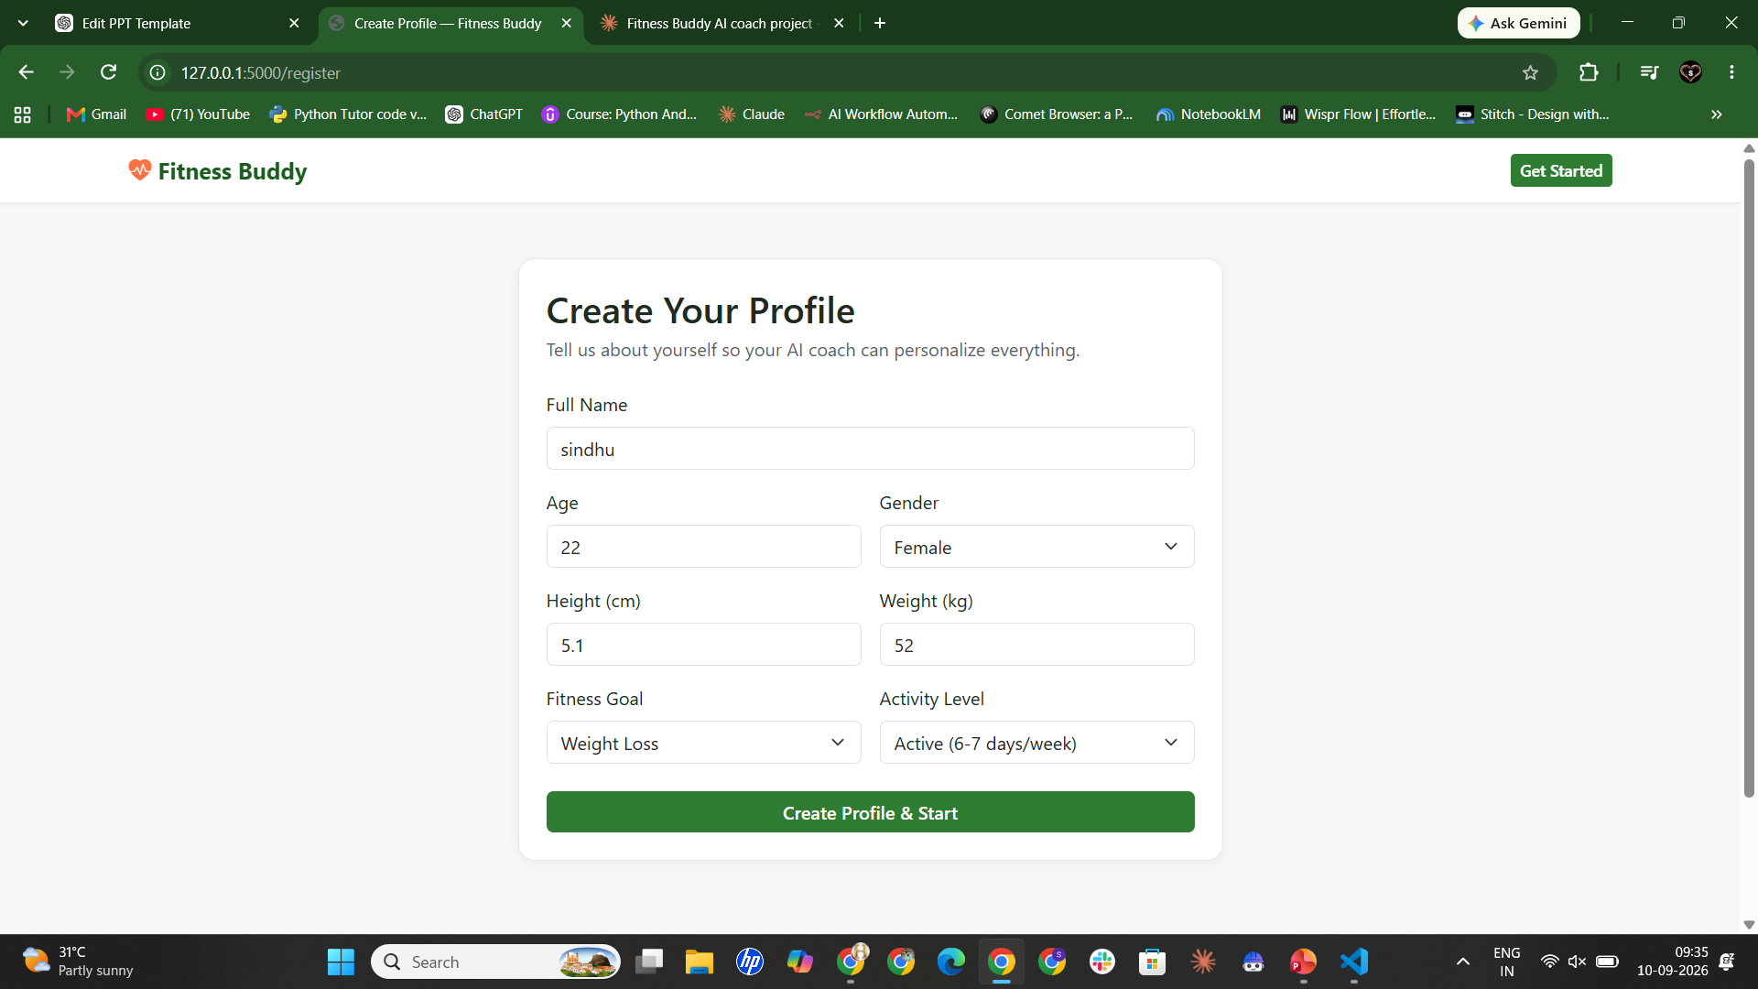
Project Output Screenshot
Please put IBM Bob output screenshots with 2-3 prompts.
You can take 2-3 more slides for each screenshot
·
·
·

Slide 13
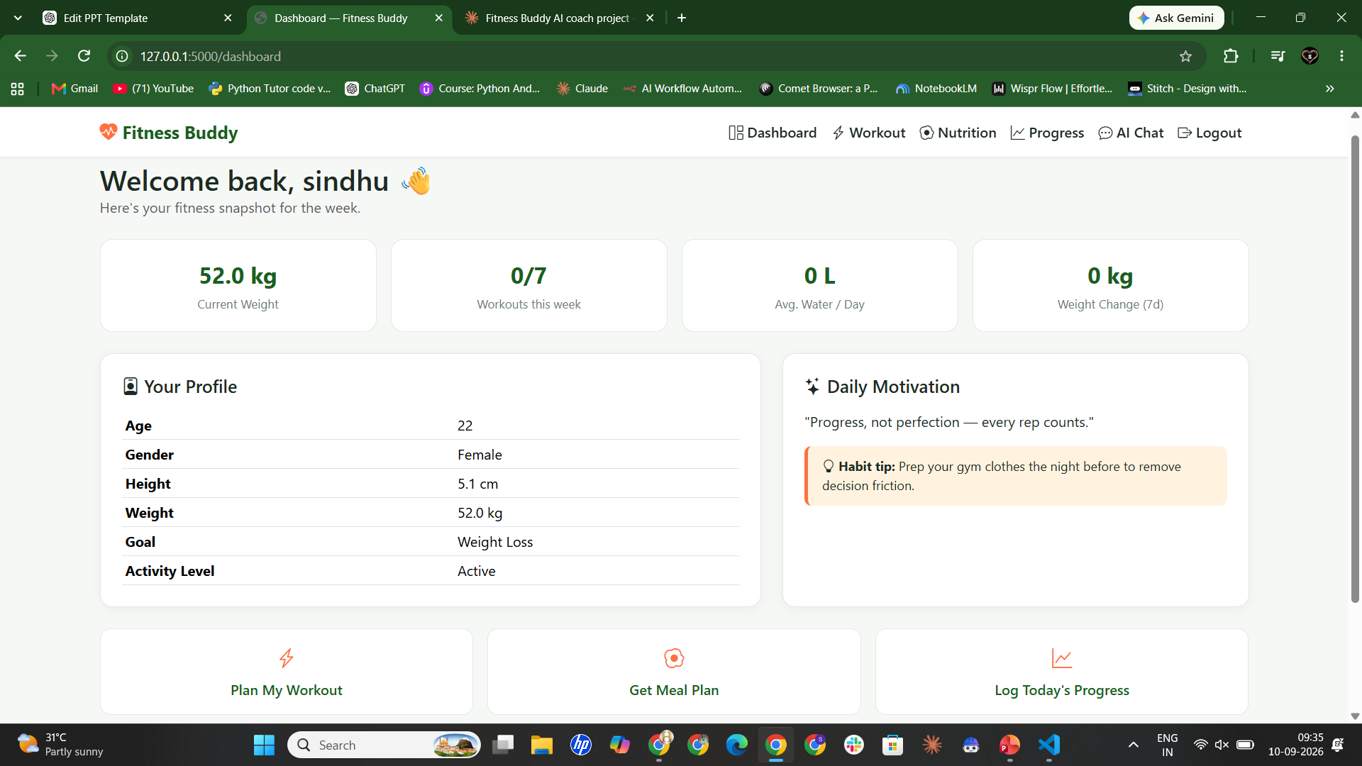
Project Output Screenshot

Slide 14
Novelty and Uniqueness
Personalized Fitness Coaching
Provides recommendations tailored to user goals.
Multi-Agent Intelligence
Separate agents for workouts, nutrition, and motivation.
Affordable and Accessible
Available anytime without expensive trainers.
Habit Building Focus
Encourages consistency through daily reminders and guidance.
Scalable Architecture
Powered by IBM Granite and IBM Cloud.

Slide 15
Git Hub Link
· Please create public github repository (Enable Add README button while creating repository) with format –
Please test and Paste the working Github URL –https://github.com/SaiHimaSindhu/AICTE_Fitness_Buddy
Make sure you have Uploaded following three files into your github repository
1) All Agent relevant files of IBM Cloud , 2) yourproblemstatement.pdf file 3) your projectpresntation.pptx file 4)any other files
·
·
·

Slide 16
Future Scope
Wearable Integration
Connect with smartwatches and fitness trackers.
Voice Assistant
Voice-based fitness coaching.
Multilingual Support
Support Telugu, Hindi, Tamil, and English.
AI Progress Tracking
Track weight loss and fitness achievement
·
·
·

Slide 17
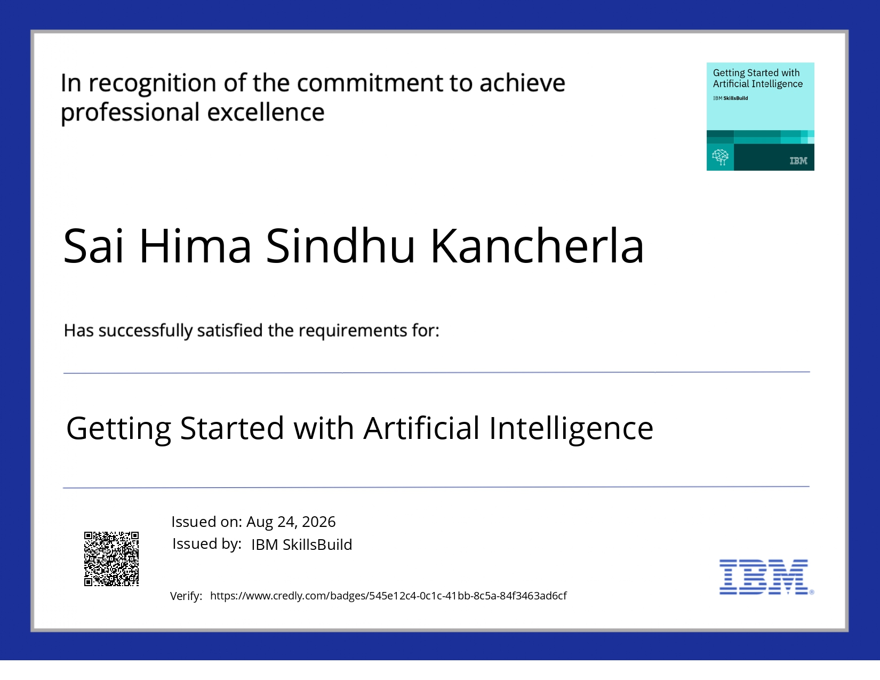
Certificates Earned:
Please add your credly certificate(Getting Started with Artificial Intelligence)

Slide 18
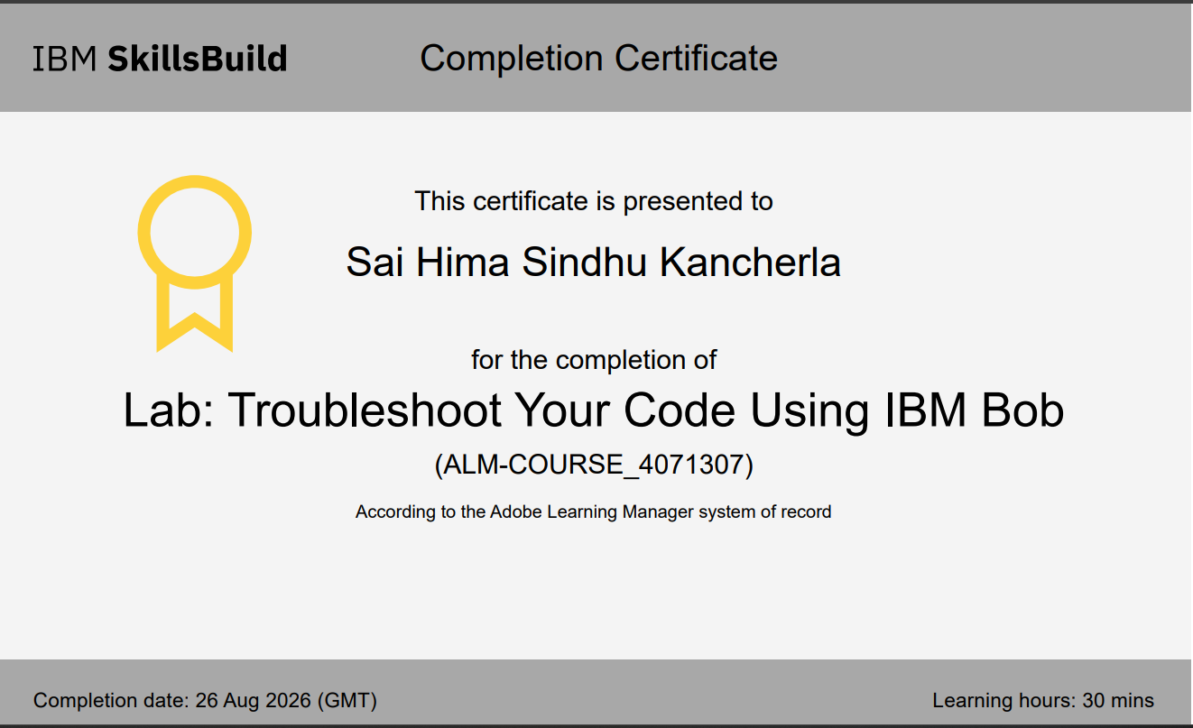
Certificates Earned:​
Add your IBM BOB Certificate

Slide 19


