Slide 1
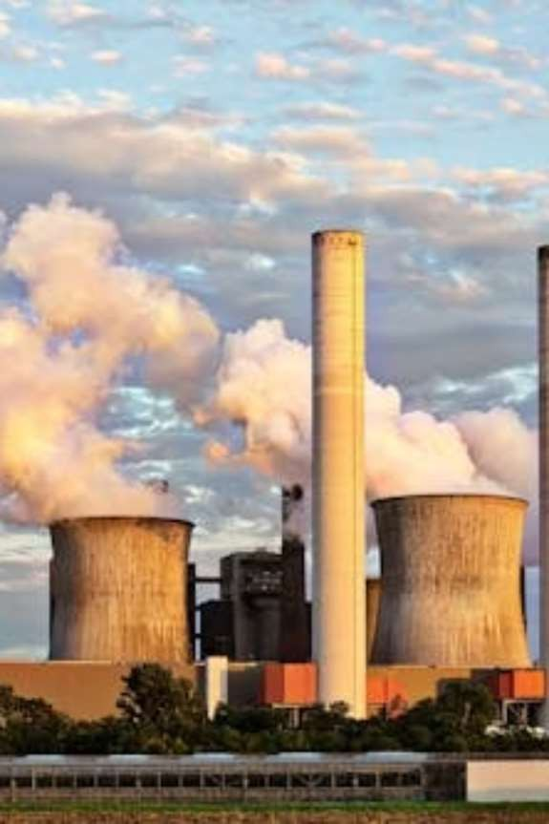
Forecas ting air quality
us ing his torical pollution data
This presentation explores a project focused on predicting air quality using historical pollution data. We'll delve into the purpose, technologies used, and the impact of such forecasting on our planet and communities.

Slide 2
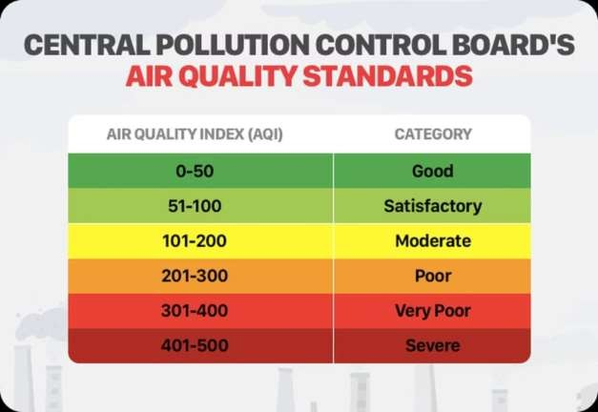
Unders tanding the Air Quality Index (AQI)
The Air Quality Index (AQI) is a vital tool for communicating the current and forecasted air quality. It translates complex pollutant concentrations into a single, easy-to-understand number, helping us assess how clean or polluted the air is and what associated health effects might be a concern.
Purpos e of AQI
To simplify complex air quality data into a single number (or
color code).
To inform the public about current air pollution levels.

Slide 3
K ey Air Pollutants Influencing AQI
The Air Quality Index (AQI) is influenced by the concentration of several key pollutants, each with distinct sources and health implications for both humans and the environment.
Carbon Monoxide (CO)
A colorless, odorless gas primarily from vehicle exhaust and industrial combustion, it reduces oxygen delivery to organs and tissues.
Sulphur Dioxide (SO2)
Released from burning fossil fuels in power plants and industrial processes, SO2 can cause respiratory issues and contributes to acid rain.
Lead (Pb)
Emitted from industrial sources and historically from leaded gasoline, lead is a highly toxic metal affecting neurological development, especially in children.
Ammonia (NH3)
Primarily from agricultural emissions (fertilizers, livestock waste), NH3 reacts in the atmosphere to form harmful fine particulate matter.
Nitrogen Dioxide (NO2)
A reddish-brown gas from vehicle engines, power plants, and industrial boilers, NO2 contributes to smog, respiratory illnesses, and acid rain formation.

Slide 4

Measuring Air Pollutants
Gas Analyzers
Specialized sensors continuously monitor gases like CO, SO2, and NO2 using various spectroscopic and electrochemical methods.
Chemical Analysis
Samples collected on filters or in impinger solutions are analyzed in laboratories for heavy metals like lead and other specific compounds.
Particulate Counters
Laser-based instruments count and size airborne particles (PM2.5, PM10) to determine their concentration in the atmosphere.
Remote Sensing
Satellite and ground-based remote sensing technologies provide broader spatial coverage for air quality monitoring.

Slide 5
Major Contributors to Air Pollution
While industrial emissions and stubble burning often dominate headlines, numerous other sources contribute significantly to urban
air pollution. Understanding these varied contributors is key to effective mitigation.
Indus trial Emis s ions
Factories, especially those near urban centers, release a variety of pollutants.
Agricultural Practices
Stubble burning in agricultural regions contributes heavily to regional haze and particulate matter.
Vehicle Exhaus t
Emissions from cars, trucks, and other vehicles are a
primary source of CO, NO2, and PM.
Cons truction & Dus t
Construction activities generate significant amounts of
particulate matter that lingers in the air.

Slide 6


The Harmful Impact of Air Pollution
On Human Health
On Our Planet
Chronic exposure to air pollutants can lead to a range of severe health issues, including:
Air pollution significantly impacts ecosystems and contributes to climate change:
Respiratory diseases (asthma, bronchitis)
Cardiovascular problems (heart attacks, strokes)
Neurological damage
Increased risk of cancer
Premature death
Acid rain damages forests and aquatic life
Smog reduces visibility and affects plant growth
Greenhouse gases contribute to global warming
Depletion of the ozone layer
Damage to historical monuments and infrastructure

Slide 7
Solutions for Cleaner Air
Technological Interventions
Transition to Clean Energy
Investing in solar, wind, and hydroelectric power reduces reliance on fossil fuels, a major source of air pollution.
Sustainable Transportation
Promoting electric vehicles, public transport, cycling, and walking to reduce vehicular emissions.
Use of air purifiers in homes and offices, advancements in emission control technologies for vehicles and industries.
Urban Planning & Green Spaces
Designing cities with more green areas and promoting tree
planting helps filter pollutants and improve air quality.
Stricter Regulations
Government policies and enforcement of emission standards for
industries and vehicles are crucial for long-term improvement.

Slide 8
Project Impact: A Step Towards a Healthier Future
Our project contributes significantly to environmental stewardship and problem- solving by providing actionable insights into air quality.
Environmental Contributor
Humanitarian Benefit
Empowering communities with timely air quality alerts allows for better health management and improved well-being.
Global Relevance
Our methodology can be adapted globally, fostering cleaner air initiatives worldwide and supporting sustainable development goals.
By forecasting pollution levels, we enable proactive measures to protect ecosystems and biodiversity.

Slide 9
Technologies:
Our forecasting model leverages robust tools and languages to process complex environmental data.
Languages: Python (for data processing, model development)
Frameworks: TensorFlow/Keras (for deep learning models), Scikit-learn (for traditional ML)
Data Storage: SQL databases, cloud storage (e.g., AWS S3)
Visualization: Matplotlib, Seaborn, Tableau/Power BI (for dashboards)
Deployment: Docker, Kubernetes (for scalable deployment)

Slide 10
Future Enhancements and Vision
Our project lays a strong foundation for future advancements, aiming for even greater accuracy and broader impact.
How is it Solving? Future Enhancements
Our model provides timely and accurate air quality forecasts, •
allowing:
Integration with real-time traffic and weather data for
enhanced accuracy.
Development of hyper-local forecasting models for specific neighborhoods.
Expansion to include more pollutant types and their interactions.
Creation of an interactive, user-friendly mobile application.
Individuals to plan outdoor activities safely.
Local authorities to issue health advisories.
Policymakers to implement targeted pollution control
measures.
Researchers to understand pollution patterns better.

Slide 11
K ey Project Outc omes
1
Forecas ting Model
Predict AQI and key pollutants (PM2.5, PM10, NO2, etc.).
2
Vis ual Das hboard
Show historical trends and future air quality predictions.
3
Alerts & Warnings
Notify when predicted AQI crosses safety thresholds.
4
Trend Analysis
Analyze pollutant contributions and seasonal patterns.
5
Admin Functionality
Upload new datasets and retrain models for updated forecasts.

Slide 12
Modules to be Implemented
1
Data Collection & Preprocessing
Load historical data, handle missing values, feature engineering.
3
Alerting & Trend Analysis
Calculate AQI categories, highlight risks, visualize long-term trends.
2
Forecasting Model
Train ARIMA, Prophet, LSTM, or XGBoost models; evaluate and save best.
4
Web Interface & Admin Panel
Streamlit dashboard for visualization, user selection, and retraining.

Slide 13
Evaluation Criteria: Proces s & Progres s
Milestone 1
Cleaned, structured dataset; EDA insights on pollution
behavior.
1
2
Milestone 2
Model RMSE/MAE within acceptable limits; tested across pollutants.
Milestone 3
Functional alerting mechanism; clear high-risk period
reports.
3
4
Milestone 4
Deployed Streamlit dashboard; working admin
features.

Slide 14
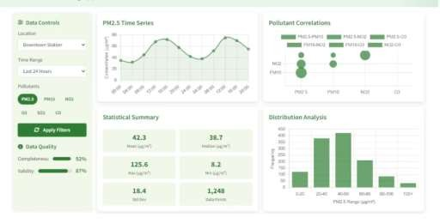
Milestone 1: Data Preprocessing & EDA
Download and preprocess air quality datasets. Conduct Exploratory Data Analysis to understand pollutant trends and correlations. Resample data and prepare features for forecasting.
Clean Data
Ensure dataset readiness for modeling.
Insightful EDA
Uncover seasonal and regional patterns.

Slide 15
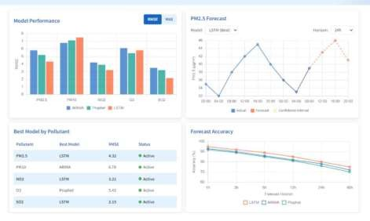
Miles tone 2: Model Training & Evaluation
Train ARIMA, Prophet, or LSTM models on historical pollutant values. Evaluate predictions using RMSE and MAE. Select the best-performing model and save it for inference.
Model Training
Develop robust forecasting models.
Performance Metrics
Evaluate with RMSE/MAE for accuracy.

Slide 16
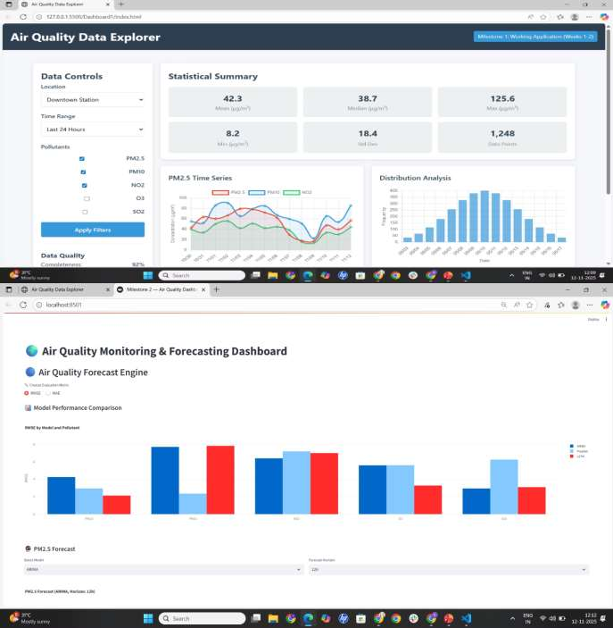
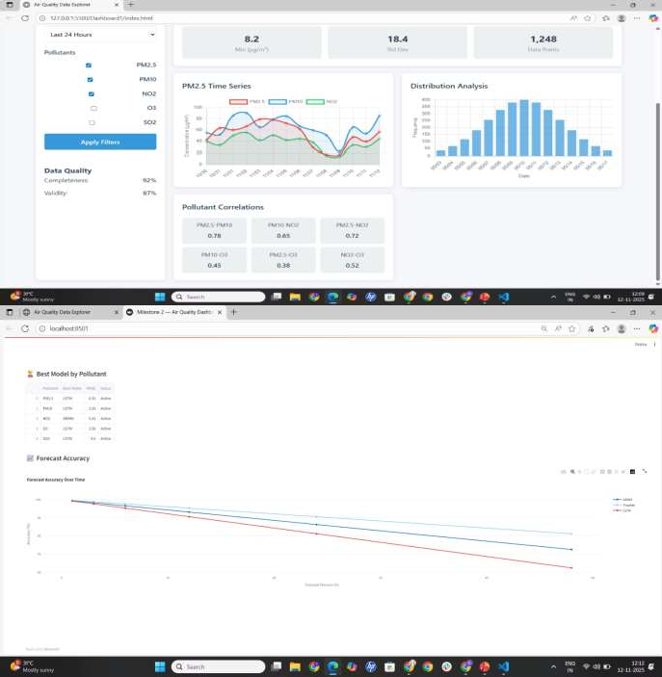
Milestone 3(Data Explorer & Forecast Engine)

Slide 17
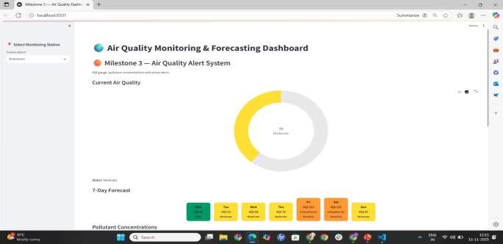
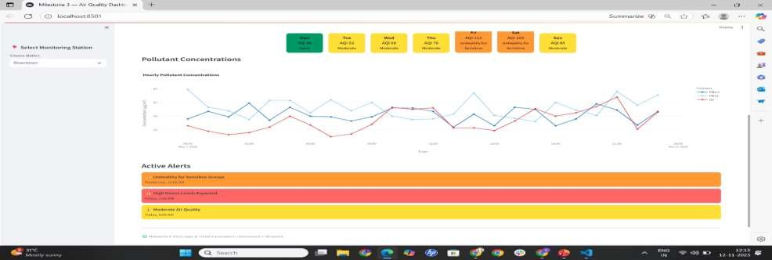
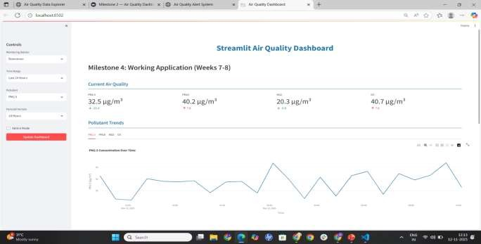
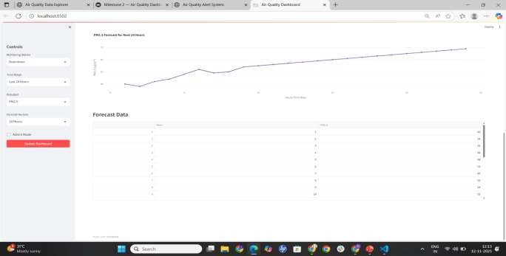
Miles tone 4(Alert Sys tem & Streamlit web dashboard)

Slide 18
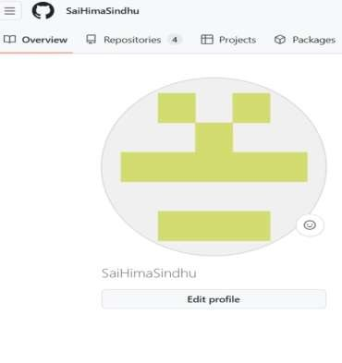
Github

