Slide 1


Predicting Psychological Disorder of a Human by Considering Health Conditions through ML
NARAYANA ENGINEERING COLLEGE - NELLORE
(AUTONOMOUS)
Department of MCA
A Project Review On
Under the Guidance of
Y. RAJASEKHAR
Dept. of CSE
Presented By
N. Sai Himaja
20711F0035
2nd MCA 4th SEM

Slide 2
Contents
Abstract Of The Project
Existing System
Con’s Of Existing System
Proposed System
Pro’s Of Proposed System
Project’s – Aim
Project’s – Scope
Requirements
Architecture
Modules
Algorithms

Slide 3
Abstract of the Project
Millions of people globally suffer from depression and it is a debilitating condition. At best it can be difficult for people to live their lives normally and happily, and at worst it leads to death by suicide. Primary care doctors are overwhelmingly finding that they are faced with the need to treat mental health conditions such as depression without any particular training of how to handle such cases.
There is evidence that an integrated approach where physicians regularly screen patients for mental health disorders and work together with psychologists and other mental health professionals to treat patients leads to reduced costs and better patient outcomes.
However, this approach can require a lot of buy-in from many individuals, require extra training, and is often not logistically feasible. Using data from the CDC National Health and Examination Survey, machine learning was applied to predict patients who may have depression based on information that could typically be found in a medical file.

Slide 4
Existing System
Existing System has prediction about human mental health.
It is done through different approaches like facial expressions and text data.

Slide 5
Con’s Of Existing System
There’s only prediction in existing system, no further approach is given.
It is harmful if we leave mental disorder patients without any treatment.
Traditional Solutions didn’t work out in many cases

Slide 6
Proposed System
In proposed system prediction of psychological disorder of a person is identified through health care related data.
Proposed system shows that 71% of those who have depression and 80% of those who don't have depression can be correctly identified.
Better results could be yielded by adding more patient information to the data or testing more types of models

Slide 7
Pro’s Of Proposed System
It will be helpful for both patients as well as doctors.
Keen observation & personal guidance will be given to patients.
Fast & accurate results will be produced

Slide 8
Project’s - AIM
The aim of this project is
- To gather data about people that would typically be in a patient’s medical record to predict depression.

Slide 9
Project’s - SCOPE
The Scope of this project is
- The patients who are predicted to have depression could potentially be referred straight to mental health professionals in their area or who accept their health care coverage. The patient’s file could also be flagged to alert the medical staff the next time they have any kind of physician appointment to prompt doctors to start the conversation with patients.

Slide 10
Requirements
Software
Operating System – Windows 7 or above
Programming language – Python
Developing Environment – Visual Studio version 2022, Jupyter
Domain – Backend
Hardware
Processor – intel CORE i3(64 bit)
RAM – 6 GB
SSD – 250 GB

Slide 11
Architecture
Collection of Data
Split list of Data
Examine Multiple Aspects of Data
Analysis Through ML Algorithms
Clean & Train Data
Choose Best Model For Prediction
Final Prediction

Slide 12
Modules
Collect Data from CDC
Examine Data
Combine Data
Final Prediction

Slide 13
Module Description
Collect Data from CDC
Gathering multiple psychological disorders symptoms from patients.
Gathering multiple health conditions of a person who consults to a psychologists .
Examine Data
Observing different aspects of Data.
Multiple Algorithm performance.

Slide 14
Module Description
Combine Data
Combine all data models.
Choose Best Model.
Final Prediction
Classify into two categories that is either depressed or not depressed.
Plotting final prediction

Slide 15
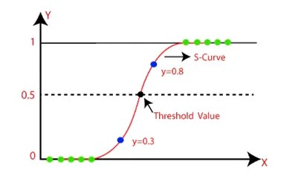
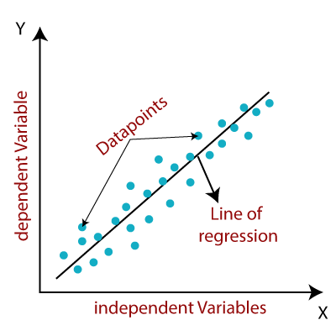
Algorithms
Linear Regression
Logistical Regression

Slide 16
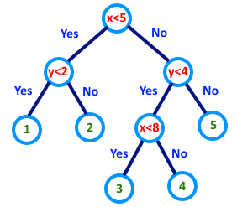

Algorithms
Decision Tree
SVM

Slide 17

UML Diagrams
Use Case Diagram
Data Collection
Store Data
Train & Test Data
Split the list of Data
Modeling Preparation
Actor
Apply Algorithms
Combine processing Data
Predicting Best Model
Result

Slide 18
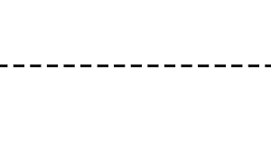
Sequence Diagram
User
Patient
Dataset
Processing
Analysis
Prediction
1.Collection Data
2.Store Data
3.Train & Test
4.Split list of data
5.Modeling Preparation
6.Performing Algorithmic Operations
8.Predicting Best Model
7.Combining Processing Data
9.Visualizing Result

Slide 19
Class Diagram
Analysis
Collection
+Collect data
+Train Model
+Split Data
+Examination
+Demographic Data
+Medical Conditions
+ML Algorithm
+load()
+train_test_split()
+plotting_counts()
+plotting_percentage()
Prediction
+Plotting
+Combine Processing Data
+Final Prediction
+plot()
+concat()
+predict()

Slide 20
Activity Diagram
Collection of Data
Load Dataset
Training & Testing
Splitting
Demographic Analysis
Visualization
Analysis through Algorithms
Health Condition Analysis
Prediction

Slide 21
Any Queries ?

