Slide 1


Course Instructor
Yara Srinivas.

Slide 2
Introduction to Parallel and Distributed Computing

Slide 3
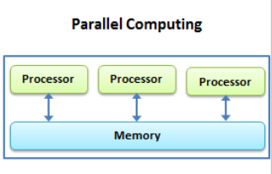
Parallel Computing
Parallel computing is a model that divides a task into multiple sub-tasks and executes them simultaneously to increase speed and efficiency.
To simulate and model real-world data dynamically, parallel computing is essential.
Parallel computing helps to decrease costs and increase efficiency.
Organizing and managing complex and large datasets can only be achieved using the approach of parallel computing.
Parallel computing ensures that hardware resources are used effectively.
Also, implementing real-time systems using serial computing is not practical. Serial computing involves processing data sequentially using a single processor.
Open Multi-Processing(OpenMP) Interface is used for parallel computing.
It executes tasks one after the other, and data is stored in a single location or memory.
Ex: GPU-based computing, supercomputers, and multi-core CPUs.
Applications: Image processing Machine learning.

Slide 4
Significance:
Several processes execute simultaneously, i.e., throughput increased.
Enhancing the system's cost or performance ratio.
A failure in any one component of a multiprocessor system has a limited impact on the rest of the system, therefore improve the performance.
Efficient use of resources.
Limitations:
A bigger pool of memory is needed than in single-processor systems.
If one processor is already utilizing an Input/output device, additional processors cannot utilize the same Input/output device, resulting in deadlock.

Slide 5

Advantages of Parallel Computing
Increased Speed: In this technique, several calculations are executed concurrently hence reducing the time of computation required to complete large scale problems.
Efficient Use of Resources: Takes full advantage of all the processing units it is equipped with hence making the best use of the machine’s computational power.
Scalability: Also the more processors built into the system, the more complex problems can be solved within a short time.
Improved Performance for Complex Tasks: Best suited for activities which involve a large numerical calculation like, number simulation, scientific analysis and modeling and data processing.

Slide 6
Disadvantages of Parallel Computing
Complexity in Programming: Parallel writing programming that is used in organizing tasks in a parallel manner is even more difficult than that of serial programming.
Synchronization Issues: Interaction of various processors when operating concurrently can become synchronized and result in problem areas on the overall communication.
Hardware Costs: The implementation of parallel computing does probably involve the use of certain components such as multi-core processors which could possibly be costly than the normal systems.

Slide 7
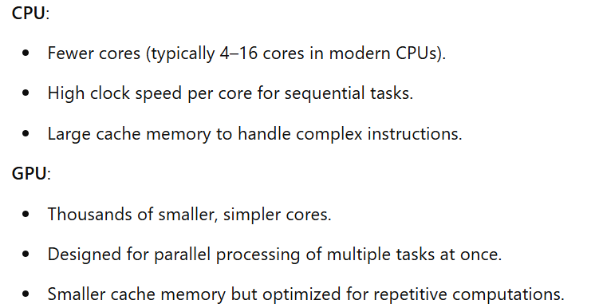
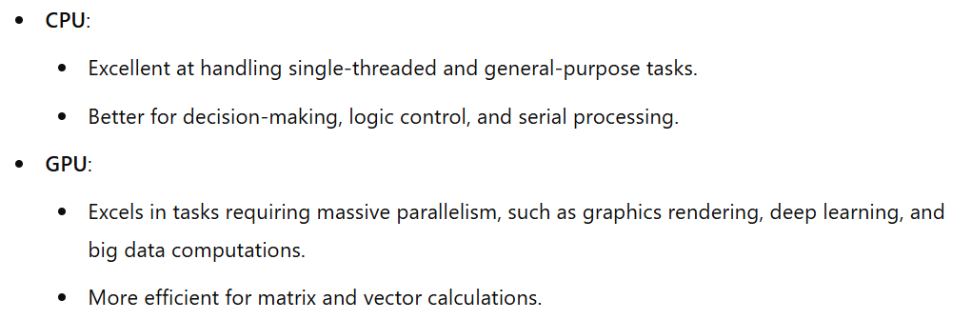
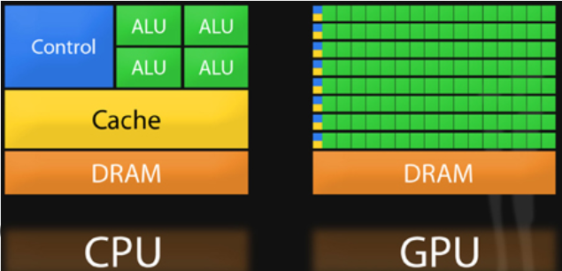
CPU vs GPU in terms of architecture and Performance Architecture Performance

Slide 8
OpenMP (Open Multi-Processing)
It is an API (Application Programming Interface) used for parallel programming in shared-memory architectures.
It enables programmers to write programs that can run simultaneously on multiple cores or processors, improving performance for computationally intensive tasks.
It allows programs to execute code concurrently on multiple threads.
Threads share a common memory space, enabling efficient communication.
Integrates with existing C, C++, and Fortran codebases using compiler directives i.e., #pragma.
Use these ‘#pragmas’ to instruct the compiler where to execute the parallel code.
We use “omp.h” header file to enable the OpenMP features.
Compilation:
gcc -fopenmp program.c -o program.exe
Run/Execution
program.exe

Slide 9
System Specifications
My laptop:
Windows 11 OS
The Intel Core i5-9300H, 8GB RAM .
Number of Cores: 4
But it can execute up to eight threads simultaneously i.e., Supports Hyper-Threading

Slide 10
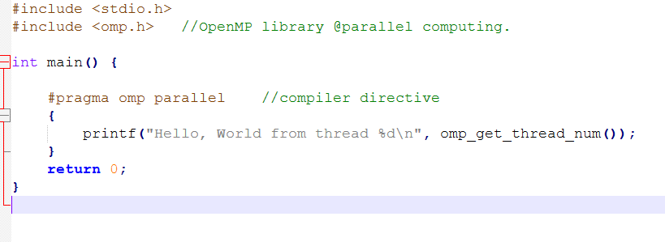

Slide 11
Types of Parallelism:
Bit-level parallelism
Instruction-level parallelism
Task Parallelism

Slide 12
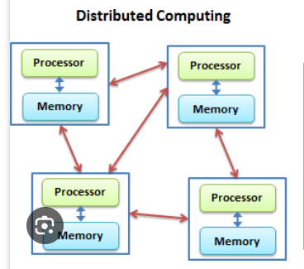
Distributed Computing
Introduction:
Distributed systems are systems that have multiple computers located in different locations.
No shared memory and computers communicate with each other through message passing.
In distributed computing a single task is divided among different computers.
It requires a system deployment before computing a task.
Message passing Interface (MPI) is used for Distributing computing.
Applications:
Global web services, Distributed file systems, and blockchain.
Examples:
Hadoop, Spark, cloud clusters, and High-Performance
Computing (HPC)

Slide 13
Advantages of Distributed Computing
Fault Tolerance: The failure of one node means that this node is no longer part of the computations, but that is not fatal for the entire computation since there are other computers participating in the process thereby making the system more reliable.
Cost-Effective: Builds upon existing hardware and has flexibility in utilizing commodity machines instead of the need to have expensive and specific processors for its use.
Scalability: The distributed systems have the ability to scale and expand horizontally through the addition of more machines in the networks and therefore they can take on greater workloads and processes.
Geographic Distribution: Distributed computing makes it possible to execute tasks at different points thereby eliminating latencies.

Slide 14
Disadvantages of Distributed Computing
Complexity in Management: The task of managing a distributed system itself can be made more difficult since it may require dealing with the latency and/or failure of a network as well as issues related to synchronizing the information to be distributed.
Communication Overhead: Inter-node communication requirements can actually hinder the package transfer between nodes that are geographically distant, greatly compromising overall performance.
Security Concerns: In general, distributed systems are less secure as compared to centralized system because distributed systems heavily depend on a network.

Slide 15
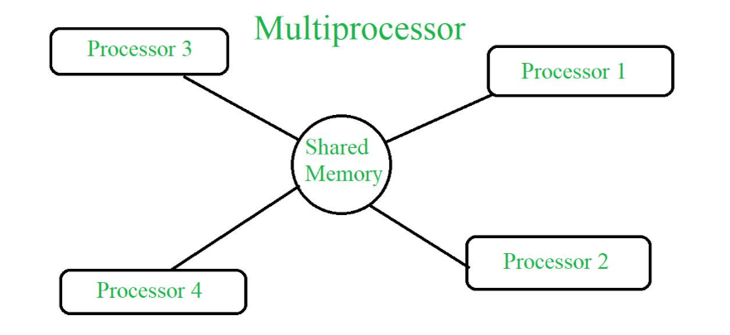
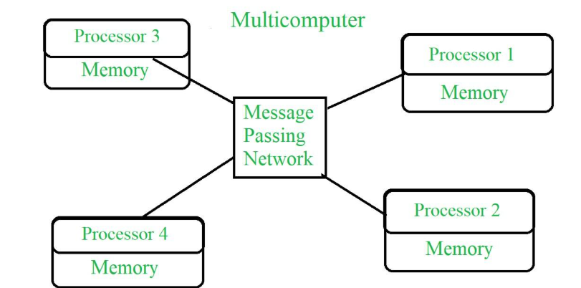
Multi processor vs MultiComputer
Multiple processors are used to share the same memory for operating and are connected to function together. MultiProcessor.
It is a tightly coupled system i.e. multiple processors share a common memory and work on the same task or system workload.
It’s also called a shared-memory system. Therefore, it has shared memory architecture.
Multi-computer multiple computers with different processors are connected and each has a different memory.
A loosely coupled system with multiple independent computers connected via a network, where each computer has its own memory and operates independently.
It’s also called a distributed-memory system. Therefore, it has distributed architecture.

Slide 16
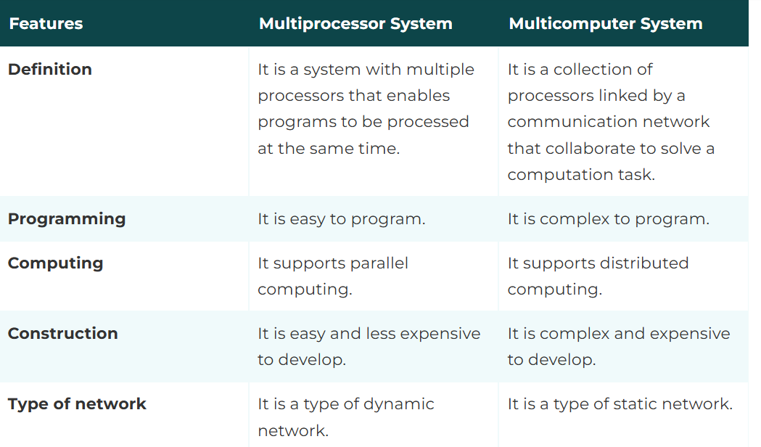
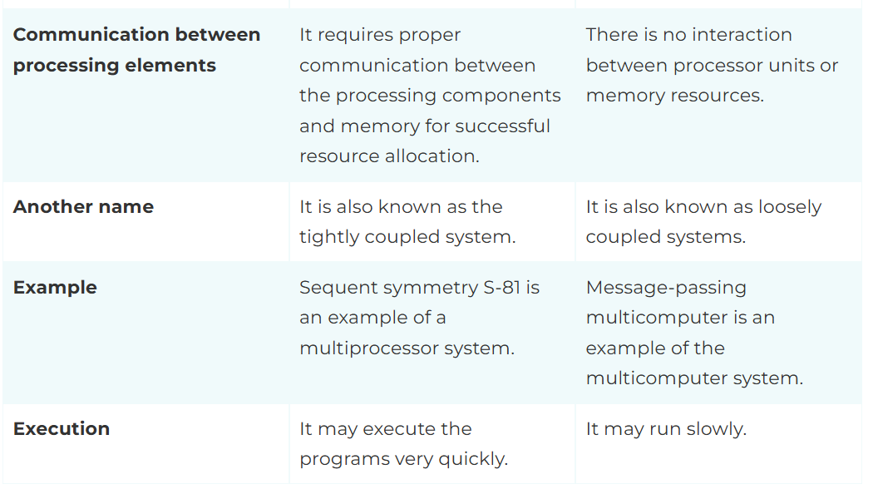

Slide 17
There are two primary models for Inter-process communication (IPC).
Shared memory model
Message Passing model
Introduction to Shared Memory Model:
IPC establishes a shared memory region for data communication between processes.
Advantages:
Fast Communication, Efficient for Large Data Transfers
Disadvatages:
Complex Synchronization, Security Risks.

Slide 18
Introduction to Message Passing Systems
The processes communicate with each other by exchanging messages.
Advantages
Simplicity,
No Synchronization Required.
Disadvantages:
Slower Communication,
More Kernel Involvement, Higher Resource Consumption

Slide 19
Shared Memory model | Message-Passing Model
It is used for communication b/w processes on a single processor (s) system, where the process resides. The code for reading and writing the data from the shared memory should be written explicitly by the Application programmer. It provides a maximum speed of computation as communication is done. Therefore, it is a faster communication strategy. It can be used in exchanging larger amounts of data. Example- Data from a client process may need to be transferred to a server process for modification before being returned to the client. | It is typically used in a distributed environment where communicating processes reside on remote machines connected through a network. No such code is required It is time-consuming as message passing is implemented through kernel intervention. Therefore, it is a slower communication strategy. It is useful for sharing small amounts of data as conflicts need not be resolved. It can be used in exchanging small amounts of data. Example- Web browsers Web Servers Chat program on WWW (World Wide Web).

Slide 20
Parallel systems architectures
These are associated with data locality and data communication.
Parallel Computer Architecture is the method of organizing all the resources to improve the performance and programmability within the limits given by technology and the cost at any instance of time.
Significance of parallel architectures:
Parallel computer architecture adds a new dimension in the development of computer system by using more and more number of processors.
The performance achieved by utilizing large number of processors is higher than the performance of a single processor at a given point of time.

Slide 21
Applications/Goals:
With the advancement of hardware capacity, the demand for a well-performing application also increased, which in turn placed a demand on the development of the computer architecture.
Before the microprocessor era, HPC system was obtained by exotic circuit technology and machine organization, which made them expensive.
Now, highly performing computer system is obtained by using multiple processors, and most important and demanding applications are written as parallel programs.
Thus, for higher performance both parallel architectures and parallel applications are needed to be developed.
To increase the performance of an application Speedup is the key factor to be considered.

