Slide 1

By: Venkata Naga Sai Kiran Challa, Chaitanya Chittella, Sai Tarun Kaniganti (Team - CSS)

Slide 2

Introduction
Challenge: The vast volume of online content makes it difficult to process and understand information efficiently; current solutions struggle with multiple formats and user preferences.
Objective: Develop solutions for faster, personalized content consumption across text, audio, and video formats.
Solution: A versatile multi-modal system for summarizing various media inputs, delivering coherent, personalized outputs.

Slide 3
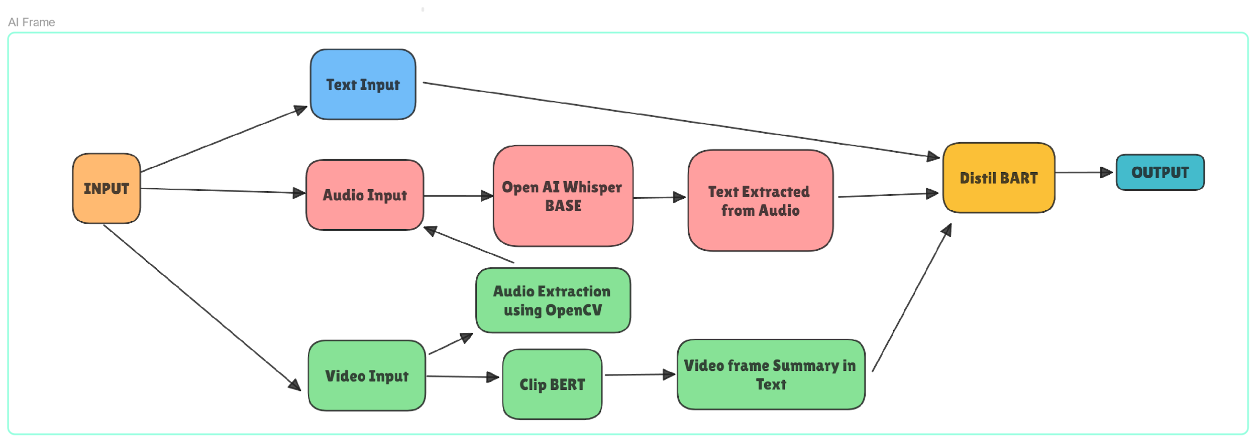
Flow Chart of Proposed solution

Slide 4
Processing Layer
Open AI Whisper BASE:
Function: Transcribes audio input into text with high accuracy, even in noisy environments.
Merits:
Lightweight and efficient, suitable for real-time processing.
Supports multilingual tasks, enhancing accessibility.
Ideal for environments with limited computational resources.
Clip BERT:
Function: Processes video frames to generate descriptive text summaries.
Merits:
Excels in handling both image and text data simultaneously.
Efficient for real-time processing in resource-constrained environments.
Versatile for multimodal AI tasks, offering adaptability and strong performance.

Slide 5
Processing Layer
Audio Extraction with OpenCV:
Function: Extracts audio from video files for transcription.
Merits:
Integrates seamlessly with Whisper BASE for converting video audio to text.
Ensures all input formats are unified into a text-based format for consistent processing.
Clip BERT (Continued):
Function: Provides textual representation of video content for summarization.
Merits:
Allows consistent processing across text, audio, and video inputs.

Slide 6
Summarization layer
Distil BART:
Function: Summarizes combined textual data from various inputs into a concise format.
Merits:
Lightweight and faster, requiring fewer computational resources.
Retains around 95% of language understanding with 60% fewer parameters.
Efficiently handles long text sequences, making it suitable for comprehensive summarization.
Output Layer:
Function: Delivers a coherent, condensed summary to the user, adaptable for various applications.
Merits:
Provides key information derived from multiple input formats.
Adaptable for educational materials, news briefings, entertainment, and accessibility solutions.

Slide 7
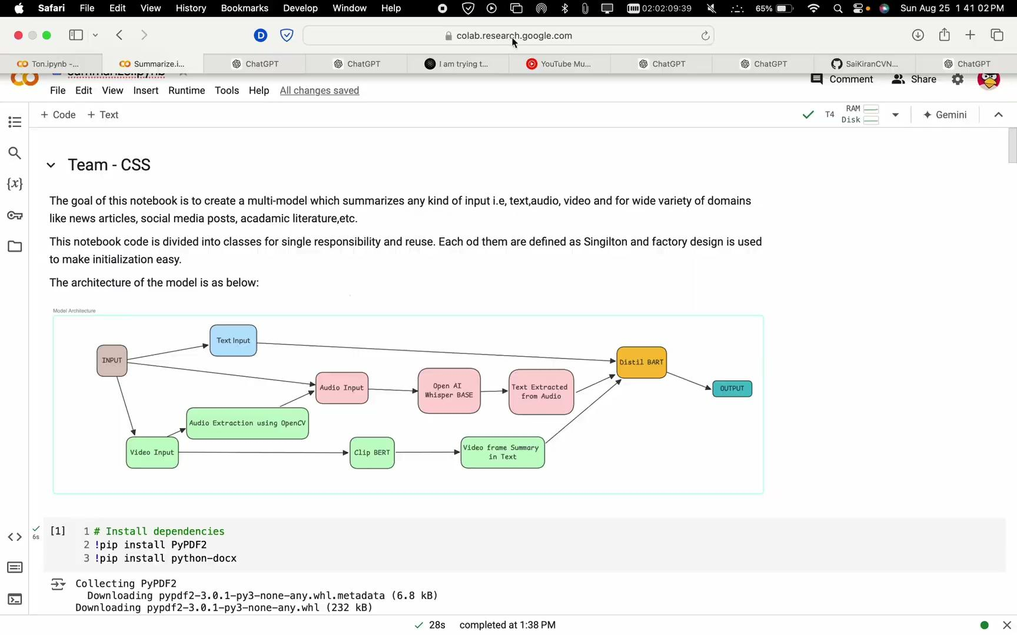
Demo

Slide 8
Conclusion
The proposed model approximately taking the time given in the following table.
For user personalization, we can adjust the summary ration w.r.t input source, or can limit the maximum number of characters.
 | CPU | GPU
Text | More than 200 words/ sec | More than 500/sec
Audio | More than 0.8min/sec | More than 1.6min audio processed per sec
Video | More than 9 sec video processed per sec | More than 16 sec video processed per second

Slide 9
Thank You

