Slide 1
Data Insights Dashboard Visualizing COVID-19 Cases in Africa, GitHub Repo Structure, Fund Performance, Browser Market Share, and Regression Line Visualizer
IT 452 Data Information And Visualization
- by Sai Kiran Nandipati
-UID:807197867
Notes:
Hi guys I am Sai Kiran Nandipati. I am a graduate student at Illinois state university. I am currently pursuing my masters in computer science and
I am also working as a research assistant under Dr. Nariman Ammar.
Today I will discuss about my idea about final project for this course and what are the visualizations used in it.

Slide 2
AGENDA
Introduction
Visualization Design Overview
Regression Line Visualizer
Performance Comparison between Two Funds
Collapsible Tree Visualization
Stacked Bar Chart
Density Plot
Challenges Faced & Contribution
Conclusion
Notes:
Coming to agenda ….
I learnt a lot from this course and assignments. To apply my skills that I learnt in practice I want my project to be more diverse and that’s the reason I selected more than one data source
In fact different data source for different visualization.
The major challenges that I faced during my final project are: data source selection, finding best fit in visualizing the data for user.

Slide 3

Introduction
Graduate Student
Research Assistant
Nationality: Indian
Masters in computer Science
Passion: Data Science, Machine learning and AI

Slide 4
Technologies and Tools
IDE: Visual studio code
Languages: Javascript, CSS and HTML
Libraries: D3.js
Notes:
1. Visual Studio Code: A versatile and lightweight integrated development environment (IDE) that provides powerful editing features for various programming languages, including JavaScript, CSS, and HTML.
2. JavaScript, CSS, and HTML: Essential web development languages used respectively for dynamic behavior, styling, and structuring content on web pages.
3. D3.js: A JavaScript library for creating interactive and dynamic data visualizations in web browsers using HTML, SVG, and CSS.

Slide 5
Visualization Design Overview
Regression Line Visualizer
Performance Comparison between Two Funds
Collapsible Tree Visualization
Stacked Bar Chart for Browser Market Share
Density Plot for African Country-wise COVID-19 Cases per Million People

Slide 6
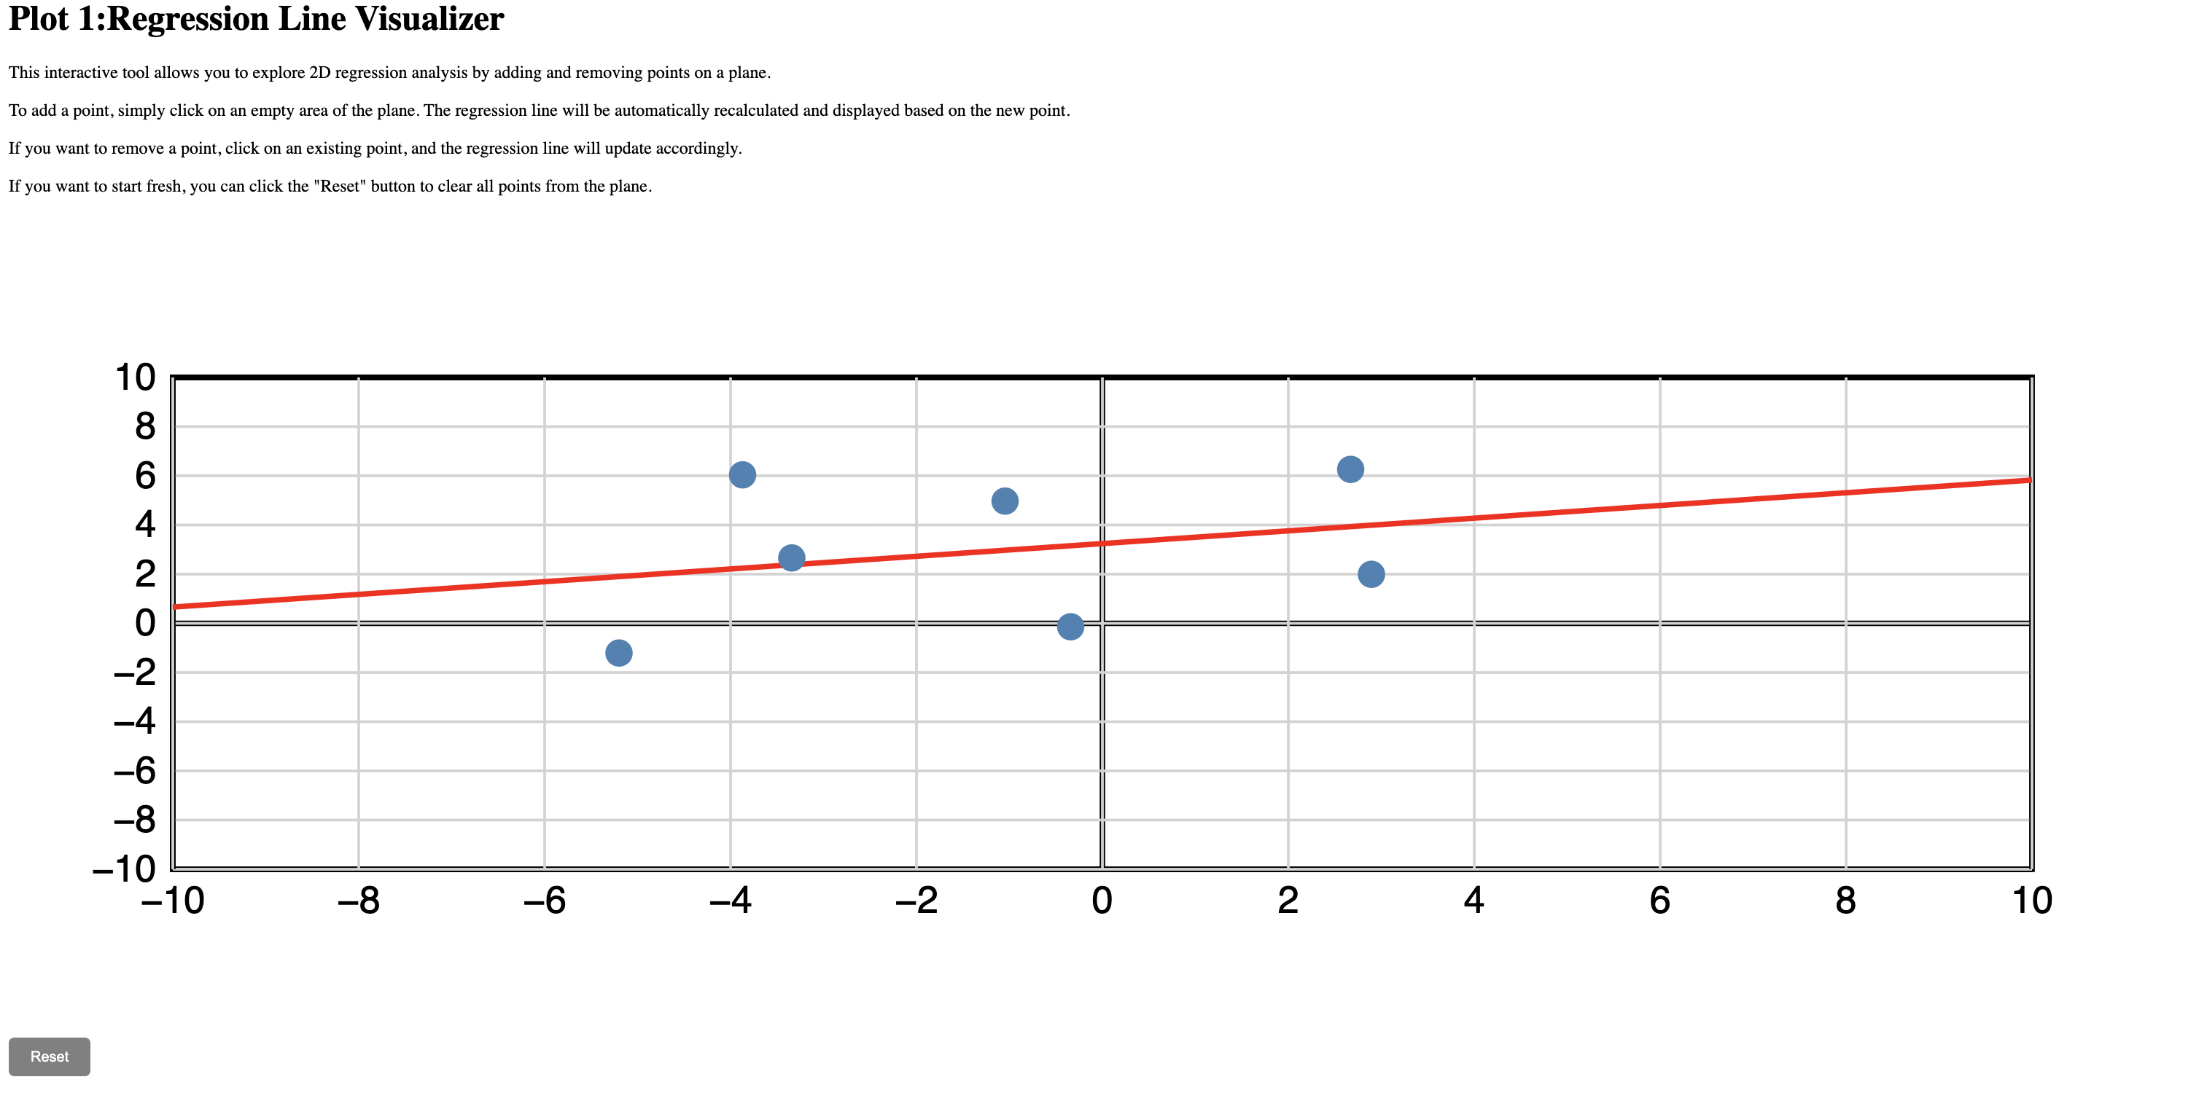
Regression Line Visualizer
Interactive Exploration: The tool enables users to explore two-dimensional regression analysis interactively.
User-Friendly Interface: Users can easily add and remove points on a blank plane by clicking, facilitating hands-on data manipulation.
Dynamic Regression Line: As points are added or removed, the regression line is dynamically recalculated and displayed, reflecting the linear relationship between the data points.
Practical Utility: The visualization serves as a valuable tool for understanding linear relationships and principles of regression analysis, offering users a hands-on approach to data exploration.
Notes:
This visualization enables users to plot points on a grid, after which it automatically calculates the best-fitting line for all the points.
This entails finding a line that minimizes the overall distance from each point to the line, accomplished through a linear regression algorithm.

Slide 7
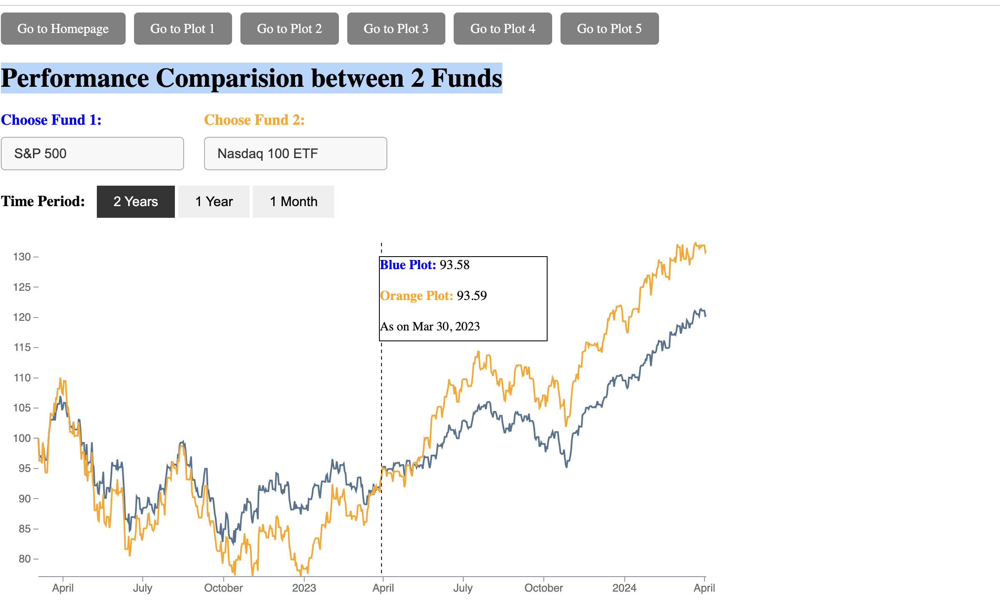
Performance Comparison between Two Funds
1 .Visual Comparison of Fund Performance:
- Allows users to compare the performance of two different funds.
- Presented as a line chart, offering a visual representation of performance trends.
2. Interactive Selection Options:
- Users can choose funds from a dropdown menu, including popular options like S&P 500 and Nasdaq 100 ETF.
- Option to specify the time period for comparison (1 month, 1 year, or 2 years).
3. Dynamic Data Display:
- Plot dynamically updates to display performance data for the selected funds over the chosen time period.
4. Hover-over Interactivity:
- Users can hover over points on the chart to view specific details such as date, fund name, and performance value.
5. Benefits for Investors and Analysts:
- Valuable tool for making informed investment decisions by comparing historical performance.
- Enhances user engagement and understanding through interactive features.
Notes:
1. Trend Visualization: Line charts excel at visualizing trends over time or across ordered categories.
2. Data Continuity: They emphasize data continuity, highlighting changes and patterns more effectively.
3. Interpolation: Line charts provide visual interpolation between data points, aiding in understanding data progression.
4. Comparative Analysis: They allow for easy comparison of multiple data series, aiding in analyzing relationships and correlations.
5. Outlier Detection: Line charts facilitate the identification of outliers and anomalies in the data.
6. Simplicity and Clarity: Line charts offer a simple and clear visualization format, making them easy to understand for diverse audiences.
7. Forecasting: They can be used for forecasting and predictive analysis by extrapolating existing trends into the future.

Slide 8
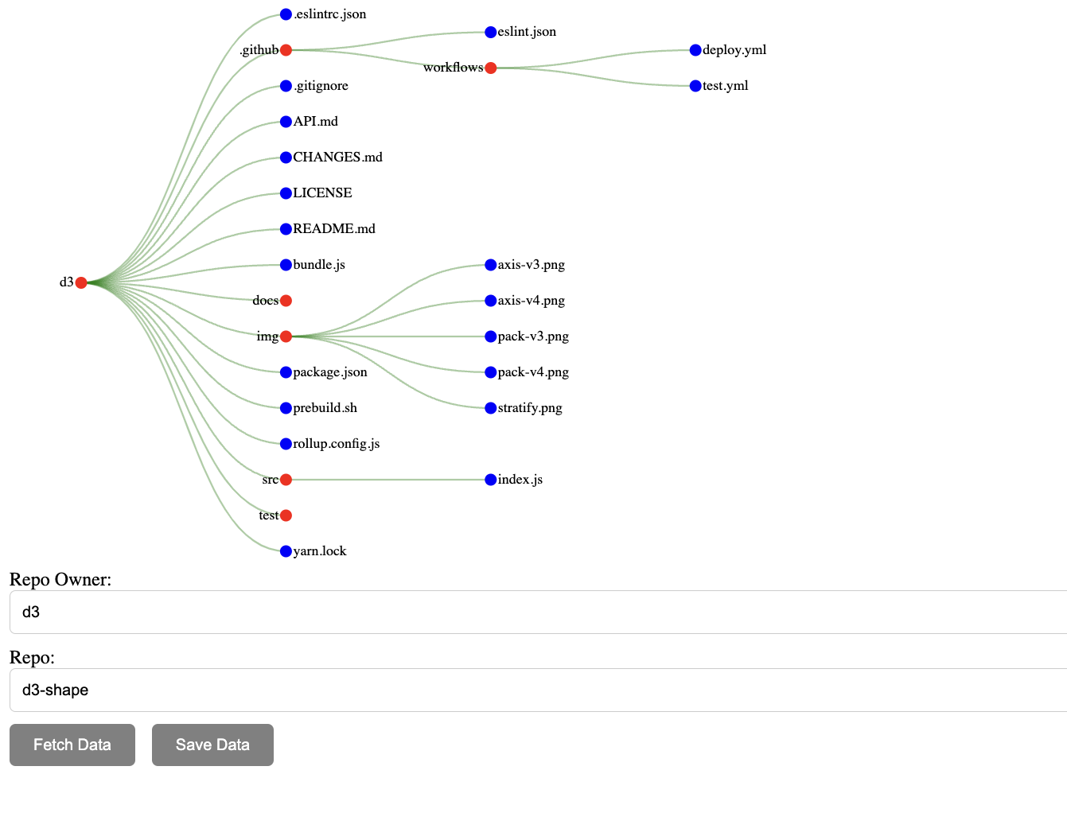
Collapsible Tree Visualization
Interactive Exploration: Users can expand and collapse directory nodes, allowing for intuitive navigation through the folder structure of any GitHub repository.
Dynamic Data Fetching: Upon clicking the "Fetch Data" button, the visualization fetches repository data from GitHub using the GitHub Contents API, ensuring real-time representation of the repository's structure.
User Input Flexibility: Users can input the owner and name of the GitHub repository they wish to visualize, providing flexibility and customization options.
Implementation with D3.js: The visualization is implemented using D3.js, a powerful JavaScript library for data visualization, ensuring robust and efficient rendering of the tree structure.
Enhanced User Experience: Feedback is provided to users through loading indicators, keeping them informed about the progress of data fetching and visualization rendering processes, thus enhancing overall user experience.
Notes:
Collapsible Tree Showing file structure of D3.js Github Repo
User can find which folder contains which files and etc.
User can expand the nodes representing folders and see the files inside of them

Slide 9
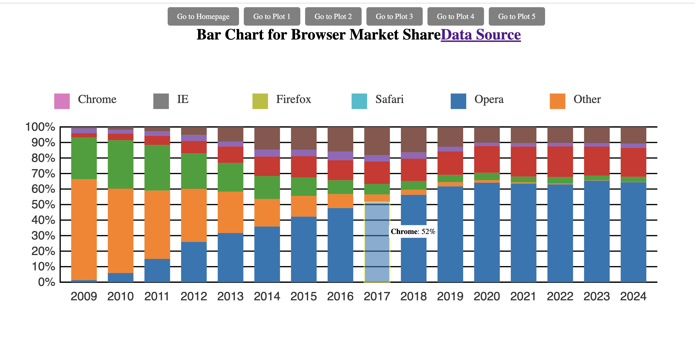
Stacked Bar Chart for Browser Market Share
Visualizes Browser Market Share:
- Bar chart displays market share trends.
- Each bar represents a year.
- Segments within bars show browser types' share.
Chart Setup and Processing:
- SVG canvas setup with dimensions.
- Data processed for plotting.
- X and Y axes scaled for data.
Interactive User Experience:
- Hover for detailed tooltips.
- Dynamic tooltip positioning.
- Segments highlight on hover.
Enhanced Data Interpretation:
- Detailed browser info on hover.
- Improves understanding of market trends.
- Enhances user engagement.
Notes:
1. Stacked Bar Chart Visualization:
- Illustrates browser market share trends.
- Each bar represents a specific year.
- Segments within bars represent the proportion of market share held by different browser types.
2. Data Source and Dynamic Generation:
- Data sourced from a CSV file named `new_bar.csv`.
- Dynamically generated using D3.js, a JavaScript library for data visualization.
- Enables user interaction by hovering over segments to view detailed information.
3. Chart Setup and Processing:
- SVG canvas setup with defined dimensions and margins.
- Data parsed and processed for plotting.
- Scales defined for X and Y axes to map data values.
- Bars created using stacked layout, with each segment representing a browser type.
4. Interactivity and User Experience:
- Event listeners enable interactivity, such as displaying tooltips on hover.
- Tooltip dynamically adjusts position to follow cursor movement.
- Segments highlighted on hover for improved readability and user feedback.
5. Enhanced Understanding and Interpretation:
- Provides users with detailed information about browser types and market share percentages.
- Facilitates interpretation of data trends through interactive features.
- Enhances user experience and understanding of browser market dynamics.
Advantages:
Comparative Analysis: Enables easy comparison between different categories or groups.
Categorical Data: Particularly effective for displaying categorical data with distinct groups or labels.
Flexibility: Can be customized in orientation, style, and color to suit different data types and presentation needs.
Interpretation: Easy to interpret without requiring complex calculations, making them accessible to diverse audiences.

Slide 10
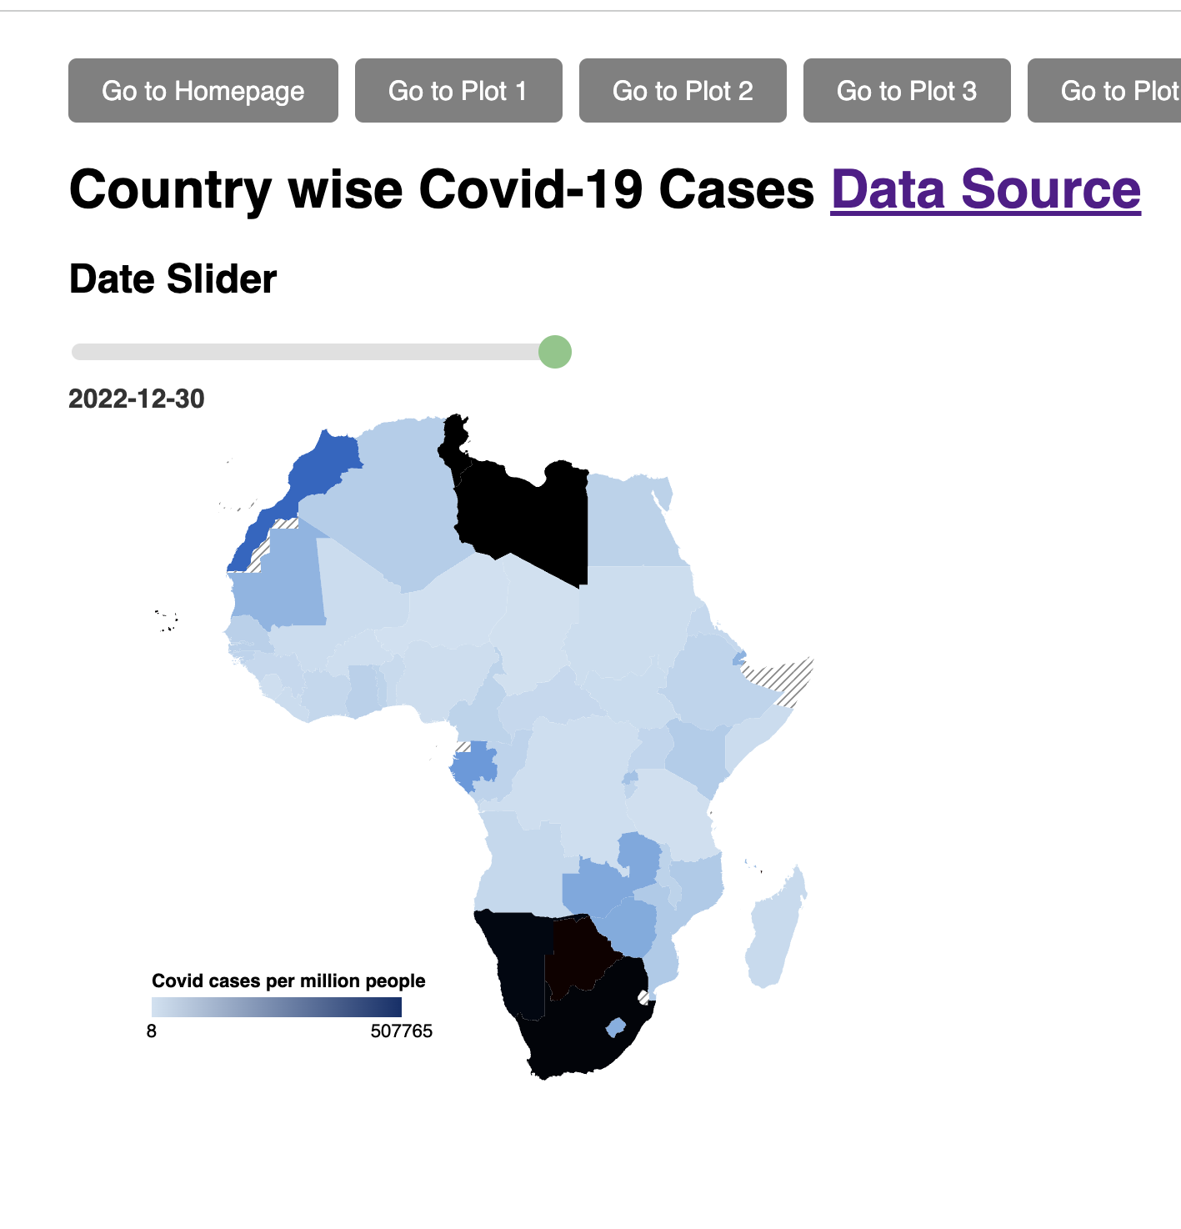
Density Plot for African Country-wise COVID-19 Cases per Million People
Interactive COVID-19 Visualization:
- Presents COVID-19 cases per million people across African countries.
- Users can explore case progression over time via a slider.
- Offers dynamic updates based on selected date for comprehensive insights.
Utilization of D3.js Library:
- Leverages D3.js for creating interactive data visualizations.
- Integrates GeoJSON and CSV data to visualize COVID-19 spread.
- Ensures powerful and flexible visualization capabilities.
Enhanced User Interaction:
- Users can adjust date slider to explore COVID-19 trends over time.
- Hovering over countries displays tooltips with detailed case information.
- Facilitates user engagement and promotes data exploration.
Notes:
The visualization illustrates the COVID-19 cases in African countries relative to their respective populations.
(Data source: ourworldindata)
By adjusting a slider, users can observe how the density of COVID-19 cases varies across different countries in Africa, represented by changes in color intensity.

Slide 11

Conclusion
Visualizing Diverse Datasets: Explored five distinct types of visualizations, including linear relationships, fund performance, and COVID-19 trends.
Empowering Informed Decisions: Each visualization provided unique insights, empowering users to make informed decisions.
Leveraging Tools: Utilized tools such as d3, JavaScript, and HTML to craft interactive and intuitive visualizations.
Facilitating Data Exploration: Visualizations facilitated data exploration and understanding, enhancing user engagement.
Powerful Insights: Visualizations serve as powerful tools for extracting insights from complex datasets.

Slide 12

Challenges Faced & Contribution
Challenges Faced
Data set selection
Visualizing the selected data in an intuitive way
My Contribution
Developed interactive regression line tool for exploring linear relationships.
Contributed to fund performance visualization with interactive elements.
Played key role in developing GitHub repository folder structure visualization.
Enhanced usability of stacked bar chart with tooltip display and dynamic adjustments.
Significantly contributed to interactive COVID-19 spread visualization across African countries.
Notes:
Regression Line Visualizer: Developed an interactive tool for two-dimensional regression analysis, enabling users to plot points, calculate regression lines using the least squares method, and manipulate data points for hands-on exploration of linear relationships.
Performance Comparison between Two Funds: Contributed to the design and implementation of a visualization comparing trends between two funds over time, incorporating interactive elements such as dropdown menus and hover-over interactions for detailed data examination.
Collapsible Tree Visualization: Played a significant role in developing a collapsible tree visualization illustrating GitHub repository folder structures, including the implementation of user input fields, data fetching from GitHub using the GitHub Contents API, and interactive features for exploration of repository hierarchies.
Stacked Bar Chart: Contributed to the functionality and user experience of a stacked bar chart representing browser market share trends, involving data processing, tooltip display on hover, and dynamic adjustments to enhance usability.
Density Plot: Played a significant role in developing an interactive choropleth map visualizing COVID-19 cases per million people across African countries, implementing functionality for dynamic updates based on selected dates, interactive exploration features, and ensuring data reliability and credibility through reputable data sourcing.
Overall, these contributions aimed to empower users to extract insights and make informed decisions through interactive and intuitive visualizations, fostering a deeper understanding of data information and visualization concepts.

Slide 13

THANK YOU

