Slide 1

EXPOSYS DATA LABS
Imagination Beyond Technology
Hiring people isn't a thing that we do,it is the thing that runs the business sucessfully and effectively"
We strongly believe in the philosophy says "Do not hire a man who works for money,but him who does it for the love of it.
This leads a business to run sucessfully to reach the effective solutions.We proud to say that our company has
We proud to say that our company has employees who loved to work,this is the secret of our success.

Slide 2
HEADER SECTION
It is located at the top of the website
It is common for all the webpages
It contains both top header section and bottom header section

Slide 3
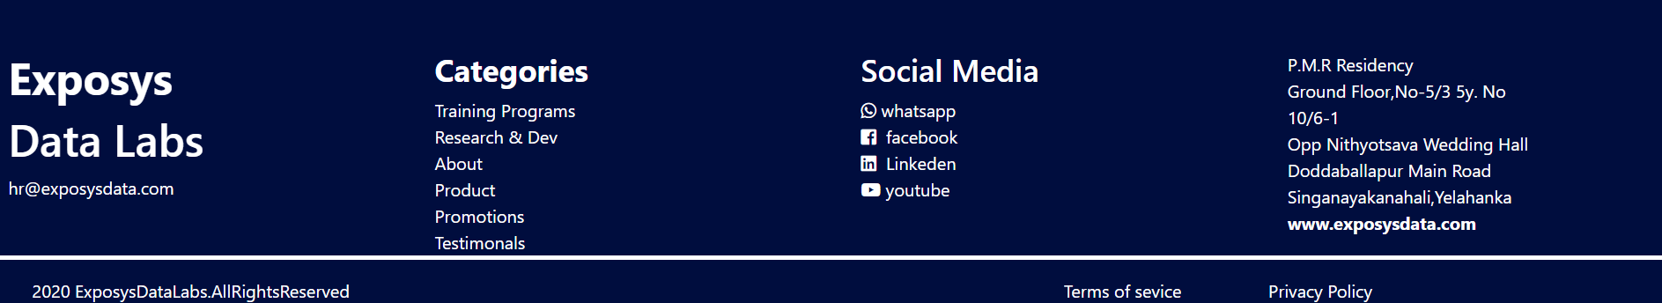
FOOTER SECTION
It is located at the bottom of the website
It is common for all the webpages
It contains both top footer section and bottom footer section

Slide 4
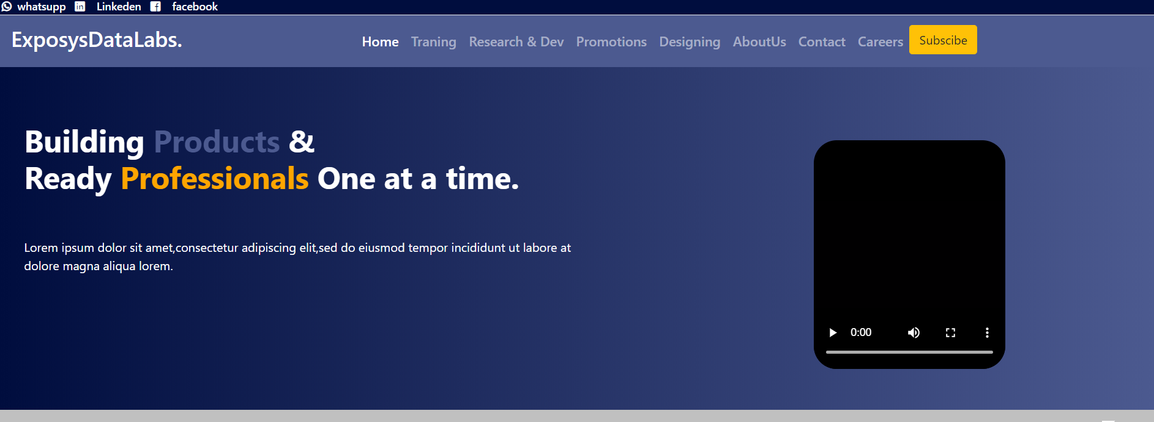
HOME
Home page gives the overview of entire website

Slide 5
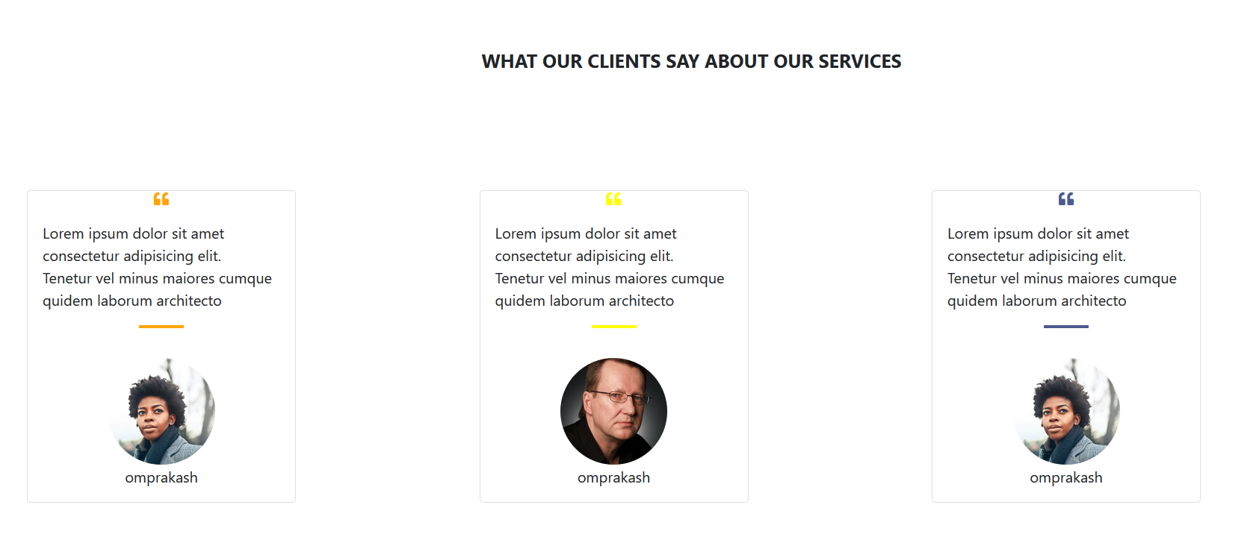
HOME

Slide 6
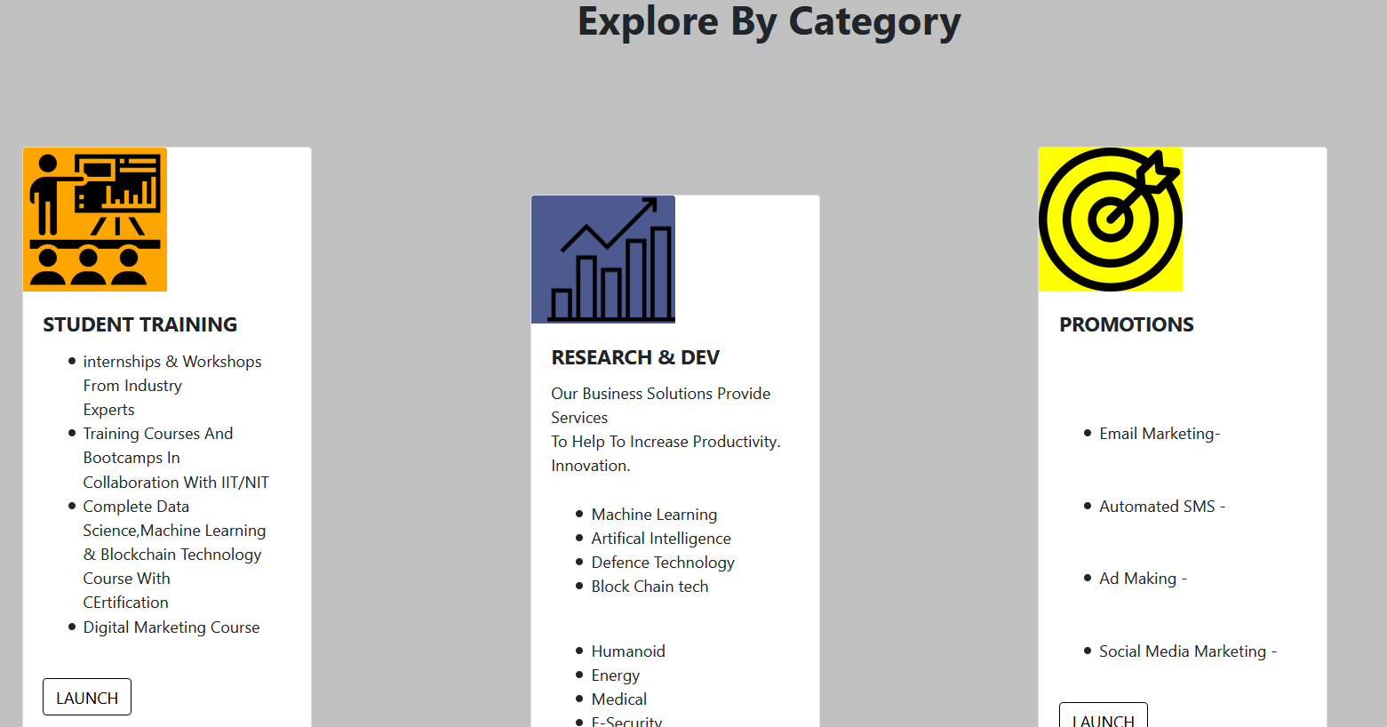
HOME

Slide 7
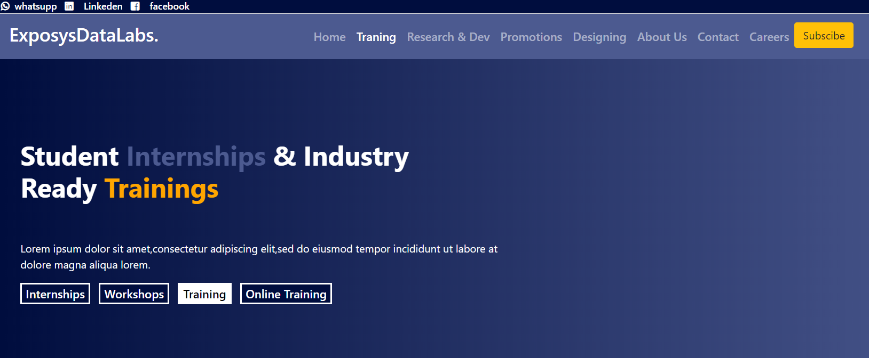
TRAINING

Slide 8
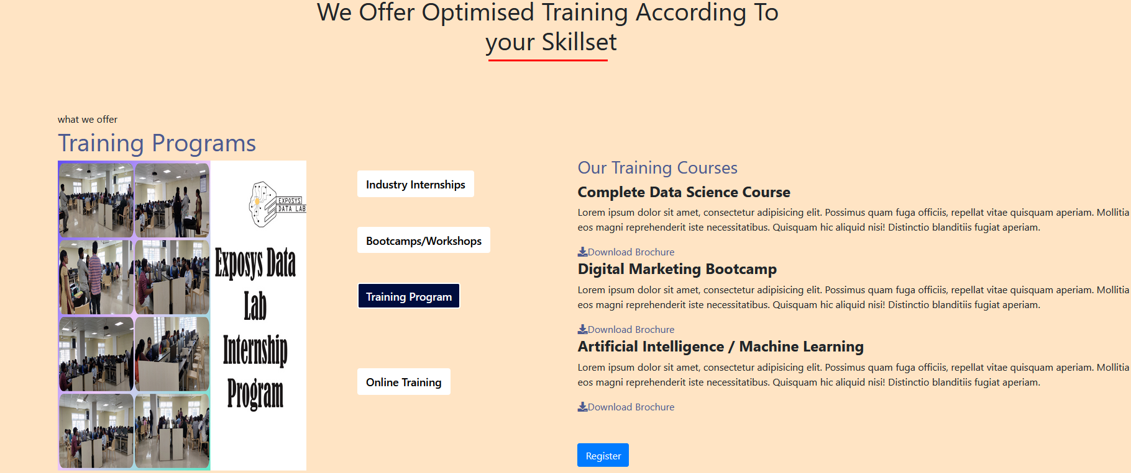
TRAINING
Training page will have the information regarding different training programs which are provided by the company such as bootcamps,workshops,online training,industry internships
If you want to know more information about that particular coarse ,then you can also download the entire coarse details.
You can register directly, just by clicking on the register button

Slide 9
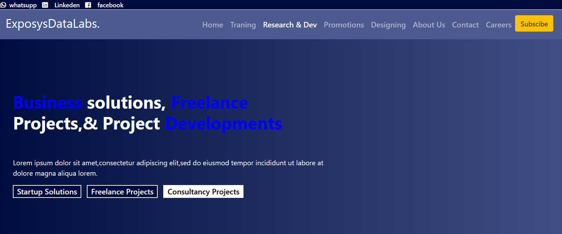
RESERACH AND DEVELOPMENT

Slide 10

RESEARCH AND DEVELOPMENT
Research and development page will have the information regarding different projects that are implementing by the exposys data labs company
Currently the projects are implementing in the feilds such as data science,iot,blockchain technology,machine learning,cloud computing,security etc
You can contact us directly, just by clicking on the contact us button

Slide 11
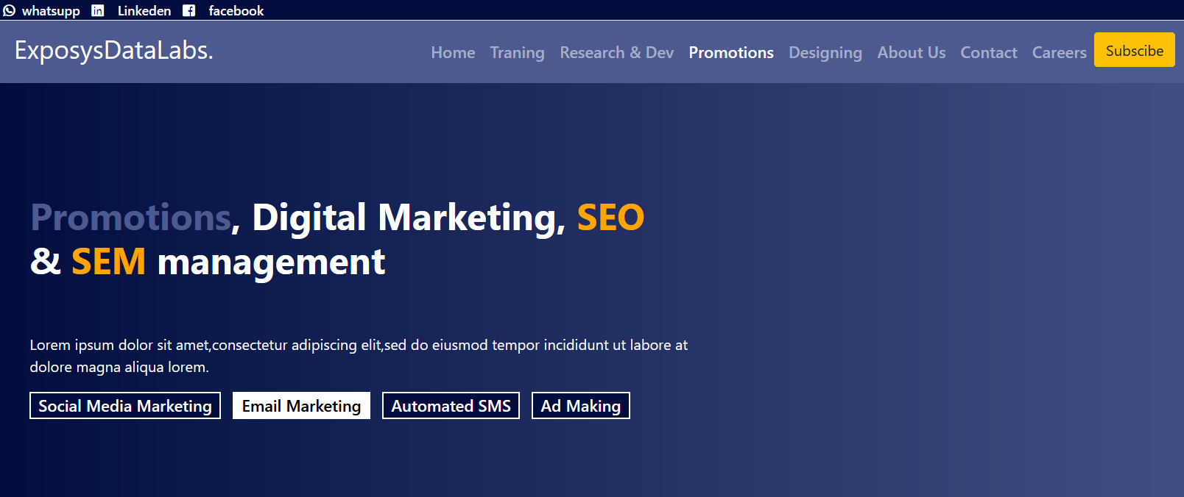
PROMOTIONS

Slide 12

PROMOTIONS
Promotions page will have the information regarding different types of promotions such as social media ,email marketing,automated sms,advertisement marketing.
You can contact us directly, just by clicking on the contact us button

Slide 13
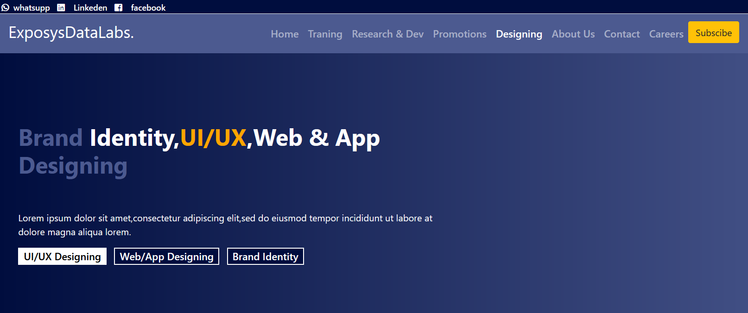
DESIGNING

Slide 14
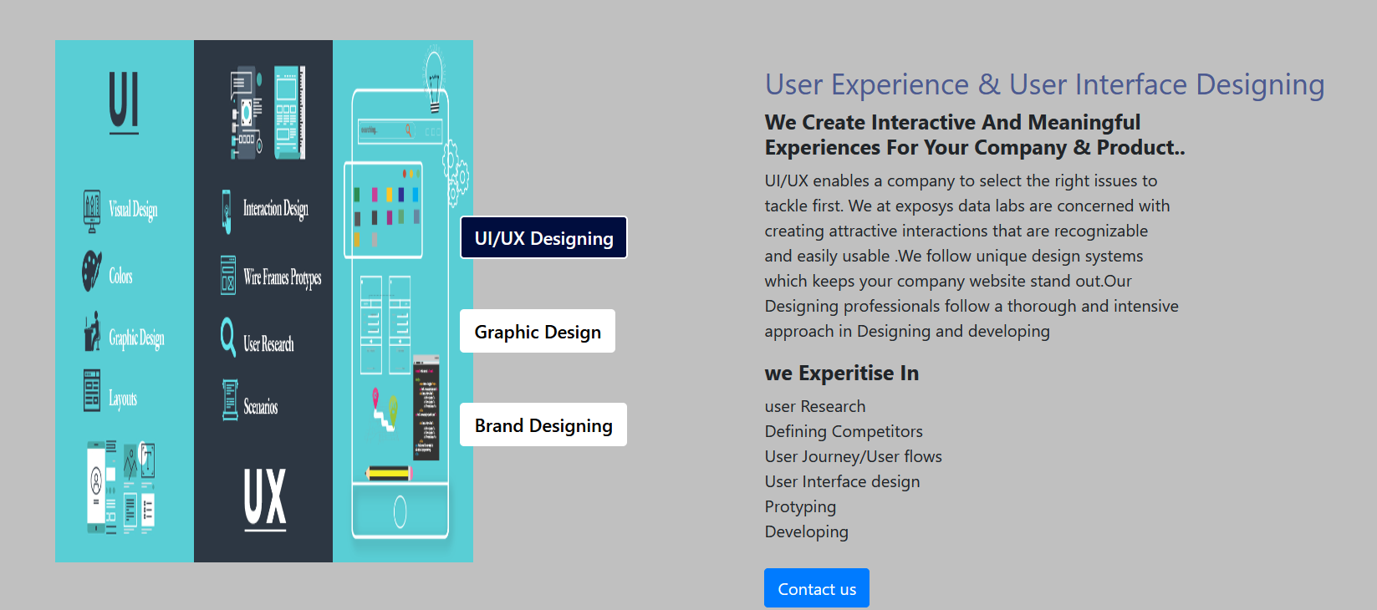
DESIGNING
Designing page will have the information regarding different types of designings such as ui/ux designing,graphic designing,brand designing.
UI/UX enables a company to select the right issues to tackle first. We at exposys data labs are concerned with creating attractive interactions that are recognizable and easily usable .We follow unique design systems
which keeps your company website stand out.Our Designing professionals follow a thorough and intensive approach in Designing and developing
Exposys data labs company is expertised in user reserach,defining competiors,protyping,developing,user interface design etc
You can contact us directly, just by clicking on the contact us button

Slide 15
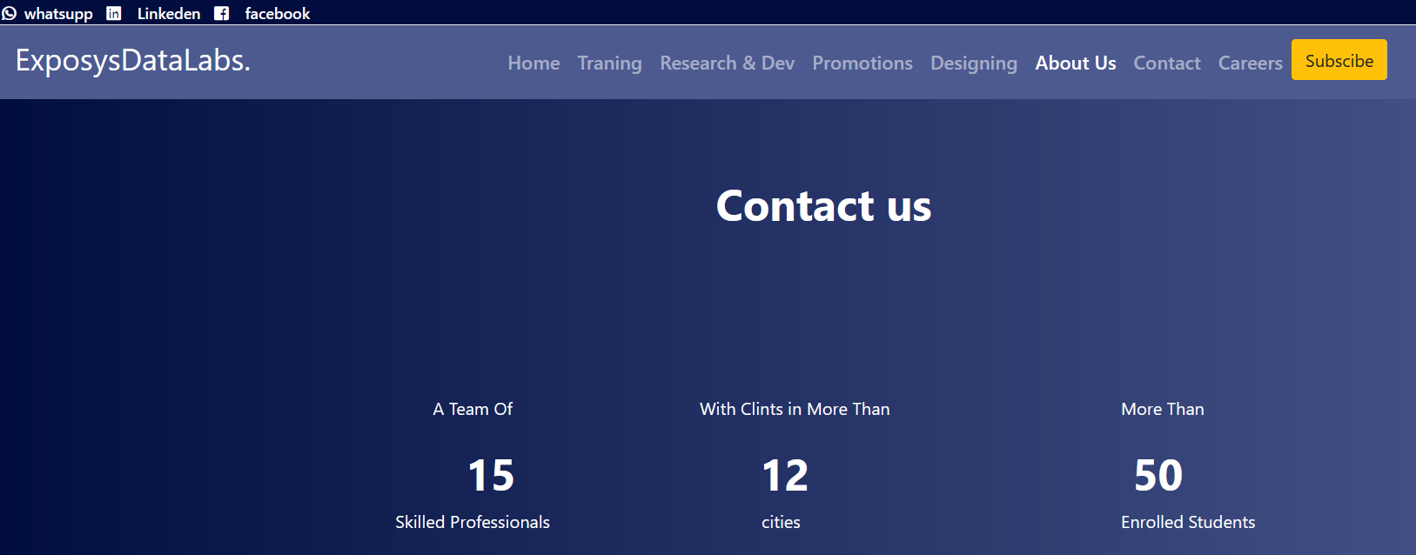
ABOUT US
Exposys data labs has 15 skilled professionals with clients in more than 12 cities with more than 50 enrolled students

Slide 16

ABOUT US

Slide 17
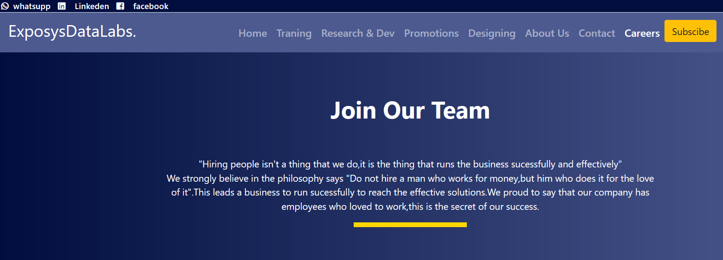
CAREERS

Slide 18

CARRERS
Exposys data labs company has the openings in software developer,web developer,full stack developer

Slide 19

CONTACT US
You can contact us directly by filling the contact us form.

Slide 20
THANK YOU !!!

