Slide 1
Patent Summarization using language models
Sai Kolapudi

Slide 2
Index
Introduction ----------------------------------------------------------------------------------------------------------------------------------------- 3
Transformer-based models----------------------------------------------------------------------------------------------------------------------- 4
Transformer-based model architecture ------------------------------------------------------------------------------------------------------- 5
Encoder-decoder models ------------------------------------------------------------------------------------------------------------------------- 6
Encoder-decoder models architecture -------------------------------------------------------------------------------------------------------- 7
Bidirectional models ------------------------------------------------------------------------------------------------------------------------------- 8
Bidirectional models architecture -------------------------------------------------------------------------------------------------------------- 9
Multi-task models --------------------------------------------------------------------------------------------------------------------------------- 10
Multi-task models architecture ---------------------------------------------------------------------------------------------------------------- 11
long-t5-tglobal-base-16384-book-summary ----------------------------------------------------------------------------------------------- 12
Pegasus-x-large-booksum-1 -------------------------------------------------------------------------------------------------------------------- 13
Big_Bird --------------------------------------------------------------------------------------------------------------------------------------------- 14
BART -------------------------------------------------------------------------------------------------------------------------------------------------- 15
XL_NET ------------------------------------------------------------------------------------------------------- --------------------------------------- 16

Slide 3
Introduction:
Summarization models can be classified in several ways. They can be classified based on the type of training, training data size, type of data, training purpose, training methods, and also based on their architecture.
Summarization models can be divided into 3 categories based on their architecture which are:
Encoder-Decoder Model
Bidirectional Model
Multi-Task Model
All these models are transformer-based models.

Slide 4
Transformer-based Model:
Transformer-based models are neural networks that are composed of a stack of self-attention layers. Self-attention is a mechanism that allows the model to learn the relationships between different words in the input text. This is done by comparing each word in the input text to all of the other words in the text, and then assigning a weight to each word based on how relevant it is to the other words.
The weights are then used to compute a new representation of the input text, which is then passed to the next layer of the model.
Self-attention mechanism allows the model to compare words that are far apart in the input text.
This is important for tasks such as text summarization, where the model needs to understand the overall meaning of the text in order to generate a summary.

Slide 5
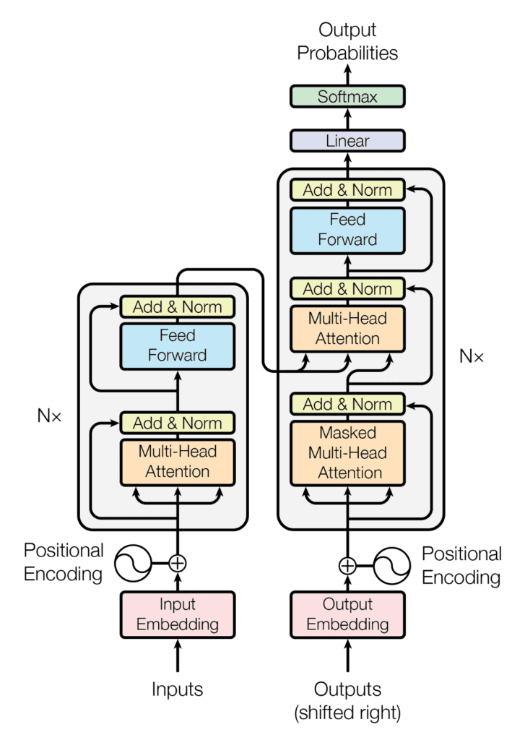
Transformer-based Model Architecture:

Slide 6
Encoder-Decoder Model
Encoder-decoder models are neural networks that are composed of two parts: an encoder and a decoder. The encoder reads the input text and produces a sequence of hidden states. The decoder then takes these hidden states as input and generates the output text.
The encoder is typically a transformer-based model, while the decoder can be a variety of different models. The most common type of decoder is a recurrent neural network (RNN). RNNs are able to process text one word at a time, which makes them well-suited for tasks such as text summarization, where the model needs to generate the output text one word at a time.
Some of the most popular encoder-decoder models for generating summaries include Pegasus, MarianMT, and MPNet.

Slide 7
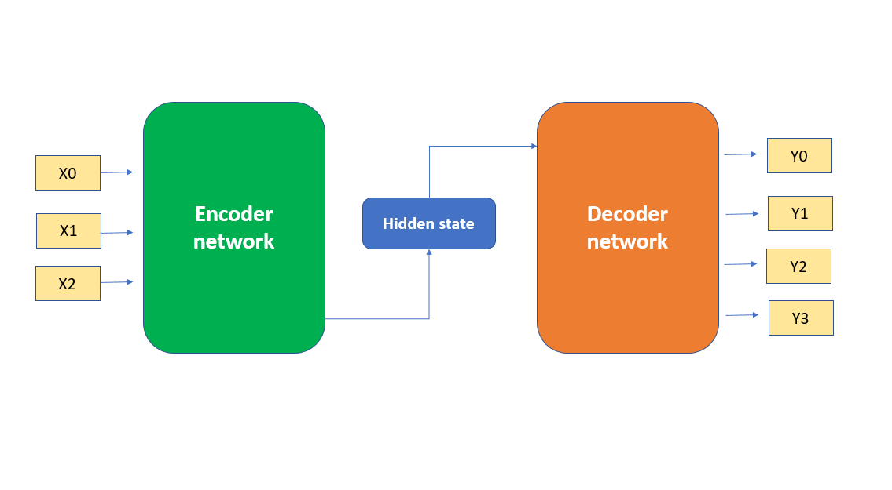
Encoder-Decoder Model Architecture:

Slide 8
Bidirectional models:
Bidirectional models are able to read text in both directions. This means that they are able to capture the context of the text more effectively than models that can only read text in one direction. This is because bidirectional models are able to see how words are related to words that come before and after them
Bidirectional models are a popular choice for natural language processing tasks that involve understanding the meaning of text.
This is because the ability to capture the context of the text is essential for understanding the meaning of complex sentences.
Some of the most popular bidirectional models for generating summaries include CTRL, FlauBERT, and FNet.

Slide 9
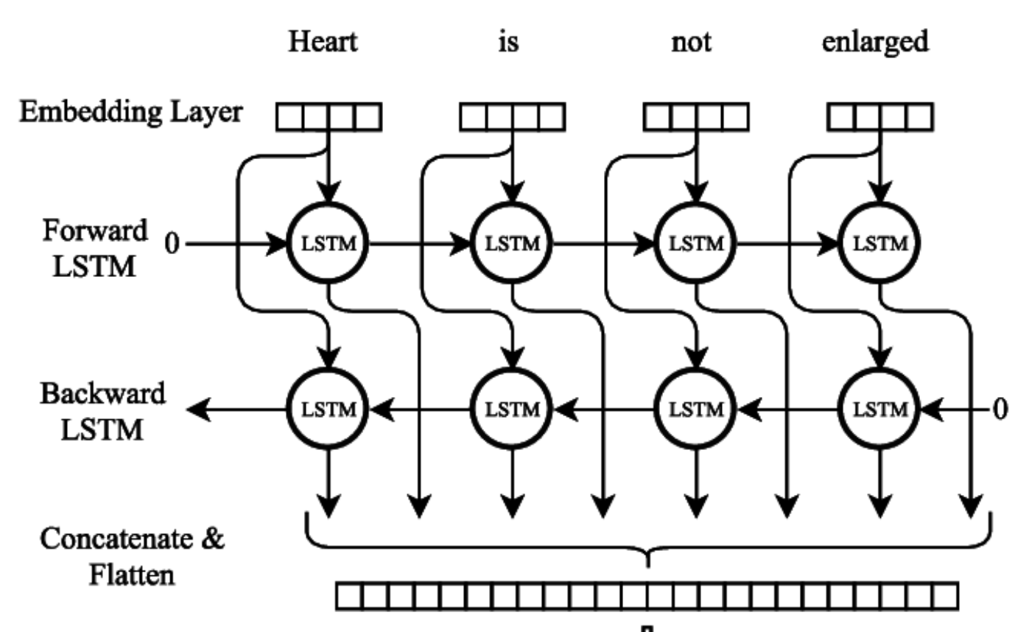
Bidirectional Model Architecture

Slide 10
Multi-task models:
Multi-task models are trained on multiple tasks. This allows them to learn more generalizable features. This is because the model is able to learn features that are useful for multiple tasks.
This can be beneficial for tasks such as text summarization, where the model needs to learn a variety of different features in order to generate a good summary.
Some of the most popular multi-task models for generating summaries include GPT NeoX, Open-LLAMA, and ProphetNet.

Slide 11
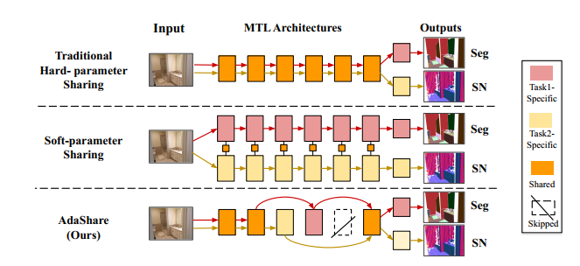
Multi-task models Architecture

Slide 12
long-t5-tglobal-base-16384-book-summary(Encoder-Decoder Model) :
Long-T5-TGlobal-Base-16384-Book-Summary is a fine-tuned version of the Google Long-T5-TGlobal-Base model on the Booksum dataset. This model has 137B parameter and it is designed to summarize long-form narrative texts such as novels, plays, and stories. It was trained on 30+ epochs of fine-tuning from the base model on V100/A100 GPUs, using 16384 token input and 1024 max output.
Long-T5:
LongT5 is an extension of the T5 model that handles long sequence inputs more efficiently. It was introduced in the paper "LongT5: Efficient Text-To-Text Transformer for Long Sequences" by Mandy Guo, Joshua Ainslie, David Uthus, Santiago Ontanon, Jianmo Ni, Yun-Hsuan Sung, and Yinfei Yang.
Long T5 uses two kinds of attention mechanisms which are :
Local attention: This attention mechanism only attends to a small window of tokens around the current token, which reduces the computational cost of attention.
Transient global attention: This attention mechanism allows the model to attend to the entire input sequence, but only for a short period of time. This helps the model to learn long-range dependencies without having to attend to the entire sequence at once.
Code , Output

Slide 13
Pegasus-x-large-booksum-1 (Encoder-Decoder Model) :
This model is a fine-tuned version of Google's Pegasus-X-Large model on the Booksum dataset. The Booksum dataset is a collection of book summaries, and the model was trained to generate summaries of arbitrary text. The Booksum dataset contains over 100,000 book summaries.
It is based on the transformer architecture and consists of several layers of multi-head self-attention and feedforward neural networks.
The model has 1.3B parameters, making it one of the largest language models available. The model has been shown to achieve state-of-the-art results on the ROUGE benchmark for text summarization.
Code
Output

Slide 14
Big_Bird (Bi-Directional Model) :
BigBird is a large language model that was trained on a massive dataset of text and code. BigBird uses a sparse attention mechanism that reduces the quadratic dependency of the attention mechanism on sequence length to linear. This makes it more efficient to process long sequences, which is important for tasks such as text summarization.
BigBird has 137B parameters, making it one of the largest language models ever trained.
It was trained on a dataset of text and code that includes Wikipedia, BooksCorpus, and arXiv.
Code
Output

Slide 15
BART (Multi-Task Model) :
BART is a transformer-based model, which means that it uses a stack of self-attention layers to learn the relationships between words in a sequence. BART is trained using the masked language modeling (MLM) objective. In MLM, the model is trained to predict masked words in a sequence. This helps the model to learn the context of words in a sequence. BART is trained for 10 epochs on a dataset of 100 million words. BART has 137M parameters, which is a measure of the complexity of the model.
Code
Output

Slide 16
XL_NET (Bi-directional Model):
XLNet is a generalized autoregressive pretraining method that learns bidirectional contexts. This means that XLNet can consider the context of a token both before and after it in the input sequence. This is important for NLP tasks that require understanding long-range dependencies, such as question answering and natural language inference.
XLNet is based on the Transformer-XL model, which is a state-of-the-art autoregressive model for NLP tasks. This means that XLNet is able to learn long-range dependencies efficiently.
XLNet has been shown to outperform BERT, the previous state-of-the-art NLP model, on a variety of downstream tasks. This suggests that XLNet is a powerful model that has the potential to improve the performance of a wide range of NLP tasks.
XLNet is one of the few models that has no sequence length limit. This makes it well-suited for long-range NLP tasks, such as machine translation.
XLNet is trained for 30 epochs on a dataset of 1.56TB of text. XLNet has 1.3B parameters, which is a measure of the complexity of the model.
Code , Output

