Slide 1

Analysis of accident points for multiple routes -A metric in Safety Index calculation
By
Sai Raghunath Kolusu

Slide 2
Objective:
To Identify accident points along different routes between 2 specific points in New York city programmatically based on 2016 NYC road accidents data and plot on a map.
Calculate the number of accidents in that route based on the accident points obtained.
Also to analyze visually , the factors that influenced these accidents .
These would aid in calculating safety index for that particular route.
Data and Variables:
Data Source- NYPD road crashes data for the year 2016 published online.
Observations : 130,000 observations
Route : Time Square in Manhattan, New York and World Trade Center.
Indicators : Location of the accident, No of fatalities, Driver condition, Vehicle type among others.

Slide 3
Methodology

Slide 4
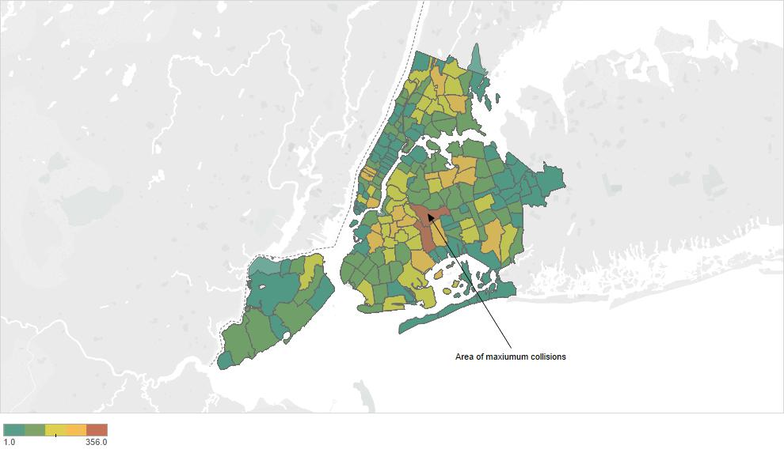
Exploratory Data Analysis
An Exploratory Data Analysis is done on the data
Most number of accidents occur in the central part of New York.

Slide 5
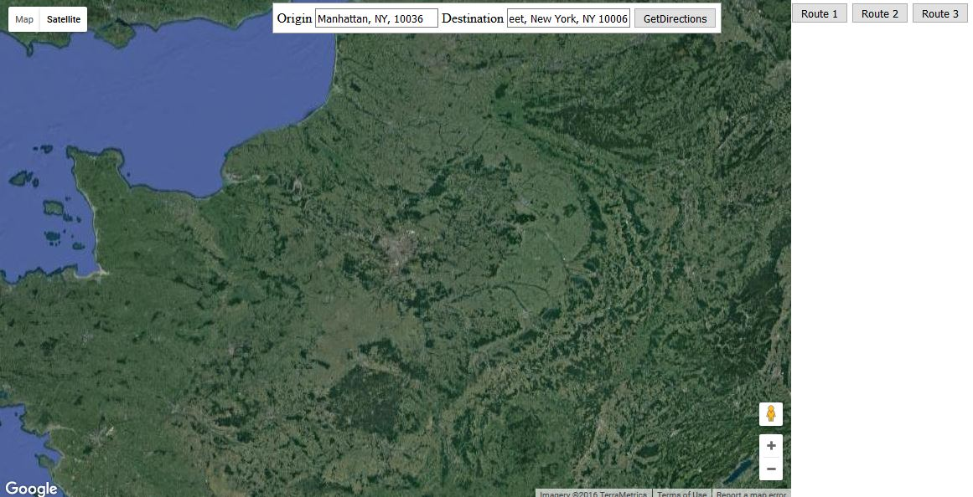
Basic Map
A Basic Map with the choice to enter Origin and Destination

Slide 6
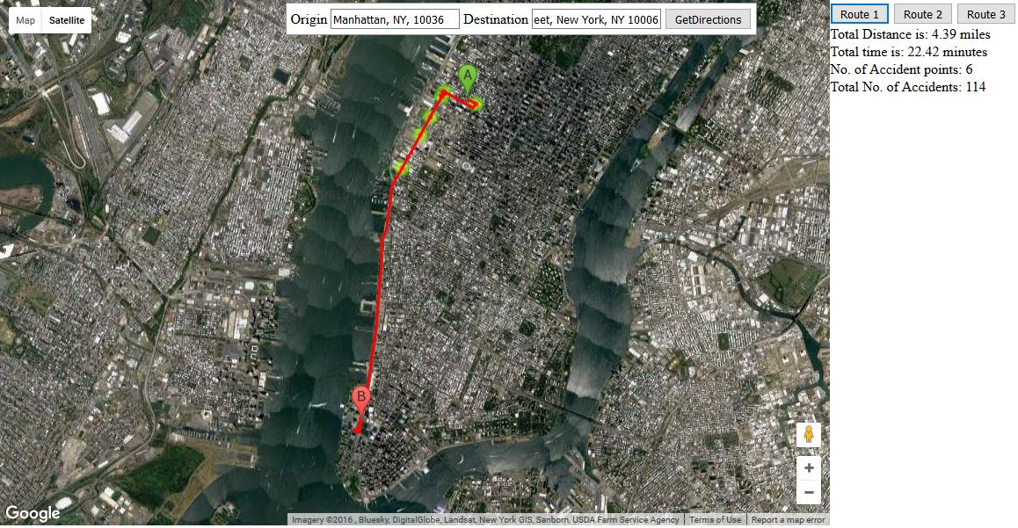
Route - 1
The 1st route between Time Square and WTC and the accident points are plotted
Also the total distance, travel time and the number of accidents in that route in 2016 are also obtained

Slide 7
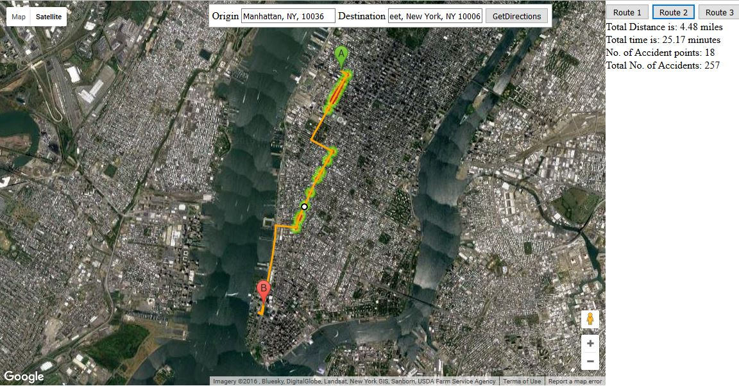
Route- 2
The same process is done for the 2nd route

Slide 8
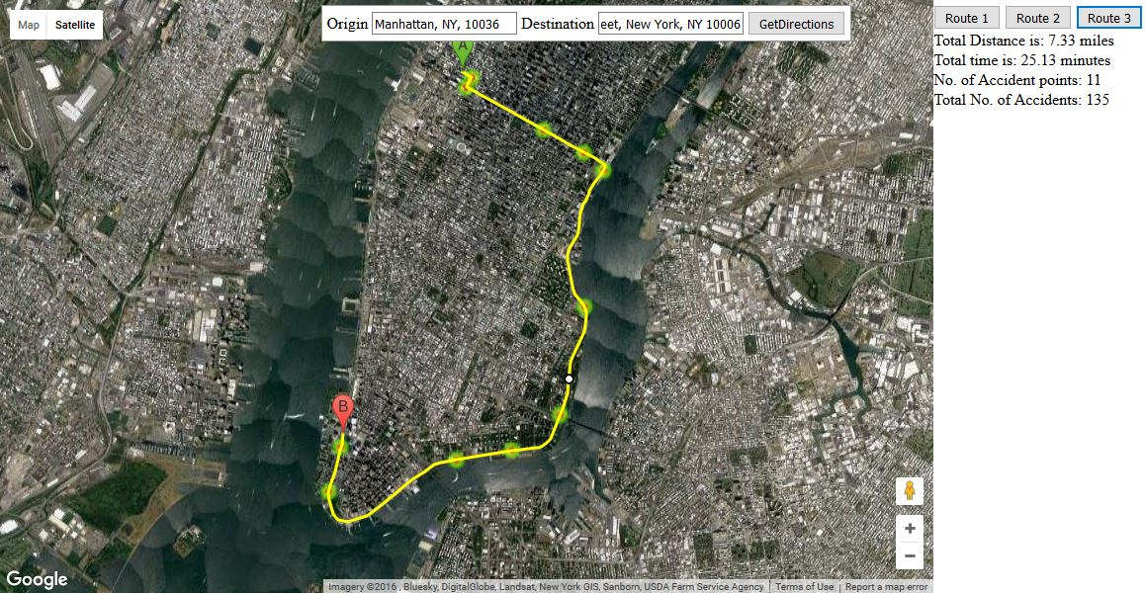
Route - 3
And also for the 3rd route

Slide 9
Code – HTML (Header)
<head>
<meta name="viewport" content="initial-scale=1.0, user-scalable=no">
<meta charset="utf-8">
<title>Geocoding service</title>
<style>
html, body, #map-canvas { height: 100%; min-height: 600px; min-width: 700px; margin: 0px; padding: 0px }
#map-canvas { height: 50%; }
#panel { position: absolute; top: 5px; left: 50%; margin-left: -350px; z-index: 5; background-color: #fff; padding: 5px; border: 1px solid #999; }
</style>
<script src="https://maps.googleapis.com/maps/api/js?v=3.exp&sensor=false&libraries=visualization"></script>
</head>

Slide 10
Code – HTML (Body)
<body>
<div id="panel">
<label>Origin
<input id="origin" type="text" value="">
</label>
<label>Destination
<input id="destination" type="text" value="">
</label>
<input type="button" value="GetDirections" onclick="calcRoute()">
</div>
<div id="control_panel" style="float:right;width:30%;text-align:left;padding-top:5px">
<div id="routes">
<input id = "r1" type="button" value="Route 1" onclick="displayRoute1()">
<input id = "r2" type="button" value="Route 2" onclick="displayRoute2()">
<input id = "r3" type="button" value="Route 3" onclick="displayRoute3()">
</div>
<div id="total"></div>
</div>
<div id="map-canvas"></div>
</body>

Slide 11
Code – JavaScript
function initialize() {
directionsDisplay = new google.maps.DirectionsRenderer();
var mapOptions = {
zoom: 7,
center: new google.maps.LatLng(48.85727000, 2.35238),
mapTypeId: 'satellite'
};
map = new google.maps.Map(document.getElementById('map-canvas'), mapOptions);
directionsDisplay.setMap(map);
}
function calcRoute() {
var start = document.getElementById('origin').value;
var end = document.getElementById('destination').value;
directionsRequest = {
origin: start,
destination: end,
provideRouteAlternatives : true,
travelMode: google.maps.TravelMode.DRIVING,
unitSystem: google.maps.UnitSystem.METRIC
}; }

Slide 12
Code – JavaScript
function showRoute(i,accpts,accdts){
initialize();
var ul = document.getElementById("vertex");
while (ul.firstChild) {
ul.removeChild(ul.firstChild);
}
directionsService.route(directionsRequest,function (response, status) {
if (status == google.maps.DirectionsStatus.OK) {
new google.maps.DirectionsRenderer({
map: map,
directions: response,
routeIndex: i,
polylineOptions: {strokeColor:col[i]}
});
computeTotalDistance(response,i,accpts,accdts);

Slide 13
Code – JavaScript
function computeTotalDistance(result,h,accpts,accdnts) {
var totalDist = 0;
var totalTime = 0;
var myroute = result.routes[h];
for (i = 0; i < myroute.legs.length; i++) {
totalDist += myroute.legs[i].distance.value;
totalTime += myroute.legs[i].duration.value;
}
totalDist = totalDist / 1000.
document.getElementById("total").innerHTML = "Total Distance is: " + (totalDist/1.6).toFixed(2) + " miles<br>Total time is: " + (totalTime / 60).toFixed(2) + " minutes<br>No. of Accident points: " + accpts + "<br>Total No. of Accidents: " + accdnts;
}

Slide 14
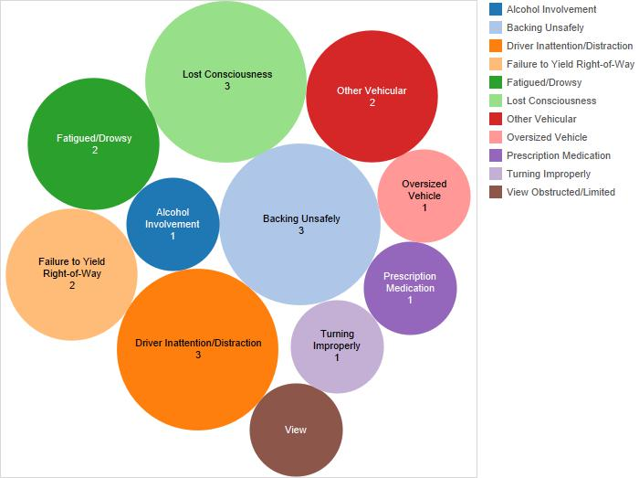
Accident Influencing factors(Route-1)
State of Driver/ Contributing factor

Slide 15
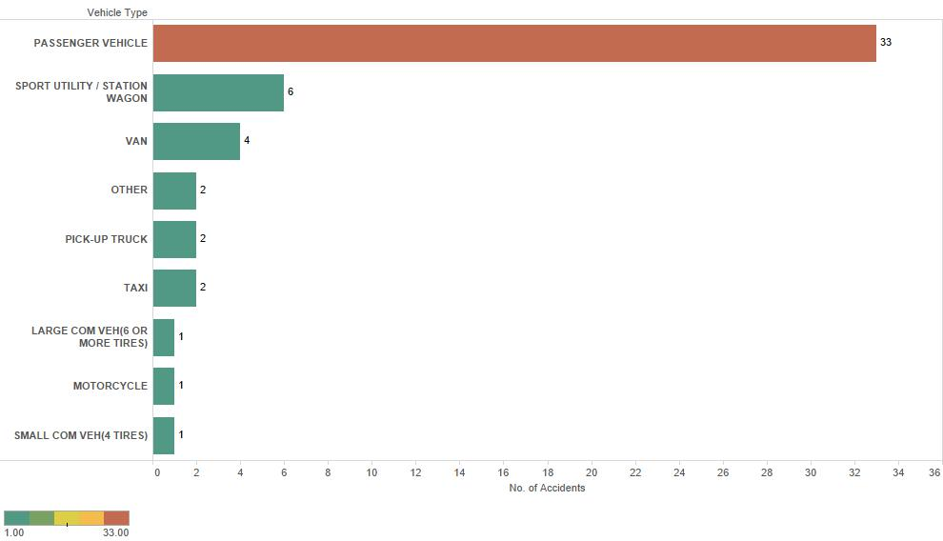
Accident Influencing factors(Route-1)
Type of Vehicle causing the accident

Slide 16
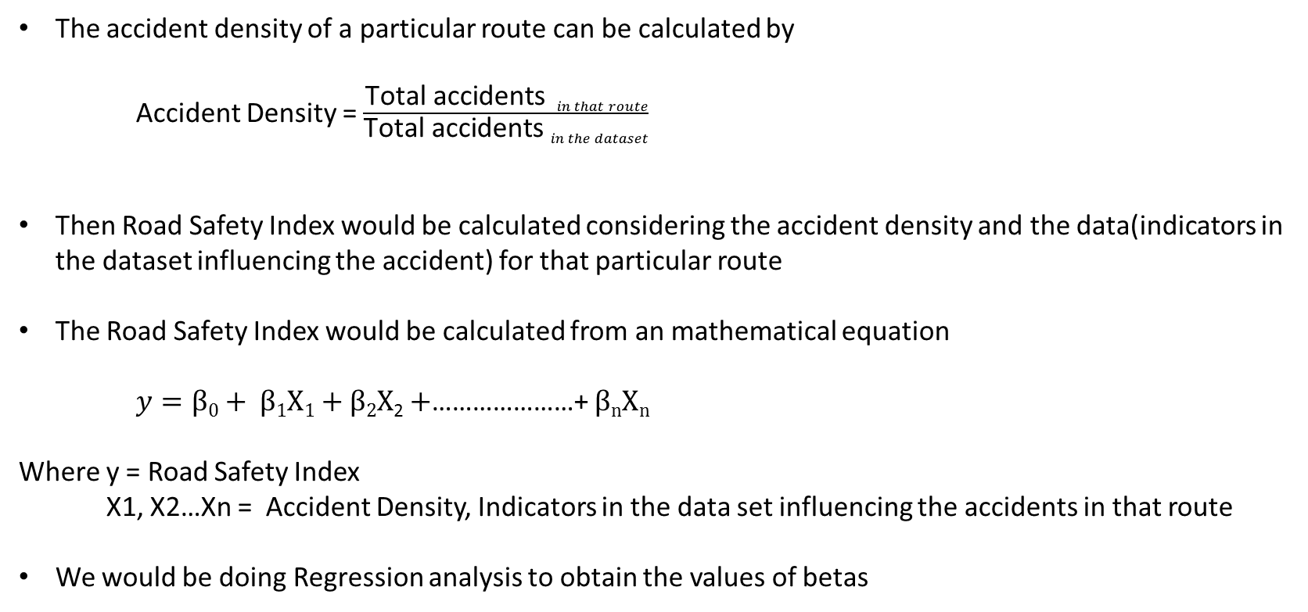
Road Safety Index Calculation
The accident density of a particular route can be calculated by
Accident Density = $\frac{\text{Total} \text{accidents} in that route}{\text{Total} \text{accidents} in the dataset}$
Then Road Safety Index would be calculated considering the accident density and the data(indicators in the dataset influencing the accident) for that particular route
The Road Safety Index would be calculated from an mathematical equation
$y=β0+ β1X1+β2X$₂ $+$…………………+ $βnXn$
Where y = Road Safety Index
X1, X2…Xn = Accident Density, Indicators in the data set influencing the accidents in that route
We would be doing Regression analysis to obtain the values of betas

