Slide 1
Mini Project 1
CUSTOMER LIFETIME VALUE
The Mean Squares

Slide 2
Executive summary
Objective Overview: Enhance customer retention and maximize margins using CLV-based strategy.
Strategic Approach: Integrative model utilizing churn prediction, margin analysis, and CLV calculation.
Key Insights: 1. Identified high-risk churn segments. 2. Uncovered key profit margin opportunities. 3. Recognized high-value customer profiles.
Actionable Recommendations: 1. Deploy targeted retention strategies. 2. Focus on nurturing high-margin relationships.
Notes:
Objective Overview:
Discuss the current challenges the business faces regarding customer retention and profitability. Elaborate on the importance of using a Customer Lifetime Value (CLV)-based strategy to address these challenges, emphasizing the strategic significance of understanding and leveraging CLV in decision-making.
Strategic Approach:
Provide a rationale for the chosen analytical models, explaining why an integrative approach that combines churn prediction, margin analysis, and CLV calculation is essential for a holistic understanding of the customer base. Mention the types of data integrated into the model and the benefits of this comprehensive approach.
Key Insights:
High-Risk Churn Segments: Elucidate on the characteristics that define high-risk segments and the potential impact on the business.
Profit Margin Opportunities: Share examples of identified opportunities where profit margins can be improved.
High-Value Customer Profiles: Describe the attributes of high-value customers and how these insights can influence marketing and sales strategies.
Actionable Recommendations:
Targeted Retention Strategies: Offer details on the specific retention strategies proposed, including how they can be tailored to different customer segments based on the insights gathered.
High-Margin Relationship Nurturing: Talk about the approach to nurturing high-margin relationships, including any specific programs or initiatives that will be implemented to enhance these relationships.

Slide 3
PROBLEM STATEMENT – IMPLICATIONS ON BUSINESS
"The Prediction Paradox": Inability to foresee churn risks customer relationships.
“Profit Margin Mysteries": Without deep insights into customer profit margins we're missing out on good investments
“LTV's Untapped Potential": Undermining Lifetime Value means devaluing customer relationships and losing money on acquisition.
"Data Rich, Insight Poor": Lacking the tools to analyze data can’t personalize experiences or anticipate needs effectively.
"One Size Misfits All": Without churn prediction and margin analysis, it’s hard to retain a diverse customer base.

Slide 4
PROPOSED SOLUTION
Utilize insights to offer targeted retention and up-selling/cross-selling campaigns to drive growth.
INCREASING CUSTOMER RETENTION
Build a robust churn prediction model to identify churning segments and boost retention.
IMPROVING PROFIT MARGINS
Predict customer profit margins effectively to nurture high profit relationships and safeguard revenue.
LEVERAGING LIFETIME VALUES
Calculating LTVs help optimize Customer Acquisition Costs and prioritize customers.
Garner actionable insights based on available KPIs to aid in data-driven decision making.
TARGETED INTERVENTIONS
EFFECTIVE DATA ANALYSIS

Slide 5
IMPLEMENTATION – DATA CLEANING, MODELING (HIGH LEVEL)

Slide 6
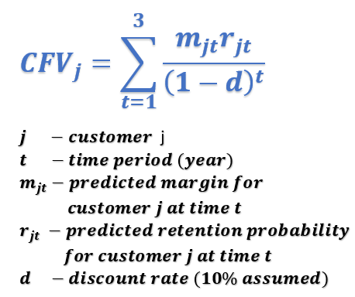
THE PROCESS
Preprocess Data
Variable Selection using Extra Trees
Random Forest for predicting churn & margin
Calculate CFV
*Technical approach detailed in the appendix

Slide 7






Marketing STRATEGY USING CLV
High
CFV
Avg: $255
LOR > 15yrs: 35%
LOR < 3yrs: 18%
CFV
Avg: $1,747
LOR > 15yrs: 45%
LOR < 3yrs: 11%
Customers
Total: 102k
Customers
Total: 64k
Retention Likelihood
Low Income: 68%
Mid Income: 25%
High Income: 7%
Purch Amt 3yrs
Median: $1,058
Low Income: 60%
Mid Income: 29%
High Income: 11%
Age
Avg: 60 yrs
Purch Amt 3yrs
Median: $261
Age
Avg: 56 yrs
CFV
Avg: $25
LOR > 15yrs: 29%
LOR < 3yrs: 24%
Customers
Total: 55k
CFV
Avg: $315
LOR > 15yrs: 33%
LOR < 3yrs: 19%
Customers
Total: 18k
Purch Amt 3yrs
Median: $150
Low Income: 72%
Mid Income: 23%
High Income: 5%
Age
Avg: 52 yrs
Purch Amt 3yrs
Median: $825
Low Income: 59%
Mid Income: 29%
High Income: 12%
Age
Avg: 55 yrs
Low
Margin $
High
Notes:
Comparison of several metrics to understand customer type in each quadrant: Customer Future Value (CFV): High Retention-High Margin customers show a substantial average CFV of approximately $1,746, suggesting high revenue potential, while Low Retention-Low Margin reflects the lowest CFV at about $25.
Total Customers: High Retention-High Margin leads with 102k customers, indicative of a strong customer base. In contrast, Low Retention-Low Margin has a significant number of customers at 55k but lower future value, highlighting potential for strategic customer value enhancement.
Tier Composition: High Retention-High Margin shows 27.53% in top tiers (Gold, Platinum, Diamond), denoting a loyal customer segment. In contrast, Low Retention-Low Margin has only 2.14%, suggesting a focus area for loyalty programs.
Age Distribution: The High Retention-High Margin quadrant is predominantly senior (55+ years) 65.06%, with a small young population – (18-34 years) 3.83%. The Low Retention-Low Margin has more young customers (10.56%) but still a senior majority (46.17%), implying a generally older customer base.
Income Distribution: High Retention-High Margin has only 60.62% in the low-income bracket (<$50k), while 9.89% are high-income (>$100k), correlating with higher CFV. Low Retention-Low Margin has 71.04% in low-income, indicating a potential to tap into upgrading income brackets.
Purchase Amount last 3 years: The median purchase amounts ($1058 for High Retention-High Margin and $150 for Low Retention-Low Margin) align with the CFV, showing a direct correlation between spending in the last 36 months and future value.
Home Value: Despite the significance of home value in churn rates, its distribution being similar across quadrants (approx. 40% having HomeValue < $100k) suggests it's less discriminative for customer segmentation in these quadrants.
Length of Residence: LOR is typically high for High Retention – High Margin customers.

Slide 8
OUTPUTS & INSIGHTS

Slide 9
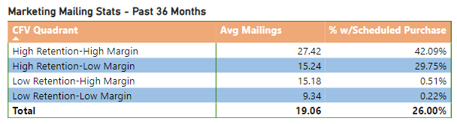
CUSTOMER MARKETING MAIL OUTREACH
High Retention - High Margin customers with high scheduled purchases are historically sent more marketing mailings over the past 36 months.
Enhance targeted marketing mailing initiatives tailored specifically for high-retention, low-margin as well as low-retention, high-margin customer segments.
Implement initiatives to reward having scheduled purchases.

Slide 10
EXECUTIVE RECOMMENDATIONS AND NEXT STEPS

Slide 11
High Retention-High Margin: "Crown Jewels“
Objective:
Strengthen and leverage strong, profitable relationships.
What to Do:
Focus on retention and deepening relationships. Offer premium experiences, cross-sell and upsell opportunities, and ensure high satisfaction.
Demographic Focus:
Focus on personalized upselling to the senior, high-income, and high-tier segments.
How We Do It:
Develop high-touch, personalized marketing campaigns. Utilize customer data to provide tailored recommendations and services.
Campaigns:
"Crown Circle" - exclusive loyalty programs, "Platinum Picks" - personalized product recommendations.

Slide 12
High Retention-Low Margin: "Growth Potential"
Objective:
Increase the profitability of loyal customer segments.
What to Do:
Evaluate and adjust offerings to improve margins. Introduce higher-margin products or bundled packages to increase average spending.
Demographic Focus:
Capitalize on the middle-aged, moderate-income tiers with targeted retention offers.
How We Do It:
Utilize targeted promotions and educational content to shift purchasing habits toward more profitable behaviors.
Campaigns:
"Value Vault" - incentives for higher-tier purchases, "Bundle Boosters" - rewards for buying bundled offerings.

Slide 13
Low Retention-High Margin: "Fleeting Fortunes"
Objective:
Enhance retention rates of high-value customers at risk of churning.
What to Do:
Implement re-engagement strategies and address any service or product pain points that may lead to customer churn.
Demographic Focus:
Engage younger, high-income, top-tier groups with innovative loyalty rewards, aligning with their high purchasing power and potential long-term value.
How We Do It:
Conduct in-depth analysis to understand churn drivers, offer personalized retention deals, and improve customer service touchpoints.
Campaigns:
"Stay & Save" - attractive renewal deals, "VIP Reconnect" - personal outreach with high-value offers.

Slide 14
Low Retention-Low Margin: "Resourceful Reach"
Objective:
Determine if increasing retention is cost-effective or if resources are better spent on new acquisition.
What to Do:
Streamline marketing efforts for efficiency. Focus on transitioning this segment to higher margins or greater loyalty through targeted strategies.
Demographic Focus:
Offer affordable, value-added services to young, low-income groups, aiming to nurture loyalty as they progress through life stages
How We Do It:
Use automated, data-driven marketing tools to personalize at scale, optimize spending, and track engagement metrics closely.
Campaigns:
"Economy Engage" - digital marketing campaigns, "Loyalty Lift" - incentives for repeat purchases.

Slide 15
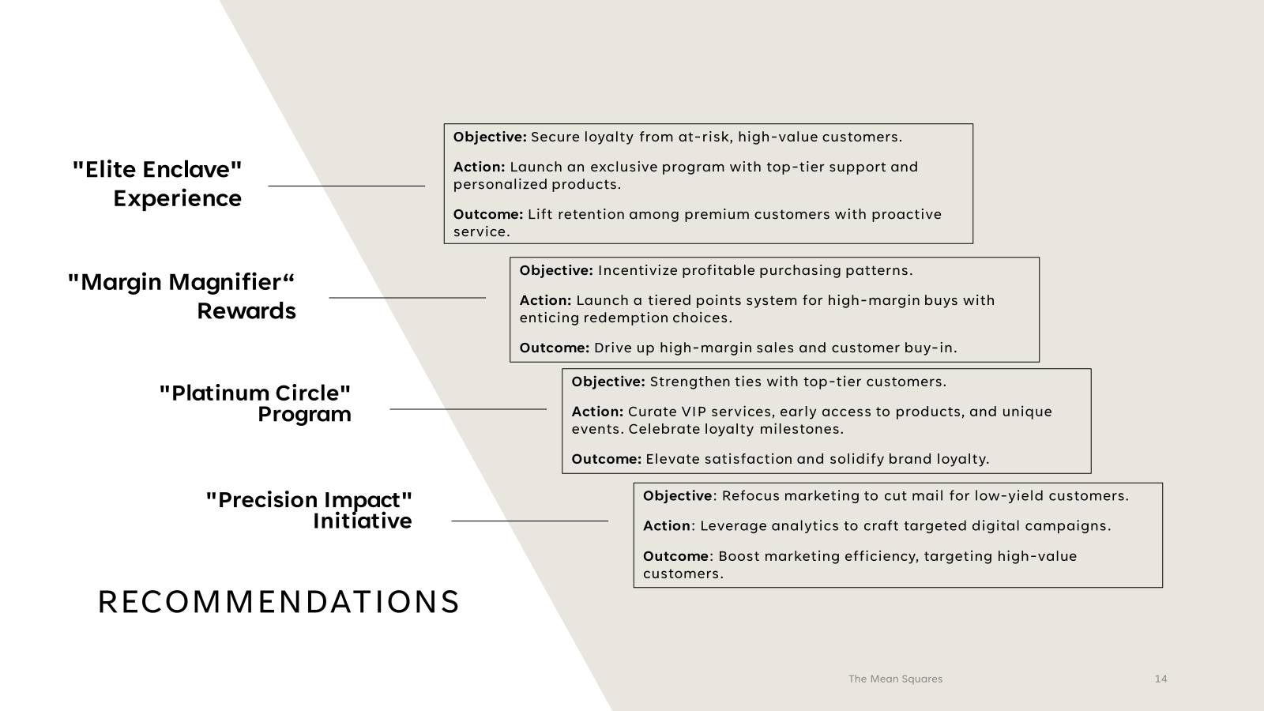
Recommendations
"Precision Impact" Initiative
Objective: Refocus marketing to cut mail for low-yield customers.
Action: Leverage analytics to craft targeted digital campaigns.
Outcome: Boost marketing efficiency, targeting high-value customers.
"Platinum Circle" Program Objective: Strengthen ties with top-tier customers.
Action: Curate VIP services, early access to products, and unique events. Celebrate loyalty milestones.
Outcome: Elevate satisfaction and solidify brand loyalty.
"Margin Magnifier" Rewards
Objective: Incentivize profitable purchasing patterns.
Action: Launch a tiered points system for high-margin buys with enticing redemption choices. Outcome: Drive up high-margin sales and customer buy-in.
"Elite Enclave" Experience
Objective: Secure loyalty from at-risk, high-value customers.
Action: Launch an exclusive program with top-tier support and personalized products. Outcome: Lift retention among premium customers with proactive service.
Notes:
Selective Engagement Initiative: "Precision Impact"
Objective: Sharpen marketing focus by reducing general mail for "Low Retention-Low Margin" customers.
Action: Utilize data analytics to identify engagement patterns that lead to profitable actions and tailor communications to induce these behaviors. Shift investment towards digital channels for more precise targeting and measurement.
Expected Outcome: Improved marketing ROI by concentrating efforts on customers with higher potential for profit and loyalty.
II. High-Value Customer Program: "Platinum Circle"
Objective: Deepen relationships with "High Retention-High Margin" customers.
Action: Offer a curated experience with a dedicated concierge service, priority access to new products, and exclusive events. Introduce a recognition system that acknowledges customer loyalty on special occasions.
Expected Outcome: Enhanced customer satisfaction and loyalty, leading to sustained high retention and margin levels.
III. Margin-Driven Rewards Scheme: "Margin Magnifier"
Objective: Motivate increased spending among high-margin customers with a dynamic rewards structure. Action: Develop a rewards scheme that multiplies points for purchases in high-margin categories. Include redemption options that encourage further high-margin purchases, such as exclusive product bundles or services.
Expected Outcome: A boost in high-margin transactions and deeper engagement with the brand's most profitable offerings.
IV. Exclusive Experience Program: "Elite Enclave"
Objective: Retain "Low Retention-High Margin" customers at risk of churn.
Action: Establish an invitation-only program offering unmatched service levels, like a direct line to senior support, emergency response for service issues, and bespoke product customization. Use predictive analytics to offer preemptive solutions tailored to individual customer needs.
Expected Outcome: Increased retention rates among high-margin customers through anticipatory service and recognition of their value to the company.

Slide 16
appendix

Slide 17
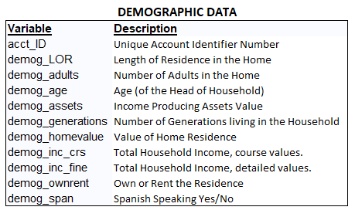
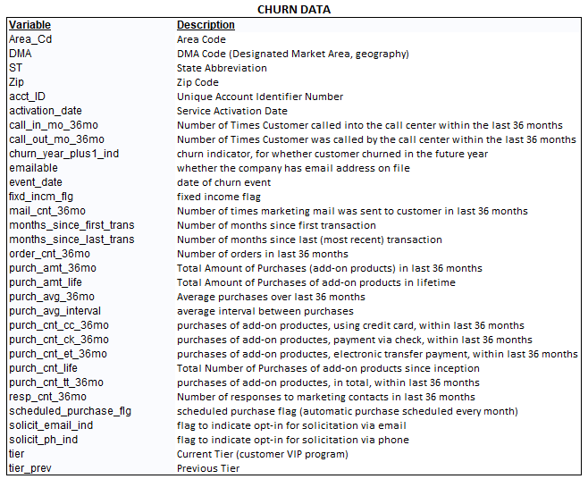
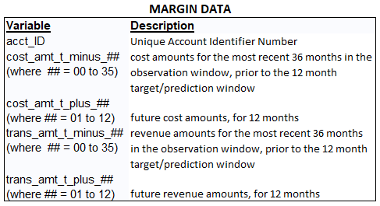
Data dictionaries

Slide 18
DATA PREPRePROCESSING
The margin for the three preceding and validation years was computed by summing the monthly revenue and deducting the corresponding aggregated costs.
Categorical variables of a hierarchical sense were mapped to integers while the rest converted to binary columns using one-hot encoding.
Percentages of total number of add-on products by purchase method were calculated.
The three data files were merged together using acct_ID and contained 239,356 observations and 109 variables.
2-Silver
Tier_Mapped
1
2
Tier
3-Gold
1-Bronze
3
4
5
4-Platnum
5-Diamond
Example of one-hot encoding
ownrent_defowner
1
0
0
0
ownrent_defrenter
0
1
0
0
ownrent_probowner
0
0
1
0
ownrent_probrenter
0
0
0
1
Definite Owner
Definite Renter
Probable Owner
Probable Renter
demog_ownrent
Example of Mapped Tier Variable

Slide 19
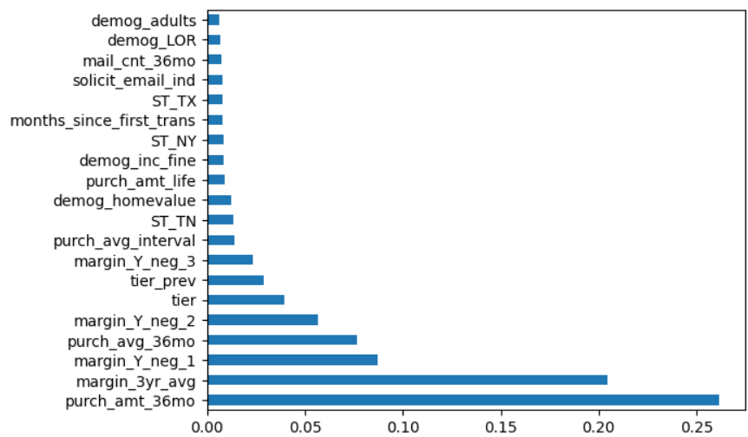
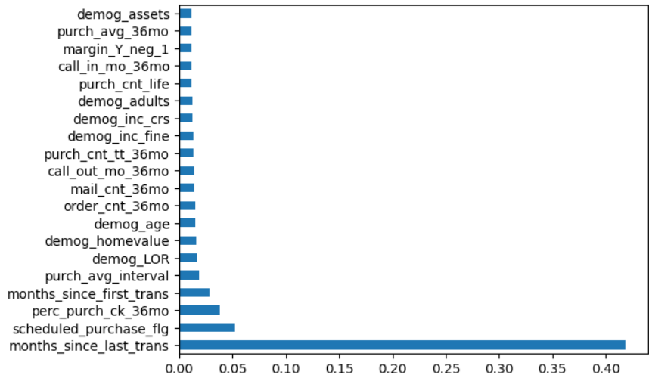
Modeling & EVALUATION
Selected Variables for Margin Model
Combined data was split into 70% for training and 30% for validation.
Extra Trees ensemble was trained to determine top 20 variables.
Using those variables, the Random Forest model performed the best for churn and margin predictions producing the best evaluation metrics.
Margin Model Results
Mean Accuracy: .732
MSE: 2,129,394
Churn Model Results
Mean Accuracy: .876
AUC_ROC: .933
Selected Variables for Churn Model

