Slide 1
From Concept to Company
Peter Hoehn

Slide 2
From Concept to Company
An overview of key steps to turn a novel life sciences solution into a viable, funded and sustainable company, with a focus on:
Understanding the critical unmet need the solution will attempt to solve
Creating an initial target product profile – how the solution will solve the critical unmet need
Developing the value proposition – market sizing, societal and economic impact of addressing the unmet need, competitive advantage, intellectual property, investments required and preliminary forecasting
Communicating the vision and the value – creating a winning pitch deck
Funding pathways
Team and Leadership Attributes
3 Sections
1
2
3
PHCS

Slide 3
From Concept to Company
Unmet Needs and the TPP
PHCS

Slide 4
Unmet Need
“Fall in love with the problem not the solution”
Arguably the most important concept for successful development of a novel life science or medical technology is truly understanding the unmet need that the new product will address
Key questions to answer include:
What is the unmet need? Why is it an unmet need?
What pain, negative outcomes, human suffering, cost does the unmet need cause?
Who cares (most) about the unmet need? How much do they care about it?
What is done now and what is the negative impact of this?
How will your product change patient care and effect a positive impact
How do you know this is an important unmet need?
PHCS

Slide 5
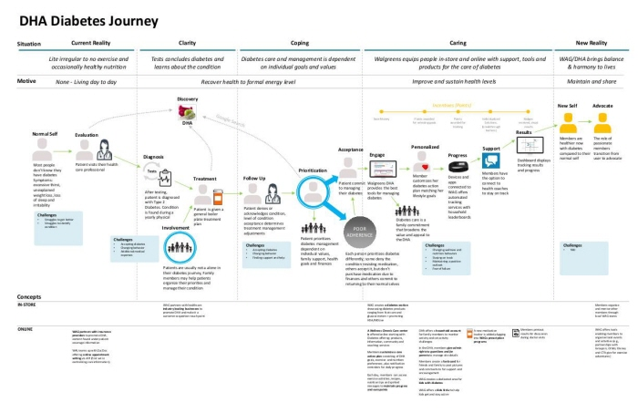
Uncovering Unmet Needs – Mapping the Patient Journey* A patient journey lays out all the steps from initial presentation to diagnosis, treatment and fulfillment and should identify key decision makers and pain points
- EXAMPLE
Key steps of a patient journey include: awareness, diagnosis, initial treatment options, fulfillment / compliance; disease progression; 2nd line treatment, etc
Should depict the key decisions at each juncture, information available to make those decisions, who makes and who influences the decision, and where are the pain points – ie where better information or better options are needed
Should be able to illuminate critical unmet needs, key stakeholders, how your product will fit in and how it will change the journey
PHCS

Slide 6
Patient journey mapping should also identify key stakeholders and decision makers
Stakeholders
Patient
Hospital
Nurse
Caregiver
GP
Payor / Ins Company
Specialist
Lab
Advocacy organization
Government
Stakeholder Unmet Needs
A patient journey can help identify unmet needs and how they impact each stakeholder
Must know what unmet needs you are solving for (eg, efficacy, side effects, cost, ease of use, etc) AND who cares most about this
Typically, patients, doctors and payors define unmet need for a disease area
Identify the most relevant stakeholders for your product – ie those who care the most and will have an influence over decisions impacting potential use of your product*
PHCS

Slide 7

Building a Target Product Profile
A target product profile should serve as the blueprint for the product you are developing
A TPP forces alignment and clear communication around the product being developed, the key features and benefits and the unmet needs being solved for
A TPP must also take into account differentiation – how will you be different than / better than current solutions AND anticipated new solutions
A TPP will evolve over time with more data
At the outset it should clearly state what you are aiming for (the optimal solution) but also include the minimal characteristics needed to be able to effectively deliver on the key unmet needs and be successful
PHCS

Slide 8
Rx Target Product Profile Template
Attribute | Minimally Acceptable | Target
Indication
Target Patient Population
Therapeutic modality
Efficacy
Safety
Dosing/Administration
Ease of use / infrastructure requirements
Mechanism of Action
Health economic value
Patient/Caregiver Benefit
Physician Benefit
Payer Benefit
PHCS

Slide 9
Dx Target Product Profile Template
Attribute | Minimum Acceptable | Target
Description of test
Claim / intended use
Target Patient Population
Gap/Issue Being Addressed by Solution
Test methodology (eg, PCR, IA, Flow, etc)
Test Distribution (eg LDT, one lab, multiple, kit, etc)
Sample prep / logistics requirements
Ease of use / infrastructure requirements
Required clinical performance (sensitivity/spec/PPV/NPV)
Test report requirements
Turn around Time
Clinical Utility
Health economic value
Patient/Caregiver Benefit
Physician Benefit
Payer Benefit (incl who will be the payer)
One of the most critical components for success with a new Dx
PHCS

Slide 10
Critical Input for Diagnostic Development: Clinical Utility
Evidence of Clinical Utility is essential to securing reimbursement and driving adoption of new diagnostic tests
Four Key Pillars of Clinical Utility
Performance
”The ability of a test to discriminate between subclasses of subjects.”
Accuracy
”The ability of a test to accurately and reliably detect a condition when it is present and the absence of a condition when it is not present”
Management
“The extent to which a diagnostic test will lead to a favorable change in clinician management of the patient being tested”
Outcomes
“The extent to which incorporating the test into clinical management will improve outcomes and / or lower costs”
Focused on diagnostic validity – traditional Dx development studies
Focused on how used in practice and expected impact – Will likely need prospective clinical studies
PHCS

Slide 11
From Concept to Company
The Value Proposition
PHCS

Slide 12
Forecasting - Net Sales Funnel
(Yes, you will need a forecast)
Total Population
Prevalence (Total Addressable Market)
Diagnosed
% treated / likely Rx candidates (Serviceable Market)
Market Access
Filters to get to a Net Sales Forecast
Price
Patient Share
Adherence / Compliance
Days of Therapy
Gross sales
Gross to Net (Discounts)
Net Sales
PHCS

Slide 13
Market Sizing: Key Concepts
Addressable market – All patients with the disease or condition who could theoretically benefit from the product
Serviceable market – The actual number of patients who could reasonably get access to the product given diagnosis rates, expected labelling, regulatory approvals, geographic launch, market access / health insurance coverage, numbers expected to be treated by the target physicians, etc
Obtainable market – The projected share of the Serviceable market the product is expected to capture
Dollar sizing of markets is typically based on the expected price of the new product (ie. If the addressable market is 10 Million and expected / projected price of the product is $50,000 per year, the Addressable Market is $500 Billion)
Serviceable Market is a much more accurate portrayal of the size of the opportunity – important to capture the assumptions around serviceable market calculations
Obtainable market assumes that the product will deliver on the target product profile – ok to be aggressive in preliminary assumptions but also should be realistic, taking into account market conditions, reimbursement, competition, etc
PHCS

Slide 14
Market Sizing Example
Peak Forecast Assumptions
$50B Total Addressable Market (US)
3M adults in US with disease XYZ
Total prevalence X expected price – signifies that the product will compete in a large market
$20B Serviceable Market
1.2M diagnosed, receiving care, etc
Total number diagnosed, receiving care, etc; important to have well grounded assumptions starting with epi data
$4.2B
Obtainable Market
Numbers expected to be treated with the product X net price
Should represent peak forecast; ok to be aggressive but must be realistic as well; should be calculated after all forecast inputs completed
PHCS

Slide 15
Market Access and Pricing – Key Considerations
Pricing and reimbursement is one of the most critical and dynamic components to commercial success - must consider:
The Clinical Benefit – eg effect size, number of responders, clinical impact, etc
Clinical Benefit in context of other current or expected treatment options
Economic impact – what would be the health economic benefit of using the product (eg reduced hospitalizations, fewer surgeries, etc)
Who will l be the payor; what is their current and expected paying habits for similar drugs in the class
Reasonable analogs – ie What is the pricing for other (current or future products)
What is the expected discount required – ie the discount needed for health plans to agree to cover
What type of data will be needed to support market access assumptions
What is the expected patient compliance / adherence
P&R assumptions to be built out and solidified over a long period of time
For initial forecasting must have a reasonable assumption of P&R based on current product and market knowledge – assumptions will not be final but must be reasonable and defendable
P&R for diagnostic tests can be even more complicated and more challenging
PHCS

Slide 16
Dx Reimbursement process can be cumbersome and lengthy
Even with appropriate clinical validity and clinical utility evidence, reimbursement for new diagnostics can be a lengthy and challenging process for a variety of reasons:
Complex and diverse reimbursement pathways consisting of many stakeholders and very different market to market
Different pathways based on site of testing – eg outpatient or in hospital
Different process that Rx - not typically assessed in parallel and Dx reimbursement often takes longer
Clinical utility evidence required – but limited guidance on what is sufficient
Traditionally a cost-based reimbursement system, often with low reimbursement levels
Difficult for reviewers to assess value of innovative solutions with long term benefit
Reimbursement is generally for the test type, not a specific brand
If you are developing a new Dx, every sophisticated investor will challenge your P&R assumptions
PHCS

Slide 17
Competitive Landscaping – Some Key Points
It is imperative to understand the current and emerging competitive landscape surrounding your product
In order to project an expected market share and price, must understand the competitive landscape
Should include current products with the same indication or use, products with similar indications or claims and used “off-label”, other products in development and current and future non-therapeutic solutions
For products in development in same class or most likely to compete should have an initial TPP comparison
Saying there will be no competition is not a good approach – there is always competition so must understand and communicate why stakeholders will choose your product vs any other alternative
Competition is a critical input to forecasting that will get refined over time – Do not need to be exhaustive for initial forecasting but should assess current products, near-term products and similar MOA products.
PHCS

Slide 18
Competitive TPP Assessment Template
Can use for comparison of key TPP inputs against most likely and / or most similar competitors
Attribute | Company Product | Product X | Product Y | Product Z
Efficacy
Safety / Tolerability
Dosing/Administration
Ease of use
Cost /Health economic value
PHCS

Slide 19
Intellectual Property
Every investor will ask about IP immediately
In life science, medical technology, Biotech, etc, IP generally means patents
For Rx development, IP generally means composition of matter (method of use, formulation or regulatory IP is important and could be sufficient, but will need to explain why)
IP for diagnostics is more nebulous and challenging (CoM generally does not exist, method patents may be sufficient) but can be successful with less entrenching IP estate
Goal is issued patents in major markets with clear, unencumbered rights
Typically will need to get rights from the University
IP is not one and done; will need an enduring IP strategy
Invest early in an IP attorney
PHCS

Slide 20
Development/Regulatory/Commercialization Roadmap
Must understand required pathway to commercial approval
Although there will still be many unknowns and many assumptions will change, should have a high-level projection of timing and cost to get to commercialization
Must understand key milestones and base funding needs / requests on achieving the milestones
Early stage funding is largely about buying down risk – ie. fund to achieve a milestone which, when met, means probability of success (and valuation) goes up
Key milestone
2027 2028 2029 2020 2031 2032 2033
Rx
Development
Preclinical Development
Phase I
Phase II
Phase III
Drug Launch
Projected
Budget
$__M
$__M
$__M
$__M
$__M
PHCS

Slide 21
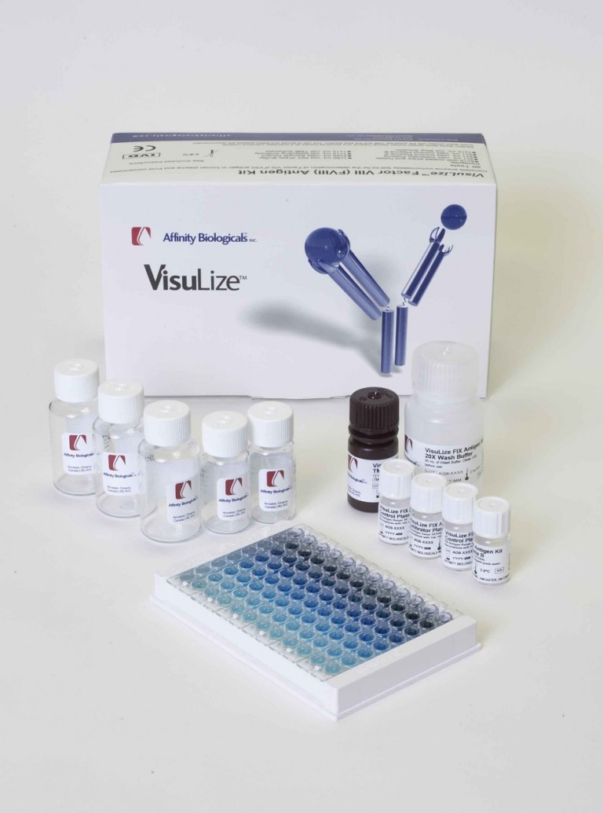
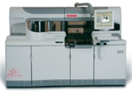
Diagnostic Regulatory Pathway Decisions can be more complex: IVD Kit vs LDT
In Vitro Diagnostic (IVD) Kit
Laboratory Developed Test (LDT)
IVD’s that are intended for clinical use and are designed, manufactured, and used within a single laboratory that is certified under the CLIA
Reagents, components, software, etc; intended to be used on a specific instrument
Must be FDA approved
Does not have to be FDA approved (but can be)
LDT’s typically have a shorter path to market because no regulatory approval required - However, distribution options may be limited and could pose a commercial disadvantage vs kits
FDA path could be a PMA, de novo or 510K – de novo and PMA generally connote something novel (no precedent) but a much more difficult pathway
Some Algorithms, decision support and interpretation tools may also not need to be FDA approved
Must understand pro’s and con’s of each pathway and decide (or plan for both)
Timelines and funding requirements (and commercial assumptions) should be based on desired pathway
PHCS

Slide 22
Pulling it all together - Generating a Revenue Forecast
Once have assumptions for the key forecast filters can generate an initial revenue forecast
For initial forecast, recommend assuming peak year sales for all filter assumptions
But must project time to peak and build over time
New Rx therapies on average take 7 – 10 years to hit peak sales; Dx typically longer but generally do not suffer rapid LOE decline
Generally, assume 3 growth phases: 1) initial slow ramp early years; 2) faster build mid years ; 3) slower build outer years (Unless have competitive info, assumptions about new data, or other factors that will impact growth)
Although not necessary for pitch decks, should have a sense of commercialization costs and potential challenges
Year on Year growth slows
Period of fastest growth
Once have year over year revenue forecast and initial projected end-to end budget, can model financial returns (eg ROI, NPV, etc)
PHCS

Slide 23
From Concept to Company
Pitch Deck, Funding and Team
PHCS

Slide 24
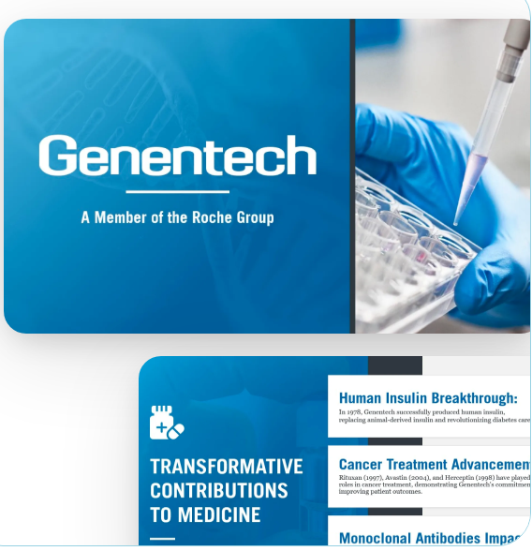
Creating a Pitch Deck – Some Key Points
Keep it simple – clear, concise and compelling
More visuals and less words, consistent and visually appealing
Have slide titles or call outs on each slide that capture the key takeaway
Communicate why this, why now and why you
Use data to back your points – clinical and commercial
Be aspirational but realistic
Communicate a clear, milestone based ask
Be able to present it in 3 mins without slides if needed
PHCS

Slide 25
Creating a Pitch Deck – Core Elements
Intro that includes a compelling hook and / or vision
Present the problem (unmet needs) – present it in human terms and illustrate the suffering, cost, etc; convey how important it is and to whom and how you know this, make it personal if it is
Introduce your solution – what you are building, why it will solve the problem, why it is different then current or future competition (why now); what stage it is in, etc
Highlight the science – the MOA, biomarker, assay differentiation etc (show the novel science that is behind the product)
Show key data that supports your science (including data that may not be yours but supports why this is a good approach)
Include some detail (in simple format) as to why your product will be different than, better then the competition
Outline the development and regulatory pathway
Capture the business opportunity including business model - how you will make money, market sizing and preliminary forecast (and be prepared to answer questions regarding exit strategy)
Present the Team (including Advisors)
Chart out the high-level development and regulatory road map and milestones over the next 12 – 24 month
Make the ask – How much you are raising; where will it get you and what will this mean (POS) once you get to this point
PHCS

Slide 26
Funding Pathways
Typical Funding Pathway
Some Key Points
VC’s do not typically fund very early stage companies
Friends & Family are the best resource to get initial funding for basic operations
Must be comfortable approaching and asking your network and expanding your network
Create a systematic method to approaching angel investors
If have a compelling, transformational platform can approach VC’s – but must be the right ones
Series C
VC, Strategic, IPO
Series B
VC
Series A
VC
Seed
Angels / VC / F&F
Pre seed
Friends & family
Most relevant for academic based start-ups
PHCS

Slide 27
Funding Pathways – Angel Investors
Angel investors are high net worth individuals who invest their own money directly, mostly in pre seed or seed
Typically, Angels invest as part of an Angel Network
There are many Angel Networks to tap into – eg, university based, city based, technology or sector
Life Science focused ones: LifeScience Angels, Bio Angels, Med Tech Innovators, Angel MD, Health Tech Capital
Many have on-line systems to connect through, seek funding and apply for pitch events
Recommend Steps:
Register with Angel sourcing programs such as: Gust | The best place to start, grow, and fund your venture.
Search and identify Angel Networks that seem most relevant to your product based on description or prior investments, or where you have a connection (eg University, City, region, etc)
Through Angel Network web sites submit information and / or a request for funding or apply to participate in an upcoming pitch event
Can also use dedicated funding platforms, eg: https://askforfunding.com/ ; AngelList – Build, Lead, Invest
Take many, many swings, find connections, relentlessly follow-up and be persistent
When possible, ask for feedback and advice (and listen); also ask for more possible connections
PHCS

Slide 28
Building the Team
Most ventures have co-founders – identify the right partner co-founder early
Assembling an inspiring team is one of the most critical first steps of a new venture
This is challenging though when there is no money for salaries – Develop an equity based advisory agreement and secure impressive, relevant advisors
When building out team and advisors, find people who complement the co-founders – different backgrounds, experiences and perspectives
Potential investors will want to know the level of dedication (time) and commitment of the team – At some point will want a fully dedicated, full time CEO with “skin in the game”
The Founders and early team leaders must be vocal, consistent and exuberant champions for the venture (if you don’t believe and are willing to take on risk and an all-consuming passion, why would investors and partners?)
If have limited experience, consider applying for one of the many start-up incubators that teach basic CEO and early venture leadership
Start-up Incubator Example:
The Institute for Life Science Entrepreneurship has opened applications for the 2026 Entrepreneur Training Program (ETP)
Key Information:
Info Webinar: Learn more about ETP, last year’s outcomes, and how the program can help turn ideas or ventures take the next step
Date: May 20, 12:00–1:00 pm ET
Register Here
ETP Application Form
Application Deadline: July 17, 2026 – 11:59 pm ET
PHCS

Slide 29
Thank you!
PHCS

