Slide 1

AI-Powered Supply Chain
Risk Intelligence Assistant

Slide 2
Business Problem
Prodapt
Supply chain managers spend significant time investigating operational risks across fragmented systems — without a unified intelligence layer.
Challenges
Current Pain
What We Need
Supplier delays increasing for critical components
Port congestion impacting shipment schedules
Warehouse inventory approaching stockout levels
Transport costs spiking unexpectedly
Demand spikes causing fulfillment bottlenecks
Threshold alerts & manual analysis only
Data scattered across ERP, WMS, TMS, vendor portals
No proactive risk intelligence
Hours spent correlating signals manually
No explainable recommendations
Natural language query interface
Semantic incident retrieval
Multi-agent risk analysis
Explainable mitigation recommendations
Real-time anomaly detection
Traditional monitoring systems cannot proactively detect, correlate, or recommend actions for emerging supply chain risks.
2

Slide 3
Proposed Solution
Prodapt
Our Approach
Natural Language Queries
Semantic Incident Retrieval
Operations teams describe supply chain problems conversationally — no SQL, no dashboards
Retrieves historical logistics disruptions by conceptual similarity using hybrid search
A composite AI system that thinks like a supply chain operations team.
Multi-Agent AI
Orchestrator routes to Supplier Risk, Shipment Analysis, or Inventory Intelligence agents based on query intent. Hybrid RAG Retrieval
ChromaDB dense + BM25 sparse + RRF fusion + cosine rerank → top-5 context. Corrective RAG (CRAG)
Auto-reformulates low-scoring queries for better retrieval. HILT — Human in the Loop
HIGH severity alerts pause for human approval before dispatch.
Explainable Recommendations
Evaluation Framework
Every mitigation recommendation cites source documents [Doc 1]...[Doc N]
DeepEval + RAGAS with 50 golden Q&A pairs grounded in real dataset values
3

Slide 4
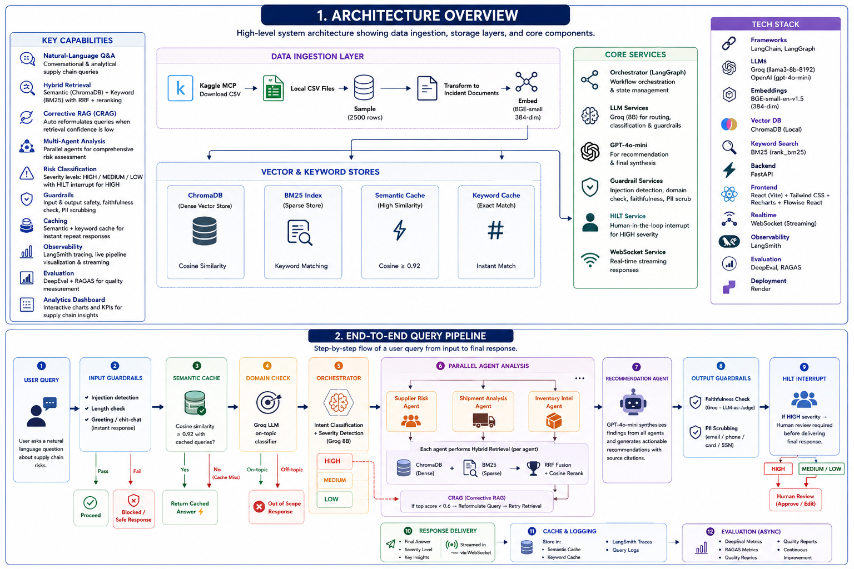
System Architecture
Prodapt
High-level view showing data ingestion, storage layers, multi-agent pipeline, and core components
4

Slide 5
Data Engineering — CSV to Vector DB
Prodapt
Chunking strategy: Row-level NL transformation — each CSV row becomes one self-contained incident document
①
②
③
④
⑤
Load
Sample
Transform
Embed
Store
pandas CSV reader
Kaggle MCP
180k DataCo rows
100 Fashion SKUs
2,500 rows
random_state=42
Balanced coverage
Fast ingestion
Row → NL incident
'Late delivery LATAM
via First Class...'
Our chunking strategy
fastembed
BAAI/bge-small-en
384-dim vectors
Local ONNX — free
ChromaDB
Cosine similarity
BM25 sparse index
Persist to disk
▶
▶
▶
▶
Why row-level chunking?
Why fastembed + BAAI/bge?
Why ChromaDB + BM25 together?
Each CSV row is already a self-contained incident record (50-150 tokens). Recursive chunking would split related fields apart, destroying semantic coherence. Row-level is the optimal strategy for structured tabular data.
Runs locally as ONNX — zero API cost during ingestion. BGE models are specifically trained for retrieval (not just similarity), scoring higher on BEIR benchmarks vs all-MiniLM. Same 384-dim, better retrieval quality.
Dense vectors miss exact keyword matches ('LATAM', 'First Class'). BM25 catches them. RRF fusion merges both ranked lists — best of semantic + keyword retrieval. Neither alone achieves the same precision.
5

Slide 6
Multi-Agent Design — LangGraph Pipeline
Prodapt
User Query
Input
Guardrails
Cache
Lookup
Orchestrator
Recommendation
Agent
Natural language
via WebSocket
Injection · length
Domain check
Semantic ≥0.92
<100ms hit
Intent + Severity
LangGraph routing
Synthesis
Faithfulness check
Supplier Risk Agent
Shipment Analysis
Inventory Intelligence
Fraud · lead times
delivery performance
Late delivery rates
carrier performance
Stockout risk
demand spikes
Hybrid Retrieval: Dense (ChromaDB top-20) + Sparse (BM25 top-20) → RRF Fusion (k=60) → Cosine Rerank top-5 → CRAG if score < 0.6
SQLite Checkpointer
LLM Task Routing
HILT — Human Review
LangSmith Tracing
Persists full pipeline state between turns — enables multi-turn memory and HILT resume
Routing tasks → Groq 8B (fast). Reasoning/Recommendation/Judge → GPT-4o-mini (quality)
HIGH severity: LangGraph interrupt_before('recommendation') — human approves before dispatch
Every agent call, LLM prompt, retrieval context, token count and latency automatically traced
6

Slide 7
Technology Stack
Prodapt
Agent Framework
LLM Providers
Retrieval & Embeddings
LangGraph — DAG pipeline with conditional edges
SqliteSaver checkpointer — multi-turn memory
4 specialist agents + orchestrator
interrupt_before for HILT
GPT-4o-mini — reasoning, recommendation, judge
Groq llama-3.1-8b — fast routing & classification
Groq llama-3.3-70b — mid-weight fallback
Fallback chain: OpenAI → Groq 70B → Groq 8B
fastembed + BAAI/bge-small-en (384-dim)
ChromaDB — persistent vector store
rank-bm25 — sparse keyword index
RRF fusion + cosine reranker + CRAG
Backend / API
Frontend
Evaluation
FastAPI + uvicorn + WebSocket
Pydantic schemas for all endpoints
LangSmith tracing — full observability
SQLite for feedback + session state
React 18 + Vite + Tailwind CSS
Live LangGraph DAG visualization
Run Quality panel (0-100 score)
5 pages: Chat, Flow, Admin, Analytics, Present
DeepEval — Faithfulness, Relevancy, Hallucination
RAGAS — Context Precision & Recall
50 golden Q&A pairs (real dataset values)
LLM-as-judge faithfulness on every live query
7

Slide 8
Evaluation Results
Prodapt
DeepEval + RAGAS — 50 golden Q&A pairs grounded in real DataCo and fashion dataset values
0.84
Faithfulness
Target ≥ 0.80 ✓
0.12
Hallucination
Target ≤ 0.20 ✓
50
Golden Q&A Pairs
Real dataset values
2×
Eval Frameworks
DeepEval + RAGAS
8

Slide 9
Live Demo
Prodapt
01
02
03
04
05
Ingest Data
Ask a Query
View Pipeline
Fraud Alert
Analytics
Admin page → select DataCo CSV → Process & Load → watch live pipeline progress
Chat: 'Which shipping mode has highest late delivery rate?' — watch Flow page DAG animate
Flow page: live node activation, Run Quality score, faithfulness result, models used
Chat: 'I have a suspected fraud order from LATAM worth $50,000' — triggers HIGH severity
Analytics page: late delivery by market, fraud by region, shipment mode breakdown
Sample queries available in presentation_queries.txt — 18 curated questions covering all agent paths, HILT trigger, and cache demo
9

Slide 10
Q & A
Questions, discussion, and feedback
Prodapt.
10

Slide 11
Thank You
Sai Krishna Gangadharuni
AI-Powered Supply Chain Risk Intelligence Assistant
Prodapt · June 2026
Prodapt.
www.prodapt.com

