Slide 1
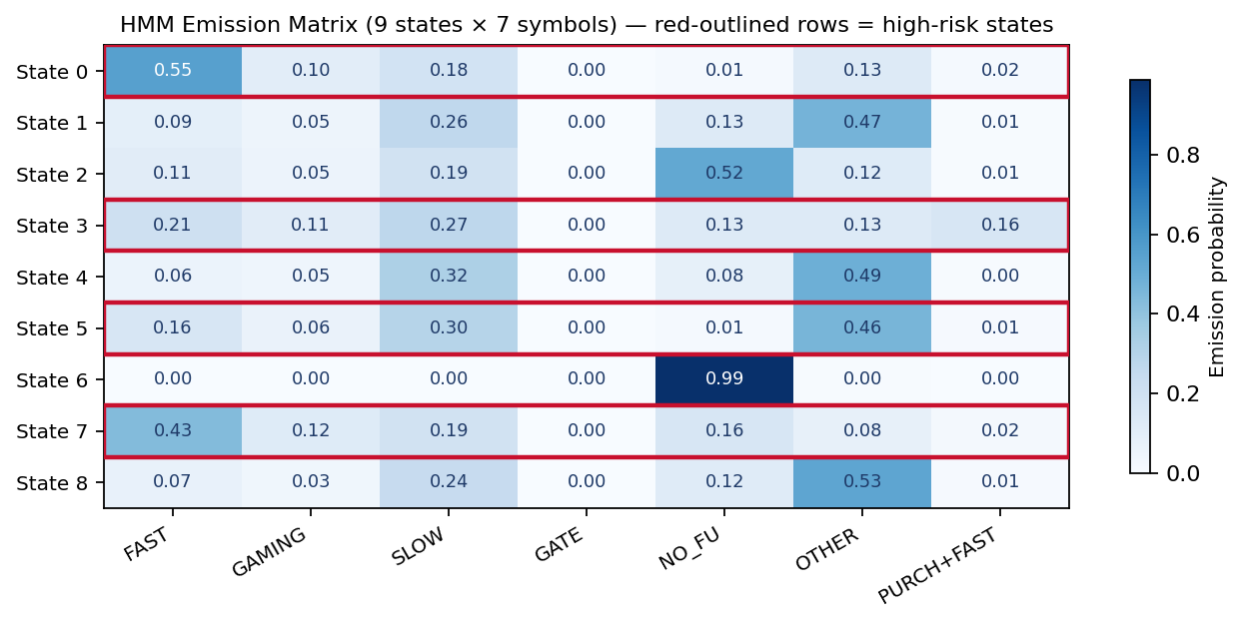
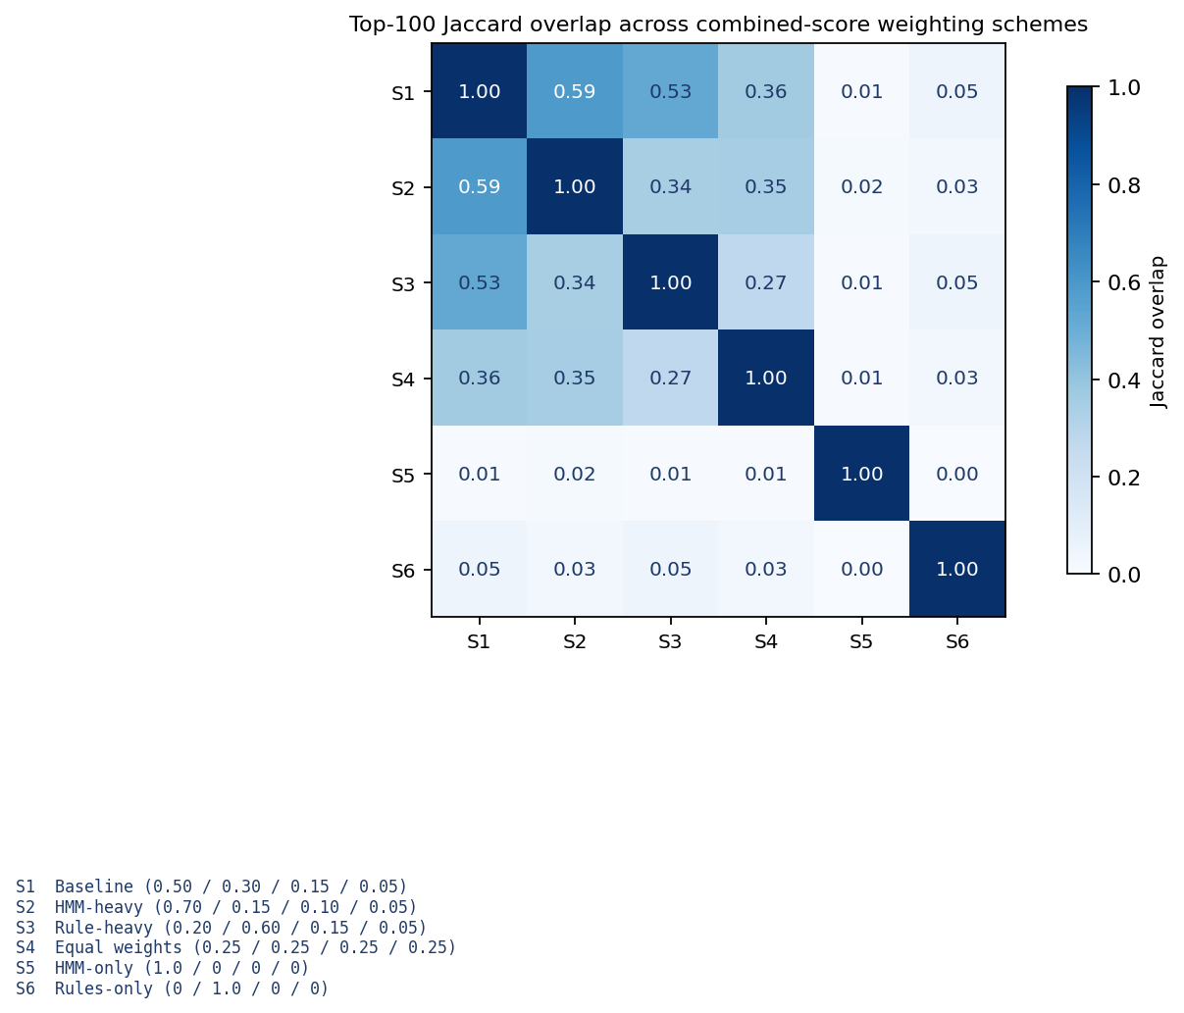
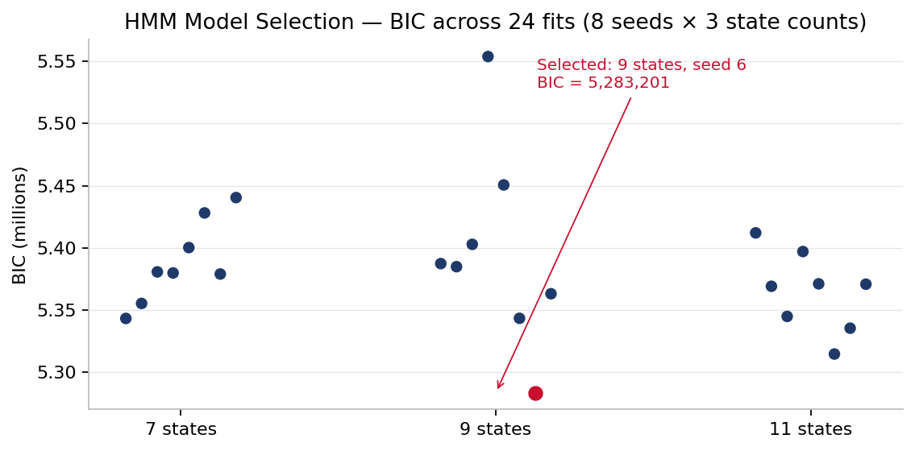
Inspector-Triggered Ticket-Purchase Fraud Detection
A Hidden Markov Model pipeline over 20 GB of mobile-ticketing logs
Team 2 · Daniel Duah · Kofi Sarfo · Martin Thulani Milanzi · Sai Krishna Vaddeboina · Sai Priya Malyala WPI MS Fintech · BUS 6550 Capstone · Sponsors: Masabi × Gemsen · April 2026
20 GB
6.4 M
98,241
9
100 / 100
88,328
raw input
activation events
HMM-eligible riders
latent states (BIC)
rules ∩ HMM overlap
HMM-only candidate pool
Research Questions
Symbol Vocabulary (First-Match-Wins)
Rule ∩ HMM — Two Shortlists
RULES (R)
HMM (H)
01
DESCRIPTIVE
What does the activation-to-scan gap distribution look like, and is there a measurable sub-population below the fare-evasion cutoff?
FAST
handheld scan ≤ 15 s
GAMING
scan 16 – 30 s (dodge band)
10,708
88,328
SLOW
scan 30 – 300 s
R ∩ H
100 / 100
02
MODELLING
Can an HMM fit to per-rider symbol sequences identify a latent fraud-shaped state that rule heuristics miss, and how stable is that structure across model-selection choices?
GATE
gate scan ≤ 120 s
NO-FU
no handheld or gate scan
03
VALIDATION
Where do the two layers (rules and HMM) agree, and what unique population does each identify?
OTHER
fall-through catch-all
R (rule pool) and H (HMM-only pool) are disjoint by construction; the 100/100 overlap is on the combined top-100 shortlist — evidence the HMM confirms the rules and also surfaces 88K new candidates with zero rule infractions.
PURCHASE→FAST
buy ≤ 60 s before activation
Key Findings
Data Flow — Raw CSVs to Shortlist
Fitted HMM · 9 States × 7 Symbols
1.0000
top posterior dominance (HMM-only shortlist)
01 INGEST
4 CSVs · 20 GB · 6.4 M events
0.9999
median posterior dominance (top 100 HMM-only)
02 SYMBOLIZE
7-symbol vocabulary per event
74 / 100
shortlist retention under HMM-heavy weighting
Wed · Providence
strongest temporal / geographic concentration
03 FIT HMM
3 states × 8 seeds · BIC pick
04 SCORE
Posterior · rule · gaming · burst
Weight Sensitivity (6 Schemes)
05 SHORTLIST
R ∩ H · H \ R supplementary
High-risk states (0, 3, 6, 7) concentrate on FAST / GAMING / PURCHASE→FAST.
Model Selection — BIC Across 24 Fits
State Topology — 4 High-Risk / 5 Benign
S0
S1
S2
S3
S4
S5
S6
S7
S8
Conclusions & Recommendations
FAST
NO-FU
SLOW
GAMING
NO-FU
SLOW
PRCH→F
GATE
OTHER
Rules catch the obvious cases; the HMM scores every eligible rider on how often their sequence occupies high-risk latent states — a defensible, model-based extension.
↳ Dispatch inspectors to Providence/Stoughton Wed evenings.
↳ Retrain the HMM quarterly on a rolling 4-month window.
↳ Extend activation feed with station_id / line_id for geo features.
9 states, seed 6 · 31,000 BIC points clear of runner-up.
High-risk state
Benign / routine
ACKNOWLEDGEMENTS
REPRODUCIBILITY
Charlie Ko (Masabi) and LF Arsenault (Gemsen) for sponsor guidance, data access, and review comments that shaped the HMM-seed sweep, weight-sensitivity analysis, and the symbol-vocabulary design.
Full methodology → UC2_v2_Report.docx
Exact counts, memory, runtimes → RUN_RESULTS.md
Notebooks 01 – 04 run in sequence · deterministic with fixed seeds 0 – 7.

