Slide 1
ITC538 Programming in Java 1
Lecture-02
[Topic-03]
Selection
[Topic-04]
Looping
(Based on Chapters-03-and-05)

Slide 2
The boolean Type and Operators
Often in a program you need to compare two values, such as whether i is greater than j.
Java provides six comparison operators (also known as relational operators) that can be used to compare two values. The result of the comparison is a boolean value: true or false.
boolean b = (1 > 2);

Slide 3
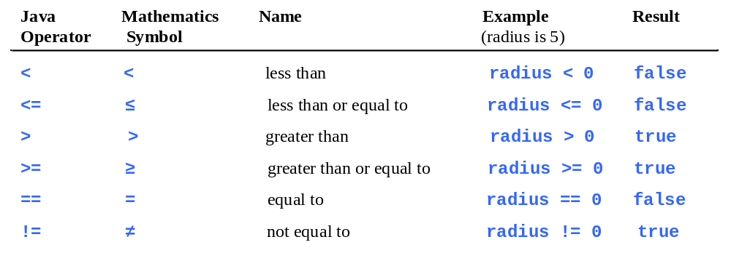
Comparison Operators

Slide 4
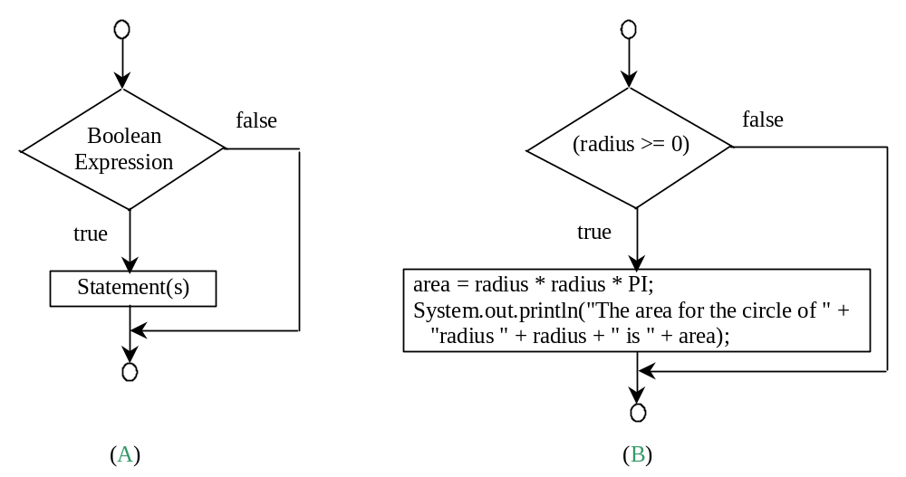
One-way if Statements
if (radius >= 0) {
area = radius * radius * PI;
System.out.println("The area"
+ " for the circle of radius "
+ radius + " is " + area);
}
if (boolean-expression){
statement(s);
}

Slide 5


Note

Slide 6
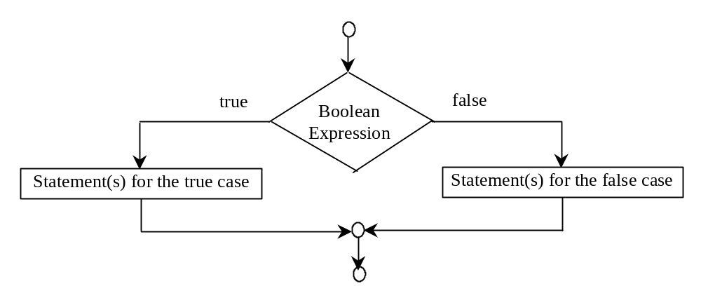
The Two-way if Statement
if (boolean-expression) {
statement(s)-for-the-true-case;
}
else {
statement(s)-for-the-false-case;
}

Slide 7
if-else Example
if (radius >= 0) {
area = radius * radius * 3.14159;
System.out.println("The area for the "
+ "circle of radius " + radius +
" is " + area);
}
else {
System.out.println("Negative input");
}

Slide 8
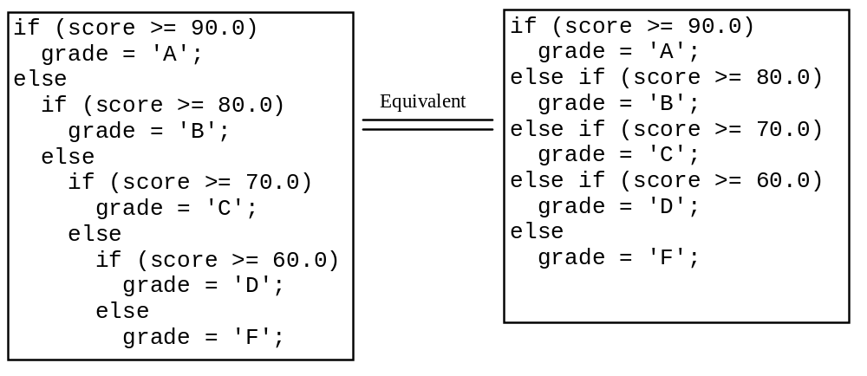
Multiple Alternative if Statements

Slide 9
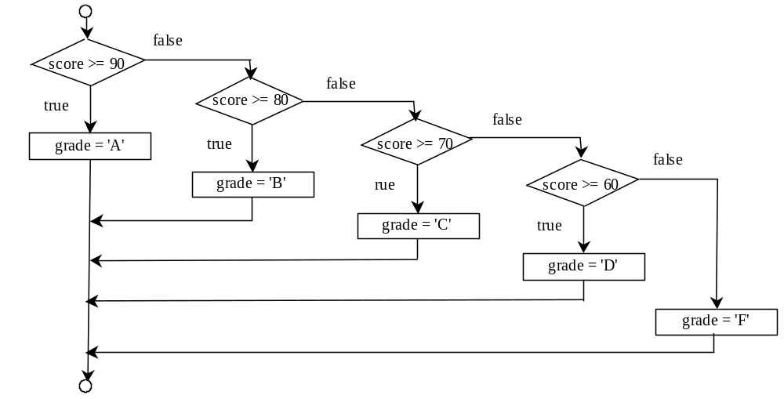
Multi-Way if-else Statements

Slide 10
Trace if-else statement
animation
Suppose score is 70.0
The condition is false
if (score >= 90.0)
grade = 'A';
else if (score >= 80.0)
grade = 'B';
else if (score >= 70.0)
grade = 'C';
else if (score >= 60.0)
grade = 'D';
else
grade = 'F';

Slide 11
Trace if-else statement
animation
Suppose score is 70.0
The condition is false
if (score >= 90.0)
grade = 'A';
else if (score >= 80.0)
grade = 'B';
else if (score >= 70.0)
grade = 'C';
else if (score >= 60.0)
grade = 'D';
else
grade = 'F';

Slide 12
Trace if-else statement
animation
Suppose score is 70.0
The condition is true
if (score >= 90.0)
grade = 'A';
else if (score >= 80.0)
grade = 'B';
else if (score >= 70.0)
grade = 'C';
else if (score >= 60.0)
grade = 'D';
else
grade = 'F';

Slide 13
Trace if-else statement
animation
Suppose score is 70.0
grade is C
if (score >= 90.0)
grade = 'A';
else if (score >= 80.0)
grade = 'B';
else if (score >= 70.0)
grade = 'C';
else if (score >= 60.0)
grade = 'D';
else
grade = 'F';

Slide 14
Trace if-else statement
animation
Suppose score is 70.0
Exit the if statement
if (score >= 90.0)
grade = 'A';
else if (score >= 80.0)
grade = 'B';
else if (score >= 70.0)
grade = 'C';
else if (score >= 60.0)
grade = 'D';
else
grade = 'F';

Slide 15
Common Errors
Adding a semicolon at the end of an if clause is a common mistake.
if (radius >= 0);
{
area = radius*radius*PI;
System.out.println(
"The area for the circle of radius " +
radius + " is " + area);
}
This mistake is hard to find, because it is not a compilation error or a runtime error, it is a logic error.
This error often occurs when you use the next-line block style.
Wrong

Slide 16
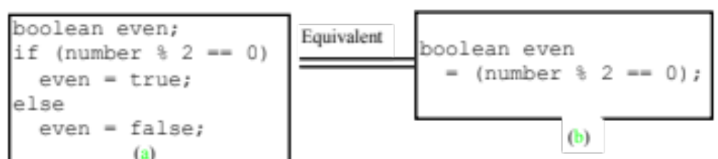
TIP

Slide 17

CAUTION

Slide 18
Logical Operators
Operator Name
! not
&& and
|| or
^ exclusive or

Slide 19
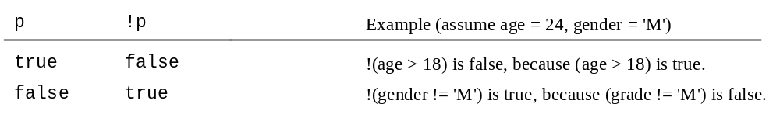
Truth Table for Operator !

Slide 20
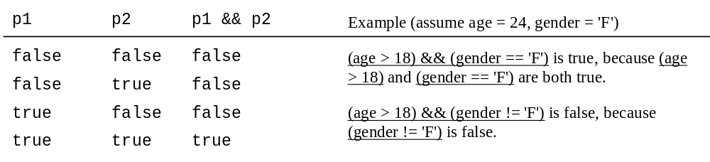
Truth Table for Operator &&

Slide 21
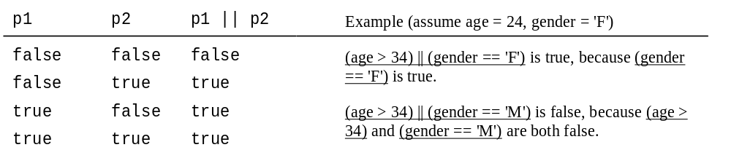
Truth Table for Operator ||

Slide 22
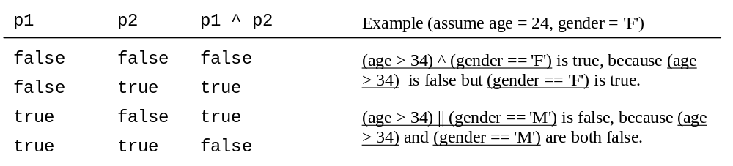
Truth Table for Operator ^

Slide 23
Examples
System.out.println("Is " + number + " divisible by 2 and 3? " + ((number % 2 == 0) && (number % 3 == 0)));
System.out.println("Is " + number + " divisible by 2 or 3? " + ((number % 2 == 0) || (number % 3 == 0)));
System.out.println("Is " + number + " divisible by 2 or 3, but not both? " +((number % 2 == 0) ^ (number % 3 == 0)));

Slide 24
switch Statement
The switch-expression must yield a value of char, byte, short, or int type and must always be enclosed in parentheses.
switch (switch-expression) {
case value1: statement(s)1;
break;
case value2: statement(s)2;
break;
…
case valueN: statement(s)N;
break;
default: statement(s)-for-default;
}
The value1, ..., and valueN must have the same data type as the value of the switch-expression. The resulting statements in the case statement are executed when the value in the case statement matches the value of the switch-expression. Note that value1, ..., and valueN are constant expressions, meaning that they cannot contain variables in the expression, such as 1 + x.

Slide 25
switch Statement Rules
The keyword break is optional, but it should be used at the end of each case in order to terminate the remainder of the switch statement. If the break statement is not present, the next case statement will be executed.
switch (switch-expression) {
case value1: statement(s)1;
break;
case value2: statement(s)2;
break;
…
case valueN: statement(s)N;
break;
default: statement(s)-for-default;
}
The default case, which is optional, can be used to perform actions when none of the specified cases matches the switch-expression.
The case statements are executed in sequential order, but the order of the cases (including the default case) does not matter. However, it is good programming style to follow the logical sequence of the cases and place the default case at the end.

Slide 26
Trace switch statement
animation
Suppose ch is 'a':
switch (ch) {
case 'a': System.out.println(ch);
case 'b': System.out.println(ch);
case 'c': System.out.println(ch);
}

Slide 27
Trace switch statement
animation
ch is 'a':
switch (ch) {
case 'a': System.out.println(ch);
case 'b': System.out.println(ch);
case 'c': System.out.println(ch);
}

Slide 28
Trace switch statement
animation
Execute this line
switch (ch) {
case 'a': System.out.println(ch);
case 'b': System.out.println(ch);
case 'c': System.out.println(ch);
}

Slide 29
Trace switch statement
animation
Execute this line
switch (ch) {
case 'a': System.out.println(ch);
case 'b': System.out.println(ch);
case 'c': System.out.println(ch);
}

Slide 30
Trace switch statement
animation
Execute this line
switch (ch) {
case 'a': System.out.println(ch);
case 'b': System.out.println(ch);
case 'c': System.out.println(ch);
}

Slide 31
Trace switch statement
animation
Execute next statement
switch (ch) {
case 'a': System.out.println(ch);
case 'b': System.out.println(ch);
case 'c': System.out.println(ch);
}
Next statement;

Slide 32
Trace switch statement
animation
Suppose ch is 'a':
switch (ch) {
case 'a': System.out.println(ch);
break;
case 'b': System.out.println(ch);
break;
case 'c': System.out.println(ch);
}

Slide 33
Trace switch statement
animation
ch is 'a':
switch (ch) {
case 'a': System.out.println(ch);
break;
case 'b': System.out.println(ch);
break;
case 'c': System.out.println(ch);
}

Slide 34
Trace switch statement
animation
Execute this line
switch (ch) {
case 'a': System.out.println(ch);
break;
case 'b': System.out.println(ch);
break;
case 'c': System.out.println(ch);
}

Slide 35
Trace switch statement
animation
Execute this line
switch (ch) {
case 'a': System.out.println(ch);
break;
case 'b': System.out.println(ch);
break;
case 'c': System.out.println(ch);
}

Slide 36
Trace switch statement
animation
Execute next statement
switch (ch) {
case 'a': System.out.println(ch);
break;
case 'b': System.out.println(ch);
break;
case 'c': System.out.println(ch);
}
Next statement;

Slide 37
Formatting Output
Use the printf statement.
  System.out.printf(format, items);
Where format is a string that may consist of substrings and format specifiers. A format specifier specifies how an item should be displayed. An item may be a numeric value, character, boolean value, or a string. Each specifier begins with a percent sign.

Slide 38

Frequently-Used Specifiers
Specifier Output Example
%b a boolean value true or false
%c a character 'a'
%d a decimal integer 200
%f a floating-point number 45.460000
%e a number in standard scientific notation 4.556000e+01
%s a string "Java is cool"

Slide 39
Operator Precedence
var++, var--
+, - (Unary plus and minus), ++var,--var
(type) Casting
! (Not)
*, /, % (Multiplication, division, and remainder)
+, - (Binary addition and subtraction)
<, <=, >, >= (Comparison)
==, !=; (Equality)
^ (Exclusive OR)
&& (Conditional AND) Short-circuit AND
|| (Conditional OR) Short-circuit OR
=, +=, -=, *=, /=, %= (Assignment operator)

Slide 40
Loops

Slide 41
Motivations
Suppose that you need to print a string (e.g., "Welcome to Java!") a hundred times. It would be tedious to have to write the following statement a hundred times:
System.out.println("Welcome to Java!");
So, how do you solve this problem?

Slide 42
Opening Problem
Problem:
System.out.println("Welcome to Java!");
System.out.println("Welcome to Java!");
System.out.println("Welcome to Java!");
System.out.println("Welcome to Java!");
System.out.println("Welcome to Java!");
System.out.println("Welcome to Java!");
…
…
…
System.out.println("Welcome to Java!");
System.out.println("Welcome to Java!");
System.out.println("Welcome to Java!");
100 times

Slide 43
Introducing while Loops
int count = 0;
while (count < 100) {
System.out.println("Welcome to Java");
count++;
}

Slide 44
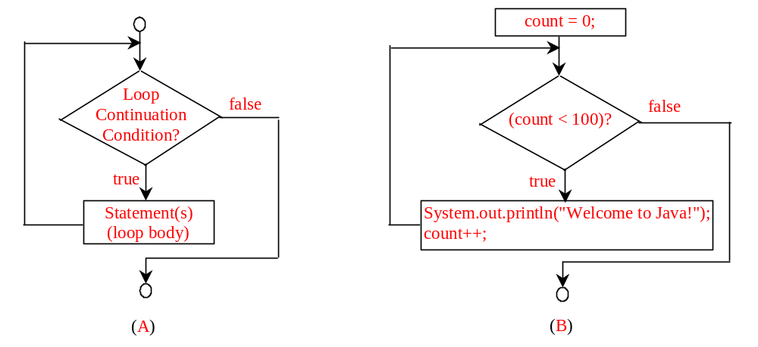
while Loop Flow Chart
int count = 0;
while (count < 100) {
System.out.println("Welcome to Java!");
count++;
}
while (condition) {
// loop-body;
Statement(s);
}

Slide 45
Trace while Loop
animation
Initialize count
int count = 0;
while (count < 2) {
System.out.println("Welcome to Java!");
count++;
}

Slide 46
Trace while Loop (cont.)
animation
(count < 2) is true
int count = 0;
while (count < 2) {
System.out.println("Welcome to Java!");
count++;
}

Slide 47
Trace while Loop (cont.)
animation
Print Welcome to Java
int count = 0;
while (count < 2) {
System.out.println("Welcome to Java!");
count++;
}

Slide 48
Trace while Loop (cont.)
animation
Increase count by 1
count is 1 now
int count = 0;
while (count < 2) {
System.out.println("Welcome to Java!");
count++;
}

Slide 49
Trace while Loop (cont.)
animation
(count < 2) is still true since count is 1
int count = 0;
while (count < 2) {
System.out.println("Welcome to Java!");
count++;
}

Slide 50
Trace while Loop (cont.)
animation
Print Welcome to Java
int count = 0;
while (count < 2) {
System.out.println("Welcome to Java!");
count++;
}

Slide 51
Trace while Loop (cont.)
animation
Increase count by 1
count is 2 now
int count = 0;
while (count < 2) {
System.out.println("Welcome to Java!");
count++;
}

Slide 52
Trace while Loop (cont.)
animation
(count < 2) is false since count is 2 now
int count = 0;
while (count < 2) {
System.out.println("Welcome to Java!");
count++;
}

Slide 53
Trace while Loop
animation
The loop exits. Execute the next statement after the loop.
int count = 0;
while (count < 2) {
System.out.println("Welcome to Java!");
count++;
}

Slide 54
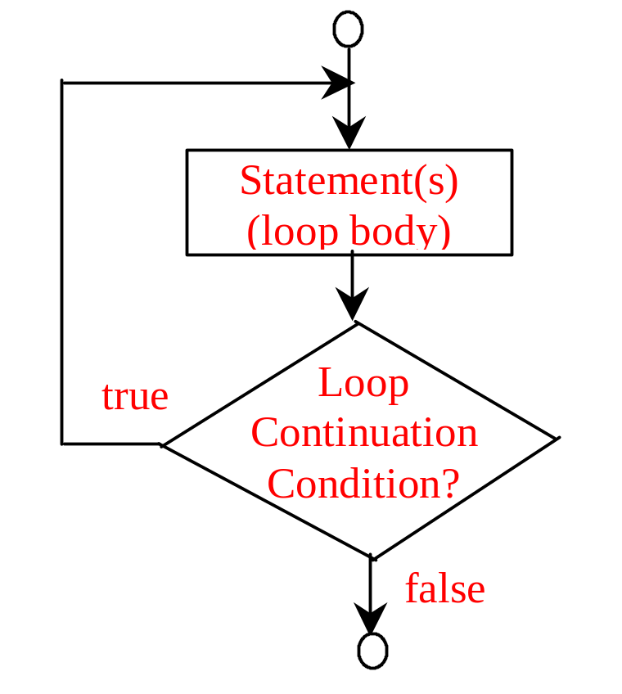
do-while Loop
do {
// Loop body;
Statement(s);
} while (loop-continuation-condition);

Slide 55
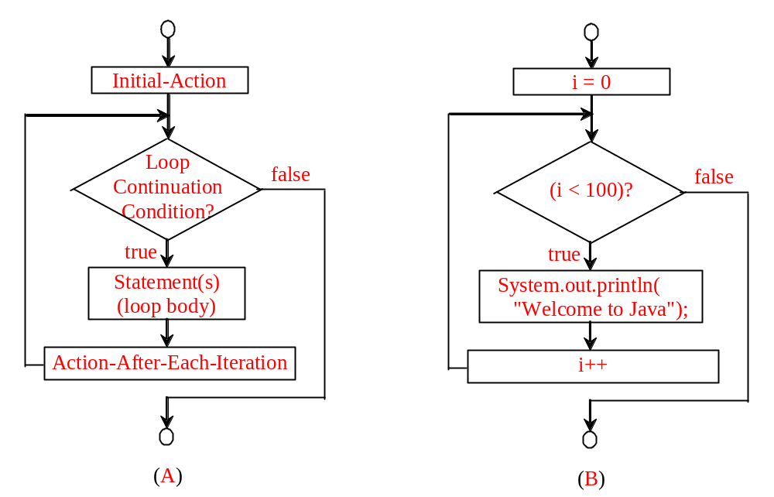
for Loops
for (initial-action; loop-continuation-condition; action-after-each-iteration) {
// loop body;
Statement(s);
}
for (int i = 0; i < 100; i++) {
System.out.println(
"Welcome to Java!");
}

Slide 56
Trace for Loop
animation
Declare and initialise i
for (int i = 0; i < 2; i++) {
System.out.println(
"Welcome to Java!");
}

Slide 57
Trace for Loop (cont.)
animation
(i < 2) is true
since i is 0
for (int i = 0; i < 2; i++) {
System.out.println( "Welcome to Java!");
}

Slide 58
Trace for Loop (cont.)
animation
Print Welcome to Java
for (int i = 0; i < 2; i++) {
System.out.println("Welcome to Java!");
}

Slide 59
Trace for Loop (cont.)
animation
Execute adjustment statement
i now is 1
for (int i = 0; i < 2; i++) {
System.out.println("Welcome to Java!");
}

Slide 60
Trace for Loop (cont.)
animation
(i < 2) is still true
since i is 1
for (int i = 0; i < 2; i++) {
System.out.println("Welcome to Java!");
}

Slide 61
Trace for Loop (cont.)
animation
Print Welcome to Java
for (int i = 0; i < 2; i++) {
System.out.println("Welcome to Java!");
}

Slide 62
Trace for Loop (cont.)
animation
Execute adjustment statement
i now is 2
for (int i = 0; i < 2; i++) {
System.out.println("Welcome to Java!");
}

Slide 63
Trace for Loop (cont.)
animation
(i < 2) is false
since i is 2
for (int i = 0; i < 2; i++) {
System.out.println("Welcome to Java!");
}

Slide 64
Trace for Loop (cont.)
animation
Exit the loop. Execute the next statement after the loop
for (int i = 0; i < 2; i++) {
System.out.println("Welcome to Java!");
}

Slide 65
Note
The initial-action in a for loop can be a list of zero or more comma-separated expressions. The action-after-each-iteration in a for loop can be a list of zero or more comma-separated statements. Therefore, the following two for loops are correct. They are rarely used in practice, however.
  for (int i = 1; i < 100; System.out.println(i++));
  for (int i = 0, j = 0; (i + j < 10); i++, j++) {
  // Do something
  }

Slide 66

Note
If the loop-continuation-condition in a for loop is omitted, it is implicitly true. Thus the statement given below in (a), which is an infinite loop, is correct. Nevertheless, it is better to use the equivalent loop in (b) to avoid confusion:

Slide 67
Caution
Adding a semicolon at the end of the for clause before the loop body is a common mistake, as shown below:
Logic Error
for (int i=0; i<10; i++);
{
System.out.println("i is " + i);
}

Slide 68
Caution (cont.)
Similarly, the following loop is also wrong:
int i=0;
while (i < 10);
{
System.out.println("i is " + i);
i++;
}
In the case of the do loop, the following semicolon is needed to end the loop.
int i=0;
do {
System.out.println("i is " + i);
i++;
} while (i<10);
Logic Error
Correct

Slide 69


Which Loop to Use?
The three forms of loop statements, while, do-while, and for, are expressively equivalent; that is, you can write a loop in any of these three forms. For example, a while loop in (a) in the following figure can always be converted into the following for loop in (b):
A for loop in (a) in the following figure can generally be converted into the following while loop in (b) except in certain special cases

Slide 70
Recommendations
Use the one that is most intuitive and comfortable for you.
In general, a for loop may be used if the number of repetitions is known.
A while loop may be used if the number of repetitions is not known, as in the case of reading the numbers until the input is 0.
A do-while loop can be used to replace a while loop if the loop body has to be executed before testing the continuation condition.

Slide 71
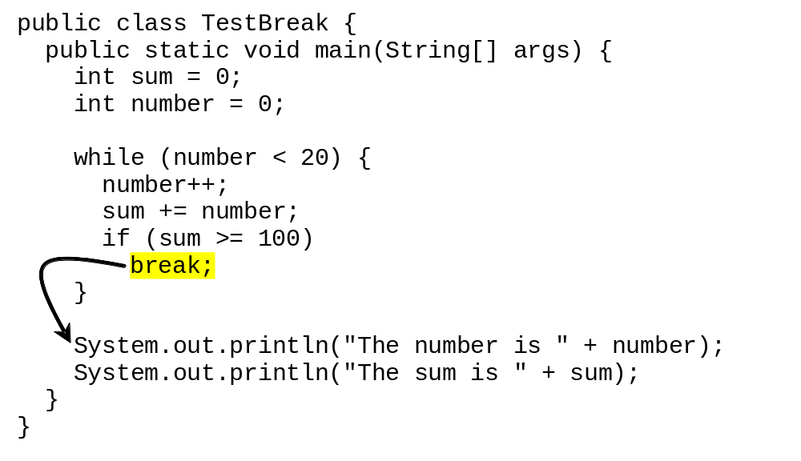
break

Slide 72
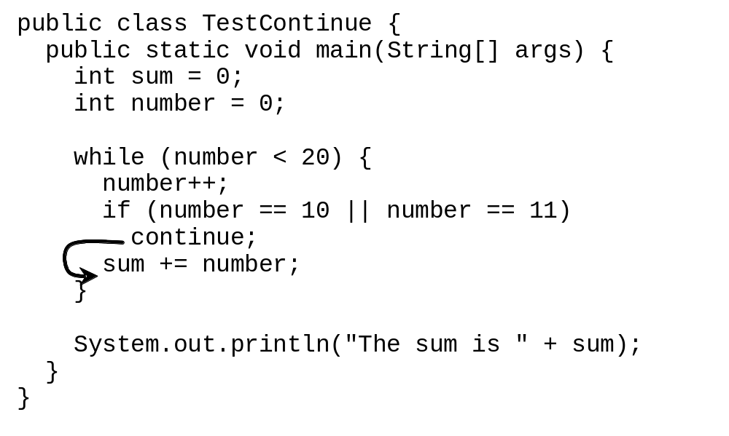
continue

