Slide 1
Project Title: SpeakEazy Project Statement: To develop a website that bridges the communication gap between Deaf and Dumb individuals and the hearing community through Sign Language Recognition.
DEPARTMENT OF CSE-AIML (CSM) – III-I Sem
E2E Project Review - 1
Batch : 2 (CSM-B)
Team Members :
1.M.SAI LOKESH 21BQ1A42A6
2.M.KEERTHI 21BQ1A42B5
3. M.NANDINI 21BQ1A42A5
4.A.MOHANA SANGEETHA 21BQ1A42B3
5.M.SRUTHI 21BQ1A42C9
6. M.SIVA NAGA RAJU 21BQ1A42A1
7.P.VENKATA LOKESH 21BQ1A42C2
8. T.VARUN SRI HARSHA 21BQ1A42C3
9.K.VENKATA KYATHI 21BQ1A4283
10.CH.KAMAL VARDHAN 21BQ1A4271
11. M.VARDHAN KUMAR 21BQ1A4299
12.N.GANESH 22BQ5A4210
13.N.TRIVENI 22BQ5A4211
Project Guide:
A .Janardhana Rao
Associate Professor,
Dept. of CSE,
VVIT

Slide 2
Project Title : SpeakEazy
DEPARTMENT OF CSE-AIML (CSM) – III-ISem
E2E Project Review - 1
Batch 2:
Project Description:
A website that bridges the communication gap between Deaf and Dumb individuals and the hearing community through Sign Language Recognition.
This website leverages cutting-edge technology and artificial intelligence to facilitate seamless communication between sign language users and individuals who may not be proficient in sign language.
Here, we use a combination of computer vision , ML, and NLP techniques.
Computer vision algorithms analyse video recordings or images of sign language users , detecting and tracking the movements of their hands ,facial expressions and body postures.
The primary goal of our project is to develop a robust and accurate sign language recognition system that can understand and interpret various sign language gestures and expressions.
Machine learning models are trained on large datasets of sign language samples , learning to recognize and associate specific gestures with their textual representation
Converting sign language into text or audio holds tremendous potential for fostering inclusivity , breaking communication barriers and empowering individuals with hearing impairments to interact more in a hearing-dominated world.
PROJECT FUNCTIONAL REQUIREMENTS: (FEATURES)
1. GESTURE TO VOICE
2. GESTURE TO TEXT
3. VOICE TO GESTURE
4. TEXT TO GESTURE
5. MULTILINGUAL SUPPORT
6. USER AUTHENTICATION
7. USER PROFILES
8. REAL TIME MESSAGING
9. DATA STORAGE
10. SECURITY MEASURES
11. USER FEEDBACK AND RATINGS
12. HELP AND SUPPORT
13. GUEST LOGIN
14. VOICE TO TEXT
15. NOTEPAD

Slide 3
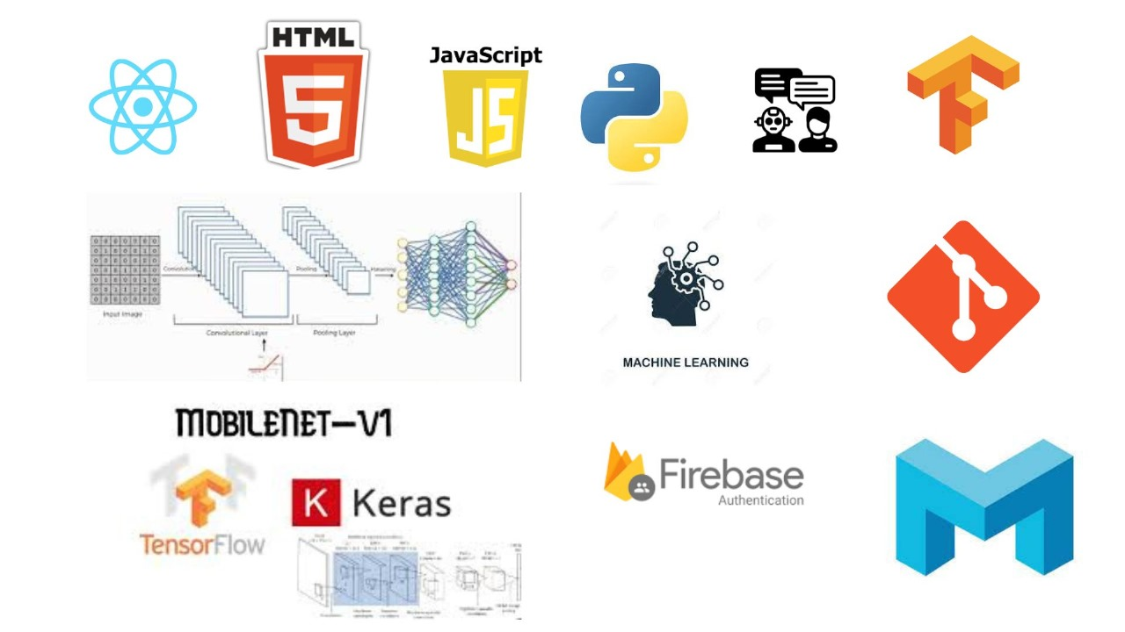
Project Title : SpeakEazy
DEPARTMENT OF CSE-AIML (CSM) – III-I Sem
E2E Project Review - 1
Batch 2:
Project Tools Required :
Frame Works: React, Angular, Django, Express.js
Front-End: JavaScript, React Native.
Back-End: MongoDB, Node.js, Express.js, Firebase Authentication, Python.
Business-Logic/ Models: ML, DL, NLP, CNN, RNN, AWS, Computer Vison with Python
Hardware Specifications: Mini Capacities for Execution of Proposed System
OS : win 10x / Linux
RAM : 2 Gb
HDD : 1 Tb
Graphic-Card : 1 Gb
Net-Bandwidth : 2 MBPS (for Cloud Computing or AWS)

Slide 4
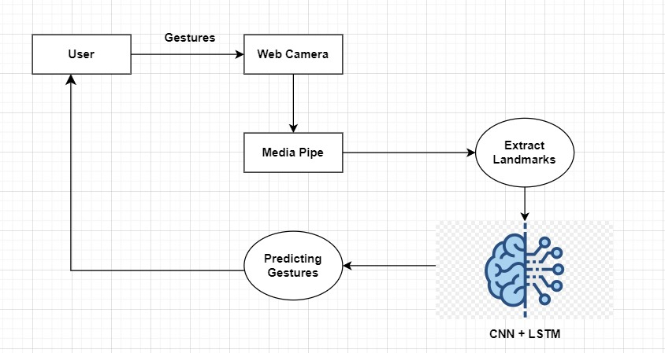
Project Title : SpeakEazy
DEPARTMENT OF CSE-AIML (CSM) – III-I Sem
E2E Project Review - 1
Batch 2:
Workflow diagram :

Slide 5
DEPARTMENT OF CSE-AIML (CSM) – III-I Sem
E2E Project Review - 1
Batch 2:
Project Tasks -Team member Allocation :
TEAM MEMBER | FEATURES ASSIGNED | TASKS TO COMPLETE
21BQ1A42A6 | GESTURE TO TEXT , TEXT TO GESTURE | TRAINING AND TESTING THE MODEL
21BQ1A42B5 | GESTURE TO TEXT, TEXT TO GESTURE | TRAINING AND TESTING THE MODEL
,21BQ1A42A5 | USER AUTHENTICATION , USER PROFILE , GUEST LOGIN | USER PROFILE AND GUEST LOGIN
21BQ1A42B3 | DATA STORAGE , MULTI LANGUAGE SUPPORT | STORING THE DATA IN GOOGLE CLOUD ,API CONNECTION, AND LEARNING EXPRESS.JS
21BQ1A42C9 | USER AUTHENTICATION , USER PROFILE , GUEST LOGIN | USER PROFILE AND GUEST LOGIN
21BQ1A42A1 | GESTURE TO TEXT, TEXT TO GESTURE | TRAINING AND TESTING THE MODEL
21BQ1A42C2 | REAL TIME MESSAGING , SECURITY MEASURES | ESTABLISHING CONNECTION BETWEEN USERS
21BQ1A42C3 | REAL TIME MESSAGING , SECURITY MEASURES | ESTABLISHING CONNECTION BETWEEN USERS
21BQ1A4283 | GESTURE TO VOICE , VOICE TO GESTURE | VOICE TO GESTURE
21BQ1A4271 | DATA STORAGE , MULTI LANGUAGE SUPPORT | STORING THE DATA IN GOOGLE CLOUD ,API CONNECTION, AND LEARNING EXPRESS.JS
21BQ1A4299 | GESTURE TO VOICE ,VOICE TO GESTURE | VOICE TO GESTURE
22BQ5A4210 | USER FEEDBACK &RATING , NOTEPAD, HELP & SUPPORT | USER FEEDBACK &RATING , NOTEPAD
22BQ5A4211 | USER FEEDBACK &RATING , NOTEPAD HELP AND SUPPORT | USER FEEDBACK &RATING , NOTEPAD

Slide 6
DEPARTMENT OF CSE-AIML (CSM) – III-I Sem
E2E Project Review - 1
Batch 2:
Project Team member Learning Status:
Team Member | Tools Learning | Status (Certification / Non Certification)
21BQ1A42A6 | *CNN ,RNN ,LSTM ,Media Pipe *OpenCV ,TensorFlow , Keras , Mobilenet | ON GOING
21BQ1A42B5 | *CNN ,RNN ,LSTM ,Media Pipe *OpenCV ,TensorFlow , Keras , Mobilenet | ON GOING
21BQ1A42A5 | * HTML, CSS , JavaScript,React,Angular,Vue.js *TypeScript ,Bootstrap , figma , canva | ON GOING
21BQ1A42B3 | *Express.js, Multi Language API | NOT YET STARTED
21BQ1A42C9 | * HTML, CSS , JavaScript,React,Angular,Vue.js *TypeScript ,Bootstrap , figma, canva | ON GOING
21BQ1A42A1 | *CNN ,RNN ,LSTM ,Media Pipe *OpenCV ,TensorFlow , Keras , Mobilenet | ONGOING
21BQ1A42C2 | *HTTP Long Polling *WebRTC (Web Real-Time Communication) | NOT YET STARTED
21BQ1A42C3 | *HTTP Long Polling *WebRTC (Web Real-Time Communication) | NOT YET STARTED
21BQ1A4283 | *Pyttsx3, Speech recognition, Pyaudio | ON GOING
21BQ1A4271 | *Express.js, Multi Language API | NOT YET STARTED
21BQ1A4299 | *Pyttsx3, Speech recognition, Pyaudio | ON GOING
22BQ5A4210 | *HTML/CSS/JavaScript *Feedback Forms, Knowledge base and FAQs | ON GOING
22BQ5A4211 | *HTML/CSS/JavaScript *Feedback Forms, Knowledge base and FAQs | ONGOING

Slide 7
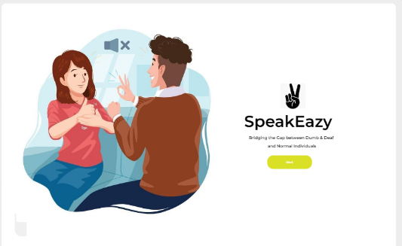
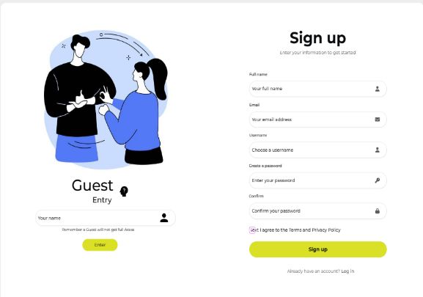
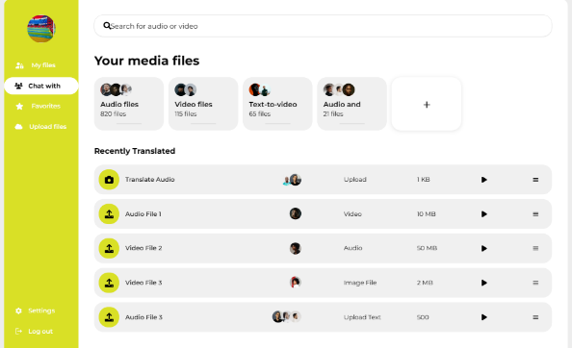
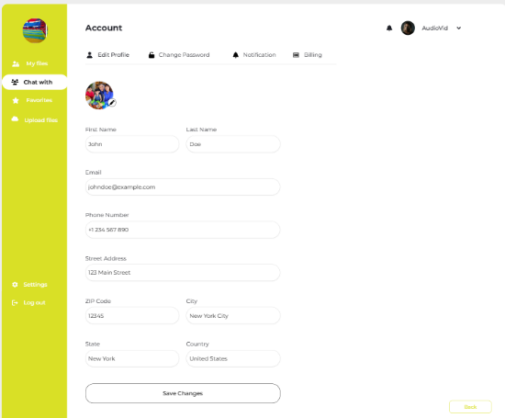
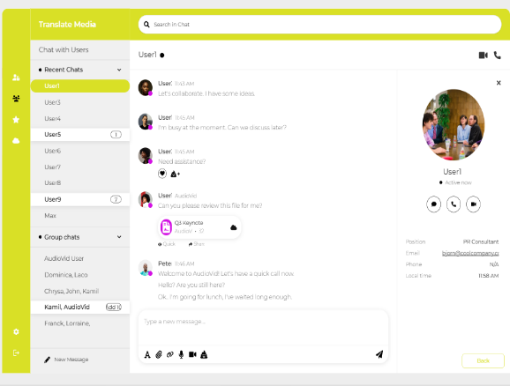
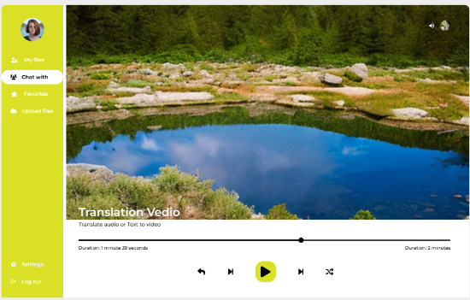





Project Title: SpeakEazy
DEPARTMENT OF CSE-AIML (CSM) – III-II Sem
E2E Project Review - 1
Batch 2:
Project Prototype:
Prototype link : https://app.uizard.io/p/ec638e1e

