Slide 1



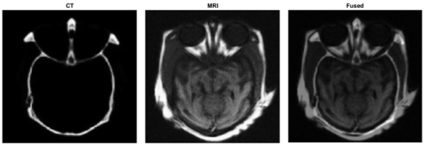
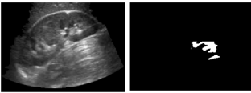
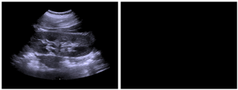
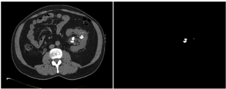
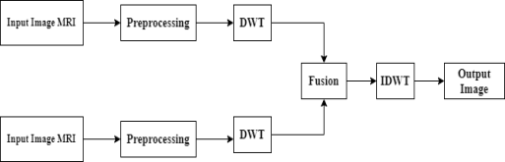
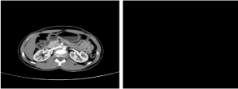
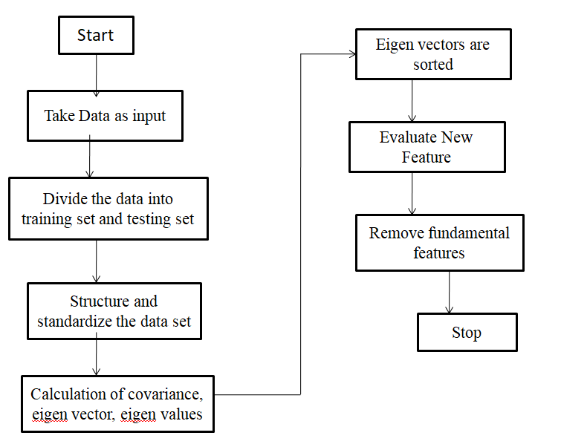


Wavelet Based Image Fusion for Kidney Stone Detection Chekkala Sai Manideep| Dr. V. Thanikaiselvan| SENSE
Motivation/ Introduction
Magnetic Resonance Imaging :-Magnetic resonance imaging (MRI) is a medical imaging technique used in radiology to form pictures of the anatomy and the physiological processes of the body in both health and disease. MRI scanners use strong magnetic fields, magnetic field gradients, and radio waves to generate images of the organs in the body.
Cross Entropy :- Cross entropy is used to measure the difference between the source images and the fused image. A smaller value corresponds to a better fusion result Obtained
Now a day’s Kidney Stones became a serious problem. If the stone is not identifying in early stage, then it may leads to the failure of the kidneys. Image processing is one of the best ways to detect the stones in the kidney. When it’s come to image fusion, it involves two or more images to obtain the most detailed image. In this technique doctors usually combine the CT and MRI medical images of a patient with a tumor to make a more accurate diagnosis. The fused image gives a better description than the source images and also it has better quality in the aspects of contrast, edge, texture and information.
Results
CT (Computed Tomography) :-It makes use of computer-processed many X-ray measurements combinations of taken from different angles to produce cross- sectional images of specific areas of a scanned object, allowing the user to see inside the object without cutting. CT is based on the principle that the density of the tissue passed by the x-ray beam can be measured from the calculation of the attenuation coefficient. Using this principle, CT allows the reconstruction of the density of the body, by two-dimensional section perpendicular to the axis of the acquisition system.
SCOPE of the Project
Fig 3 : Input CT and MRI images and Output Fused image
For Instance, doctors can annually combine the CT and MRI medical images of a patient suffering with tumour to make a more accurate diagnosis. Medical fusion image is to combine functional image and anatomical image together into one image. In our first step, we will make a fused image of CT and MRI image, later we will examine the Kidney stone detection test using the Ultrasound, CT images of human kidney.
Ultrasound Sound Imaging :- Ultrasound imaging uses high-frequency sound waves to view inside the body. Because ultrasound images are captured in real time, they show the movement of the body's internal organs as well as the blood flowing through the blood vessels. Unlike X-ray imaging, there is no ionizing radiation exposure associated with ultrasound imaging.
Fig 4 : Ultrasound images of kidney with and Without stones
Methodology
Fig 5 : CT images of kidney with and Without stones
Fig 1 : Wavelet Based Image Fusion
Standard Deviation :- The Standard deviation of an image of size M × N is defines as
Average Grading :- The mean gradient of an image with size M × N is defined as
Information Entropy :- The information entropy of a classical formulation of an image is defined as
Conclusion :-
We combined wavelet transform and various fusion rules to fuse CT and MRI images. Using this method we fused other head and abdomen images. A feature extraction procedure was used to measure the exact coordinates of the stone and the overall appearance of the stones created from the image. The accuracy of this method is 96.82%.
Fig 2: Steps of PCA-based feature extraction

