Slide 1
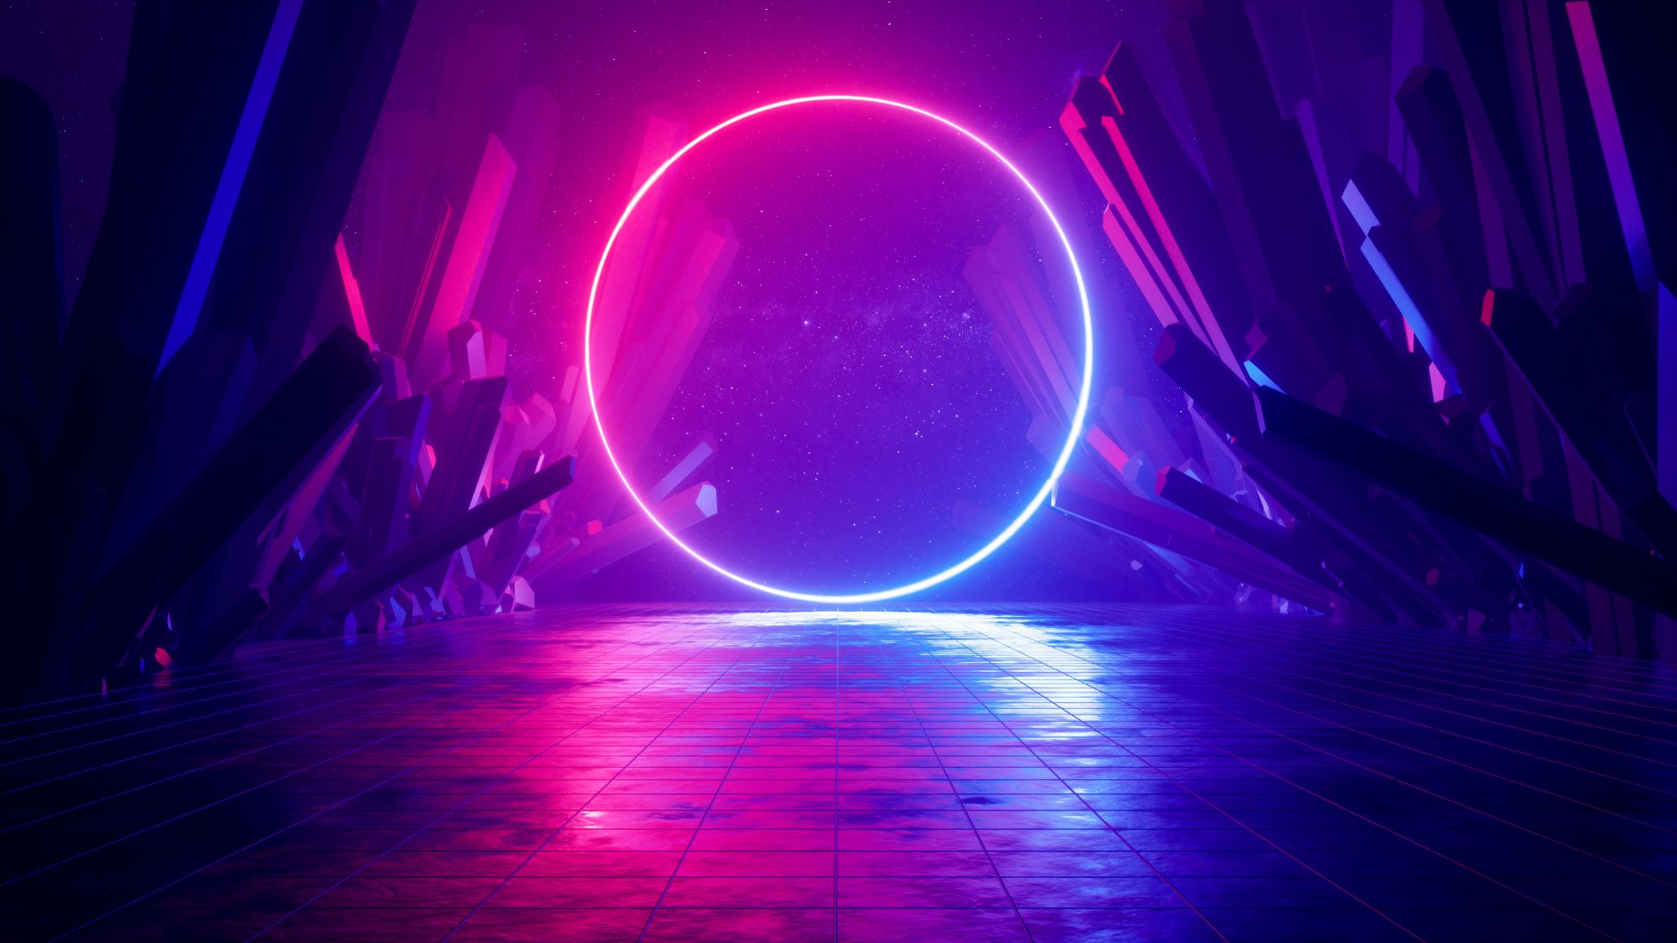

Wavelet based Image fusion for Kidney Stone Detection Final Review
Name :- Chekkala Sai Manideep
Reg no :- 19BEC0178
Under the Guidance of
Dr. Thanikaiselvan V.
School of Electronics Engineering
Vellore Institute of Technology, Vellore
April 2023

Slide 2
Introduction
Now a day’s Kidney Stones became a serious problem. If the stone is not identifying in early stage, then it may affect the person severely.
It is difficult to identify the stones in the scanned images of kidneys such as CT, MRI and Ultrasound images.
The Scanned Images contains some noise and we need to pre process the image so that we can able to detect the stone in the scanned image.
When it’s come to image fusion, it involves two or more images to obtain the most detailed image.
The fused image gives a better description than the source images and also it has better quality in the aspects of contrast, edge, texture and information.
We propose an efficient method of fusion using Wavelet transform. The Wavelet used here is Haar Wavelet. These fused coefficients are reconstructed using inverse wavelet transform.

Slide 3
Literature Servey
S.no | Auther Name | Title of the Paper | Journal | Methodology | Remarks
1 | Yong Yang, Dong sun park, Nini Rao | Medical image fusion via an effective wavelet-based approach | EURASIP Journal on Advances in Signal Processing 2010(8) | A novel wavelet-based approach for medical image fusion | Window-based activity measurement. low-frequency- Visibility high-frequency Variance.
2 | S M Mahbubur RahmanM, Omair Ahmad, M.N.s. Swamy | Contrast-based fusion of noisy images using discrete wavelet transform | IET Image Processing 4(5):374 – 384(2010) | A novel rule has been proposed to obtain the fused DWT coefficients of two noisy images. | The source images are decomposed by DWT and the coefficients are denoised.
3 | Mahesh K. Jat ,Pradeep Kumar Garg, Susheela Dahiya | A comparative study of various pixel-based image fusion techniques as applied to an urban environment | International Journal of Image and Data Fusion 4(3):197-213(2013) | A new contrast-based image fusion algorithm is developed in the wavelet-domain considering that the source images are noisy. | The source images are decomposed by DWT and the coefficients are denoised.
4 | Wenlong Zhang, Xiaolin Liu, Wuchao Wang, Yujun Zeng | Multi-exposure image fusion based on wavelet transform | International Journal of Advanced Robotic Systems15(2):172988141876893 (2018) | A novel wavelet-based algorithm for the fusion of multi-exposed images | Enhancement is applied for the fused image.
5 | Michel Roux, M. He , X. Li | Multifocus image fusion based on redundant wavelet transform | IET Image Processing 4(4):283 - 293 (2010) | A method for fusion of multifocus images is presented. | Activity measurement using edge enhanced details

Slide 4
Literature Survey
S.no | Auther Name | Title of the Paper | Journal | Methodology | Remarks
6 | Min Fen Shen, Zhi Fei Su, Jin Yao Yang, Li Sha Sun | An Image Fusion Algorithm Based on Redundant Wavelet Transform | Applied Mechanics and Materials 687-691:3656-3661 (2014) | A multi-focus image fusion algorithm based on redundant wavelet transform is proposed | Low-frequency: variance high-frequency: absolute value
7 | Saurabh Prasad, Wei Li, James Edwin Fowler, Lori Bruce | Information Fusion in the Redundant-Wavelet-Transform Domain for Noise-Robust Hyperspectral Classification | IEEE Transactions on Geoscience and Remote Sensing 50(9):3474-3486(2012) | The resulting high-dimensional feature spaces often result in statistically ill-conditioned class-conditional distributions. | Activity measurement of high-frequency bands are computed using entropy
8 | Michele Griffa, Rolf Kaufmann, Andreas Maier, Christian Riess | Towards quantification of kidney stones using X-ray dark-field tomography | IEEE 14th International Symposium on Biomedical Imaging (ISBI 2017) | This paper addresses streak reduction in limited angle tomography. | It measures Accuracy, precision
9 | Viswanath Kala, Dr.Gunasundari R | Design and analysis performance of kidney stone detection from ultrasound image by level set segmentation and ANN classification | 2014 International Conference on Advances in Computing, Communications and Informatics (ICACCI) | It uses ANN Algorith | This makes the detection of kidney abnormalities rather challenging task.
10 | Kalannagari Viswanath, Dr.Gunasundari R | Analysis and implementation of Kidney stone detection by reaction diffusion level set segmentation | VLSI Design 2015(1):1-10(2015) | The challenges are overcome by employing suitable image processing techniques. | During surgical processes it is vital to recognize the true and precise location of kidney stone.

Slide 5
Literature Servey
S.no | Auther Name | Title of the Paper | Journal | Methodology | Remarks
11 | X. Li, S.-Y. Qin | Efficient fusion for infrared and visible images based on compressive sensing principle | IET Image Processing 5(2):141 - 147(2011) | The potential application of compressive sensing (CS) principle in the image fusion for infrared (IR) and visible images is studied | Compressive sensing is used. Activity measurement using standard deviation.
12 | Anjan Gudigar , Raghavendra U, Jyothi Samanth, U Rajendra Acharya | Automated detection of chronic kidney disease using image fusion and graph embedding techniques with ultrasound images | Biomedical Signal Processing and Control 68(10225):102733(2021) | Image fusion and graph embedding techniques | The proposed method achieved 100 % accuracy for a two-class system, and 99.09 % accuracy for a multi-class categorization scenario.
13 | Wang Xin, Wei You-Li, Liu fu | A new multi-source image sequence fusion algorithm based on SIDWT | Image and Graphics (ICIG), 2013 Seventh International Conference on(2013) | Maximum selection for low-frequency and weighted average for high-frequency | Window-based activity measurement. low-frequency- contrast high-frequency edge gradient energy.
14 | Annameti Rohith | Detection of Kidney Stones in Ultrasound Images Using Median Filter Compared with Rank Filter | Revista Gestão Inovação e Tecnologias 11(4):1096-1111(2021) | Morphological Operation is used | The detection rate is improved using the Median filter compared with rank filter in terms of accuracy and sensitivity
15 | Y.-R. Zhou, A.-H. Geng, Q. Zhang | Fusion of infrared and visible images based on compressive sensing | Revista Gestão Inovação e Tecnologias 11(4):1096-1111(2021) | A novel method to fuse infrared and visible images was proposed based on compressive sensing theory. | Compressive sensing is used. Activity measurement using standard deviation.

Slide 6
Motivation
A kidney stone usually does not cause symptoms until it has moved into the kidney or passed into one of the ureters.
Kidney Stones are the life threatening situation, if the diagnosis is not done in short time it may leads to the failure of the kidneys.
For the operation, it is necessary to locate the stone position accurately. When it comes to scanned images, due to noise and poor contrast it is difficult the identify the stone in scanned images.
To overcome this issue image processing technique is used to detect the location of stone.
We also going to Apply Image fusion technique and create a fused image of CT and MRI images

Slide 7
Software Details
MATLAB
MATLAB is a programming platform designed specifically for engineers and scientists to analyze and design the systems and products that change our world.
The heart of MATLAB is the MATLAB language, a matrix-based language that allows the most natural expression of computational mathematics.
MATLAB combines a desktop environment tuned for iterative analysis and design processes with a programming language that directly expresses matrix and array mathematics.
It includes a live editor for creating scripts that combine code, output, and formatted text in an executable notebook. Millions of engineers and scientists worldwide use MATLAB for a wide variety of applications in industry and academia, including deep learning and machine learning, signal processing and communications, image and video processing, control systems, test and measurement, computational finance, and computational biology.

Slide 8
Objectives
Study of Wavelet Image fusion Technique and obtain a fused image of CT and MRI images.
We are going to understand the process and advantages of these fused images.
Understand the problems occurs due to kidney stone formation
By using the image processing method we are going to reduce the noise in the Scanned images of a patient’s kidney scan and dectect the acurate position of the stone located in the patient’s kidney

Slide 9
Methodology
Wavelet Transform :-
Wavelet transforms, provides a framework in which a signal or image is decomposed into levels. Each level corresponds to a coarser resolution or lower frequency band and higher frequency bands. There are two main groups of transforms, continuous and discrete. Of particular interest is the DWT, which applies a two-channel filter bank (with down sampling) iteratively to the low pass band (initially the original signal). The wavelet representation then consists of the low-pass band at the lowest resolution and the high pass bands obtained at each step. This transform is invertible and non redundant.

Slide 10
Fusion Rules
Activity level measurement :-
The process of measuring activity level (the quality of a pixel in an image) can be classified into three methods namely coefficient based, window based and area based measurements.
Coefficient Based Activity (CBA) :- In CBA, the activity level is measured as given In Equation
𝐴_{𝐼}(𝑃) = |𝐷_{𝐼}(𝑝)| 𝑜𝑟 𝐴_{𝐼} (p) = |𝐷_{𝐼}(𝑝)|² ----------Eq(a)
A_{I}(p) - the activity level of a pixel at position p.
Window Based Activity (WBA) :-The WBA employ a small (typically 3 × 3 or 5 ×5) window centred at the current coefficient position. Thus, the activity level A_{I}(p) is determined by the coefficients surrounding p using a small window.

Slide 11
Fusion Rules
Coefficient combining methods :-
Coefficient combining involves combining low-frequency and high-frequency coefficients from source images. Choice-Max (CM) is the simplest selection method as given in the equation
𝐷_{𝑧} (𝑝) = 𝐷_{𝑥}(𝑝) ,𝑖𝑓 𝐴_{𝑥}(𝑝) ≥ 𝐴_{𝑦}(𝑝) (or) 𝐷_{𝑦}(𝑝),𝑖𝑓 𝐴_{𝑥}(𝑝 ≤ 𝐴_{𝑦}(𝑝) ----------Eq(b)
In high-frequency bands, a large DWT coefficient corresponds to sharpness, luminance changes, and thus leads to important features in the image such as edges, lines, and region boundaries.
Therefore, the CM method is useful in comprehensive data collection.
Weighted Average (WA) :- For each p, the composite DZ is obtained using the equation
𝐷_{𝑧} (𝑝) = 𝑊_{𝑥}(𝑝)𝐷_{𝑥}(𝑝) + 𝑊_{𝑦}(𝑝) 𝐷_{𝑦}(𝑝) ----------Eq(c)
The weighting factors W_{X}(p) and W_{y}(p) can be deterministic or dependent on the activity levels of X and Y.

Slide 12
Fusion Rules
Adaptive weighted average (AWA) :- The AWA scheme is a special WA scheme whose weight W_{X}(p) is not deterministic or depends on cross-correlation but only for the neighborhood around p, As Give in Equation
W_{x}(p) = |D_{x}(p) – D’_{x}(p)|² ----------Eq(d)
Where, D_{x}(p) is average value over the neighborhood (say N×M) centered at p. Simply speaking, the weight represents the degree of interest of pixel p.

Slide 13
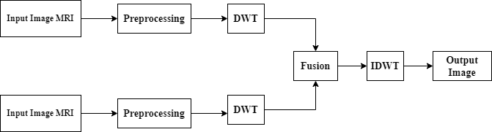
Wavelet Based Image Fusion
Fig.1 Wavelet based Image fusion

Slide 14
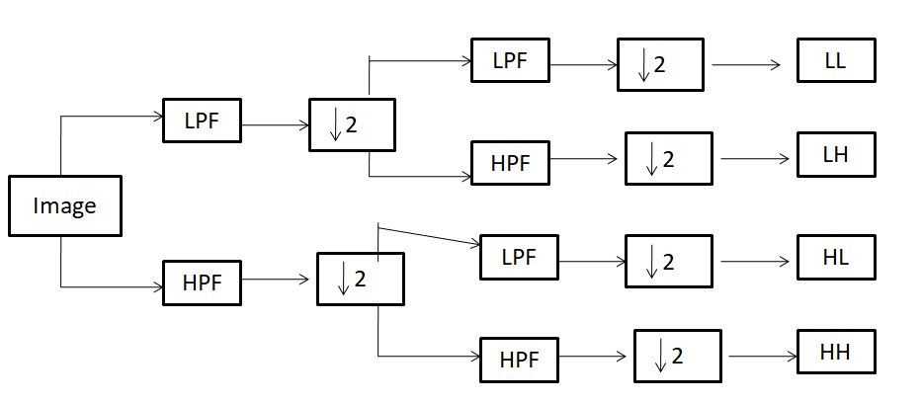
Discrete Wavelet Transform
Fig.2 One stage of 2-D Discrete Wavelet Transform multi resolution image decomposition

Slide 15
Discrete Wavelet Transform
Step 1:- Images to be fused must be registered to ensure corresponding pixels are aligned.
Step 2:- These images are decomposed into successive wavelet transformed images based on the wavelet transform. Images transformed with K-level decomposition have one low-frequency component (low-low band) and 3K high-frequency components (low-high bands, high-low bands, and high-high bands).
Step 3:- The transition coefficients of different components or bands are handled with a specific fusion rule.
Step 4:- The fused image is constructed by inverse wavelet transform based on the combined transform coefficients from step 3.

Slide 16
Discrete Wavelet Transform
The discrete wavelet transform (DWT) is an implementation of the wavelet transform using a discrete set of the wavelet scales and translations obeying some defined rules.
In other words, this transform decomposes the signal into mutually orthogonal set of wavelets, which is the main difference from the continuous wavelet transform (CWT), or its implementation for the discrete time series sometimes called discrete-time continuous wavelet transform (DT-CWT).
The discrete wavelet transform (DWT), which applies a two- channel filter bank (with down sampling) iteratively to the low pass band (initially the original signal).
The DWT is a spatial-frequency decomposition that provides a flexible multi resolution analysis of an image.

Slide 17
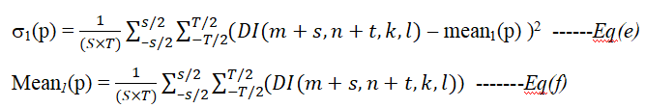
High Frequency Band Fusion
For high frequency bands, because the purpose of image fusion requires that the fused image not discard any useful information and conserve effectively Details of input images such as edges, lines and area boundaries, it is generally believed that the details of a the image is mainly included in the high-frequency picture.
It is generally believed that the details of an image are mainly included in the high-frequency of the image
Where S × T is the neighboring size, and mean₁(p), σ₁(p) denote the mean value and variance value of the coefficients centered at (m, n) in the window of S×T, respectively. The fusion Scheme follows

Slide 18
Low Frequency Band Fusion
To simplify the interpretation of the various alternatives available, which consists of a fusion rule, two source images, X and Y, and a fused image Z.
This method can be easily extended than two films. Since the low-frequency band is the original image at coarser resolution level, the smoother it is considered and a sub sampled version of the original image.
Therefore, most of the information of their source images is kept in it Low-frequency band.
Based on extensive analysis, here for the low-frequency band, a fusion scheme is chosen maximum local visibility is proposed.
Therefore, this method can be done by a human observer who is likely to provide better details. The fusion rule first computes the window-based visibility of all coefficients in the low-frequency band.

Slide 19
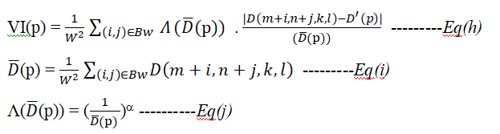

Low Frequency Band Fusion
The visibility of the wavelet coefficients is defined as
Where B_{w} is a w × w block, Λ(D(p)) is the weighting factor, VI(p) denote the visibility in the block, α is a visual constant obtained by perceptual experiment, and its range is from 0.6 to 0.7 .
After calculating all visibility coefficients in the low-frequency band, corresponding coefficients with high visibility are then selected in the fused image as follows :

Slide 20
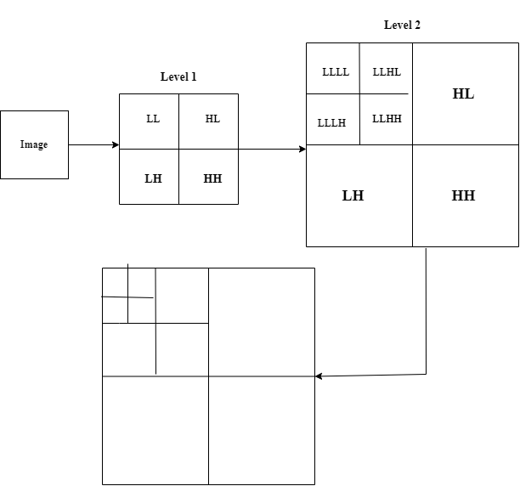
Haar Wavelet
Fig.3 Haar Wavelet transform for an Image

Slide 21
Haar Wavelet
The Haar wavelet transform (HWT) has gained widespread acceptance in signal processing and image compression.
Because of their inherent multi-resolution nature, wavelet-coding schemes are especially suitable for applications where scalability and tolerable degradation are important.
Haar wavelets are the fastest to compute and simplest to implement.
Other types of wavelets might give better results but at a higher cost.
Perform a standard 2D Haar wavelet decomposition of every image in the database

Slide 22

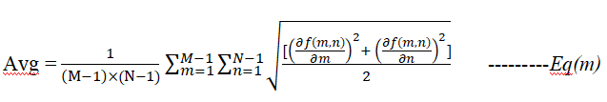
Performance Measures
Standard Deviation :- The Standard deviation of an image of size M × N is defines as
Where f (m, n) is the pixel value of the fused image at position (m, n), μ is the mean value of the image. Standard deviation is the most common measure of statistics, and diffusion is used to estimate how widely the gray values ​​are spread in an image. So, the bigger the standard deviation, the better the result.
Average Grading :- The mean gradient of an image with size M × N is defined as
Where f (m, n) has the same meaning as in the standard deviation. The average reflects the resolution of the fused image. It is used to measure the spatial resolution of fused image, that is, a larger mean gradient means higher clarity.

Slide 23


Performance Measures
Information Entropy :- The information entropy of a classical formulation of an image is defined as
Where L is the number of gray levels, and P_{l} is the ratio between the l (0 ≤ l ≤ L−1) number of gray-valued pixels. Information entropy measures the richness of information in a picture. Therefore, the higher the entropy, the better the performance.
Cross Entropy :- Cross entropy is used to measure the difference between the source images and the fused image. A smaller value corresponds to a better fusion result Obtained:
Where P_{l} and Q_{l} represent the gray level histogram of the source image and fused image, respectively

Slide 24
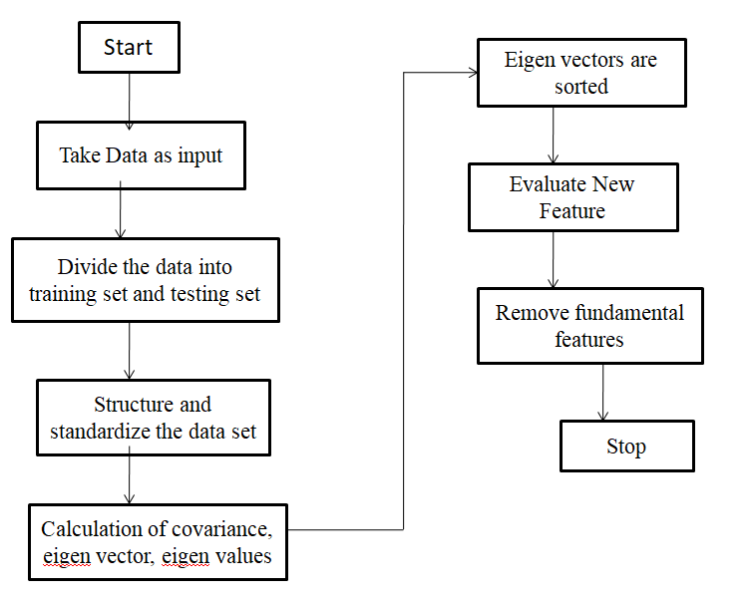
Kidney Stone Detection
Fig 4 : Steps of PCA based feature Extraction

Slide 25
Steps of PCA-Based Feature Extraction
Image Collection :-
Let us consider the some of the Ultrasound images were collected in the dataset d. The dataset for quality images, q = i(n), n = 1, 2,...,N. The quality is determined using a perception-based image quality evaluator score with score < = 40. An image is selected from the collection and marking process of the stone.
Feature Extraction :-
In this work we feature an unsupervised learning technique called Principal Component Analysis (PCA) extraction technique. Feature extraction technique is mainly implemented with 5 steps : Collecting data set, partitioning the data set, structuring the data set, calculating eigen values ​​& eigenvectors and finally evaluating new features by removing duplicate and unwanted features.

Slide 26

Steps of PCA Based Feature Extraction
Image Enhancement :-
The goal of image enhancement is to reduce ultrasound image degradation that occurs during imaging scanning acquisition. Noise, blur and camera misfocus can all cause degradation.
A level set function is used in this system to ensure proper orientation. It is in the image preprocessing stage. The Merriman and Sethian techniques are popular for image enhancement, especially smoothing and removing curves shrinks.
The Average intensity in a small neighborhood is ϕ(m,n) and the median is ϑ(m,n), then the evolution between max(p,0) and min(p,0) is expressed.

Slide 27
Steps of PCA Based Feature Extraction
Image Adjustment :-
CT images must be adjusted at the desired location and the gray image area must be binarized. The system in MATLAB initially reads a grayscale image and sets a matrix of images. Any pixel above 20 is classified as a binary 1 and any pixel below 20 is classified as a binary 0 and the comparison is made using a threshold value of 20. As a result, grayscale is binarized.
Photo Segmentation :-
It divides the digital photo into a set of pixels referred to as superpixels. This step uses a clustering technique that divides the input image into several groups based on their internal range to each other. It is used to identify the relevant features or the exact location where most of the study is to be done. Here, 250 pixels is kept as a threshold value to get the region of interest and wash out the extra parts. This is also known as thresholding.

Slide 28
Steps of PCA Based Feature Extraction
Morphological Analysis :-
Morphological analysis changes the shape of an object from one form to another. Morphological techniques are used to smooth the region of interest.
Morphological approaches are used to process images based on their appearance while organizing elements.
This removes unnecessary information (pixels) from the outer part of the region of interest during processing. A
closed parameter-based planar curve or surface is considered as T(n, t): [0, 1]mU⁺ → U^{k} . If k = 3 then it is a surface, and k = 2, then it is a planar curve.
Here, t is the time generated by the movement of the initial curves T₀(n) in the inward direction of R. If H is the energy function, the curve evolution equation can be expressed as
T(n,t=0) = T₀(n) -------Eq(q)
T_{t} = H -----Eq(r)

Slide 29
Application of Morphological Analysis
Dilation adds pixels to boundary of an object. Dilation makes objects more visible and fills in small holes in the object.
Erosion removes pixels from the boundary of an object. Erosion removes islands and small objects so that only substantive objects remain.
You can use morphological opening to remove small objects from an image while preserving the shape and size of larger objects in the image.
A flood fill operation assigns a uniform pixel value to connected pixels, stopping at object boundaries.
You can use neighborhood processing to find global and regional minima and maxima in images.

Slide 30
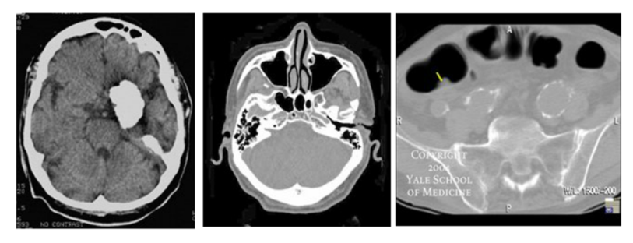
CT (Computed Tomography)
It makes use of computer-processed many X-ray measurements combinations of taken from different angles to produce cross- sectional (tomographic) images of specific areas of a scanned object, allowing the user to see inside the object without cutting.
CT is based on the principle that the density of the tissue passed by the x-ray beam can be measured from the calculation of the attenuation coefficient.
Using this principle, CT allows the reconstruction of the density of the body, by two-dimensional section perpendicular to the axis of the acquisition system.
It is a diagnostic imaging procedure that uses x-rays to build cross-sectional images of the body.
Cross-sections are reconstructed from measurements of attenuation coefficients of x-ray beams in the volume of the object studied.
Fig 5 : CT Image

Slide 31
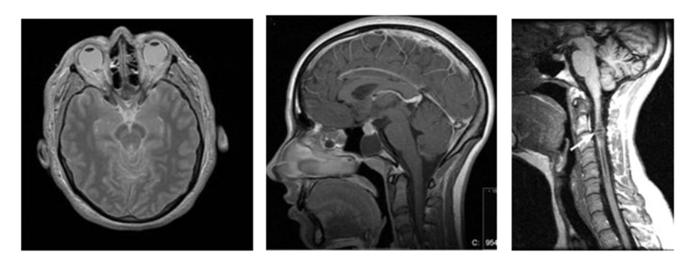
Magnetic Resonance Imaging
Magnetic resonance imaging (MRI) is a medical imaging technique used in radiology to form pictures of the anatomy and the physiological processes of the body in both health and disease.
MRI scanners use strong magnetic fields, magnetic field gradients, and radio waves to generate images of the organs in the body.
Magnetic resonance imaging (MRI) makes use of the magnetic properties of certain atomic nuclei. An example is the hydrogen nucleus (a single proton) present in water molecules, and therefore in all body tissues.
The hydrogen nuclei behave like compass needles that are partially aligned by a strong magnetic field in the scanner.
The nuclei can be rotated using radio waves, and they subsequently oscillate in the magnetic field while returning to equilibrium.
Simultaneously they emit a radio signal. This is detected using antennas (coils) and can be used for making detailed images of body tissues.
Fig 6 : MRI Image

Slide 32
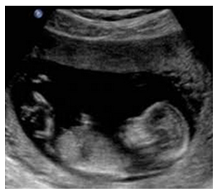
Ultrasound Sound Imaging
Ultrasound imaging uses high-frequency sound waves to view inside the body.
Because ultrasound images are captured in real time, they show the movement of the body's internal organs as well as the blood flowing through the blood vessels.
Unlike X-ray imaging, there is no ionizing radiation exposure associated with ultrasound imaging.
In an ultrasound exam, a transducer is placed directly on the skin or inside a body opening.
A thin layer of gel is applied to the skin so that ultrasound waves are transmitted from the transducer through the gel into the body.
An ultrasound image is produced based on the reflection of waves from body structures.
Fig 7 : Ultrasound Image

Slide 33
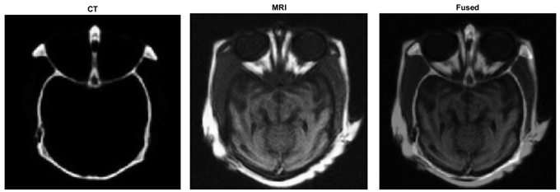
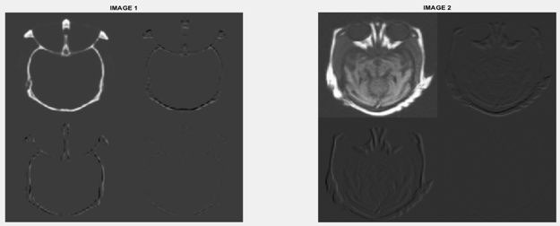
Results
Wavelet Based Fused Image
Fig 8 : Output fusion image of CT and CT and MRI images
Fig 9 : Fusion results of the CT and MR images

Slide 34
Explaination
We have to apply Wavelet transform for both CT and MRI images.
The fused image consists of both CT and MRI information.
We have to apply LL1, LH1, HL1, HH1 2D wavelet transformation to the input images by using Haar filter.
Once we separate the matrix then whe have to apply 2D IDWT to get fused image.
D1=[LL1,LH1;HL1,HH1];
D2=[LL2,LH2;HL2,HH2];
After applying wavelet transform, we have to convert it to double
M1=double(D1);
To fuse the 2 images I created function called Average
Where CA, CH, CV and CD represents the adjacent, horizontal , vertical and diagonal matrices of fused wavelet coefficient matrix.

Slide 35
Tabulation
Fusion Method | Standard Deviation | Average Gradiant | Information Entropy | Cross Entropy
DWT | 41.152 | 6.734 | 6.178 | 1.9428
Table1 : Quantitative evaluation results of the DWT fusion method

Slide 36
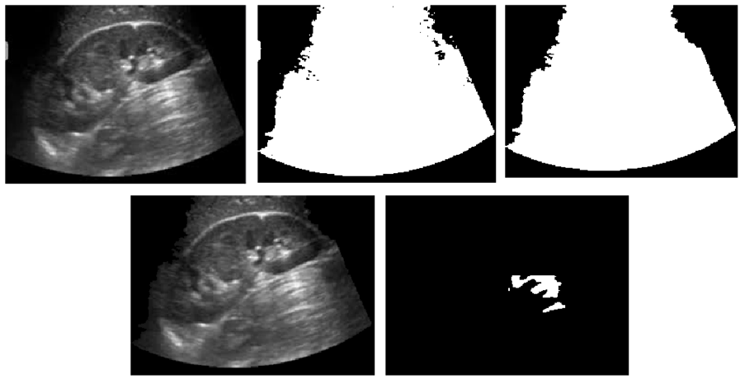
Kidney Stone Detection
Ultrasound Images
Fig 10(a) : Input Image
Fig 10(b) : Grey Image
Fig 10(c) : Region of Interest
Fig 10(d) : Pre Processed Image
Fig 10(e) : Stone Detected Region

Slide 37
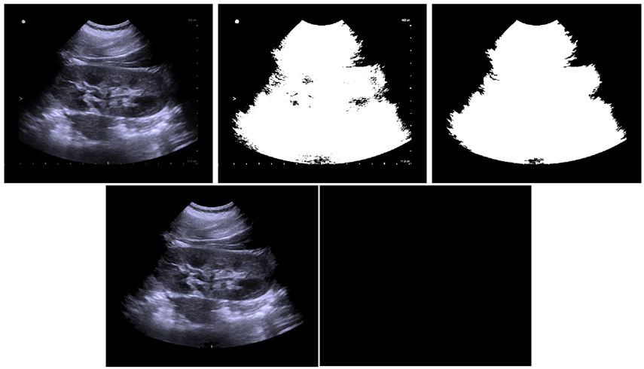
Ultrasound images
Fig 11(a) : Input Image
Fig 11(b) : Grey Image
Fig 11(c) : Region of Interest
Fig 11(d) : Pre Processed Image
Fig 11(e) : Stone Not Detected

Slide 38
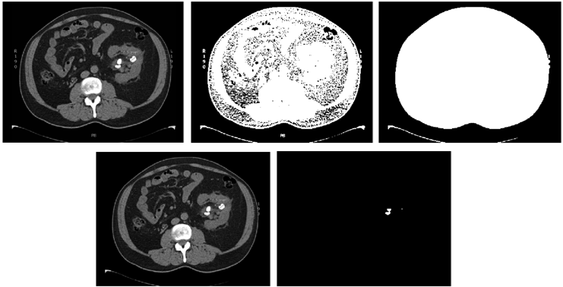
CT Image
Fig 12(a) : Input Image
Fig 12(b) : Grey Image
Fig 12(c) : Region of Interest
Fig 12(d) : Pre Processed Image
Fig 12(e) : Stone Detected Region

Slide 39
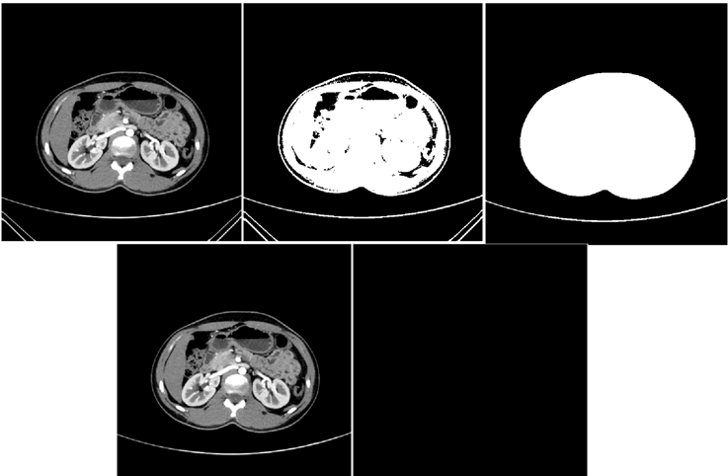
CT Image
Fig 13(a) : Input Image
Fig 13(b) : Grey Image
Fig 13(c) : Region of Interest
Fig 13(d) : Pre Processed Image
Fig 13(e) : Stone Not Detected

Slide 40
Explaination
First takes a fresh RGB image as input
In this process uigetfile is used to get file in any location.
With imread command we canread the image
We convert the image from RGB to grayscale and set pixel values ​​greater than 20 (threshold value) to binarize the grayscale image.
After that we apply a complement image which is inverse of the input image
For the command figure; imshow(c) we will get complement image.
For the command figure; imshow(m) we will get the region of interest where the stone is located
Preprocessed image is that where all the text on the image will be removed
After that, the pre-processed RGB image converted to a gray scale image. To reduce the noise, we perform a median filtering process in the preprocessing step of the image.
In the 3rd figure mentioned in the output result, the shaded region is the region of interest where the stone is located
After that we use imadd to enhance image and applying threshold of 250. We usually try to keep the pixel above 250 to reduce noise.
The imdilate is a morphological operator to dilate the image and bb, col and row are the value of region of interest.
The value of bb is given to roipoly so that we will get particular region of interest
Apply filter image over the region of interest image
Apply boundary level if num>1, Stone is detected

Slide 41
Scope for Improvement
Sometimes it become difficult to identify the tumor formed in the brain by observing the scanned images.
By using this image fusion technique we can identify the accurate position where the tumor formed
The Fused image consists data of both CT and MRI images .
By using the kidney detection method, we can accurately clarify weather the patient suffers with stones or not.
Initially, the kidney stones where confirmed by blood test and urine tests, by this method it does not need to go for further medical tests.
As early we detect the stones , it is safe to diagnosis of the patient’s kidney.

Slide 42
References
Prema T. Akkasaligar, Sunanda Biradar, Veena Kumbar, Kidney stone detection in computed tomography images, 2017 International Conference On Smart Technologies For Smart Nation
P. Mirajkar Pradnya, D. Ruikar Sachin, Wavelet based image fusion techniques, 2013 International Conference on Intelligent Systems and Signal Processing DOI: 10.1109/ISSP21356.2013 1-2 March 2013
Yujie Xu, Huabin Wang, Xiumei Yin, Liang Tao, MRI and PET/SPECT Image Fusion Based on Adaptive Weighted Guided Image Filtering, 2020 IEEE 5th International Conference on Signal and Image Processing (ICSIP) DOI: 10.1109/ICSIP49896.2020 23-25 Oct. 2020
Xuan Yang, Qingchao Zeng, Xun Liu, Qingliang Jiao, Ming Liu , CT and MRI image fusion based on weight difference between L1 and L2 norm, 2021 IEEE 2nd International Conference on Big Data, Artificial Intelligence and Internet of Things Engineering (ICBAIE) DOI: 10.1109/ICBAIE52039.2021 26-28 March 2021
V. Amala Rani, S. Lalithakumari, A Hybrid Fusion Model for Brain Tumor Images of MRI and CT, 2020 International Conference on Communication and Signal Processing (ICCSP) DOI: 10.1109/ICCSP48568.2020 28-30 July 2020
Akanksha Soni, Avinash Rai, Kidney Stone Recognition and Extraction using Directional Emboss & SVM from Computed Tomography Images, 2020 Third International Conference on Multimedia Processing, Communication & Information Technology (MPCIT) DOI: 10.1109/MPCIT51588.2020 11-12 Dec. 2020

Slide 43
References
Siddharth Rajput, Abhilasha Singh, Ritu Gupta, Automated Kidney Stone Detection Using Image Processing Techniques, 2021 9th International Conference on Reliability, Infocom Technologies and Optimization (Trends and Future Directions) (ICRITO) DOI: 10.1109/ICRITO51393.2021 3-4 Sept. 2021
Wan Mahani Hafizah, Eko Supriyanto, Jasmy Yunus, Feature Extraction of Kidney Ultrasound Images Based on Intensity Histogram and Gray Level Co-occurrence Matrix, 2012 Sixth Asia Modelling Symposium DOI: 10.1109/AMS20807.2012 29-31 May 2012
Praveen R Mirajkar, Kishan Ashok Bhagwat, ArunVikas Singh, Ashalatha M E, Acute ischemic stroke detection using wavelet based fusion of CT and MRI images, 2015 International Conference on Advances in Computing, Communications and Informatics (ICACCI) DOI: 10.1109/ICACCI35697.2015 10-13 Aug. 2015
Jionghua Teng, Xue Wang, Jingzhou Zhang, Suhuan Wang, Wavelet-based texture fusion of CT/MRI images, 2010 3rd International Congress on Image and Signal Processing DOI: 10.1109/CISP16830.2010 16-18 Oct. 2010

Slide 44
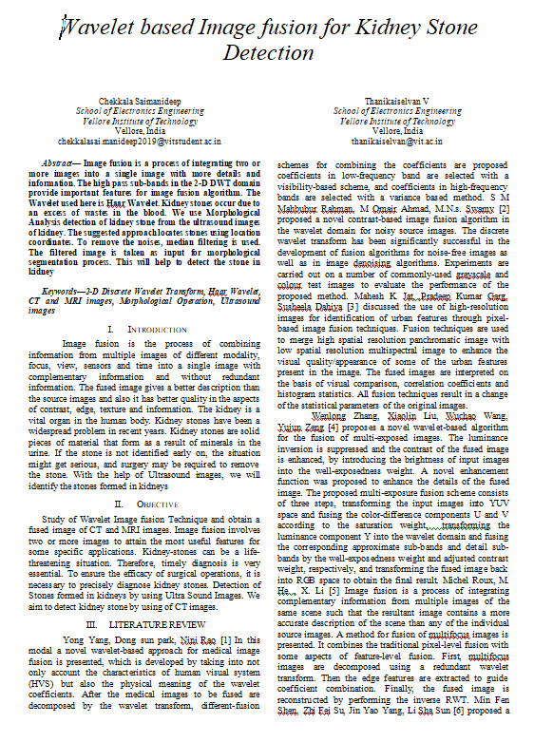
Paper Publication
We have written IEEE paper titled “Wavelet based Image fusion for Kidney Stone Detection “ paper is submitted to the guide for publication

