Slide 1
Model TM-Score vs CASP TM-Score

Slide 2
Molprobity Results comparision with CASP
Protein | Molprobity | CASP Molprobity
T0843 | 2.42 | 3.02
T0837 | 3.18 | 1.58
T0806 | 2.04 | 1.37
T0757 | 2.02 | 0.83
T0666 | 2.92 | 1.23
T0792 | 3.02 | 1.18
T0694 | 2.21 | 0.7

Slide 3
All atom – Clash Scores (Molprobity)

Slide 4
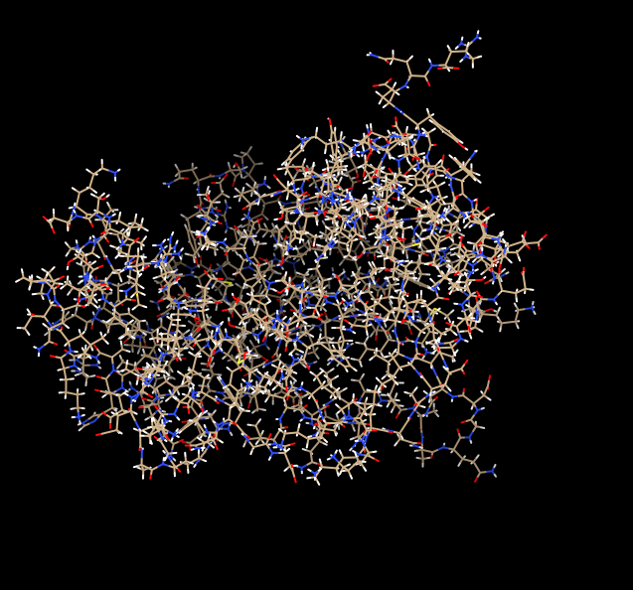
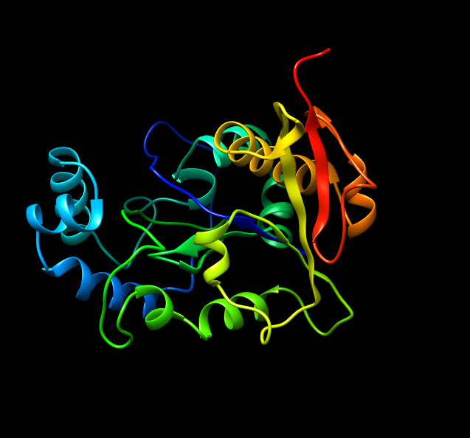
Sample Protein (T0806) Views With Chimera
All Atom View
Ribbon View

