Slide 1
Project Proposal
Template identification -> Blast (options: pdb; PSI-Blast)
Sequence alignment -> Needleman Wunch algorithm, T-Coffee
Modeller processing -> Aligned files, pdb files, script files
Model view and validation -> Chimera, Rasmol, TM-Score, Molprobity, Swissmodel model assessment, CASP Model Verification.
Refinement -> Blast options, PDB, Sequence alignment.

Slide 2
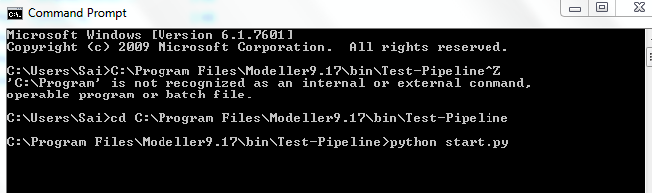
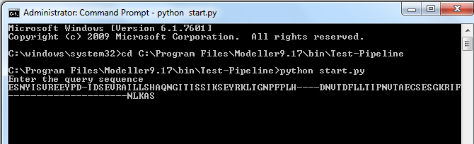
pipelining
Start the pipeline by calling start.py file
Generated script file, ask for user input for query (CASP) sequence; process the query and it automatically creates query.ali (In PIR format)

Slide 3
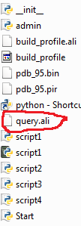
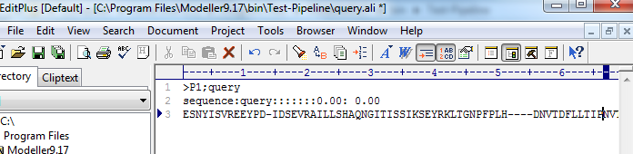
Sample Pipeline Implemented

Slide 4
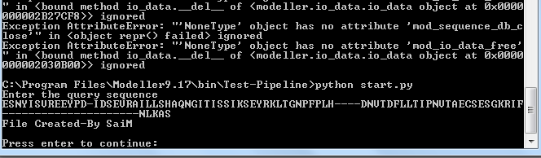
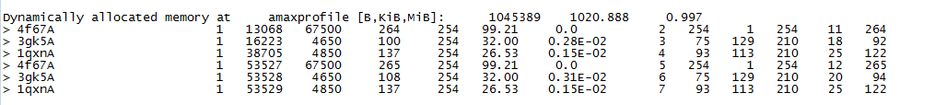
Sample pipeline implemented
Press enter after the verification (If needed to start running the modeler script files)
Sample log O/P file generated by modeler
Start the modeller with script 1

Slide 5
Pipelining steps
Similarly the other scripts are implemented as follows:
Next for script 2, Asks for identification of templates, user need to enter the template id’s (Should be pdb names); Alternative, we can use API to download pdb’s according to ID’s.
Start the next script, ask for user to select the best template by enter template id.
Runs script 3 and script 4. outputs the models, based on scores obtained user need to enter the best model id
Finishes the process and outputs are generated.

Slide 6
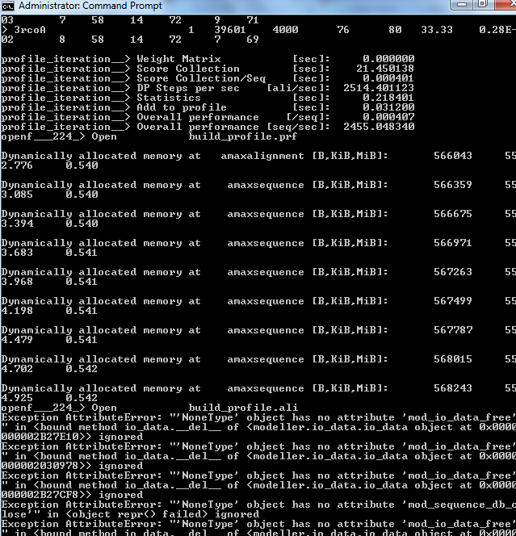
Modeller Processing
Drawbacks: Information on console (as off now, can be separated - Refinement)
Sample script for pdb file download
#Processing as follows:
TemplateList = [] #C1 with open('RefinedPDBCodeList') as inputfile: for line in inputfile: RefinedPDBCodeList.append(line.strip().split(',')) print(RefinedPDBCodeList[0]) ['5TF3.pdb'] import urllib.request for i in range(0, 1): #S2 - range(0, len(RefinedPDBCodeList)): path=urllib.request.urlretrieve('http://files.rcsb.org/download/101M.pdb', '5TF3.pdb')

Slide 7
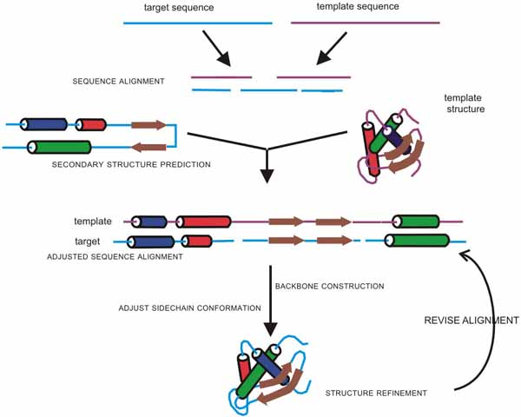
Results

Slide 8
Model TM-Score vs CASP TM-Score

Slide 9
Molprobity Results comparision with CASP
Protein | Molprobity | CASPMolprobity
T0843 | 2.42 | 3.02
T0837 | 3.18 | 1.58
T0806 | 2.04 | 1.37
T0757 | 2.02(5th in the list) | 0.83
T0666 | 2.92 | 1.23
T0792 | 3.02 | 1.18
T0694 | 2.21 | 0.7
T0651 | 2.18 (13th in CASP List) | 1.27

Slide 10
All atom – Clash Scores (Molprobity)

Slide 11
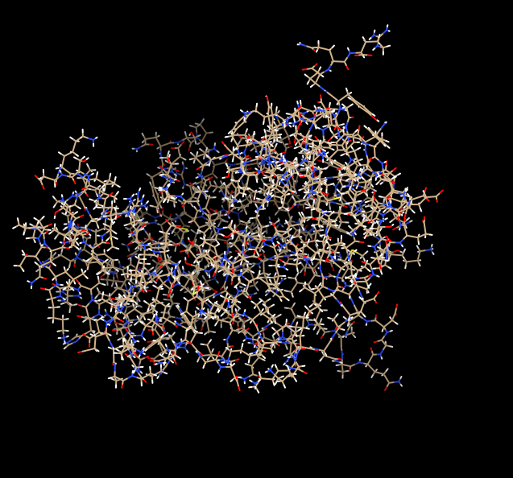
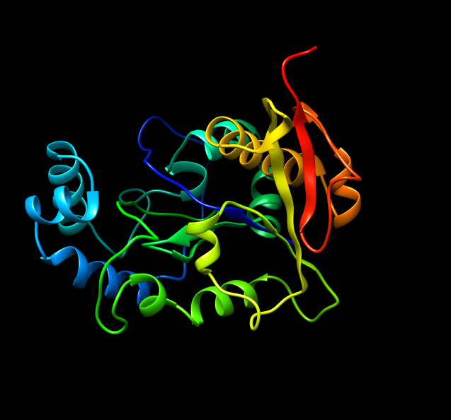
Sample Protein (T0806) Views With Chimera
All Atom View
Ribbon View

Slide 12
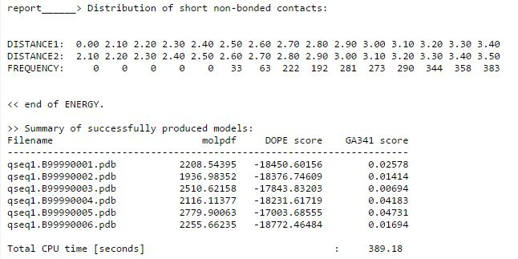

Challenges
T0651; PSI-BLAST; Modeller 9.17, Script4 result:
Confusion

Slide 13
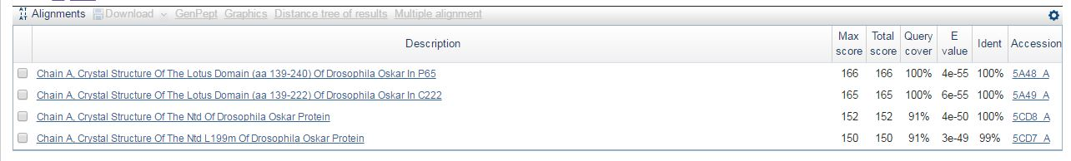
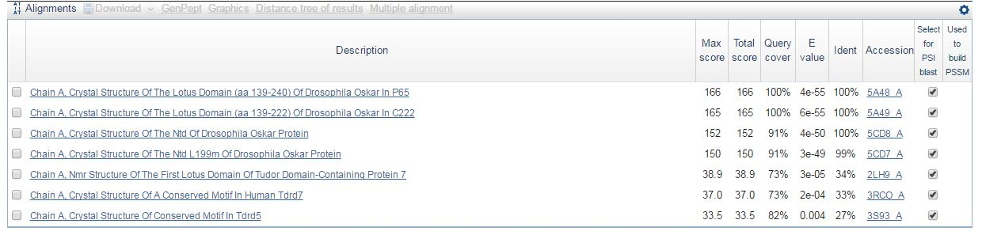
Challenges and Refinement
T0792 protein search in blastp
T0792 protein search in PSI blast

Slide 14
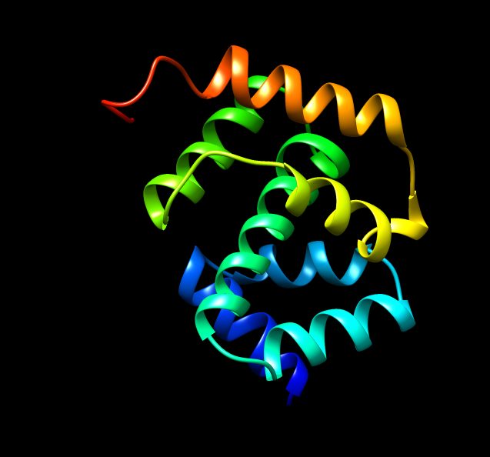
Case studies
With alignment of sequences:
T0792 Query with and without alignment
Taken 3s93 as template and identified best model for each
But, in each of the cases the TM-Score is same = 0.4172
Most of the scores changes with template selection*
With visual interpretation of protein:
TM-Score of the shown protein is: 0.2287
Can you guess
TM-Score??
Model seems to be well structured…

