Slide 1
Comparative protein modelling
CS 797I: Introduction to Bioinformatics
Fall 2016
Dr. Debswapna Bhattacharya
Sai Manikanta Godavarthi

Slide 2
Contents
Project Management
Input
Query Sequence
Template Search
Modeller Tool
Input files
Scripts
Output
Evaluation
Refinement
Automation, Refinement

Slide 3
Project management
Data: we share sequences among ourselves equally and pre process them and make them ready as a input for modeller and accordingly document all the steps.
Software:
sequence alignment : JAVA (Needleman-wunch), BLAST, T-Coffee.
File formatting: python 2.7x
Protein modelling: Modeller 9.17, Python 2.7x.
Evaluation: Swiss-Model, Molprobity, Chimera.
Timeline: pre-processing(1-2 days), Modelling (3-4 days), Evaluation (1Week-2weeks, If need to reprocess everything)
Challenges: choosing templates, sequence alignment.

Slide 4



Input
Select the query sequence from CASP
Search for similar sequence in protein database
We can use blast, PDB, etc.
Search for matching sequence with highest match(not choosing the same query sequence as template)
These are our templates
Template Searching
.fasta
….
Query Sequence
Select
Search
Templates
Protein Database

Slide 5


Input
Pair wise / Multiple sequence alignment with query and template/s
Alignment is done using tools like:
Blast or Needleman-Wunsch or T-Coffee.
Convert Query into PIR format and store it in .ali extension
Download PDB format for each the templates
Also convert aligned templates into PIR format
File Formats
Sequence Alignment
Template
Query
PIR format
PIR format

Slide 6
Modeller
Modeller is a protein modelling tool, which takes query sequence along with template sequence and model our query similar to template
The inputs are files we obtained in previous steps
Couple of scripts to be executed in python for modeler to run, each script to be given a file input based on previous script output

Slide 7

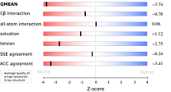

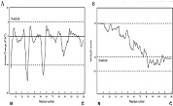
overview
Input
Output
{
…
Sequence Aligned Query and Templates
Template Files
{
…
Modeller
PIR format
{
Query File
PIR format
{
…
Script Files

Slide 8
Modeller
Script 1: read (query.ali)
Search(similar sequences; here we provided our templates, so it compares with them)
Write (alignment file/ profile file, Text & PIR format)
Script 2: for(each of template sequences)
{ Compare (among themselves for similarity)
malign() //multiple sequence alignment
malign3d() // an iterative least-squares superposition of the
// 3D structures
Dendogram(pair-wise sequence alignment distances)
}
write(log file)
Select the best template based on the result on output file let’s call it as “Temp_best”
Script 3: append_model(Temp_best) //PDB to alignment
append(query.ali) //appending query sequence file to model
align2d() // align the two sequences
write (query- Temp_best.ali) //aligned file of query and template
write (query- Temp_best.pap) //for visualization
Script 4: automodel(query-Temp_best.ali, knowns=“Temp_best”,
sequence=“query”, access_methods=(Dope, soap,
GA431_sore)) //start modelling and validate with selected
//scoring techniques
Start_model=1
End_model= x //’x’ can be the value of number of models
Sample code execution:
Input files:
Query.ali
Templates in PIR and PDB format

Slide 9

Modeller
Here we select the template based on the scores obtained in log file which include DOPE, molpdf, and GA341 scores i.e. higher GA431 or low DOPE or low molpdf scores, accordingly we choose the best model.
DOPE - statistical potential optimized for model assessment energy function
GA341 score - percentage sequence identity between the template and the model as a parameter
Moldpdf – Modeller objective function
Steps for execution
Script 5: input is selected model file which is in pdb format
Output profile file is generated which can be evaluated with different python packages.
This PDB file can be used to evaluate the model
Notes:
DOPE uses the standard MODELLER energy function, This is a statistical potential optimized for model assessment
GA341 score - method uses the percentage sequence identity between the template and the model as a parameter
Moldpdf – Modeller objective function

Slide 10
Output & Evaluation
Based on the scores obtained by using above tools, we verify the accuracy of the protein that we modelled.
Using Swiss-Model tool to identify the Q-mean scores, Solvent properties, Cß interactions, all atom interactions, and torsion scores
Using Molprobity tool we can obtain scores for bond angles, bond lengths, Energy values and all details in clear. We can also obtain Ramachandran plot and its values.
Similarly we are planning to use other tools if needed.

Slide 11
Refinement
Some times our results might not be accurate or of good quality.
Making changes at specific steps we can increase the quality and accuracy to higher percentage.
Steps include:
At step1: Choosing Template sequence
At Step2: Applying different techniques to align the sequences, with a single change of residue in sequence, it may impact for greater accuracy
At step3: choosing correct files after evaluation of output log files generated

Slide 12

Automation
Automation
1
Query Sequence
Modeller
Sequence=raw_input(“enter sequence”)
Join(sequence,PIR_Header)
with open(“query.ali", "a") as myfile: myfile.write(PIR_sequence)
Template
Sequence
Automating the process
Ideas of refinement for better accurate model
Asking user to enter file name(after evaluating log output) instead of changing code at every place
Refinement
Using other sequence alignment for the results obtained for script3 (Input for script4)
Trying different models after script4 (if confusing between model scores obtained)
Trying different databases for better matches***
2

Slide 13


Motor Protein
Any Questions?

Slide 14


Slide 15
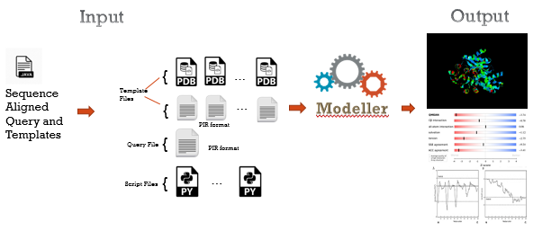
Templates
Select
Template/s
No
YES
Model Ok?
END

