Slide 1
Comparative Protein Modelling
Sai Manikanta Godavarthi
Bio Informatics
Fall 2016

Slide 2
Contents
Proposal
Implemented System
Results
Challenges
Case Studies
Conclusion

Slide 3
Project Proposal
Template identification -> Blast (options: pdb; PSI-Blast)
Sequence alignment -> Needleman Wunch algorithm, T-Coffee
Modeller processing -> Aligned files, pdb files, script files
Model view and validation -> Chimera, Rasmol, TM-Score, Molprobity, CASP Model Verification.
Refinement -> Blast options, PDB, Sequence alignment.

Slide 4
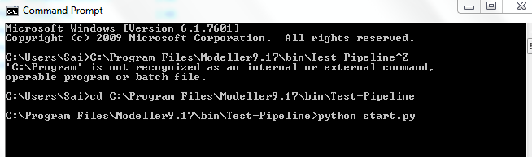
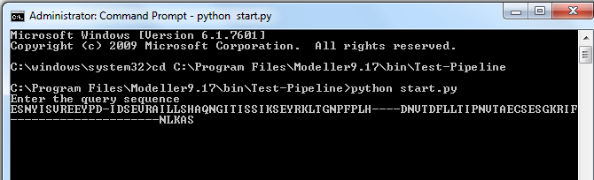
pipelining
Start the pipeline by calling start.py file
Generated script file, ask for user input for query (CASP) sequence; process the query and it automatically creates query.ali (In PIR format)

Slide 5
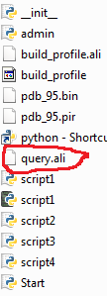
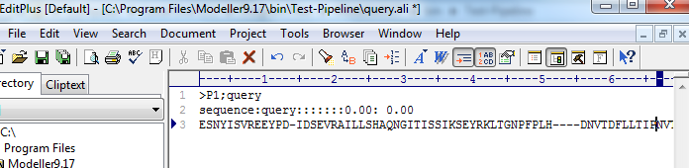
Sample Pipeline Implemented

Slide 6
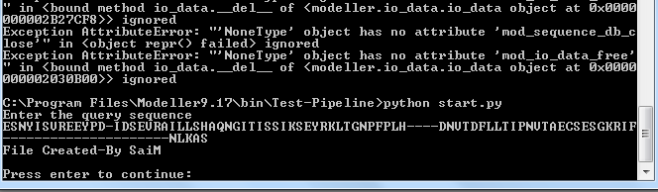
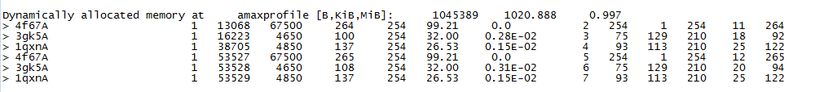
Sample pipeline implemented
Press enter after the verification (If needed to start running the modeler script files)
Sample log O/P file generated by modeler
Start the modeller with script 1

Slide 7
Pipelining steps
Similarly the other scripts are implemented as follows:
Next for script 2, Asks for identification of templates, user need to enter the template id’s (Should be pdb names); Alternative, we can use API to download pdb’s according to ID’s.
Start the next script, ask for user to select the best template by enter template id.
Runs script 3 and script 4. outputs the models, based on scores obtained user need to enter the best model id
Finishes the process and outputs are generated.

Slide 8
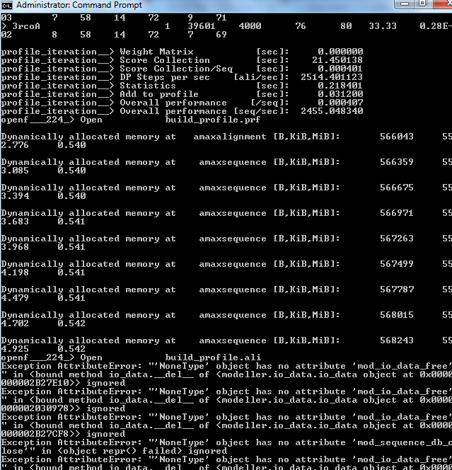
Modeller Processing
Drawbacks: Information on console (as off now, can be separated - Refinement)
Sample script for pdb file download
#Processing as follows:
TemplateList = [] #C1 with open('RefinedPDBCodeList') as inputfile: for line in inputfile: RefinedPDBCodeList.append(line.strip().split(',')) print(RefinedPDBCodeList[0]) ['5TF3.pdb'] import urllib.request for i in range(0, 1):
#S2 - range(0, len(RefinedPDBCodeList)): path=urllib.request.urlretrieve('http://files.rcsb.org/download/5TF3.pdb', '5TF3.pdb')

Slide 9
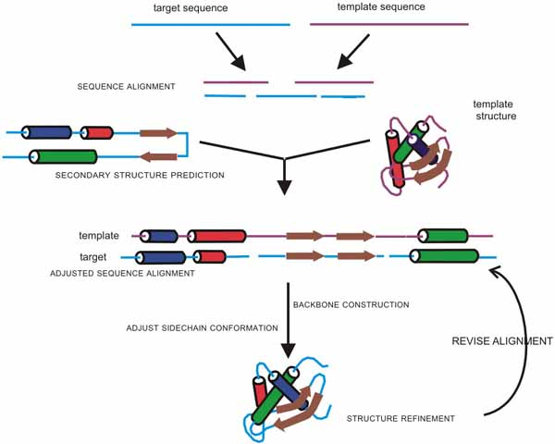
Results

Slide 10
Model TM-Score vs CASP TM-Score

Slide 11
Molprobity Results comparision with CASP
Protein | Alignment Used | Molprobity Score | CASP-Molprobity Score
T0843 | Multiple sequence | 2.42 | 3.02
T0837 | Pair-wise | 3.18 | 1.58
T0806 | Pair-wise | 2.04 | 1.37
T0757 | Pair-wise | 2.02(5th in the list) | 0.83
T0666 | Multiple sequence | 2.92 | 1.23
T0792 | Multiple sequence | 3.02 | 1.18
T0694 | Multiple sequence | 2.21 | 0.7
T0651 | Multiple sequence | 2.18 (13th in CASP List) | 1.27
T0678 | Pair-wise | 2.19 | 0.74
T0856 | Pair-wise | 2.82 | 1.66

Slide 12
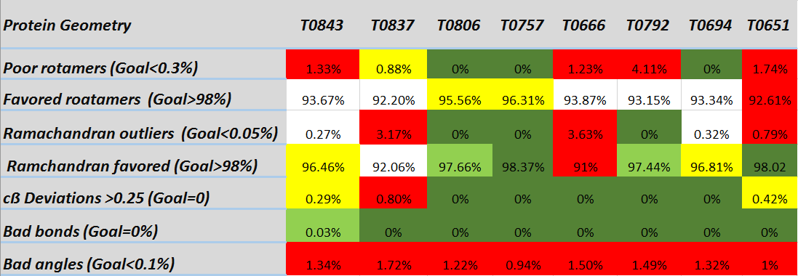
Molprobity Results for proteins
Bad
Good
Above Average
Average
Undecided

Slide 13
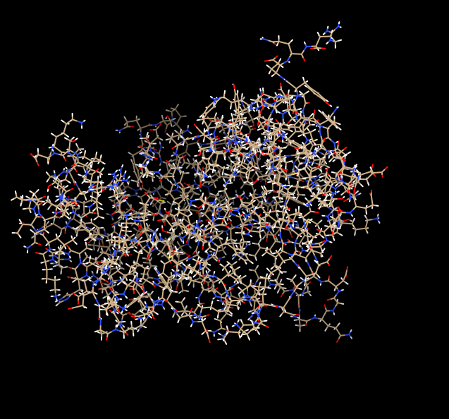
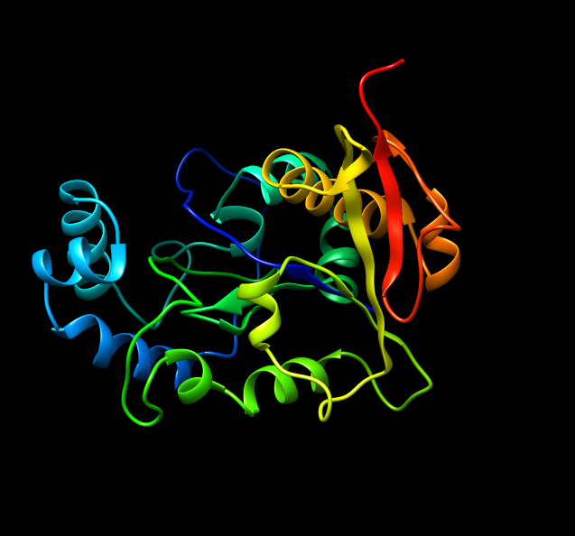
Sample Protein (T0806) Views With Chimera
All Atom View
Ribbon View

Slide 14
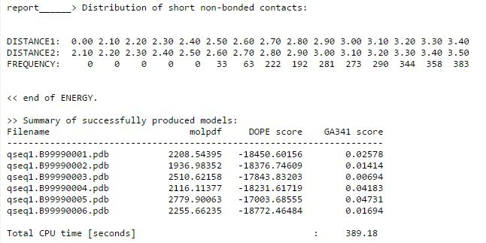

Challenges
T0651; PSI-BLAST; Modeller 9.17, Script4 result:
Confusion

Slide 15
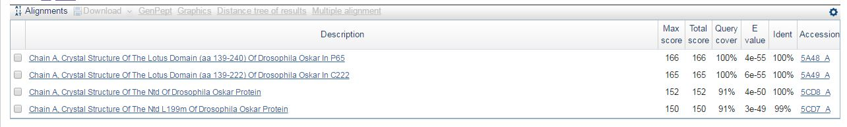
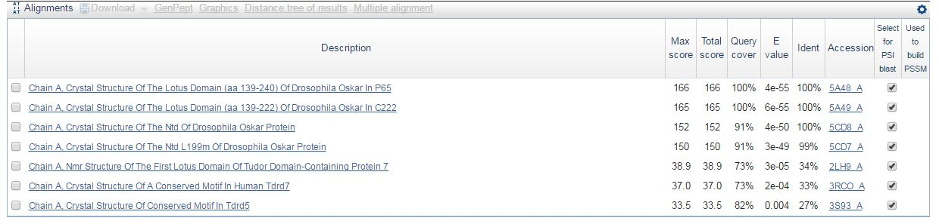
Challenges and Refinement
T0792 protein search in blastp
T0792 protein search in PSI blast

Slide 16
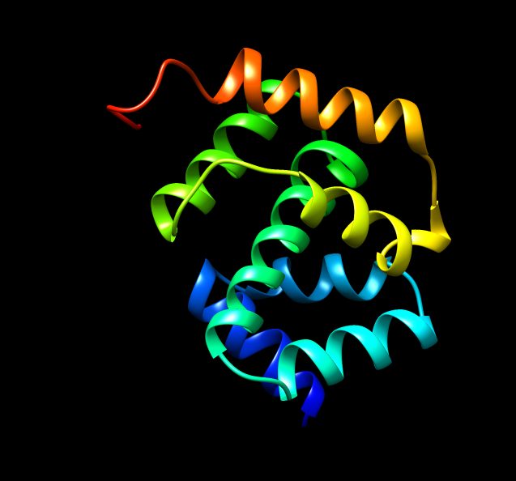
Case studies
With alignment of sequences:
T0792 Query with and without alignment
Taken 3s93 as template and identified best model for each
But, in each of the cases the TM-Score is same = 0.4172
Most of the scores changes with template selection*
With visual interpretation of protein:
TM-Score of the shown protein is: 0.2287
Multiple sequence alignment some times yielding bad result, rather know the template and then align the query sequence
TM- Score or Molprobity results?? – Still confused to choose the best among them
Can you guess
TM-Score??
Model seems to be well structured…

Slide 17
Conclusion
Lot of take away (Knowledge wise) from the project
Finding templates is the not easy and one of the main reasons for bad modelling.
Identity is not the only criteria for similarity of sequences (Biology knowledge needed to understand the type that protein belongs to for easy identification)
Not just finding scores, but lot of other analysis needed as well including visual analysis

Slide 18
Thank You

