Slide 1
Pizza_Sales_Report
File created on: 25-05-2025 23:43:22

Slide 2
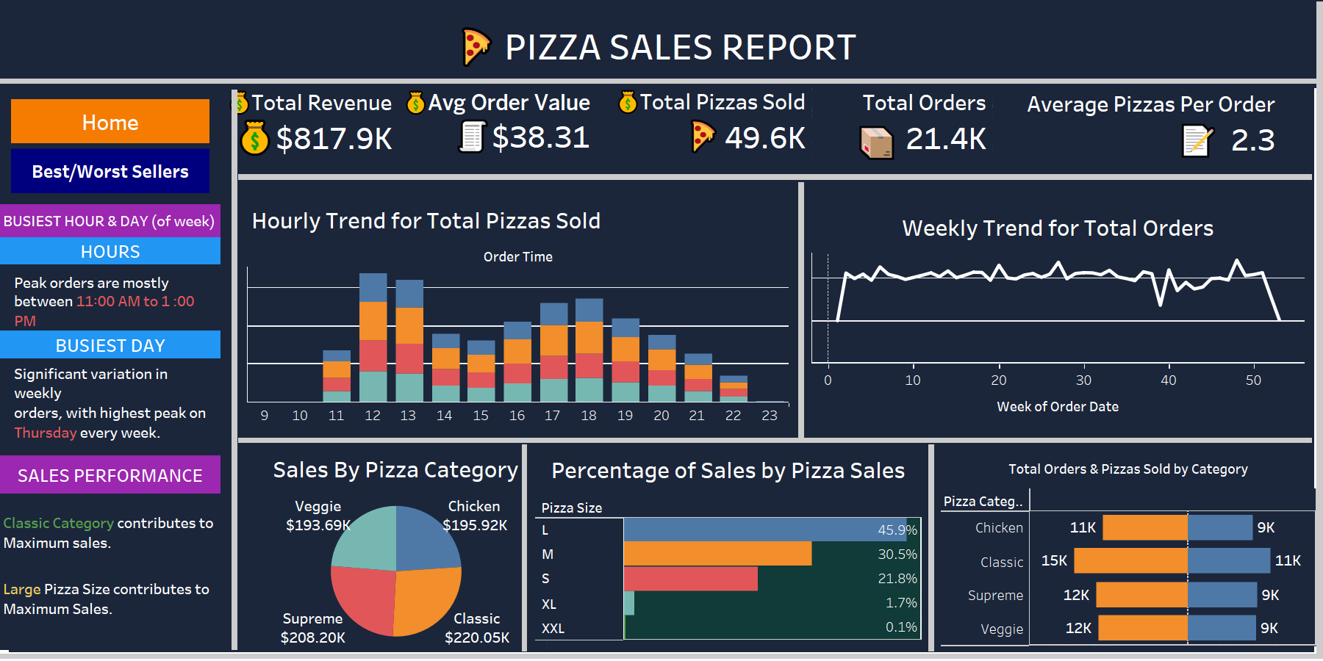

Slide 3
