Slide 1
Heuristic Optimization Algorithms
Group 8
KN Vardhan
Tata Sai Manoj
VKS Deepak Reedy
Notes:
Check the fonts and streamline fonts in all slides.

Slide 2
What is a Heuristic Algorithm?
•A heuristic algorithm is a method for finding near-optimal solutions to a problem of optimization.
•Heuristics are a commonly utilized technique for a variety of reasons.

Slide 3
What is a Heuristic Algorithm?
•Problems for which there is no exact answer or whose formulation is unknown, or if it is computationally intensive.
•However, the trade-off is in terms of optimality (or) correctness in favor of speed.

Slide 4
Travelling Salesman Problem
We have to find the shortest tour that visits each city exactly once and then return to the starting city.
Belongs to the class of NP-hard optimization problems.
The Hamiltonian cycle problem is a well-known NP-complete problem, which implies the NP-hardness of TSP.

Slide 5
Reducing Hamiltonian Cycle to TSP
If we consider a graph G, we can find the complement of the graph in polynomial time.
Assign weights of ‘0’ to the old edges, and weights of ‘1’ to the new edges.
If we find a Hamiltonian cycle of cost = 0, then the cycle only consists of the edges present in the original graph. This implies that there is a solution to the Travelling Salesman Problem for that graph.

Slide 6
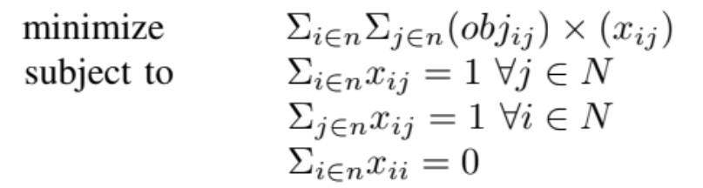
Formulation of TSP

Slide 7
Simulated Annealing
Simulated Annealing is the heuristic we apply to find a near-optimal solution for the TSP.
The term “annealing” refers to a process in thermodynamics in which metal is heated to a high temperature and then cooled gradually to achieve the desired shape.

Slide 8
Simulated Annealing
Similarly, our algorithm begins with a initial solution (generated), and then continues to generate candidate solutions until the stopping criterion is satisfied.
As the number of iterations continue to grow, only highly optimum choices are made to the best solution. This is indicated by the decreases in temperature, which increases the value of “rho”, in turn making it harder for the probability distribution to pick an non-optimal choice.

Slide 9
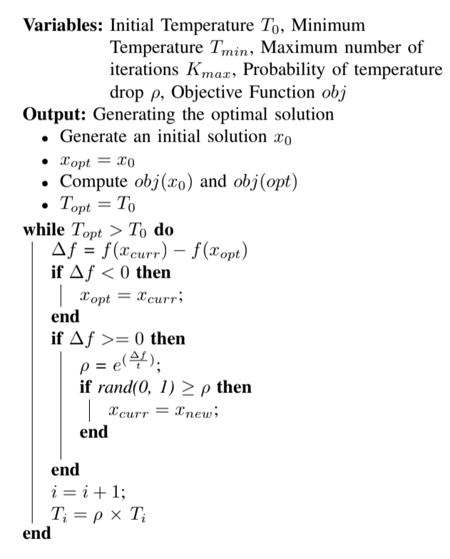
High Level Description
(Pseudocode)
The following link is the animation of the Travelling Salesman Problem with Simulated Annealing.

Slide 10




Optimizations in the Algorithm
The temperature can be changed in a variety of ways (other than the one given in the description).
Linear cooling cannot capture the fluctuation efficiently.
Linear cooling : - Natural Logarithmic cooling : - Exponential cooling : -
Quadratic cooling : -

Slide 11
Tabu Search
Tabu search is a Heuristic algorithm, which incorporates an iterative, adaptive memory-based neighborhood search method with many applications. It can used on non-convex problems to get an approximate globally optimal solution.

Slide 12
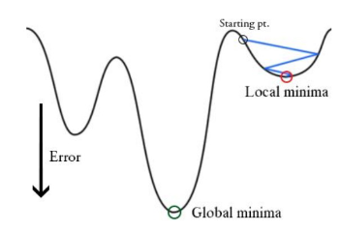
Tabu search for non-convex problems

Slide 13
Motive for Tabu Search Heuristic
Tabu search enhances the performance of local search by relaxing its basic rule.
First, at each step worsening moves can be accepted if no improving move is available (like when the search is stuck at a strict local minimum).
If a potential solution has been previously visited within a certain short-term period or if it has violated a rule, it is marked as "tabu" (forbidden) so that the algorithm does not consider that possibility repeatedly. Tabu Search uses its memory to search beyond local optima.

Slide 14
Single Machine Total Weighted Tardiness Problem
(SMTWTP)
Consider a set of jobs that need to be processed on a single machine that can handle at most one job at a time. Each job is assigned to a processing time that describes the time that is needed to process job , a due dated that describes the time point when the processing of job should have been finished, and a weight that represents the priority of job.
Given such a set of jobs, we need to find the schedule with minimum total weighted tardiness.
This is an non-convex, combinatorial, NP-hard problem, we demonstrate the tabu search algorithm based on the SMTWTP.

Slide 15


Mathematical modeling
Number of jobs = n ∈ ℕ
Processing time of job j = p_{j}
Due date of job j = d_{j}
Weight of job j = w_{j}
π is a permutation of length n which is a bijective mapping
π : [1, 2, ..., n] → [1, 2, ..., n]
we represent a permutation π as the n-tuple (π(1), ..., π(n))
Completion time of job j = C_{j}
Tardiness of job j = T_{j}

Slide 16


Mathematical modeling
Objective : to minimize the total tardiness of all jobs
Total tardiness is give by
The expression of a schedule π is also called the total
weighted tardiness of π. In terms of only initially given
variables our objective is

Slide 17
Algorithm Demonstrating Tabu search on SMTWTP
Start with an initial schedule and initialize current schedule to initial schedule. This can be any schedule that fits the criteria for an acceptable solution. And initialize best schedule to initial schedule.
Generate a set of neighbouring schedules to the current schedule. From this set, the schedules that are formed by moves in the Tabu List are removed with the exception of the schedules that fit the Aspiration Criteria.
Choose the best schedule out of this modified neighbourhood. If this schedule is better than the current best schedule, update the current best schedule to this. Then, regardless if it is better than current schedule, we update current schedule to this schedule.

Slide 18
Algorithm Demonstrating Tabu search on SMTWTP
Update the Tabu List by removing all moves that are expired past the Tabu Tenure and add the new move( from previous current schedule to present )to the Tabu List. If frequency memory is used, then also increment the frequency memory counter with the new move.
If the Termination Criteria, number of iterations reached maximum iteration, is met, then the search stops or else it will move onto the next iteration.

Slide 19
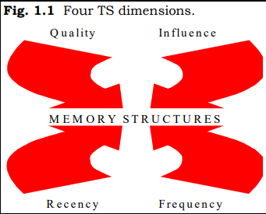
Key features of Tabu Search
Recency based memory structure keeps track of solutions attributes that have changed during the recent past.
Tabu tenure is the iteration up which certain move in tabu table is restricted.
Frequency based memory structures keep track of moves that occur with certain frequency in previous iteration.

Slide 20
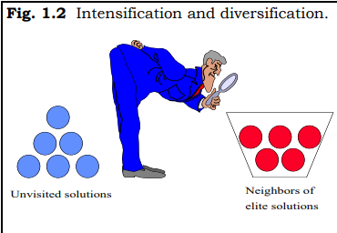
Key features of Tabu Search
Diversification drives the search into regions dissimilar to those already examined.
Intensification is to initiate a return to regions in the configuration space in which some stored elite solutions lie, these regions can then be searched more thoroughly.
Aspiration Criteria(optional) cancel out the Tabu and the move can be made even if it’s in the Tabu List.

Slide 21
It is important to note that by varying the Initial solution, Tabu Tenure, Aspiration criterion, and number iteration for termination along with effective use of Memory structures for Intensification and diversification we can improve the results of our optimization problem.

Slide 22
KnapSack Problem
Problem in Combinatorial Optimization

Slide 23
Knapsack Problem
A heuristic algorithm sacrifices optimality, accuracy, precision to solve a problem faster and more efficiently than standard approaches. When approximate answers are satisfactory and getting exact solutions become computationally difficult, we use heuristic algorithms.
One of the most common use of heuristic comes in the Knapsack Problem. The heuristic algorithm for this problem used is Greedy Approximation Algorithm. The Greedy Approximation Algorithm sorts the items based on their value per mass and adds the items with the highest ratio (value / mass) as long as there is space remaining.
Here, we try to find the best possible approximate answer using the Ant Colony Optimization (ACO) for the 0-1 Knapsack Problem.

Slide 24
What is a Knapsack Problem
The knapsack problem is described as;
Given a set of items,
Each item has a certain value “v”, and weight “w”.
Goal is to make V (= Σv) as maximum as possible with W (=Σw) ≤ K.
With the above goal (constraint), we need to find list of such items.
Different types of knapsack problems:
0-1 Knapsack Problem
Bounded Knapsack Problem (BKP)
Unbounded Knapsack Problem (UKP)

Slide 25
Why are knapsack problems of special interest?
The decision problem form of the knapsack problem is NP-Complete. Thus, there is no known algorithm for differentiating various cases, both correct and fast.
There is a pseudo-polynomial time algorithm using dynamic programming.
While the decision problem is NP-complete, the optimization problem is not. Thus, there is no concreteness to prove that a given solution is optimal or not. Given on the above queries, solving knapsack problem is quite challenging.

Slide 26
Before going to ACO Algorithm
def knapsack(wt, val, W, n):
if n == 0 or W == 0: return 0
if t[n][W] != -1: return t[n][W]
if wt[n-1] <= W:
t[n][W] = max(
val[n-1] + knapsack(
wt, val, W-wt[n-1], n-1),
knapsack(wt, val, W, n-1))
return t[n][W]
elif wt[n-1] > W:
t[n][W] = knapsack(wt, val, W, n-1)
return t[n][W]
val = [] # list of items’ values
wt = [] # list of items’ weights
W # maximum weight for the knapsack
n = len(val)
t = [[-1 for i in range(W + 1)] for j in range(n + 1)]
def knapsack(wt, val, W, n):
…… # function defined next to the main code
print(knapsack(wt, val, W, n))

Slide 27
Ant Colony Optimization Algorithm
An evolutionary strategy developed after observing how ants find the shortest & quickest path between their colony and a food source.
Ants are formed randomly on nodes and migrate stochastically from a starting node to viable adjacent node.
Each ant builds a complete solution using several steps, with an intermediate/partial solution at each step.

Slide 28
Ant Colony Optimization Algorithm
An ant k develops an intermediate solution by moving from node i to node j in each step.
The ant analyzes a set of possible expansions from its present node at each step and goes to one of them with highest probability of success.
The best solution outcome from every ant’s solution will be taken as our most approximate optimal solution.

Slide 29
THANK YOU

