Slide 1
University of Maryland, Baltimore county MPS Data Science, Fall 2023 Data 603 final project Presentation group #7 Analyzing Job Market Trends Using LinkedIn Job Listings Data
Professor – Dr. Najam Hassan
Project Team:
Saivarun Kotha – FW61697
Varun Aditya Madala – ZW71217
Sai Manvitha Nadella – FT44056

Slide 2
Introduction
In today's dynamic job market, understanding trends and demands is crucial for professionals and organizations.
Our project aims to analyze 1.3 million job listings scraped from LinkedIn in 2024 to gain insights into job market dynamics, identify skill demands, and enhance job recommendation systems.
This project is not only academically relevant but also provides practical insights that can benefit professionals, recruiters, and policymakers.
Through this analysis, we seek to contribute to the field of data science and provide actionable insights for stakeholders in the job market.
We have also developed a job recommendation system to develop a job (content-based) recommender system that accurately matches job seekers' skills with the most appropriate Linkedin job postings. In doing so, to provide job seekers with actionable information and strategic guidance.

Slide 3
Objectives
Analyze Job Market Trends
Goal: Identify the most in-demand job titles and industries in different cities or countries.
Why?: Lack of comprehensive data on current job market trends hinders informed decision-making for job seekers and employers.
Company Hiring Patterns
Goal: Determine the top companies hiring for specific job positions.
Why?: Understanding which companies are actively hiring for certain positions can help job seekers target their applications effectively.
Skill Mapping
Goal: Utilize skills data to determine the most sought-after skills in different job categories.
Why?: Identifying the skills in high demand can help educational institutions and training programs tailor their offerings to meet market needs.
Job Recommendation System
Goal: To alleviate the challenges faced by job seekers in the current job market by providing them with personalized and relevant job recommendations.
Why?: Motivated by the increasing complexity and competitiveness of the job market, exacerbated by economic uncertainties and layoffs. There is a clear need to bridge the gap between job seekers' skill sets and the requirements of job postings.

Slide 4
Data Sources and Collection
The dataset was obtained from Kaggle, a platform for data science and machine learning datasets. The dataset contains 1.3 million job listings scraped from LinkedIn in 2024, providing a rich source of information for analysis.
Data Sets
job_skills.csv (Includes skills and job id)
job_summary.csv (Includes summary of each job id)
Linkedin_job_postings.csv (Includes entire description of job posting)
Data Collection Method
The dataset was originally collected using web scraping techniques to extract job listings from LinkedIn. The data includes information such as job title, company, location, skills required, and job description.

Slide 5
Data Sources and Collection
job_skills.csv
<class 'pandas.core.frame.DataFrame’>
RangeIndex: 1296381 entries, 0 to 1296380 Data columns (total 2 columns):
# Column Non-Null Count Dtype
--- ------ -------------- -----
0 job_link 1296381 non-null object
1 job_skills 1294346 non-null object
dtypes: object(2)
linkedin_job_postings.csv
<class 'pandas.core.frame.DataFrame’>
RangeIndex: 1348454 entries, 0 to 1348453 Data columns (total 14 columns):
# Column Non-Null Count Dtype
--- ------ -------------- -----
0 job_link 1348454 non-null object
1 last_processed_time 1348454 non-null object
2 got_summary 1348454 non-null bool
3 got_ner 1348454 non-null bool
4 is_being_worked 1348454 non-null bool
5 job_title 1348454 non-null object
6 company 1348443 non-null object
7 job_location 1348435 non-null object
8 first_seen 1348454 non-null object
9 search_city 1348454 non-null object
10 search_country 1348454 non-null object
11 search_position 1348454 non-null object
12 job_level 1348454 non-null object
13 job_type 1348454 non-null object
dtypes: bool(3), object(11)
job_summary.csv
<class 'pandas.core.frame.DataFrame’>
RangeIndex: 1296381 entries, 0 to 1296380 Data columns (total 2 columns):
# Column Non-Null Count Dtype
--- ------ -------------- -----
0 job_link 1296381 non-null object
1 job_summary 1294346 non-null object
dtypes: object(2)

Slide 6
Data Sources and Collection
Challenges in Data Collection
Ensuring Data Quality: Addressing issues such as incomplete or inaccurate data, and standardizing formats for consistency.
Managing Large Dataset: Dealing with the volume of data requires efficient storage and processing solutions.
Legal and Ethical Considerations: Ensuring compliance with LinkedIn's terms of service and data protection regulations.
Data Preprocessing
Cleaning the raw data to remove duplicates, handle missing values, and format data for analysis.
Transforming the data into a structured format suitable for analysis using big data platforms.

Slide 7


Tools and Technologies
PySpark:
Purpose: Apache Spark is a fast and general-purpose cluster computing system for big data processing.
Usage: Spark will be used for processing the large dataset of job listings, enabling efficient data manipulation and analysis. PySpark is also used for implementation of Job Recommendation System
Python (Jupyter IDE):
Purpose: Python is a versatile programming language widely used for data cleaning, analysis, and visualization.
Usage: Python libraries such as Pandas and NumPy will be used for data cleaning and manipulation tasks. It is also used for Exploratory Data Analysis using Matplotlib and seaborn libraries.

Slide 8


Tools and Technologies
MongoDB:
Purpose: The purpose of using MongoDB in the project is to serve as a data store for hosting the job-related data.
Usage: MongoDB is a NoSQL database that offers flexibility and scalability, making it suitable for handling large volumes of unstructured or semi-structured data, such as job postings and skill data.
PowerBI:
Purpose: Power BI is used in the project for data visualization and reporting purposes.
Usage: After analyzing and processing the data using Python in Jupyter IDE and Spark, Power BI is used to create interactive visualizations and dashboards that provide insights into the job market trends, company hiring patterns, skill mapping, and job recommendations.

Slide 9
Tools and Technologies
Reasons for Choosing Tools:
Scalability:
PySpark provides scalability for processing large datasets efficiently.
Versatility:
Python's versatility and rich ecosystem of libraries make it ideal for data analysis tasks.
Familiarity:
Jupyter Notebooks and SQL are widely used tools in the data science community, ensuring ease of use and familiarity for team members.

Slide 10



Data Stack Diagram:
Data Visualization
Data Preprocessing:
WordNet Lemmatizer
Count Vectorizer
Tf-Idf Vectorizer
Cosine Similarity Function
Recommendation
system using SQL Query Generator
Data Storage
and Ingestion
Data Preprocessing
Exploratory
Data Analysis
Data Extraction
Job Recommendation
System

Slide 11
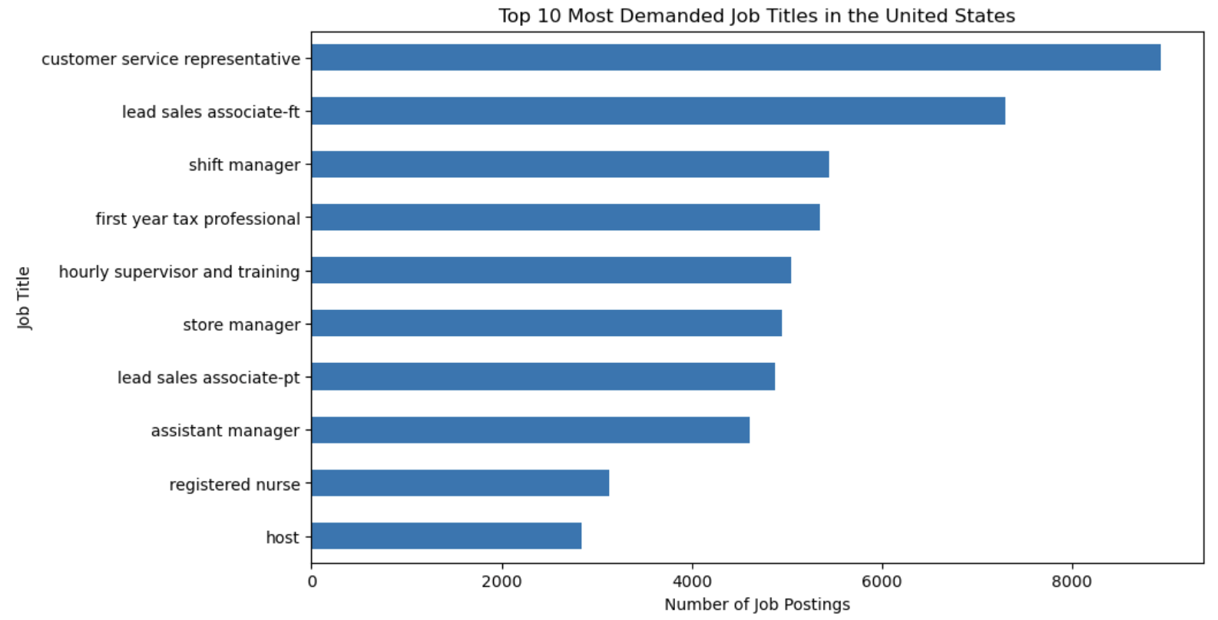
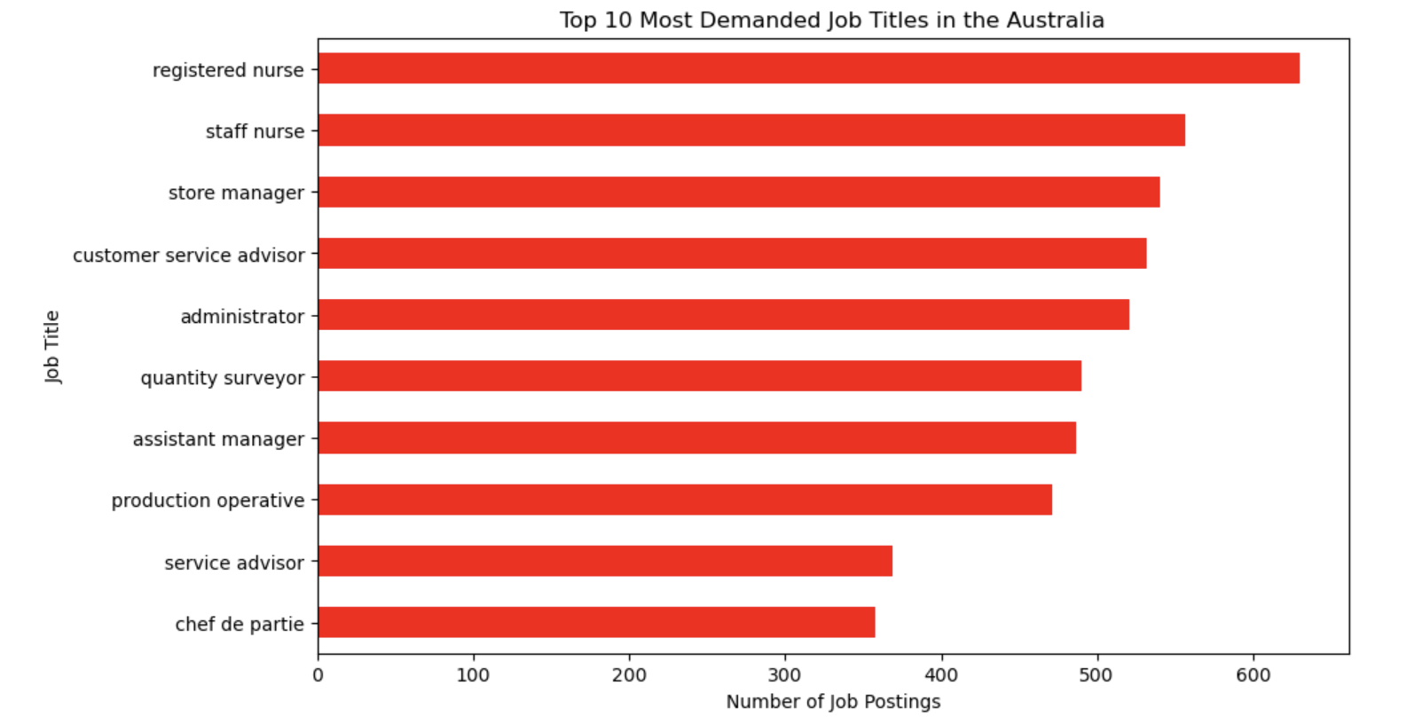
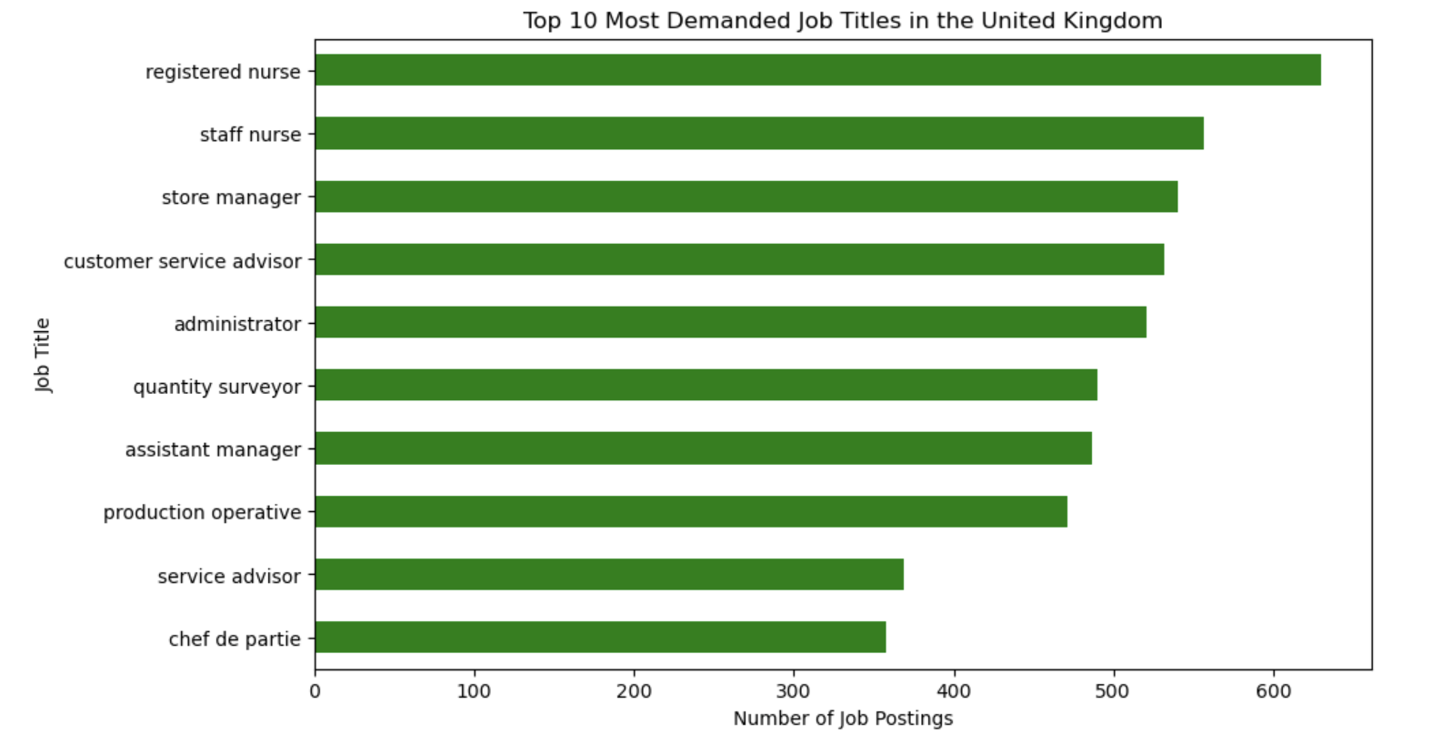
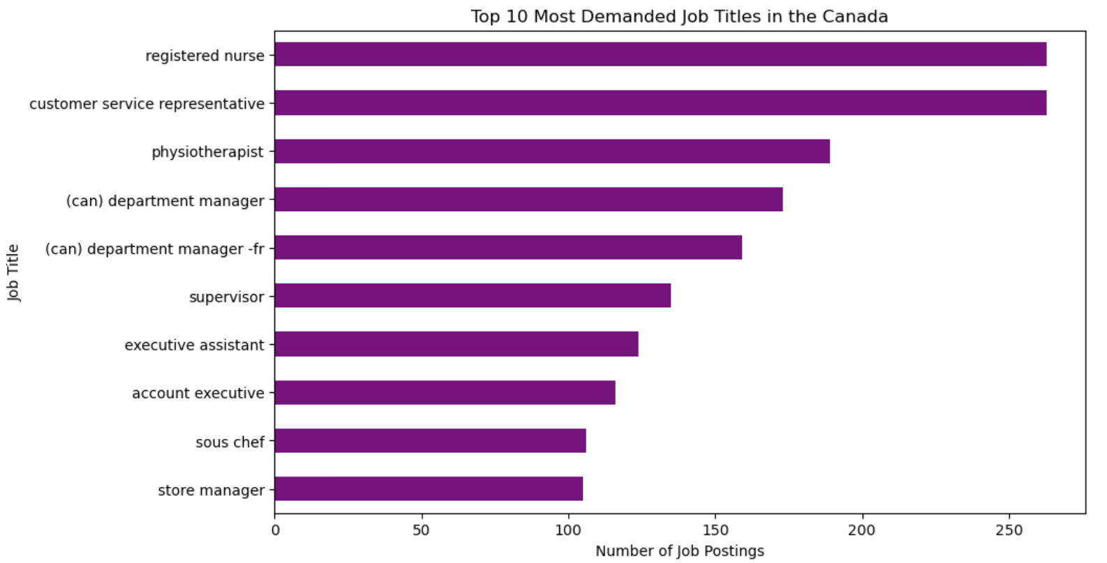
Job Demand In Different Countries:
Notes:
The length of each bar corresponds to the number of job postings for each listed job title, indicating the level of demand for that role. The longer the bar, the higher the demand for that job title. The “Customer Service Representative” role has the longest bar, indicating it is the most demanded job in US.

Slide 12
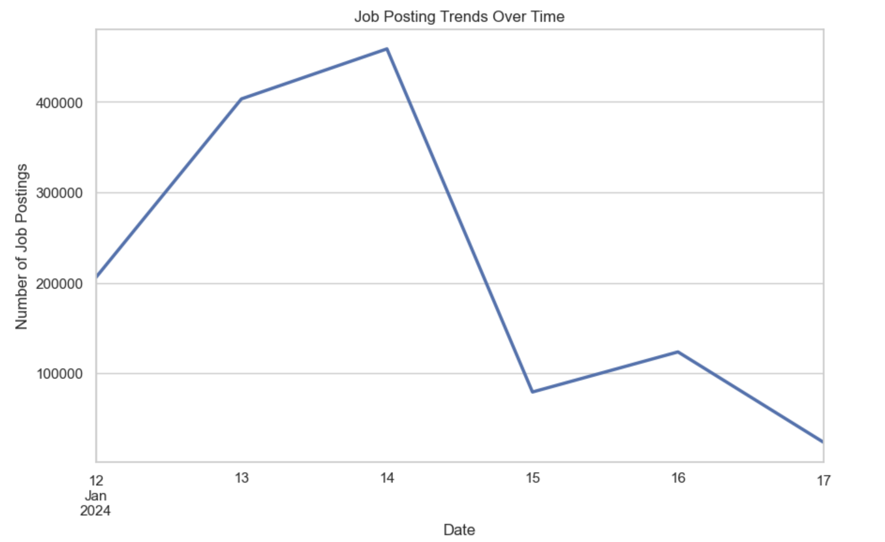
Job Posting Trends Over Time
The graph displays the number of job postings over a six-day period from January 12, 2024 to January 17, 2024.
This trend suggests that job seekers would have the most opportunities if they were to search for jobs around January 14. However, it’s important to note that these trends can vary and may not be the same in the future.
Notes:
The graph displays the number of job postings over a six-day period from January 12, 2024 to January 17, 2024.
The graph starts on January 12, with a relatively low number of job postings.
There is a significant increase in job postings in the following days, reaching its peak on January 14 with approximately 400,000 postings. This indicates that most of the jobs were posted on weekend days. (january,13- Saturday & january, 14-Sunday)
After reaching this peak, there is a sharp decline in the number of job postings. By January 17, the number of job postings drops to around 50,000. This sharp decline could be due to a variety of factors such as the end of a job posting cycle or a decrease in job availability.
This trend suggests that job seekers would have the most opportunities if they were to search for jobs around January 14. However, it’s important to note that these trends can vary and may not be the same in the future.

Slide 13
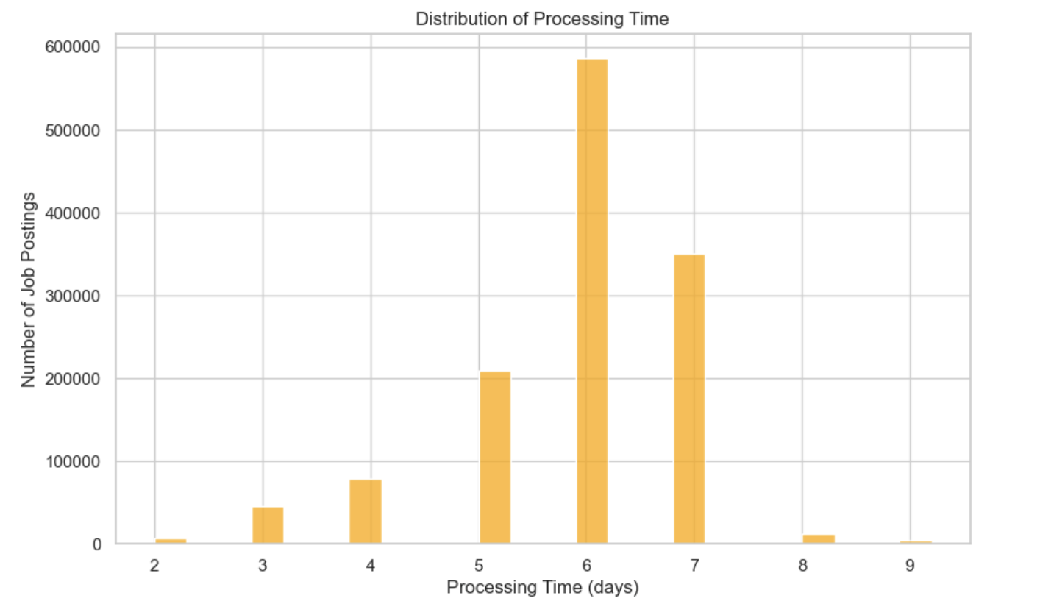
Distribution of Processing Time
The provided chart is a bar graph that represents the distribution of processing time for job postings.
This chart provides valuable insights into the distribution of processing times for job postings.
It can help in understanding the efficiency of the job posting process and identifying potential areas for improvement.
For instance, strategies could be developed to evenly distribute the processing load across all days to avoid significant fluctuations.
Notes:
Here are some insights based on the chart:
The chart shows the number of job postings processed within a specific number of days. The x-axis represents the “Processing Time (days)”, ranging from 2 to 9 days, while the y-axis represents the “Number of Job Postings”, reaching up to 600,000.
There are six bars representing data for processing times of jobs on different days. The bars for day 6 & day 8 have significantly higher values than others, with day six being the highest with over half a million job postings processed. This suggests that the sixth and eighth days were the most active in terms of job posting processing.
Days 2 through 5 and days 8 & 9 have very low values comparatively. This indicates that fewer job postings were processed on these days.
The chart shows a general trend of fluctuating processing times, with some days being more active than others. This could be due to various factors such as the volume of job postings received, the efficiency of the processing system, or the availability of resources on specific days.

Slide 14
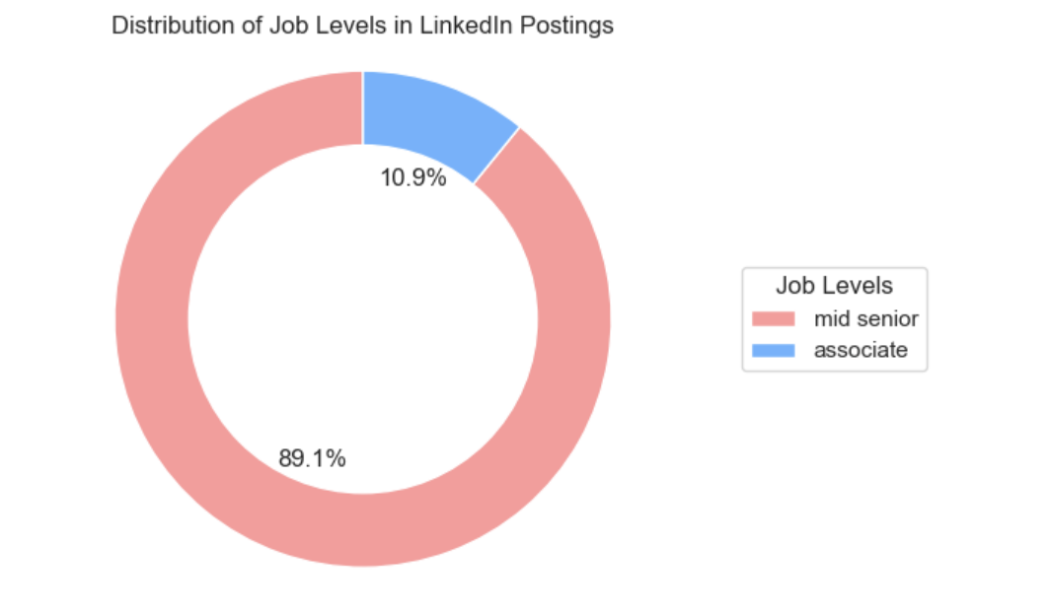
Distribution of Job Levels in LinkedIn Postings
The chart shows two job levels: mid-senior and associate. The mid-senior level jobs are depicted in pink and constitute the majority at 89.1%. On the other hand, associate level jobs are depicted in blue and make up 10.9% of the total.
This chart provides valuable insights into the job market dynamics on LinkedIn, particularly regarding the distribution of job levels. It can be useful for job seekers to understand where they might have the best chances of finding job postings that match their level of experience.
Notes:
This distribution indicates a higher demand or availability of mid-senior level jobs compared to associate level jobs on LinkedIn. It suggests that LinkedIn is a platform where more experienced professionals are likely to find opportunities that match their skill level.
However, the relatively smaller percentage of associate level jobs does not necessarily mean that there are fewer opportunities for less experienced professionals. It could also indicate that such jobs are not posted as frequently or that they get filled more quickly.

Slide 15
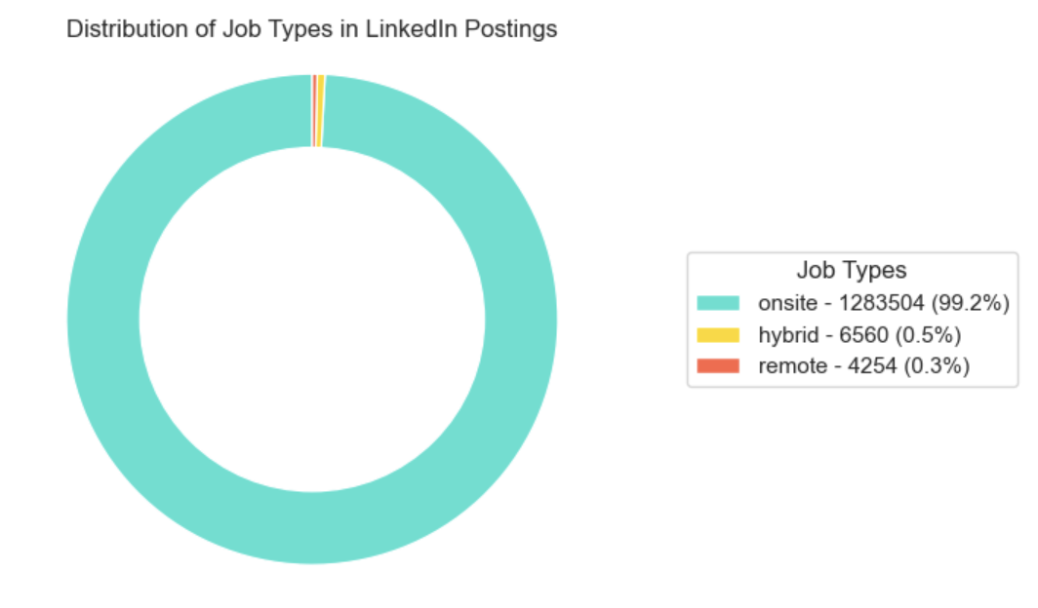
Distribution of Job Types in LinkedIn Postings
The chart shows three job types: onsite, hybrid, and remote. The onsite jobs are depicted in cyan and constitute the majority at 99.2%. Hybrid jobs are depicted in golden and make up 0.5% of the total, while remote jobs are depicted in red and account for 0.3%.
This chart provides valuable insights into the job market dynamics on LinkedIn, particularly regarding the distribution of job types. It can be useful for job seekers to understand where they might have the best chances of finding job postings that match their preferred work arrangement.
Notes:
This distribution indicates a significant dominance of onsite job postings on LinkedIn, suggesting that companies might still be largely favoring traditional in-office work settings.
Hybrid and remote job opportunities constitute a minimal portion of the total job postings, indicating limited availability or preference for these types of working arrangements.

Slide 16
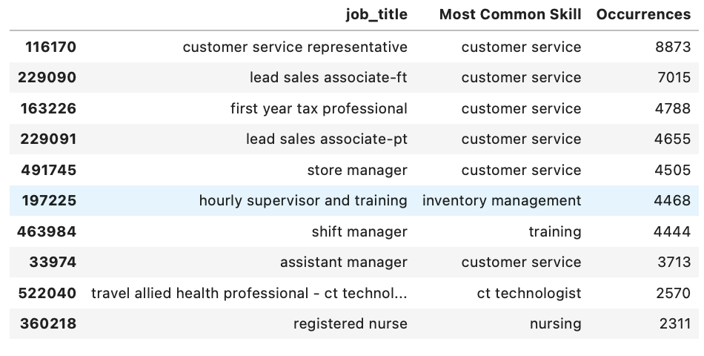
Most sought-after skills in different jobs
By finding the most common skill for each job title, you can get an idea of what skills are most in demand for each type of job. This can be useful for job seekers, recruiters, or anyone doing labor market research.

Slide 17
Job Recommendation System:
In an age marked by job cuts and economic uncertainty, the job market has become increasingly challenging for both experienced professionals and recent graduates. The aftermath of such disruptions has led to heightened competition and a pervasive sense of uncertainty for job seekers. One major challenge in this scenario is the mismatch between applicants' skills and the requirements of the positions they seek.
Objective: To create a job recommender system that accurately matches job seekers' skills with the most suitable job postings on LinkedIn, providing them with practical information and strategic advice.
Content-based recommendation is an approach that tailors suggestions to users based on how closely the attributes or content of item align with their preferences. In this project, this method will focus on recommending job titles based on the similarity between the skills of the job seeker and those listed in the job postings. It will also consider other user preferences such as job location, level, and type.
Retrieving data from MongoDB;
Running Spark Session;
Changing the data into Spark Dataframe and performing the following functions

Slide 18
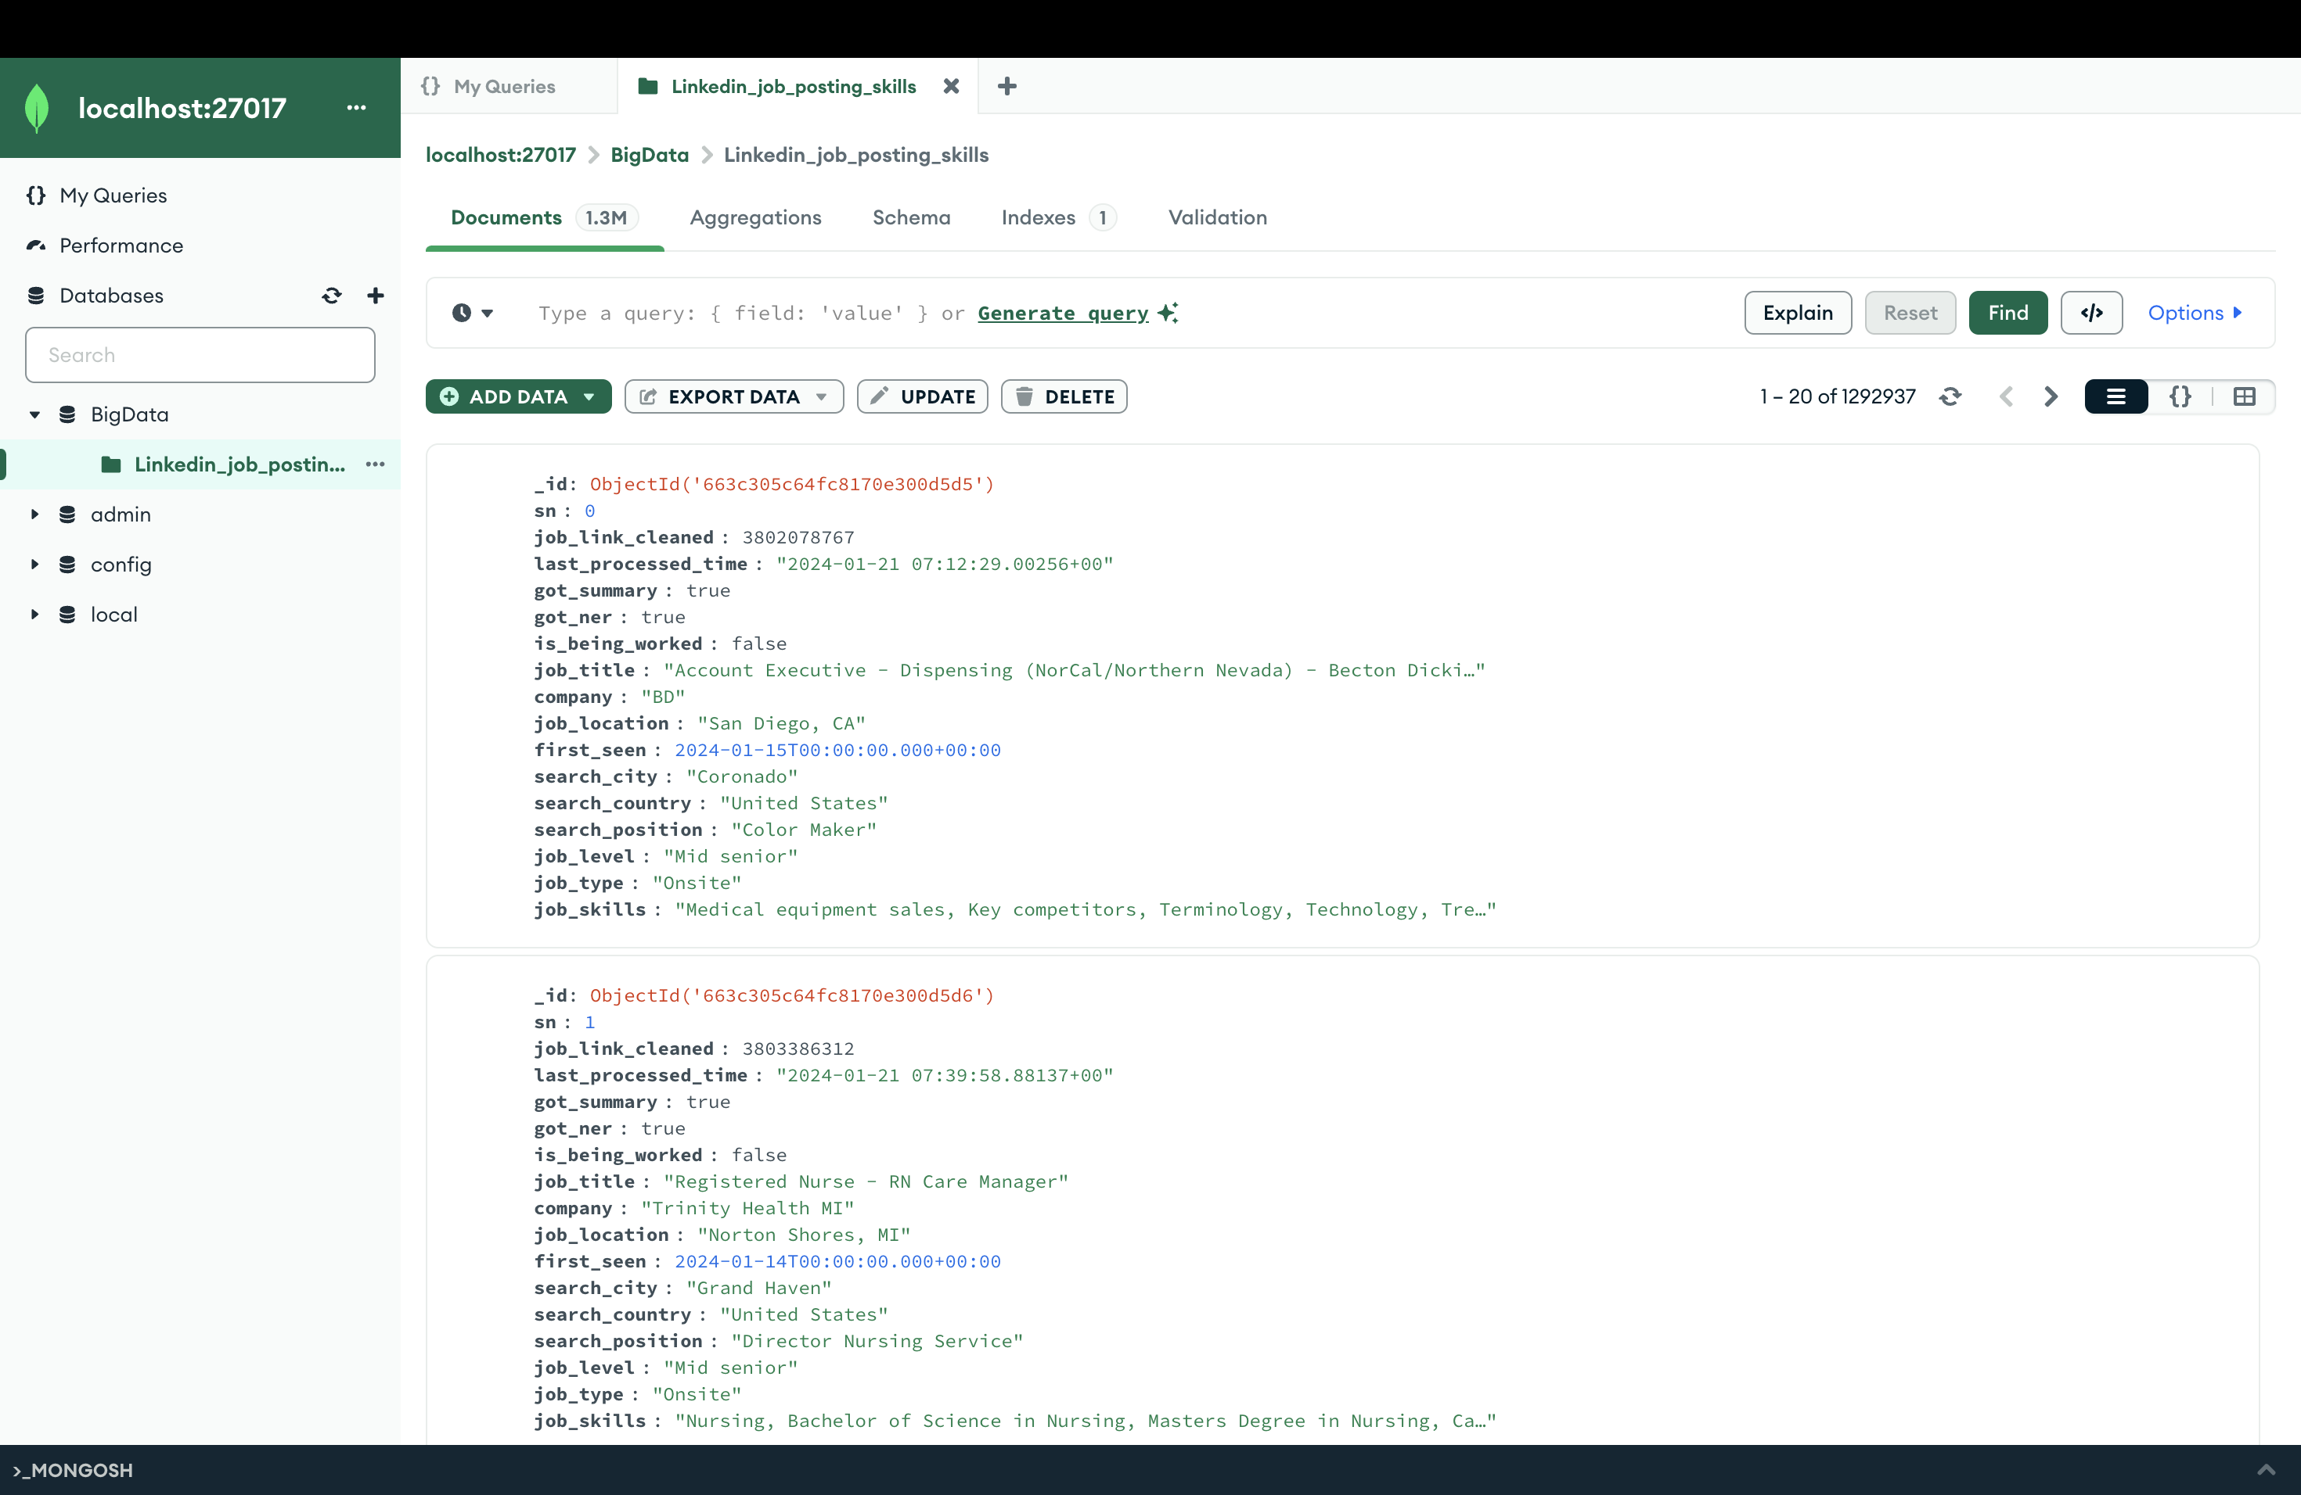

Slide 19
Job Recommendation System:
Pre-processing the "job_skills" column
Job skills were parsed and tokenized into a list as phrases like "data analysis" rather than individual words "data" and "analysis". This method enables a more precise representation and understanding of the skills needed for each job, ensuring that subsequent analyses are based on meaningful combinations of skills rather than isolated terms.
Applying CountVectorizer
This was achieved by fitting the cleaned “job skills” column using the CountVectorizer package in Pyspark. In order to control the size of the sparse vectors, we set a minimum document frequency threshold of 100, filtering out less common or potentially noisy job skill phrases in order to focus on skills that occur with sufficient frequency and relevance across the dataset.
Calculate TFIDF & Completing the Item (Job Listing) Profile
The Inverse Document Frequency (IDF) is computed to assess the importance of each term across the entire data set, more frequently appearing job skill phrases will be given a lower weightage. This IDF value is then scaled with the TF values to compute the Term Frequency - Inverse Document Frequency (TF-IDF) scores. The TF-IDF gives a score that measures how important a job phrase is, in relation to the other job phrases that appear in the LinkedIn job dataset.
Preparing the User Profile (Test Cases)
The user profile (test cases) is constructed based on the job seeker’s input, consisting of the key job attributes including the job location (city and country), level, type and skillset.
The user’s preference for job city, country, level and type will constitute the Spark SQL query used to filter the item profile.
Notes:
Pre-processing the jobskills column;
Job skills were parsed and tokenized into a list as phrases like "data analysis" rather than individual words "data" and "analysis". This method enables a more precise representation and understanding of the skills needed for each job, ensuring that subsequent analyses are based on meaningful combinations of skills rather than isolated terms.
Lemmatization, a crucial step in the data cleaning process, involves reducing words to their base or root form, thereby standardizing variations and improving the consistency of the dataset. This process is particularly valuable for maintaining semantic coherence and enhancing the accuracy of subsequent analyses.
Additionally, removing stop words plays a significant role in refining the dataset by eliminating common words that contribute little to the overall meaning. By filtering out stop words, the focus shifts to meaningful content, thereby improving the quality and relevance of the processed data.
Applying CountVectorizer
This step is akin to calculating the Term Frequency (TF) of each job skill. This is a measure of how frequently a job skill phrase appears in the dataset of job postings.
This was achieved by fitting the cleaned “job skills” column using the CountVectorizer package in Pyspark. In order to control the size of the sparse vectors, we set a minimum document frequency threshold of 100, filtering out less common or potentially noisy job skill phrases in order to focus on skills that occur with sufficient frequency and relevance across the datas
Calculate TFIDF & Completing the Item (Job Listing) Profile
Next, the Inverse Document Frequency (IDF) is computed to assess the importance of each term across the entire data set, more frequently appearing job skill phrases will be given a lower weightage.
This IDF value is then scaled with the TF values to compute the Term Frequency - Inverse Document Frequency (TF-IDF) scores. The TF-IDF gives a score that measures how important a job phrase is, in relation to the other job phrases that appear in the LinkedIn job dataset.
Similar to the data cleaning steps for job listing skills described in sections 3-5, each input user skill phrase will be tokenized, lemmatized and stopwords removed. Subsequently, the TF-IDF sparse vector will be calculated based on the CountVectorizer & IDF fitted on the skills within job listings described in section 5, thereby forming the user’s skills profile.

Slide 20
Job Recommendation System:
Building the SQL Query & Filtered Item (Job Listing) Profile
In order to reduce the number of job listings that need to be compared for skills similarity as well as make the search more efficient and targeted, the PySpark dataframe containing the full item profile is filtered using a SQL query to obtain listings that match the user’s desired (i) job location, (ii) level and/or (iii) skills. These three features are optional, and the user may fill them in any combination, or not at all (in which the entire item profile will be assessed). The resulting dataframe will form the ‘filtered’ item profile.
Define the Cosine Similarity Function
Recommendation Algorithm: Matching Most Relevant Jobs Based on User's Skills
Based on the skills TF-IDF vectors from the item (for each job listing) and user profile, the cosine similarity scores are calculated. A higher score suggests a higher degree of similarity between the job requirements and the user's skill set, making the job more relevant and suitable for the user. The final recommendation to the user includes the top 5 most relevant jobs with the highest cosine similarity scores.
The output is then exported to output_job_skills_match.csv
Notes:
7. Building the SQL Query & Filtered Item (Job Listing) Profile
In order to reduce the number of job listings that need to be compared for skills similarity as well as make the search more efficient and targeted, the PySpark dataframe containing the full item profile is filtered using a SQL query to obtain listings that match the user’s desired (i) job location, (ii) level and/or (iii) skills. These three features are optional, and the user may fill them in any combination, or not at all (in which the entire item profile will be assessed). The resulting dataframe will form the ‘filtered’ item profile.
Recommendation Algorithm: Matching Most Relevant Jobs Based on User's Skills
Based on the skills TF-IDF vectors from the item (for each job listing) and user profile, the cosine similarity scores are calculated. A higher score suggests a higher degree of similarity between the job requirements and the user's skill set, making the job more relevant and suitable for the user. The final recommendation to the user includes the top 5 most relevant jobs with the highest cosine similarity scores.

Slide 21
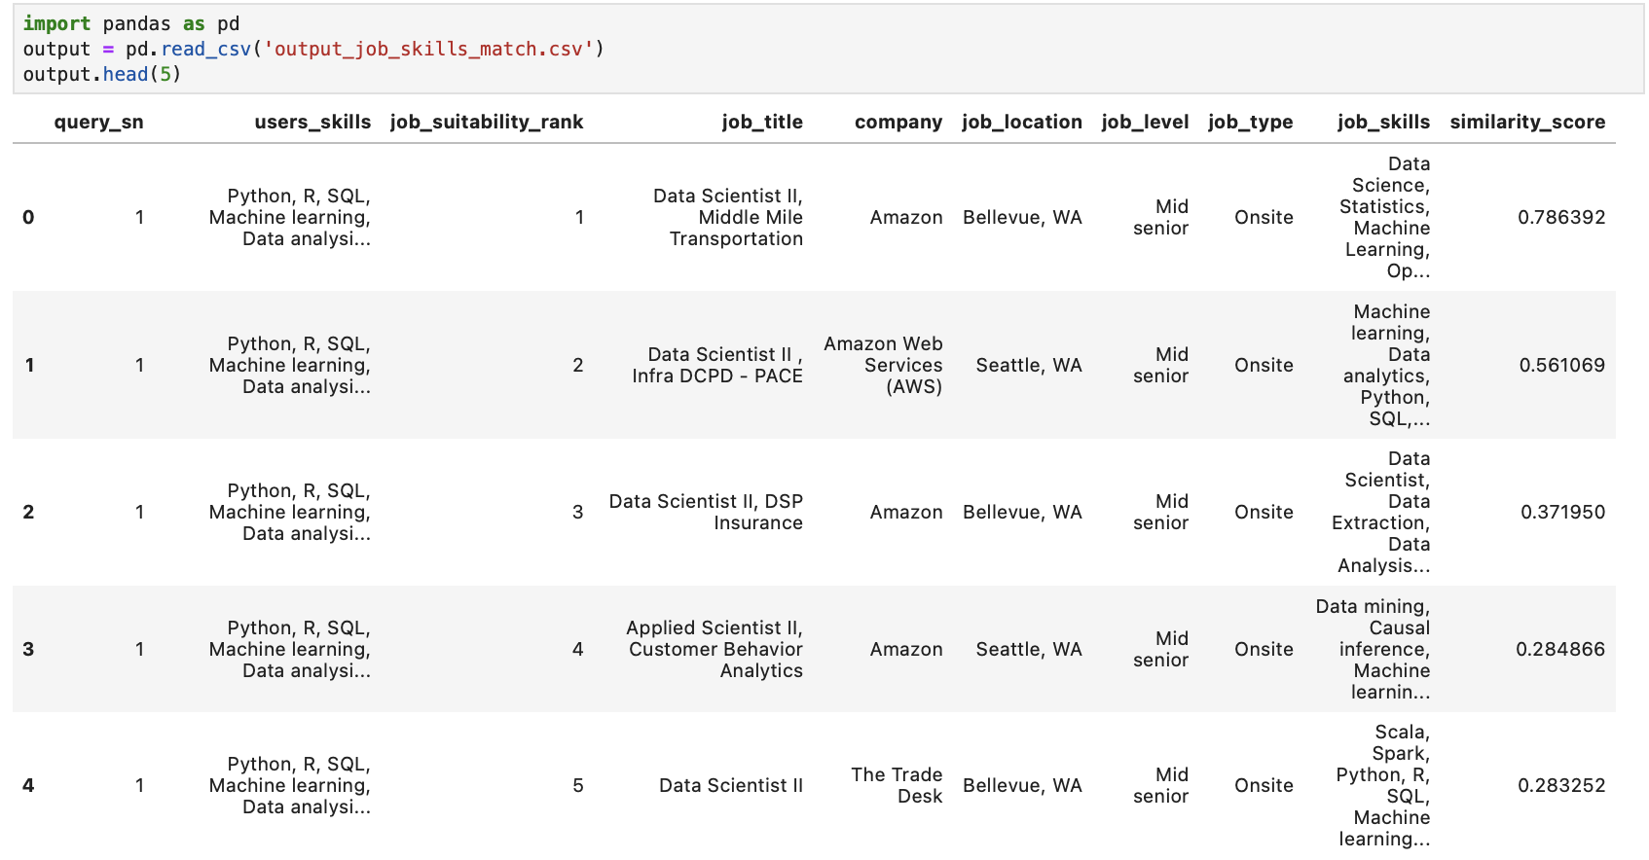
Job Recommendation System:

Slide 22
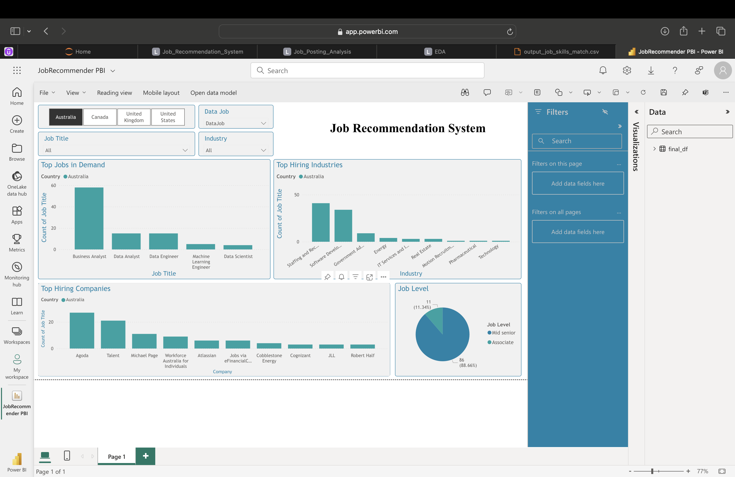
Power BI Report

Slide 23
Future Opportunities:
Enhanced Personalization: Developing more advanced recommendation systems that consider a broader range of user data, such as past job experiences, education, and endorsements, to provide even more personalized job suggestions.
Market Trend Prediction: Using machine learning algorithms to analyze historical job posting data and predict future job market trends, helping job seekers and employers anticipate changes and adapt their strategies accordingly.
Skill Gap Analysis: Conducting in-depth analysis to identify skill gaps in the job market and provide recommendations for individuals and organizations to bridge these gaps through training and education programs.
Real-time Job Matching: Implementing real-time job matching algorithms that instantly match job seekers with open positions as soon as they are posted, increasing efficiency for both job seekers and recruiters.
Competitive Intelligence: Providing tools for companies to analyze their competitors' hiring trends and strategies, enabling them to stay competitive in the talent market.
Geospatial Analysis: Incorporating geospatial analysis to understand job market dynamics in different regions, helping job seekers identify locations with higher demand for their skills.

Slide 24
Upcoming technologies that have the potential to impact the business strategy:
Natural Language Processing (NLP): NLP can enhance the analysis of job postings by extracting more nuanced information from job descriptions, such as required skills, qualifications, and responsibilities, leading to more accurate job matching and recommendation systems.
Machine Learning (ML) and Artificial Intelligence (AI): ML and AI algorithms can improve the accuracy of job recommendations by analyzing user behavior and preferences, as well as by predicting future job market trends based on historical data.
Blockchain: Blockchain technology can be used to verify the authenticity of job postings and candidates' credentials, reducing the risk of fraudulent job postings and improving the overall trustworthiness of the job market.
Big Data Analytics: Advanced big data analytics techniques can enable deeper insights into job market trends, company hiring patterns, and skill mapping, allowing for more informed decision-making by job seekers and employers.

Slide 25
References:
Hosain, Md & Liu, Ping. (2020). LinkedIn for Searching Better Job Opportunity: Passive Jobseekers' Perceived Experience. The Qualitative Report. 25. 3719-3732. 10.46743/2160-3715/2020.4449.
Utz S, Breuer J. The Relationship Between Networking, LinkedIn Use, and Retrieving Informational Benefits. Cyberpsychol Behav Soc Netw. 2019 Mar;22(3):180-185. doi: 10.1089/cyber.2018.0294. Epub 2019 Jan 16.
Eseryel, U. & Booij, Richard & Eseryel, Deniz. (2018). Recruitment through Linkedin: Lessons learned from the Fortune 100 Companies.

Slide 26

THANK YOU

