Slide 1
University of Maryland, Baltimore county MPS Data Science, Fall 2023 Data 601 project Presentation #2 group #5 financial risk analysis in stock market
Professor – Dr. Ajinkya Borle
Project Team:
Sai Manvitha Nadella - FT44056
Rinee Chesna Anand - SY44333
Sivateja Gopinatham - ZO27532
Sampath Kumar Rayavarapu - TW34813
Jaya Prakash Gangineni - KX35537

Slide 2
RE-CAP OF THE MOTIVE:
We will analyze the portfolio of stocks to provide consultation on investment management based on the investor’s requirements.
We will explore how data science methodologies, techniques, and tools are leveraged to analyze and assess financial risks. We will delve into the significance of this field, its real-world applications, and the impact it can have on financial stability and profitability.
Yet to Find!!
What are the trends identified?
How could these trends apply to investors?
How could these trends help influence investment strategy?
How to identify the right investment opportunity and recommend a portfolio as per the investor's exact need?

Slide 3
Technologies/tools to be used:
Python
Jupyter Notebook Interface
Tableau
Libraries:
Numpy
Pandas
Matplotlib, seaborn
datetime
Development Environment
Data Manipulation, Data Analysis, Statistical Analysis
Data Visualization, Reporting

Slide 4
General framework (RECAP):
Ask: Understand the background, business task and objectives, key deliverables.
Prepare: Collect the data which is stored in CSV files and this data is of leading companies listed in New York Stock Exchange and 1 file market benchmark S&P 500 index prices for the same period.
Process: Preparing the environment, importing dataset, data cleaning and manipulation.
Analyze: Performing statistical analysis like (annualized risk, annualized returns, cumulative returns and sharp ratio) and analyzing the trends in data.
Share: Visualizing data and findings, normalization, visualization of normalized data.
Act: Delivering insights and providing recommendations based on the analysis.

Slide 5
Step 1: ASK
Taking the Investors’ Portfolio
Types of Investors:
Conservative
Aggressive
Amount to be Invested:
High or Low
How to identify the right investment opportunity and recommend a portfolio as per the investor's exact need?
Return on investment: sometimes called the rate of return (ROR)—is the percentage increase or decrease in an investment over a set period.

Slide 6
Step 2: prepare
The data is stored in 24 CSV files and this data is of 24 leading companies listed in New York Stock Exchange (Kaggle) and 1 file market benchmark S&P 500 index prices for the same period.
The information for every stock ranges from 1st October 2010 to 30th September 2020.
The stocks belong to different domains:
Technology / ITeS
Travel/Aviation/Hospitality
Banking/Financial Services and Insurance
Pharmaceuticals/Healthcare/Life Sciences

Slide 7
Step 2: prepare
DATA COLUMNS :
- Date
- Open price: Price of stock at the start of the day
- Close price: Price of stock at the end of the day
- High price: Highest price reached by the stock on that day
- Low price: Lowest price reached by the stock on that day
- Adjusted close price: Stock price adjusted to include the annual returns (dividends) that the company offers to the shareholders
- Volume traded: Number of stocks traded on the day

Slide 8
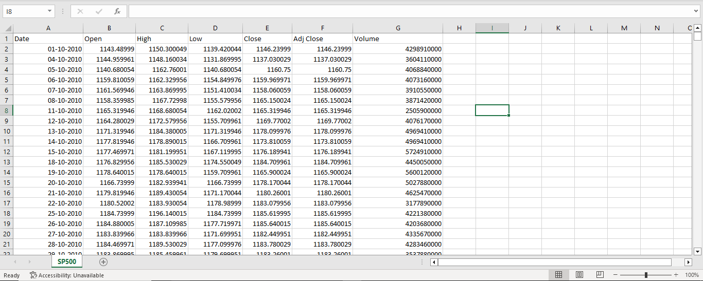

Slide 9
Step 2: prepare
LIMITATIONS OF DATASET:
Data collected from 1st October 2010 to 30th September 2020.
There are 24 different files we must merge them in one file to do statistical analysis.

Slide 10
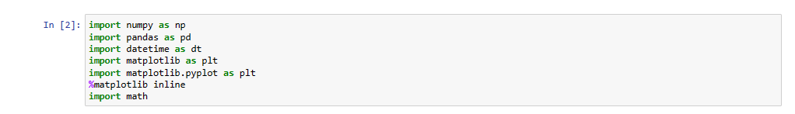
Step 3: process
Preparing the environment for project.
Installing the necessary packages for the project.
Numpy
Pandas
Matplotlib
DateTime

Slide 11
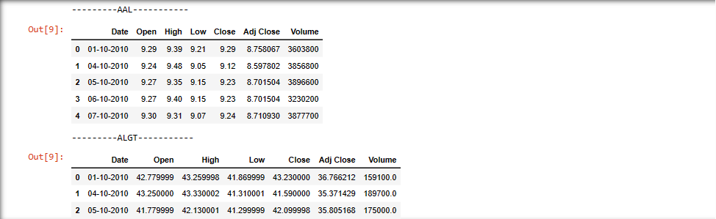
Step 3: process
Importing the Dataset
Data Cleaning and Manipulation
Observe and familiarize with data
Check for null or missing values
Perform sanity check of data

Slide 12
Step 3: PROCESS
Things in progress:
Treating Missing Values
Merging the datasets
Renaming the columns for statistical analysis.
Changing Datatype of Date Field to Datetime for Time-Series analysis.

Slide 13

THANK YOU

