Slide 1
Infosys Springboard Internship Project Food – Ordering - System

Slide 2

Introduction
Project Title: Online Food Ordering System
Technologies Used: Django, SQLite3
Overview: A multi-role platform for customers, restaurants, and delivery personnel with custom navigation and functionality.

Slide 3
Modules used
Django Framework
Apps : accounts, restaurant, delivery, customer
SQLite3 Database
Pillow : Used for image processing in Django projects
How to install : pip install <module_name>

Slide 4
Commands used in terminal
Create Django Project: django-admin startproject <project_name>
Create Django App: python manage.py startapp <app_name>
Virtual Environment :-
Create: python -m venv <env_name>, Activate: <venv_name>\Scripts\activate
Migrations:
python manage.py makemigrations (Generates migration files based on the changes in your models, preparing the SQL needed to modify the database schema.)
python manage.py migrate (Applies the generated migrations to the database, executing SQL commands to sync the database schema with the current models.)
Run Server: python manage.py runserver

Slide 5
Usage of files in django project
manage.py: Entry point for running the server, migrations, and project setup.
settings.py: Configuration settings for the project.
urls.py: URL routing for different views.
models.py: Database models definition.
views.py: Handles logic for each view.
templates/: HTML files for each app's pages.

Slide 6
Models - Database Design
Customer App:-
Customer: User login and signup
Cart Item: Stores items added to cart
Delivery App:
Delivery: User login and signup
Restaurant App:
Restaurant: User login and signup
MenuItems: Stores menu items for the restaurant

Slide 7
Views
Customer App:-
Functionalities:
Signup, Login
Home, About
Food Items (Displays restaurants)
Menu (Items per restaurant)
Cart (Add, View), Profile View and Edit
Accounts App:
select_role: Role selection page
redirect_login: Redirects to role-specific login
logout: Sign out for all roles
Restaurant App:
Functionalities:
Signup, Login
Home, About
Menu (View, Edit, Delete Items)
Orders (Manage customer orders)
Delivery App:
Functionalities:
Signup, Login
Home, About
To Be Delivered, Delivered Orders

Slide 8
URLS
Base URL: http://127.0.0.1:8000/
uuid means : UUIDs ensure that each restaurant has a globally unique identifier, avoiding potential conflicts even if records are imported from different sources or databases.
Restaurant App URLs:
/signup/ - Restaurant signup page
/login/ - Restaurant login page
/<uuid:restaurant_id>/home/ - Restaurant home page
/<uuid:restaurant_id>/about/ - About page for a specific restaurant
/<uuid:restaurant_id>/orders/ - View orders for the restaurant
/<uuid:restaurant_id>/menu/ - Restaurant menu page
/menu/edit/<int:item_id>/ - Edit menu item
/delete_item/<int:item_id>/ - Delete menu item
Delivery App URLs:
/signup/ - Delivery signup page
/login/ - Delivery login page
/home/ - Delivery home page
/about/ - Delivery about page
/to_be_delivered/ - Orders to be delivered
/delivered/ - Delivered orders page

Slide 9
URLS
Customer App URLs:
/signup/ - Customer signup page
/login/ - Customer login page
/home/ - Customer home page
/about/ - Customer about page
/food_items/ - List of restaurants with food items
/restaurant/<uuid:restaurant_id>/menu/ - Menu for a specific restaurant
/add-to-cart/ - Add items to cart
/cart/ - View cart
/profile/ - Customer profile page
/profile/edit/ - Edit profile
Accounts App URLs:
/ - Role selection page
/redirect_login/ - Redirect to role-specific login
/logout/ - Logout for all roles

Slide 10
Website urls & images

Slide 11
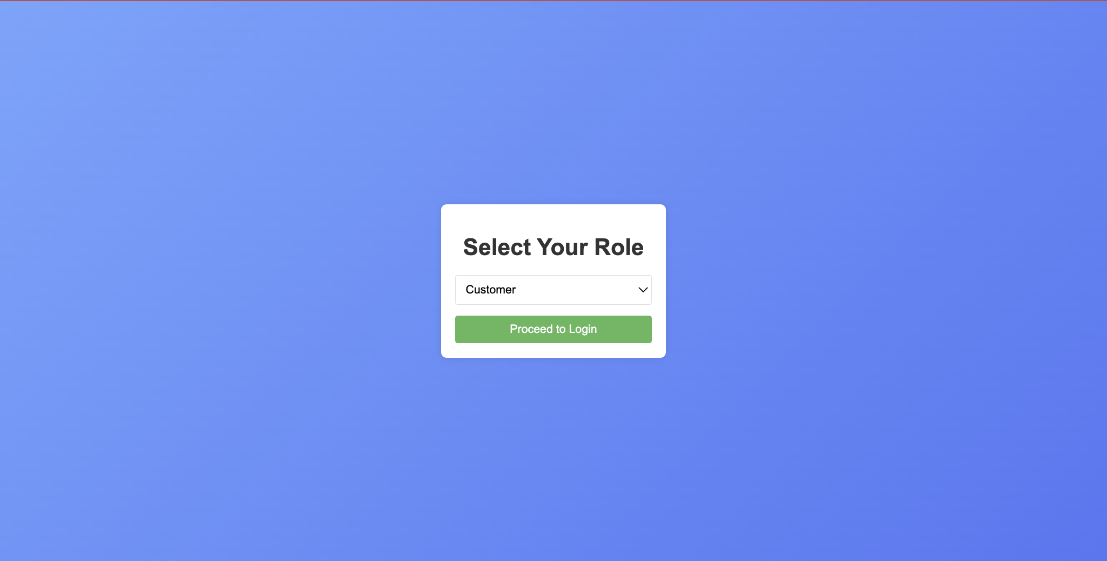
http://127.0.0.1:8000/

Slide 12
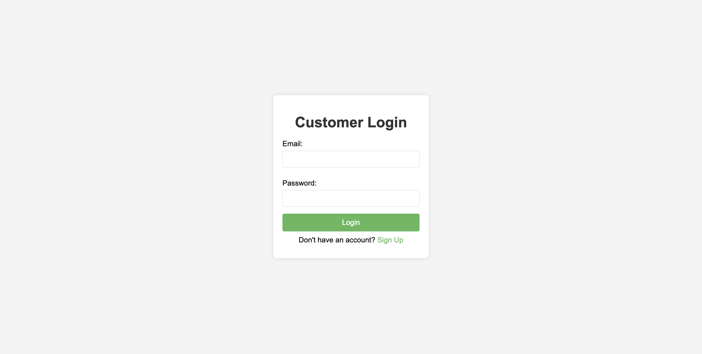
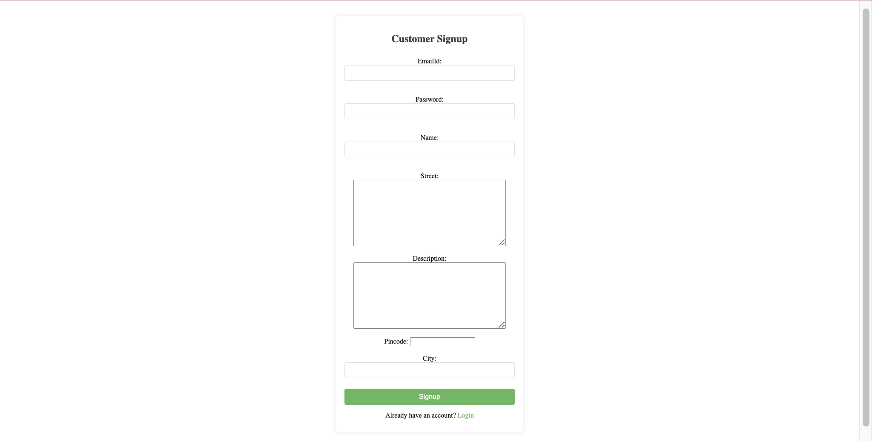
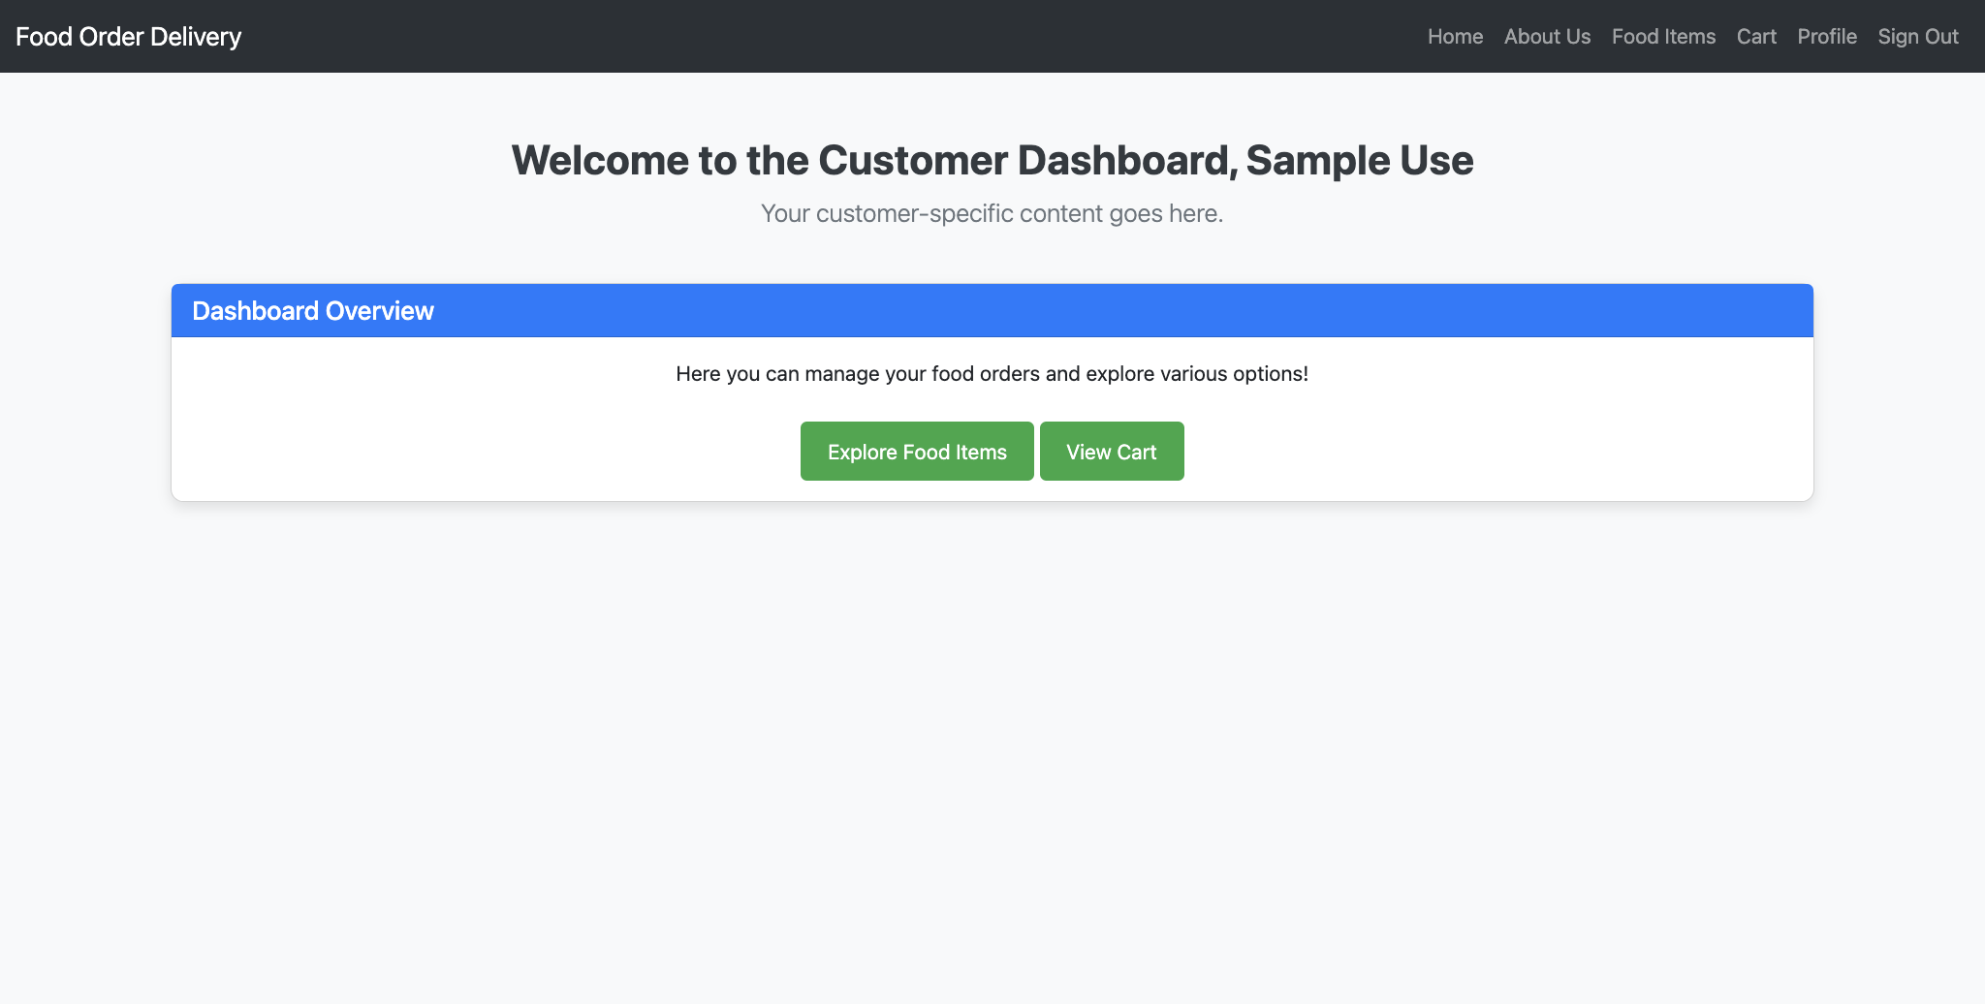
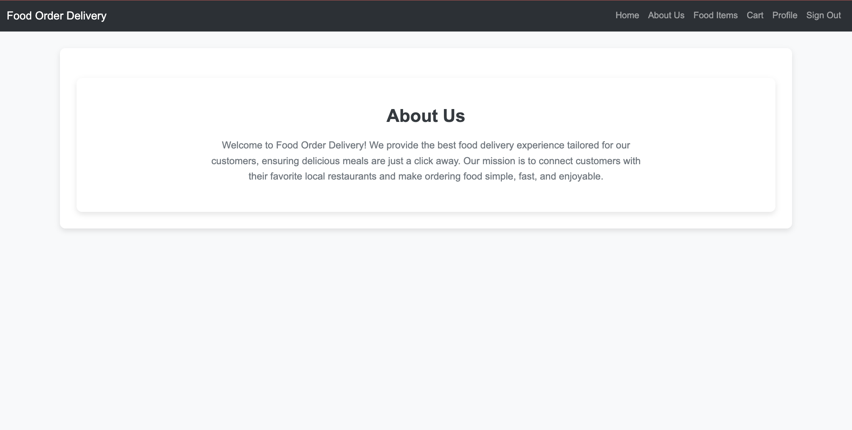
http://127.0.0.1:8000/customer/signup/
http://127.0.0.1:8000/customer/login/
http://127.0.0.1:8000/customer/home/
http://127.0.0.1:8000/customer/about/
http://127.0.0.1:8000/customer/food_items/
http://127.0.0.1:8000/customer/restaurant/<uuid:restaurant_id>/menu/
http://127.0.0.1:8000/customer/add-to-cart/
http://127.0.0.1:8000/customer/cart/
http://127.0.0.1:8000/customer/profile/
http://127.0.0.1:8000/customer/profile/edit/

Slide 13
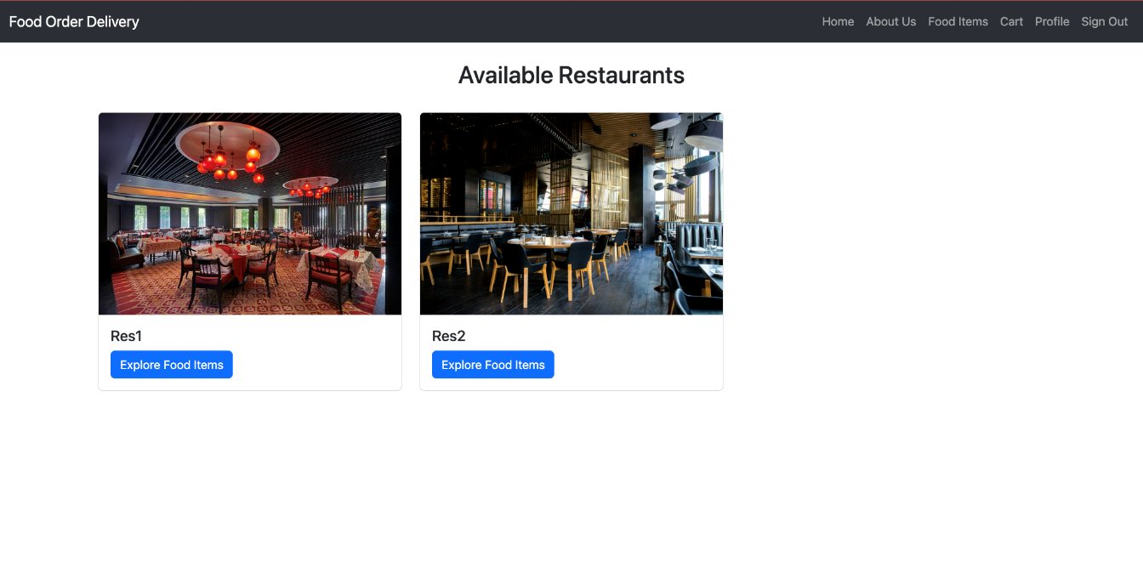
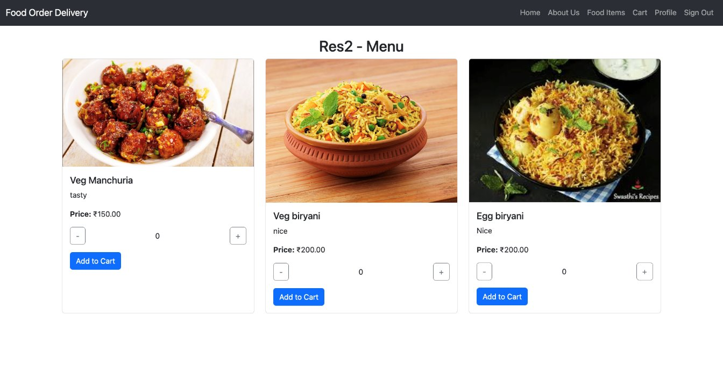
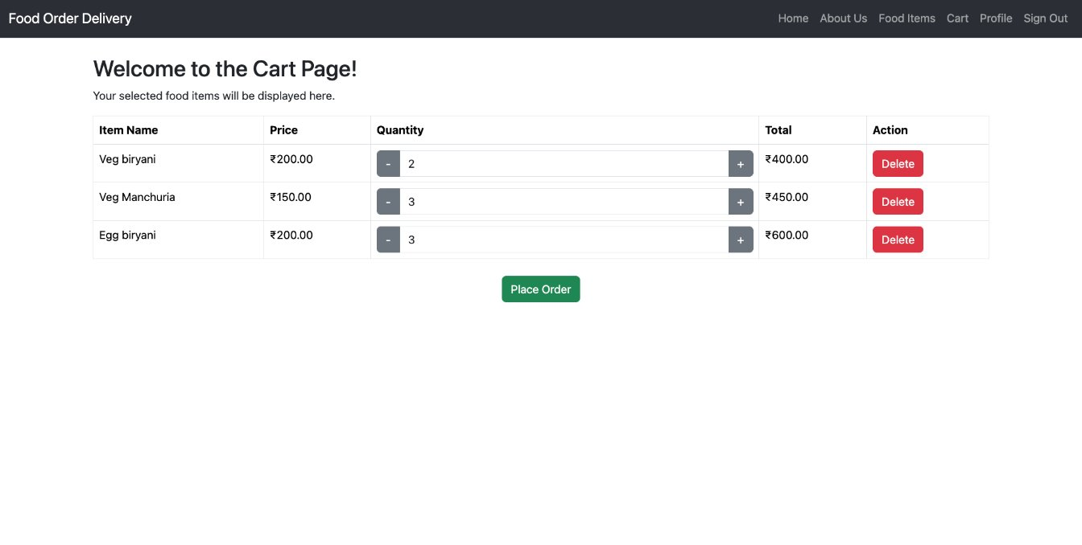
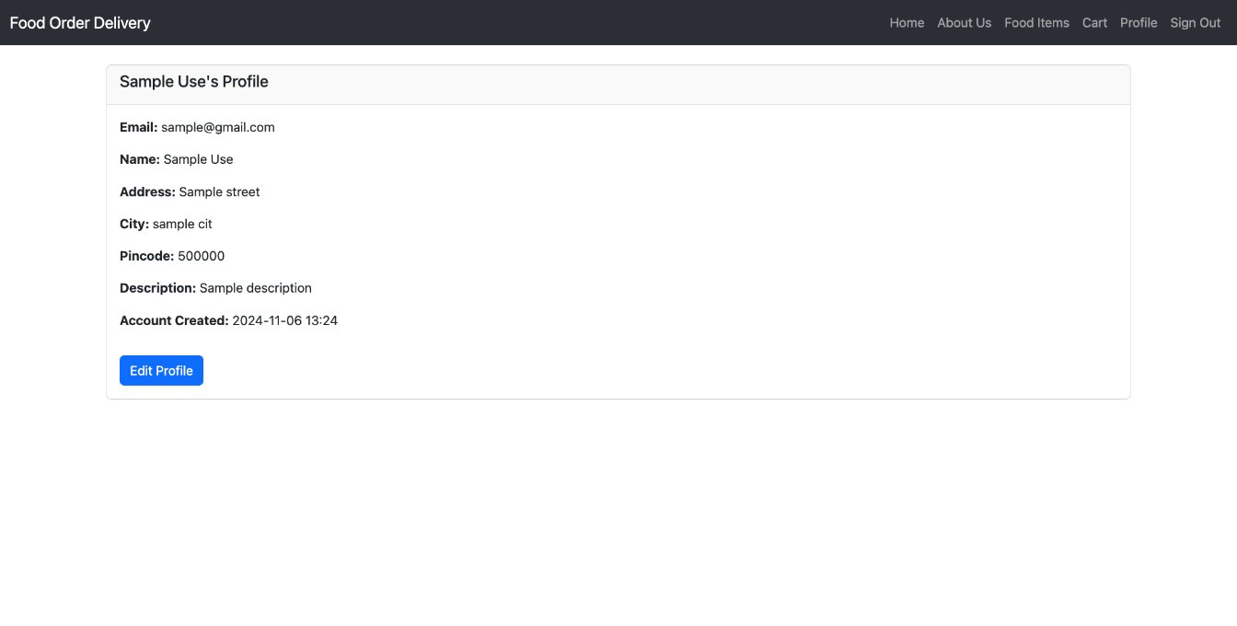
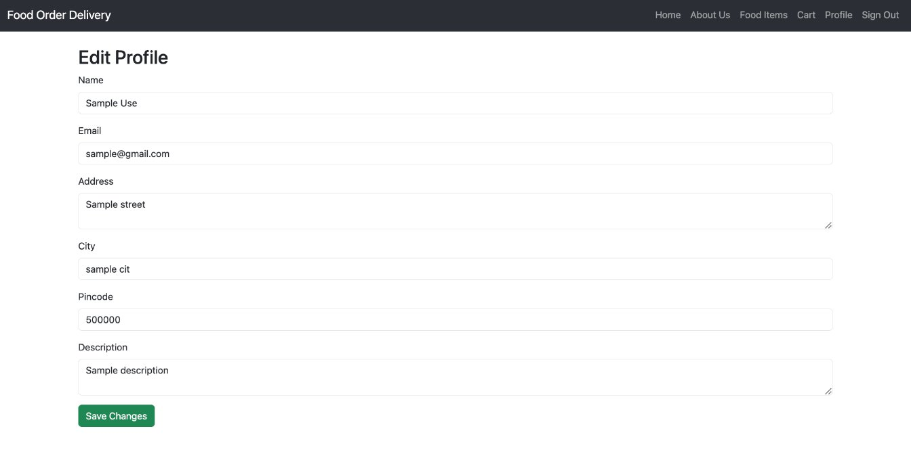

Slide 14
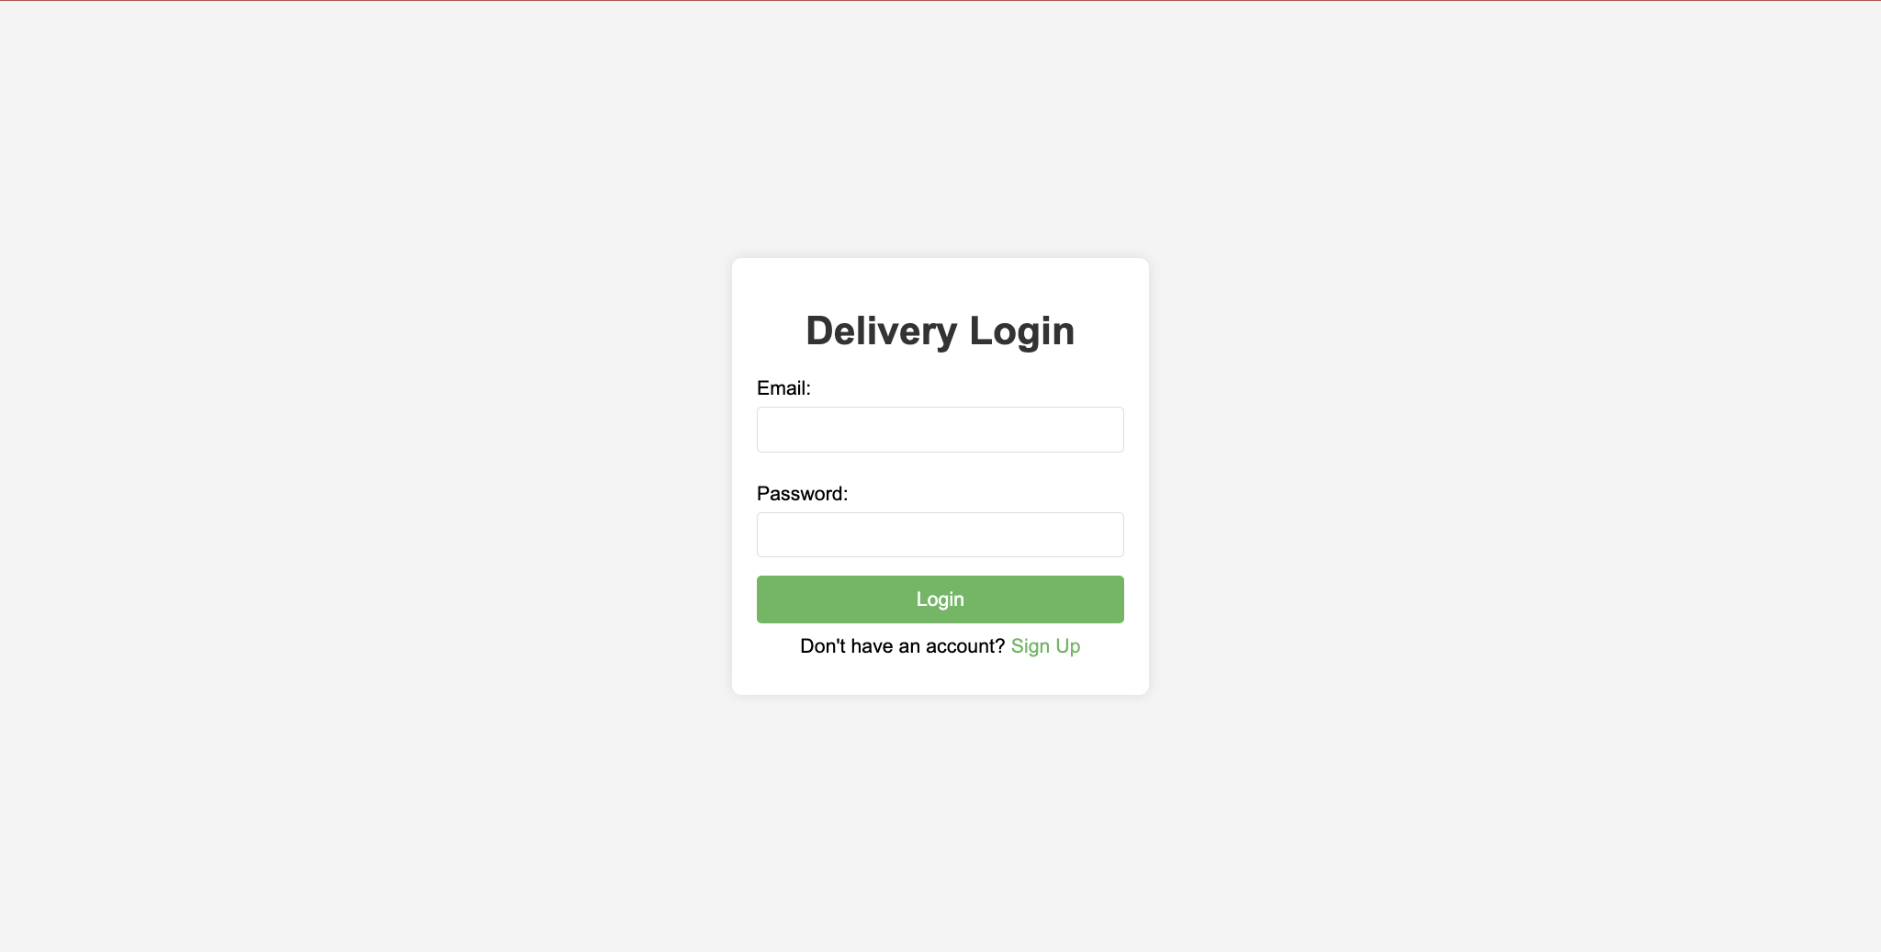
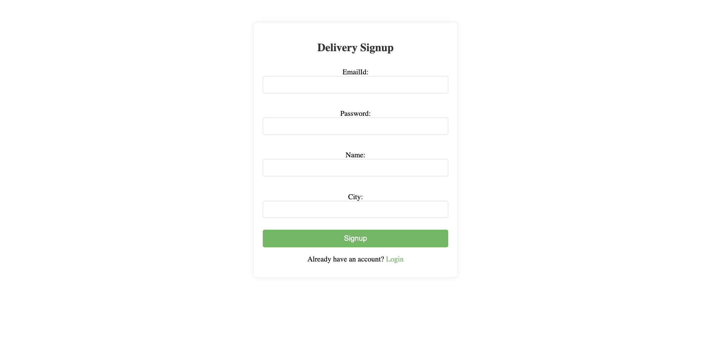
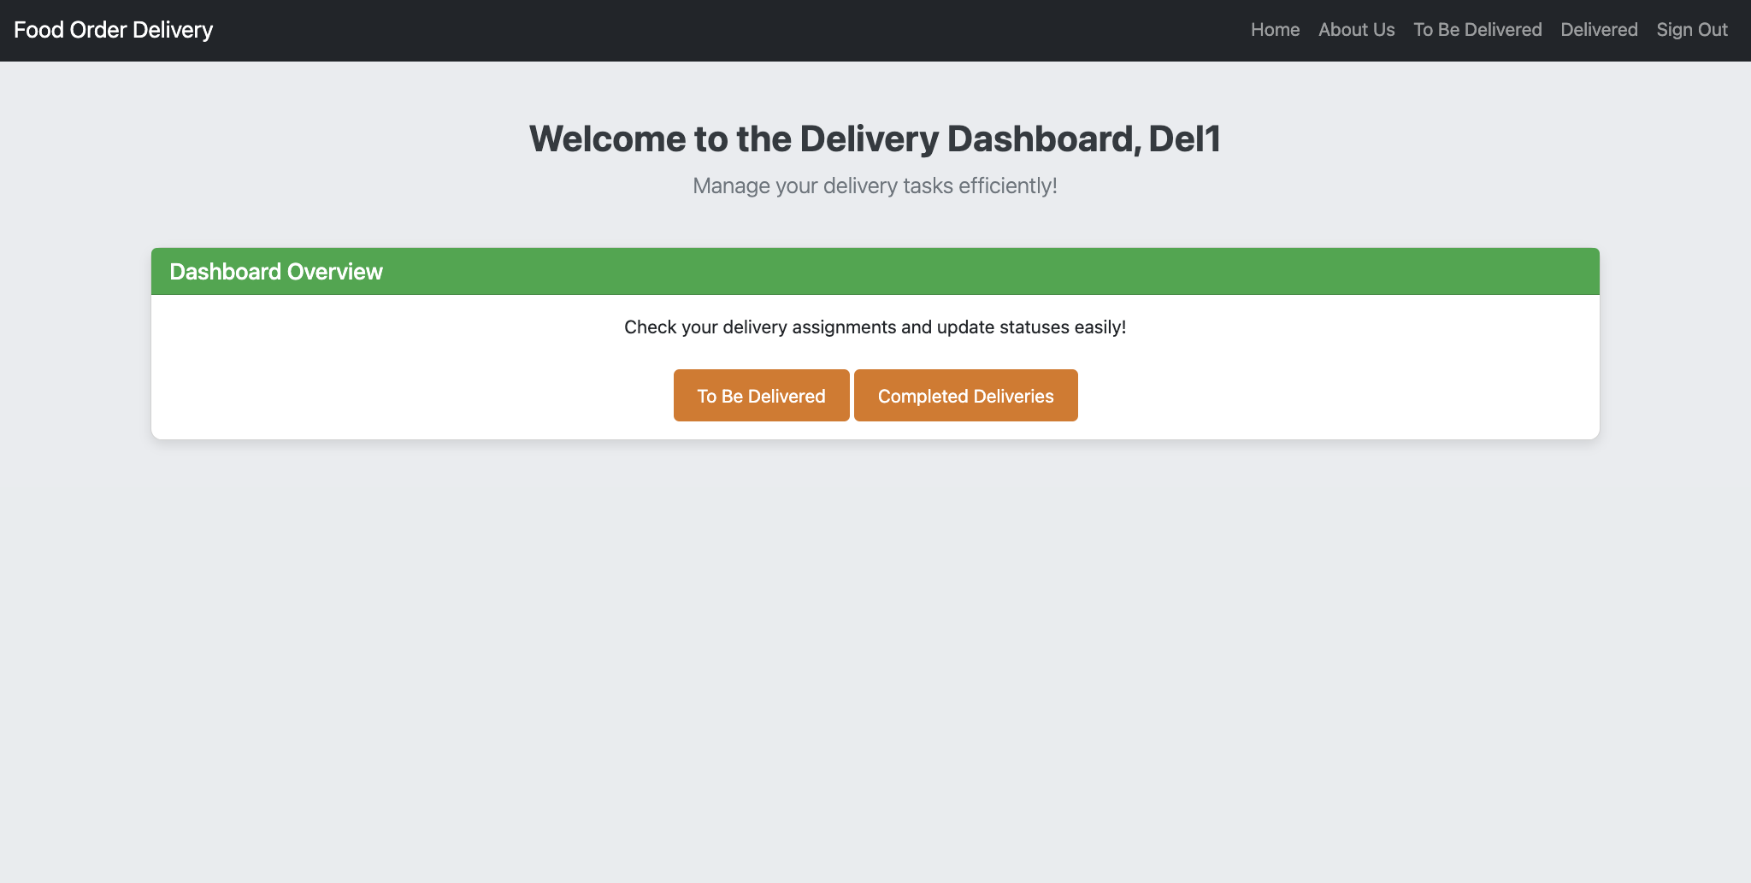
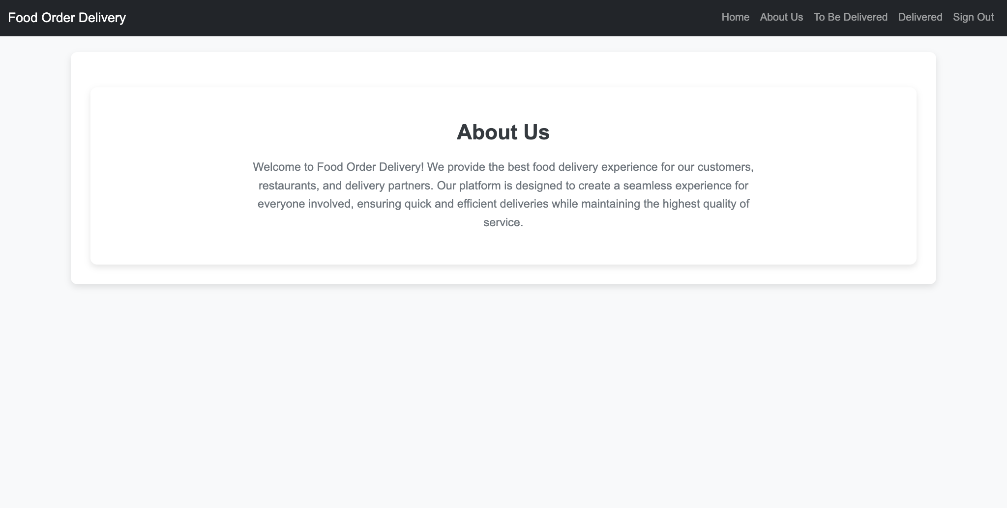
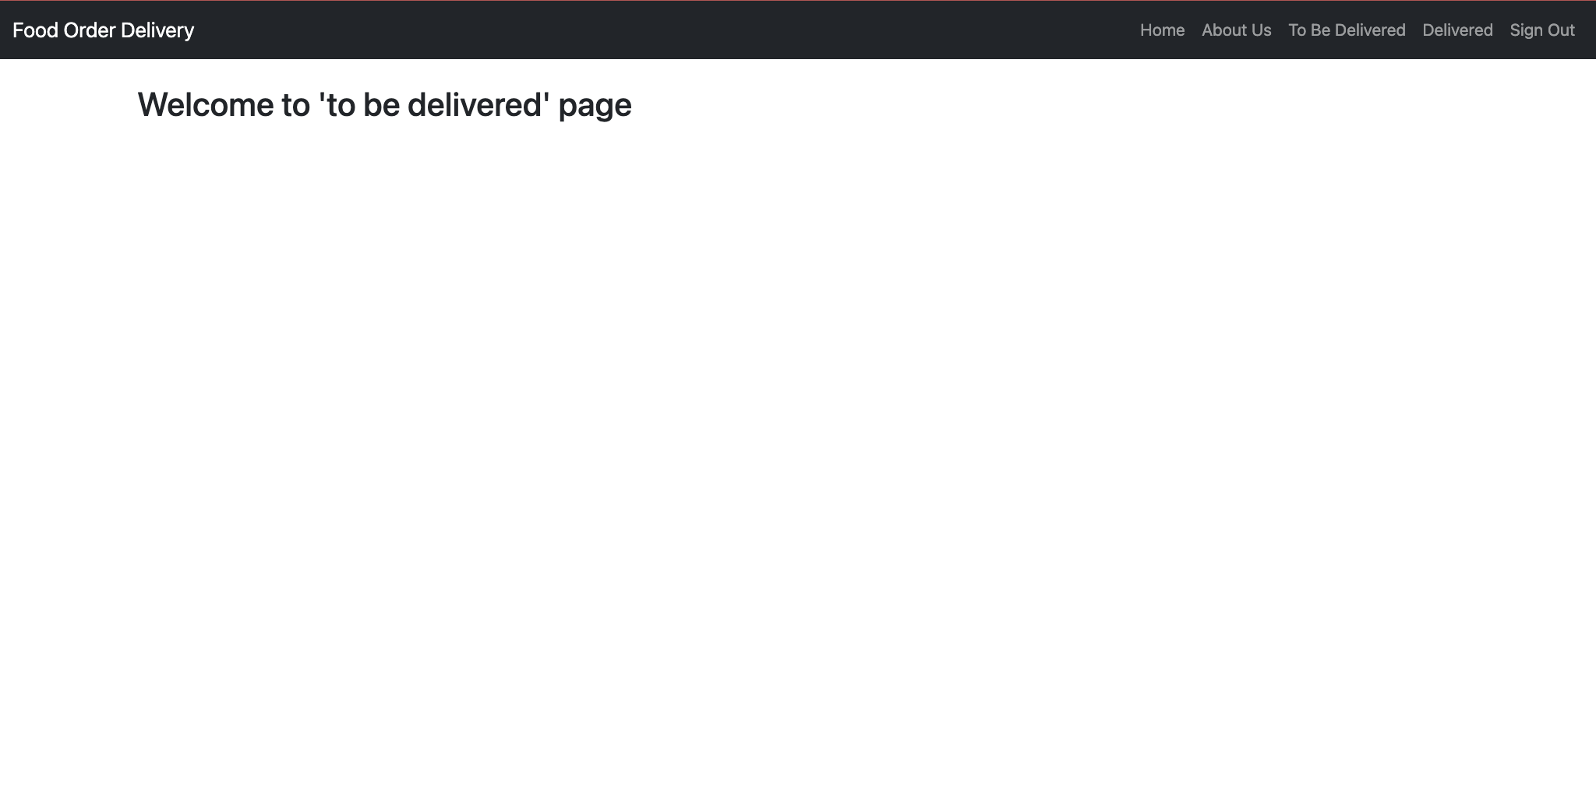
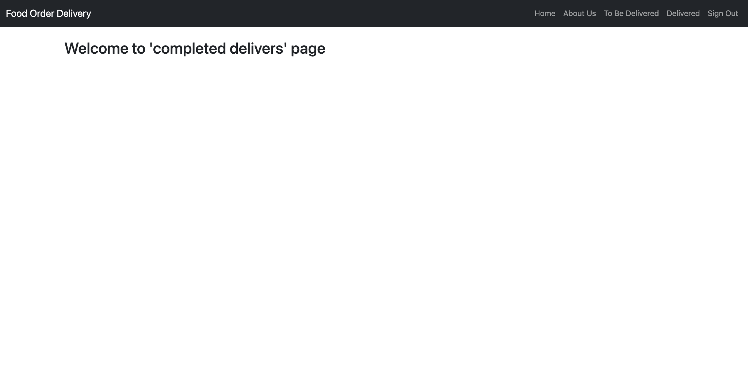
http://127.0.0.1:8000/delivery/signup/
http://127.0.0.1:8000/delivery/login/
http://127.0.0.1:8000/delivery/home/
http://127.0.0.1:8000/delivery/about/
http://127.0.0.1:8000/delivery/to_be_delivered/
http://127.0.0.1:8000/delivery/delivered/

Slide 15
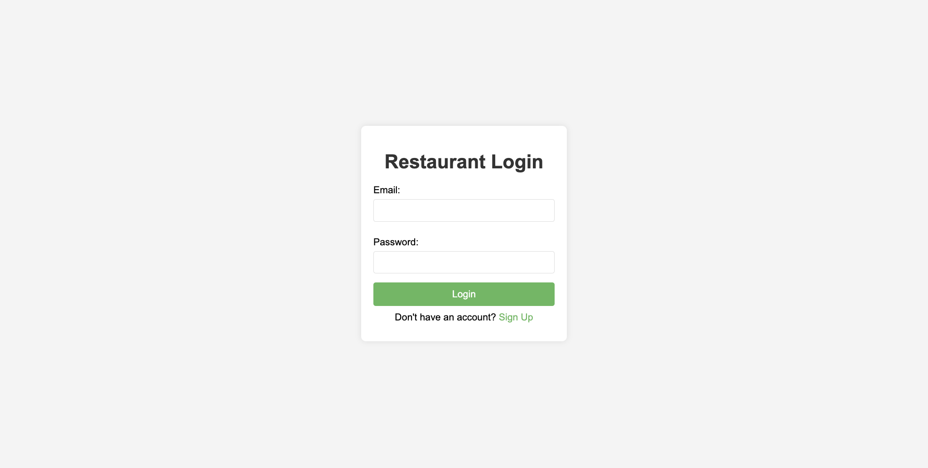
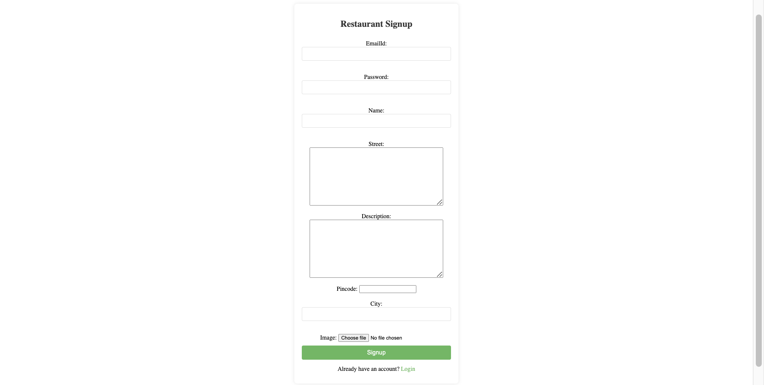
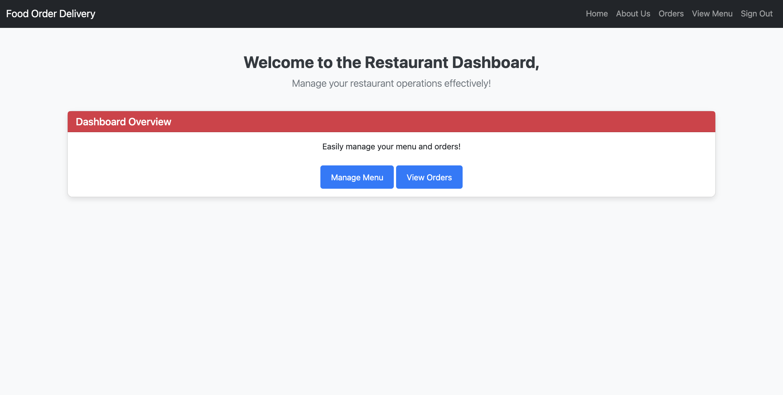
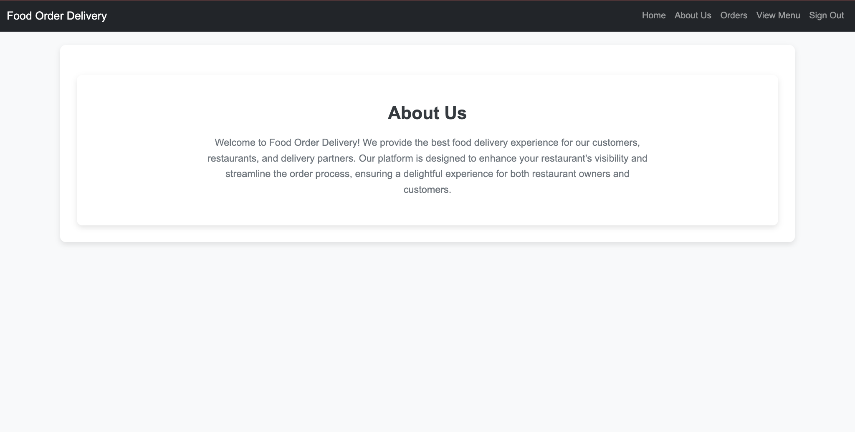
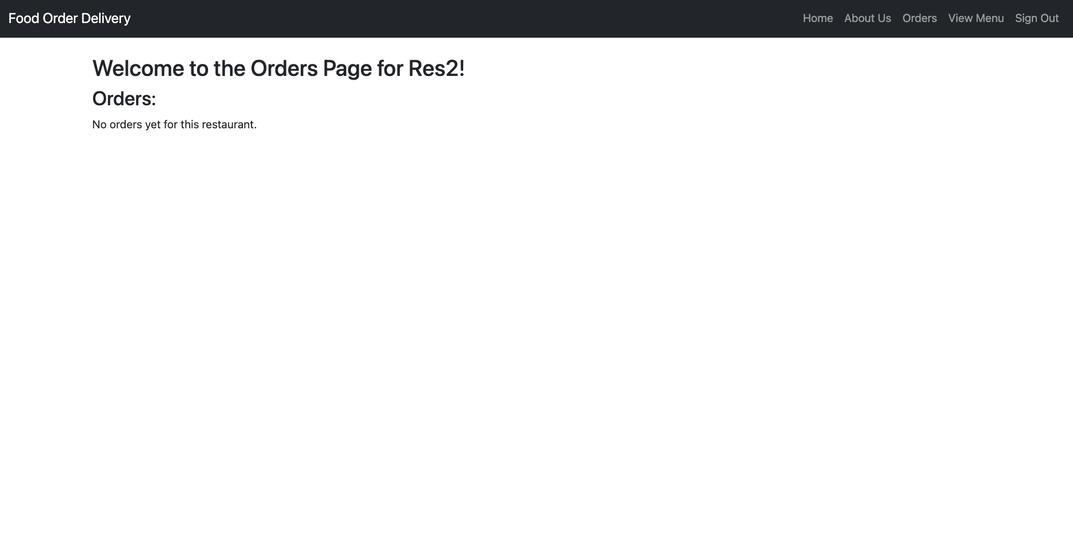
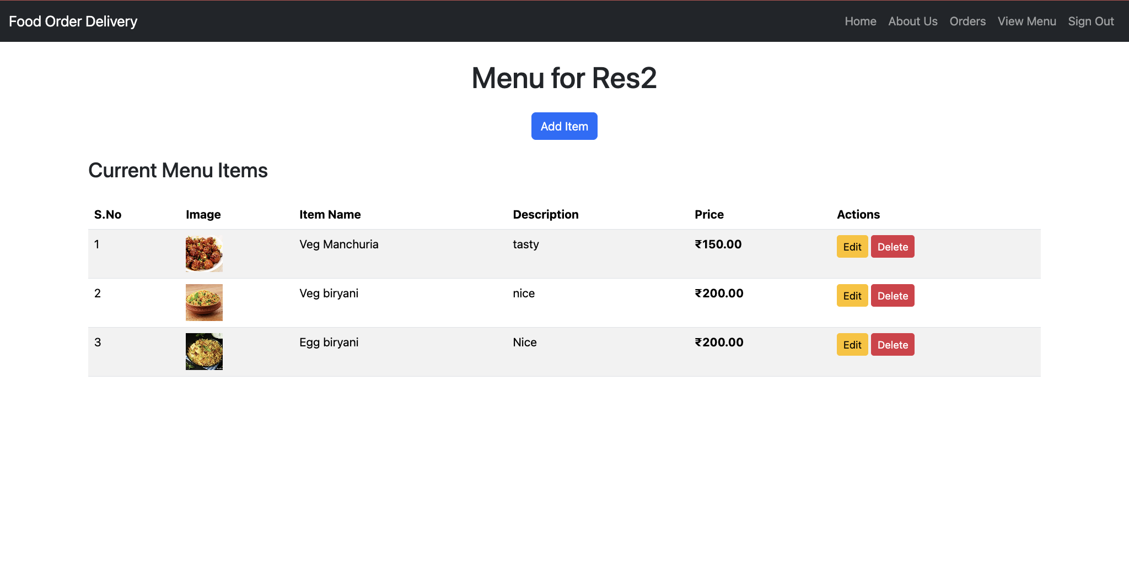
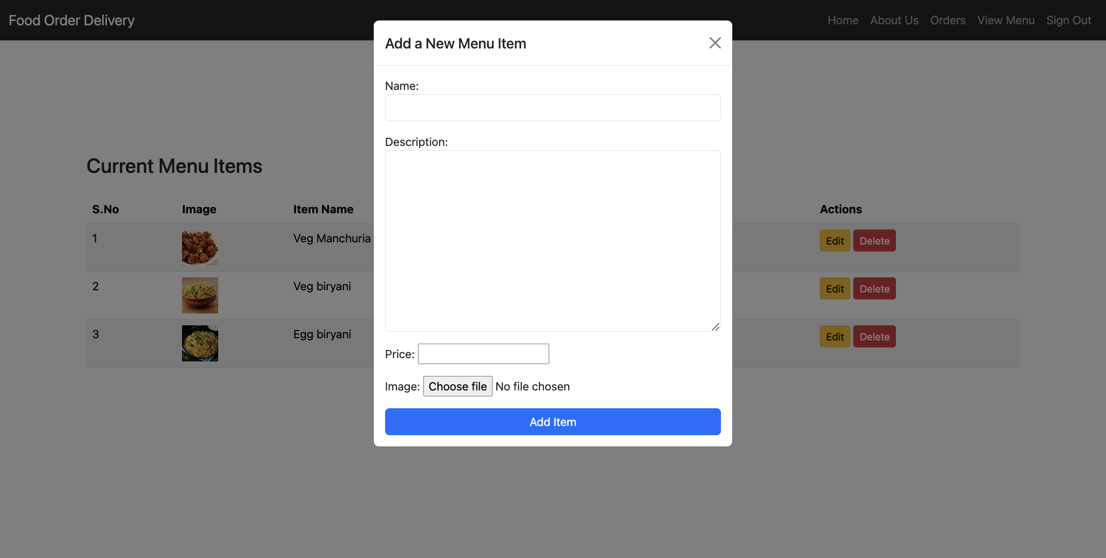
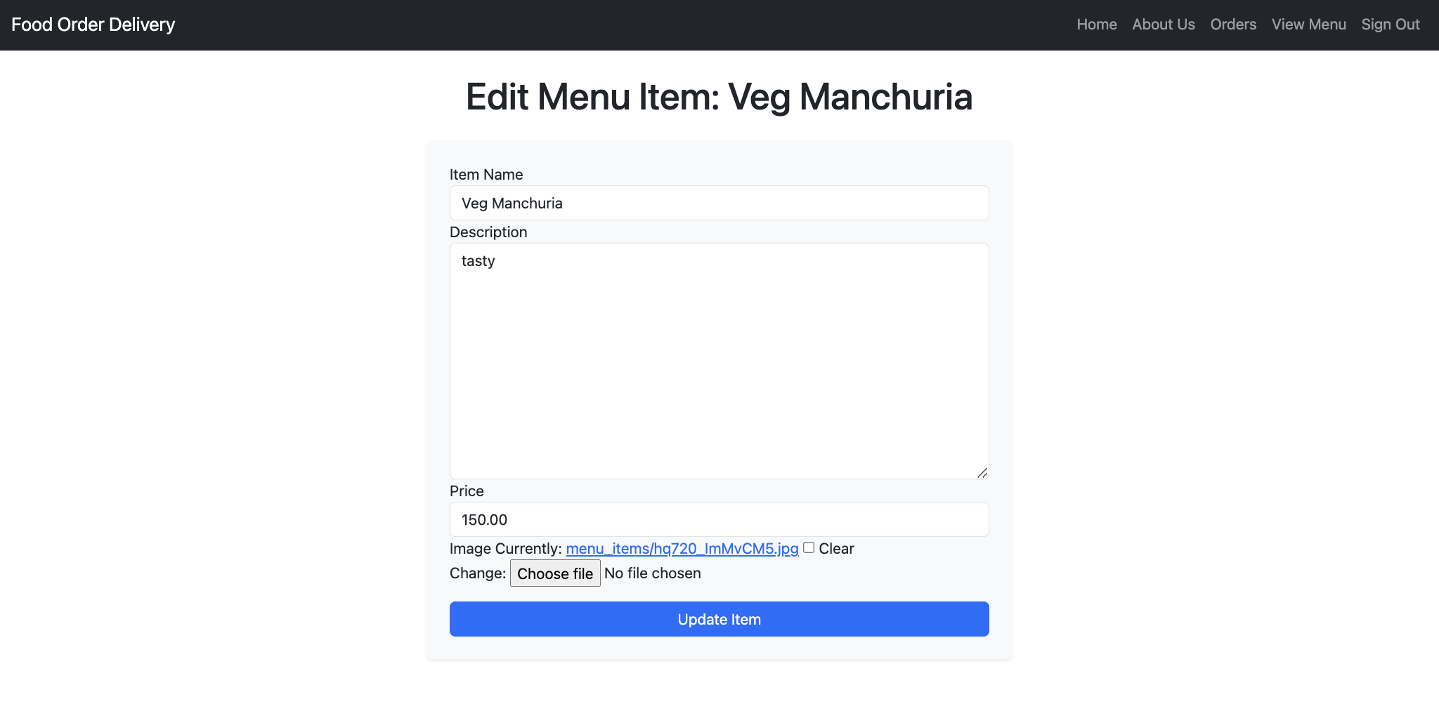
http://127.0.0.1:8000/restaurant/signup/
http://127.0.0.1:8000/restaurant/login/
http://127.0.0.1:8000/restaurant/<uuid:restaurant_id>/home/
http://127.0.0.1:8000/restaurant/<uuid:restaurant_id>/about/
http://127.0.0.1:8000/restaurant/<uuid:restaurant_id>/orders/
http://127.0.0.1:8000/restaurant/<uuid:restaurant_id>/menu/
http://127.0.0.1:8000/restaurant/menu/edit/<int:item_id>/
http://127.0.0.1:8000/restaurant/delete_item/<int:item_id>/

Slide 16
Thank you

