Slide 1

Robopet Companion : A Revolutionary Mental Health Support System
Presenter Names:
N.CH. SAI MEGHANA - 2023000914
Guide Name:
DR. T. MOHANA NAGA VAMSI
M.TECH : CSE – DATA SCIENCE : 2023000914 , GST, Visakhapatnam

Slide 2


Mentalhealth Assistant Ally
Contents
1. Abstract
2. Objectives
3. Flow Chart
4. Requirement Analysis
5. Methodology
6. Results
7. Conclusion
M.TECH : CSE – DATA SCIENCE : 2023000914 , GST, Visakhapatnam

Slide 3
Abstract
Mental health issues like anxiety and depression are prevalent across all age groups, with significant impacts on personal and professional life. People often struggle to express their emotions due to fear of judgment and lack of confidentiality. This paper presents a solution in the form of a portable AI-driven robopet companion designed to provide non-judgmental emotional support and mental health counseling. Features such as real-time emotion detection, mood tracking, behavioral analysis, and personalized interactions ensure the robopet is a reliable, 24/7 support system. This paper discusses the motivation behind the project, its development process, and the technologies involved, including AI, deep learning, and neural networks.
M.TECH : CSE – DATA SCIENCE : 2023000914 , GST, Visakhapatnam

Slide 4
Objectives
Survey Analysis and Insights:
Conduct a comprehensive survey to assess mental health conditions across various demographics, identifying key factors such as persistent stress, decision-making difficulties, and limited access to resources.
Data Analysis Using Power BI and DAX:
Utilize Power BI's DAX formulas to derive meaningful insights from survey data, highlighting significant mental health indicators such as self-harm thoughts and resource availability gaps.
Development of the MAA Application:
Design and develop the Mental Health Assistance Ally (MAA) mobile application to assist individuals in accessing mental health services.
Incorporate personality tests (GAD-7, BDI, and PSS), panic attack aids, mood tracking, journaling with sentiment analysis, and motivational resources.
Sentiment Analysis and Emotion Detection:
Implement facial emotion detection and text sentiment analysis during journaling to capture users' true emotional states, even when masked by optimistic language.
Robotic Pet Companion Concept:
Conceptualize a humanoid robotic pet as an AI-driven emotional companion to provide continuous mental health assistance and companionship.
Enhance real-time emotional tracking and interactive engagement.
M.TECH : CSE – DATA SCIENCE, GST, Visakhapatnam

Slide 5
Objectives
6.Confidentiality and Security:
Ensure privacy and data security through encryption and secure access controls within the MAA application and robotic companion features.
7.Addressing Barriers to Mental Health Assistance:
Explore the willingness of individuals to seek mental health support and identify challenges, including stigma and resource limitations, to enhance support mechanisms.
8.Targeted Mental Health Monitoring:
Establish criteria for classifying mental health conditions (e.g., anxiety, depression, and stress levels) and generate automated alerts to guardians in critical cases.
9.User-Centered Design and Iterative Improvement:
Gather user feedback to iteratively refine the design of the robotic pet and ensure its adaptability to different user requirements.
10.Future Research:
Expand research on the impact of the humanoid robot on diverse social groups and improve its functionalities to become socially intelligent and seamlessly integrated into daily life.
M.TECH : CSE – DATA SCIENCE, GST, Visakhapatnam

Slide 6
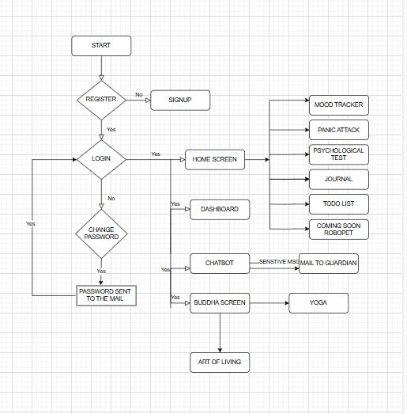
FLOW CHART

Slide 7
Requirement Analysis
Survey Result Count in %
Features Count | Under 18 | 18 – 24 | 25 – 34 | 35 – 44 | 45 – 55 | 55+
Decision Doubt | 75 | 62.07 | 60.49 | 33.33 | 40 | 14.29
Depression | 100 | 78.45 | 75.31 | 55.56 | 70 | 42.86
Stress | 50 | 34.48 | 29.75 | 33.43 | 35 | 14.29
Internal Pain | 75 | 72.42 | 66.67 | 62.96 | 55 | 71.43
Fear of Judgement | 100 | 69.83 | 74.07 | 62.96 | 75 | 100
Low Confidence | 100 | 81.03 | 80.25 | 66.67 | 65 | 28.58
Self Harm | 25 | 22.41 | 20.99 | 14.81 | 15 | 14.29
Seek Help | 50 | 73.27 | 74.07 | 70.37 | 60 | 57.15
Unaware of Resource | 75 | 71.33 | 67.65 | 68.57 | 71.43 | 70
M.TECH : CSE – DATA SCIENCE : 2023000914 , GST, Visakhapatnam

Slide 8
Methodology
Features
F.No | Feature | Model / Method | Dataset / Data Required | Status | Mobile Integration
1 | Journalling (Text + Face Emotion Detection) | LSTM + DeepFace | IMDB | DONE | Pending
2 | Journal – Email (If user text contains sensitive harmful data die, kill, suicide etc) | smtp | Parent mail id | DONE | Pending
3 | Personality Test (BDI – Depresion test, PSS – Stress, GAD - Anxiety) | Conditional | User input analysis | DONE | Pending
4 | Personality Test – Email (Moderate & High level) | Smtp | Parent mail id | DONE | Pending
5 | Chatbot for counselling | Gemini API | intent.json (Own dataset) | DONE | DONE
Ongoing work : Have to integrate all features in to the mobile app - [Flutter + Firebase]
M.TECH : CSE – DATA SCIENCE : 2023000914 , GST, Visakhapatnam

Slide 9
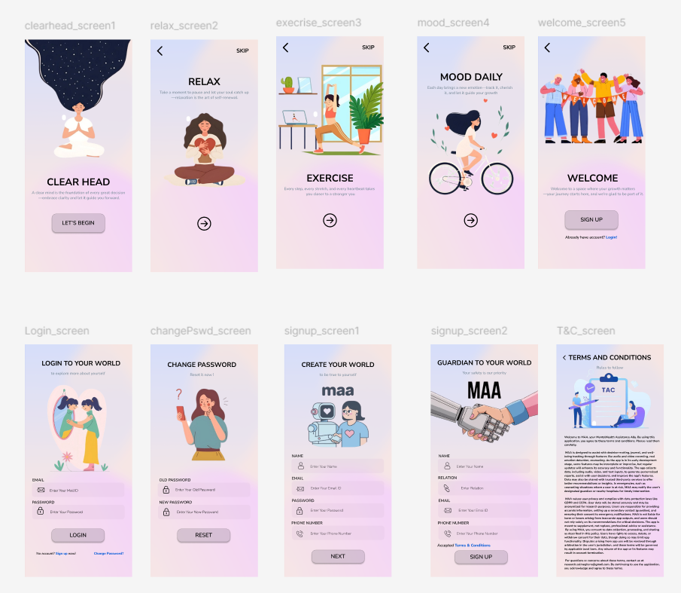
RESULTS

Slide 10
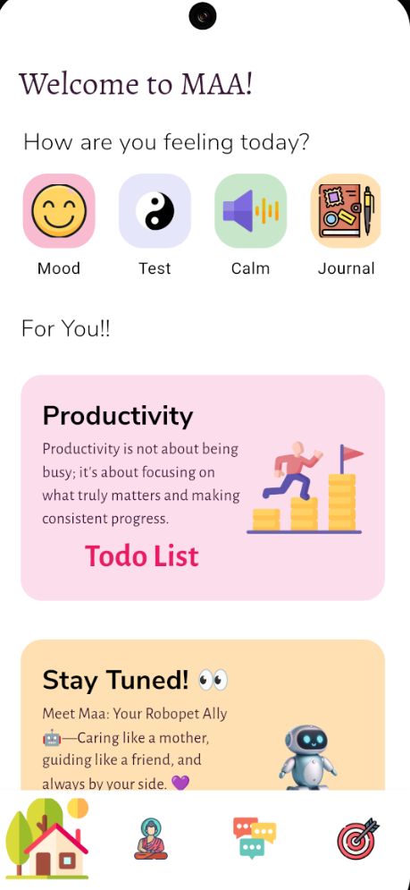
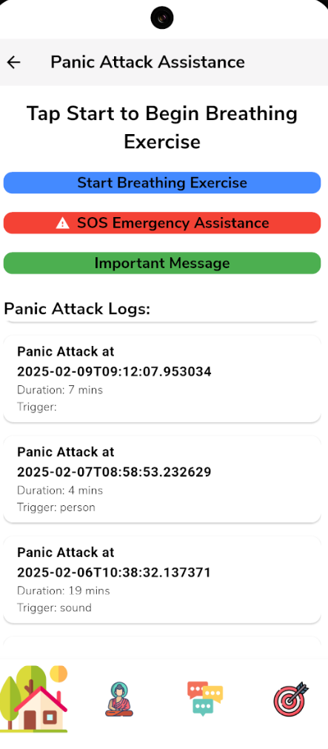
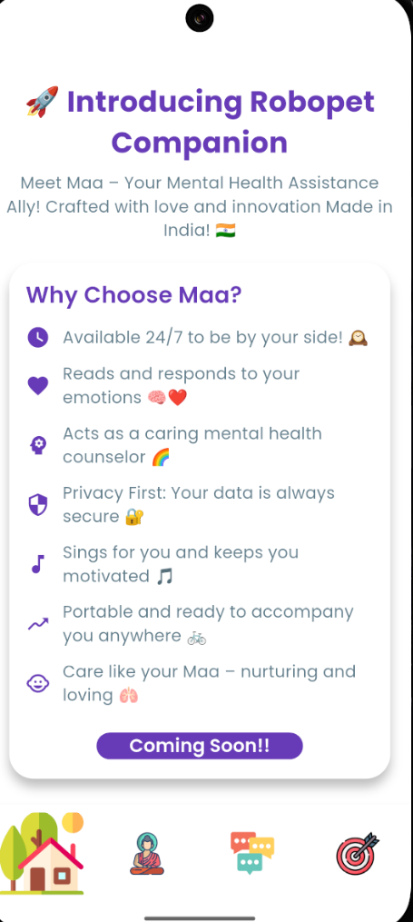
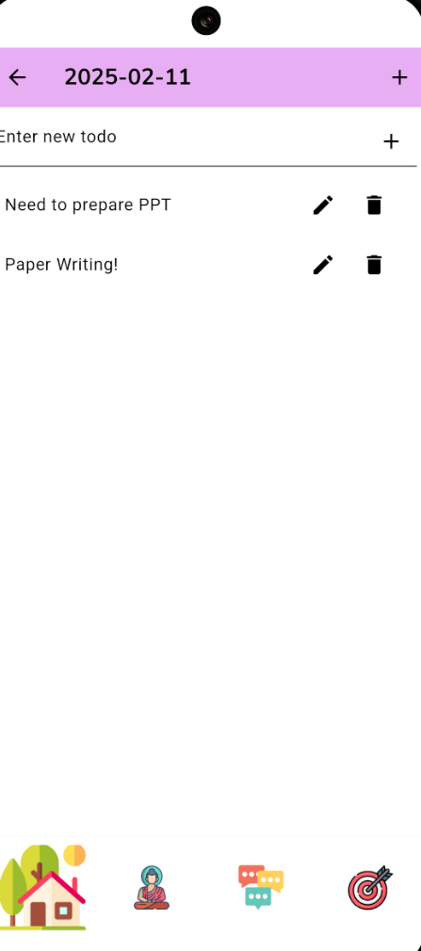
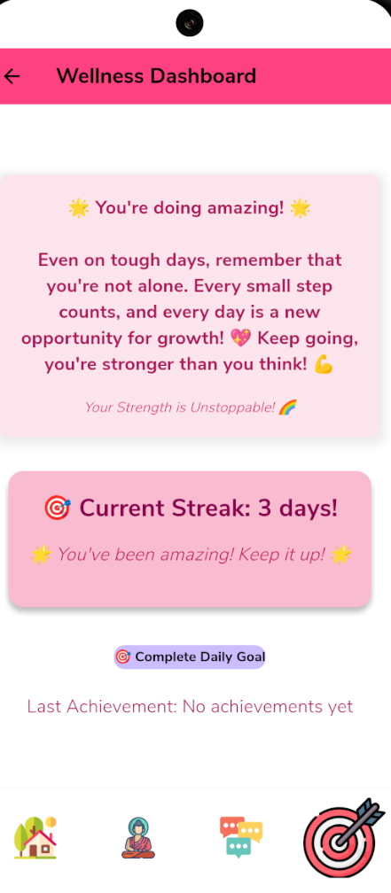
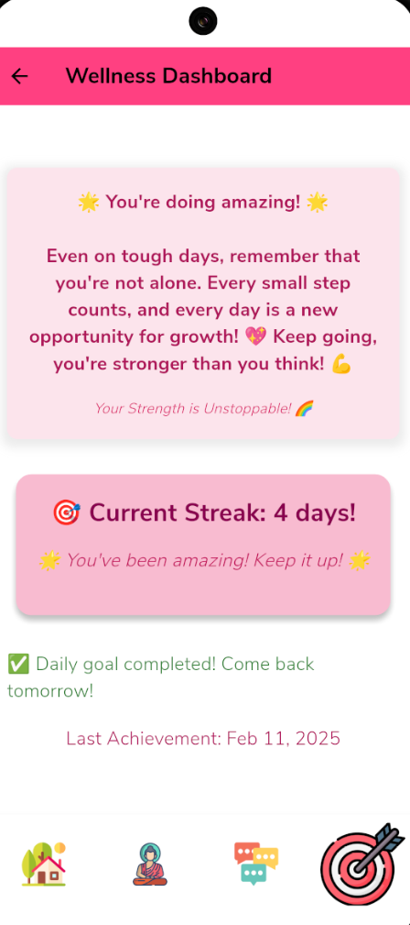
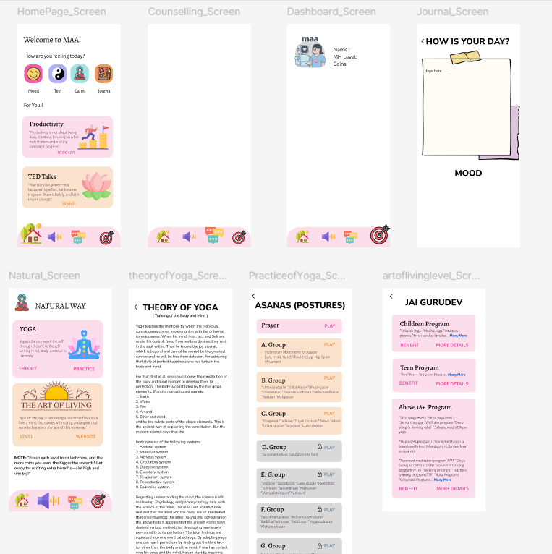
RESULTS

Slide 11
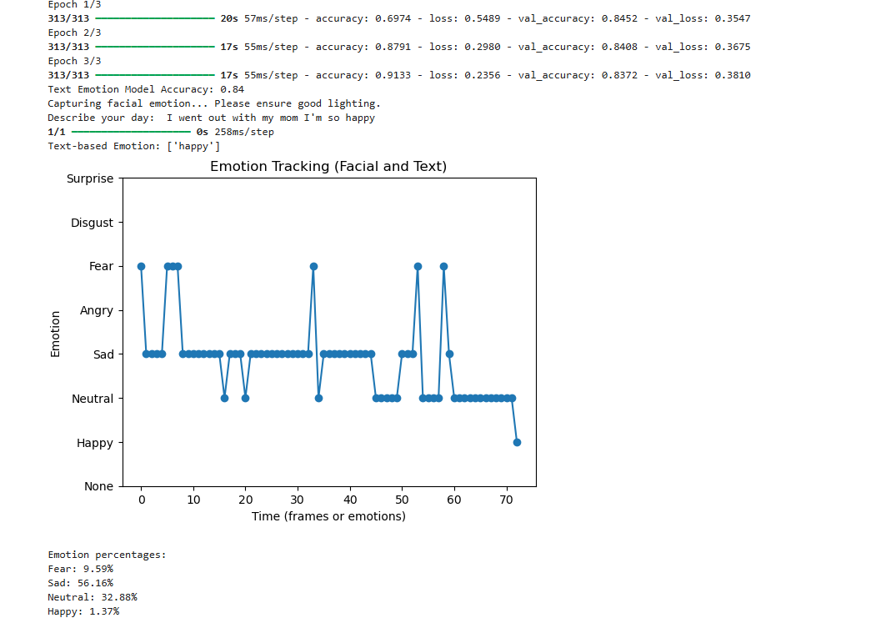
Journal - Result

Slide 12
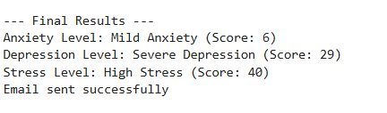
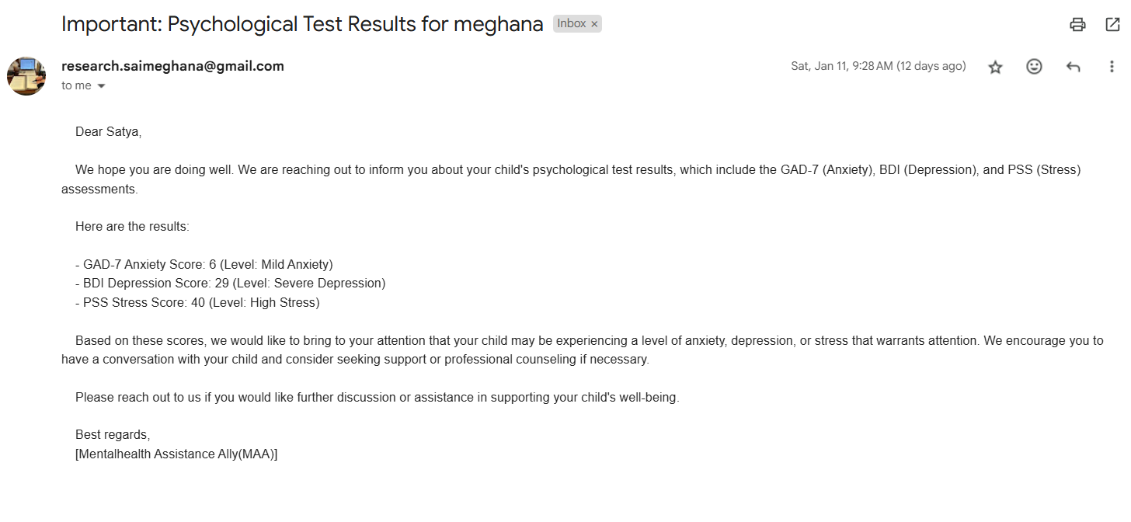
Personality Test - Result

Slide 13
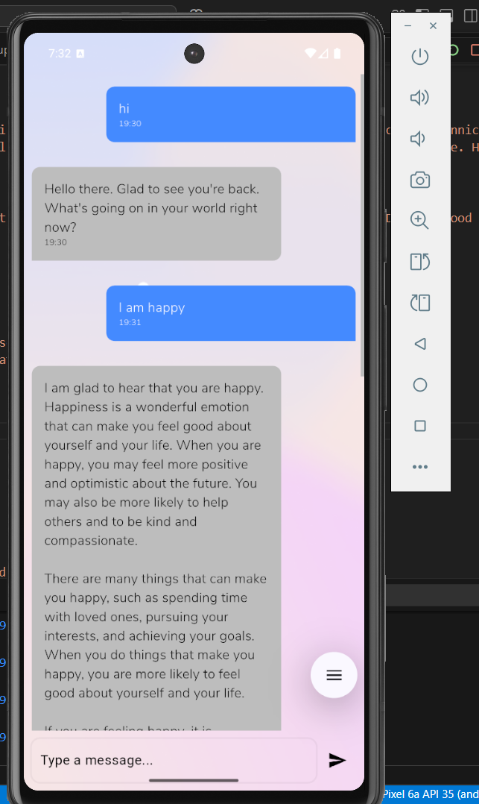
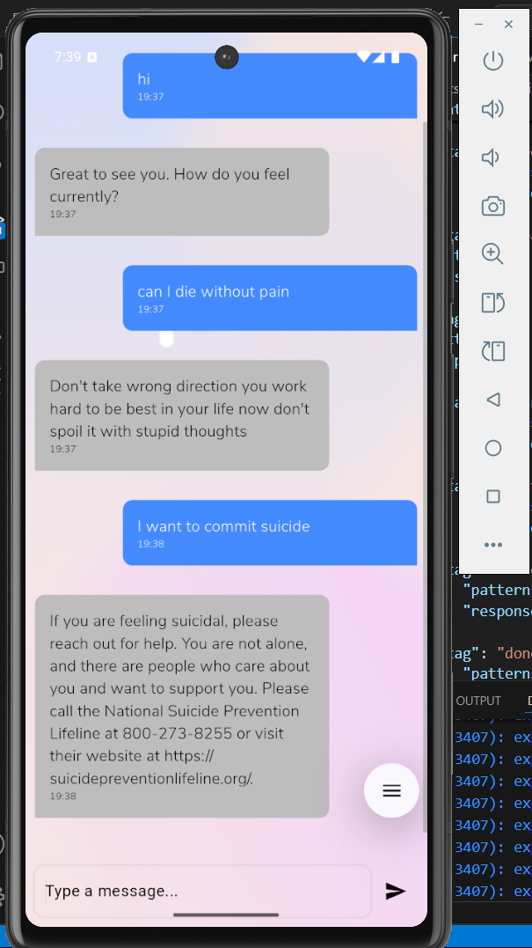
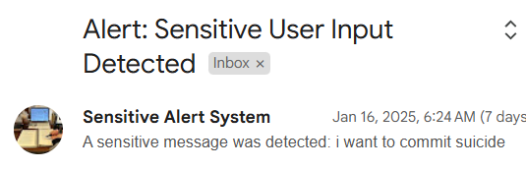
Chatbot – Counsellor – Sensitive alert - Result

Slide 14
Conclusion
The proposed robopet companion offers a unique solution to the mental health challenges faced by individuals today. By providing consistent, personalized support without the risk of judgment or emotional fatigue, the robopet aims to improve the emotional well-being of users across all age groups. The implementation of advanced AI technologies will ensure that the robopet remains a reliable and effective companion for mental health counseling.
M.TECH : CSE – DATA SCIENCE : 2023000914 , GST, Visakhapatnam

Slide 15
Thank You
M.TECH : CSE – DATA SCIENCE : 2023000914 , GST, Visakhapatnam

