Slide 1
CUSTOMER SEGMENTATION
Done By:
SAI MOHAN P
Date :
16-07-2023

Slide 2

OVERVIEW
PROBLEM STATEMENT
With growing demands and cut-throat competitions in the market, a Superstore is seeking your knowledge in understanding what works best for them. They would like to understand which products, regions, categories and customer segments they should target or avoid.
The problem at hand is to perform customer segmentation for a superstore in order to gain a deeper understanding of the customer base and optimize various aspects of the business. By segmenting customers into distinct groups based on their purchasing behavior, demographics, and preferences, the superstore aims to enhance customer targeting, personalize marketing efforts, and improve overall business performance.

Slide 3
Importance of Customer Segmentation
Targeted Marketing: Customer segmentation enables targeted marketing efforts by dividing the customer base into distinct groups based on their characteristics, preferences, and behavior. This allows businesses to tailor marketing messages, promotions, and campaigns to specific segments, resulting in higher response rates and improved customer engagement.
Personalized Customer Experiences: Customer segmentation allows businesses to create personalized experiences for their customers. By understanding the unique needs and preferences of different segments, businesses can deliver customized products, services, and recommendations, fostering stronger connections and enhancing customer satisfaction.
Efficient Resource Allocation: With customer segmentation, businesses can allocate their resources more efficiently. By focusing marketing efforts and resources on high-value customer segments, businesses can optimize their return on investment, minimize wasteful spending, and maximize the impact of their marketing initiatives
Improved Customer Retention: Customer segmentation helps businesses identify at-risk customers and implement targeted retention strategies. By recognizing the specific needs and pain points of different segments, businesses can proactively address customer concerns, deliver tailored solutions, and build long-term customer loyalty.
Business Growth and Profitability: Effective customer segmentation directly impacts business growth and profitability. By understanding customer segments and their unique characteristics, businesses can identify new market opportunities, develop targeted product offerings, and tailor pricing strategies to maximize revenue and profitability.

Slide 4
DATASET INFORMATION
Dataset Name | Superstore Sales Dataset
Number of Instances | 8399
Number of Attributes | 13
Missing Values? | No

Slide 5
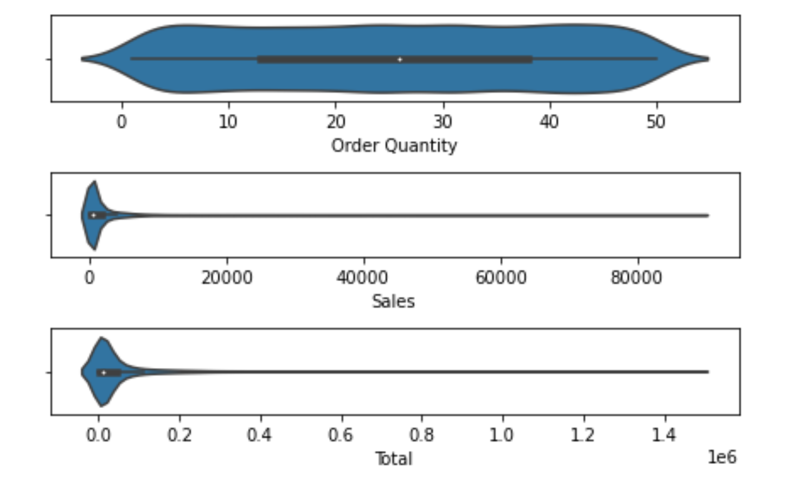
Univariate Analysis(Numerical):
Based on the Numerical columns violin plot:
Order quantity feature has no outlier values maximum order quantity range is in between 15 to 35.
Sales feature is highly right skewed which shows only limited no of customers sales are higher.
Total is a calculated column which means multiplication of order quantity with sales . So,Total also skewed because of Sales feature influence.

Slide 6
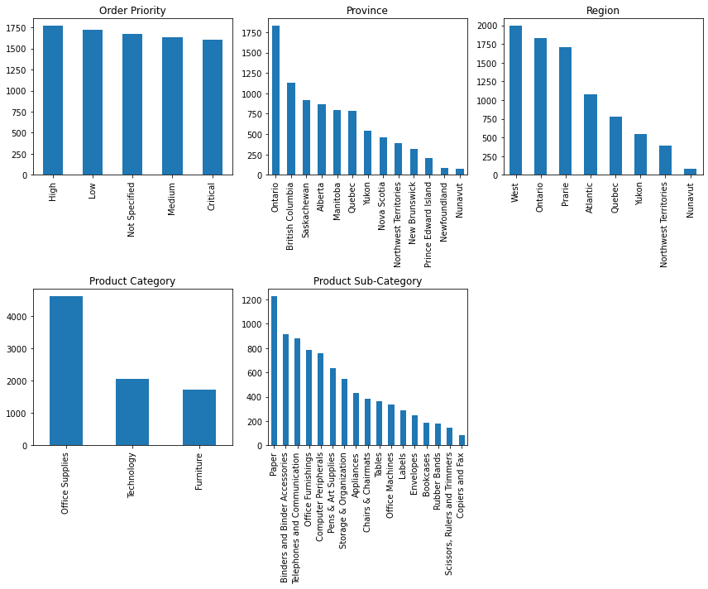
Univariate Analysis(Categorical):
Based on the Categorical columns count plots:
Order priority shows in each priority most records are in dataset whih explains all category of priority is important.
In both Province and Region features Ontario got higher records west , Atlantic , prarie regions are similar change in count of records in this dataset
Product sub category is looks like a bin of product category. It shows that most of the records or orders are in the office supply category.

Slide 7
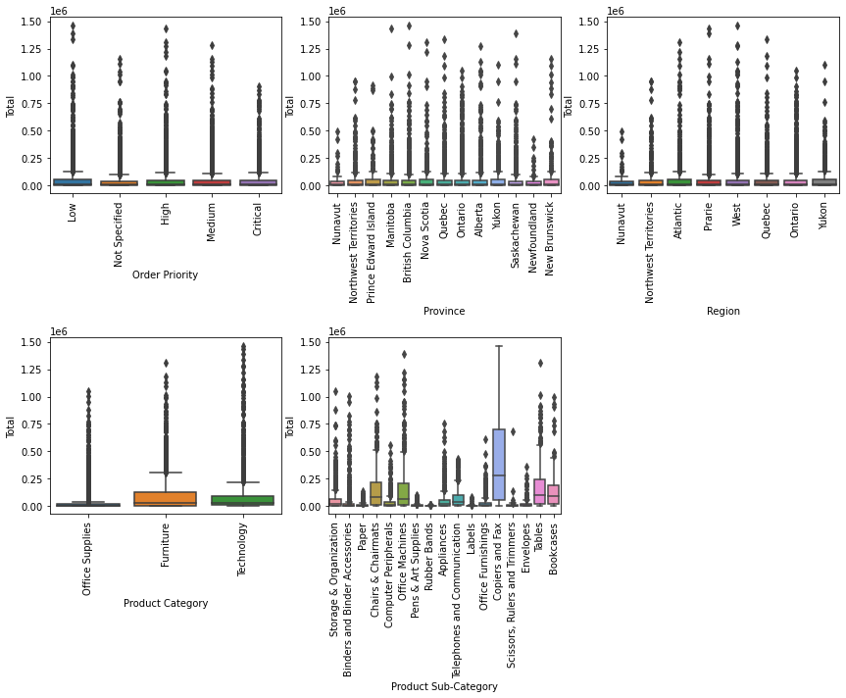
Bivariate analysis relationship between Numerical and Categorical variable
From the scatterplots we can see that there isn’t much difference between order priority feature . But,Rest of the categorical features got some significance difference between each categories total sales.

Slide 8
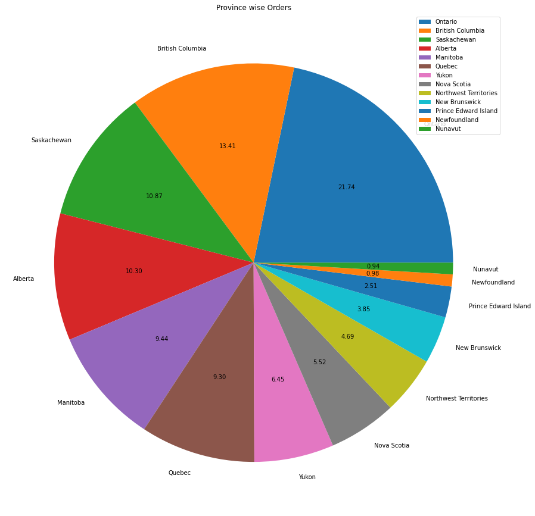
Bivariate analysis relationship between Categorical and Categorical Features
Province wise orders assigned:
Based on the pie chart around 22 percentage of orders were from Ontario and least count of orders were from Nunavut. Saskachewan , Alberta , Manitoba and Quebec these province getting almost same frequency of orders.the second least number of orders got province is Newfoundland.

Slide 9
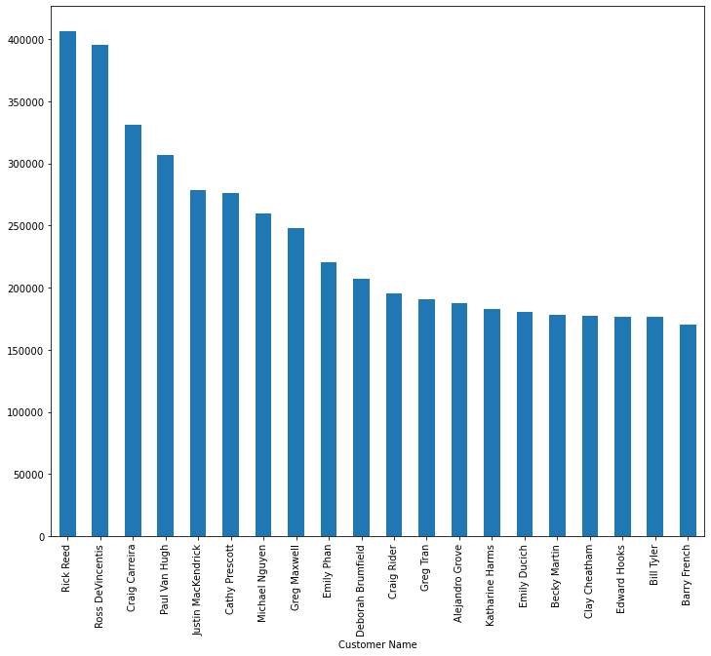
Top 20 Customers based on their average amount paid for the Orders

Slide 10
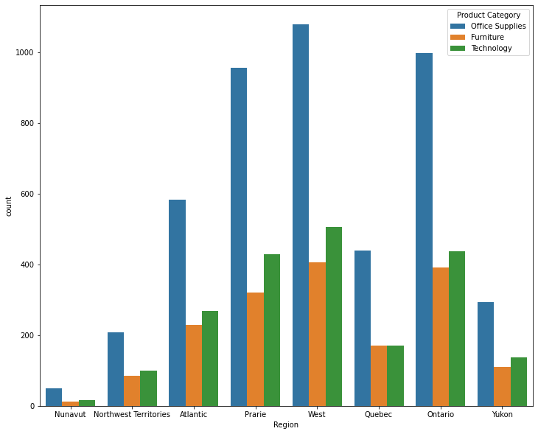
Region Wise Product Categories Ordered
Region wise Product category Ordered:
West region got higher orders in office supplies category orders.
Prarie and Ontario got maximum number of orders in each category in same size a little bit difference between order frequencies.this two regions got secont highest orders count.
Nunavut,Northwest territories and Yukon are the least number of orders count among the other regions compare to those Northwest and Yukon Nunavut is very less frequency of orders got in each category.

Slide 11
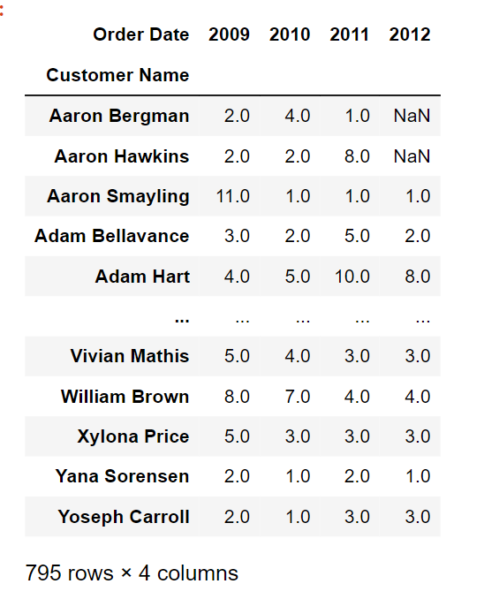
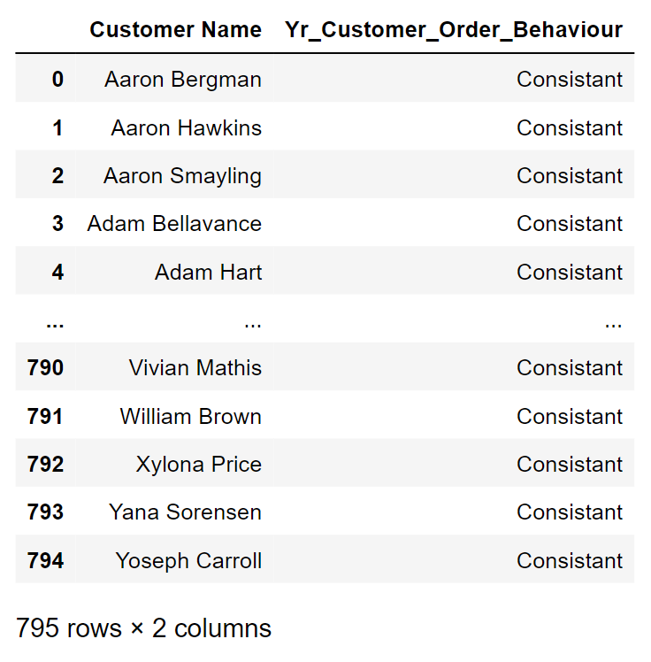
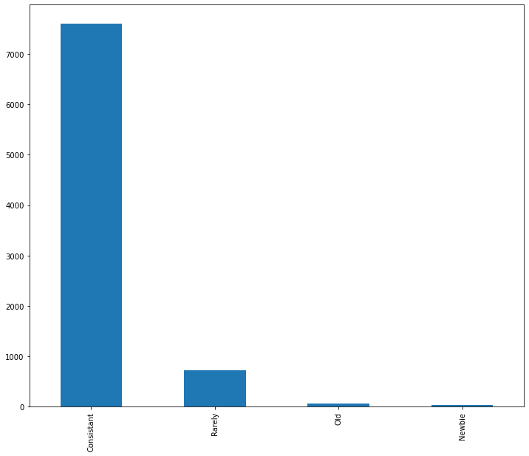
Feature Engineering
Customer Year wise Order Behaviour: Resulted Feature: Each Customers Order Count Every Year

Slide 12
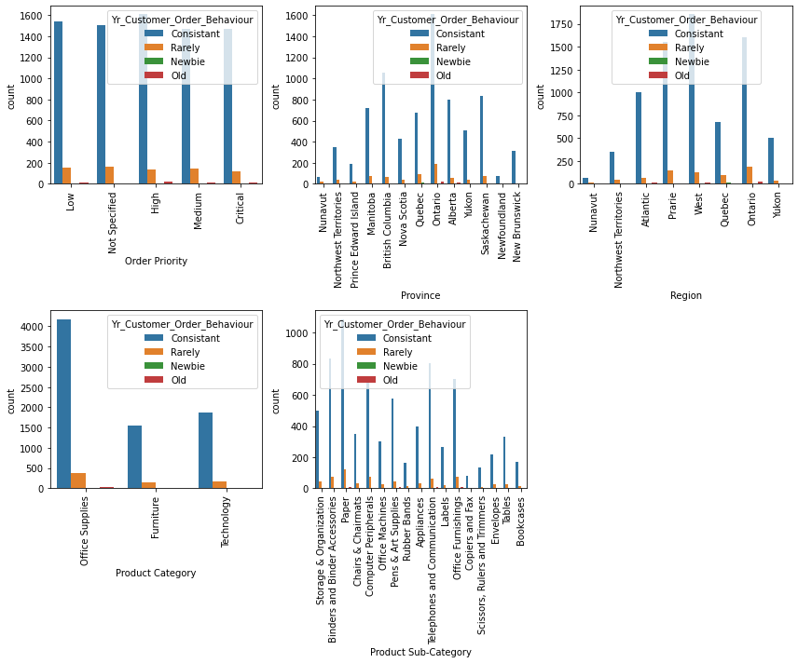
New Feature Contribution on Each Categorical Features

Slide 13
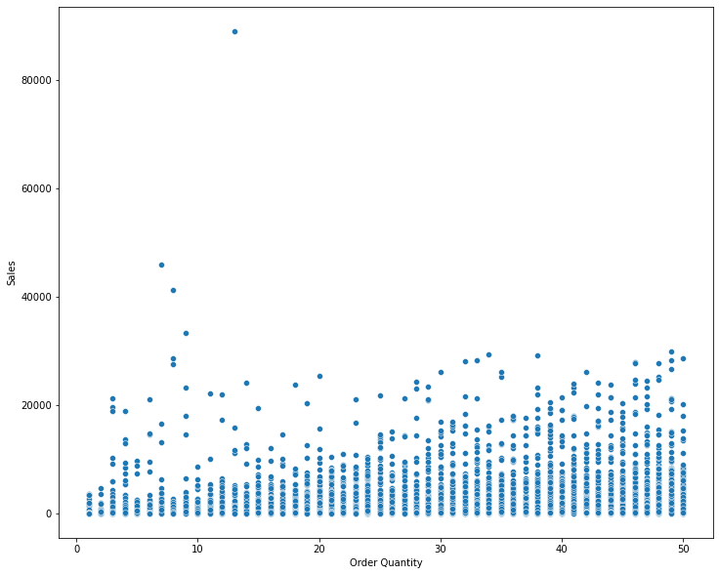
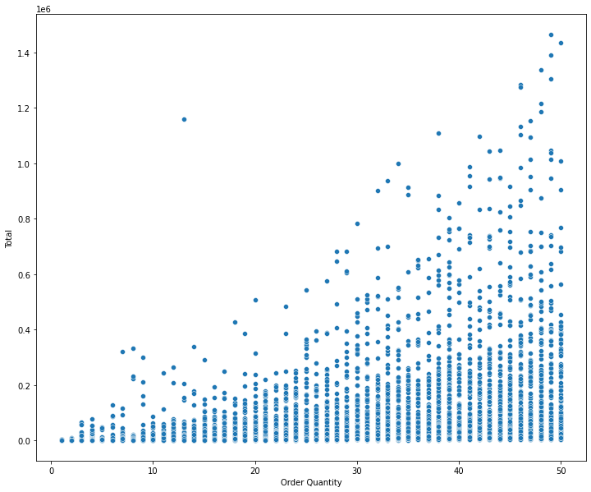
Problem Facing For Clustering
Based On the above two scatter plots:
In this dataset only three numerical features are available.While,it's clearly able to see there is no pattern or shape like a clusters.so,it's hard to make clusters using this numerical features.Defalutly if numerical features are available K means is good ML algorithm to find clusters or Aggloramative clustering technique .But, In this dataset three types of approach can be use.
Default : K means
RFM Analysis
K modes : Particularly for Categorical clustering algorithm

Slide 14
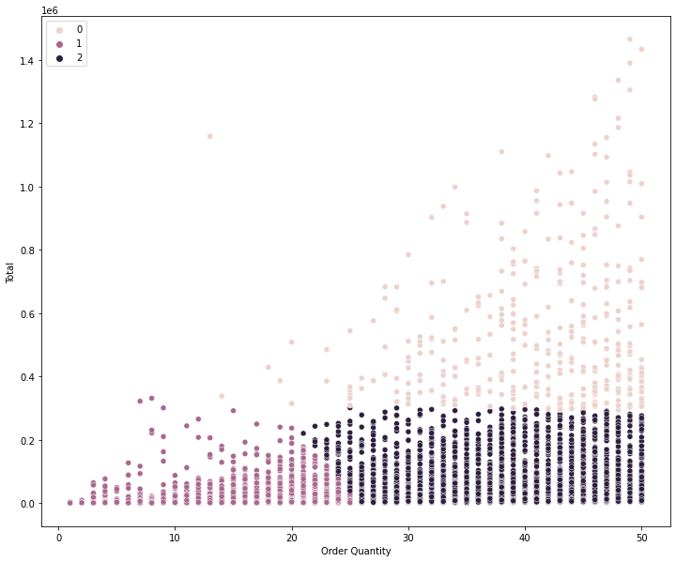
Final Cluster From K-means ML Model (BI)
0 - These are the customers.who bought most often and spend highest money.they are providing most revenew like they are big organization like It companies or government organization they spend more mony with demand high orders with high quantity.So,they are like super customers of the store.
2 - These are the customer,who spend resonabale amount with medium quantity.like they have enough money to spend but they spend in the limited way.they like small organization so,orders were limited.they look for offers and discounts.we can offer customer a special cards like to get discounts by using this in next purchase if only purchase above some certain amount.
1 - These customers are like they spend for there personal products or some temporary purpose like retail stores or small business.they spend less money with less demand in quanties and orders.we can provide some packages of products based on there needs with some profitable budget.

Slide 15
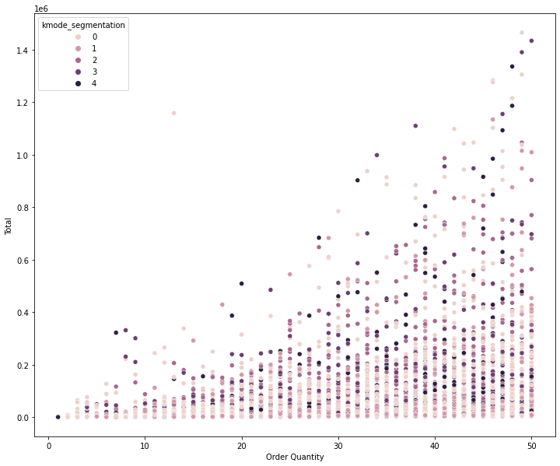
K-Modes Final Clusters (BI)
This method of clustering is new.which is use to make clusters with only the categorical features in the dataset.by this scatter plot is hard to classify the customers and it looks bad in visual.But,I tried this method may be it will work if the parameter tuning is done.

Slide 16
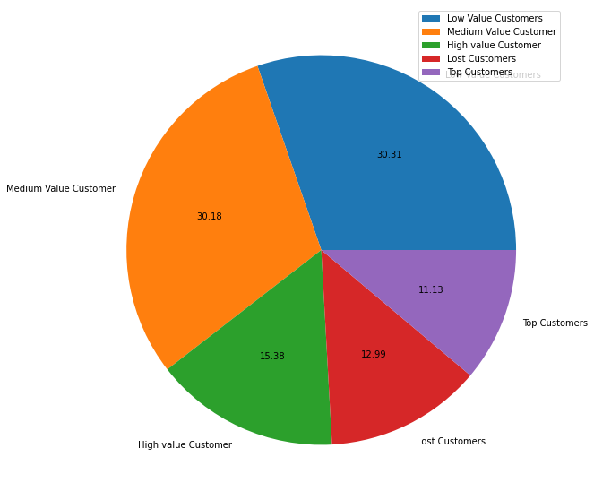
RFM Analysis Clusters (BI)
Top Customers: These are your best customers, who bought most recently, most often, and are heavy spenders. Reward these customers. They can become early adopters for new products and will help promote your brand.
Highly Value Customers: These are your recent customers with lesser than top customers and greater than medium ones frequency and who spent a good amount. Offer membership or loyalty programs or recommend related products to upsell them and help them become your Loyalists or Champions.
Medium Value Customers: These are your customers who have a high overall RFM score but are not frequent shoppers but medium spenders. Start building relationships with these customers by providing onboarding support and special offers to increase their visits.
Low Value Customers: These are your customers who purchased often and spent medium amounts, but haven’t purchased recently. Send them personalized reactivation campaigns to reconnect, and offer renewals and helpful products to encourage another purchase.
Lost Customers: These are customers who used to visit and purchase quite often, but haven’t been visiting recently. Bring them back with relevant promotions, and run surveys to find out what went wrong and avoid losing them to a competitor.

Slide 17

Challenges
Understanding the Dataset
Understanding the Features
Exploratory Data Analysis (which include Data Cleaning,Visualizing.Feature Engineering)
Finding the Best Cluster Model
Conclusion
In Clustering project , We cannot assure the cluster are all correctly assigned.But,In these three types of approach.I conclude with choosing one method of cluster that is RFM Analysis cluster.Because,It cluster in a way of each customer total behaviour in the record of four years by features like over all orders and the total revenew build by each customer.it clustered in a acceptable way.So,The best Clusters are assigned by RFM Analysis.

Slide 18



