Slide 1

LeaseLens
It reads incoming leases and flags only the ones that need review.
A short demo of what it does, why it is useful, and how it is built.
Built solo · Sai
Notes:
I'm Sai. This is LeaseLens. It reads incoming leases automatically and flags only the ones that need a person to review. I'll show what it does, why it is useful, and how I built it.

Slide 2




WHY IT'S USEFUL
Reading leases by hand doesn't scale
Property managers receive signed leases as PDFs. Today, someone opens each one and types the rent, deposit, and dates into their system by hand, one document at a time.
Slow at volume
Manual entry can't keep up as the portfolio grows.
Costly mistakes slip through
An illegal deposit or missing signature is easy to miss.
Who it's for
Leasing teams that process leases in bulk, and the property-management platforms they run on. Clean leases pass through automatically, so people only review the exceptions.
Every lease is different
Free-text PDFs, scans, the occasional non-lease.
Notes:
Property managers receive leases as PDFs and key them in by hand. It is slow, and the costly errors, like a deposit above the legal limit, are easy to miss at volume. This is built for leasing teams that process leases in bulk. Clean leases pass through automatically, and people only review the exceptions.

Slide 3






HOW IT WORKS
Every lease runs the same six steps
Automatic up to the last step. A person only comes in to confirm or override what was flagged.
1
2
3
4
5
6
Classify
Gate-check
Extract
Validate
Reason
Review
Bounce non-leases early.
Fail fast; OCR scans.
Pull terms from free text.
Hard policy rules.
Market & risky clauses.
Confirm or override.
Next: the live demo. Open the inbox and run a lease through it.
Notes:
Every lease runs the same six steps: classify the document, run a gate check that includes OCR for scans, extract the key terms, validate against rules, review the contract text, then hand the result to a person. The first five steps are automatic. Now I'll open the app.

Slide 4
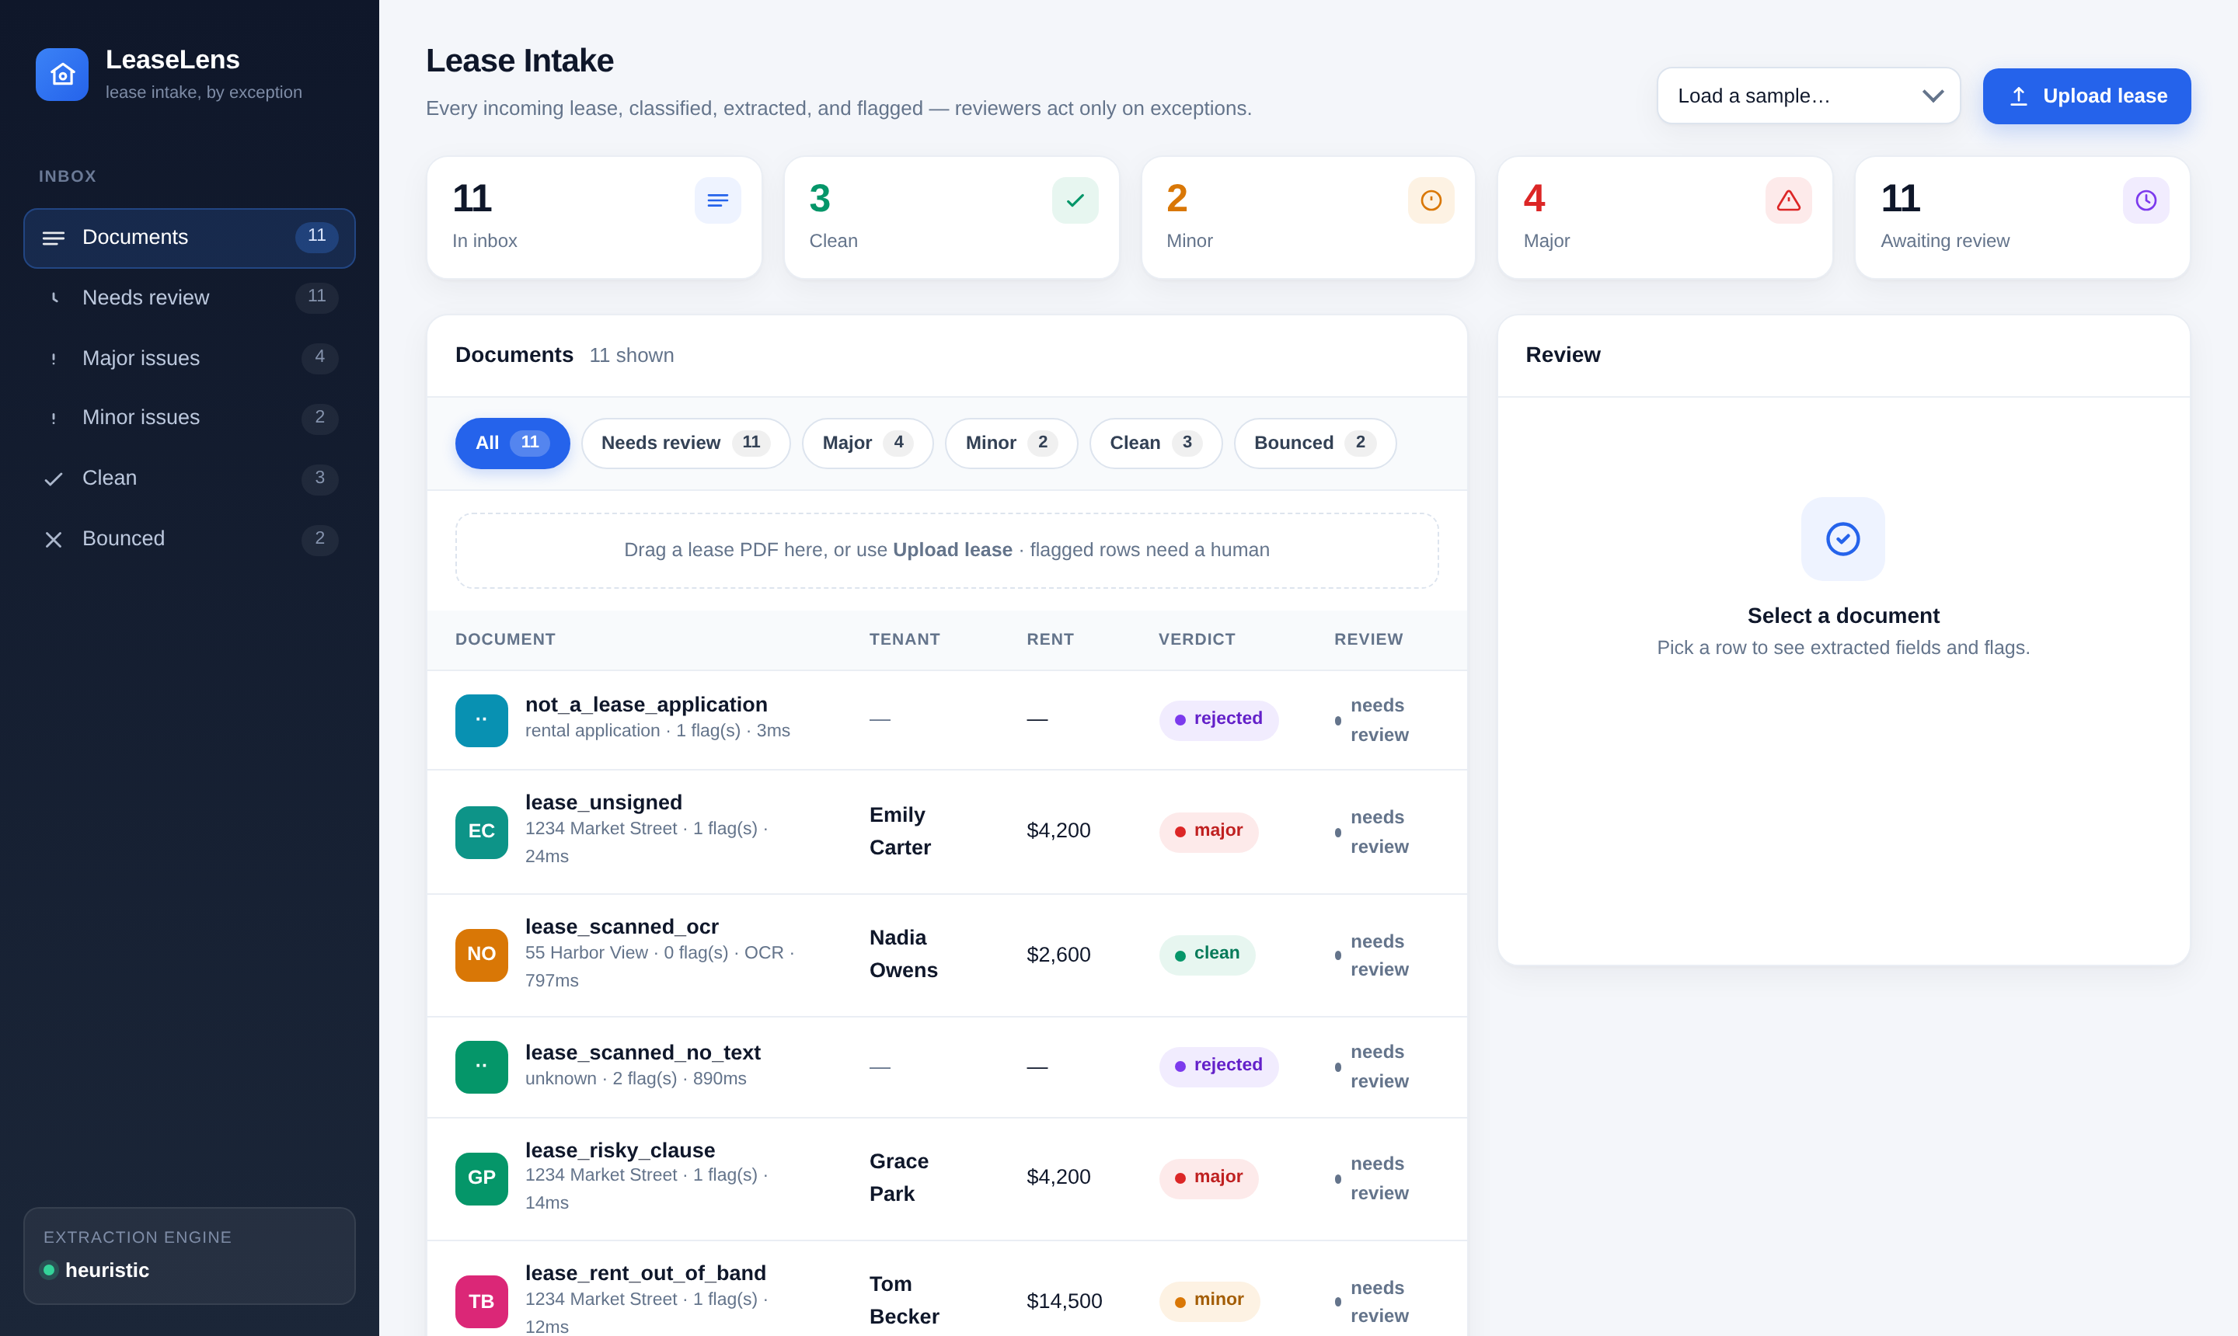
SEE IT IN ACTION
The reviewer's inbox
One row per lease, color-coded by verdict. Open one to see the fields it pulled and the issues it flagged.
Notes:
This is the app. One row per lease, color-coded by verdict. Open a lease to see the extracted fields and the issues it flagged. Do the live walkthrough here: open a flagged lease, show the deposit flag, then show a scanned one that was read with OCR.

Slide 5

HOW IT'S BUILT
Simple by default, swappable intelligence
Stack
The key design choice
Backend
Python · FastAPI · async
Read PDF
pdfplumber text + Tesseract OCR for scans
Reading a document has two interchangeable modes behind one interface:
Extraction
Regex profile / LLM profile (one interface)
regex · offline, no API key
Validation
Plain, deterministic policy rules
Reasoning
Clause checks + rent ranges, LLM-upgradeable
LLM · same interface, just add a key
UI
Single-page reviewer inbox, no build step
Swap one for the other and nothing else changes. The AI is a component you can turn on, not the whole system.
Quality
Test suite over real sample leases
Notes:
The backend is Python and FastAPI. It uses pdfplumber to read text and Tesseract for OCR on scans. The main design choice is that reading a document has two interchangeable modes behind one interface: a fast offline mode that needs no API key, and an AI model you turn on by adding a key, with no other changes. The rules are simple and readable, and a test suite covers the sample leases.

Slide 6


LeaseLens
Read the document,
flag what matters, skip the rest.
Thank you for watching. Happy to walk through the code or where it goes next.
mulaganss@gmail.com
github.com/…/leaselens
Sai
Notes:
That is LeaseLens. It reads the document, flags what matters, and skips the rest. Thank you for watching. Swap in the real repo link before recording.

