Slide 1

Employee management system
PRESENTED BY :
C.Dasaratha Rami Reddy
Ch.Sushruth
B.Uday Yadav

Slide 2
Employee Management System

Slide 3

Introduction
The Employee Management System is a database-driven application designed to simplify and streamline human resource (HR) operations within an organization. Managing employee details manually is often time-consuming, error-prone, and inefficient. This project aims to overcome these challenges by creating a centralized system that stores, manages, and updates employee-related information effectively . The system maintains comprehensive records of employees, including their personal details, job roles, qualifications, salary structures, leave records, and payroll data. By organizing this information into relational tables with proper links (foreign keys), the system ensures data accuracy, integrity, and consistency across all modules.With features like payroll calculation, leave tracking, and department-wise role management, the Employee Management System provides quick access to vital information and supports better decision-making. Ultimately, the project helps organizations save time, reduce errors, and improve overall HR efficiency.

Slide 4
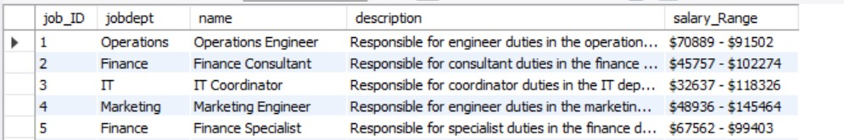
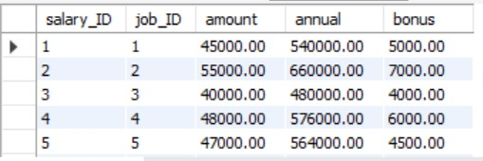
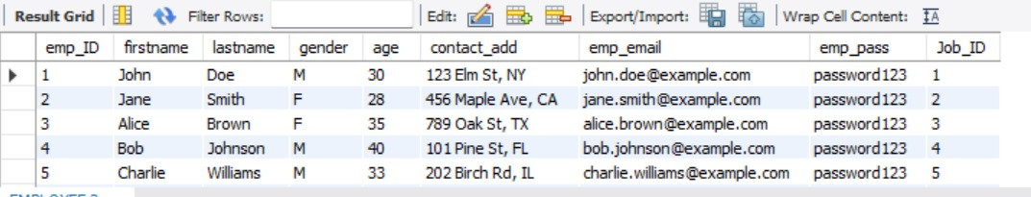
Tables
Job Department Table
Employee Table
Salary Bonus Table

Slide 5
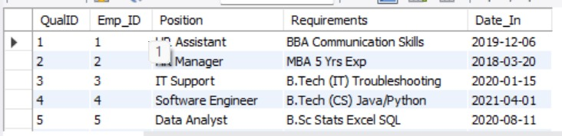
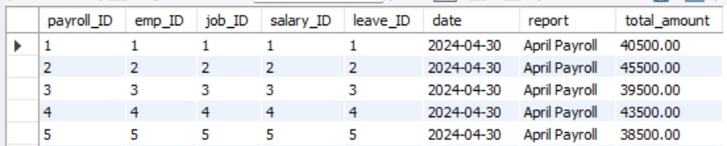
Tables
QualificationTable
Pay Roll Table

Slide 6
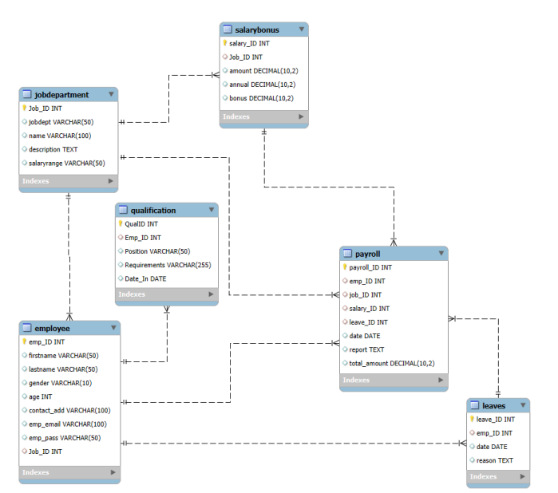
ER Diagram

Slide 7
Problem Statement
The objective of this project is to design and implement an Employee Management System that efficiently stores and manages employee-related data within an organization. The system needs to track various aspects of employee information, including personal details, job roles, salary structures, qualifications, leave records, and payroll data. The system should ensure the integrity and consistency of data by using relational tables with appropriate foreign keys and cascading actions. The system should allow for easy management and querying of employee data, providing insights such as payroll calculation, leave tracking, and department-specific job roles. The goal is to streamline HR operations, ensuring that all relevant employee data is accessible and accurately updated across different modules.

Slide 8

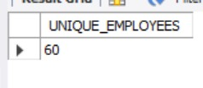
1. How many unique employees are currently in the system?

Slide 9
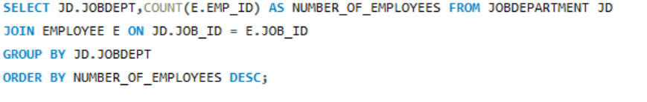
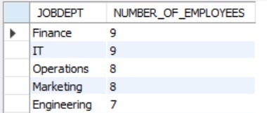
2. Which departments have the highest number of employees?

Slide 10
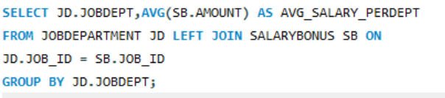
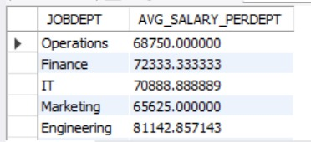
3.What is the average salary per department?

Slide 11
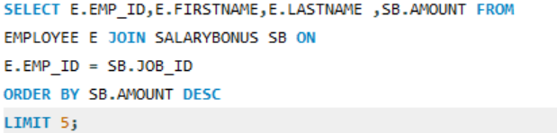
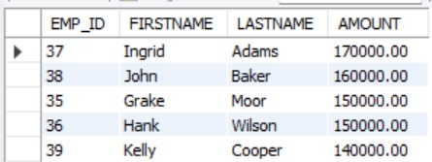
4. Who are the top 5 highest-paid employees?

Slide 12
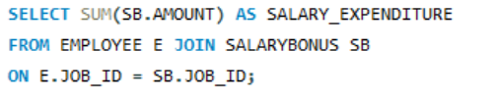

5. What is the total salary expenditure across the company?

Slide 13
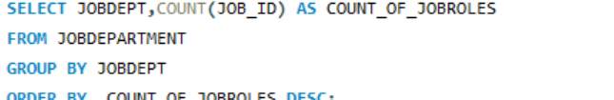
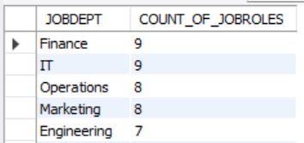
6. How many different job roles exist in each department??

Slide 14
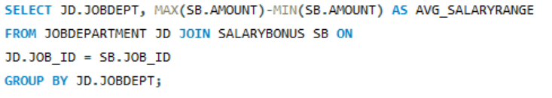
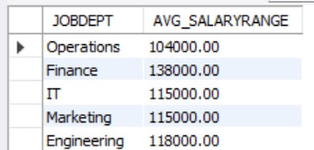
7. What is the average salary range per department??

Slide 15
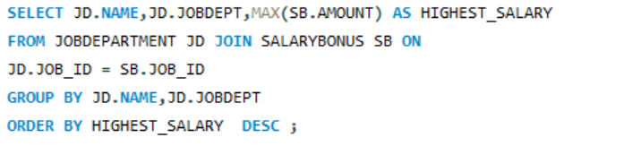
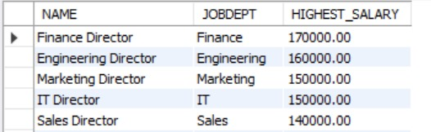
8. Which job roles offer the highest salary?

Slide 16
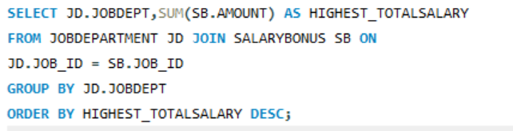
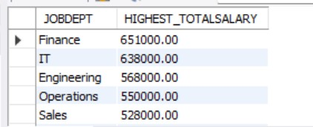
9. Which departments have the highest total salary allocation?

Slide 17
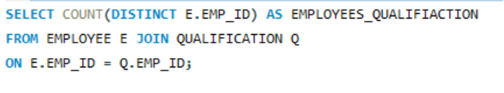

10. How many employees have at least one qualification listed?

Slide 18
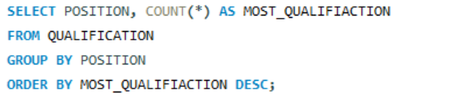
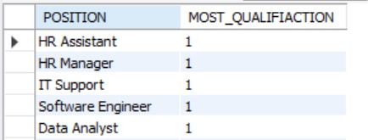
11. Which positions require the most qualifications?

Slide 19
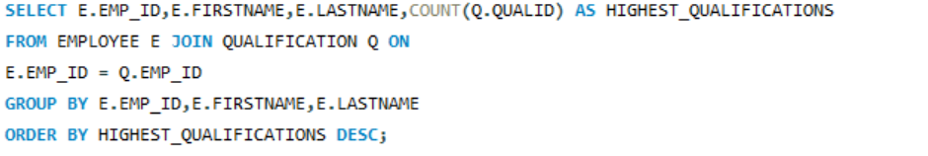
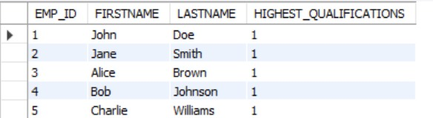
12. Which employees have the highest number of qualifications?

Slide 20
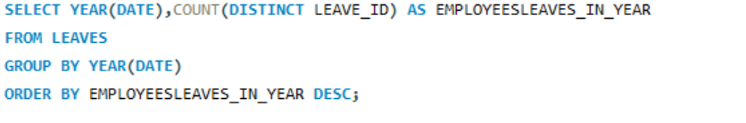

13. Which year had the most employees taking leaves?

Slide 21
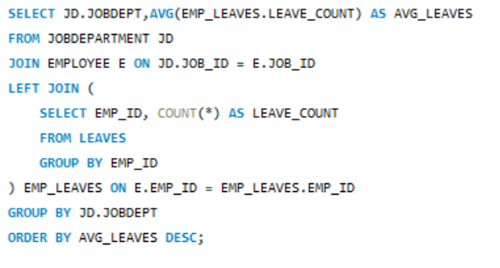
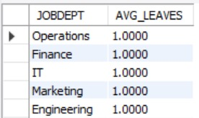
14. What is the average number of leave days taken by its employees per department?

Slide 22
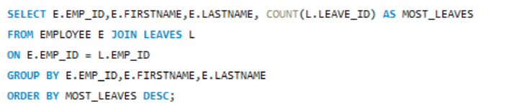
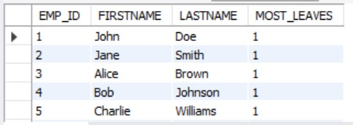
15. Which employees have taken the most leaves?

Slide 23


16.What is the total number of leave days taken company-wide?

Slide 24
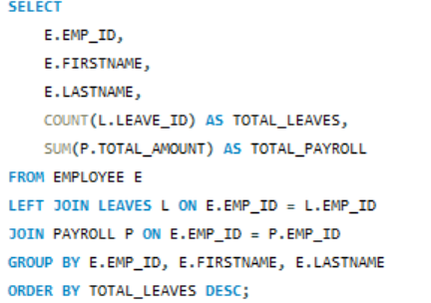
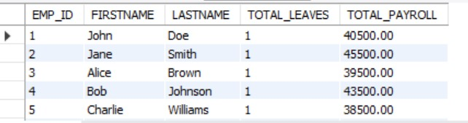
17. How do leave days correlate with payroll amounts?

Slide 25
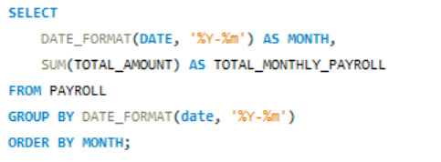

18. What is the total monthly payroll processed?

Slide 26
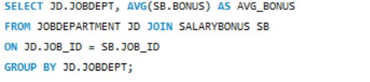
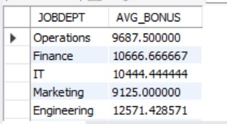
19. What is the average bonus given per department?

Slide 27

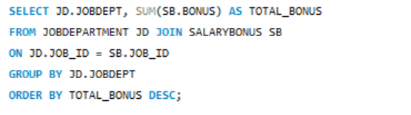
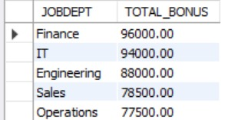
20. Which department receives the highest total bonuses?

Slide 28



21. What is the average value of total amount after considering leave deductions?

Slide 29
THANK YOU

