Slide 1
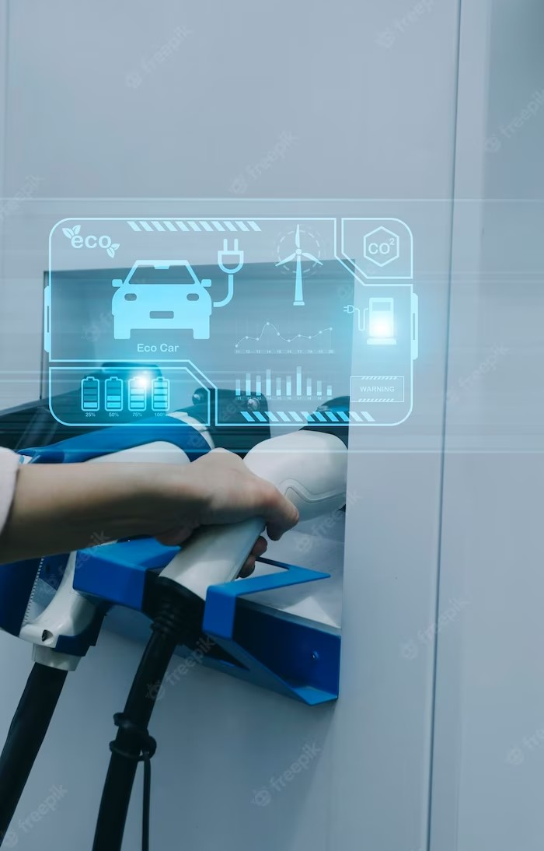
Real-Time Highway Accident Detection Model Based on Big Data Processing and Computational Intelligence

Slide 2
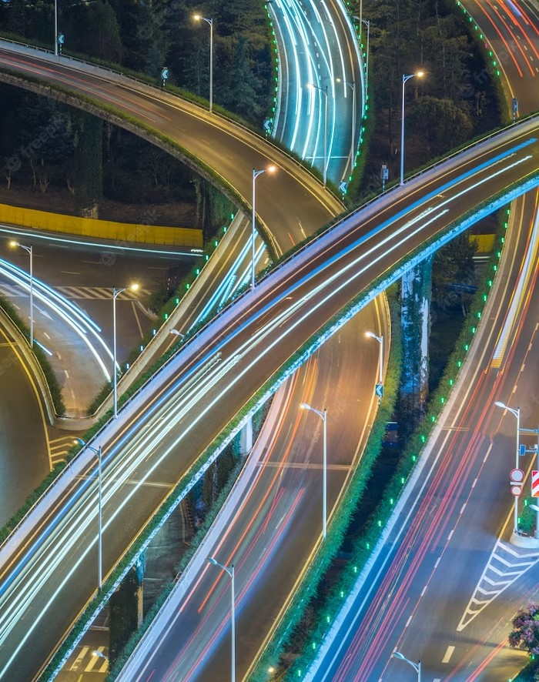
Introduction
A real-time highway accident detection model based on big data processing and computational intelligence is a new approach to highway safety that combines advanced technology and analysis to prevent accidents and save lives.

Slide 3

Current Challenges
Current highway safety systems are reactive and rely on human input. The lack of real- time autonomous systems leads to delays in accident detection and response.
Big data and computational intelligence can help address these issues by providing real-time analysis and decision-making capabilities.

Slide 4

Real-Time Accident Detection
Real-time accident detection is a key feature of the proposed model. By utilizing sensors and machine learning algorithms, the system can quickly identify accidents and notify emergency services. This can reduce response times and potentially save lives.

Slide 5
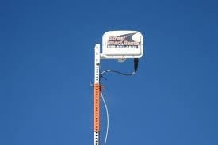
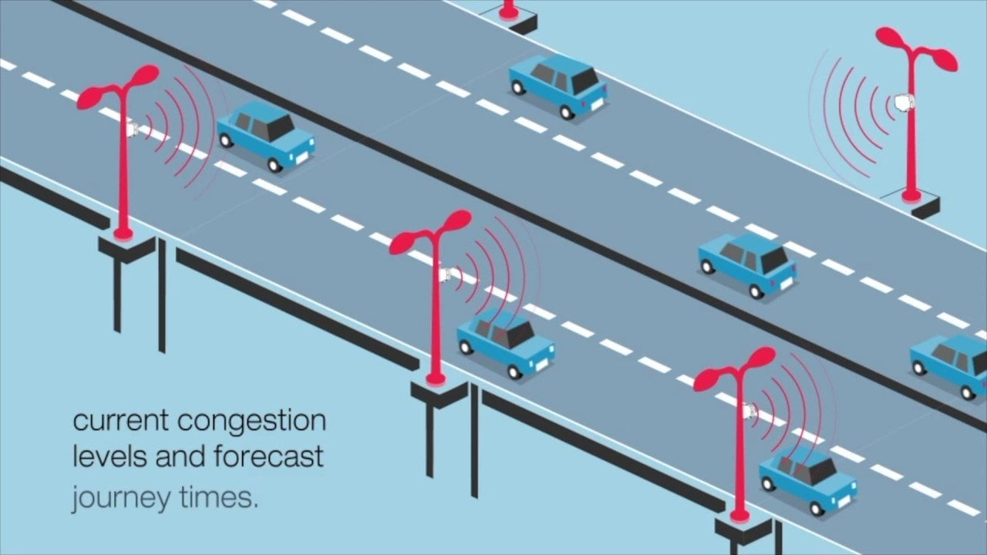
Data processing
RTMS(Remote Traﬁc microwave senser):
it is a radar technology based vehical detection device.
The following data items are collected every 2 minutes through the sensors from each lane separately:
Number of cars passing every 2 minutes
Average speed of the vehicles in the last 2 minutes.
Date/Time information.

Slide 6

Big Data Preprocessing
In order to process the data,big data processing techniques are adapted. The acquired raw data is passed through an ETL (Extract-Transform-Load) process through HDFS and Apache Spark. The
original data is stored format and imported environment via Sqoop.
in SQLServer to Hadoop
The imported data is then processed on a 10-PC cluster using Spark and HDFS. The individual lane data are averaged in order to get a single directional feature.

Slide 7
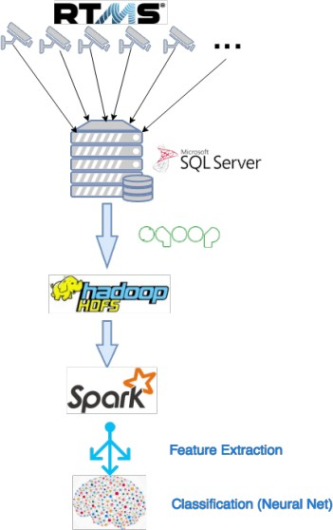

DATA ANALYSIS AND FEATURE E TRACTION
The data from the sensors and the event logs are combined together to extract the most appropriate features for the accident detection model.

Slide 8
ACCIDENT DETECTION MODEL
Different computational intelligence models are analyzed for accident detection. We can select models like nearest neighbor, regression tree, and feedforward neural networks.
Nearest neighbor is one of the simplest classiﬁers that has been widely used for pattern recognition/classiﬁcation problems.
Regression tree is another simple classiﬁer that uses the entropy and class variance information for machine learning problems
Feedforward neural networks are commonly used in complex nonlinear data mapping, function approimation, machine learning, and classiﬁcation problems.

Slide 9
Conclusion
Highway safety is crucial to reducing the number of accidents and saving lives by using big data and computational intelligence, has the potential to transform the way we approach highway safety. By providing real-time accident detection and prevention capabilities, we can make our roads safer for everyone.

Slide 10
Thanks!

