Slide 1
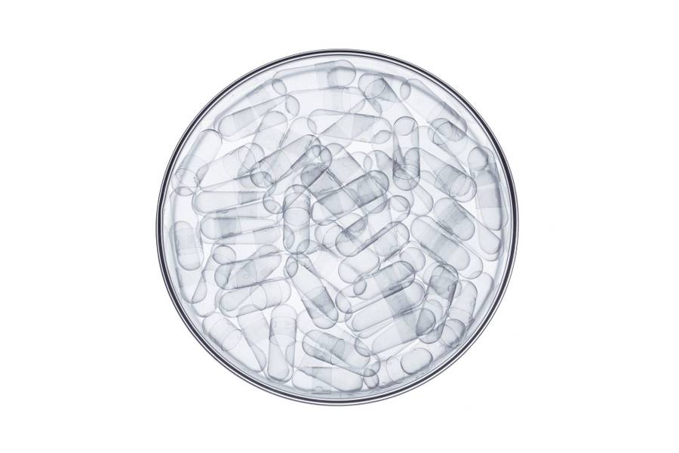
nfc

Slide 2
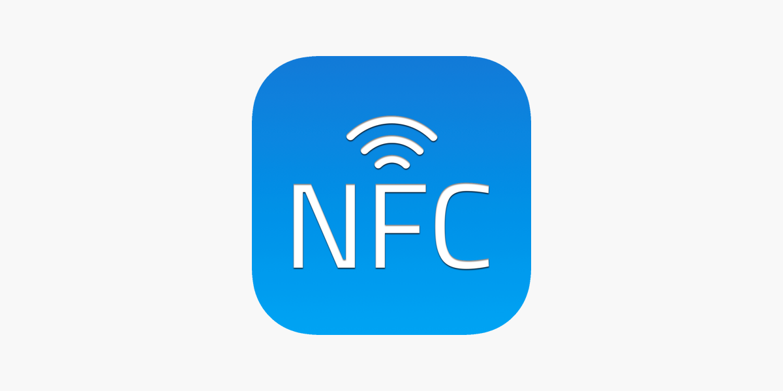
What is nfc?
NFC, or near-field communication, is a short-range wireless technology that allows your phone to act as a transit pass or credit card, quickly transfer data.

Slide 3
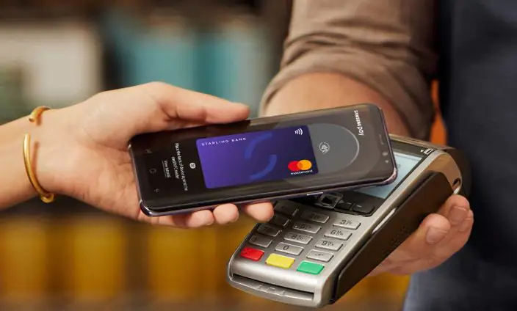
Why nfc?
Secure transactions.
Exchange digital content.
Connect electronic devices with a touch.
Less risk factor.
Faster.

Slide 4

How nfc is used?
NFC (near field communication) is what enables two devices to communicate wirelessly when they’re close together.
NFC is actually a subset of something called RFID (radio-frequency identification), a technology that allows us to identify things through radio waves. RFID is nothing new — it’s been used for decades for things like scanning items in grocery stores and luggage on baggage claims, and tagging cattle.

Slide 5
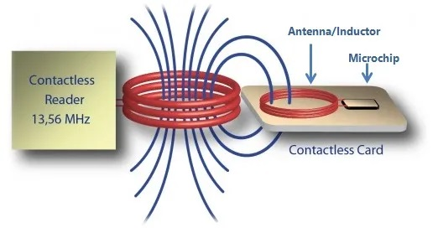
NFC operates on the principle of inductive coupling, at least for short-range implementations. This essentially involves the reader device generating a magnetic field by passing an electric current through a coil.
When a tag (with its own coil) is brought nearby, the field induces an electric current within the tag — sans any wires or even physical contact. Then, once the initial handshake is complete, any stored data on the tag is wirelessly transmitted to the reader.

Slide 6
applications
Smart cards.
E-wallet(payment using smart phones).
Smart ticketing.
Medicine and healthcare.
Keyless access.
Logistics and shipping.
NFC information tags.

Slide 7
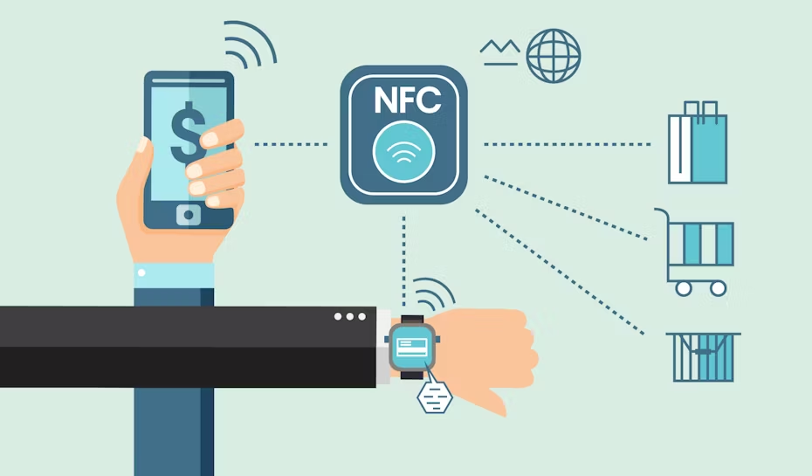
NFC: powering up the “call to action”

Slide 8
Nfc vs rfid
Operating distance is less.
Works only at high frequency.
Two way communication.
Can read single tag at a time.
Operating distance is high.
Works at both low and higher frequencies.
One way communication.
Can read huge volume of data.

Slide 9
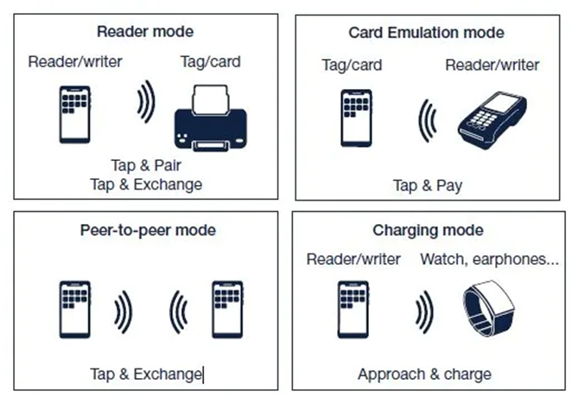
Nfc chips
A Near-Field Communication chip (NFC chip or NFC chipset) is a silicon component or Integrated Circuit (IC) that can be used in different ways, depending on the targeted application.
The NFC chips embedded in each component of the system make the wireless communication possible. For example, an NFC chip can be embedded in a banking card and a payment terminal, or in a passport, where it is used to store biometric data.
An NFC communication system includes two separate parts: an NFC reader chip and an NFC tag. The NFC reader chip is the active part of the system, because as its name suggests, it “reads” (or processes) the information before triggering a specific response. It provides power and sends NFC commands to the passive part of the system, the NFC tag.
There are three types of NFC chips: NFC readers, NFC tags, and NFC controller chips.

Slide 10

Thank you

