Slide 1
PartyGuard iOS
Team 21
Bash Guardians

Slide 2
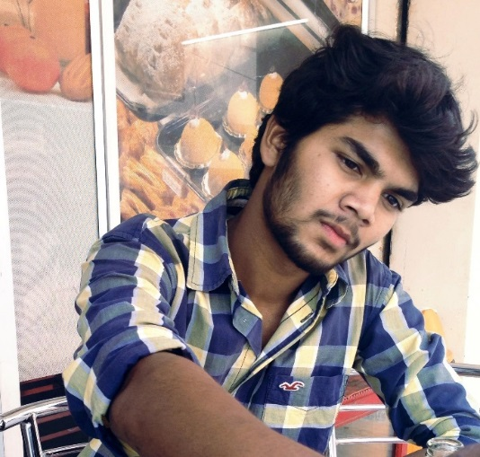
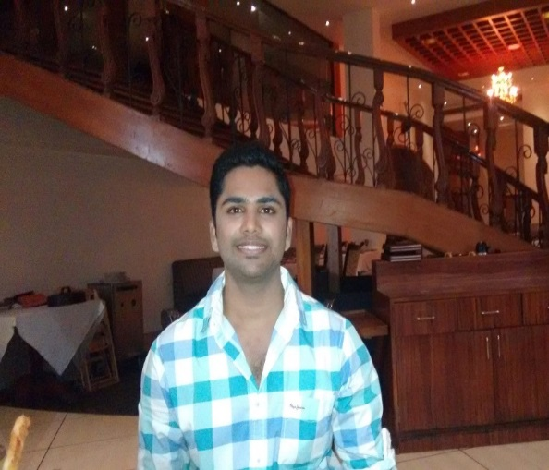
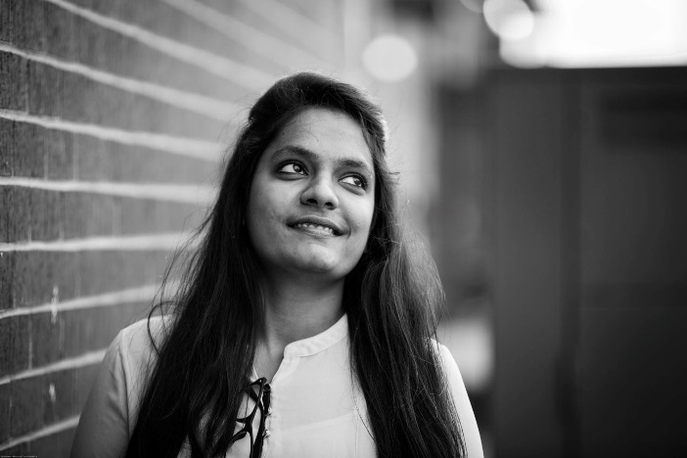
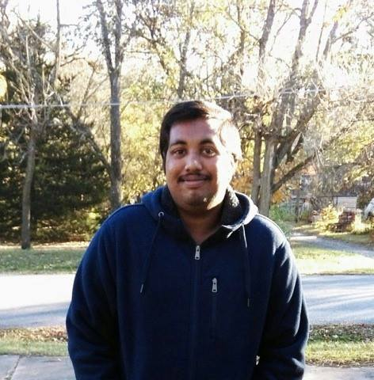
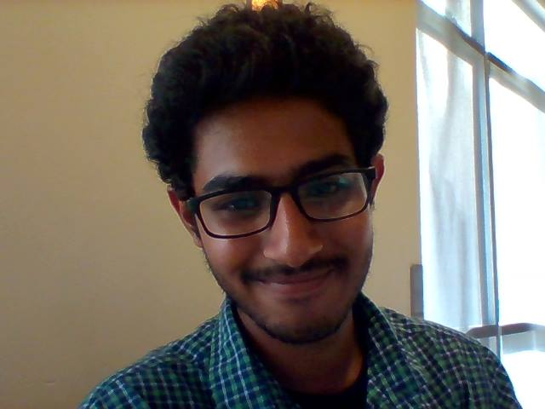
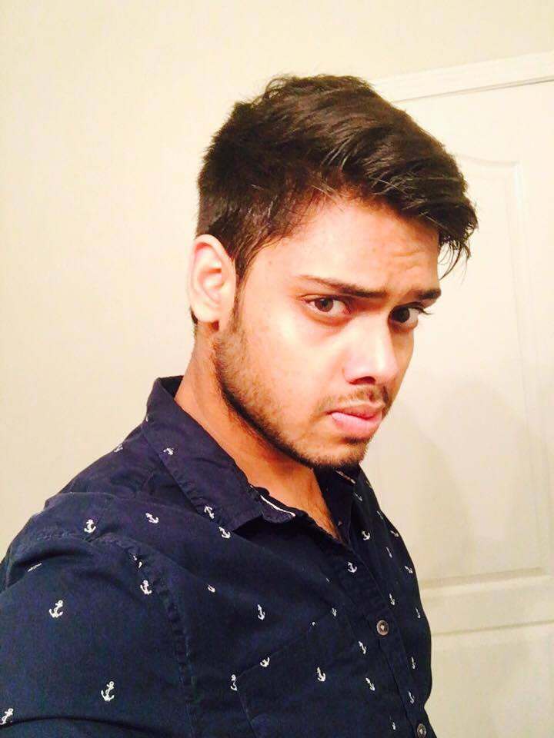
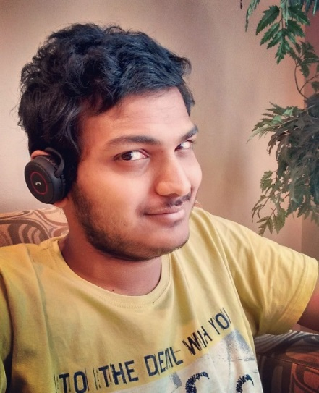
Team Members
Vinod
Yashwanth
Spandana
Naveen
Nandeesh
Pushpak
Sanjeev

Slide 3
Roles and Responsibilities
Primary Contact – Spandana
Issues Management – Pushpak
Communications and Documentation Management – Vinod
Quality and testing management – Yashwanth
Requirements Management – Nandeesh
Data Management – Naveen
Client Management - Sanjeev

Slide 4
Client Information
Client Name: Stansbury Jacob
Email id: s516098@mail.nwmissouri.edu
Mission: Develop PartyGuard iOS application

Slide 5
PartyGuard iOS
Mobile application designed for users to prevent sexual assaults and accidents. There are three different types of users for this application: Host user, Guard user and Basic user. Host user creates a profile of their fraternity house by giving details like contact information, area and appoints guard users. Host user and guard users will get alerts/notifications of specific situations to be solved from the basic user. The basic user creates an account and they can open the application during a party to report any situation for which host user and guard user will be responsible for solving the problem.

Slide 6
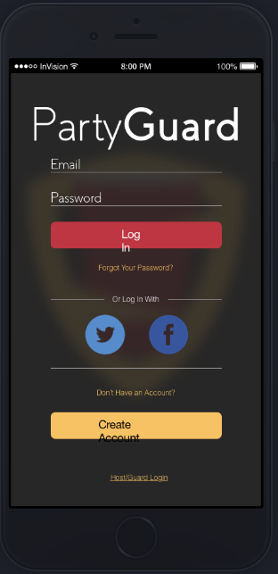
Type of User

Slide 7
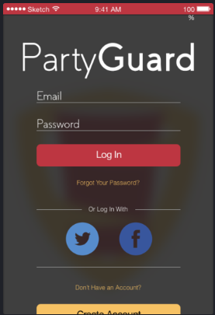
Respective User Login

Slide 8
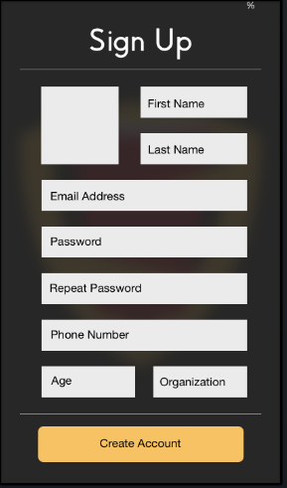
Registration

Slide 9

Application Guide

Slide 10
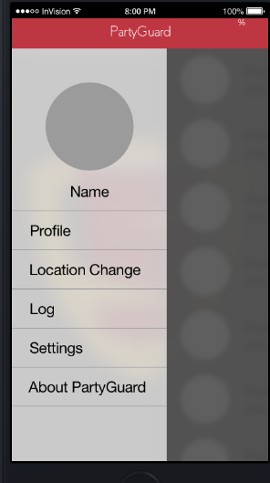
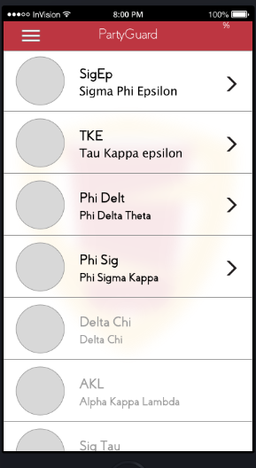
Home Screen with Menu

Slide 11
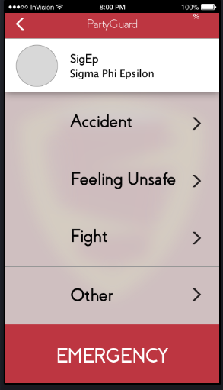
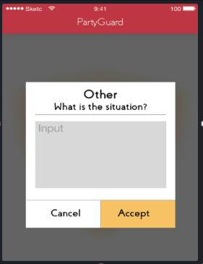
Issue Reporting

Slide 12
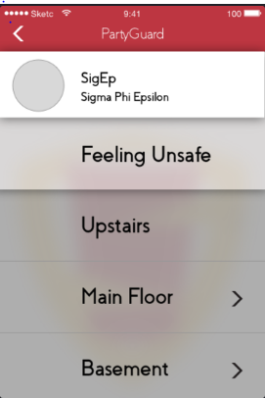
User Location

Slide 13
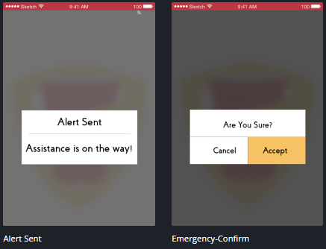
Message prompts and Confirmation Dialogues

Slide 14
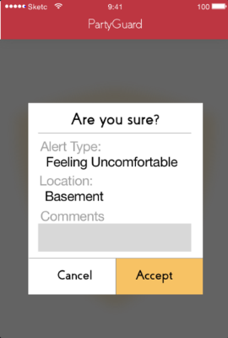
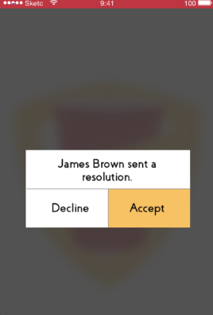
Contd..

Slide 15
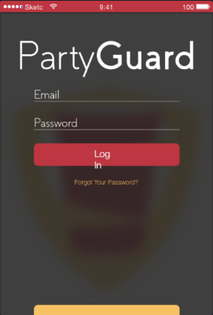
Host User login

Slide 16
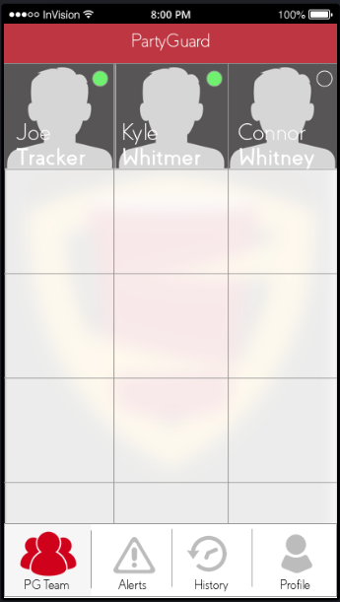
PG Team

Slide 17
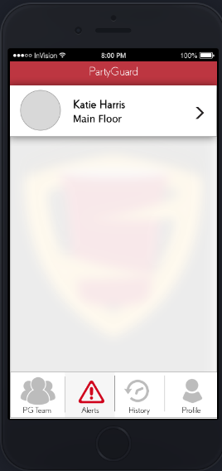
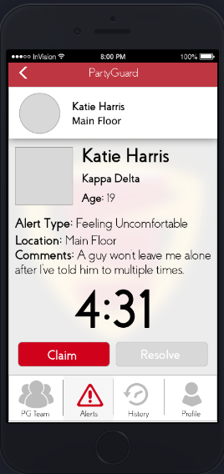
Alerts

Slide 18
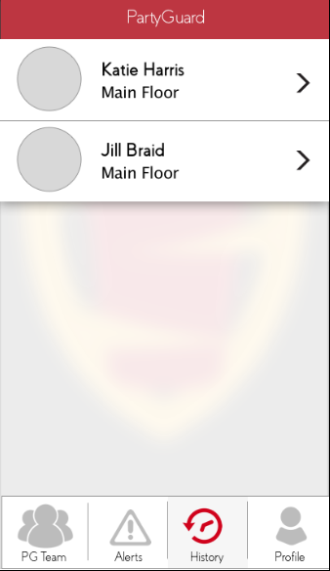
History

Slide 19
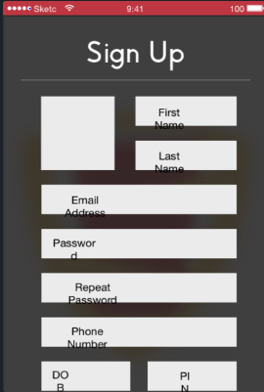
Host/Guard Profile

Slide 20
Technologies
Integrated Development environment : XCode 8.0
Build Tool: Swift Build
Technology Stack : Swift, Cocoa Pods, Google Maps API

Slide 21
Source Code Hosting Site
BitBucket
Trello

Slide 22
Plan for Hosting Service
App Store

Slide 23
Collaboration
Web Services – Team 22 (Megatrons)

Slide 24
Thank You!

