Slide 1
PartyGuard IOS App
BASH GUARDIANS

Slide 2







Team Members
Sai Spandana
Nandeesh
Vinod Somu
Pushpak
Sai Naveen
Sanjeev
Yashwanth
Team 21 – PartyGuard BashGuardians
1

Slide 3
Team Member Responsibilities
Role | Team Member
Primary Contact | Sai Spandana Chava
Client Management | Sanjeev Koneru
Requirements Management | Nandeesh Tankasala
Data Management | Naveen
Issues Management | Pushpak
Quality and Testing Management | Yashwanth Teja
Communications and Documentation Management | Vinod Somu
Team 21 – PartyGuard BashGuardians
2

Slide 4
PartyGuard-IOS
“PartyGuard” is an IOS application that could be used by students of Northwest Missouri State University.
It is a mobile application designed for users to help prevent sexual assaults and accidents happening within Greek life, specifically Fraternity houses. There are three different types of users for this application, basic user, and the host user and guard user. The basic user creates an account through Facebook/standalone account having required contact information and identification. After the account is created they can open the application during a party to report any situation to the host user where help is needed within the fraternity Once reported, the host and guard user is responsible for resolving the conflict
Team 21 – PartyGuard BashGuardians
3

Slide 5
Technologies and Tools
Swift
Xcode
BitBucket(Source code hosting site)
Source Tree
Trello
GitHub
JIRA
Team 21 – PartyGuard BashGuardians
4

Slide 6
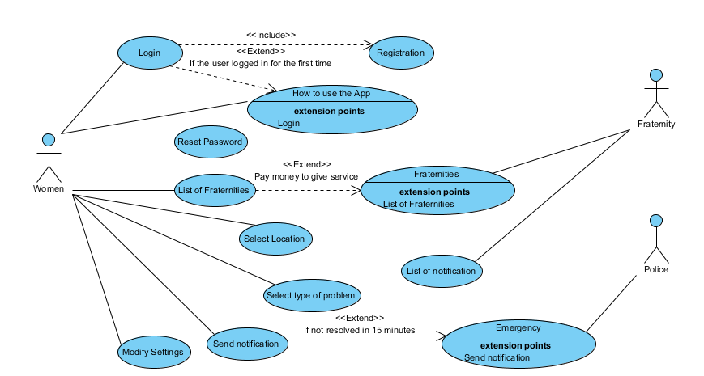
Use Case Diagram – Basic User
Team 21 – PartyGuard BashGuardians
5

Slide 7
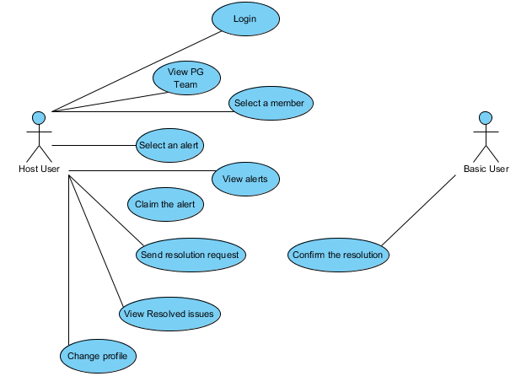
Use Case Diagram – Host User
Team 21 – PartyGuard BashGuardians
6

Slide 8
Challenges faced during Development
Talking to University Police for the application to be implemented practically.
Adding Constraints
Adding Menu
To resolve merge conflicts in bit bucket
Team 21 – PartyGuard BashGuardians
7

Slide 9
PartyGuard Demo
Team 21 – PartyGuard BashGuardians
8

Slide 10
Teams will be working with
We have collaborated with Web services team “Megatrons” to make sure that Partyguard IOS applications works with no errors.
Team 21 – PartyGuard BashGuardians
9

Slide 11
Thank You

