Slide 1
Requirements Management - Workshop-1
Team:
Pavan Kanumuri
Swetha Gajam
Nandeesh Tankasala
Kusumasree Kommineni
Srikanth Chippa
Seshu kumar Gandhapuneni
Hima Teja Gutta
Santosh Boyina

Slide 2








Team Members
Pavan Kanumuri
Swetha Gajam
Nandeesh Tankasala
Kusumasree Kommineni
Srikanth Chippa
Seshu Gandhapuneni
Hima Teja Gutta
Santosh Boyina

Slide 3
Contents
Requirements Definition and Process
Requirements Gathering - Waterfall v/s Agile
Functional and Non-Functional Requirements
Use cases
Use case Diagram
Requirements Traceability Matrix
Change Request Management
Jira
Exercise

Slide 4
Requirements
Definition:
A necessary element
Needed and Wanted
Capability to which a project outcome (product or service)
should conform
Identifying the Specific and Accurate Requirements
Bad Requirements?=
Wasted Resources
Client Dissatisfaction
Pavan Kanumuri

Slide 5
Process Involved
Requirements Elicitation
Requirements Analysis
Requirements Specification
Requirements Validation
Pavan Kanumuri

Slide 6
Techniques Used
Elicitation:
Interviewing
Brainstorming
Workshops
Analysis: Prototyping
Specification And Validation: SRS Document
Pavan Kanumuri

Slide 7
Actors Involved
Providing Requirements: Sponsor
Gathering and Analyzing Requirements: Business Analyst
Feasibility Analysis and Change Proposals: Architect or Developer
Requirements Review: QA Lead, Business Analyst, Architects, Developers and Project Sponsor
Pavan Kanumuri

Slide 8
Requirement Methodologies
The purpose of requirements management is to ensure that an organization documents, verifies, and meets the needs and expectations of its customers and internal or external stakeholders.
It is a continuous process throughout the project.
Requirements management involves communication between the project team members and stakeholders, and adjustment to requirements changes throughout the course of the project.
Swetha Gajam

Slide 9
Waterfall model
Linear-sequential life cycle model
Process oriented
Most of the requirements are gathered at the start of the project, in the requirement phase.
It is a sequential process.
The project team has the project scope and the a detailed description of what needs to built.
The requirements are gathered in a very detailed level.
Testing starts only after the project completion.
The phases do not overlap. There is no room for change.
Swetha Gajam

Slide 10
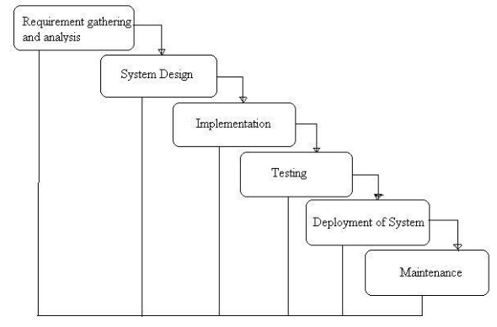
General Overview of waterfall model
Fig 2.1 General Overview of waterfall model
Img src: http://istqbexamcertification.com/wp-content/uploads/2012/01/Waterfall-model.jpg
Swetha Gajam

Slide 11
Pros and Cons of Waterfall model
Pros
Simple and easy to use.
Each phase is modeled and completed one at a time(Phases do not overlap)
Works well for small projects where requirements are very well understood.
Cons
It is difficult to change the previous processes.
Not a good model for complex and object oriented projects
Difficult with changing requirements. Poor model for long and ongoing projects.
Swetha Gajam

Slide 12
Agile model
Incremental model
People oriented
Alternative to traditional project development methodolgy.
Helps to respond to unpredictability through incremental and iterative work in a project.
Working software and customer collaboration is involved.
Working software is the principle measure of progress.
Uses sprints or iterations to design and deliver the predetermined features.
Focused on quick response to change and continuous development.
Swetha Gajam

Slide 13
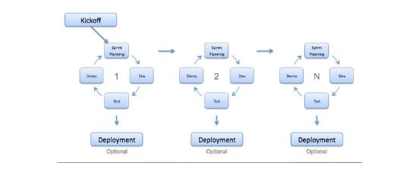
Diagram of Agile model
Fig 2.2 Agile working model diagram
Img src: http://istqbexamcertification.com/wp-content/uploads/2012/01/Agile-model.jpg
Swetha Gajam

Slide 14
Pros and Cons of Agile model
Pros
Simple and easy to use.
Rapid delivery of project software -> Customer satisfaction
Customers, developers and testers are in constant communication with each other.
Late changes can be accommodated.
Cons
Difficult to assess the effort needed for large deliverables at the start of the project life cycle.
Lack of emphasis on necessary designing and documentation.
Chances of occurrence of unknown risk is more compared to waterfall model.
Swetha Gajam

Slide 15
Functional and Non–Functional Requirements
Nandeesh Tankasala

Slide 16
Definition
Functional requirements: Describe system services or functions.
Some typical functional requirements:
Administrative functions
Authentication
Data processing
Non-functional requirements: They are constraints on the system or the development process, one can also consider it as an quality attribute of the system.
Some typical Non functional requirements:
Performance
Security
Reliability
Efficiency, Stability, Scalability
Simply put Non-functional requirements describe how system works, while functional requirements describe what the system should do.
Nandeesh Tankasala

Slide 17
Examples
For PartyGuard Application:
Functional Requirement: Able to report an incident to the Guard/Host with in a particular fraternity.
Non-Functional Requirement: Able to report it within a certain amount of time.
For Paperplane Application:
Functional: Ability to add or plan travel and other activities
Non-Functional: Ability to do it 24/7 with no down time.
Generic example:
Functional: A worker helmet being adjustable and able to fit all head sizes.
Non-Functional: Helmet should be durable and shouldn’t break for pressure less than 10000psi.
Non functional requirements may be more critical than Functional requirements.
Nandeesh Tankasala

Slide 18
Use Case
Methodology used in system analysis to identify, clarify and organize system requirements.
Use case are a way to capture functional requirements of a system.
Kusumasree Kommineni

Slide 19
Use Case Characteristics
Organizes functional requirements.
Models the goals of system/actor interactions.
Records path from trigger events to goals.
Describes basic course of action, and also alternate courses of action.
Multi-level.
Kusumasree Kommineni

Slide 20
Elements of a Use Case
Actor
Stakeholder
Primary Actor
Preconditions
Triggers
Main success scenarios
Alternative paths
Kusumasree Kommineni

Slide 21
Use Case Example
Use Case Name : Place Order
Actors:
Registered Shopper
Non-registered Shopper
Fulfillment System
Billing System
Kusumasree Kommineni

Slide 22
Use Case Example
Triggers :
The user wants to purchase items that has been selected.
Preconditions:
User should first select the items that are to be purchased.
Post-Conditions:
The order will be placed.
User will have a tracking number.
User will know the estimated delivery time.
Kusumasree Kommineni

Slide 23
Use Case Example
Basic Flow:
User will first select the items to be purchased, and then places an order.
The user will confirm the order with existing shipping and billing address.
The system will present the total cost of the items with applicable taxes and shipping charges.
User will get a tracking number once he/she make a confirmation about the order.
Kusumasree Kommineni

Slide 24
Use Case Example
Once the system submit the order to the fulfillment system then the user will get an estimated delivery date.
The system will request the billing system to charge the user for the order once if the order is placed.
Billing system will confirm that the charges has been placed for the order.
The system will submit the order to the fulfillment system for processing.
Kusumasree Kommineni

Slide 25
Use Case Example
The fulfillment system make sure that the order is being processed.
The system will indicate the user that order has been placed.
The user will exit the system.
Alternative flows:
User desire to use different billing and shipping address.
User will enter different billing and shipping address
System will validate the information.
The use case continues.
Kusumasree Kommineni

Slide 26
Use Case Example
User discovers any error in billing or shipping address and if he/she want to change it.
User will indicate that the billing and shipping information is incorrect and will edit it.
System will validate the information
The use case continues.
Kusumasree Kommineni

Slide 27
Use Case Example
The user will determine that the order is not acceptable and will cancel the order.
The user will cancel the request.
The system will confirm that the order has been cancelled.
The use case continues.
Kusumasree Kommineni

Slide 28
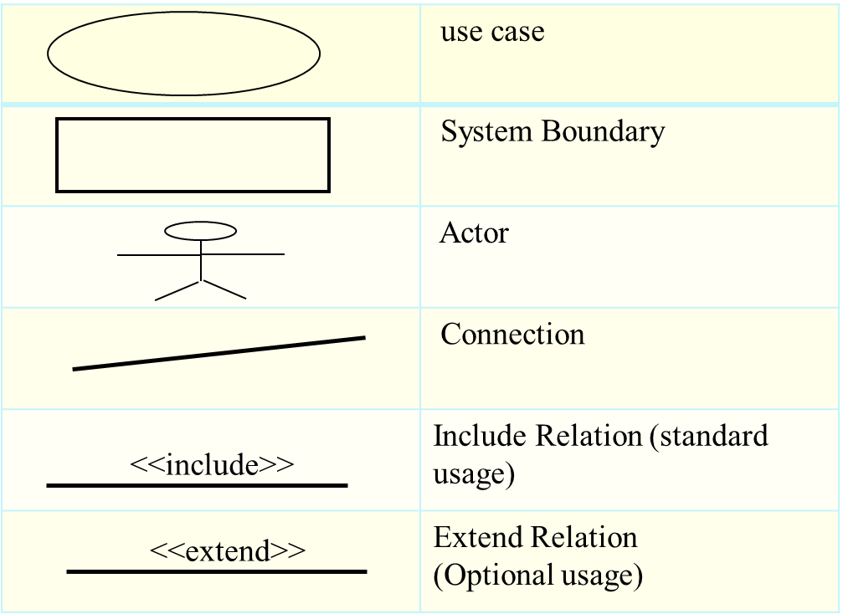
Use-Case Diagram
Visual treat of system functionality.
Interaction between actors and system.
Types of Relationships
Includes
Extends
Srikanth Chippa

Slide 29
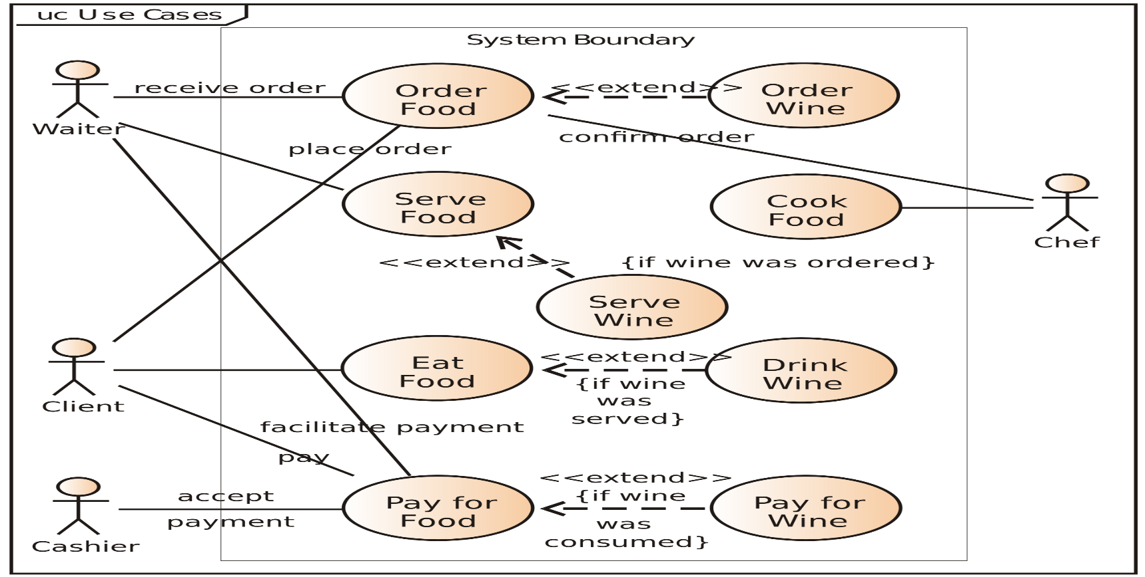
Use-Case diagram Example
[ A business Use Case Diagram depicts a model of several business use cases ]. Retrieved from: https://upload.wikimedia.org/wikipedia/commons/thumb/1/1d/Use_case_restaurant_model.svg/2000px-Use_case_restaurant_model.svg.png
Srikanth Chippa

Slide 30
ADVANTAGE
Useful for early structuring of requirements; iterative revisions.
May be understood by users on the intuitive level.
Provides a global look of a system – it’s basic functionality (use cases) and environment (actors).
Srikanth Chippa

Slide 31
Requirement Traceability Matrix
Requirement Traceability Matrix or RTM is a document created at the very beginning of a project as it forms the basis of the project's scope and deliverables that will be produced.
The Matrix is bi-directional.
The main purpose of Requirement Traceability Matrix is to see that all test cases are covered so that no functionality should miss while development and testing.
Seshu Kumar Gandhapuneni

Slide 32
RTM Parameters
Requirement ID – BA Team
Risks – BA Team
Requirement Type and Description – BA Team
Trace to design specification – Architect or Developer
Unit test cases - Developer
Integration test cases - Developer
System test cases – QA Team
User acceptance test cases – Client QA Team
Verified? – Done by client
Seshu Kumar Gandhapuneni

Slide 33
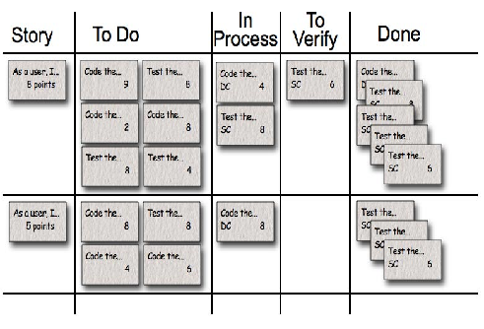
RTM in agile
RTM is usually applicable for waterfall model of implementation.
Agile uses “Scrum Task Board” for traceability
Seshu Kumar Gandhapuneni

Slide 34
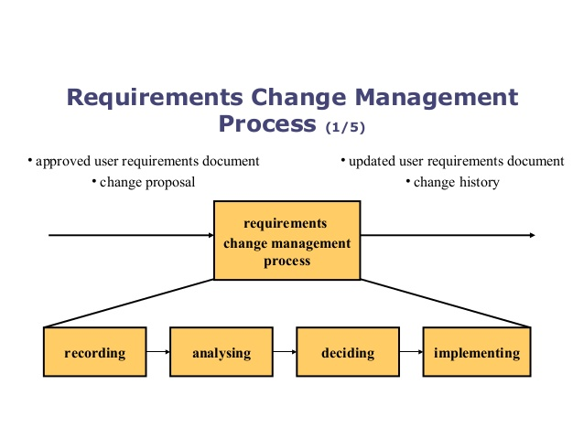
Requirements Change Management Process
Img src: http://www.slideshare.net/abasit83/requirement-change-management
Hima Teja Gutta

Slide 35
Requirements Change Management Process
Recording:Stakeholders submit proposals for requirements changes using a pre-defined form
Analysing a change request: Analyse how it effect time, budget, what are benefits?, is it valid or not? , how components and requirements effected?
Deciding on a change request: Change requests are considered formally by a group or a person who decide whether or not the change should be accepted
Implementing a change: Updating the requirements document, Informing all the necessary people
Hima Teja Gutta

Slide 36
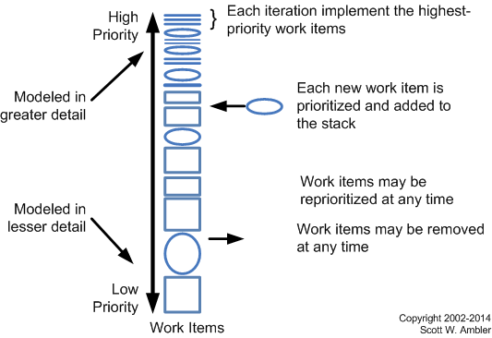
Requirement Mgmt. in Agile
Img src: http://agilemodeling.com/essays/changeManagement.html
Hima Teja Gutta

Slide 37
Change Request Template
Element | Description
Date | The date the CR was created
CR# | Assigned by the Change Manager
Title | A brief description of the change request
Description | Description of the desired change, the impact, or benefits of a change should also be described
Submitter | Name of the person completing the CR Form and who can answer questions regarding the suggested change
Phone | Phone number of the submitter
E-Mail | Email of the submitter
Product | The product that the suggested change is for
Version | The product version that the suggested change is for
Priority | A code that provides a recommended categorization of the urgency of the requested change (High, Medium, Low)
Hima Teja Gutta
Notes:
Src: https://www.google.com/url?sa=t&rct=j&q=&esrc=s&source=web&cd=1&cad=rja&uact=8&ved=0ahUKEwj3rKrv3IjPAhVHRCYKHUzsC2gQFggcMAA&url=http%3A%2F%2Fwww2.cdc.gov%2Fcdcup%2Flibrary%2Ftemplates%2Fcdc_up_project_management_plan_template.doc&usg=AFQjCNGEtu4zMCpo_Xh4TvUk46TDclnzrw&sig2=HpLDa63bL3K4MApH-2Xq5w&bvm=bv.132479545,d.eWE

Slide 38
Change History template
ROW # | DOCUMENT & Version, Release or Build Number | REVISION DATE | REVISION DESCRIPTION | REVISION TRACKING NOTES
1 | Cool-Eye User Guide, V.2.1.5 | 2/3/2012 | ADDED a new section “4.1” about “Calibrating the Lenses” to Chapter 4 “System Configuration”. | Bug Tracker # 2365
2 | Cool-Eye Installation Guide , Build 43 | 5/1/2013 | EDITED the Glossary and ADDED two new items: “DDG” and “CB Porting”. | RE: PM email dated 1/4/2013
3 | Terra-Eye Quick Start Guide, Draft 4, Release 1.0.2 | 12/9/2014 | DELETED Chapter 3 “Importing Data.” ADDED two sections “5.2” and “5.3” to Chapter 5 “Post-Install Care”. | TW-1234
Src: http://www.technicalcommunicationcenter.com/2014/06/23/how-to-design-a-document-revision-history-template/
Hima Teja Gutta

Slide 39
INTRODUCTION TO JIRA
Developed by Atlassian, a Australian company
Specifically built for agile teams
Offers bug tracking, feature creation, agile planning and activity monitoring
They are available for both scrum boards and Kanban boards
Deals with
Planning
Tracking
Releasing
Reporting
Advantages:
Real time reporting
Integrates directly with the code
Constantly re-evaluates based on feedbacks
Santosh Boyina

Slide 40
JIRA FOR REQUIREMENT MANAGEMENT
Can use JIRA for requirement management in its workflow, custom fields and reporting
Can be used to create sub tasks, which can be tracked too
Can link related requirements together and with feature requirements too
Can view both confluence and requirement tracking together
JIRA allows us to create RTM
It is very useful to create RTM in JIRA than creating RTM in excel as we may face version updating issues in excel
Santosh Boyina

Slide 41
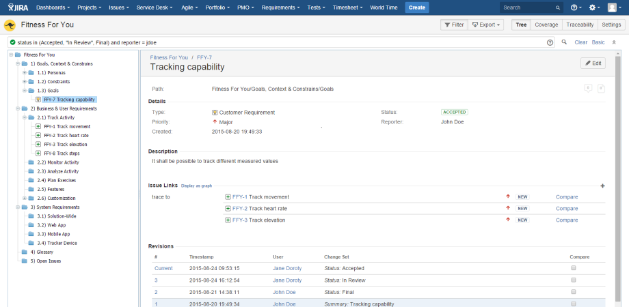
Requirement tracking in JIRA
Src:https://marketplace.atlassian.com/plugins/com.easesolutions.jira.plugins.requirements/server/overview
Santosh Boyina

Slide 42
Issue Tracking Tools
Some more:
Lean Testing
Freshservice
Incident Management Software
Mantis
Trac
IBM Rational ClearQuest
IssueTrak
Santosh Boyina

Slide 43
Useful Resources
Use case: http://www.utm.mx/~caff/doc/OpenUPWeb/openup/guidances/concepts/use_case_BB199D1B.html
Creating RTM: http://www.guru99.com/traceability-matrix.html
Requirements Process: http://ptgmedia.pearsoncmg.com/images/0321419499/samplechapter/robertson_ch02.pdf
Change Request Management: https://support.sap.com/content/dam/library/SAP%20Support%20Portal/support-programs-services/solution-manager/consulting/application-incident-management/change-request-management-r6c3.pdf

Slide 44
Useful Resources
Issue Tracking: https://sifterapp.com/academy/overview/why/
Use cases: http://csis.pace.edu/~marchese/CS389/L9/Use%20Case%20Diagrams.pdf

Slide 45
References
http://istqbexamcertification.com/what-is-agile-methodology-examples-when-to-use-it-advantages-and-disadvantages/
http://istqbexamcertification.com/what-is-agile-model-advantages-disadvantages-and-when-to-use-it/
http://istqbexamcertification.com/what-is-waterfall-model-advantages-disadvantages-and-when-to-use-it/
https://www.google.com/url?sa=t&rct=j&q=&esrc=s&source=web&cd=1&cad=rja&uact=8&ved=0ahUKEwja7pC5x4jPAhWCHR4KHbhBD7gQFggeMAA&url=http%3A%2F%2Fwww.cs.fsu.edu%2F~baker%2Fswe1%2Frestricted%2Fnotes%2Fppt%2FUseCaseDiagrams.ppt&usg=AFQjCNH-VRrnARK5GTOB8bAgDgWeD68Wfg&sig2=V1b9x23vgJq4oOiOUwvLVw
Santosh Boyina

Slide 46
References
http://www.mountaingoatsoftware.com/agile/scrum/task-boards
http://programmers.stackexchange.com/questions/33722/what-is-the-difference-between-requirements-elicitation-and-requirements-analysi
Santosh Boyina

Slide 47
THANK YOU

