Slide 1
Software Quality and Unit Testing
Presented by:
Lahari Surneni
Adithya Rayaprolu
Keerthi Padaraju
Ashish Peruru
Sairam Madhavaram
Adarsh Pidaparthy
Yashwanth
Arun Nadipudi

Slide 2








Team members
Lahari Surneni
Adithya Rayaprolu
Keerthi Padaraju
Ashish Peruru
Sairam Madhavaram
Adarsh Pidaparthy
Yeshwanth Teja
Arun Nadipudi

Slide 3
Contents
Software testing
Software quality
Unit testing
jUnit
xUnit
qUnit
Jasmine and Karma
Unit testing tools
Lahari Surneni

Slide 4
Software Testing
Software testing can be conducted as soon as a software executes or even partially exists.
It is a process of executing a program or application under positive and negative conditions by manual or automated means.
It checks mainly for
Specification
Functionality
Performance
Lahari Surneni

Slide 5
Software Testing (cont.)
The approach to software development often determines when and how testing is conducted.
In a phased process, most testing occurs after system requirements have been defined and then implemented in testable programs.
In contrast, under an Agile approach, requirements, programming, and testing are often done concurrently.
Lahari Surneni
Notes:
We all are done with our midterm presentations, so did anyone started testing in your projects?

Slide 6
Software Testing(cont.)
Properties followed under test:
Meets the requirements that guided its design and development.
Responds correctly to all kinds of inputs.
Performs its functions within an acceptable time.
Is sufficiently usable.
Can be installed and run in its intended environments.
Achieves the general result its stakeholders desire.
Lahari Surneni

Slide 7
Types of testing
Static Testing:
Reviews, walkthroughs, or inspections are referred to as static testing.
Static testing is often implicit, as proofreading, plus when programming tools/text editors check source code structure or compilers (pre-compilers) check syntax and data flow as static program analysis.
Dynamic Testing:
Executing programmed code with a given set of test cases is referred to as dynamic testing.
Dynamic testing takes place when the program itself is run. It may begin before the program is 100% complete in order to test particular sections of code and are applied to discrete functions or modules.
Lahari Surneni

Slide 8
Testing methods
Black box testing:
No knowledge of internal program design or code required.
Tests are based on requirements and functionality
Black-box testing methods include:
Equivalence
Partitioning
Boundary value analysis
All-pairs testing
State transition tables
Lahari Surneni

Slide 9
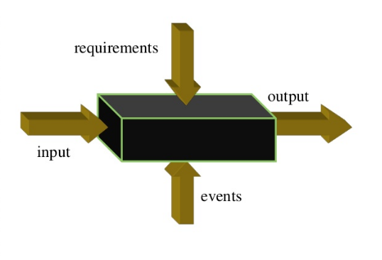
Black box testing
Lahari Surneni

Slide 10
Testing methods (cont.)
White box testing:
Knowledge of internal program design and code required.
Tests are based on coverage of code statements, branches, paths, conditions.
Techniques used in white-box testing include:
API testing
Code coverage
Fault injection methods
Mutation testing methods
Static testing methods
Lahari Surneni
Notes:
API testing – testing of the application using public and private APIs (application programming interfaces)
Code coverage – creating tests to satisfy some criteria of code coverage (e.g., the test designer can create tests to cause all statements in the program to be executed at least once)
Fault injection methods – intentionally introducing faults to gauge the efficacy of testing strategies

Slide 11
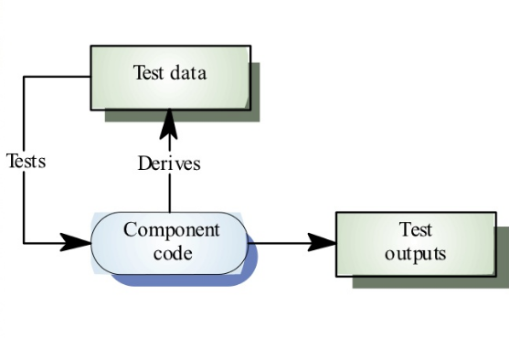
White box testing
Lahari Surneni

Slide 12
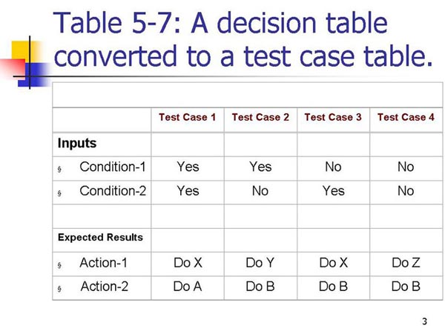
Sample testing table
Lahari Surneni

Slide 13
Testing levels
Unit testing
Integration testing
System testing
Lahari Surneni
Notes:
In our presentation we focus on unit testing mainly

Slide 14
Software quality
The aim of software quality management is to manage the quality of software and its development process
A quality product is one which meets its requirements and satisfies the user
A quality culture is an organizational environment where quality is viewed as everyone responsibility
Adithya Rayaprolu

Slide 15
Unit test for Visual Studio
A separate unit test is created for each method that you select in the Create Unit Test dialog box.
Each unit tests that is generated has empty variables and a placeholder Assert statement.
To make the test meaningful, you have to initialize the variables and replace the placeholder with an appropriate Assert statement
When you first generate unit tests, a test project is created in your solution
or each class you are testing, a separate unit test file is created in the test project
Adithya Rayaprolu

Slide 16
Unit test for Net Beans
The IDE lets you create tests, using wizards and templates, for the popular JUnit and TestNG test frameworks
Once you have created tests for your Java classes, you can run them individually or all at the same time.
The Test Results window shows the results of the tests you run.
Adithya Rayaprolu

Slide 17
Unit Test for Xcode
Defining Test Scope
Performance Testing
User Interface Testing
App and Library Tests
XCTest—the Xcode Testing Framework
Adithya Rayaprolu

Slide 18
Code Metrics
Maintainability Index
Cyclomatic Complexity
Depth of Inheritance
Class Coupling
Lines of Code
Adithya Rayaprolu

Slide 19
Test Coverage Percentages
Test coverage percentages are just an arbitrary numbers, we have to be concentrating on all the factors that contribute to the logic.
Test each and every functionality in the project.
There is also a trouble that high percentage numbers may end in low quality testing.
Empirical studies also revealed that high code coverage is time consuming and leads to relatively low bug detection rate.
Code coverage of 70-80% is a reasonable goal for system test, but set higher goal for projects with higher failure costs.
Adithya Rayaprolu

Slide 20
Unit Testing
Unit testing is a software testing process where individual units of source code are tested to determine if there are fit for use.
Typically written and run by software developers to ensure that code meets its design and behaves as intended.
-Keerthi Padaraju
Notes:
Goal of unit testing is to isolate each part of the program and show that the individual parts are correct.
It is concerned with functional correctness and completeness of individual program units .

Slide 21
Traditional testing vs Unit Testing
Traditional Testing:
Test the system as whole.
Individual components are rarely tested.
Errors go undetected.
Isolation of errors, difficult to track down.
Unit Testing:
Each part is tested individually.
All components are tested at least once.
Errors picked up earlier.
Scope is smaller, easier to fix errors.
-Keerthi Padaraju

Slide 22
Unit Testing Ideals
Isolatable
Repeatable
Automatable
Easy to write
-Keerthi Padaraju

Slide 23
Why Unit Test
Faster Debugging.
Faster Development.
Better Design.
Excellent Regression Tool.
Reduce Future Cost
-Keerthi Padaraju

Slide 24
Benefits
Unit testing allows the programmer to refactor code at a later date, and make sure the module still works correctly.
By testing the parts of a program first and then testing the sum of its parts, integration testing becomes much easier.
Unit testing provides a sort of living documentation of the system.
-Keerthi Padaraju

Slide 25
Guidelines
Keep unit tests small and fast.
Unit tests should be fully automated and non-interactive.
Make unit tests simple to run.
Fix failing tests immediately.
Keep testing at unit level.
Keep tests independent.
Name tests properly.
-Keerthi Padaraju
Notes:
1. Ideally the entire test suite should be executed before every code check in. Keeping the tests fast reduce the development turnaround time.
2. The test suite is normally executed on a regular basis and must be fully automated to be useful. If the results require manual inspection the tests are not proper unit tests.
3. Configure the development environment so that single tests and test suites can be run by a single command or a one button click.
4. Each developer should be responsible for making sure a new test runs successfully upon check in. If a test fails as part of a regular test execution the entire team should drop what they are currently doing and make sure the problem gets fixed.
5. Avoid the temptation to test an entire work-flow using a unit testing framework, as such tests are slow and hard to maintain.
6. To ensure testing robustness and simplify maintenance, tests should never rely on other tests nor should they depend on the ordering in which tests are executed.
7. Each test method should test one distinct feature of the class being tested and name the test methods accordingly. The typical naming convention is test[what] such As testSaveAs(), testAddListener(), testDeleteProperty() etc.

Slide 26
What is Junit?
Junit is a open source framework that has been designed for the purpose of writing and running test in java programming language.
Originally written by Erich Gamma and Kent Beck. There are many ways to write test cases.
Ashish Peruru

Slide 27
Regression – Testing Framework
Junit is a regression-testing framework that developers can use to write unit tests as they develop systems.
This framework creates a relationship between development and testing.
This helps to develop test suites that can be run anytime when you make any changes in your code.
This all process will make you sure that the modifications in the code will not break your system without your knowledge.
Ashish Peruru

Slide 28
Why use Junit?
Junit provides also graphical user interface(GUI) which makes it possible to write and test source code quickly and easily.
To write and run repeatable tests.
Programmers normally write their code, then write tests for it. Better to write tests while writing code.
JUnit provides a framework to keep tests small and simple to test specific areas of code.
We can run multiple tests concurrently. The simplicity of JUnit makes it possible for the software developer to easily correct bugs as they are found.
Ashish Peruru

Slide 29
JUnit helps the programmer
Define and execute tests and test suites
Formalize requirements and clarify architecture
Write and debug code
Integrate code and always be ready to release a working version
Ashish Peruru

Slide 30
Guidelines for using JUnit
Make sure to test before and after integration with other modules.
Assume a feature DOESN’T work until you have proven that it does by testing everything that could possibly break.
Use informative test names.
Try to test only one thing per method to make it easier to find where error occurred.
Write tests immediately after you write the function, when it’s fresh in your mind.
Ashish Peruru

Slide 31
xUnit testing
xUnit is the collective name for several unit testing frameworks which derived from structure and functionality from Smalltalk's SUnit.
SUnit was written in a highly structured object-oriented style, which lent easily to contemporary languages such as Java and C#.
From SUnit, the names of other frameworks came into existence replacing the letter S with respective programming languages.
X stands for programming language. Most Famous is J-UNIT for Java, but exists for almost all programming languages C-unit, Cpp-Unit, DUnit, Junit, Nunit.
Sai Madhavaram
Notes:
Sunit is designed by Kent Beck in 1998,

Slide 32
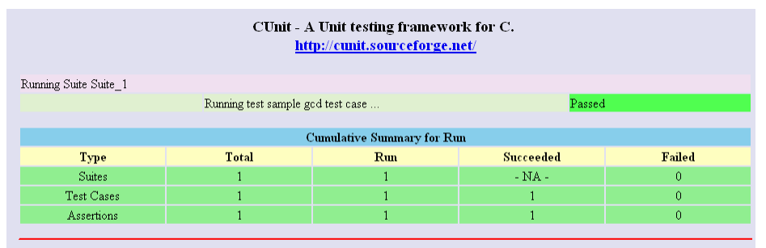
xUnit Architechture
Test runner
A test runner is an executable program that runs tests implemented using an xUnit framework and reports the test results.
Sai Madhavaram

Slide 33
xUnit Architechture(Cont.)
Test case
A test case is the most elemental class. All unit tests are inherited from here.
Formal test cases
In order to fully test that all the requirements of an application are met, there must be at least two test cases for each requirement: one positive test and one negative test.
Informal test cases
For applications or systems without formal requirements, test cases can be written based on the accepted normal operation of programs of a similar class.
Sai Madhavaram

Slide 34
xUnit Architechture(Cont.)
Test case format includes
test case ID
test case description
test step or order of execution number
related requirement(s)
depth
test category
author
check boxes for whether the test can be or has been automated
pass/fail
remarks
Sai Madhavaram

Slide 35
xUnit Architechture(Cont.)
Test fixtures
A test fixture (also known as a test context) is the set of preconditions or state needed to run a test. The developer should set up a known good state before the tests, and return to the original state after the tests.
Test suites
A test suite is a set of tests that all share the same fixture. The order of the tests shouldn't matter.
Collection of related test cases.
Can be executed automatically in a single command
Sai Madhavaram

Slide 36
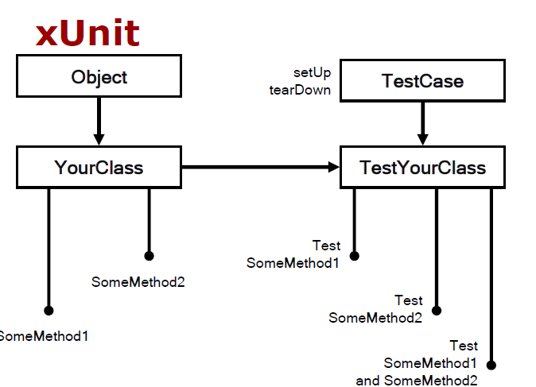
Sairam Madhavaram

Slide 37
QUnit
A unit testing framework capable of testing any generic JavaScript code.
Just 3 Files
qunit.css
qunit.js
qunit.html
Popular choice for JavaScript based projects

Slide 38
Qunit(Contd..)
To use Qunit:
Create a HTML page
Create a div with id “qunit”
Load its java script and CSS files
Write your tests and assertions

Slide 39
Assertions
Qunit mainly supports three types of assertions
Ok: Boolean assertion, passes if the first argument is truthy
Equal: non strict assertion
equal(‘1’, 1, ‘they are equal’)
StrictEqual: Strict type and value comparison assertion
StrictEqual(‘1’, 1, ‘they are equal’)
deepEqual: strict, recursively compares array elements and objects
deepEqual(items, items1, ‘even the elements in the array are
equal’)

Slide 40
Assertions(Contd..)
throws: tests if a callback throws an exception
notEqual, notStrictEqual, notDeepEqual

Slide 41
Qunit Test- runner page
Hide passed tests
Check for Globals - ensures the code under test and the test code does not export/ change any global properties.
No try-catch – Tells Qunit to run tests outside of a try catch block; throws native exception helping in debugging.
Can rerun individual tests or a specific module

Slide 42
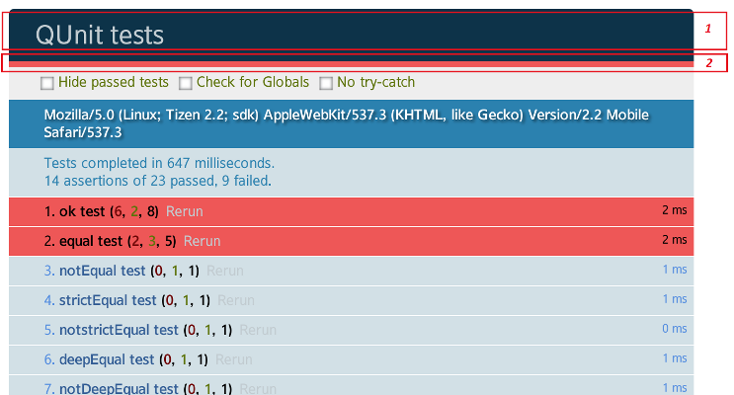
Test results

Slide 43
Callbacks
Qunit introduces callbacks to be called before and after test execution
testStart(startCallback)
Invoked before the execution of each test
Used to build and prepare the objects
testDone(doneCallback)
Invoked after the execution of each test
Mostly used for clean up operations

Slide 44
Jasmine
Jasmine is a behavior-driven development framework for testing JavaScript code.
It does not depend on any other JavaScript frameworks.
It has a clean, obvious syntax so that you can easily write tests.
Yeshwanth Teja

Slide 45
Suites
A suite describes your tests.
A test suite begins with a call to the global Jasmine function
describe() with 2 parameters string and a function.
String - a name or title for a spec suite - usually what is being tested.
Function- block of code that implements the suite.
describe("A suite", function() {
it("contains spec with an expectation", function() { expect(true).toBe(true);
});
});
Yeshwanth Teja

Slide 46
Specs
Specs are defined by calling the global Jasmine function it, which, like describe takes a string and function.
The string is the title of the spec and the function is the spec, or test.
A spec contains one or more expectations that test the state of the code.
An expectation in Jasmine is an assertion that is either true or false.
A spec with all true expectations is a passing spec. A spec with one or more false expectations is a failing spec.
Yeshwanth Teja

Slide 47
It block functions
Since describe and it blocks are functions they can contain any executable code necessary to implement the test.
JavaScript scoping rules apply, so variables declared in a describe are available to any it block inside the suite
describe("A suite is just a function", function() {
var a;
it("and so is a spec", function() { a = true;
expect(a).toBe(true);
});
});
Yeshwanth Teja

Slide 48
Expectations
Expectations are built with the function expect which takes a value, called the actual. It is chained with a Matcher function, which takes the expected value.
it("and so is a spec", function() { a = true;
expect(a).toBe(true);
Yeshwanth Teja

Slide 49
Matchers
Each matcher implements a Boolean comparison between the actual value and the expected value. It is responsible for reporting to Jasmine if the expectation is true or false. Jasmine will then pass or fail the spec.
Any matcher can evaluate to a negative assertion by changing the call to expect with a not before calling the matcher.
expect(a).toBe(true);
Yeshwanth Teja

Slide 50

Karma is a tool that enables the running of source code (i.e. JavaScript) against real browsers via the CLI. The fact that it runs against real browsers rather than “fakes” with a virtual DOM is extremely powerful. DOM implementations vary across browsers therefore the idea is to use the actual browsers for correctness.
npm install -g karma-cli
Yeshwanth Teja

Slide 51
HTML file
<html>
<head> <title>Magic Calculator</title> </head>
<body> <input id="x" type="text"> <input id="y" type="text"> <input id="add" type="button" value="Add Numbers"> Result: <span id="result" />
<script type="text/javascript" src="lib/calculator.js"></script>
<script> calculator.init(); </script>
</body>
<html>
Yeshwanth Teja

Slide 52
test/calculator.test.js
describe('Calculator', function() {
it('should add numbers'); });
Yeshwanth Teja

Slide 53
test/calculator.js
describe('Calculator', function() {
// inject the HTML fixture for the tests
beforeEach(function() {
var fixture = '<div id="fixture"><input id="x" type="text">' +
'<input id="y" type="text">' +
'<input id="add" type="button" value="Add Numbers">' +
'Result: <span id="result" /></div>';
document.body.insertAdjacentHTML( 'afterbegin', fixture); });
// call the init function of calculator to register DOM elements
beforeEach(function() { window.calculator.init(); });
it('should return 3 for 1 + 2', function() {
document.getElementById('x').value = 1;
document.getElementById('y').value = 2;
document.getElementById('add').click();
expect(document.getElementById('result').innerHTML).toBe('3'); });
Yeshwanth Teja

Slide 54
Tool Classification
Frameworks – JUnit, NUnit, etc…
Generation – automatic generation of unit tests
Selection – selecting a small set of unit tests from a large set of unit tests
Prioritization – deciding what is the “best order” to run the tests
Arun Nadipudi

Slide 55
Unit Test Generation
Creation of a test suite requires:
Test input generation – generates unit tests inputs
Test classification – determines whether tests pass or fail
Manual testing
Programmers create test inputs using intuition and experience
Programmers determine proper output for each input using informal reasoning or experimentation
Arun Nadipudi

Slide 56
Tools Recommended
Some of the tools recommended are
Web Testing Tools
Selenium
Watir
Mobile Testing Tools
Testdroid
MoneyTalk
Arun Nadipudi

Slide 57
Characteristics of Good Unit Tests
Isolated: Each Unit Test Should Be Able to Run Independently
Test Only One Condition at a Time
Repeatable
Thorough
Mock External References
Arun Nadipudi
Notes:
Generally in a project, all the tests are run at one time. The order in which the tests are run cannot be determined; for this reason, the tests should be independent of each other. In the preceding example, either a positive scenario or the negative scenario can get executed first.
There should only be one assert statement for each test method. In the preceding example, there are two test methods: one to verify the positive and one for the exception scenario. Now, when the tests are run, each scenario is validated separately. Explicit assertion for every method gives an instant insight of the failed tests and helps analyze the scripts easily.
The tests should return the same result whenever and how many times it's executed. The result shouldn't change from one execution to another.
Thorough testing is related to how many units of code are verified. Code coverage gives a good indication of how much testable code is verified. A code coverage of 80% and above is a good indication that most of the code is covered by unit test scripts
Mock external references, the test script, when run should not depend on external entities such as connection to a database or WCF or a configuration file. Mocking external references essentially means that it's assumed that the expected data is returned from the source and the testable code only verifies the actions that are performed on that data.

