Slide 1
Project Documentation
Sreshtha Kolluru
Vinod Somu
SaiRajKiran kandula
Harish Yeddluri
Arshad Abdul
Harish Kumar Chilukuri
Sai Raghavarao Singamneni
Jhansi Mora

Slide 2








Sreshtha Kolluru
Vinod Somu
SaiRajKiran kandula
Harish Yeddluri
Arshad Abdul
Harish Kumar Chilukuri
Sai Raghavarao Singamneni
Jhansi Mora

Slide 3
Overview
Introduction
Documenting client meeting
Good documentation standards
User Manual
README
Javadocs
Swagger tool
Doxygen tool
Visual Studio tool
Rules to write good commit messages

Slide 4
If people don’t know why your project exists,
they won’t use it.
If people can’t figure out how to install your app,
they won’t use it.
If people can’t figure out how to use your app,
they won’t use it

Slide 5
Project Documentation
User Documentation
README / Installation instructions
User Manual
Design Documentation
client call memos, emails, and minutes of meetings with client
User stories or use cases
System description
System requirements specifications
User interface design documents
Data descriptions and designs

Slide 6
Project Documentation for Project Management
To make sure project requirements are fulfilled
What, who, and when it has been done
Improving the visibility of a project's status

Slide 7
Why write the docs?
You will be using your code later
You want people to use your code
Documentation changes are a lot less scary than code changes.
It makes your code better

Slide 8
Importance of documenting meetings:
Decisions made by client/instructor.
Next steps planned.
Tracking of action items.
Reduced ambiguity.
Source of information to the people not attend the meeting.
Some tools: Google docs, OneNote, Evernote, Meeting Mix, Text pad, Agreedo, etc.
Notes:
You can make meeting success by using efficient clients meeting agenda.
Google docs: collaborative note taking tool
OneNote: if you are a Microsoft user
Evernote: great note taking tool
Meeting mix: Pretty good all in one tool, also supports agenda sharing

Slide 9
Specifications for documenting meetings:
Well pre-planned.
- come up with effective meeting agenda.
- agenda must contain
- date and time
- names of meeting participants
- acceptance or corrections to previous meeting minutes
- Next steps
- Next meeting date and time
- get the copies of agenda prior to the meeting.
Notes:
Planning well in advance will ensure effective meeting.

Slide 10
How important is documentation in Projects?
It provides evidence that tasks are completed as they should be.
Can happen in all the stages.
Better project management.
Can be future use/reference.
Some examples are: Milestone report, Design document, Requirement documents etc.

Slide 11
Good Documentation Practices:
Requirements of Good Documentation Practice.
It should be
Concise
Legible
Accurate
Traceable
Notes:
Concise means Document must tell entire story and should be understandable by all internal/external customers.
Legible means Document must be readable by internal/external customers.
Accurate means Document must be error-free.
Traceable means Each aspect of the document must be traceable, such as who recorded it, where and why.

Slide 12

User Manual
Notes:
Reference: http://www.ccjk.com/design/user-guide/
Repository link: https://drive.google.com/drive/folders/0ByqZd-MEzuGyblRvbnc0ZGV1OWc?usp=sharing

Slide 13
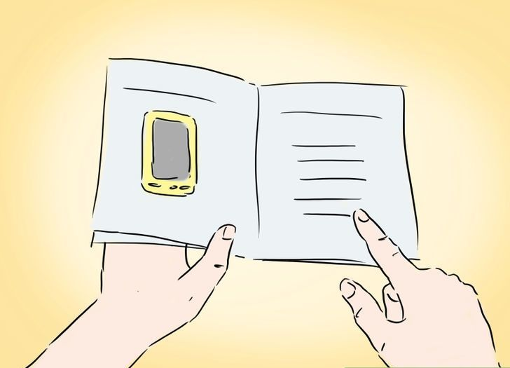
User Manual
What is user manual?
What does the user manual contain?
Who will write the user manual?
Fig: User manual
Notes:
Reference: Fig: http://www.wikihow.com/Create-a-User-Manual?cid=120719133001422745744&rid=110916223653452507062
User Manual is a document or let’s say a guide, which contains all the required information to use an application or a device.
The user manual includes a description of the system functions and the associated images, and step-by-step process of using a system.
It is usually written by a technical writer, sometimes programmers and product designer should also involve.

Slide 14
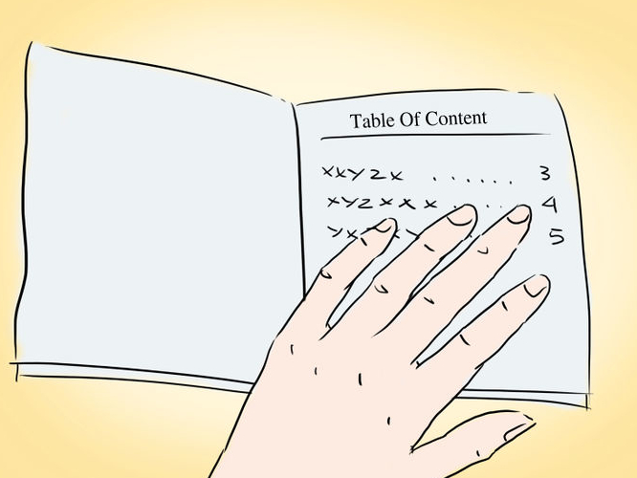
User Manual Contains
A cover page
A title page
A preface
A contents page
A guide on how to use the main function of the system
A troubleshooting section
A FAQ section
Help and contact details
A glossary and, an index
Fig: Table of content
Notes:
Reference: Fig: http://www.wikihow.com/Create-a-User-Manual?cid=120719133001422745744&rid=110916223653452507062

Slide 15
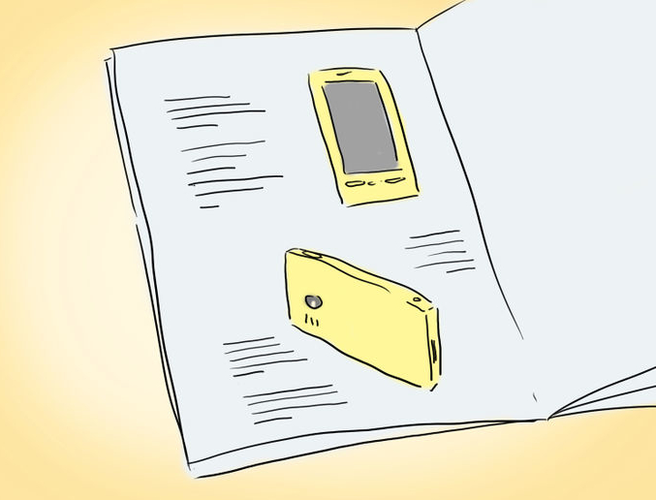
How to Write User Manual
Do an audience analysis: interact with the users
Do a task analysis
Decide on your manual’s layout
Including Essential Information
Fig: Layout
Notes:
Reference: Fig: http://www.wikihow.com/Create-a-User-Manual?cid=120719133001422745744&rid=110916223653452507062
You have to interact with the users before writing a user manual.
2. Identify and organize the steps needed to use the application.
3. There are several ways you can streamline your manual. You can use bold for headings. You can use letter size 16 for Main headings and 14 for sub heading.
4. Provide information about operation, Include error messages and how to resolve them.
Prototype: https://drive.google.com/file/d/0ByqZd-MEzuGyMzhwanN1cGFqVzA/view?usp=sharing

Slide 16
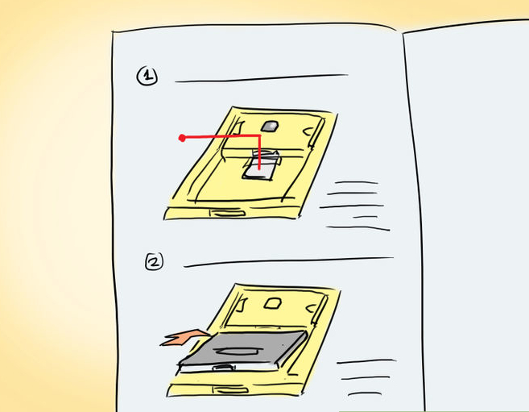
How to Write User Manual (contd.)
Write numbered instructions
Decide what kind of vocabulary you’ll use
Keep your writing brief
Proofread the manual
Fig: Numbered Instructions
Notes:
Reference: Fig: http://www.wikihow.com/Create-a-User-Manual?cid=120719133001422745744&rid=110916223653452507062
5. Numerically ordered instructions will help the reader stay more focused on the process of using the application.
6. Simple vocabulary for simple websites and technical terminology for technical websites.
7. Instead of a few long paragraphs, use one or two-sentence chunks.
8. A manual can lose credibility due to grammar and spelling mistakes.

Slide 17
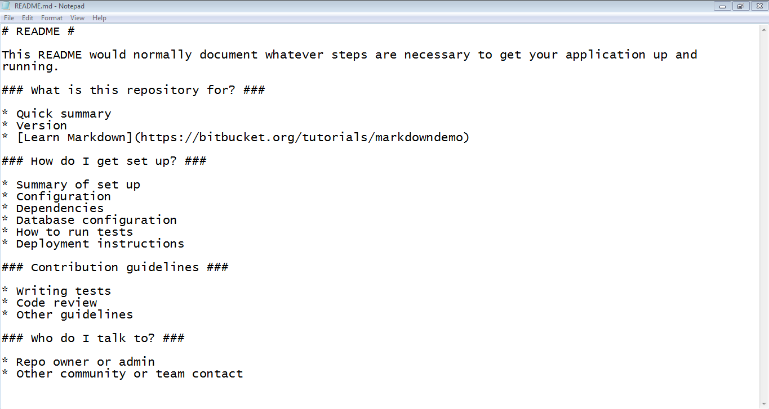
README
File containing information of other files/project.

Slide 18
Contents of README
Introduction
Requirements
Installation
Configuration
FAQ

Slide 19
Javadocs
Documentation generator for Java language.
HTML format is used for being able to hyperlink related documents together.
Uses tree structure while relating documents.

Slide 20
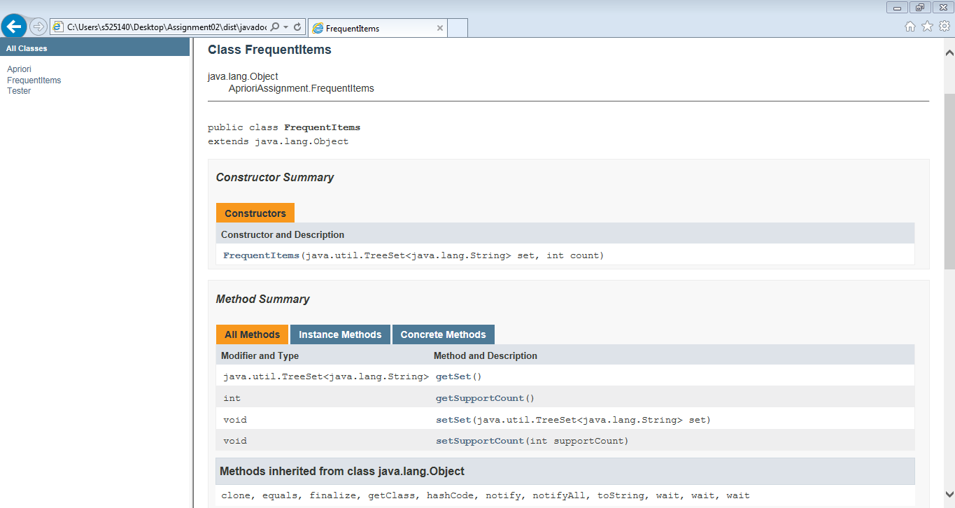
Javadocs

Slide 21
A brief introduction to Doxygen

Slide 22
What does a compiler do?
A compiler ignores comments and processes the code.
What does Doxygen do?
It ignores the code and processes to comments.
Used to create HTML documentation.

Slide 23
Getting started with Doxygen
Download from doxygen.org
Do this only once in directory (folder) containing your source code
Then whenever you change your code and wish to update the documentation

Slide 24
How does Doxygen help?
It helps in
Generating on-line documentation or offline reference manual from documented source files
Extracting the Code Structure and visualising the relations between various elements by means of include dependency graphs, inheritance diagrams, and collaboration diagrams, which are all generated automatically

Slide 25
Creating a Configuration File
Doxygen determines settings from Configuration file.
Doxywizard is a GUI front-end for configuring and running doxygen.
Steps to take to configure and run doxygen.
Wizard
Expert
Load

Slide 26
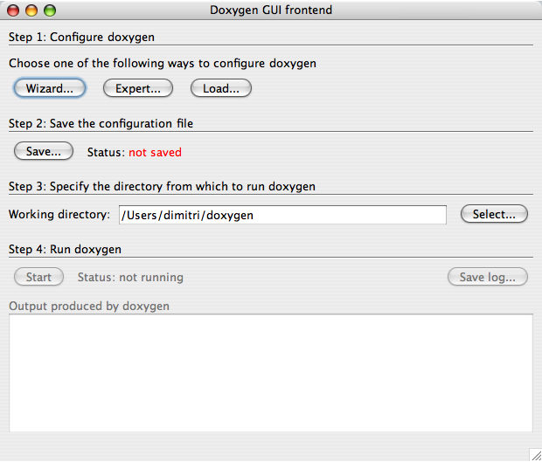
Doxygen GUI front-end

Slide 27
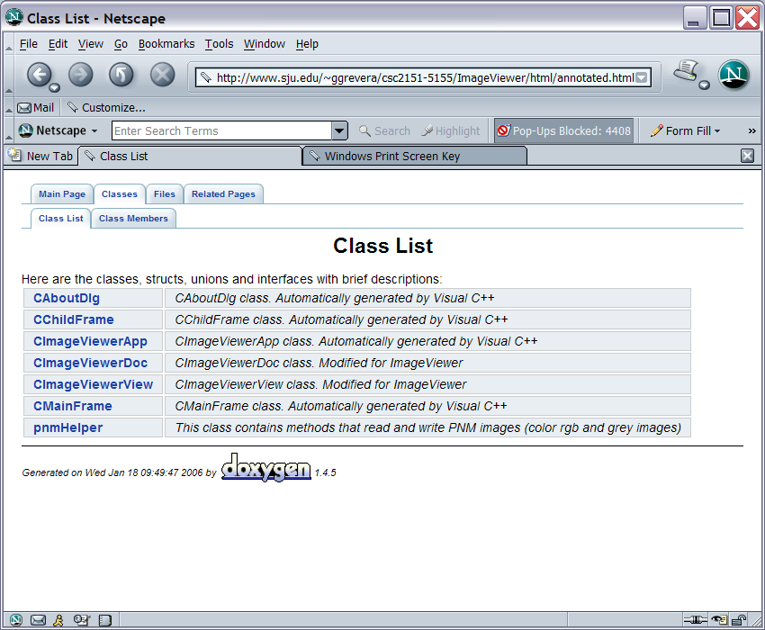

Slide 28
Introduction on Swagger tool
We have an API that we want to document. Specifically, a REST API.
Swagger come to life because,
The generated document should be both human, machine readable.
Swagger 2.0, made the format acceptable in both JSON and YAML, to make it even easier to edit.
11/10/2016
Harish Kumar Chilukuri
Notes:
Notes:
“We can maintain a document with the information or an HTML website, or even have it generated by some tool from our code. The downside to this approach is that we need to keep it maintained manually (or via a semi-automatic process) and, while it is human-readable, it’s not really machine-readable.
Another approach is to use Web Application Description Language, which can be generated by some tools. In this case, it’s machine-readable, but definitely not human-readable. Also, writing a WADL manually is a tedious process.” (URL: http://swagger.io/getting-started-with-swagger-i-what-is-swagger/)

Slide 29
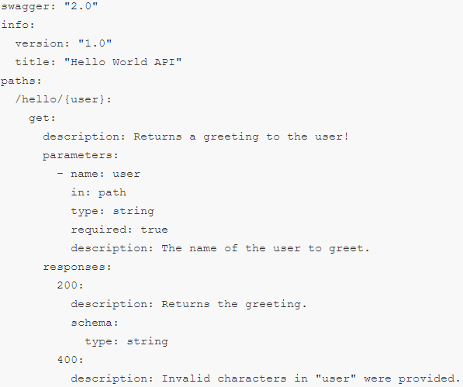
Swagger looks like
11/10/2016
Harish Kumar Chilukuri
Notes:
Notes:
“In the example above we describe a simple “Hello World API”. It has a single URL exposed – “/hello/{user}”. “user” is the single parameter to the API, defined as part of the path, and we say it’s a string.” (URL: http://swagger.io/getting-started-with-swagger-i-what-is-swagger/)

Slide 30
How do I get started?
A top-down approach
A bottom-up approach
Swagger UI to explore the API
11/10/2016
Harish Kumar Chilukuri
Notes:
Notes:
“A top-down approach where you would use the Swagger Editor to create your Swagger definition and then use the integrated Swagger Codegen tools to generate server implementation.
A bottom-up approach where you have an existing REST API for which you want to create a Swagger definition. Either you create the definition manually (using the same Swagger Editor mentioned above), or if you are using one of the supported frameworks (JAX-RS, node.js, etc.), you can get the Swagger definition generated automatically for you.
If on the other hand you're an API Consumer who wants to integrate with an API that has a Swagger definition you can use the online version of the Swagger UI to explore the API (given that you have a URL to the APIs Swagger definition) - and then use Swagger Codegen to generate the client library of your choice.” (URL: http://swagger.io/getting-started/)

Slide 31
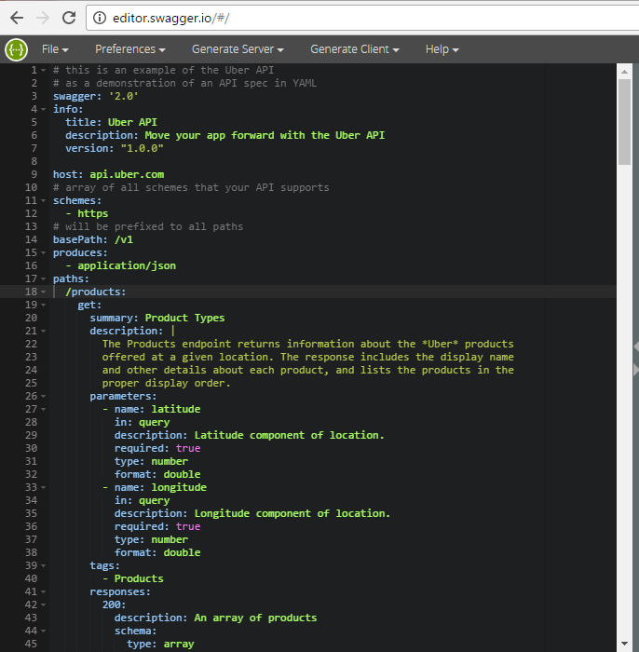
Online Swagger Editor
11/10/2016
Harish Kumar Chilukuri
Notes:
Notes:
URL: http://editor.swagger.io/#/

Slide 32
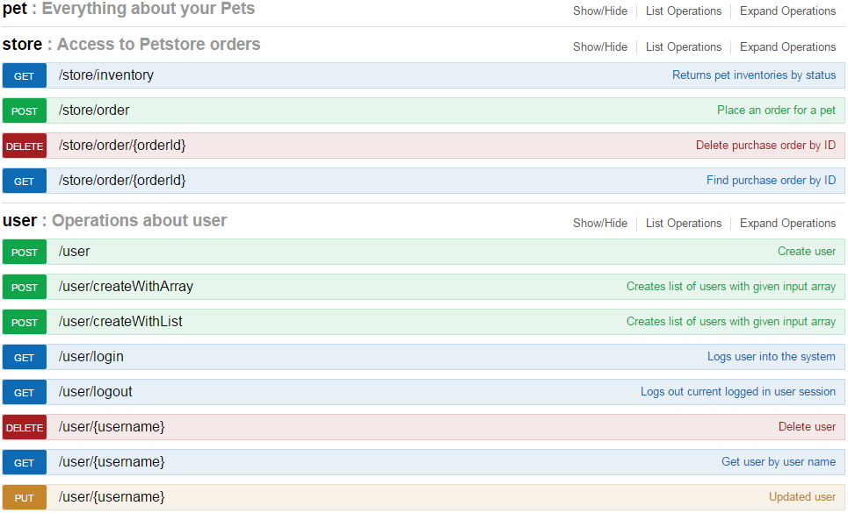
Example
11/10/2016
Harish Kumar Chilukuri
Notes:
Notes:
URL: http://petstore.swagger.io/#/user

Slide 33
SandCastle Help File Builder
Using SandCastle Help File Builder we can set up the projects to produce XML comments, and create a help file project
The Sandcastle tools are used to create help files for managed class libraries containing both conceptual and API reference topics.
API reference topics are created by combining the XML comments that are embedded in the source code with the syntax and structure of the types which is acquired by reflecting against the associated .NET Framework assembly.

Slide 34
Why should we write commit messages?
To speed up the reviewing process.
To help us write a good release note.
To help the future developers(it could be you), say five years into the future, to find out why a particular change was made to the code or why a specific feature was added.
Notes:
Do everyone write a message while committing? That’s a good number…But, are you doing it correctly? Lets get into the topic to know more about it. Y should we write commit messages and what are the rules to write good commit messages.
Release notes are documents that are shared with end users of an organization. They tell about the corrections, changes or enhancements made to the service or product the company provides. This document is usually circulated only after the product or service is thoroughly tested and approved against the specification provided by the development team.

Slide 35
The seven rules of a great git commit message:
Separate subject from body with a blank line
Limit the subject line to 50 characters
Capitalize the subject line
Do not end the subject line with a period
Use the imperative mood in the subject line. Ex: Write “Fix bug” and not “Fixed bugs” or “Fixes bugs”
Wrap the body at 72 characters
Use the body to explain what and why vs. how
Notes:
Firstly, not every commit requires both a subject and a body. Sometimes a single line is fine, especially when the change is so simple that no further context is necessary.
50 characters is not a hard limit, just a rule of thumb. Keeping subject lines at this length ensures that they are readable.
Subject line is the title and titles don’t end in periods.
Remember: Use of the imperative is important only in the subject line. You can relax this restriction when you're writing the body.
Git never wraps text automatically. When you write the body of a commit message, you must mind its right margin, and wrap text manually.

Slide 36
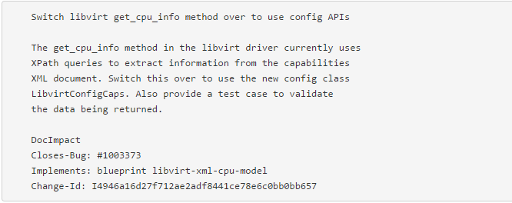
Example of good practice:

Slide 37
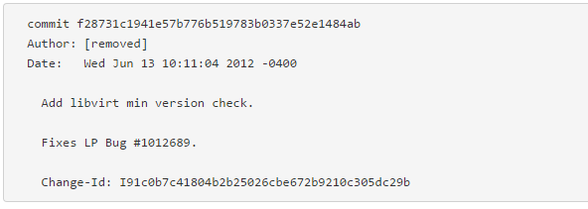
Example of bad practice:
Notes:
This commit message is merely documenting what was done, and not why it was done.
These are not the mandatory rules to write a commit message. But, following these rules helps your fellow developers of your team and probably it could be you who might want to review the changes in the code. So, practising these rules is a good thing. If u ppl haven’t followed these rules, start practicing now. This is all about communication and documentation management. Thankyou.

