Slide 1
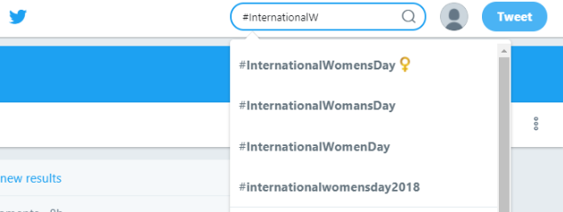
#HashTag Generator
Rohan Jahagirdar
Sai Nikhil D

Slide 2
PROBLEM STATEMENT
Presently, people have to know what HashTag associates with their social media post. This also takes additional effort.
The problem here is, though the post is related, it gets mapped to different HashTags creating a problem for analysis.
Currently, only after you start typing a HashTag – you get spell check and generalized suggestions.
There are no standard definitions for HashTag’s

Slide 3
PROPOSED SOLUTION
The platform generates HashTags, relating it to the:
post’s content
user’s geographic location
user profile
trending topics
connections of user
time

Slide 4
Milestones for a MVP
Suggest the most appropriate HashTag based on factors
Data Collection
Tokenizing the data
Data Cleaning
Creating a corpus
Creating a pipeline to fetch live data
Creating a knowledge Graph by using ML
Defining a HashTag
Profiling the User
Identify the keywords in the post

Slide 5
Detailed Description of Steps
Data Collection :
Collected Trending HashTags for specific locations
Wrote CRON jobs to collect tweets of collected HashTags
Created a pipeline for storing the csv’s in a destination folder and consuming it for processing

Slide 6
Detailed Description of Steps
Building a Knowledge Graph:
Tokenize the data using NLTK tokenizer
Creating a corpus of collected data after removing stop words.
Training the model with the corpus.

Slide 7
Knowledge Graph
Created vectors for each word in the corpus using Word2Vec (or GloVe).
Built a virtual knowledge graph which can relate entities based on cosine similarity of vectors.
Suggest the most relevant HashTag from the keywords of user’s post(pending)

Slide 8
Next Steps
Validating the results from the trained Model
Make tweaks at the steps which require more efficiency
Determining the keyword from the Tweet (using SpaCy)
Make changes to various attributes while training the model, to get more accurate results
Create a good visualization for the output
Defining a HashTag using Ontology (using DbPedia RDF)
Data Collection
Machine Learning Models

Slide 9
Trends in Boston
C:\Users\Rohan Jahagirdar\Desktop\NEU\ADSA\Final>python locationTrends.py{'Percoco', 'Brent Celek', 'Sam Bradford', 'David Wright', '#PTALegCon', 'Danny Amendola', '#WinterStormSkylar', 'John McEntee', '#OpenInBOS', '#EndTheLies', 'Craig Mack', '#FLTravelChat', '#NationalK9VeteransDay', 'Zayn and Gigi', 'Corey Nelson', '#FantasticBeasts', '#GroundControlToMajorTomIm', 'Scott Gordon', 'Teddy Bridgewater', 'Prime Minister May', '#WallsDontWork', '#SaludTues', '#hire18', 'Air Force One', '#TheGap18', 'Austin Wynns', '#SUMC18', '#blizzard', 'Rex Tillerson', 'Nikolai Glushkov', 'Silent Barn', 'Kyle Williams', 'Kirk Cousins', '#ellies', '#NJBudget', 'Trey Burton', 'Paul Richardson', '#WWDC18', '#snowday', '#JMUGivingDay', '#313Day', '#JeopardyCategoriesAboutMe', '#CruiseChat', 'Phil Murphy', '#withempathy', '#Act2EndViolence', 'Demaryius Thomas', '#NexstarWX'}

Slide 10
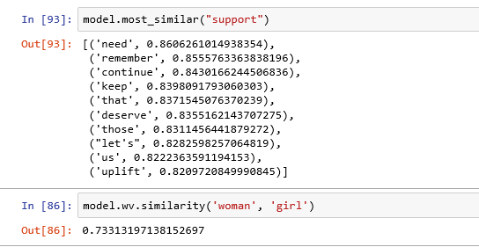
Model Output

Slide 11
Resources
Twitter API
AWS EC2
Yahoo PlaceFinder
Tweepy
NLTK tokenizer and stop words
Word2Vec
Cosine Similarity
SpaCy
Ontology

Slide 12
Thank You

