Slide 1
SOCIAL MEDIA SCRAPING
V.Hyndavi(160116737066)
N.Sai Nikhita(160116737076)
G.Pavan Kalyan(160116737098)
J.Sai Sushma(160117737017)
E.Preethi Vardhan(1601167737011)

Slide 2
Problem Statement:
Feedback scraping from social media:
CBIT Confessions page is a platform where issues related to our
college are posted ,here we are trying to scrape those
confessions and extract positive feedback so as to constructively
utilize them.

Slide 3
Tech Stack
Python scripting
Flask(Back end)
Bootstrap,html,css(Front end)
NLP

Slide 4
Approach:
Scraping comments from CBITConfessions page(static scraping)
Applying NLP(National Language Processing)to preprocess
Applying Sentiment Analysis
Retrieving the positive(constructive) posts
Applying flask in the back end to display positive comments and all the relatable outputs in our website

Slide 5
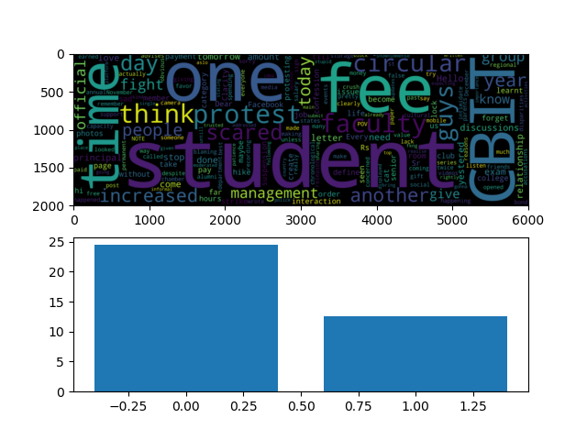
Screen Shots

Slide 6
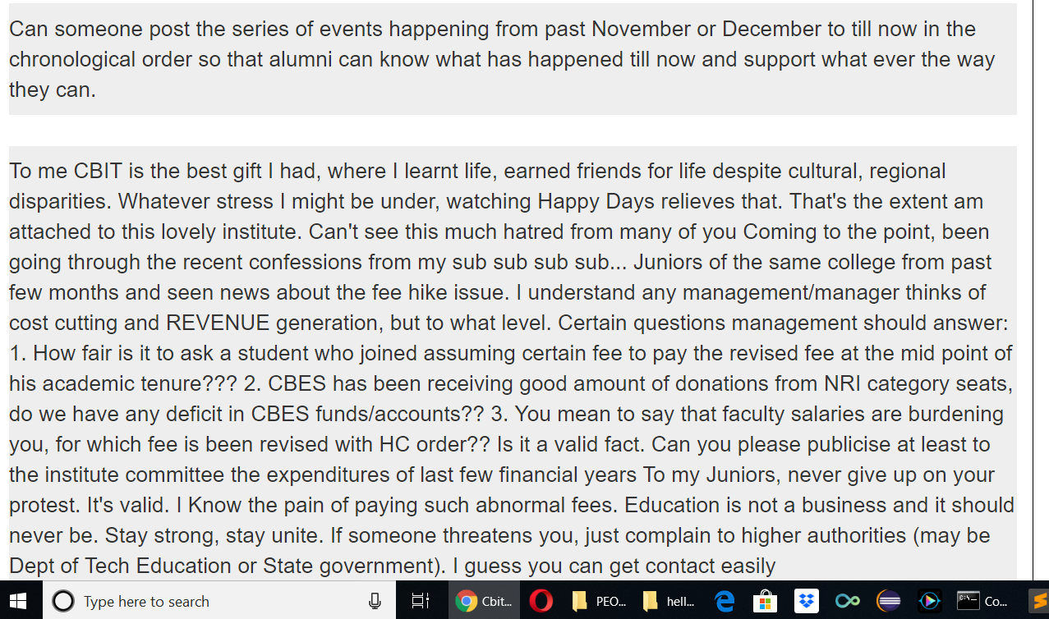
Constructive Comments

Slide 7
Future Scope
We can extend this such that the constructive feedback in our website helps the management to implement some of the ideas for the betterment
An application should be developed where the corresponding Team should receive the most constructive feedback as an email notification on a week basis and the respective work starts.

Slide 8
Thank You.!

