Slide 1

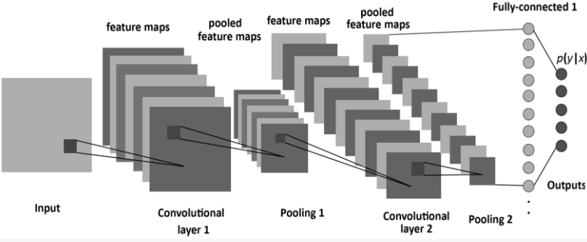
Nature Scope: Multi-class Image Classification using Convolutional Neural Networks

Slide 2
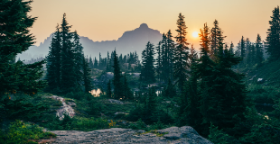
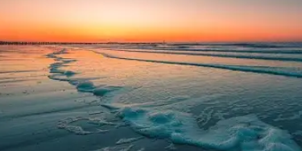
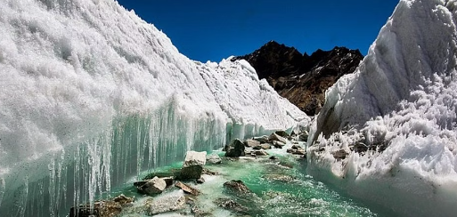
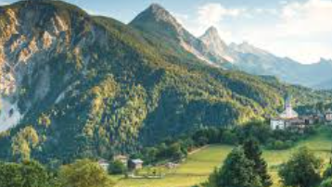
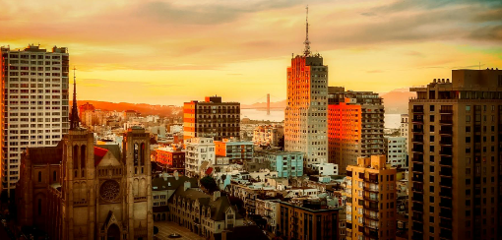
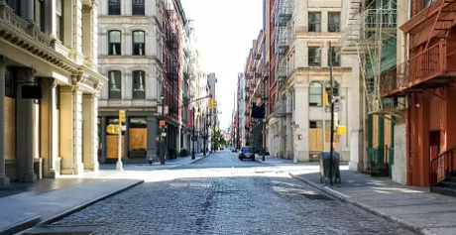
Abstract
This project introduces NatureScope, a robust Convolutional Neural Network (CNN) model for classifying six natural scenes: glacier, forest, sea, building, mountain, and street.
Leveraging advanced deep learning techniques, NatureScope accurately categorizes images, aiding environmental monitoring, urban planning, and tourism.
Extensive experimentation ensures high accuracy and generalization on diverse datasets. NatureScope emerges as a valuable tool, empowering researchers, policymakers, and enthusiasts to explore and appreciate natural landscapes through computer vision technology.

Slide 3
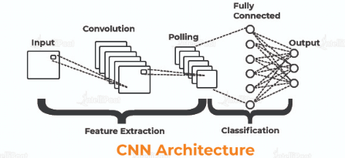
Introduction: Background
In recent years, technology has advanced rapidly, with computer vision systems becoming increasingly vital in various areas. Among these, classifying natural scenes from images is crucial for tasks like environmental monitoring, city planning, and tourism.
Automatically sorting images of nature into categories like glacier, forest, sea, building, mountain, and street is essential for making sense of large volumes of visual data. Traditional methods used handcrafted features and basic machine learning, limiting their ability to handle the complexities of natural images.
To overcome these limitations, we introduce Nature Scope, a cutting-edge Convolutional Neural Network (CNN) tailored for classifying natural scenes. Nature Scope learns complex patterns from raw pixel data, enabling accurate categorization.
Through advanced techniques and extensive testing, Nature Scope achieves high accuracy on diverse datasets. Its development marks a significant stride in computer vision, offering a valuable tool for researchers, planners, and enthusiasts to explore and understand the natural world using artificial intelligence

Slide 4


Objectives
Develop Nature Scope, a Convolutional Neural Network (CNN) model, specifically designed for multi-class image classification of natural scenes including glaciers, forests, seas, buildings, mountains, and streets.
Utilize deep learning techniques to automatically learn hierarchical representations from raw pixel data, enabling Nature Scope to accurately classify images into their respective categories.
Achieve high levels of accuracy and generalization performance through extensive experimentation and fine-tuning of Nature Scope on diverse datasets.
Provide a robust tool for researchers, policymakers, and enthusiasts to explore, analyze, and understand the natural world through the lens of artificial intelligence, thereby facilitating tasks such as environmental monitoring, urban planning, and tourism.
Contribute to the advancement of computer vision technology by introducing Nature Scope as a state-of-the-art solution for the classification of natural scenes from images.

Slide 5
Overview of dataset
The dataset comprises two main folders, namely "train" and "test," which were sourced from Kaggle. The "train" folder contains the training subset of images used to train the classification model. Within the "train" folder, there are six subfolders, each corresponding to a specific class of natural scenes. These classes include glaciers, forests, seas, buildings, mountains, and streets.
The "test" folder contains images reserved for evaluating the performance of the trained model. These images are not used during the training phase but are utilized after model training to assess its predictive capabilities.
The dataset structure facilitates supervised learning, with labeled examples provided for each class. During model training, the images from the "train" subset are fed into the Convolutional Neural Network (CNN) model to learn patterns and associations between features and class labels. Subsequently, the trained model's performance is evaluated using the images from the "test" subset, allowing for the assessment of its ability to correctly classify unseen images.

Slide 6
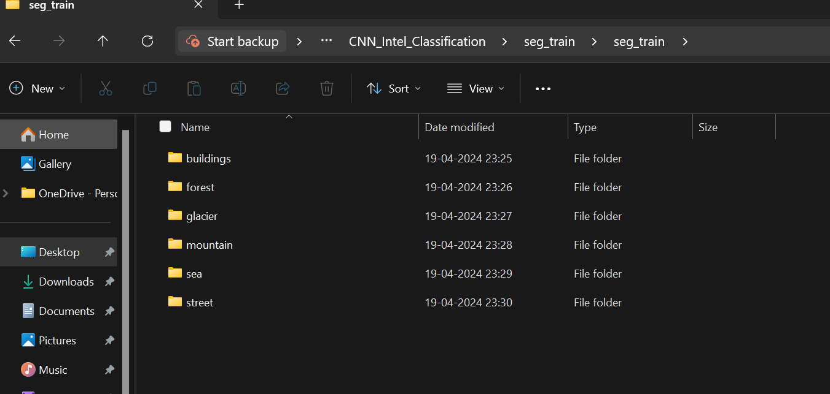

Slide 7
Literature Review
Image Classification Using Convolutional Neural Networks:
Convolutional Neural Networks (CNNs) have revolutionized image classification tasks. Researchers such as Krizhevsky et al. (2012) demonstrated the effectiveness of CNNs in image classification tasks, achieving state-of-the-art performance on benchmark datasets like ImageNet.
Transfer Learning for Natural Scene Classification:
Transfer learning, a technique where pre-trained models are fine-tuned for specific tasks, has gained prominence in natural scene classification. Work by Razavian et al. (2014) showed that features learned from large-scale datasets like ImageNet can be transferred and adapted to achieve impressive performance on natural scene classification tasks.
Data Augmentation Techniques:
Data augmentation techniques play a crucial role in training deep learning models, particularly for tasks with limited datasets. Approaches such as rotation, flipping, and scaling have been widely used to augment training data and improve model generalization. Simard et al. (2003) demonstrated the effectiveness of data augmentation in improving the robustness of CNNs.

Slide 8
Evaluation Metrics for Image Classification:
Various evaluation metrics are used to assess the performance of image classification models. Accuracy, precision, recall, and F1-score are commonly used metrics for binary and multi-class classification tasks. Additionally, techniques such as confusion matrices and receiver operating characteristic (ROC) curves provide insights into model performance across different classes.
Applications of Image Classification in Environmental Monitoring and Urban Planning:
Image classification has diverse applications in environmental monitoring and urban planning. For example, researchers have used satellite imagery to monitor deforestation, track urban sprawl, and assess land cover changes. Image classification models can aid policymakers in making informed decisions related to land use, resource management, and infrastructure planning.
Challenges and Future Directions:
Despite the progress in image classification, several challenges remain, including handling imbalanced datasets, addressing class imbalance, and improving model interpretability. Future research directions may focus on developing more robust and interpretable models, incorporating domain knowledge into model architectures, and exploring novel data augmentation techniques tailored for natural scene classification tasks.

Slide 9
Step-By-Step Approach of Building Nature Scope: Multiclass CNN Model
Step-1: Import Required Libraries
from tensorflow.keras.layers import Dense, Dropout, Flatten, Conv2D, MaxPooling2D, BatchNormalization:
This line imports specific layers from the tensorflow.keras.layers module. Each layer has a specific function in building neural network models:
Dense: Fully connected layer where every neuron is connected to every neuron in the preceding and succeeding layers.
Dropout: Regularization technique that randomly sets a fraction of input units to zero during training to prevent overfitting.
Flatten: Layer used for flattening the input, typically used when transitioning from convolutional layers to fully connected layers.
Conv2D: Convolutional layer for 2D spatial convolution over images.
MaxPooling2D: Downsamples the input representation by taking the maximum value over a window of defined size.
BatchNormalization: Layer that normalizes and scales inputs, helping stabilize and speed up the training of deep neural networks.
from tensorflow.keras.models import Sequential:
Imports the Sequential model from tensorflow.keras.models. Sequential is a linear stack of layers used for building deep learning models layer-by-layer.
import tensorflow as tf:
Imports the TensorFlow library. TensorFlow is an open-source machine learning framework developed by Google for building various machine learning and deep learning models.
from tensorflow.keras.preprocessing.image import ImageDataGenerator:
Imports ImageDataGenerator from tensorflow.keras.preprocessing.image. ImageDataGenerator is used for real-time data augmentation and preprocessing of images during training.

Slide 10
from tensorflow.keras.preprocessing.image import ImageDataGenerator:
Imports ImageDataGenerator from tensorflow.keras.preprocessing.image. ImageDataGenerator is used for real-time data augmentation and preprocessing of images during training.
from tensorflow.keras.callbacks import ModelCheckpoint:
Imports ModelCheckpoint callback from tensorflow.keras.callbacks. ModelCheckpoint is used to save the model weights during training based on specified conditions or criteria.
import matplotlib.pyplot as plt:
Imports the pyplot module from the matplotlib library. matplotlib.pyplot provides a MATLAB-like plotting interface to create various plots and visualizations.
import seaborn as sns:
Imports the seaborn library, which is built on top of matplotlib and provides a high-level interface for drawing attractive and informative statistical graphics.
from sklearn.metrics import confusion_matrix:
Imports the confusion_matrix function from the sklearn.metrics module. The confusion matrix is a tool used to evaluate the performance of a classification model.
import pandas as pd:
Imports the pandas library, which is used for data manipulation and analysis. pd is a commonly used alias for pandas.
import numpy as np:
Imports the numpy library, which is a fundamental package for scientific computing with Python. np is a commonly used alias for numpy.
Each of these libraries and modules serves a specific purpose in the context of building, training, evaluating, and visualizing deep learning models.

Slide 11
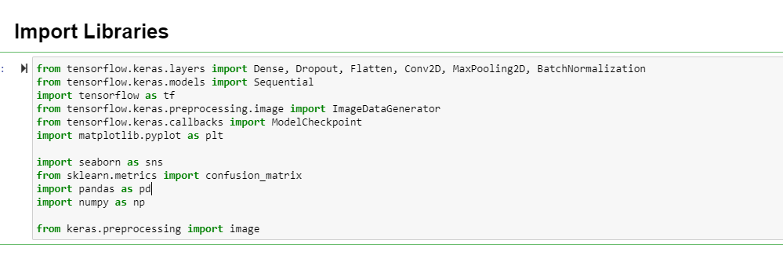

Slide 12
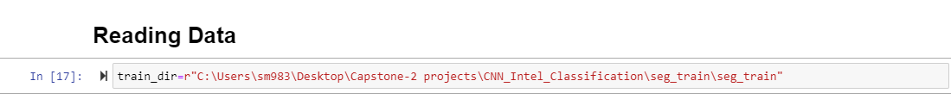
Step-2:Reading Data from Folder:
The variable train_dir is assigned the file path "C:\Users\sm983\Desktop\Capstone-2 projects\CNN_Intel_Classification\seg_train\seg_train", which likely contains the training data for a convolutional neural network (CNN) model.
The data is organized in such a way that it represents different categories or classes of images, possibly related to classifying images of scenes or landscapes based on their contents. This variable name suggests that it's specifically intended for the training set directory.

Slide 13
Step-3:Specifying preprocessing Parameters of Images
This code snippet sets up data generators for training and validation images using ImageDataGenerator from TensorFlow's Keras API. Here's a breakdown of each part:
train_datagen = ImageDataGenerator(...):
Creates an instance of ImageDataGenerator for data augmentation and preprocessing during training.
width_shift_range = 0.1 and height_shift_range = 0.1:
Specifies the range for randomly shifting the width and height of images during augmentation. Here, it allows shifting up to 10% of the total width and height.
horizontal_flip = True:
Enables random horizontal flipping of images during augmentation. This can help increase the diversity of the training dataset.
rescale = 1./255:
Rescales the pixel values of the images to the range [0, 1]. Dividing by 255 standardizes the pixel values, making them easier to work with for neural networks.
validation_split = 0.2:
Specifies the fraction of the data to reserve for validation. In this case, 20% of the total dataset will be used for validation during training.

Slide 14
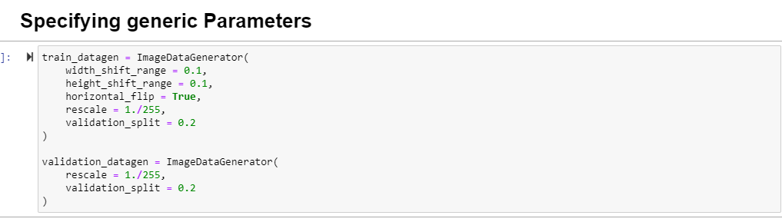
validation_datagen = ImageDataGenerator(...):
Creates a separate instance of ImageDataGenerator for preprocessing/validation data.
rescale = 1./255 (inside validation_datagen):
Similar to the rescale parameter in train_datagen, this rescales the pixel values of validation images to the range [0, 1].
validation_split = 0.2 (inside validation_datagen):
Specifies the same validation split percentage as in train_datagen, ensuring consistency between training and validation data preprocessing.
In summary, these data generators are configured to perform various augmentation techniques like shifting and flipping on the training images while also rescaling their pixel values. For validation images, only rescaling is applied. The validation_split parameter ensures that a portion of the data is reserved for validation during training.

Slide 15
Step-4:Setting up Data Generators for Training and Validation Images
This code sets up data generators for training and validation datasets using the flow_from_directory method from TensorFlow's Keras API. Here's a simplified explanation:
train_generator:
Generates batches of training data.
Loads images from the train_dir directory.
Resizes images to a fixed size of 128x128 pixels.
Processes data in batches of 64 images at a time.
Converts images to grayscale.
Expects categorical labels for classification tasks.
Utilizes a subset of the data specified for training.

Slide 16
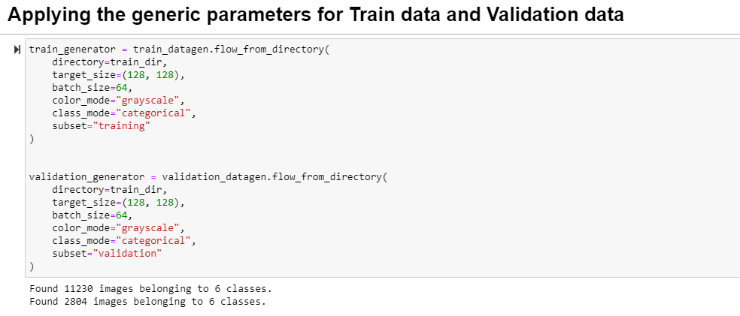
validation_generator:
Generates batches of validation data.
Also loads images from the train_dir directory.
Resizes images to 128x128 pixels.
Processes data in batches of 64 images.
Converts images to grayscale.
Expects categorical labels for classification.
Utilizes a subset of the data specified for validation.
In essence, these generators prepare the training and validation data for feeding into a neural network model. They handle tasks like data loading, preprocessing, batching, and label formatting, making it easier to train and evaluate the model.

Slide 17
Step-5:Visualizing Training Data: Images and Categories
Get a Batch of Images and Labels: batch = next(train_generator)
This line just grabs a group of images and their corresponding categories from our dataset, ready to be used for training.
Create a Grid to Display Images: fig, axes = plt.subplots(nrows=5, ncols=5, figsize=(10, 10))
Imagine this as setting up a big picture frame that can hold 25 smaller pictures. We're making it big enough to fit on a screen.
Go Through Each Picture Slot: for i, ax in enumerate(axes.flat)
We're going to look at each of the 25 smaller picture slots inside our big frame, one at a time.
Show Each Picture: ax.imshow(batch[0][i], cmap='gray')
For each slot, we put a picture inside it. The batch[0][i] part tells us which picture to put there. We're showing the picture in grayscale.
Find Out Which Category Each Picture Belongs To: label_idx = batch[1][i].argmax()

Slide 18
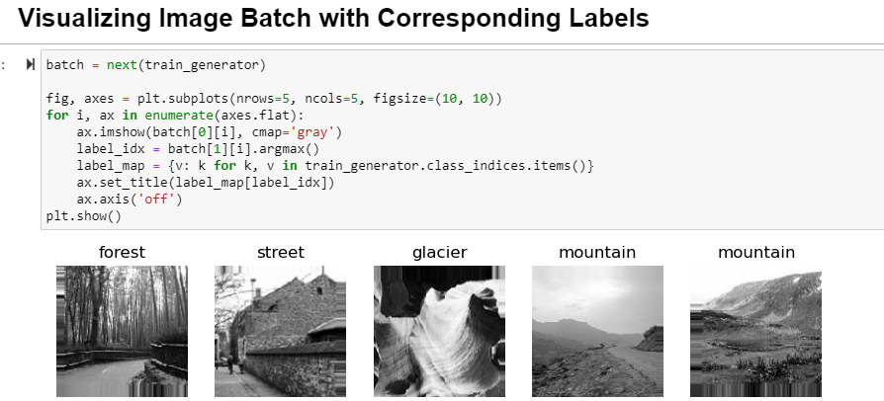
We figure out which category (like "dog", "cat", etc.) each picture belongs to by looking at its label.
Prepare a Map from Category Numbers to Names: label_map = {v: k for k, v in train_generator.class_indices.items()}
We make a list that tells us what each category number means in words, like "0" means "dog", "1" means "cat", etc.
Put Category Names on Top of Pictures: ax.set_title(label_map[label_idx])
We write the category name on top of each picture so we know what we're looking at.
Remove Unnecessary Lines Around Pictures: ax.axis('off')
We clean up the picture frame by removing any extra lines around the pictures.
Finally, Show the Picture Frame: plt.show()
We display the big frame filled with pictures on the screen so we can see them all at once.
So, in simple words, this code just shows us a bunch of pictures from our training data along with their categories, all organized neatly in a grid on our screen.

Slide 19
Step:6:Building a Convolutional Neural Network for Image Classification with TensorFlow
Importing Necessary Libraries:
We import specific layers and models from TensorFlow's Keras API, which we'll use to build our neural network.
Creating a Sequential Model:
We're setting up a neural network model using the Sequential API. This means we'll add layers one after another, in a sequence.
Adding Convolutional Layers:
We add the first convolutional layer (Conv2D) with 32 filters (small image detectors) of size 3x3, using the ReLU activation function. This layer processes input images with dimensions of 128x128 pixels and 1 channel (grayscale).
We add a Batch Normalization layer after each convolutional layer to standardize and normalize the activations, which helps in faster and more stable training.
Adding Pooling and Dropout:
We add a max pooling layer (MaxPooling2D) with a pool size of 2x2, which reduces the spatial dimensions of the feature maps, helping to reduce computational complexity and overfitting.
We apply dropout regularization by randomly setting 25% of the neuron outputs to zero during training, which helps prevent overfitting by forcing the network to learn more robust features.

Slide 20
Flattening and Adding Dense Layers:
We flatten the output from the convolutional layers into a 1D array.
We add a fully connected layer (Dense) with 256 neurons and ReLU activation function, which learns complex patterns in the flattened feature maps.
The final dense layer has 6 neurons with a softmax activation function, which outputs probabilities for each of the 6 classes. Softmax ensures that the output probabilities sum up to 1, making it suitable for multi-class classification tasks.
Compiling the Model:
We compile the model using categorical crossentropy loss, which is suitable for multi-class classification tasks.
We use the Adam optimizer with a learning rate of 0.0001, which adapts the learning rate during training to improve convergence.
We specify that we want to track the accuracy metric during training.
Model Summary:
We print a summary of the model architecture, including the type and shape of each layer, the number of parameters, and the output shape at each layer.
In simple terms, this code sets up a neural network model for image classification. It consists of convolutional layers for feature extraction, pooling and dropout layers for reducing overfitting, and dense layers for classification. Finally, it compiles the model with appropriate loss, optimizer, and metrics for training.

Slide 21
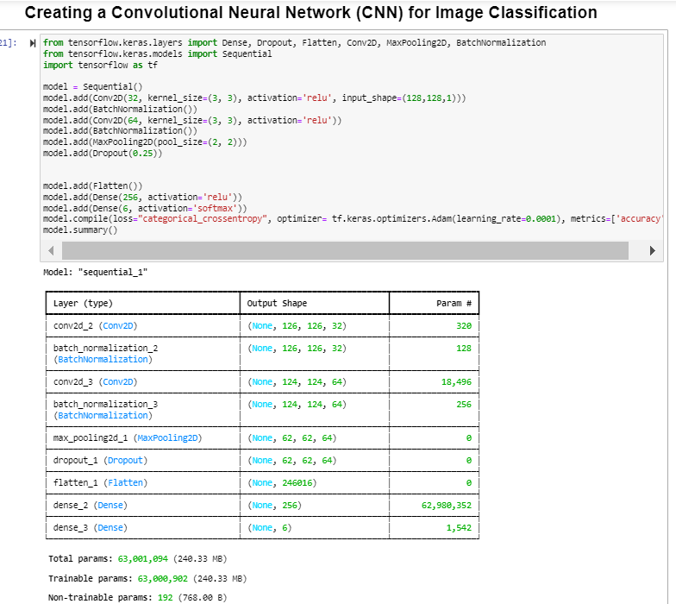

Slide 22
Step:7:Saving Best Model Weights with TensorFlow's Keras ModelCheckpoint Callback
Importing necessary modules:
from tensorflow.keras.callbacks import ModelCheckpoint: Imports the ModelCheckpoint callback from TensorFlow's Keras library. This callback allows us to save the model's weights during training.
Creating a checkpoint callback:
checkpoint_callback = ModelCheckpoint(...): Initializes a ModelCheckpoint object.
filepath='model.weights.h5': Specifies the file path where the model weights will be saved.
monitor='val_accuracy': Monitors the validation accuracy during training.
save_best_only=True: Saves only the best model weights based on the monitored metric (validation accuracy in this case).
save_weights_only=True: Saves only the model weights without saving the entire model architecture.
mode='max': Specifies the mode for determining the best model. In this case, it's 'max', meaning the highest validation accuracy.
verbose=1: Prints messages about the checkpoint saving process during training.

Slide 23
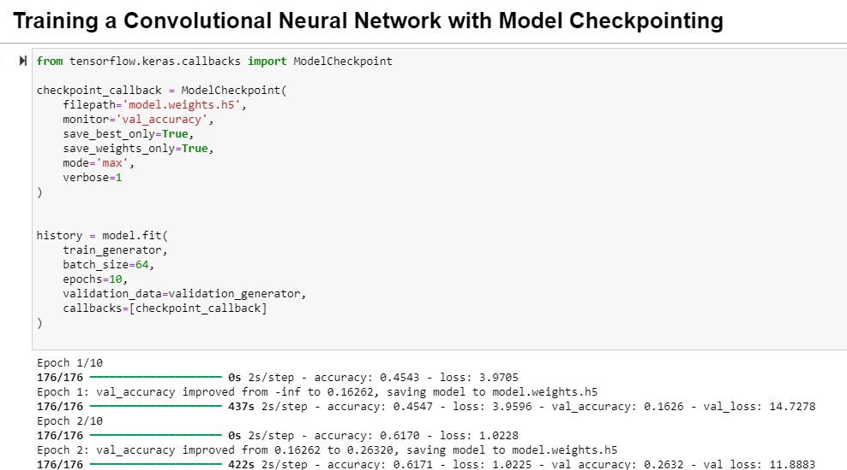
Training the model:
history = model.fit(...): Trains the neural network model.
train_generator: Data generator for training data.
batch_size=64: Number of samples per gradient update.
epochs=10: Number of epochs (iterations over the entire dataset) for training.
validation_data=validation_generator: Data generator for validation data.
callbacks=[checkpoint_callback]: Specifies the checkpoint callback to be used during training. This ensures that the best model weights are saved based on the validation accuracy.
Overall, this code trains a neural network model and saves the best model weights based on validation accuracy using the ModelCheckpoint callback in TensorFlow's Keras API.

Slide 24
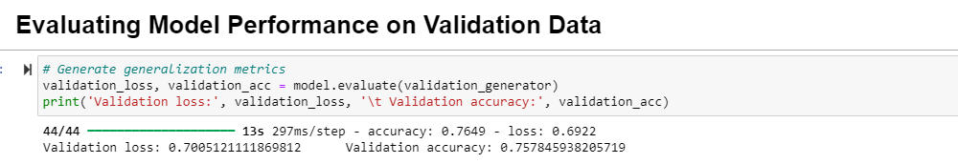
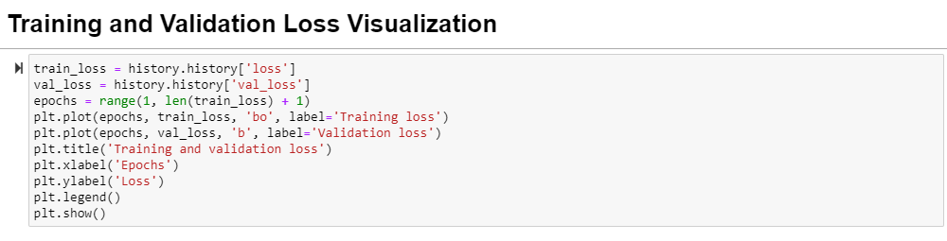
Step-8:Evaluating Model Performance
Step-8.1:Checking Model Performance on Validation Data
This code checks how well the trained model performs on validation data by calculating the loss and accuracy metrics. It then prints out these metrics.
Step-8.2:Visualizing Model Training and Validation Loss over Epochs
This code creates a plot that shows how the loss of the model changes as it learns from the training data over multiple epochs. It also shows how well the model generalizes to unseen validation data. By comparing the training and validation loss curves, we can understand how the model is performing during training and whether it's overfitting or underfitting.

Slide 25
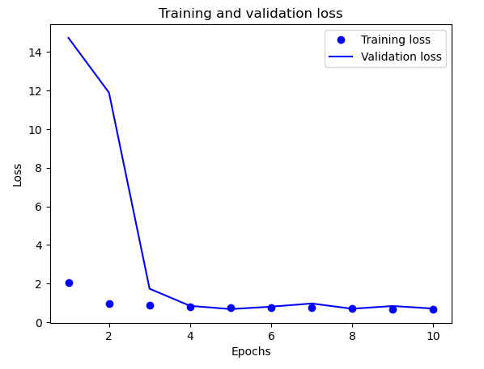
Step:8.3:Tracking Model Accuracy during Training and Validation
This code generates a plot illustrating the changes in model accuracy over epochs for both the training and validation datasets. By comparing the two curves, it offers insight into how well the model learns from the training data and generalizes to unseen validation data, aiding in understanding the model's training progress and generalization performance.

Slide 26
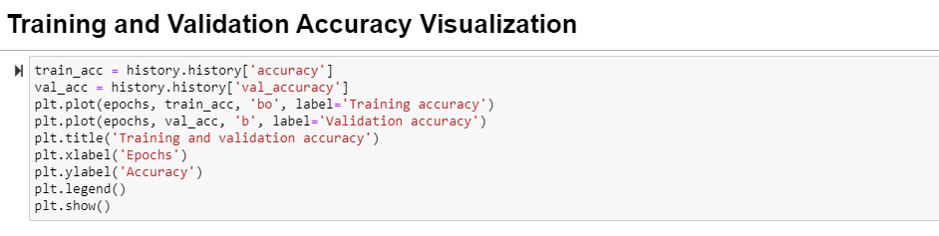
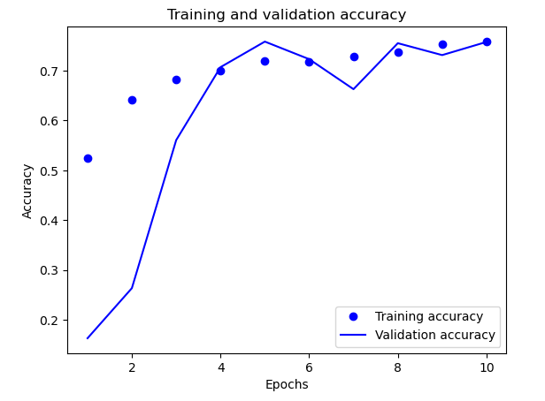

Slide 27
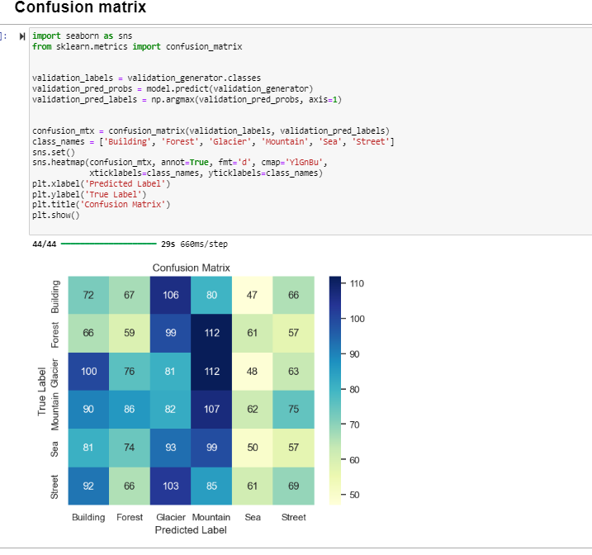
Step-8.3:Evaluating Model Performance with Confusion Matrix
This code segment generates a confusion matrix to assess the classification model's performance on the validation dataset. It computes the confusion matrix using the true labels and predicted labels, then visualizes it as a heatmap. The heatmap provides insights into the model's accuracy for each class, aiding in the identification of misclassifications or areas for improvement.

Slide 28
Step:9:Image Classification Using a Pre-trained CNN Model
img_path: Specifies the file path of the input image.
img = image.load_img(img_path, target_size=(128, 128), color_mode='grayscale'): Loads the image from the specified path, resizing it to a target size of 128x128 pixels and converting it to grayscale.
img_array = image.img_to_array(img): Converts the image to a NumPy array.
img_array = np.expand_dims(img_array, axis=0): Adds an extra dimension to the image array to match the expected input shape of the model.
img_array /= 255.: Normalizes the pixel values of the image array to the range [0, 1].
prediction = model.predict(img_array): Uses the trained model to predict the class probabilities for the input image.
label_map = {v:k for k,v in train_generator.class_indices.items()}: Creates a dictionary mapping class indices to class labels.
predicted_label = label_map[np.argmax(prediction)]: Determines the predicted class label by finding the index with the highest probability in the prediction array and then mapping it to the corresponding class label using the label_map.
print(" prediction of this image is", predicted_label): Prints the predicted class label of the input image.

Slide 29
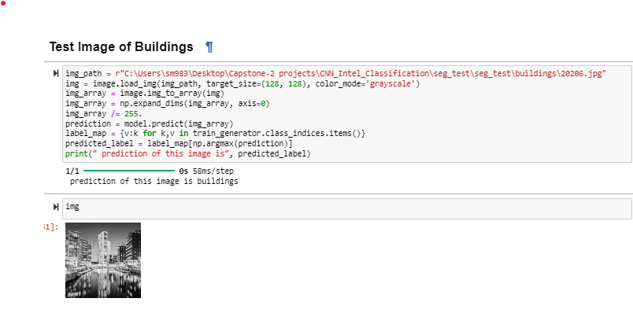
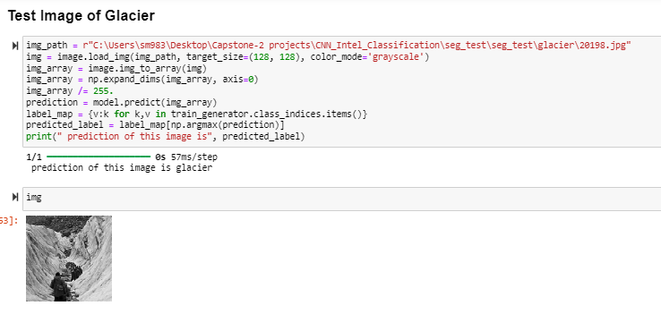

Slide 30
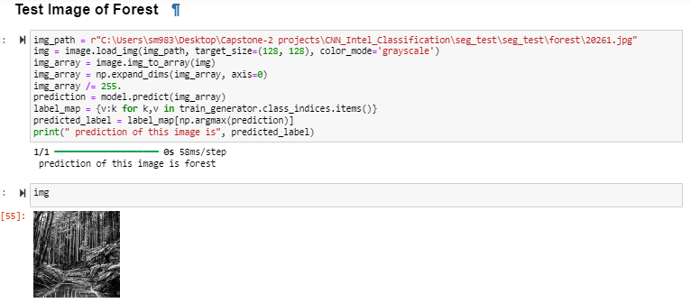
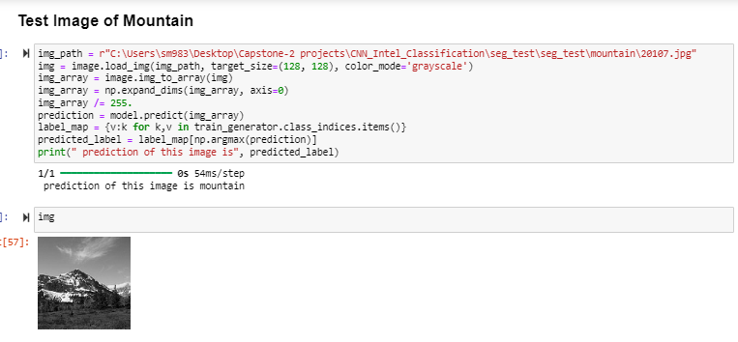

Slide 31
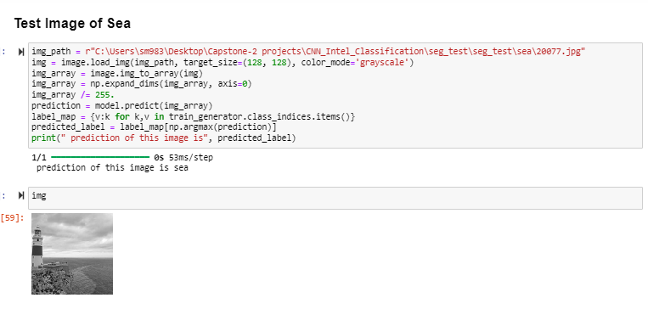
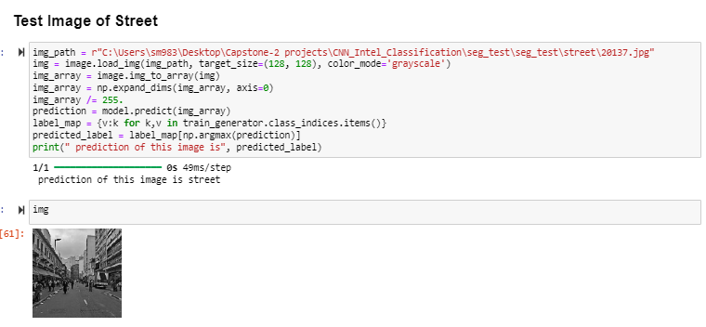

Slide 32
Conclusion
Our project successfully employed deep learning techniques, specifically convolutional neural networks, to classify images of natural scenes into distinct categories such as forest, glacier, mountain, sea, building, and street.
Through extensive training and evaluation, we achieved a commendable accuracy rate, demonstrating the effectiveness of the CNN model in recognizing and categorizing diverse natural environments.
This project not only deepened our understanding of image classification but also highlighted the vast potential of deep learning in various real-world applications.
Moving forward, the insights gained from this project could be utilized in numerous domains, including environmental monitoring, urban planning, tourism, and disaster management.
As technology continues to advance, the integration of CNN-based image classification systems into practical solutions holds promise for enhancing our understanding and interaction with the natural world

Slide 33

Thank You
PGA-20
Under Guidance of: Arun Upadhyay
Submitted By: Rayapati Sai Nikitha
Date:
24-04-2024

