Slide 1

A Step-by-Step Power BI Analysis of
Dashboard
Dashboard Development

Slide 2
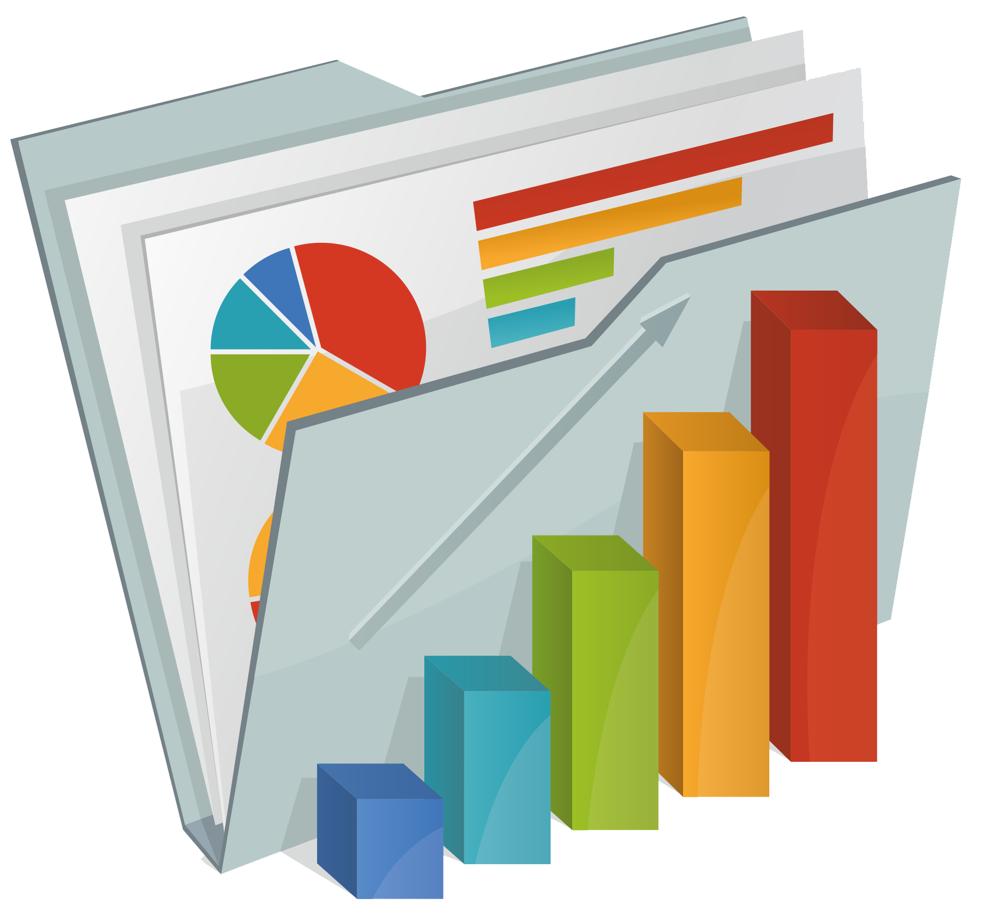
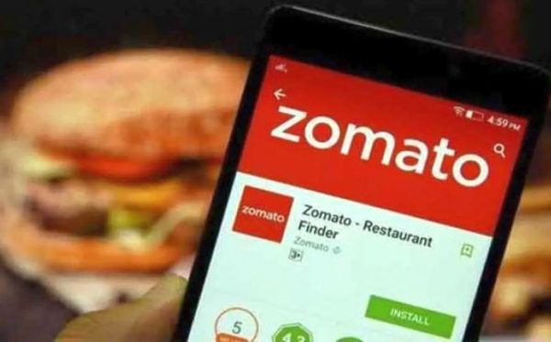

Abstract
This project delves into the creation of a comprehensive Power BI dashboard for Zomato analysis, focusing on user behaviour, city-wise trends, and an overview of sales performance.
The dashboard offers insights into user preferences, city-specific dining habits, and key metrics such as sales amounts, quantities, and top-rated items.
Through three distinct dashboards, this analysis provides a simplified yet detailed exploration of Zomato's data landscape, aiding in informed decision-making and strategic planning for stakeholders in the food industry.

Slide 3

Introduction
Background:
Zomato, a key player in the food industry, relies on understanding customer behaviour and market dynamics to thrive in the competitive food delivery market.
With the aim of addressing challenges such as user engagement and sales optimization, the Zomato Dashboard Analysis project employs data-driven insights to inform decision-making processes.
Using Power BI, the project converts data into actionable insights showcased in visually appealing dashboards, emphasizing crucial metrics such as user behaviour and city-wise sales performance.
Through user segmentation and city trend analysis, Zomato gains tools for strategic interventions to improve user satisfaction, service delivery, and long-term profitability.
Ultimately, the project's objective is to empower Zomato with actionable insights for customer retention, sales growth, and sustained competitiveness in the food delivery market, driven by a comprehensive understanding of customer behaviour and market dynamics.

Slide 4

Objectives
The objectives of the Zomato Dashboard Analysis project are clear and focused:
Comparison:
Compare user behaviours between those who regularly use Zomato services and those who disengage prematurely.
Understanding:
Gain insights into why certain users withdraw from Zomato prematurely, including their demographic characteristics, usage patterns, and interactions with the platform.
Retention Strategies:
Develop strategies to enhance user satisfaction and loyalty, aiming to prevent premature disengagement and encourage long-term usage of Zomato services.
By achieving these objectives, the project aims to equip Zomato with actionable insights to improve user retention and overall platform performance.

Slide 5
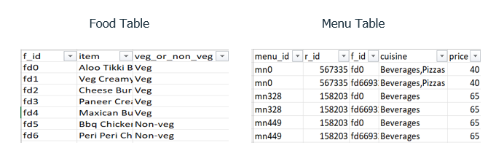
Overview of the Datasets:
Food, menu, orders, restaurant, and users tables were used to construct Zomato's Power BI dashboard. This involved managing relationships between tables, creating DAX expressions, and preprocessing steps to clean data before building the project.

Slide 6
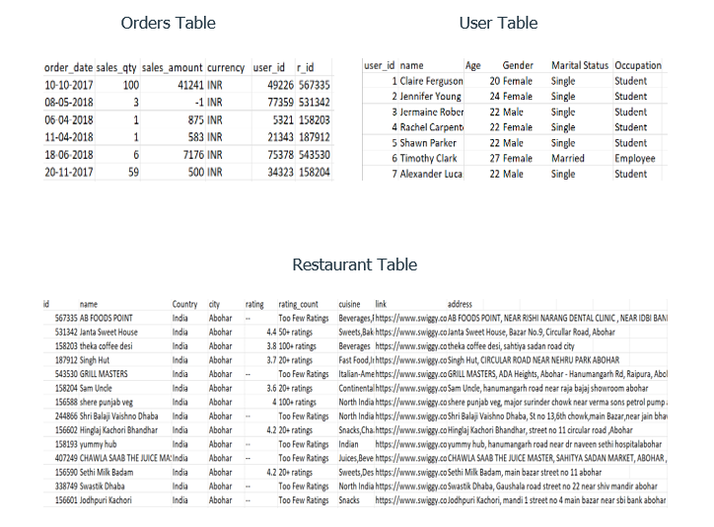

Slide 7
Literature Review: Previous Studies on Customer Behaviour Analysis For Zomato
Understanding why customers behave the way they do on Zomato is crucial for improving the platform's performance. Previous research has revealed several key factors that influence customer behaviour:
Demographics:
Age and Income: Younger customers and those with unstable incomes tend to show unpredictable ordering patterns.
Location: Urban, suburban, and rural customers may have different preferences and habits based on their geographic location.
Ordering Behaviour:
Frequency and Size: Customers who order small amounts frequently might have different needs than those who order large amounts infrequently.

Slide 8

Cuisine Preferences: Customers often have distinct preferences for certain types of cuisine.
User Experience:
App Interaction: How customers engage with the Zomato app can provide insights into their satisfaction and loyalty.
Customer Support: Positive experiences with customer support can enhance customer satisfaction.
Promotional Strategies:
Personalized Offers: Tailoring promotions based on past behavior can encourage repeat orders.
Loyalty Incentives: Loyalty programs can help retain valuable customers.
Understanding these factors can help Zomato improve its services and retain its customer base effectively.

Slide 9
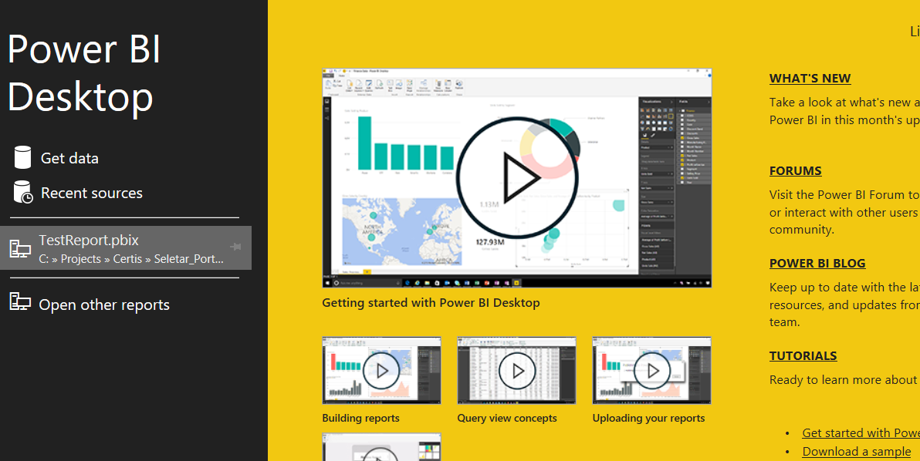
Review of Relevant Literature on Data Analysis Methods For Zomato Using Power BI:
In the realm of Zomato analysis through Power BI, researchers delve into various data analysis methods to extract insights into customer behavior and platform dynamics. Here's a concise overview of pertinent literature:
Power BI for Zomato Analysis:
Power BI serves as a pivotal tool for visualizing and analysing Zomato data. Leveraging its robust features, researchers gain insights into customer preferences, ordering patterns, and restaurant performance through interactive dashboards and data visualizations.

Slide 10
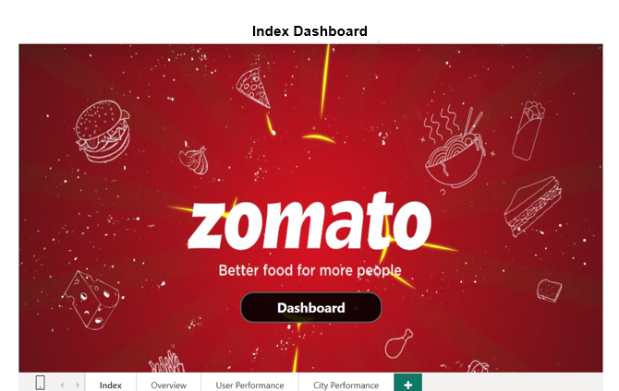
Data Visualization and Exploration using Dashboards in Power BI:

Slide 11
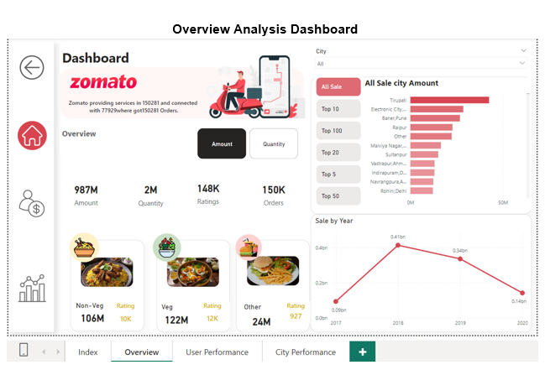

Slide 12
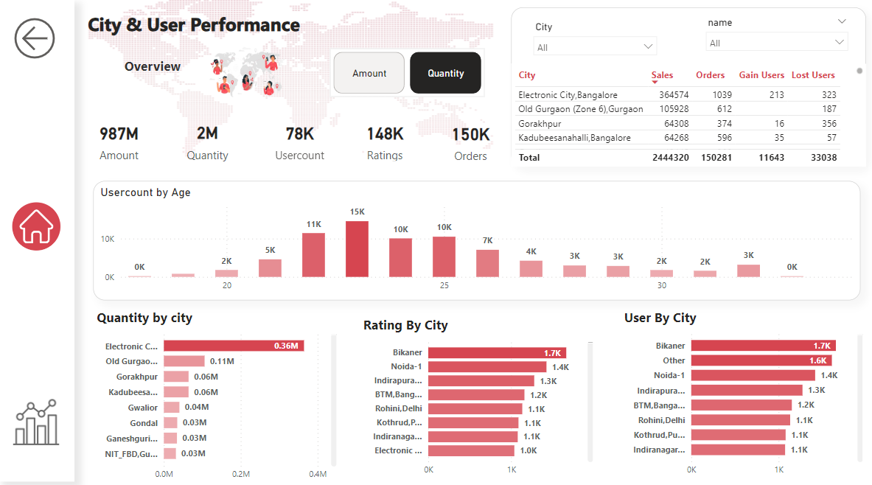

Slide 13
Step-by-Step approach taken to Build Zomato Dashboard:
Importing Data and Data cleaning:
In the Power BI platform, data sourced from Excel files from web platforms have been imported. Following this, data cleaning procedures have been implemented on the food, menu, orders, restaurant, and user datasets to ensure they are suitable for creating visualizations and extracting insights.
Importing Data from Excel:
When accessing the Power BI dashboard space, you'll find the "Get Data" icon in the toolbar. This feature allows you to import data from various sources. Since our files for analysis are in Excel format, we select "Excel" as our data source and proceed to import all five mentioned files accordingly.
Transforming Data:
When importing data into Power BI, a pop-up appears prompting us to choose between loading or transforming the data. If no changes are required before loading the data into the Power BI platform, we can directly click on "Load."
However, if any data cleaning steps are needed, we can click on "Transform" to perform these actions. In our case, we will import files individually by first transforming each file before importing

Slide 14
Step-by-Step approach of cleaning data:
Encountering an issue with one of the files where headers were included as a row, we utilized the "Use First Row as Headers" option available in the toolbar of the Transform window in Power BI. This action addressed the problem and ensured that the first row was correctly designated as the header for the affected file.
To link the "Orders" and "Restaurants" tables in Power BI:
1.Import both tables.
2.Go to the "Model" view.
3.Drag the unique ID column from "Orders" to the matching column in "Restaurants."
4.Confirm and test the connection.
5.Adjust if necessary and save.
To create bar charts for city sales and quantities, we merged tables using the ID column, mapped all cities with the orders table, and removed null values.
To enable an interactive slicer, we've transformed the sale_amount and sale_quantity columns into rows by selecting them and clicking "unpivot columns.This action generates two new columns: "attribute" (renamed to "type") and "value."
We've renamed the type column values to "amount" for sale_amount and "quantity" for sale_quantity, facilitating a clearer distinction between the two.

Slide 15
And we've merged the food table with the menu table, utilizing the restaurant ID present in both tables. By mapping the food categories from the food table with the menu table, we've established connections. This linking enables us to connect the menu table with the orders table, allowing us to display sale value cards and ratings cards for food categories.
Crafting DAX functions to enhance dashboard clarity and provide insightful analytics:
We made a "Measure Table" to keep all measurements together and avoid confusion
We Created a Dax formulas for:
for creating cards for sale_value and Quantity_value: ‘Sale_Value = SUM(orders[Value])’
creating card for Total_Ratings: ’ Rating_Count = COUNT(restaurant[rating])’
creating card for Total_Orders: ‘Order_Count = COUNT(orders[order_date])’
This DAX function creates an interactive slicer for selecting top cities based on quantity or amount. It ranks cities by sales value, allowing users to choose top 5, 10, 20, 50, or 100 cities. The function filters the cities based on the selected rank
The "TopN_Sale" function calculates the rank of cities based on sales value, then filters them according to the user-selected rank from the slicer. The "RankTable" provides options for selecting different top city ranks.
We've formulated some DAX expressions for our user analysis dashboard:
To generate a bar chart visualizing user count by age, we require the total user count. We've crafted a DAX expression named "usercount" to fulfill this requirement.
Usercount = DISTINCTCOUNT(users[user_id])
To create a card visual for active users created a DAX expression named “ActiveUser”
ActiveUser = DISTINCTCOUNT(orders[user_id])

Slide 16
Visuals Created for City & User Performance Dashboard
In this dashboard, we've constructed a table showcasing city-wise sales orders, gained users, and lost users.
Additionally, card visuals have been incorporated to display the total sale amount, total sale quantity, total ratings, and total orders.
We've also included bar charts for sales amount/quantity by city, which dynamically adjusts based on the selection of either amount or quantity.
Similarly, there are bar charts for ratings and users by city, offering comprehensive insights into various aspects of the data.
We've enhanced interactivity and navigation throughout the dashboards by incorporating button icons for seamless user experience.

Slide 17




Creating Actions for Button Icons:
We've implemented various buttons to facilitate navigation within the dashboards:
A home page button for returning to the main page from any location within the dashboard.
Specific detail page icons, such as for the user analysis dashboard and the city performance dashboard, to directly access detailed analyses.
An index page button labeled "Dashboard" to navigate back to the overview analysis page.
These buttons are configured with actions in Power BI, enabling seamless navigation across multiple dashboards.
Home Button
Dashboard Button
Dashboard Navigation Button
Back Button

Slide 18
Conclusion
After analyzing the data in Power BI, we found that user engagement remains consistent over time, with a steady influx of new users balanced by a relatively low rate of user churn.
Our geographical analysis revealed that certain cities exhibit higher user activity and restaurant engagement, suggesting potential areas for targeted marketing efforts.
Additionally, our analysis of restaurant performance highlights opportunities for improving partnerships and recommendations to enhance user experience.
Overall, the insights gained from this project provide valuable guidance for optimizing strategies to drive user growth and satisfaction on the Zomato platform

Slide 19

THANK YOU
PGA-20
Under Guidance of: Arun Upadhyay
Submitted By: Rayapati Sai Nikitha
Date: 24-04-2024

