Slide 1
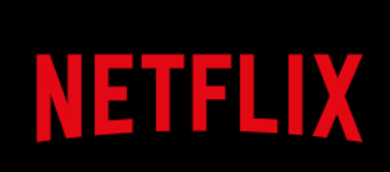
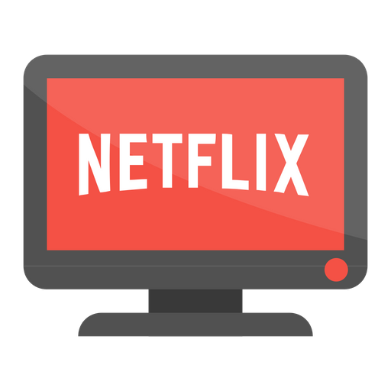
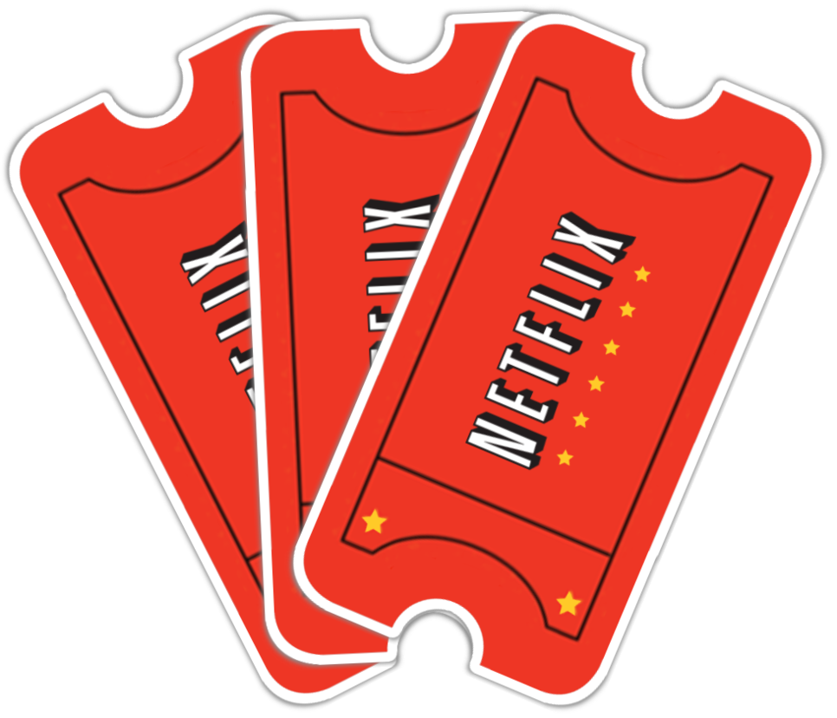
A Step-By-Step Tableau Analysis of
Dashboard Development

Slide 2

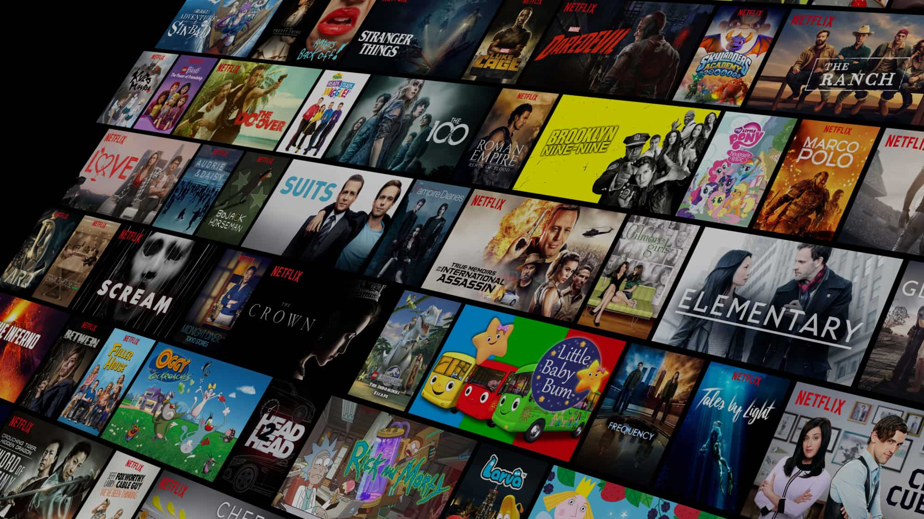

Abstract
This project dives into Netflix's world of movies and TV shows, focusing on how many are available and how they're rated, across different regions. Using data provided by Netflix, we explore the number of titles released in each region, along with their ratings and durations.
We start by counting how many movies and TV shows Netflix has in various regions. Then, we look at how viewers rate them to understand what's popular. Lastly, we check out how long each movie and TV show is.
By analyzing this data, we aim to understand what content Netflix offers and how viewers respond to it. These insights can help Netflix make better decisions about what to produce and where to focus their efforts.

Slide 3
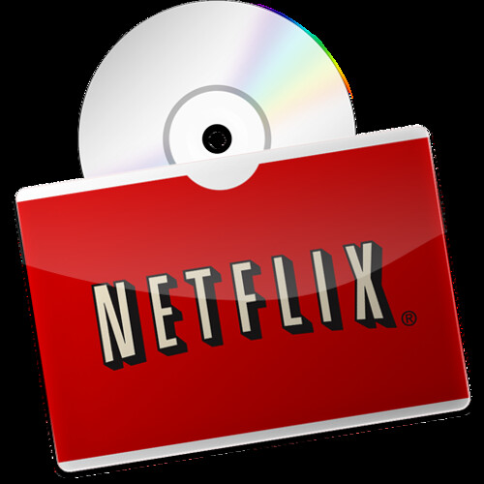
Introduction: Background
Netflix has become a household name, offering a treasure trove of movies and TV shows for audiences worldwide. Understanding the landscape of Netflix's content is crucial for both viewers and the company itself. In this study, we delve into the realm of Netflix content, focusing on movies and TV shows, to uncover valuable insights.
Netflix continuously expands its library, catering to diverse tastes and preferences across different regions. By analyzing data provided by Netflix, we aim to shed light on the quantity, quality, and characteristics of its content offerings.
Our investigation centers on three main aspects: the number of movies and TV shows available on Netflix, viewer ratings for these titles, and the duration of each title. By exploring these factors, we seek to understand Netflix's content strategy, audience preferences, and potential areas for improvement.
This study provides a foundation for understanding the vast world of Netflix content and its implications for both viewers and the streaming platform itself. By unraveling the intricacies of Netflix's content landscape, we aim to inform decision-making processes and enhance the overall viewing experience for audiences worldwide.

Slide 4

Objectives
Quantify Content:
Determine the number of movies and TV shows available on Netflix in different regions.
Evaluate Viewer Reception:
Assess viewer ratings for Netflix content to understand audience preferences and popularity.
Analyze Duration:
Investigate the duration of movies and TV shows on Netflix to identify trends and patterns in content length.
By achieving these objectives, we aim to gain insights into Netflix's content landscape, informing strategic decisions and enhancing the viewing experience for audiences worldwide.

Slide 5
Overview of Dataset
The dataset used in this study originates from Kaggle, a prominent platform for data science competitions and datasets. It contains information about Netflix titles in a CSV format, encompassing various attributes such as:
show_id: A unique identifier for each title.
type: Indicates whether the entry is a movie or a TV show.
title: The name of the movie or TV show.
director: The director(s) of the title.
cast: The cast members involved in the production.
country: The country or countries associated with the title.
date_added: The date when the title was added to Netflix.
release_year: The year when the title was originally released.
rating: The content rating assigned to the title.
duration: The duration of the title (in terms of episodes for TV shows and minutes for movies).
listed_in: The categories or genres the title belongs to.
description: A brief summary or description of the title.

Slide 6
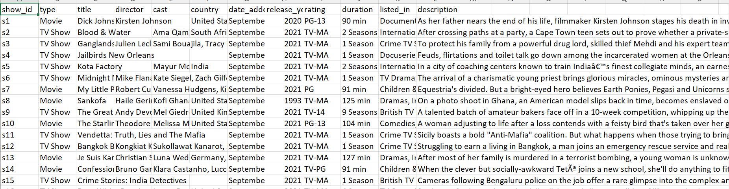
This dataset serves as the foundation for our analysis, enabling us to explore various facets of Netflix's content catalog, including its diversity, distribution, and characteristics. By examining these attributes, we aim to derive insights that inform our understanding of Netflix's content landscape and its implications for both viewers and the platform itself.

Slide 7
Literature Review : Previous Studies on User Behaviour Analysis for Netflix
Previous studies have shed light on various aspects of viewer behavior on streaming platforms, particularly focusing on the dynamics of Netflix. These studies have employed diverse methodologies to analyze viewer preferences, content consumption habits, and the factors influencing user engagement.
Genre Preferences:
Research has highlighted the significance of genre preferences in driving viewer engagement on Netflix. Studies have found that certain genres, such as drama, comedy, and thriller, tend to attract larger audiences, while niche genres also garner dedicated followings. Understanding these genre preferences is crucial for content creators and platform developers to tailor their offerings to match viewer tastes.
Regional Variances:
Viewer behavior on Netflix exhibits regional variances influenced by cultural, linguistic, and demographic factors. Studies have emphasized the importance of localized content and recommendations to cater to diverse audience segments effectively. Additionally, research has shown that viewers in different regions exhibit distinct genre preferences and viewing habits, necessitating region-specific content strategies.
Content Discovery and Recommendation Systems:
The effectiveness of content discovery and recommendation systems plays a pivotal role in shaping viewer behavior on Netflix. Research has explored various algorithms and techniques employed by Netflix to personalize recommendations based on user preferences, viewing history, and demographic information. Studies have demonstrated the impact of recommendation algorithms on user engagement metrics such as watch time, retention, and satisfaction.

Slide 8
Impact of Original Content:
The proliferation of original content on Netflix has significantly influenced viewer behavior and platform dynamics. Research has examined the popularity of Netflix Originals across different genres and demographics, as well as their role in driving subscriber growth and retention. Studies have also investigated viewer perceptions of original content quality, production values, and its impact on the overall Netflix experience.
Binge-Watching Phenomenon:
Binge-watching, defined as the continuous consumption of multiple episodes or seasons of a TV series in a single sitting, has become a prevalent behavior among Netflix users. Research has explored the psychological motivations behind binge-watching, its effects on viewing habits and sleep patterns, and its implications for content delivery and audience engagement strategies.
Social Influence and User Interactions:
The role of social influence and user interactions in shaping viewer behavior on Netflix has been investigated in several studies. Research has examined the impact of social media discussions, recommendations from friends and family, and user reviews on content discovery and viewer decision-making processes. Understanding the social dynamics surrounding content consumption can provide valuable insights for enhancing user engagement and platform features.
Overall, literature on viewer behavior analysis on Netflix provides valuable insights into the complexities of content consumption habits, preferences, and interactions within the streaming ecosystem. By synthesizing findings from existing studies, researchers can inform content creators, platform developers, and marketers to optimize content strategies and enhance viewer satisfaction on Netflix.

Slide 9
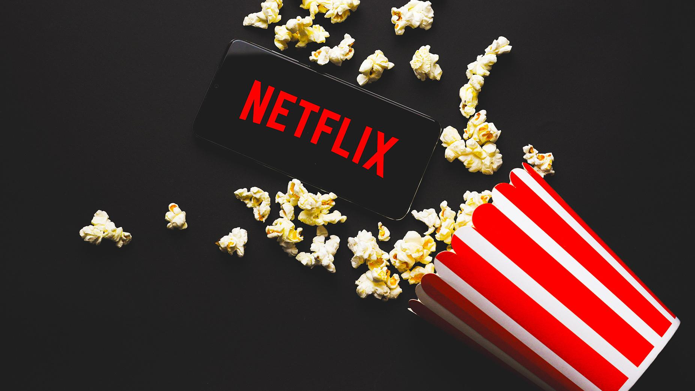

Review of Relevant Literature on Data Analysis Methods for Netflix Using Tableau
Studies have explored the ways in which Tableau, a powerful data visualization tool, can be applied to analyze data from Netflix.
Researchers have investigated how Tableau can help understand the content available on Netflix, how users interact with it, where users are located geographically, how different content performs, and how Netflix generates revenue.
By using Tableau to examine these aspects, researchers have provided valuable insights that can inform decision-making processes for Netflix, helping them make informed choices about content selection, audience targeting, and business strategies.

Slide 10
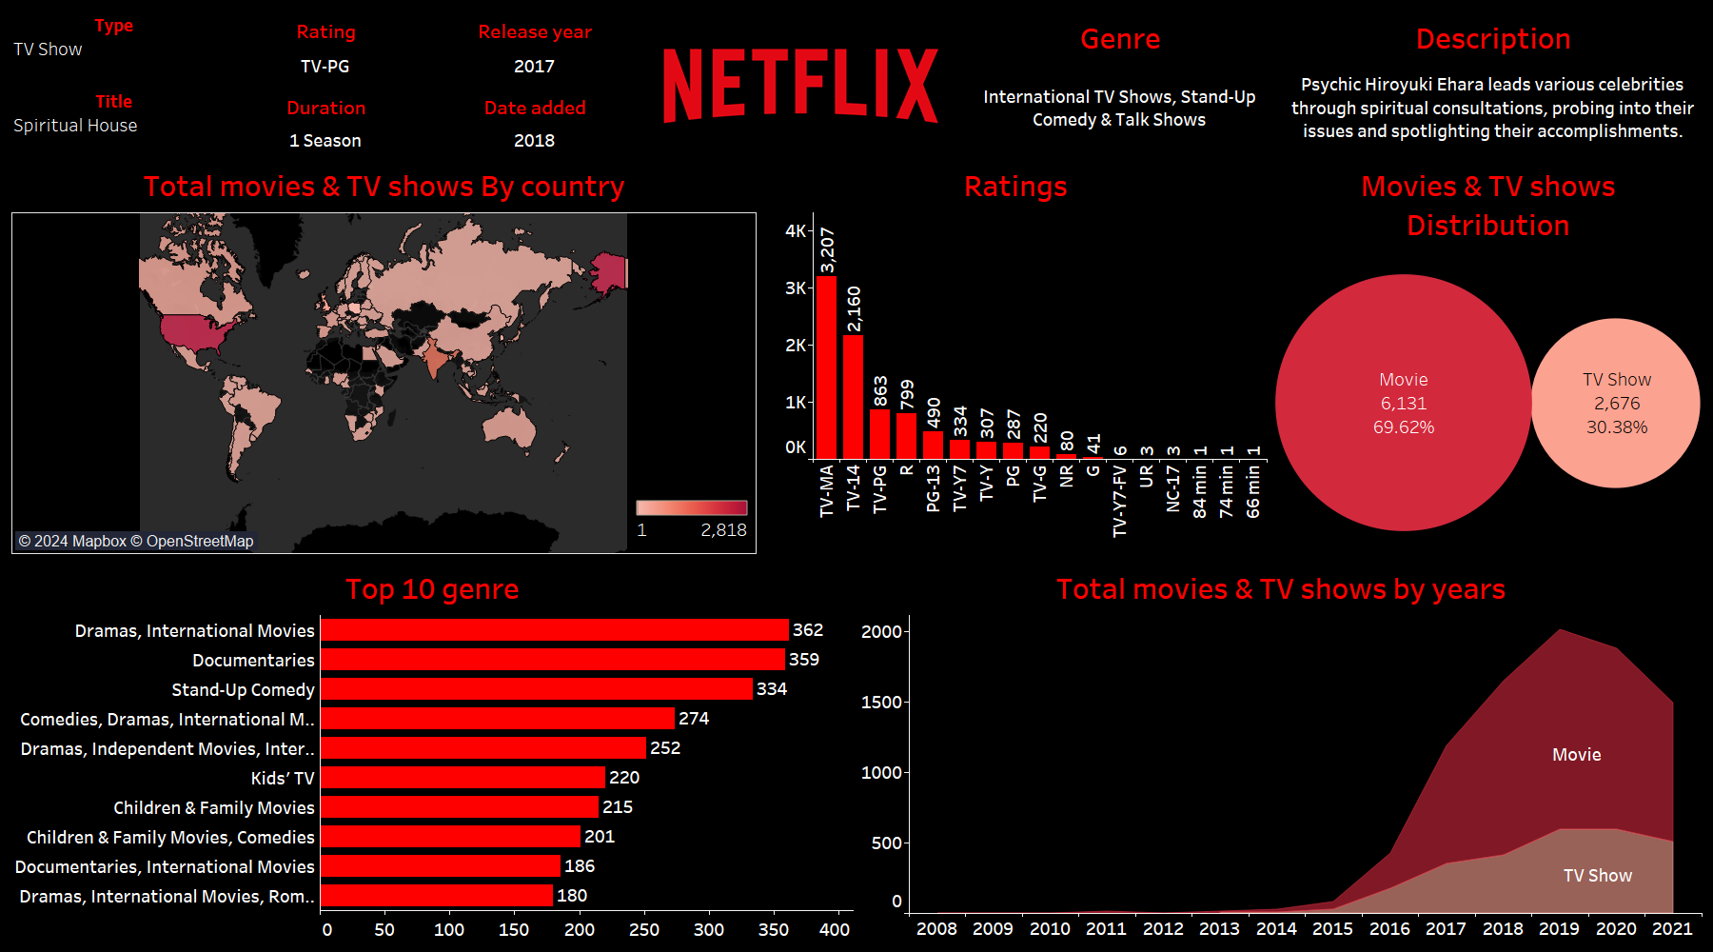
Data Visualization And Exploration using Dashboard in Tableau

Slide 11
Step-by-Step approach taken to Build Netflix Dashboard
Importing Data and creating Individual Visualizations:
The dataset used in this analysis originated from a CSV file containing Netflix titles, updated as of 2021 and accessible on Kaggle. This file was obtained from Kaggle and imported into Tableau as a text file, selecting the CSV option during the import process. Upon importing, the data was visible in the "Data Source" tab of Tableau.
The dataset comprises 12 fields and 8807 rows from the "Netflix_titles.CSV" file.
Subsequently, we utilized Tableau's formatting options to create various charts for effective data visualization:
We plotted the addition of different TV shows and movies to Netflix over time, categorizing them by year.
We generated a map visualization to illustrate the distribution of content releases by country, with darker colors indicating higher numbers of movies/TV shows released.
A bar plot was created to visualize the top 10 genres for both TV shows and movies.
We designed a chart to display the percentage and total count of movies versus TV shows.
Another chart was created to represent the distribution of ratings across the dataset.
Moving forward, we aim to create additional visuals such as displaying detailed information (e.g., description, duration, release year, added year, rating, genre) for selected movies or TV shows.

Slide 12
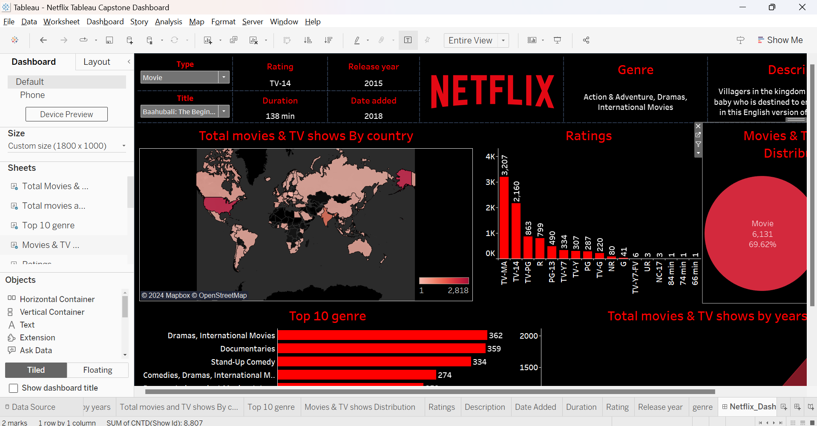
Creating Final Dashboard
Arrange each visualization on the dashboard meticulously to ensure clarity and coherence.
Apply formatting to the background, adopting the iconic black and red theme reminiscent of Netflix's branding.
Additionally, incorporate intuitive navigation elements to enhance user experience.
Ensure that the font and text colors are consistent with the overall theme. Finally, consider adding a title featuring the Netflix logo and a subtitle to the dashboard to provide context and guide the viewer's attention.

Slide 13
Publishing Report
https://prod-apnortheast-a.online.tableau.com/t/chanduchinthaginjalacbe8449dd0/views/Data_Science_Salary_Analysis_Clear/DataScienceSalaryAnalysisDashboard?:origin=card_share_link&:embed=n

Slide 14
Conclusion
The Tableau dashboard provides valuable insights into Netflix's content library and user engagement.
Through visualizations and analysis, we discovered trends such as the distribution of content across genres, the popularity of specific titles, and user preferences based on ratings and reviews.
Additionally, the dashboard highlighted regional differences in content consumption and viewing habits, indicating opportunities for localized content strategies.
Furthermore, insights into viewer demographics and viewing patterns can aid in targeted content recommendations and marketing campaigns.
Overall, the Netflix dashboard serves as a powerful tool for understanding audience behavior and informing strategic decisions to enhance the platform's content offerings and user experience

Slide 15

Thank You
PGA-20
Under Guidance of: Arun Upadhyay
Submitted By: Rayapati Sai Nikitha
Date:
24-04-2024

