Slide 1

EMPLOYEE LEAVE MANAGEMENT SYSTEM
SDP - 39

Slide 2
PROJECT DESCRIPTION
The Employee Leave Management System is a web-based application designed to streamline and automate the process of managing employee leave requests within an organization. It serves as a centralized platform where employees can submit leave requests, and managers or HR administrators can review, approve, or reject the requests. The system aims to ensure accurate leave tracking, improve leave planning, and enhance the overall efficiency of managing employee leave.

Slide 3
DONE BY
2200031890 - Deepika
2200031942 - Bhargavi
2200032029 - Pardhiv

Slide 4
TABLE OF CONTENTS
01
02
03
04
INTRODUCTION
USER PERCEPTION
05
RESPONES FROM SURVEY
RESEARCH FINDINGS
SWOT ANALYSIS

Slide 5

INTRODUCTION
EMPLOYEE LEAVE MANAGEMENT SYSTEM provides Streamline leave requests, approvals, and tracking for a more organized and efficient leave management process.

Slide 6
USER PERCEPTION
USER-FRIENDLY
TRANSPARENCY
EFFORTLESS
Employee Leave Management System offers a seamless and user-friendly experience.
The centralized platform not only simplifies the process but also ensures transparency in the status of requests.
Submitting leave requests becomes effortless through an intuitive web interface.

Slide 7
RESEARCH FINDINGS FROM SURVEY

Slide 8
ISSUES FACED BY EMPLOYEES
User Interface Complexity
Communication Gaps
Privacy Concerns
A complex or unintuitive user interface can pose challenges for employees in understanding how to use the system effectively, potentially causing delays in submitting leave requests.
Inadequate communication features within the system may lead to misunderstandings regarding leave approval status or other important updates, causing frustration among employees.
Employees may have concerns about the privacy and security of their personal leave-related information within the system, affecting their confidence in using the platform

Slide 9
ISSUES FACED BY MANAGERS
1
Complex Approval Workflows
Complicated approval workflows may result in confusion for managers
2
difficulties in coordinating leave data with broader workforce management.
Integration Challenges
3
Resistance from employees in adapting to the new leave management system can pose a challenge
Employee Resistance

Slide 10
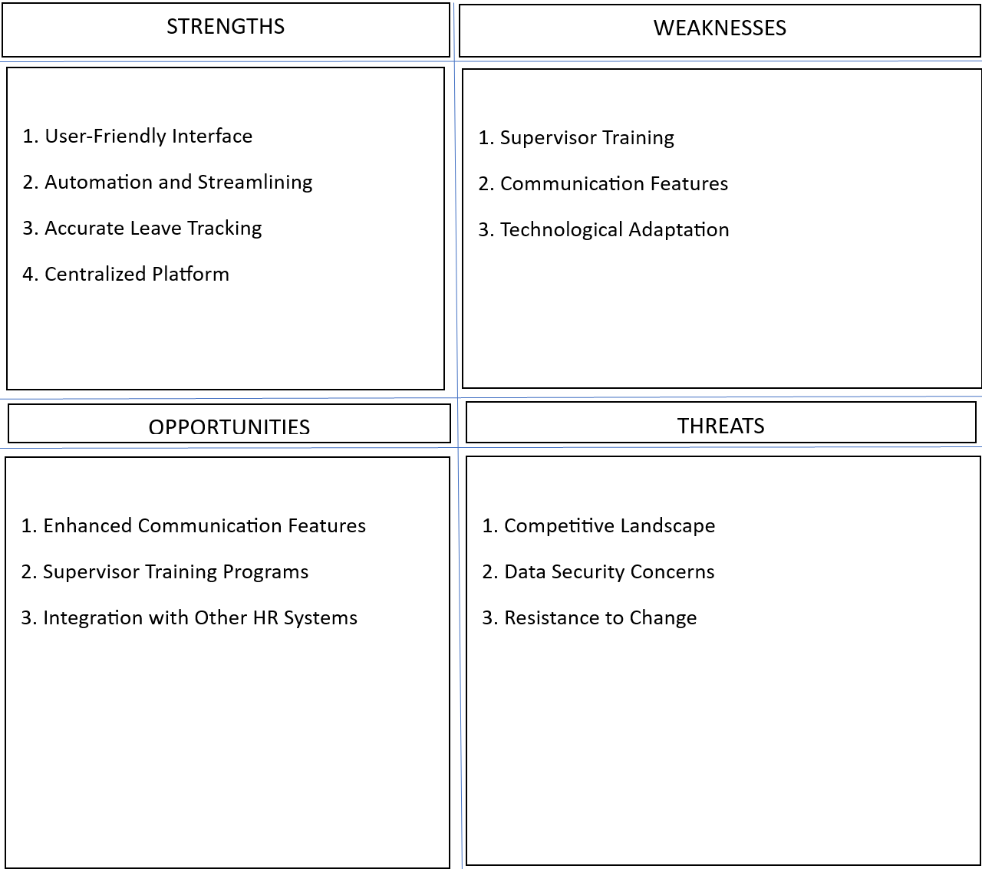
SWOT ANALYSIS

Slide 11


RESPONSES FROM SURVEY

Slide 12
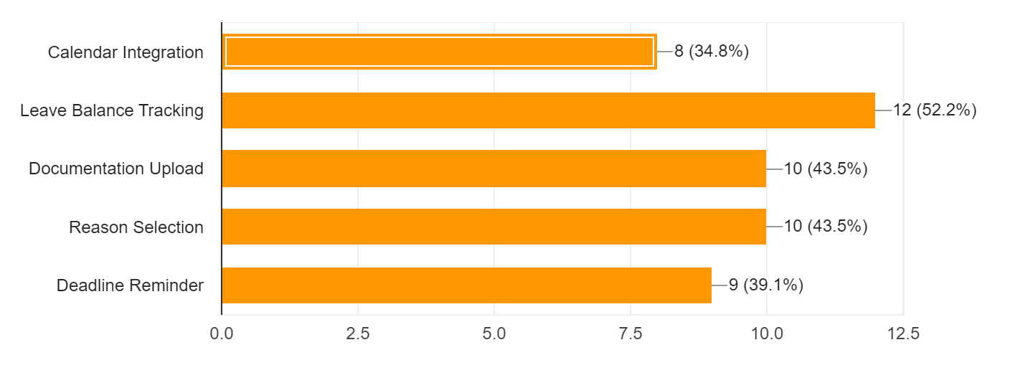
INTEGRATIONS/FEATURES

Slide 13
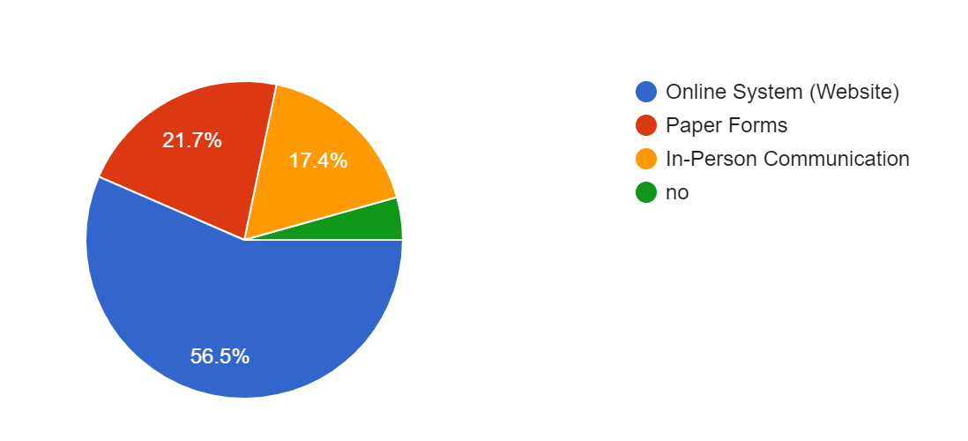
LEAVE REQUESTING TECHNIQUES

Slide 14
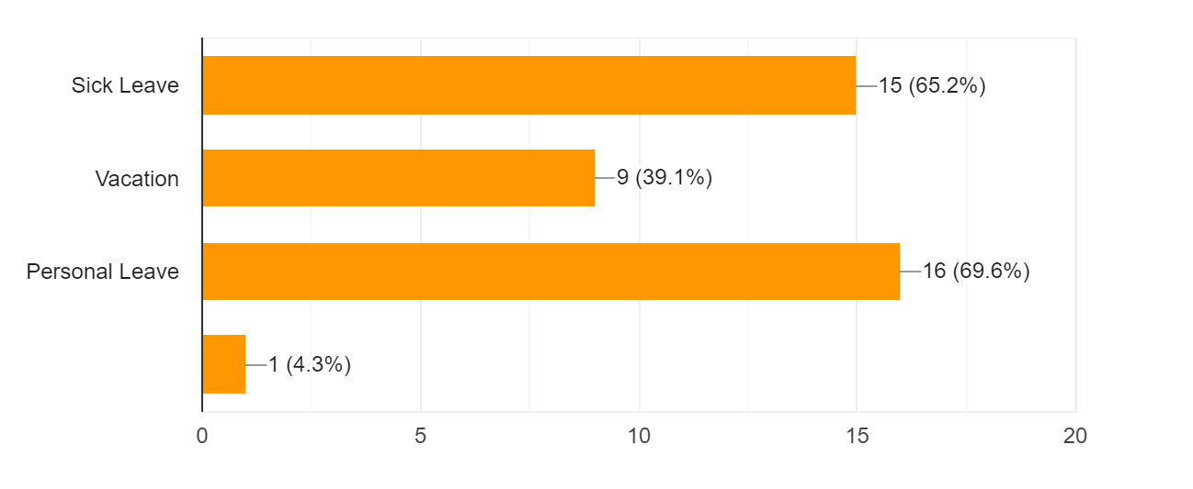
VARIOUS LEAVES

Slide 15
CONCLUSION
In conclusion, the Employee Leave Management System stands as a pivotal solution in modern organizational dynamics. By leveraging web-based automation, it not only simplifies but revolutionizes the intricate process of handling employee leave requests. Serving as a centralized hub for submission, review, and approval, it ensures a seamless and transparent workflow between employees and managers or HR administrators.

Slide 16
THANK YOU
-Team 25

