Slide 1



Online_retail_Analysis.
View in Power BI
Last data refresh:
5/15/2023 4:53:51 PM UTC
Downloaded at:
5/15/2023 4:54:45 PM UTC

Slide 2
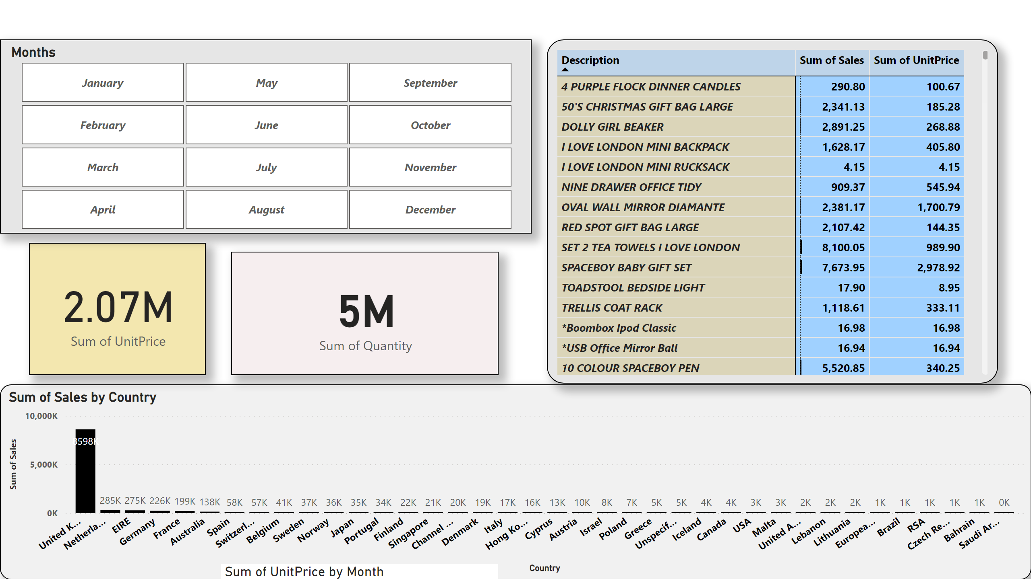
question1
Notes:
columnChart
No alt text provided
card
No alt text provided
areaChart
No alt text provided
slicer
No alt text provided
pivotTable
No alt text provided
card
No alt text provided

Slide 3
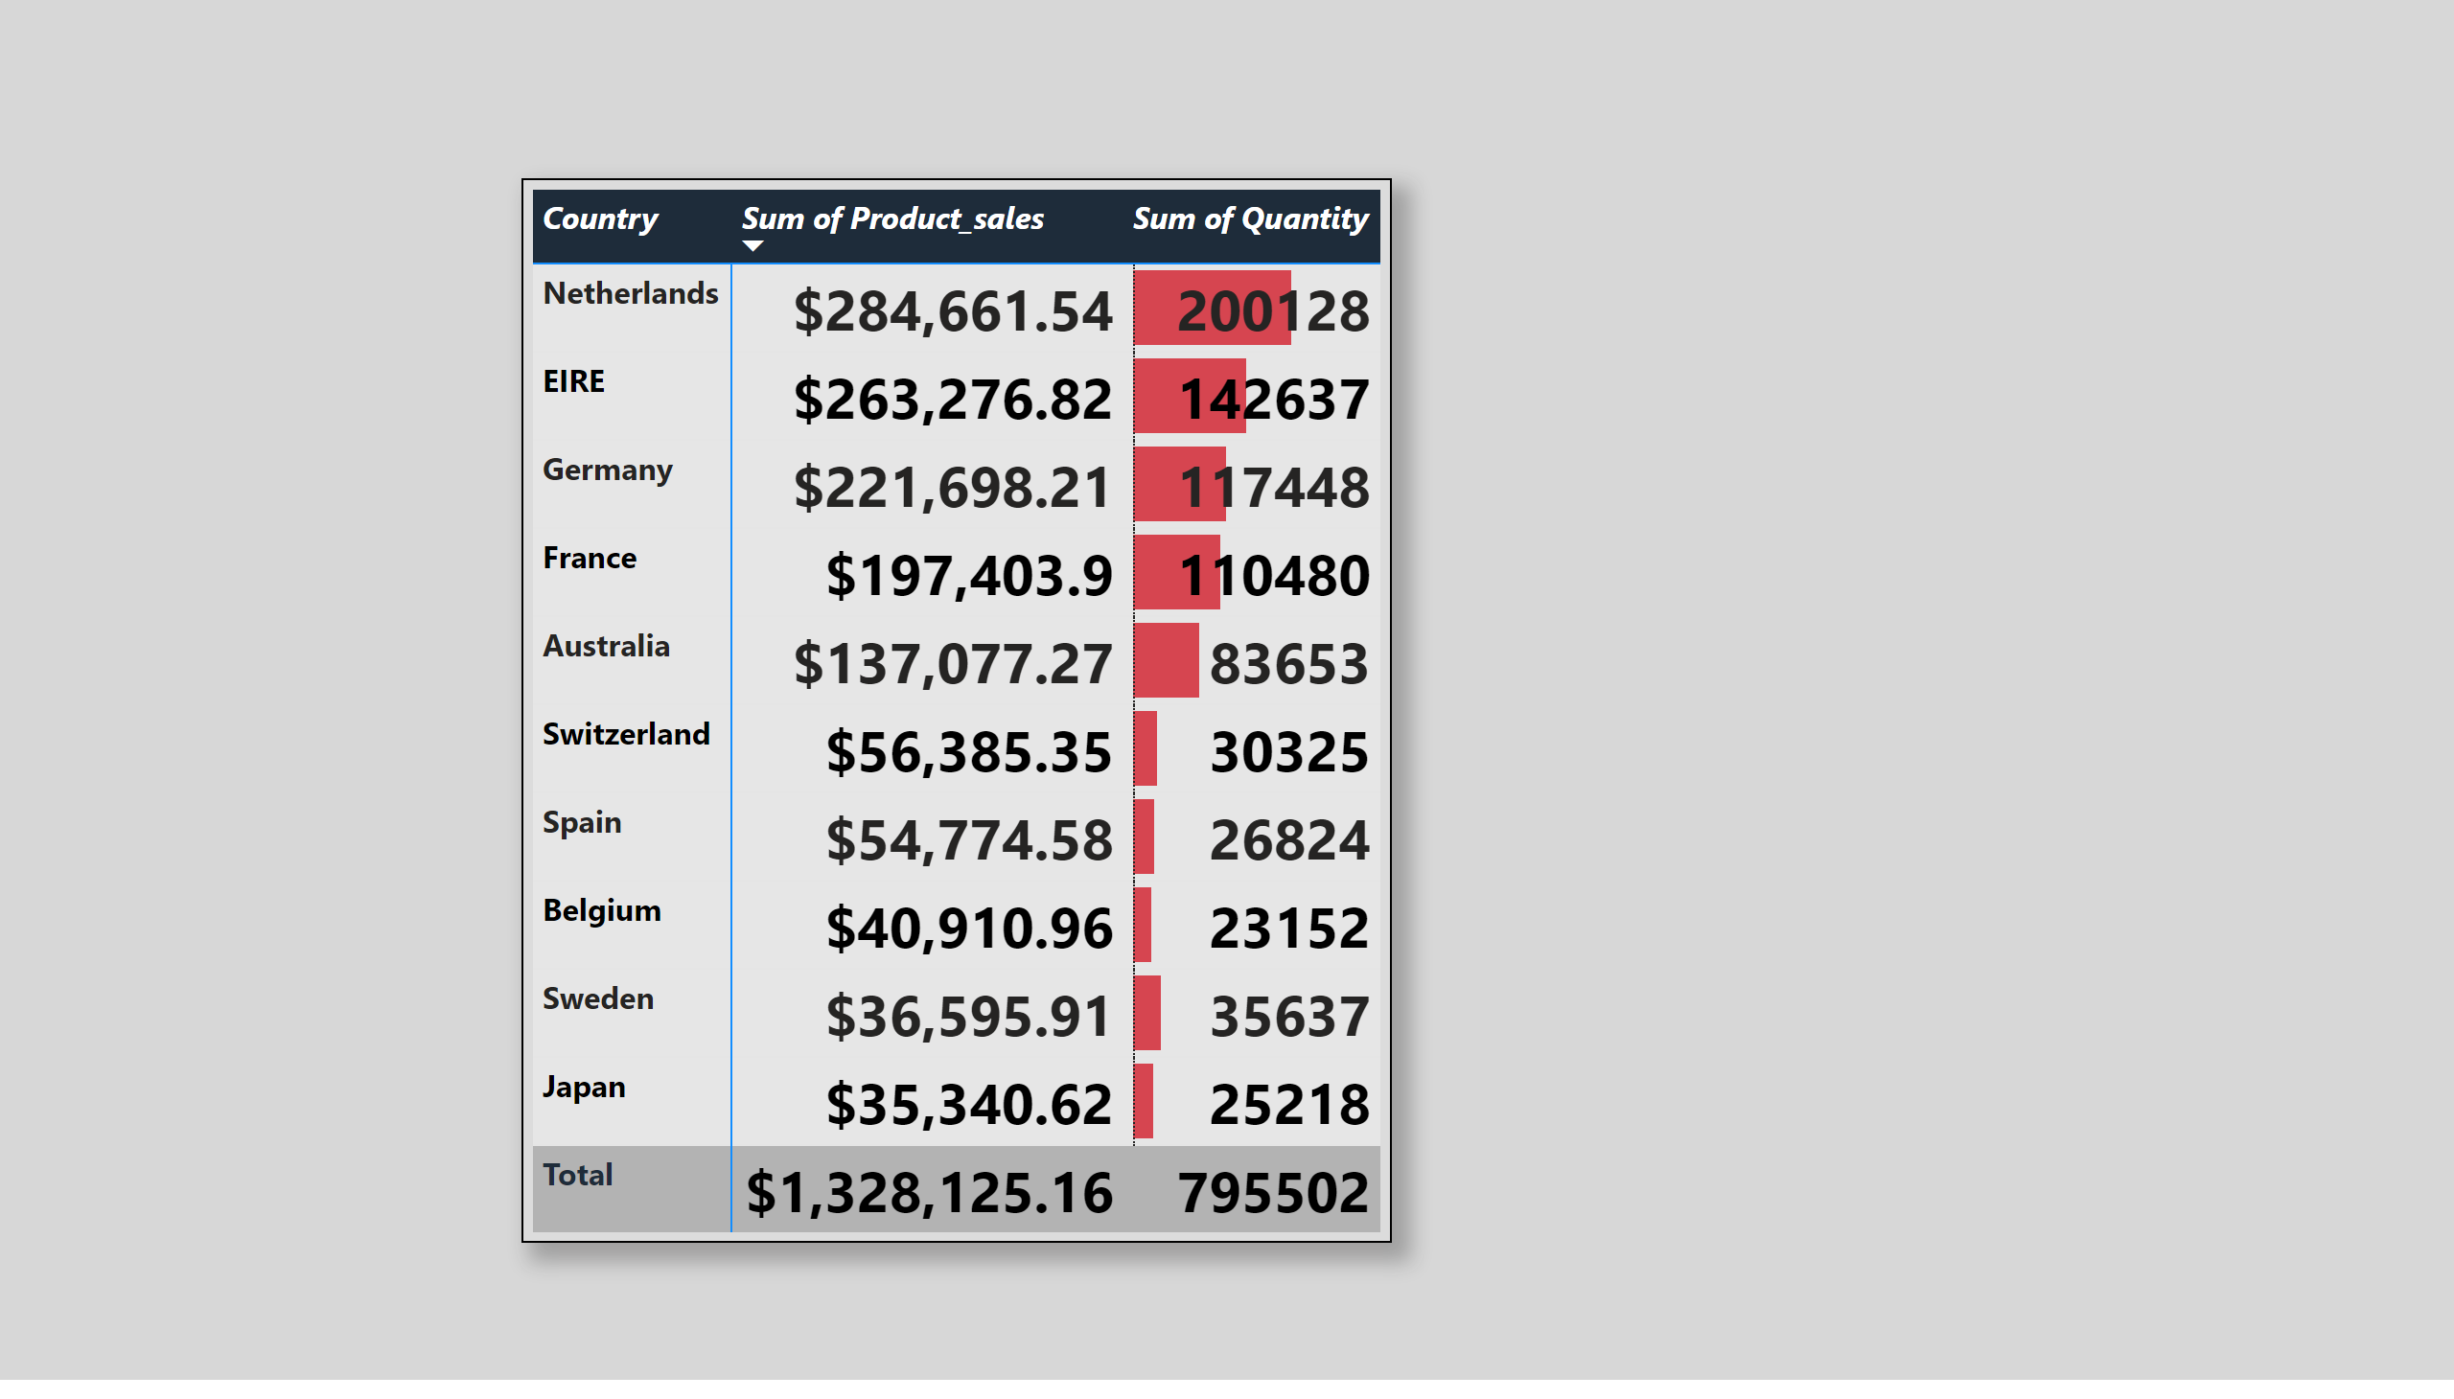
question_2
Notes:
pivotTable
No alt text provided

Slide 4
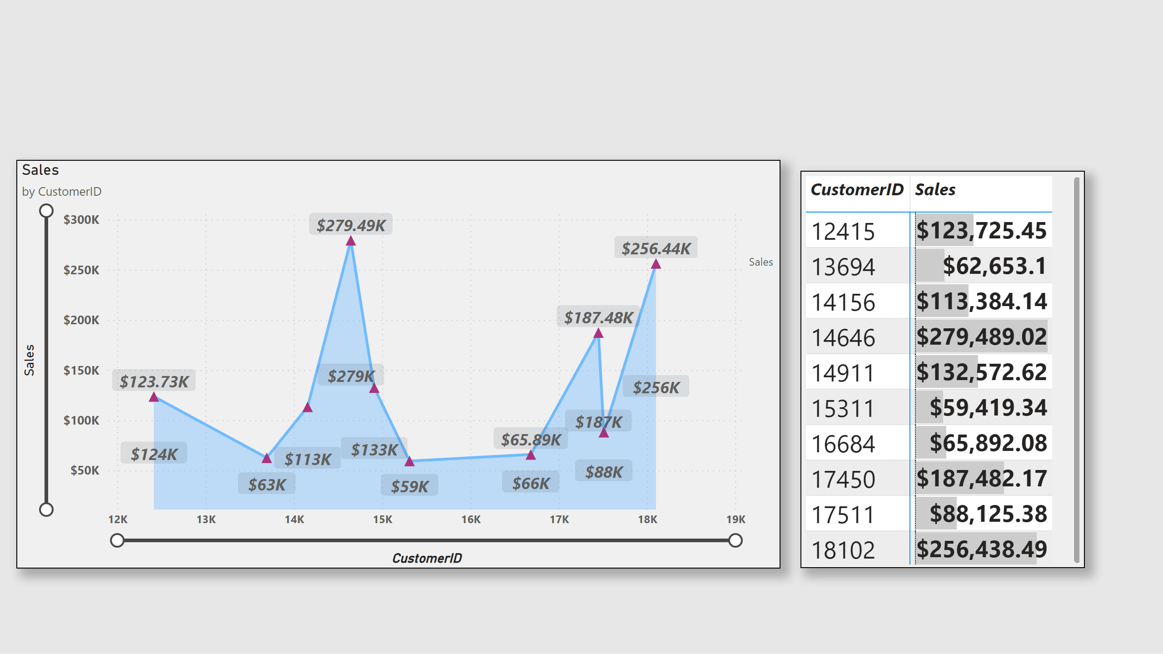
question 3
Notes:
stackedAreaChart
No alt text provided
pivotTable
No alt text provided

Slide 5
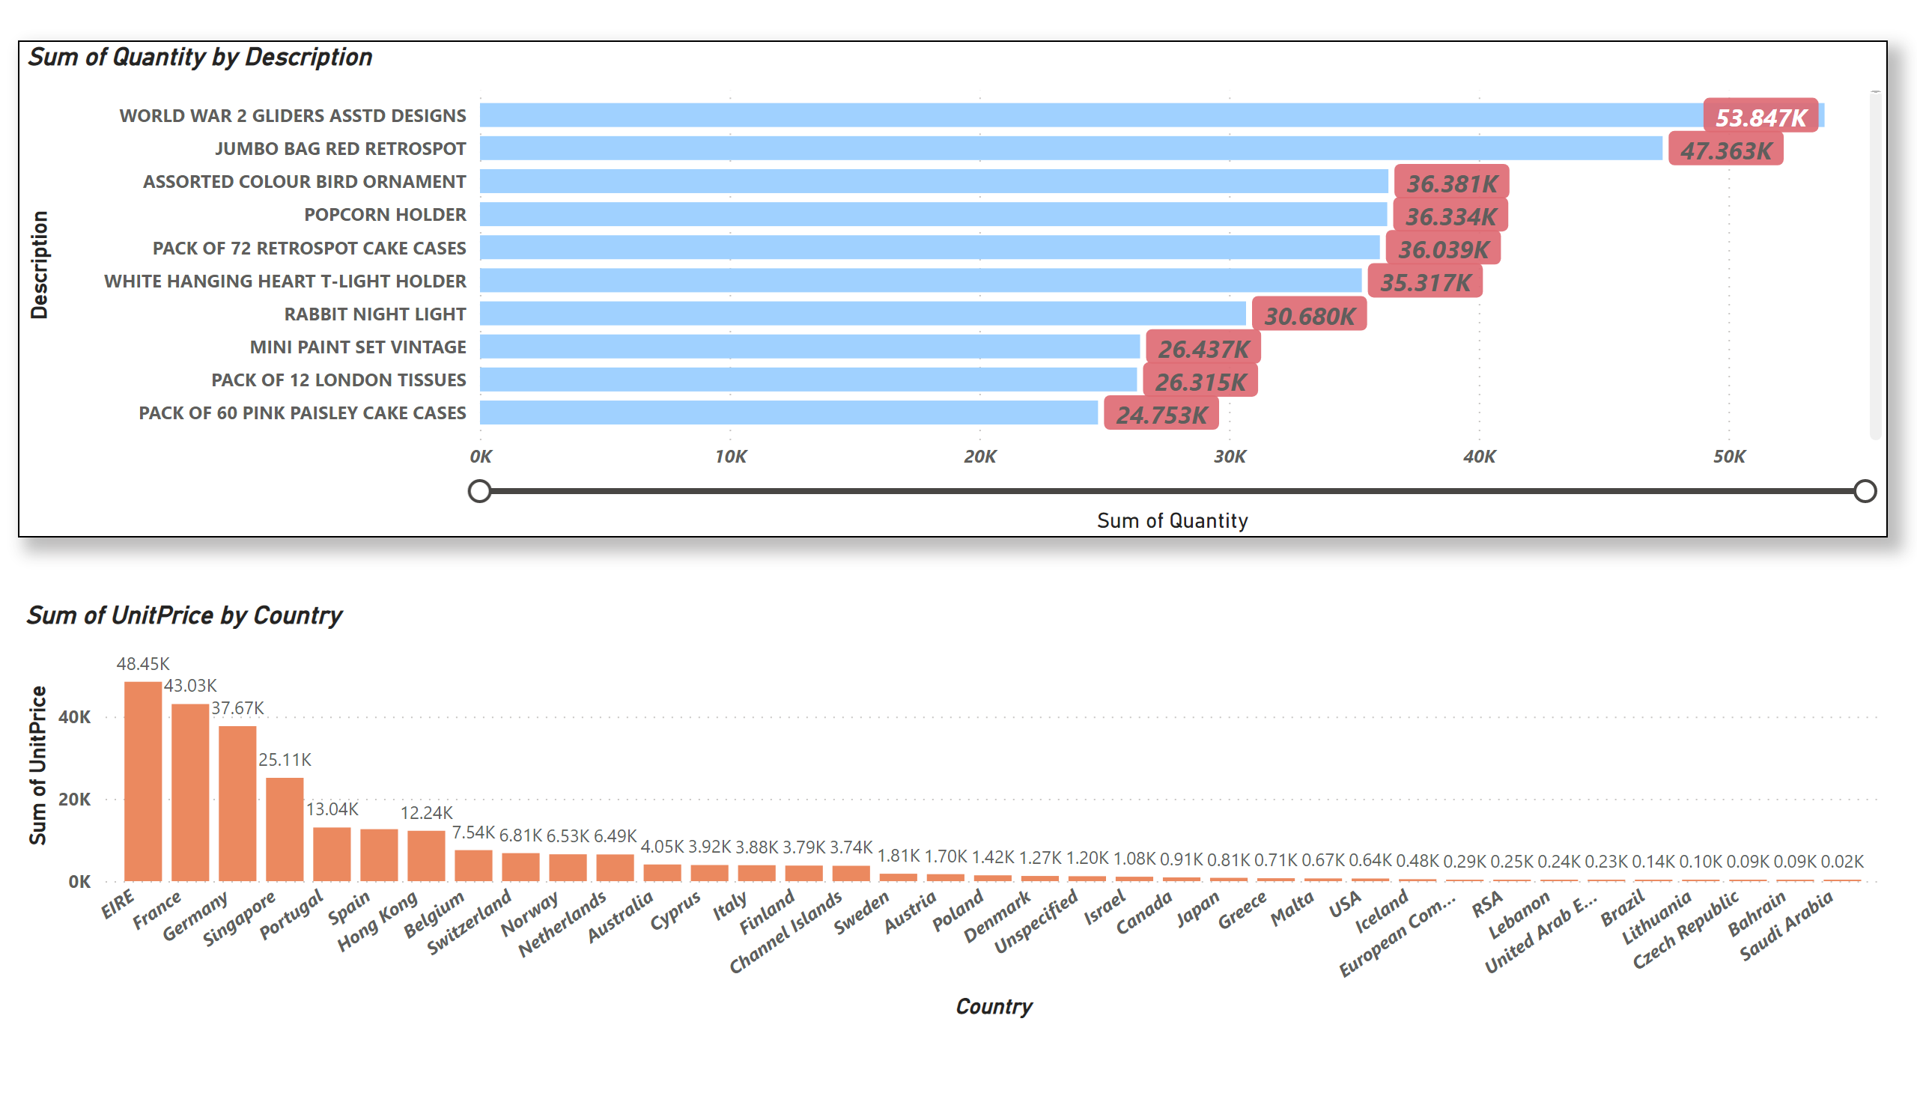
question_4
Notes:
clusteredColumnChart
No alt text provided
barChart
No alt text provided

